Slide 1
Accelerator Status Report
Monday 5/21/2018

Slide 2
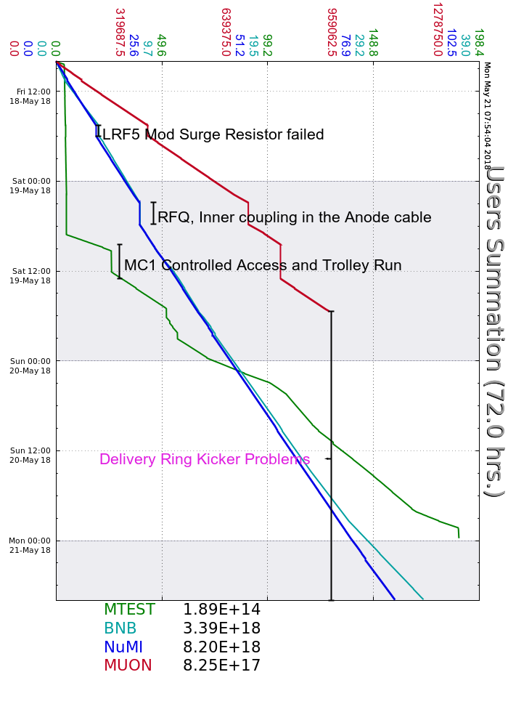
Friday
LRF5 surge resistor
Saturday
RFQ anode cable connector
MI20 LCW pump 3 trip, spurious pressure reading
MC-1 kicker problems --Turn off/open access.
Sunday
Quiet
Your Shift Plot
could be here!
Ask me how!
Weekend Update

