Slide 1
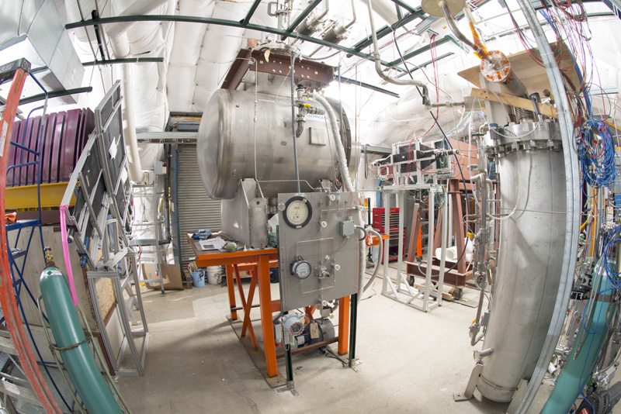
Simulation of optical processes
Hans Wenzel
22nd May 2018

Slide 2
Outline
Three modes to run optical simulation
Optical processes in Geant 4
Liquid Argon TPC’s:
Refraction index and propagation speed
Rayleigh scattering: effect on timing and imaging
Absorption length

Slide 3
Three modes to run optical simulation.
Geant4 Simulation
1. Standard way:
SimEnergyDeposit
e.g. nest take account correlations
Optical photons
electrons
Photon detector LUT
Drift to wire etc.
2. Full simulation:
Enable optical processes and propagation in Geant4→ check LUT.
(very CPU expensive (>1000X) but might be replaced specialized ray tracers running on GPU’s (OPTIX) geant4 optical processes have been implemented by Simon Bly)
3. Obtaining LUT:
Full Geant4 simulation currently done in a separate program (LightSim) → no reason not to integrate in LArSoft

Slide 4
Optical processes in Geant4
Production:
Cerenkov Process
Scintillation Process
WLS
Transition Radiation
Boundary Process:
Total internal reflection etc. at boundaries
between materials with different refraction
index.
Surface Process:
e.g. reflection on metallic surface needs
Surface properties.
Stepping:
Absorption
Rayleigh scattering
Mie Scattering

Slide 5
Optical physics in Geant 4
In Geant4, the optical physics has an exceptional position among the physics processes:
it adds:
special particles (optical photons).
The only particle that can be reflected or refracted at optical surfaces,
only particle created in optical processes like scintillation, Cherenkov radiation, and wavelength-shifting (WLS).
G4OpticalPhoton differs from the “usual” high-energy particle-physics photon (G4Gamma) in Geant4.
new properties for materials and optical surfaces. Optical properties need to be assigned to the materials whenever optical physics processes are to be considered in the simulation. Every material needs at least a refractive index spectrum (which corresponds to the dispersion relation) and an attenuation length spectrum, though the attenuation length is by default set to infinity if it is not defined. Special optical materials, i.e. scintillating and WLS materials, additionally require the specification of the emission spectra as well as of the rise and decay times. More properties can be assigned to optical surfaces between volumes, e.g. the reflectivity of the surface.
arXiv:1612.05162
Peculiarities in the Simulation of Optical Physics with Geant4

Slide 6
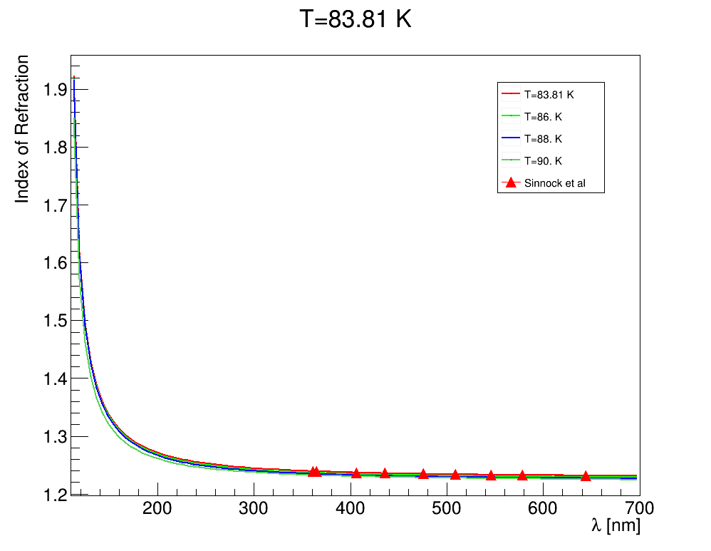
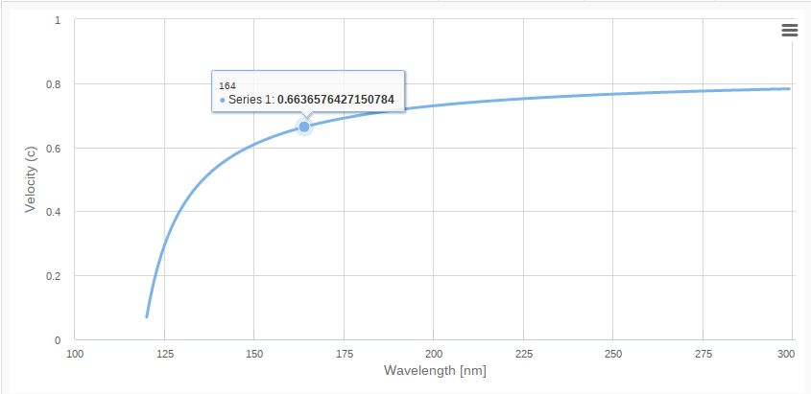
Refraction index and propagation speed
ArXiv:1502.04213
group velocity is equal to the phase velocity
vp=c/n only
when the refractive index is a constant
root [0] .L LAr.C++
root [1] init(); // initialize
root [2] sellmeierLAr();
root [3] rindextable();
<matrix name="RINDEX" coldim="2" values="1.7712*eV 1.23148
1.78626*eV 1.23154
1.80157*eV 1.2316
1.81715*eV 1.23166
.....
10.6975*eV 1.72744"/>
n = c/vp = ck/ω.

Slide 7
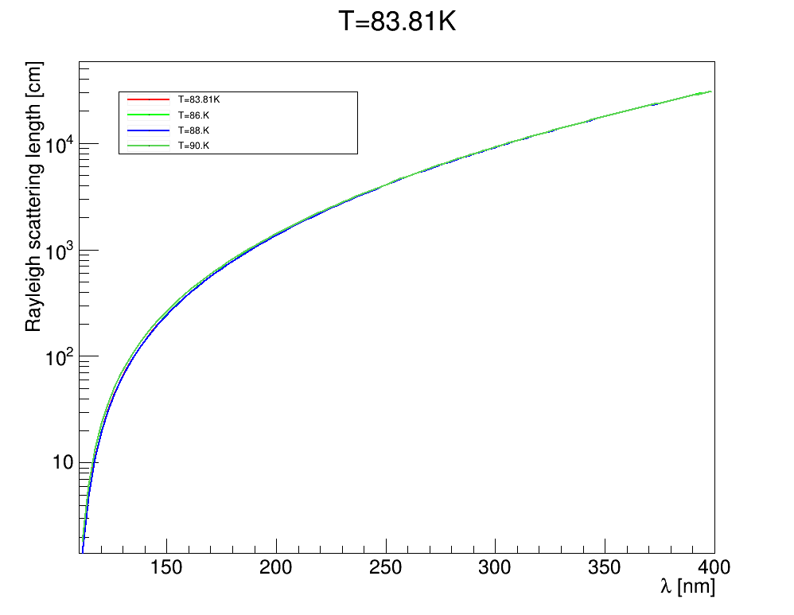
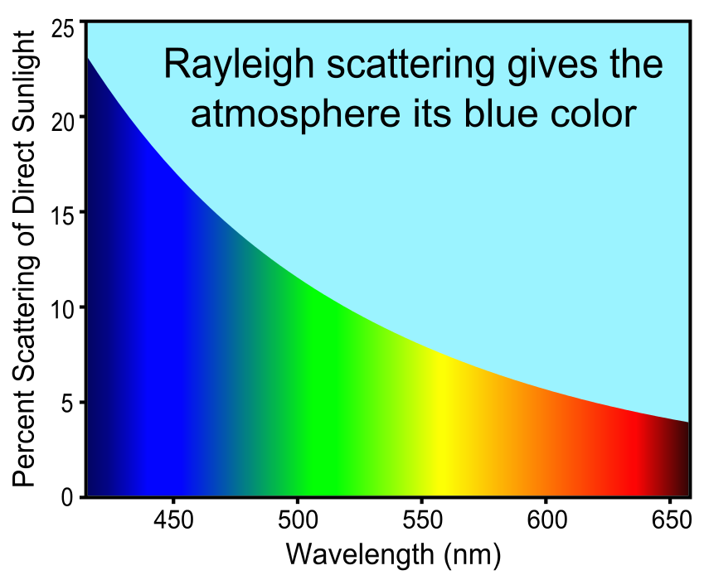
Rayleigh scattering
root [0] .L LAr.C++
root [1] init(); // initialize
root [2] rayleigh();
root [3] rayleightable()
ArXiv:1502.04213

Slide 8
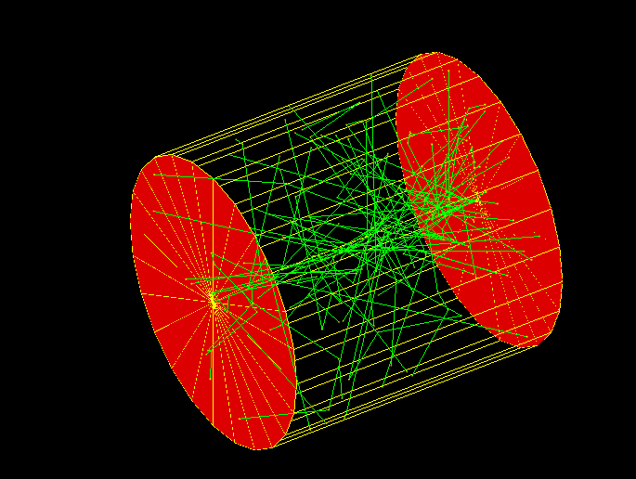
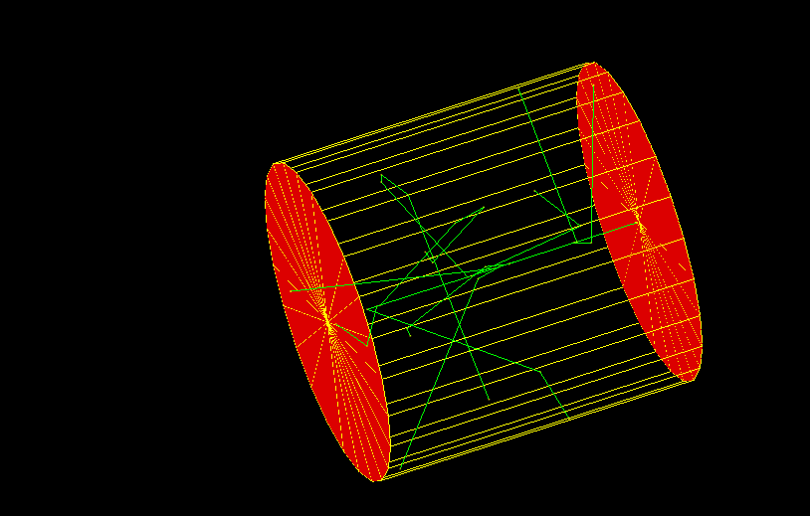
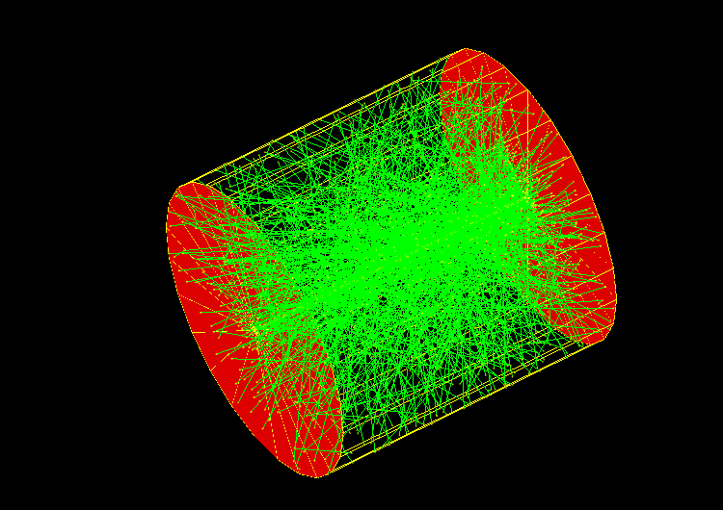
Rayleigh scattering
100
10
Length: 1m
Radius 0.5m
1000

Slide 9
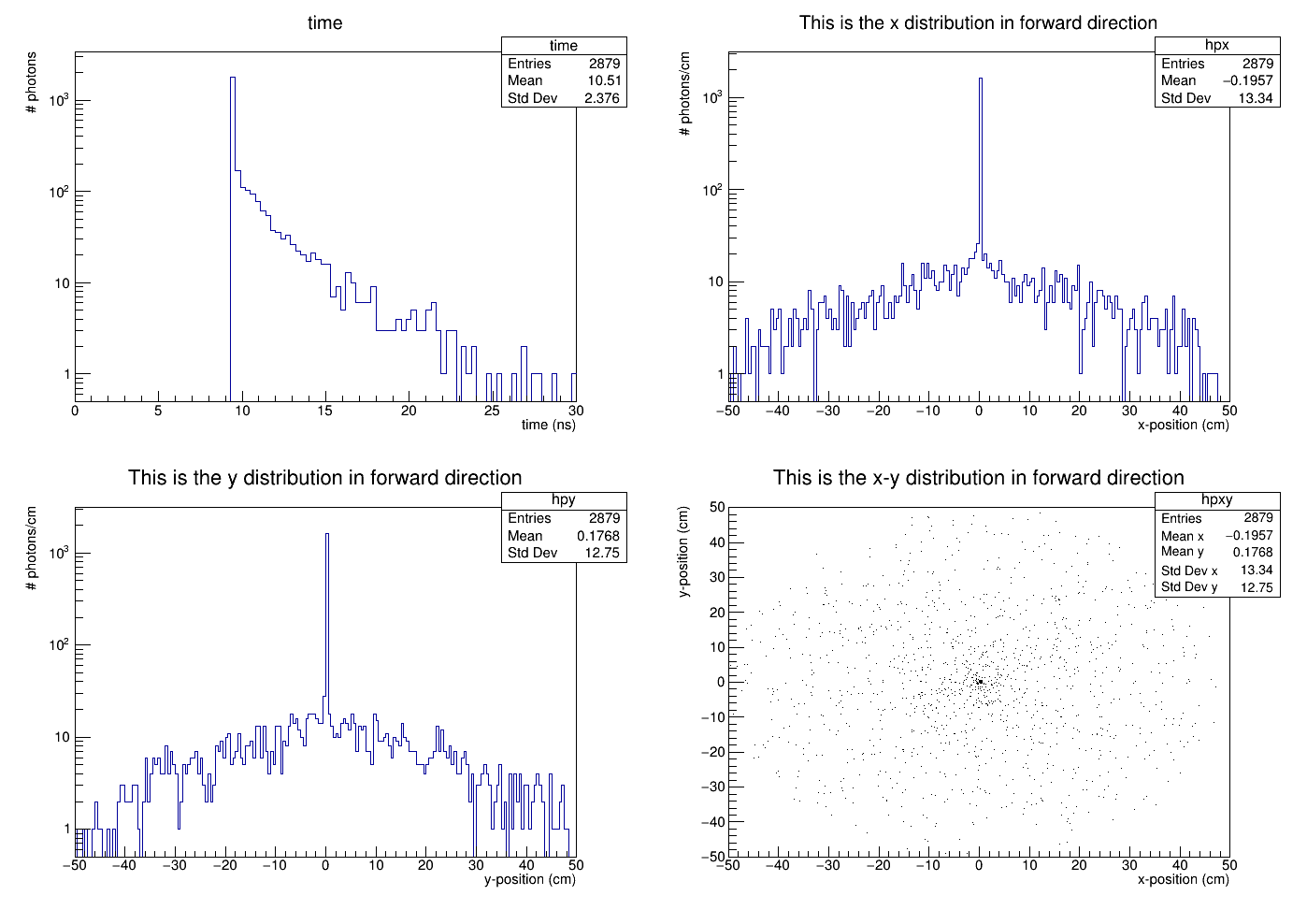
Rayleigh scattering: effect on timing and imaging
10000 incident photons
No scitillation time constant involved.

Slide 10
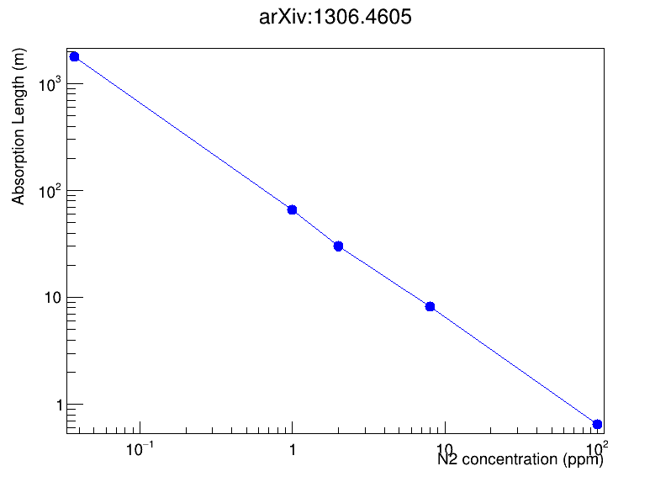
Absorption length
arxiv:1611.02481: 52.7 cm
arxiv:1502.04213: 60 +/- 6 cm
55 +/- 5cm
mboone specs.

