Slide 1



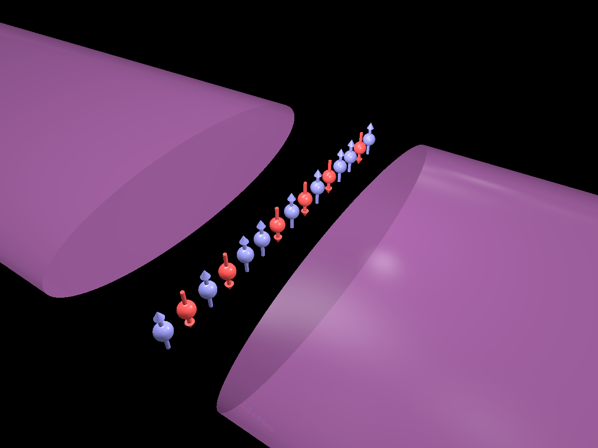
Trapped-ion systems for Quantum
Simulation of Lattice Gauge Theory
Guido Pagano
University of Maryland
Joint Quantum Institute
September 2018
HEP
Quantum Science
For HEP

Slide 2
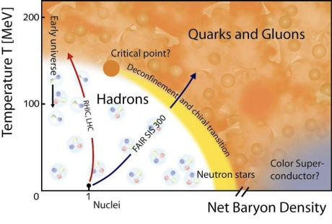
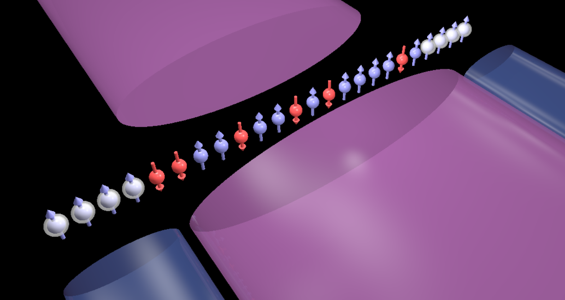
Introduction
Solving QCD on a lattice:
MonteCarlo has sign problem
Possibilities offered by NISQ
(Noisy Intermediate-Scale Quantum) devices
Trapped-ions quantum systems:
Single qubit manipulation and detection
High fidelity entanglement
Scalable to > 100 qubits per module
HEP on NISQ devices
Proof of principle with digital and hybrid approaches
Proposals for analog implementation

Slide 3
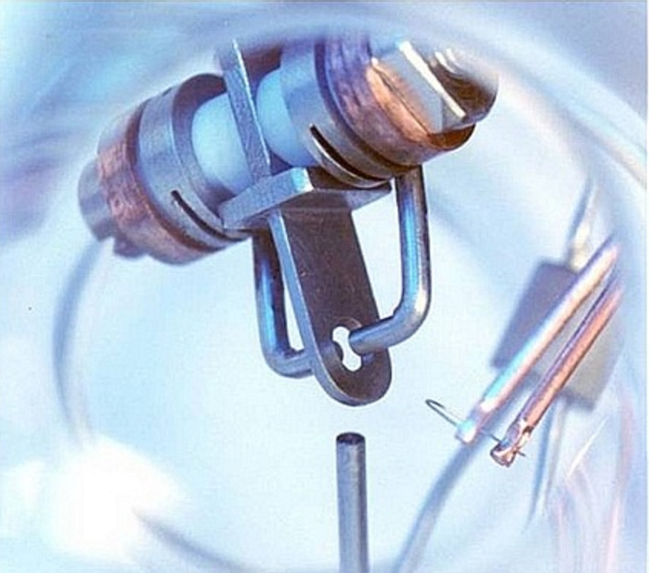
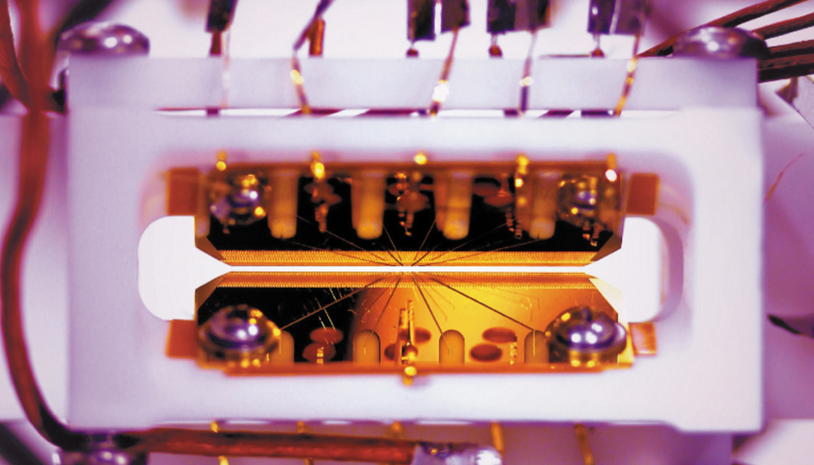
Trapped-ion systems: a powerful quantum platform
Precision measurements
Ion clock
3 × 10⁻¹⁸
accuracy
Quantum computing
Synthetic quantum matter
Programmable quantum gates

Slide 4
Trapped-ion systems: a powerful quantum platform
New directions in
Ion trapping quantum technologies:
High Energy Physics:
Dirac Equation:
R. Gerritsma, et al., Nature 463, 68 (2010)
Schwinger model in 1+1D:
E. Martinez, et al., Nature 534, 516 (2016)
Quantum Chemistry
C. Hempel, et al. PRX 8, 031022 (2018)
BioPhysics
D. Gorman, et al., PRX 8, 011038 (2018)
Quantum simulation of
out-of-equilibrium
spin models:
Many body localization
J. Smith et al., Nat. Physics, 12, 907 (2016)
Time Crystals
J. Zhang, et al., Nature 543, 217 (2017)
Dynamical Phase transitions
J. Zhang, GP, et al., Nature 551, 601 (2017)

Slide 5

A many-body system assembled atom by atom
¹⁷¹Yb⁺ Clock states qubit
²P_{1/2}
F=0
F=0
Coherence time: T₂>10 minutes
²P_{1/2}
F=0
High fidelity state preparation: > 99.9% in ~ 10 µs
355 nm
High speed readout: > 99.9% in ~ 100 µs
High Fidelity one (>99% in 1 µs) and two qubit gates (>98% in 500 µs)
F=1
12.6 GHz
²S_{1/2}
F=0

Slide 6
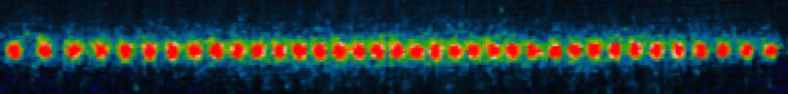
Wiring Trapped-ion Qubits with Laser beams
r
~2 mm
d ~10 nm
Spin dependent force
Cirac & Zoller (1995)
Molmer & Sorensen (1999)
Solano, et al. (1999)
Milburn, et al. (2000)

Slide 7
Laser-ion interactions
Laser Parameters
Lamb-Dicke Limit

Slide 8
Wiring Trapped-ion Qubits with Laser beams
Carrier
Transverse
modes
Transverse
modes
Beatnote frequency

Slide 9
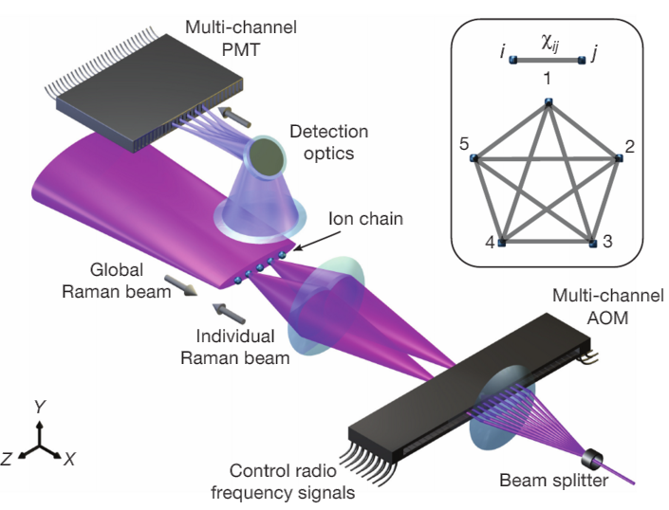

Programmable quantum computer with 5 qubits
1 S. Debnath et al. Nature 536, 63 (2016) 2 NML et al., PNAS 114, 13 (2017)
3 NML et al., Sci Adv. 3, 10 (2017) 4 C. Figgatt et al., Nat. Communs. 8, 1918 (2017)
5 N. Solmeyer et al., accepted QST (2018 ) 6 NML et al., arxiv 1712.08581 (2017)
7 K. A. Landsman et al., arxiv 1806.02807 8 M. Benedetti et al., arxiv 1801.07686 (2018)
9 A. Seif et al., arxiv 1804.07718(2018)

Slide 10
Suite of Algorithms implemented on trapped ion qubits
application | # qubits | # 2Q gates | # 1Q gates | fidelity | reference | collaborator
CNOT | 2 | 1 | 3 | 99% | Nature 536, 63 (2016)
QFT Phase est. | 5 | 10 | 70-75 | 61.9% | Nature 536, 63 (2016)
QFT period finding | 5 | 10 | 70-75 | 69.5-97% | Nature 536, 63 (2016)
Deutsch-Jozsa | 5 | 1-4 | 13-34 | 93%-97% | Nature 536, 63 (2016)
Bernstein-Vazirani | 5 | 0-4 | 10-38 | 90% | Nature 536, 63 (2016)
Hidden Shift | 5 | 4 | 42-50 | 77% | PNAS 114, 13 (2017) | Microsoft
Grover Phase | 3 | 10 | 35 | 85% | Nat. Comm. 8, 1918 (2017) | NSF
Grover Boolean | 5 | 16 | 49 | 83% | Nat. Comm. 8, 1918 (2017) | NSF
Margolus | 3 | 3 | 11 | 90% | PNAS 114, 13 (2017) | Microsoft
Toffoli | 3 | 5 | 9 | 90% | PNAS 114, 13 (2017) | Microsoft
Toffoli-4 | 5 | 11 | 22 | 71% | Debnath Thesis | NSF
Fredkin Gate | 3 | 7 | 14 | 86% | arXiv:1712.08581 (2017) | Intel
Fermi-Hubbard Sim. | 5 | 31 | 132 |  | arXiv:1712.08581 (2017) | Intel
Scrambling Test | 7 | 15 | 30 | 75% | arXiv: 1806.02807 (2018) | Perimeter, UCB
Bayesian Games | 5 | 5 | 15 |  | Qu. Sci. Tech 3, 045002 (2018) | Army Res. Lab.
Machine Learning (detection) | 5 | n/a | n/a |  | arXiv:1801.07686 (2018) | JQI
Machine Learning (state synth) | 4 | 5*N | 30*N | 90% | In preparation (2018) | NASA
[[4,2,2]] Error Det. | 5 | 6-7 | 20-25 | 98%-99.9% | Sci. Adv. 3, e1701074 (2017) | Duke
Full Adder | 4 | 4 | 16 | 83% | In preparation (2018) | NSF
Simultaneous CNOT | 4 | 2 | 8 | 94% | In preparation (2018) | NSF
Deuteron Simulation | 3 | 21 | 11 | 0.7% error | unpublished | ORNL

Slide 11
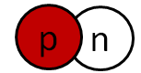
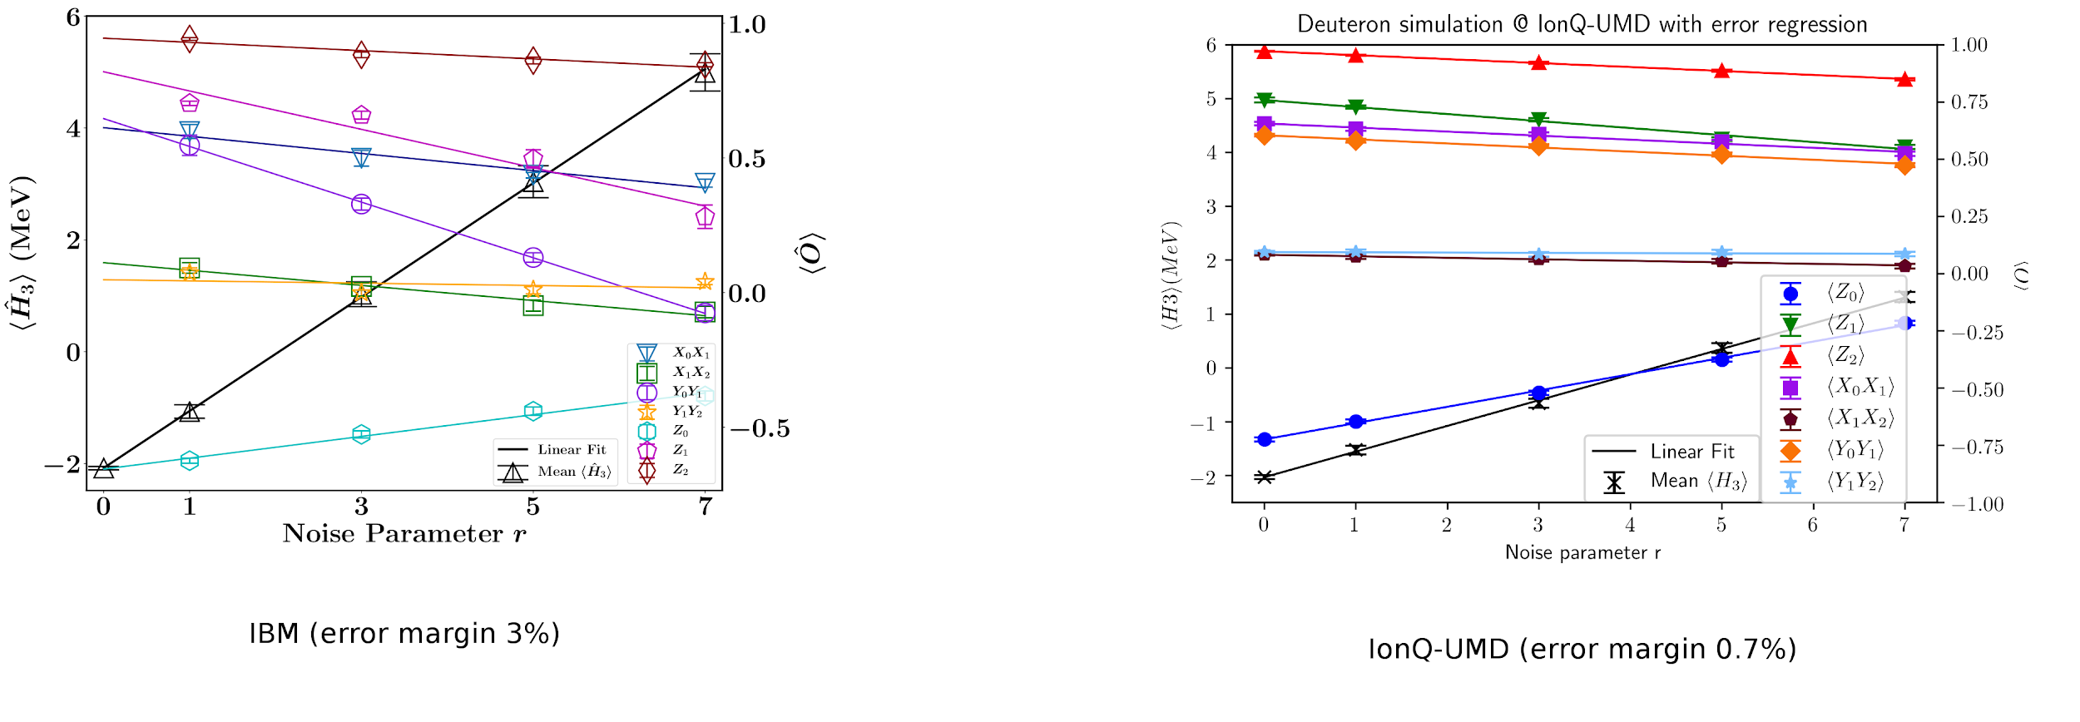
Simulating the Ground State of Deuteron
Extrapolated ground state energy for theoretically determined optimal angles (exact: -2.22 MeV):
Preliminary
Noise parameter r
IBM 3-qubit ansatz
3% error
UMD 3-qubit ansatz
0.7% error
UMD 4-qubit ansatz
(<0.5% error)
E.F. Dumitrescu, et al., Phys. Rev. Lett. 120, 210501 (2018)
Unpublished
Unpublished
(Note: implementing 3-qubit ansatz on Rigetti system was not possible)

Slide 12
Generating Spin Hamiltonians
Carrier
w
Transverse
modes
Transverse
modes
w+w_{HF}±μ
-μ
+μ
Beatnote frequency
33 THz
²P_{1/2}
ω
ω+ω_{HF} ±μ
|↑_{z}⟩
AOM
²S_{1/2}
|↓_{z} ⟩

Slide 13
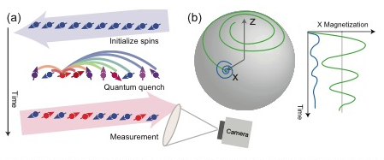
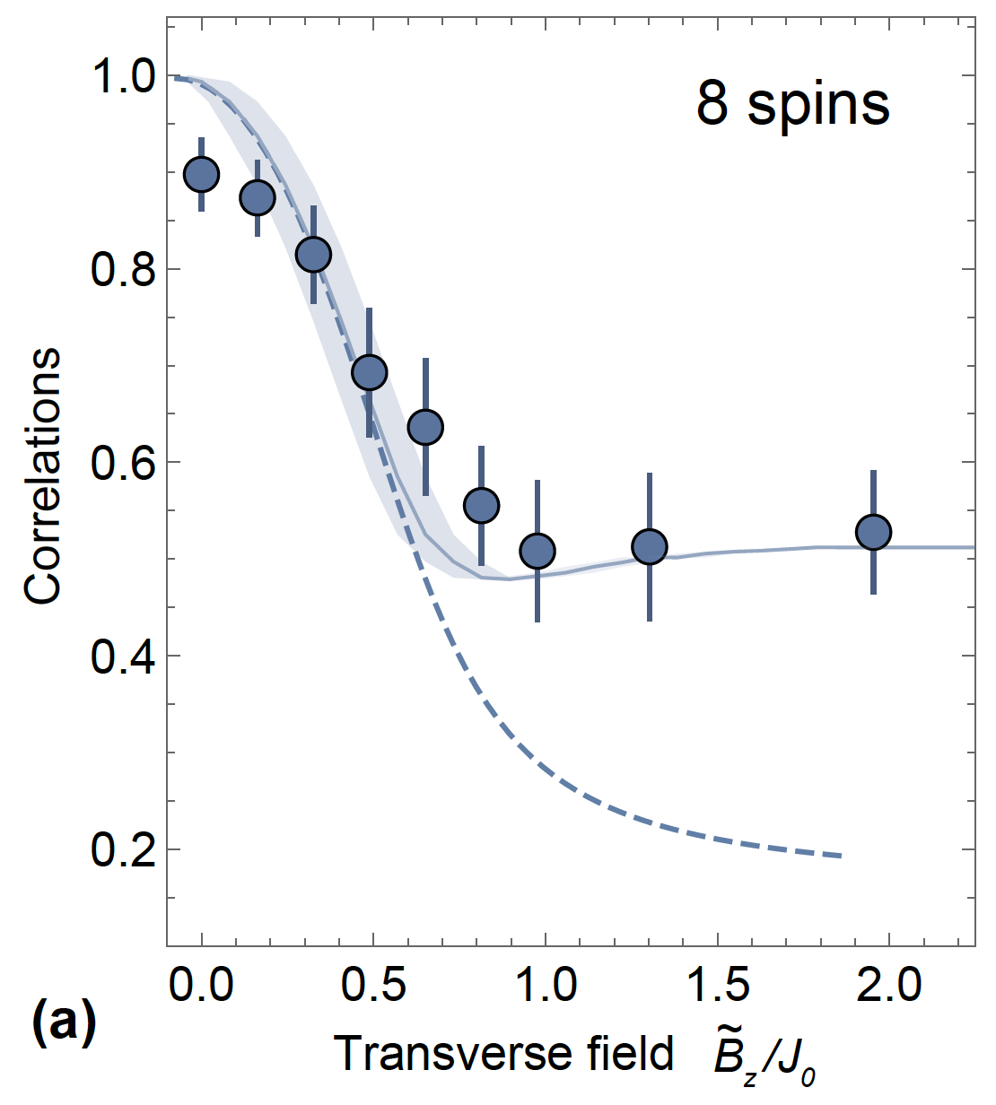
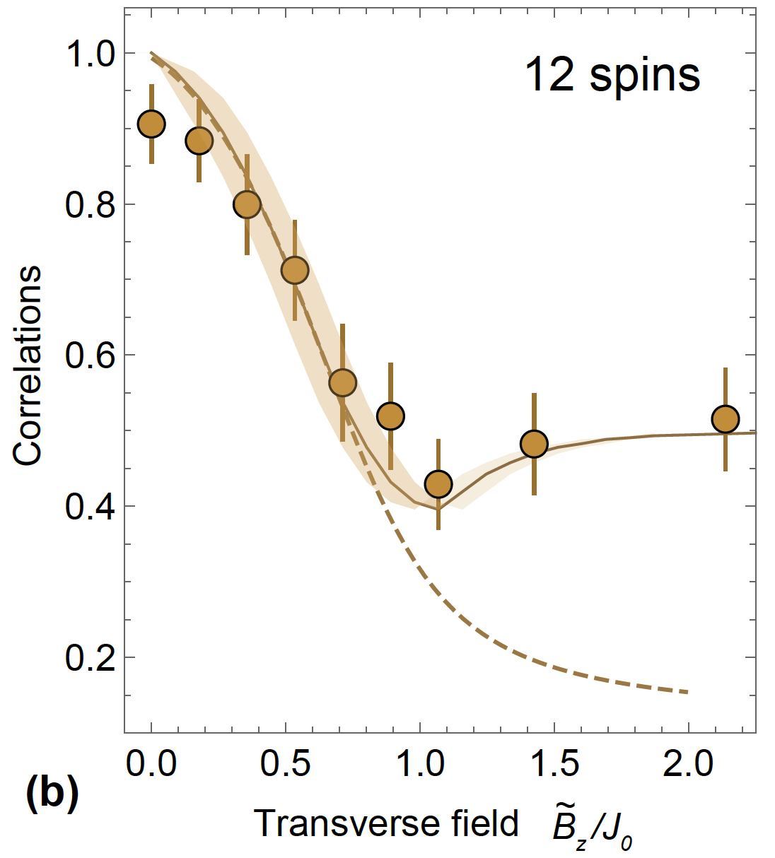
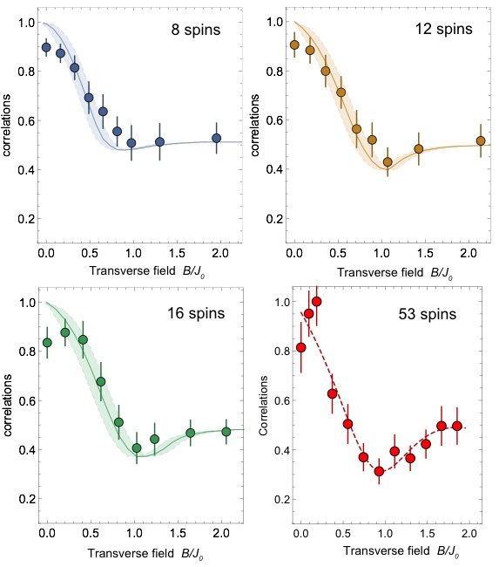
Spin models: Dynamical phase transition

Slide 14
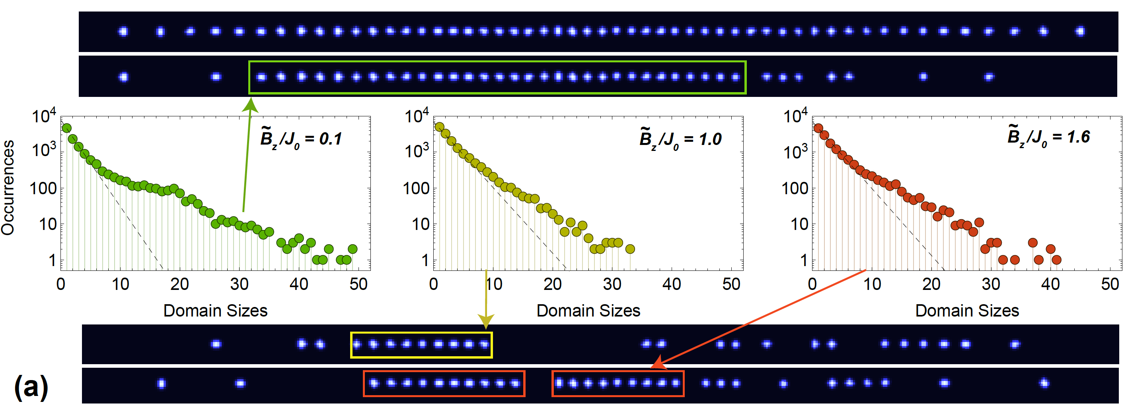
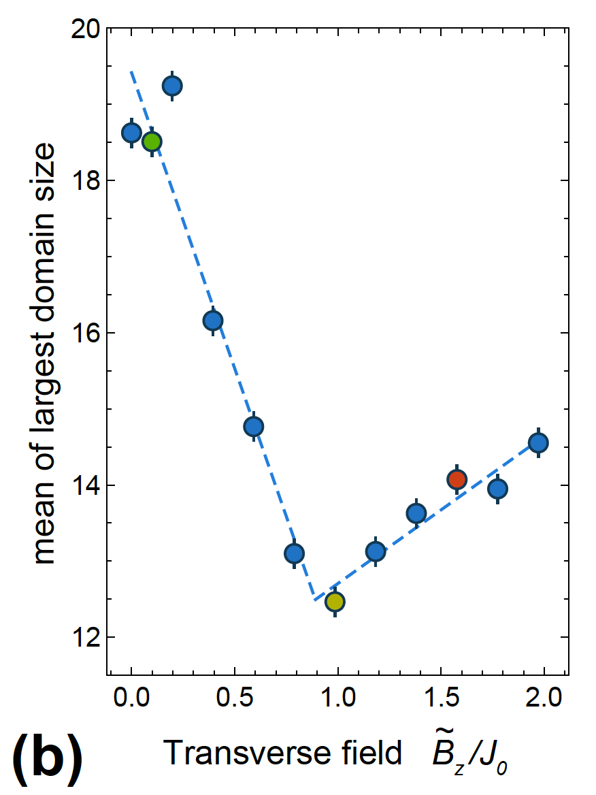
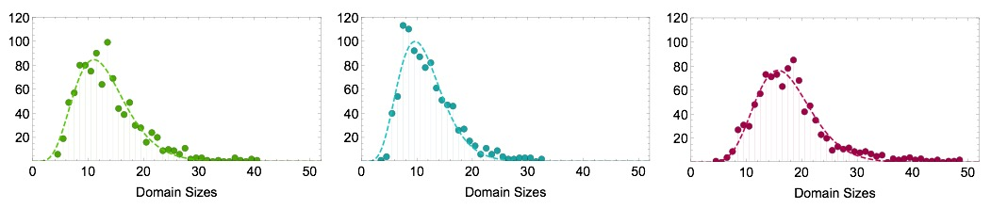
Spin models: Dynamical phase transition
Formation probabilities (K. Najafi and M. A. Rajabpour), PRB 93,125139 (2016)
Distribution of largest domain size
J. Zhang, GP, et al., Nature 551, 601 (2017)

Slide 15
Quantum Approximate Optimization Algorithms
Adiabatic protocol:
,
QAOA: new method to prepare non trivial quantum states
  E. Fahri et al., arXiv:1411.4028, (2014)
  E. Fahri et al., arXiv:1412.6062, (2014)
  G. Verdon et. al, arXiv:1712.05304, (2017)
  W. W. Ho and T. H. Hsieh, arXiv:1803.00026, (2018)

Slide 16

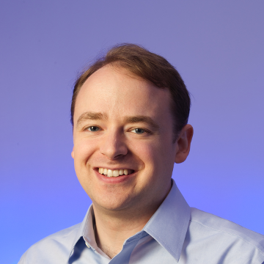
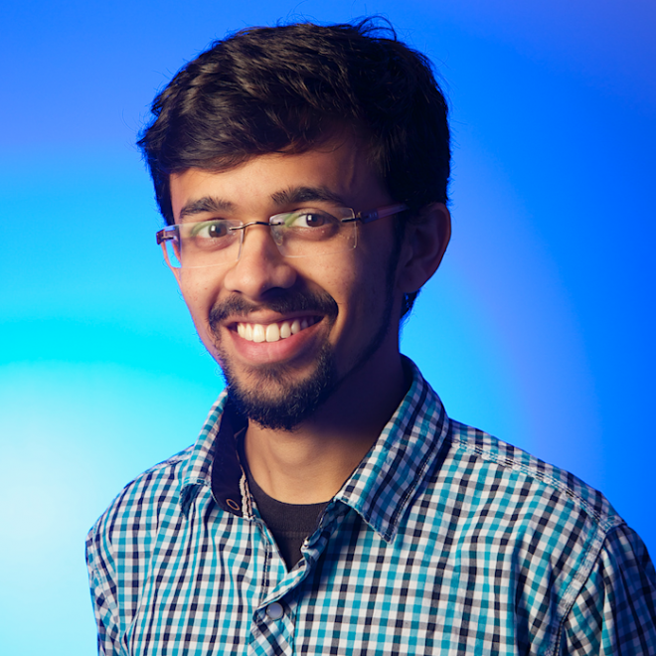
Quantum Approximate Optimization Algorithms
p=1 QAOA with 7 qubits
Preliminary
S. Jordan
A. Bhapat

Slide 17
From Spin models to HEP models
Free massless fermions in 1+1D
Kogut – Susskind staggered fermions
Jordan Wigner transformation
Notes:
In this representation, the fermion operator i on an even (odd) site corresponds to the upper (lower) component of the original Dirac spinor of the continuum theory, which are connected by the discrete chiral transformation.

Slide 18
From Spin models to HEP models
Kogut – Susskind staggered fermions
+
Jordan-Wigner Transformation
Two Challenges:
Engineer three-body interactions
2) Preserve Gauss Law

Slide 19
1+1D Schwinger model with IBMx2 and IBMx5
Fully Digital implementation with superconducting qubits
SU(4) parametrization
Trotterization
Klco, et al., Arxiv 1803.03326 (2018)

Slide 20
1+1D Schwinger model with trapped ions
Hybrid implementation with long range interactions
Particle-antiparticle hopping
Mass
term
Gauge field
E. Martinez, et al., Nature 534, 516 (2016)

Slide 21
Fully analog approach with trapped ions
P. Hauke, et. al., PRX 3, 041018 (2013)
Encoding Matter and Gauge fields
In two different qubits:
J is perturbative in
the 2-body coupling
D. Yang, et al., PRA 94, 052321 (2016)
Highly occupied boson model
(HOBM):
Microtraps to tailor phonon hopping
High <n> Fock state
Spin Quantum Link Model:
Phonons = matter fields
Spin = gauge fields (S=1/2)

Slide 22
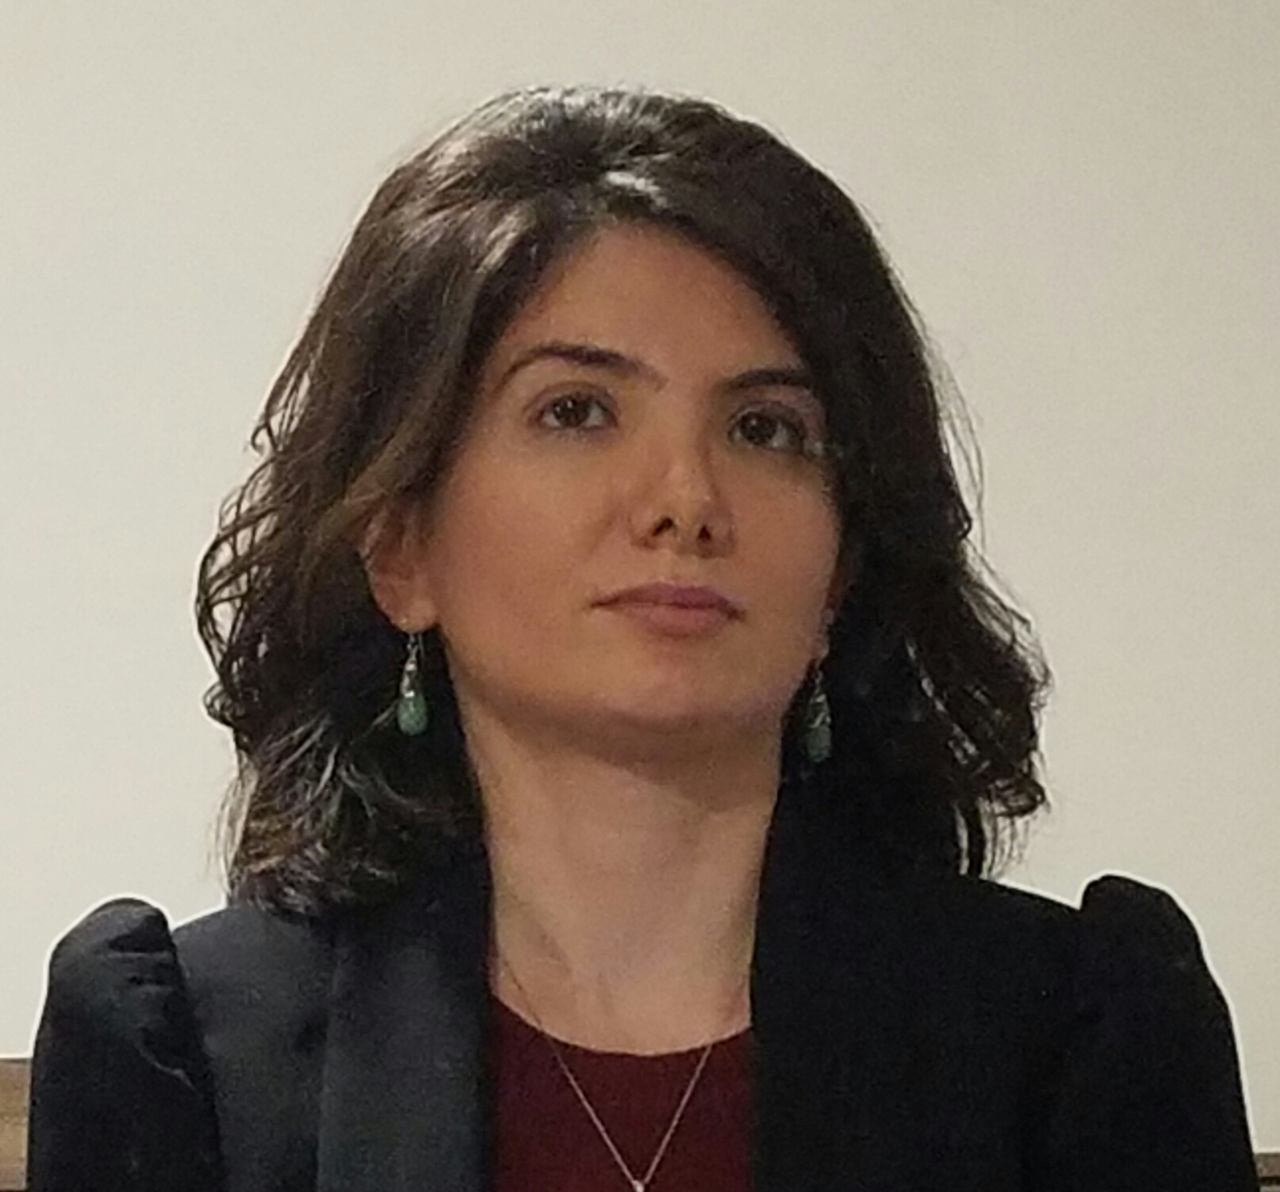
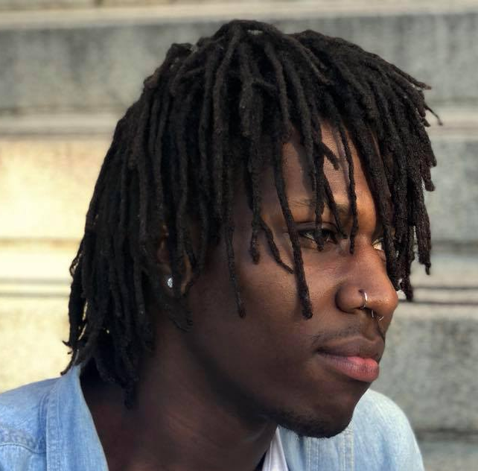
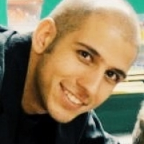
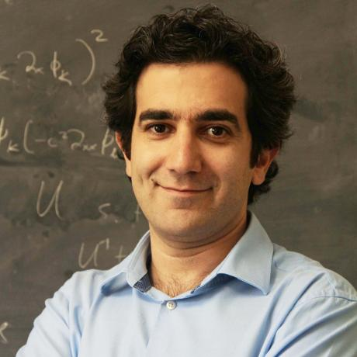
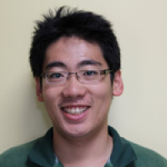
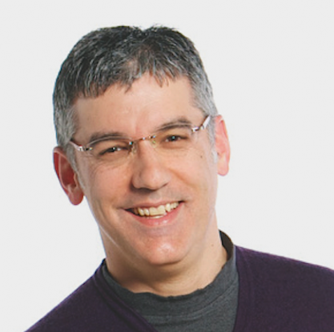
Fully analog approach with trapped ions
Optimization approach for analog Schwinger model
with small system sizes
Z. Davoudi
A. N. Shaw
A. Seif
M. Hafezi
J. Zhang
C. Monroe

Slide 23
Fully analog approach with trapped ions
Generalization of
Molmer Sorensen
scheme with multiple
Frequency tones
Carrier
Transverse
modes
Transverse
modes
Beatnote frequency

Slide 24
Fully analog approach with trapped ions
Magnus expansion of the full evolution:
Playing with laser parameters to
enhance resonantly three body terms:

Slide 25

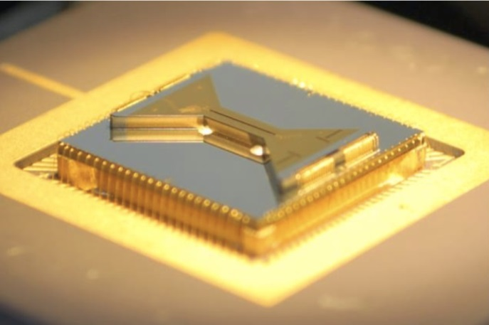
Summary and outlook
Great opportunities offered by near term quantum platforms
Trapped-ion systems offer features that makes analog
implementation of Lattice HEP models possible
Two new systems coming up:
Cryogenic Analog Quantum simulation platform:
~100 qubits
Global control
New Quantum computing platform:
~30 qubits
Full control

Slide 26
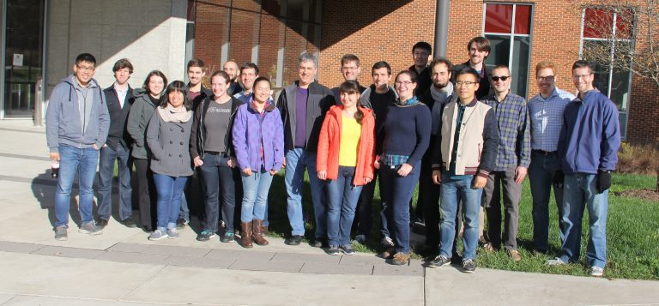








Acknowledgments
Z. Davoudi
A. N. Shaw
A. Seif
M. Hafezi

Slide 27
Generating Spin Hamiltonians
Carrier
ω
Transverse
modes
Transverse
modes
ω+ω_{HF}±μ
-μ
+μ
Beatnote frequency
33 THz
²P_{1/2}
ω
ω+ω_{HF} ±μ
|↑_{z}⟩
²S_{1/2}
|↓_{z} ⟩

Slide 28
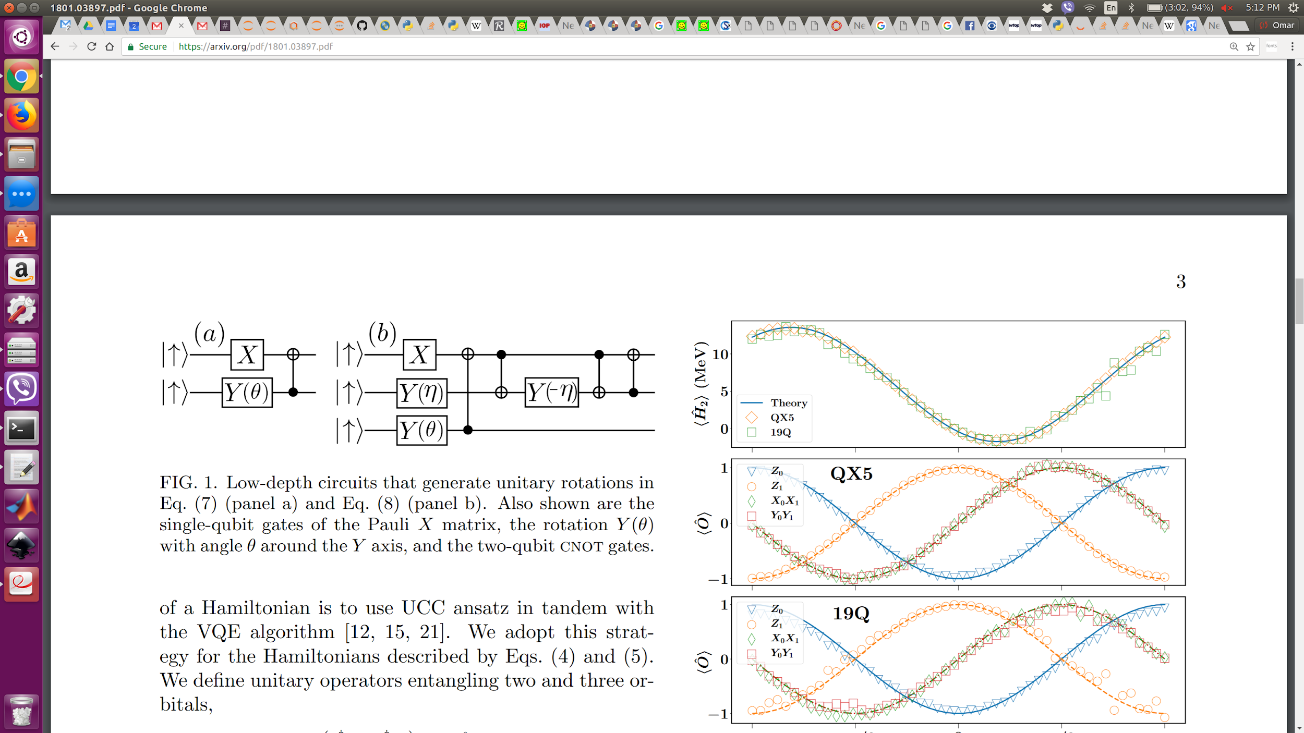
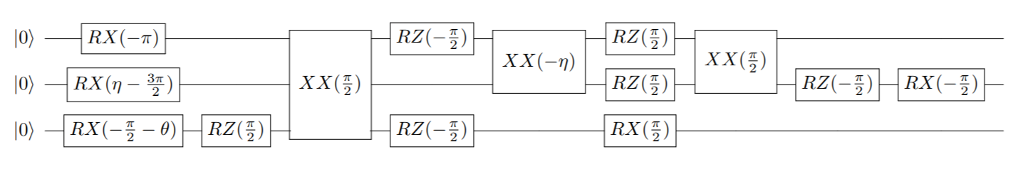
Generating Spin Hamiltonians
ORNL (R. Pooser, E. Dumitrescu, P. Lougovski, A. McCaskey)
UMD (K. Landsman, N. Linke, D. Zhu, CM)
IonQ (Y. Nam, O. Shehab, CM)
canonical
UCC ansatz
… compiled
to our native
gate set
H = (15.531709)I + (0.218291)Z₀ − (6.125)Z₁ − (9.625)Z₂
−(2.143304)X₀X₁ −(2.143304)Y₀Y₁ −(3.913119)X₁X₂ − (3.913119)Y₁Y₂
E.F. Dumitrescu, et al., Phys. Rev. Lett. 120, 210501 (2018)

Slide 29
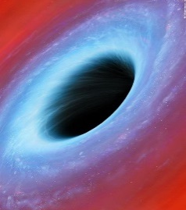




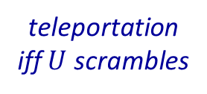
Quantum Scrambling Litmus Test (7 qubit circuit)
N. Yao (UC Berkeley)
B. Yoshida (Perimeter)
arXiv:1803.10772
Quantum scrambling
The “complete diffusion” of entanglement within a system
Relevant to information evolution in black holes
Hayden and Preskill, J. HEP 9, 120 (2007); Susskind and Zhao, arXiv:1707.04354 (2017)
OTOC measurements can be ambiguous
Arbitrary
input state
teleportation fidelity
K. Landsman, et al., arXiv:1806.02807
teleportation
iff scrambles
scrambling parameter
U
:

