Slide 1
Main Injector/Recycler
D. Capista
Friday Operations Meeting
25 May 2018

Slide 2
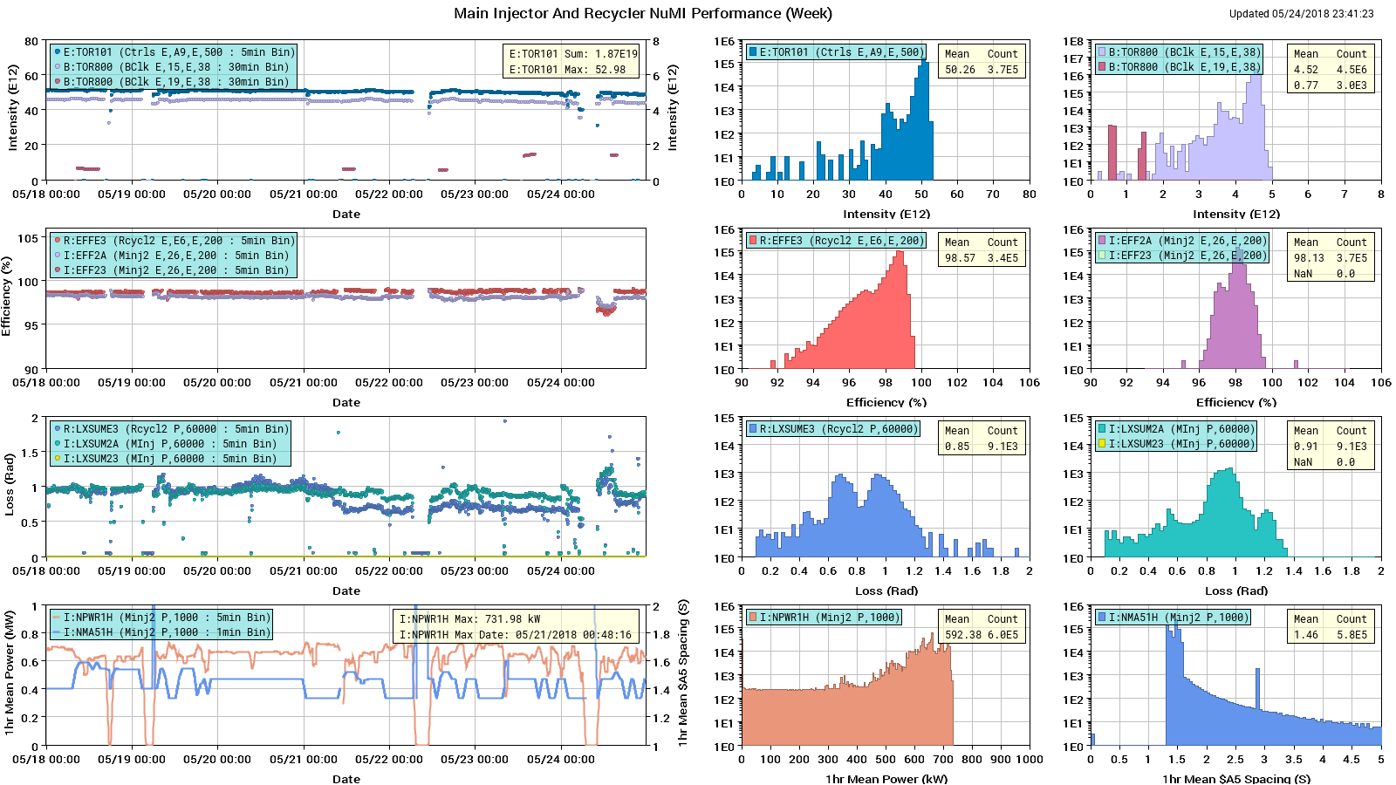
NuMI Performance

Slide 3
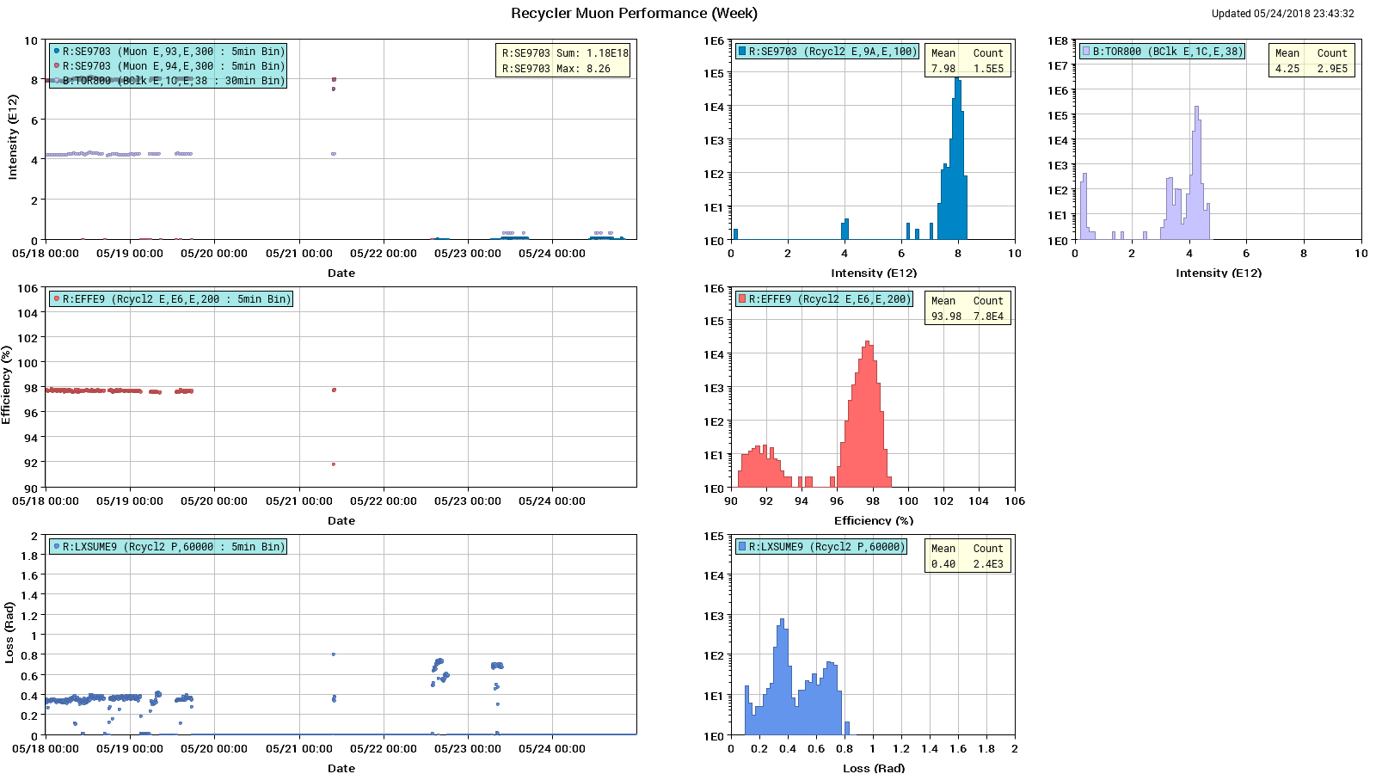
Muon Performance

Slide 4
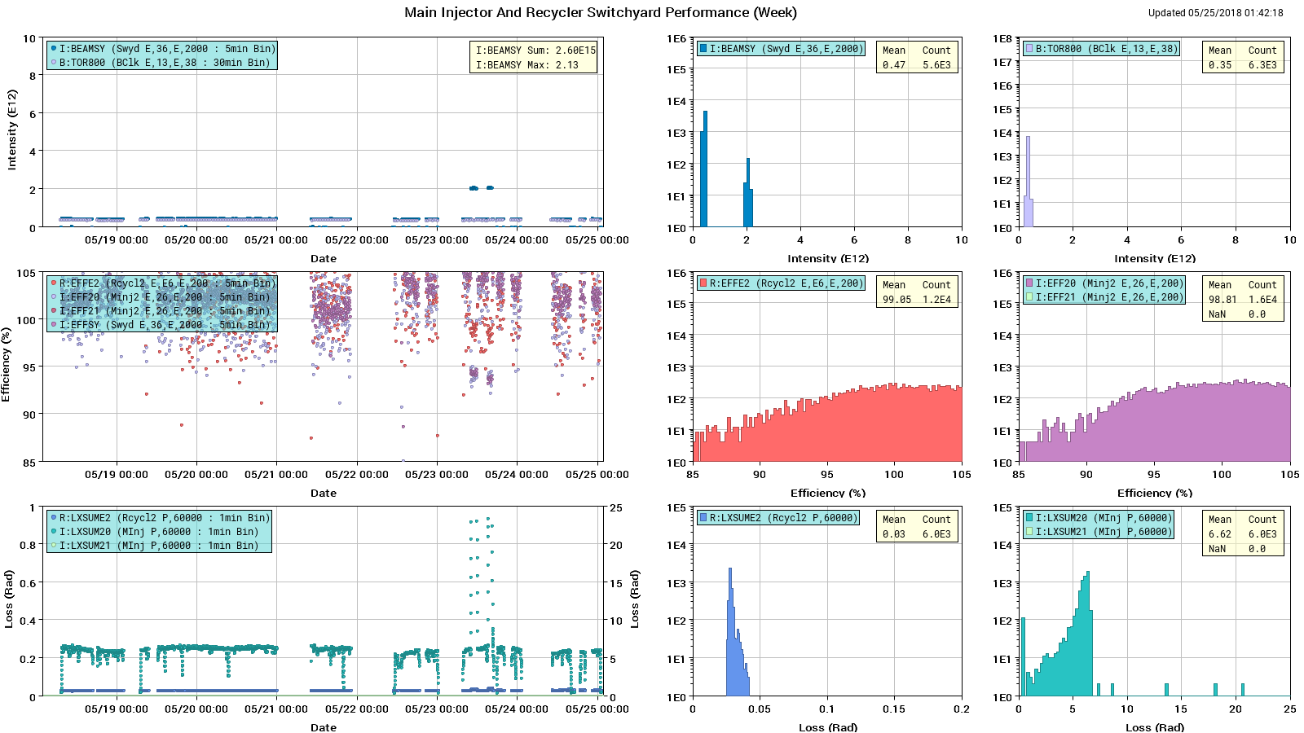
SY Performance

Slide 5
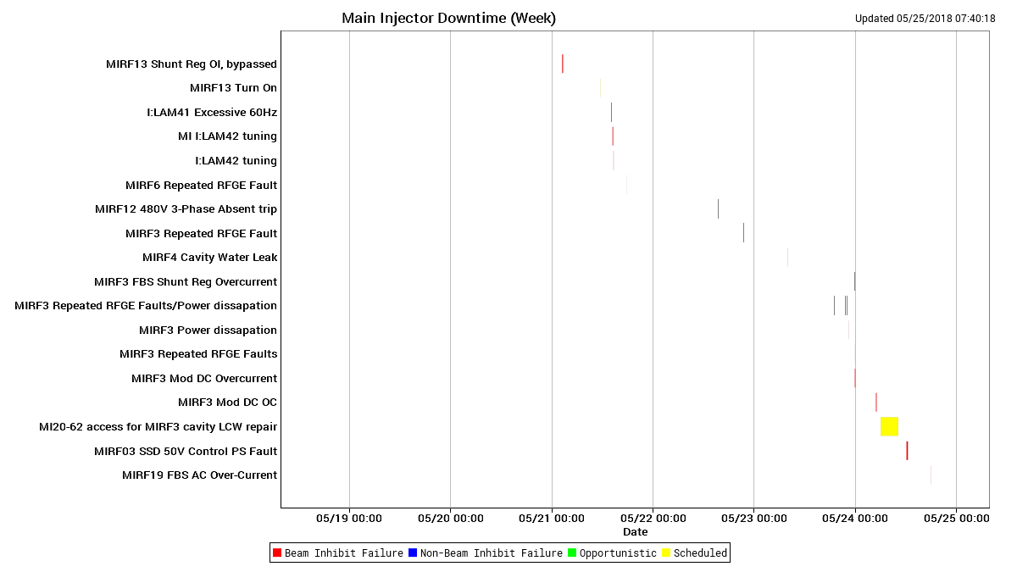
Downtime MI

Slide 6
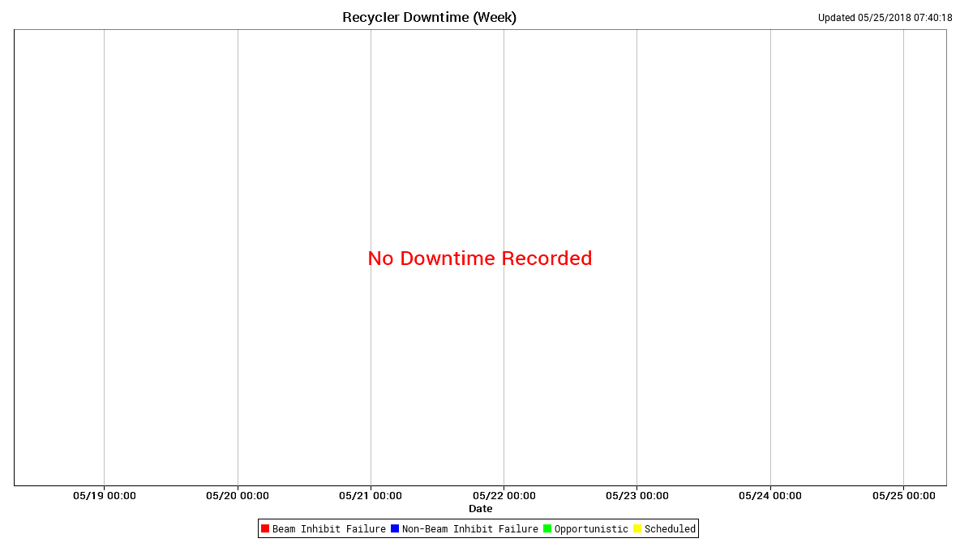
Downtime RR

Slide 7
Next Week
Studies
1.2 sec fast ramp.
MI TBT lattice measurement
8-GeV.
Use $2B ramped 1.67 second cycle.
RR TBT lattice measurement
Recycler Software Upgrade (R2)
RR 53MHz cavity heating
G-2 running, NuMI off
Recycler Software Upgrade (R2)
Vacuum issues
MI52 septa
Abort line beampipe needs to be replaced
Abort tuning at various energies
MI60 Magnet system pump/motor #2 is offline.

