Slide 1
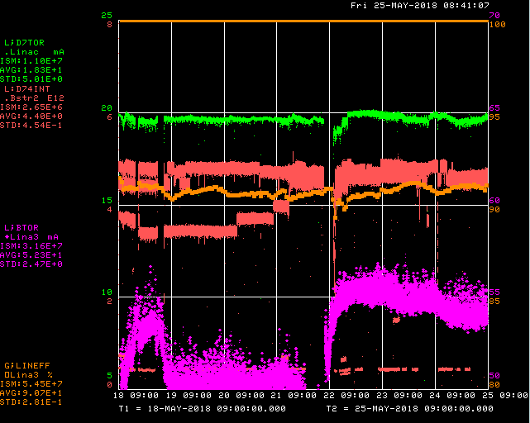
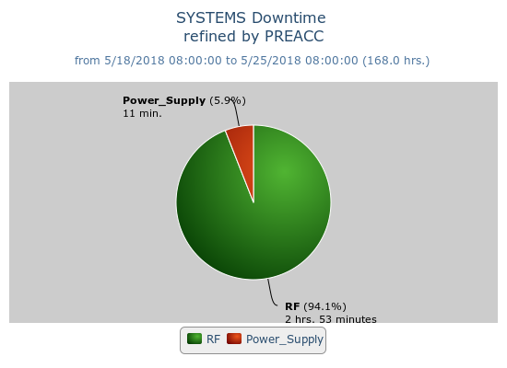
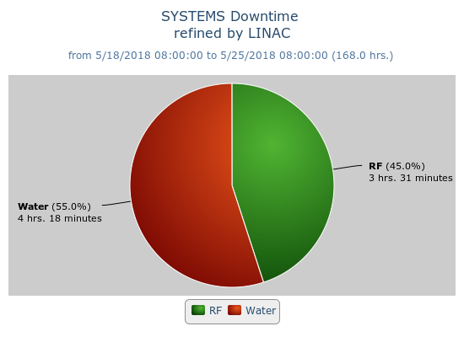
Preacc/Linac Weekly Performance
Friday – LRF5 Marx swap issues
Saturday – Driver anode cable failure
Tuesday – Debuncher cooling skid leak

Slide 2
Current Conditions/Plans
Source B – 54 mA
Linac input – 21 mA
Linac output – 19 mA, ~4.6E12 p/pulse
No planned downtime

