Slide 1
Can we mount the CE boxes horizontally ?
Marco Verzocchi - Fermilab

Slide 2
What is needed for this ?
Instead of a flat connector on the FEMB PCB use a 90º connector
Cables to come out perpendicular to the FEMB or backward (relative to the FEMB insertion direction, opposite to protoDUNE, see sketch on next slide) [red and purple lines on the previous page)
Do we have sufficient space between the end of the rotated FEMB and the wall of the cryostat ? (Yes, see Manhong slides)
We will need a support for the FEMBs in this position (additional metal bar/bars), will they conflict with the field cage and its hinges ? This is not in Manhong’s slides, I think it is needed, will it interfere with the latches for the field cage ?
Bubbles in Liquid Argon will not be channelled through frame
If we do it, we will do it both on top and on the bottom we do not want to have two different sets of APAs and of FEMBs

Slide 3
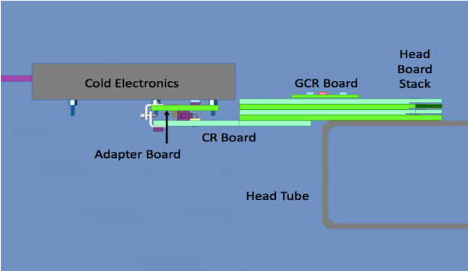
Proposal

Slide 4
Mechanical support for the CE boxes
Additional mechanical support shown in red, with screw(s) in black to hold the CE box in place

