Slide 1
DUNE Cabling
Manhong Zhao, BNL
5-31-2018

Slide 2
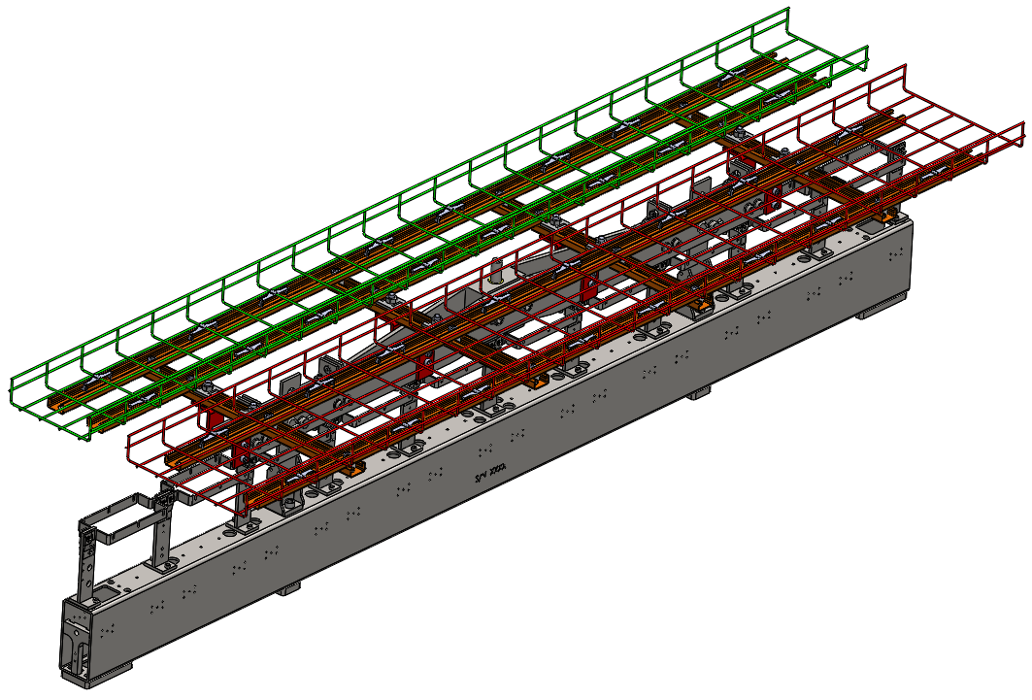
Cable tray assembly on upper APA
358mm
256mm
269mm
4 long unistrut channels support the cable weight

Slide 3
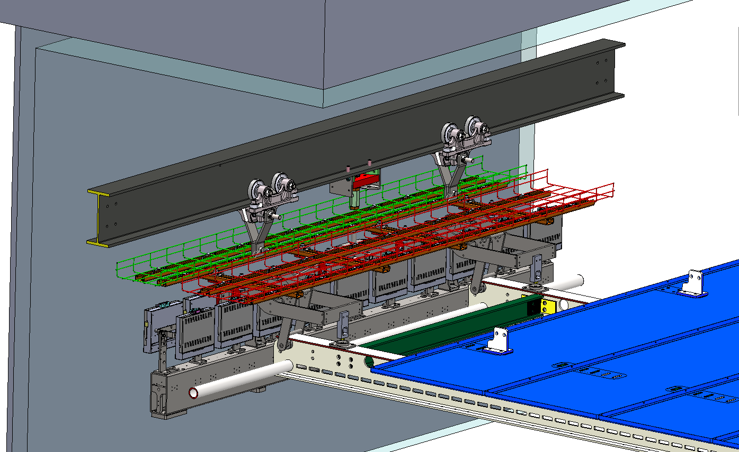
Mock-up of cabling from upper APA to feedthrough port
70mm
corrugation

Slide 4
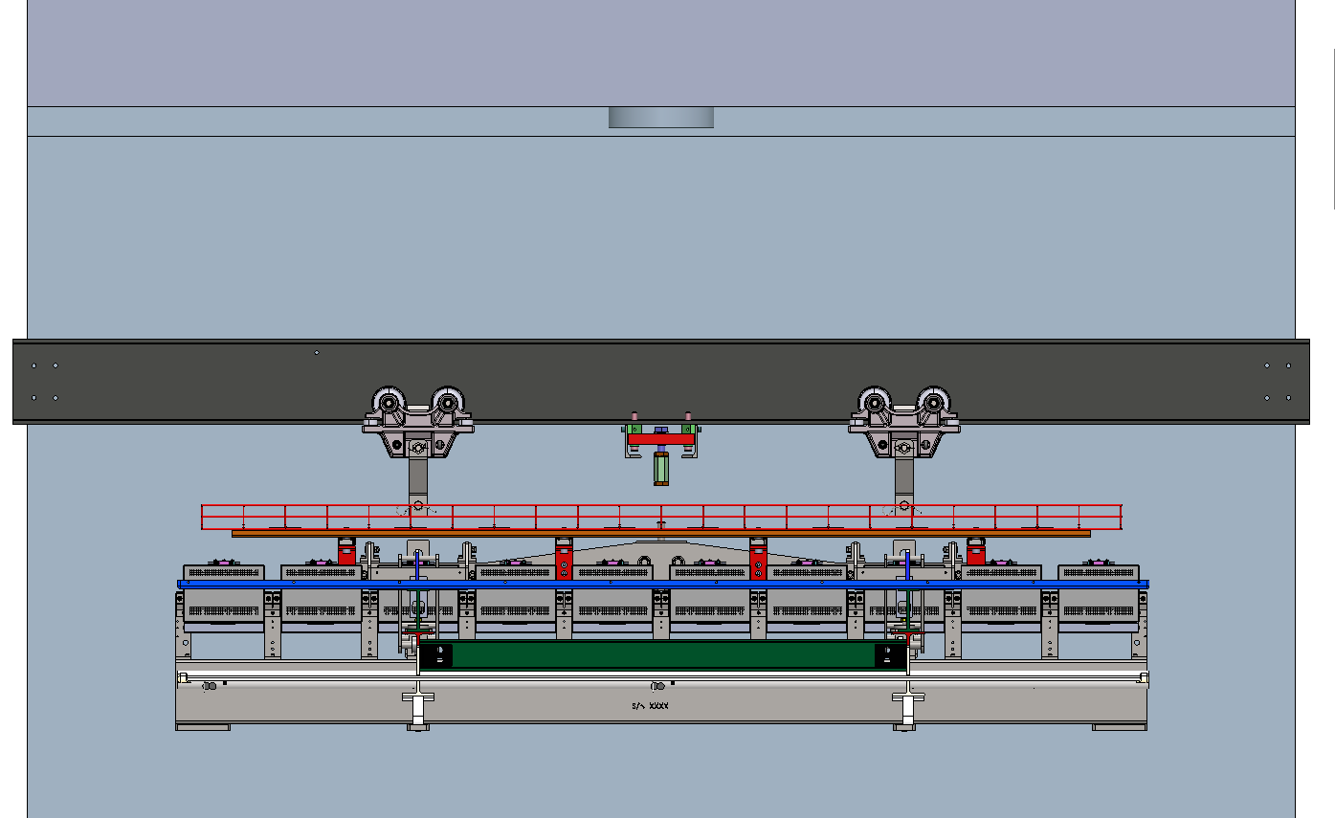

Slide 5
402mm
400mm
480mm
550mm
332mm
76mm

Slide 6
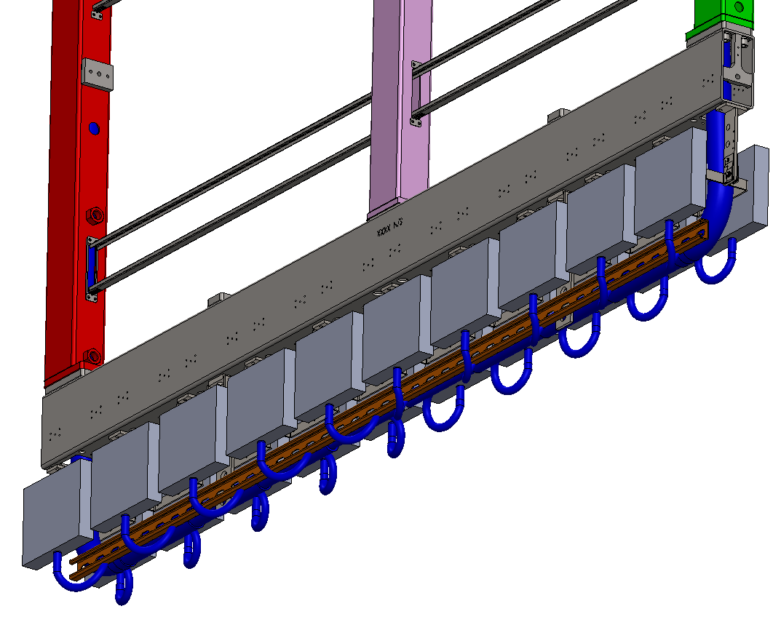
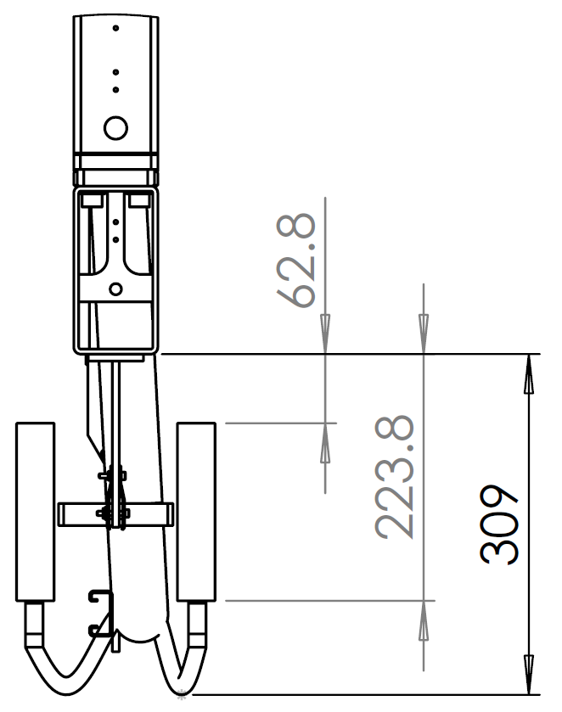
Cable routing at bottom APA
Assumed a bending radius of 35mm (70mm dia).

Slide 7
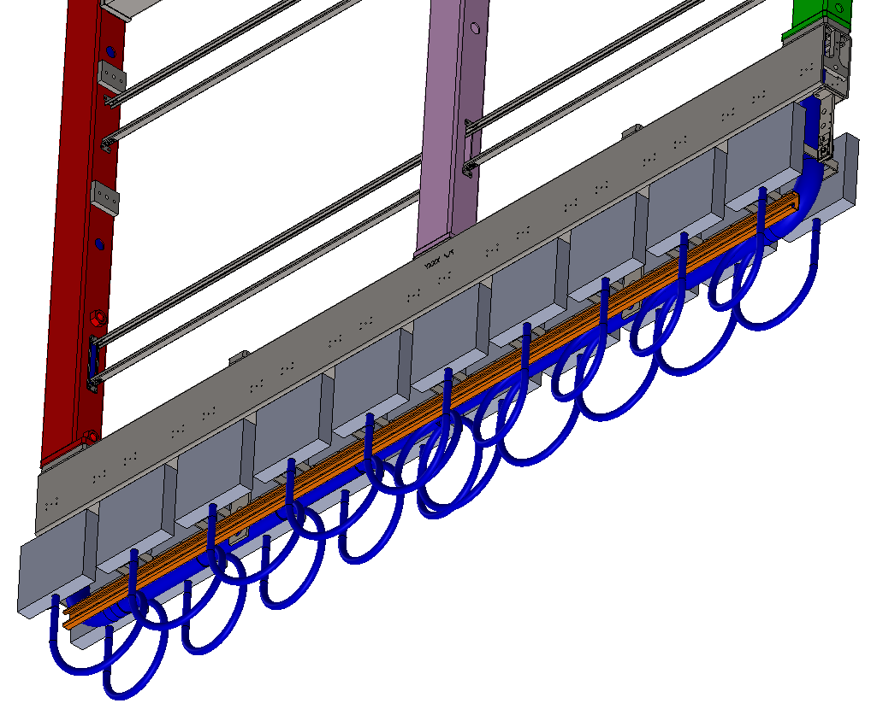
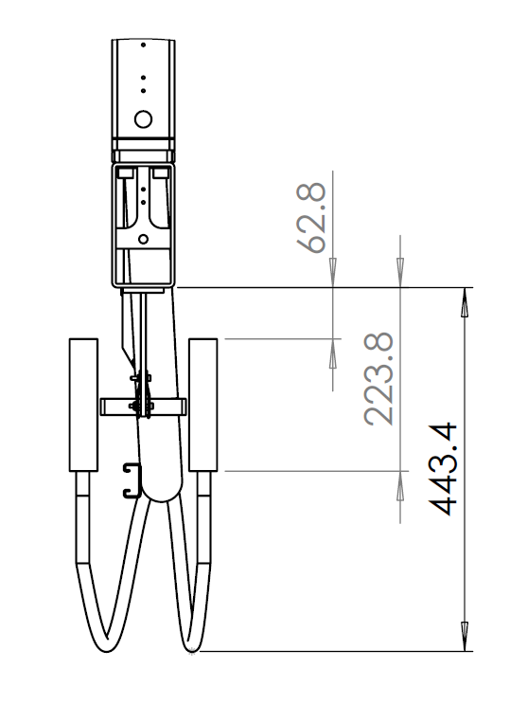
Cable routing at bottom APA
Assumed a generous bending radius of 100mm (200mm dia).
Actual minimum bending radius of one bundle can be 30mm ~ 40mm.

Slide 8
CE mounted horizontally on lower APA
155mm
118mm

Slide 9
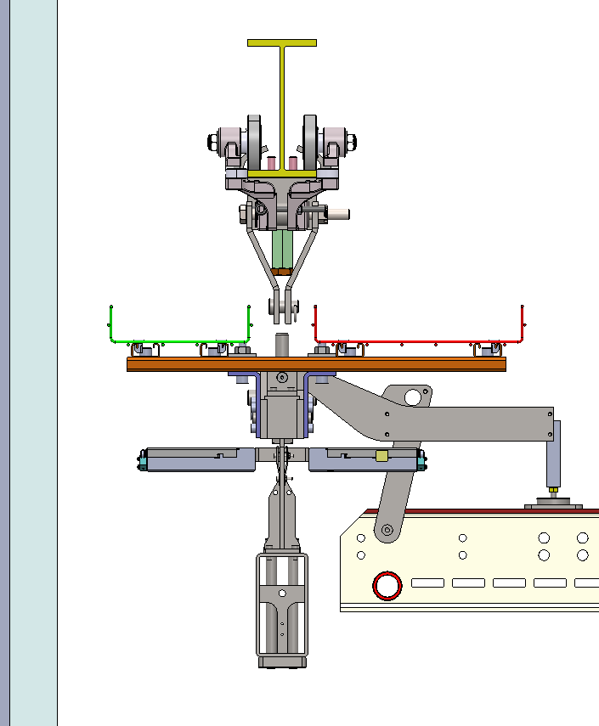
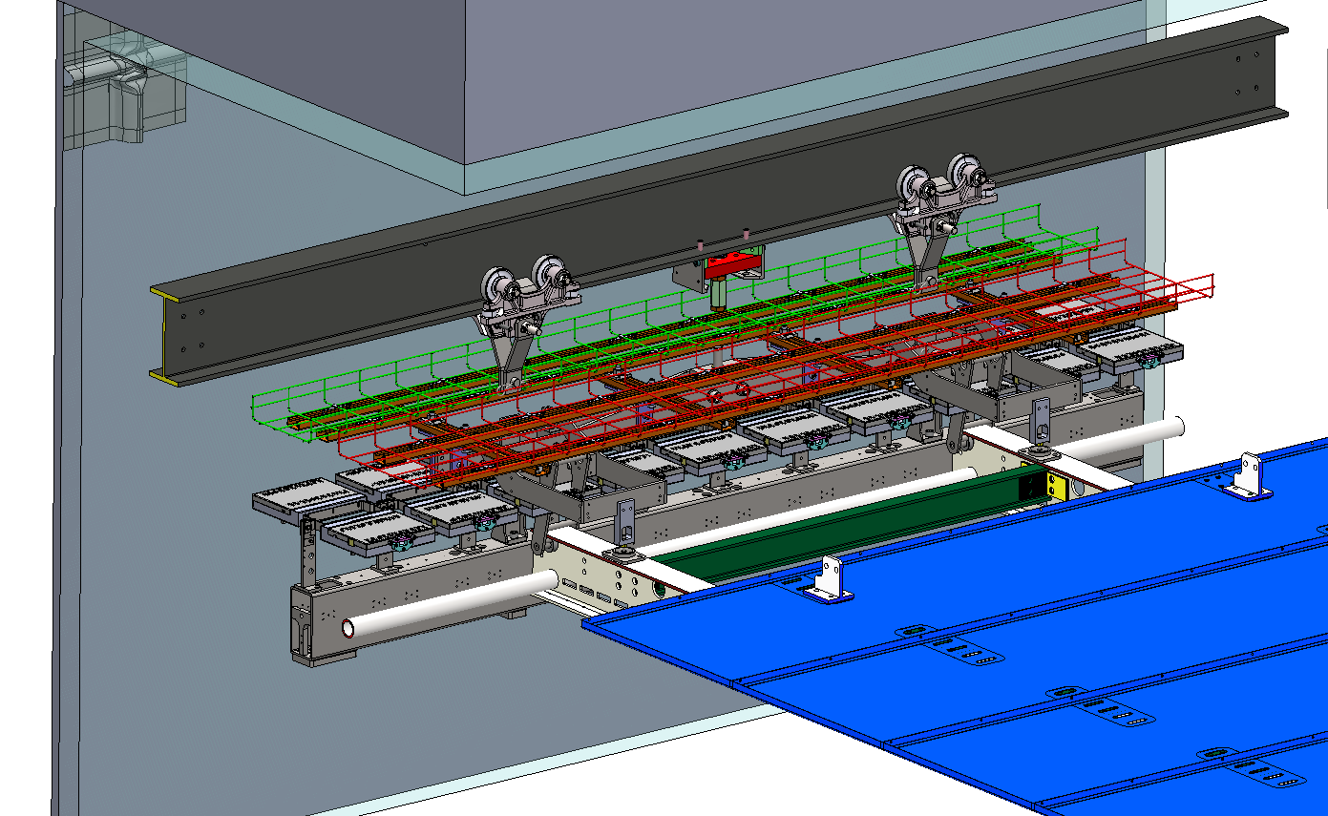
CE mounted horizontally on upper APA

