Slide 1
Electron cloud studies and application to BNL eRHIC
Yichen Ji – Illinois Institute of Technology
Budker Seminar
July 9th 2018
Advisor: Linda Spentzouris, Robert Zwaska
In Collaboration: Yuri Alexahin

Slide 2
Table of contents
Review of e-cloud and previous work
eRHIC: Electron-Ion collider
  Superconducting magnets vulnerable to e-cloud related heat deposition
Posinst simulated heat deposition rate in eRHIC dipole
  Non-uniform - Very concentrated in some places
  Could be suppressed by low SEY coating
Coatings proposed by eRHIC group
  Measurement of SEY at LINAC lab and MI-10
  Vacuum-to-vacuum transport

Slide 3
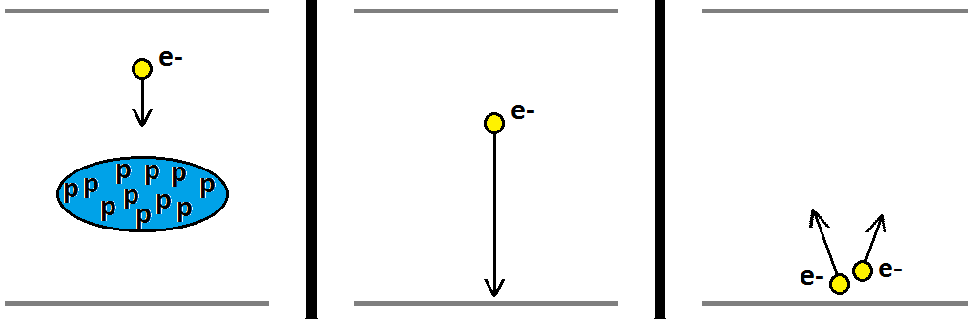
Electron cloud effect
E-cloud : exponential generation of unwanted electron inside beam pipe
  Limit accelerator performance: cause instabilities, over heating
Secondary electron yield (SEY): on average, how many electrons are knocked off a surface per incident electron
  Conditions to lower SEY when exposed to electron bombardment
POSINST code simulates the process

Slide 4
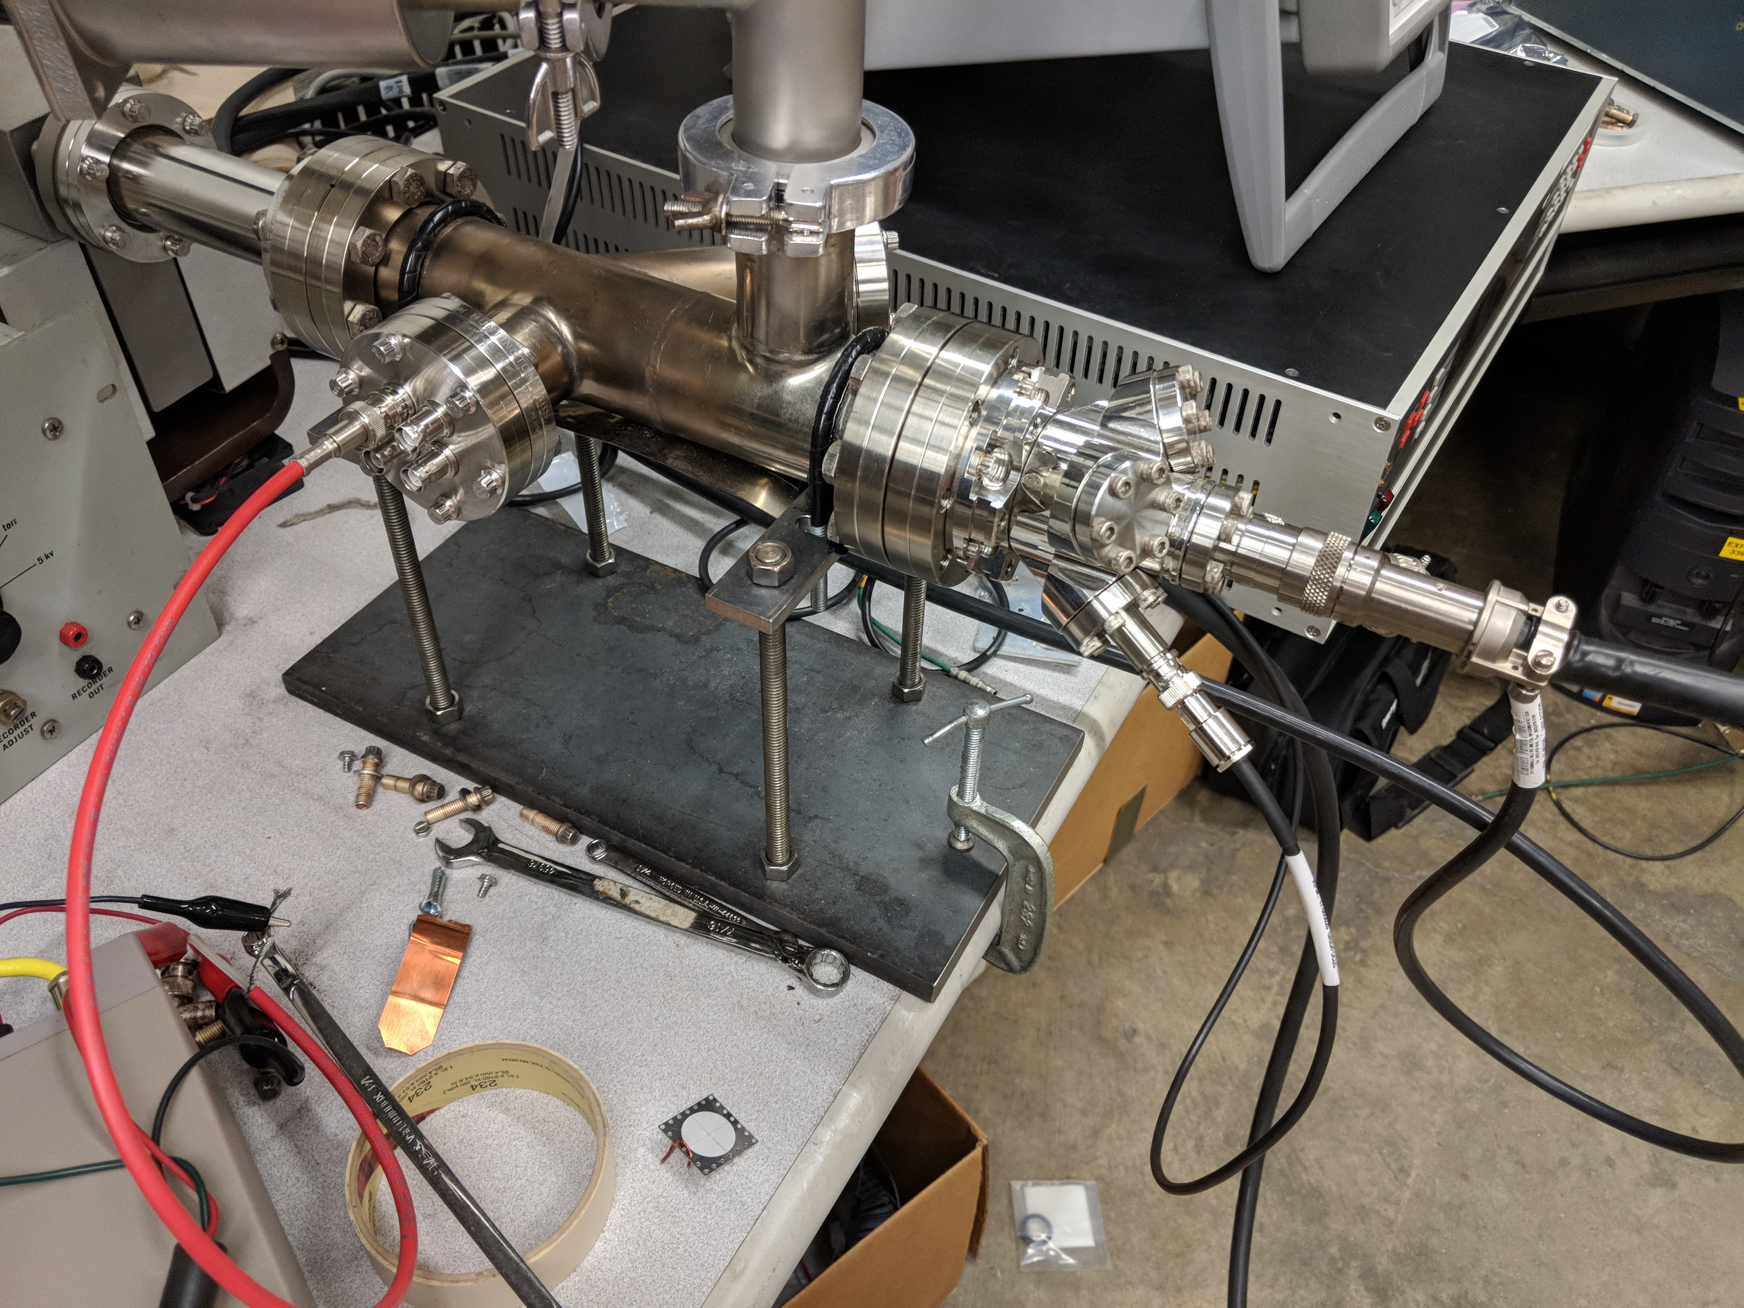
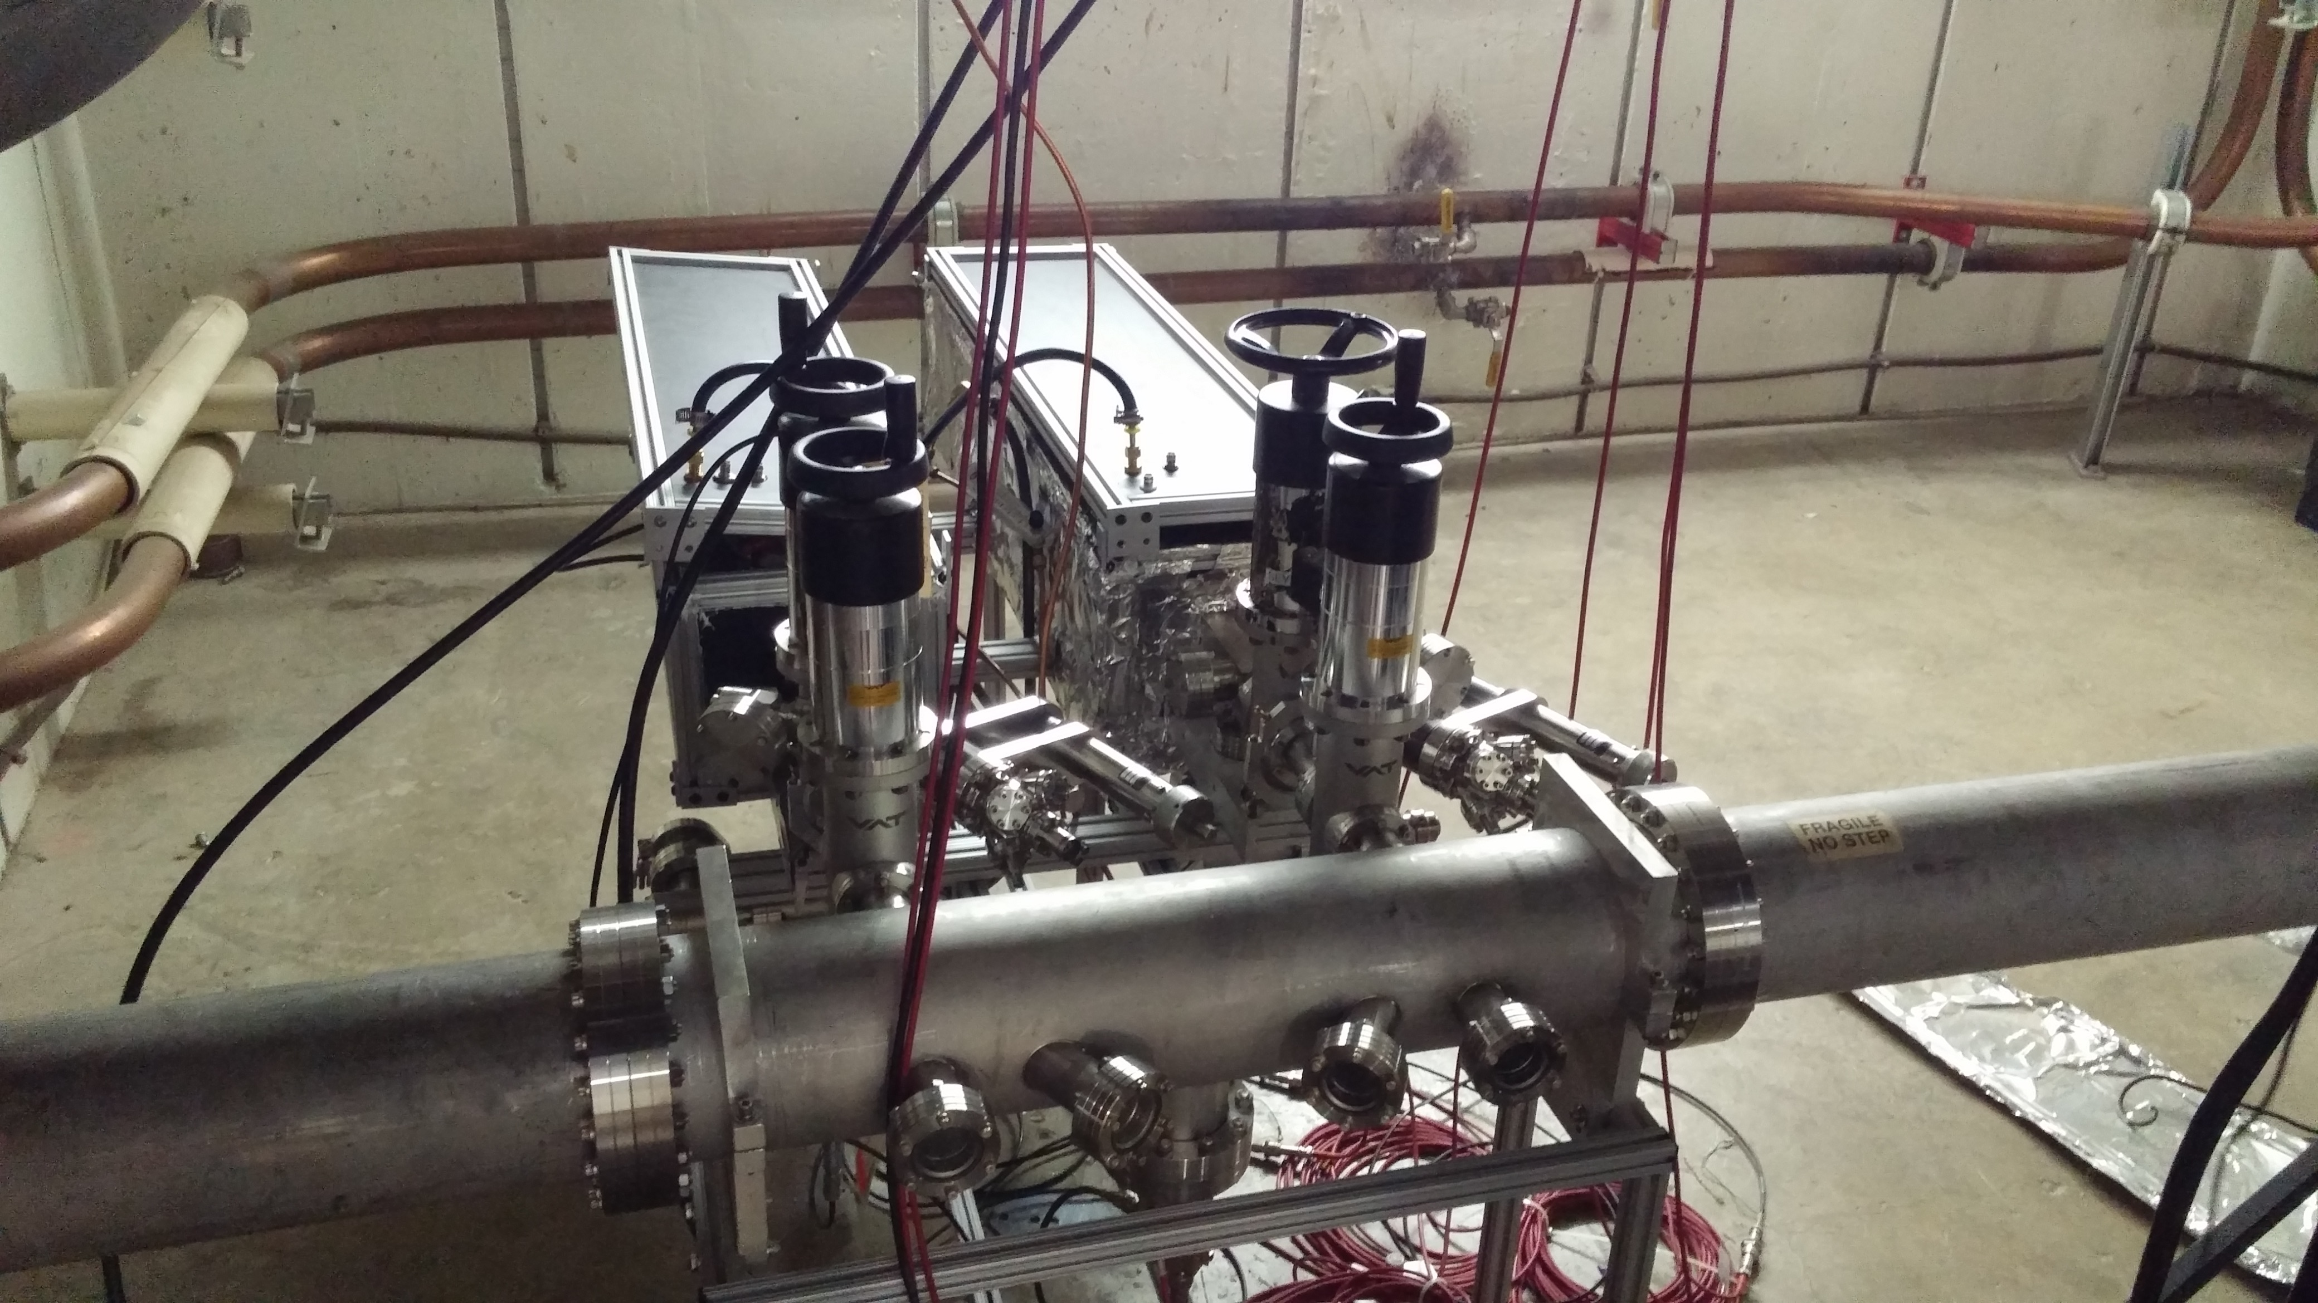
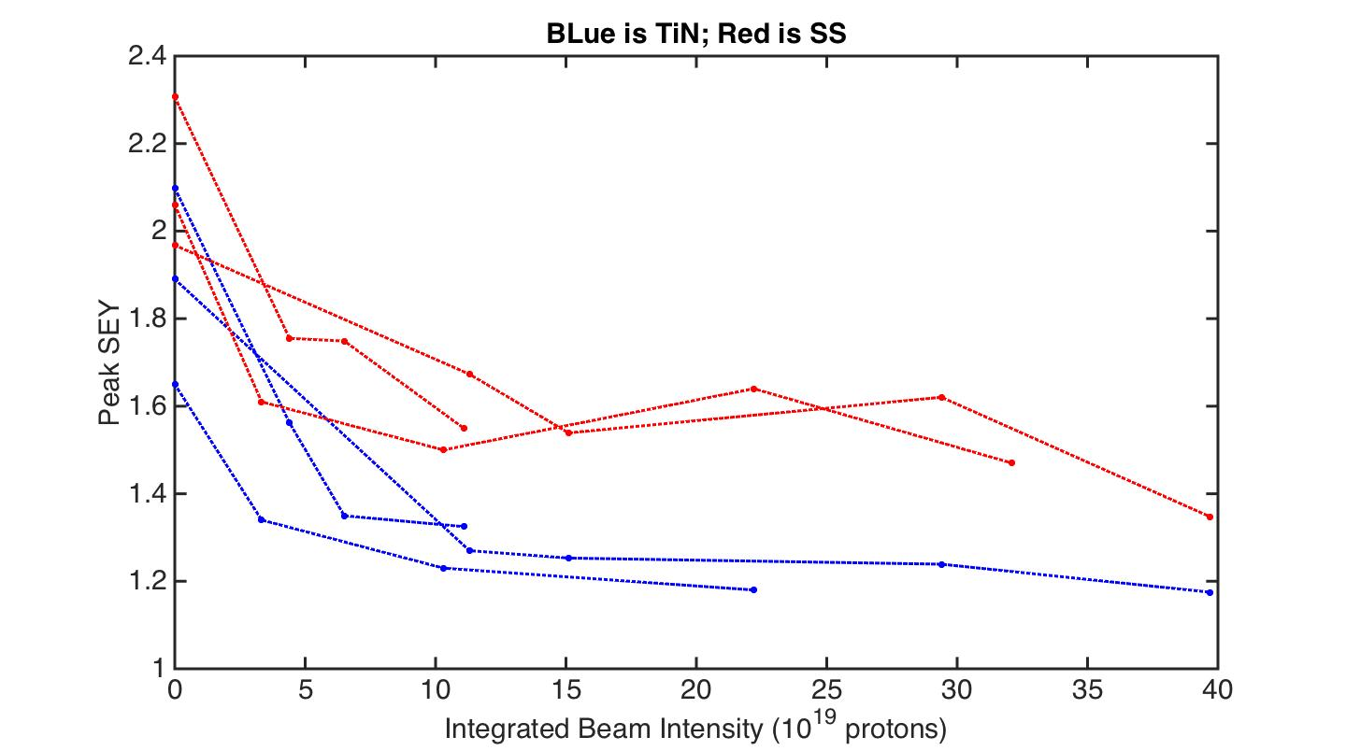
SEY Measurements equipment and results
Two measurement stands built
  Comparable results
Take ~0.5 years for conditioning study per sample
About 5% precision
TiN has been studied
  Start at : SS: 2.3, TiN 2.1
  Condition to: SS: 1.35 TiN 1.18

Slide 5
POSINST: E-cloud Build-up Simulation Code
POSINST is written by Miguel Furman (LBNL).
Geometry: semi-2D: solve field in (x,y) and develop electrons in 3D slice
Field solver: Particle in Cell, Poisson solver, beam pipe dimensions (boundary conditions)
Secondary emission model: Furman-Pivi probabilistic model
Beam model: preset static beam with selectable distribution functions
B-field: solenoid, Dipole, Quadropole
The measured SEY curve is compared with the POSINST’s SEY model.

Slide 6
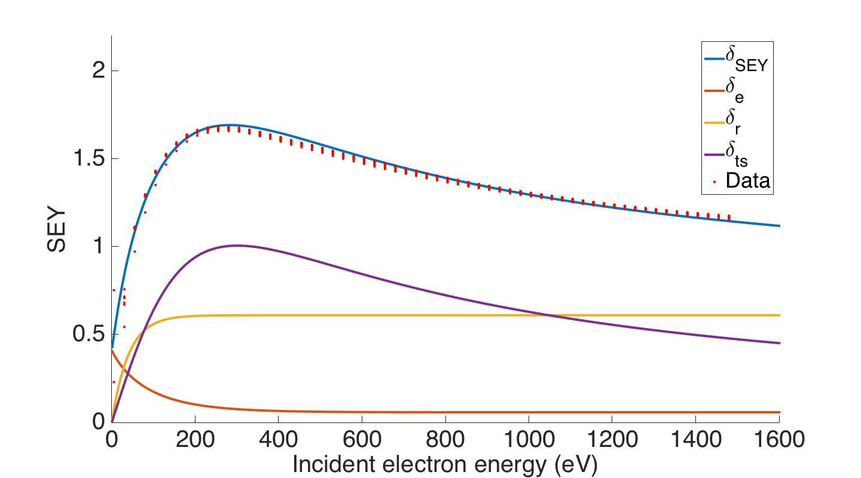
SEY data and the Furman-Pivi model
Comparison between measured and simulated SEY (SS316L)
SEY model components: elastic, rediffused and true secondary electrons

Slide 7
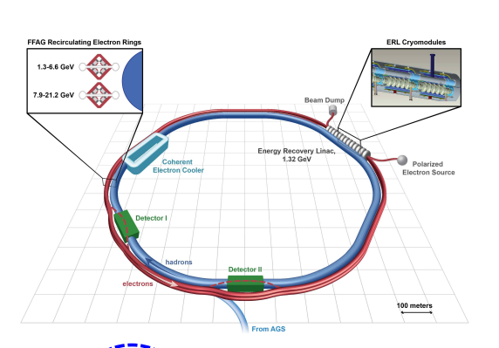
eRHIC: an Electron-Ion Collider at BNL
Electron-Ion collider proposed by nuclear physics and particle physics communities to study gluons and QCD
eRHIC, JLEIC proposed machines
eRHIC features 50-275 GeV protons or up to 100 GeV/u gold ions collide with 5-20 GeV electrons with luminosity of 10³² – 10³⁴ cm⁻²s⁻¹
Key feature vulnerable to E-cloud: due to superconducting magnets

Slide 8
Why superconducting magnets are vulnerable to E-cloud
The heat deposition of e-cloud could exceed Cryogenic limit
  Deposits large amount of heat (up to 200 W/m) to surface
  Cryogenic limit is 1 W/m
  Can be mitigated by low enough SEY
How to mitigate this problem
  Simulate E-cloud build up process
    Convert the the Cryogenic limit to a SEY limit
    POSINST could be used
    Decide if a specific surface treatment reaches SEY limit
  Study low SEY coatings
    Understand how surface treatment performs under accelerator operation
    Understand the conditioning limit
    Decide if dedicated conditioning cycle is needed

Slide 9
eRHIC proton ring parameters
 | eRHIC | Main Injector
Circumference [km] | 3.8 | 3.3
Beam Energy [GeV] | 275 | 120
RF frequency [MHz] | 563 | 53
Harmonic number | 7140 | 588
Filling pattern | 330/360, 660/720, 1320/1440 | 492/588
Bunch spacing [ns] | 35, 17, 8.8 | 19
Bunch density [proton/bunch] | 10.5e10, 6e10 | 11e10
RMS Bunch length [cm] | 7, 5 | 30
Dipole strength [T] | 4.8 | 1.37
Beam pipe geometry | round | elliptical
Beam pipe size radius, semi-major/minor axes [cm] | 6 | 5.8, 2.4

Slide 10
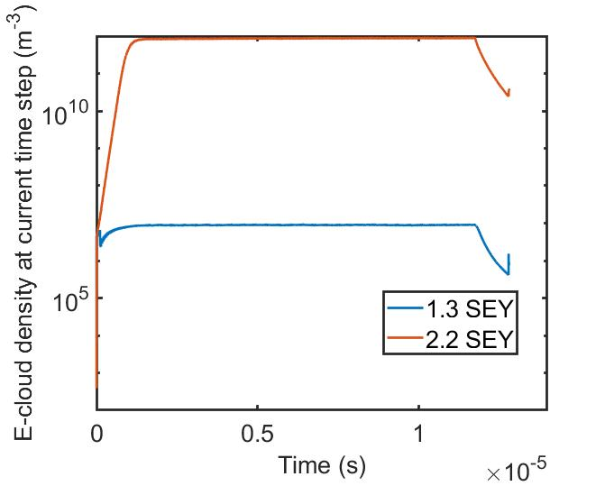
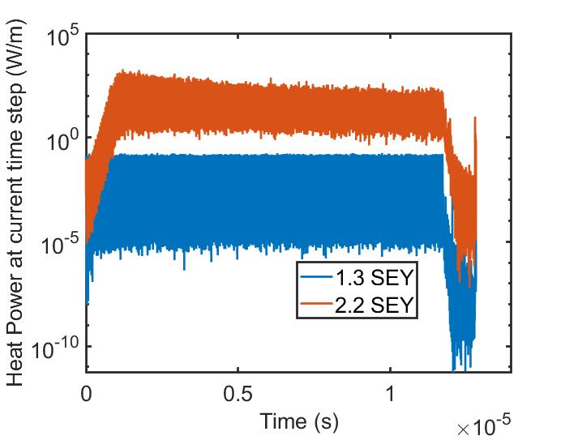
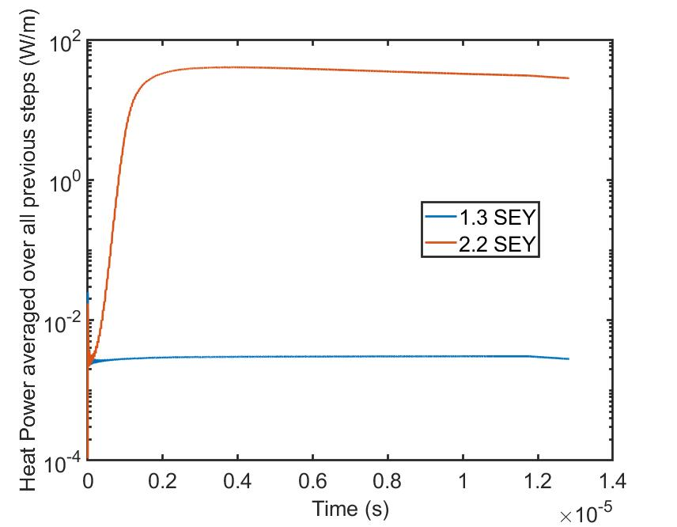
POSINST comparison between high and low SEY
35 ns bunch spacing in eRHIC
Comparison between two extreme cases:
  E-cloud well saturated at 2.2 SEY
    28.09 W/m; 7.4*10¹⁰ m⁻³
  E-cloud not present at 1.3 SEY
    0.001 W/m; 8.1*10⁶ m⁻³

Slide 11
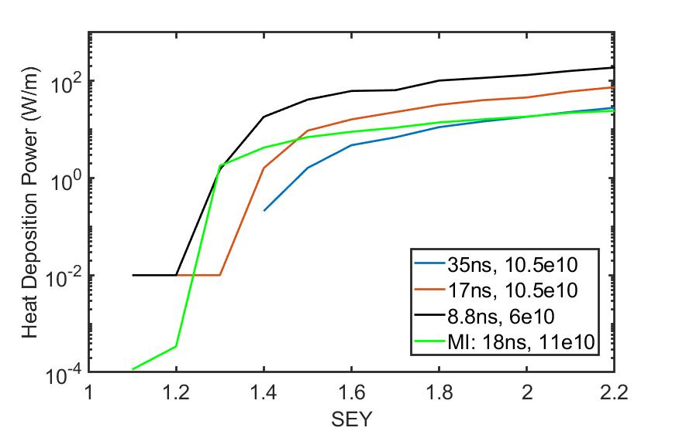
POSINST simulated heat deposition rate over the full beam pipe per turn

Slide 12
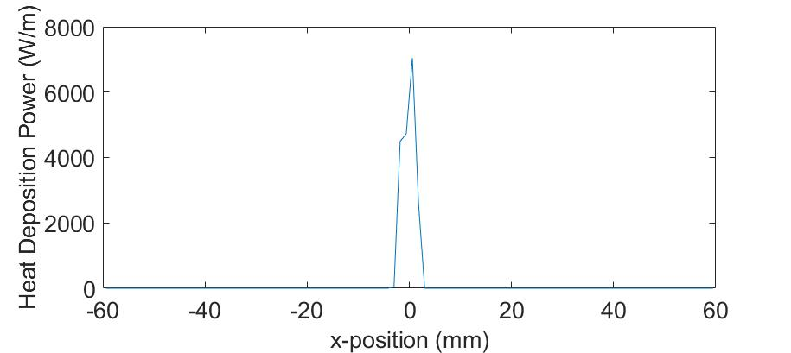
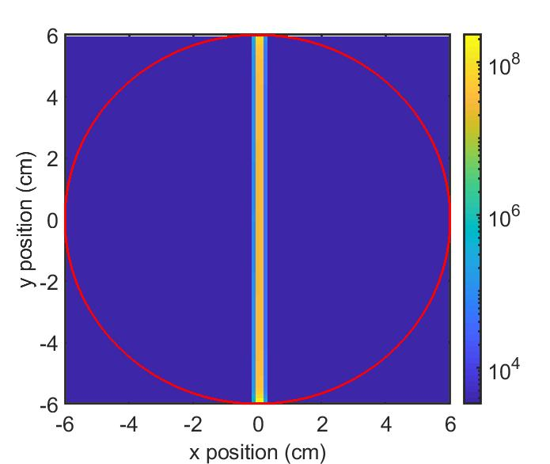
Heat deposition distribution over the beam pipe
Histogram over 100 bins in the x-direction
Electrons are concentrated at the few millimeter center region (4bins) by the dipole field (8.8ns bunch spacing, 2.2 SEY, 189.5 W/m)
This is the widest scenario, in most scenarios electrons are concentrated at the center bin
Local heat deposition power could be 30-60 times higher than average heat deposition power

Slide 13
eRHIC Cryogenic heat load limit converted to SEY limits
8.8 ns | Averaged | local | E-cloud density
SEY | W/m | W/m | Electron/m⁻³
1.2 | 0.01 | 0.7 | 7.5*10⁶
1.3 | 1.51 | 72.5 | 2.7*10¹⁰
17 ns | averaged | local | E-cloud density
SEY | W/m | W/m | Electron/m⁻³
1.3 | 0.01 | 0.4 | 8.8*10⁶
1.4 | 1.61 | 80.3 | 4.9E*10¹⁰
35 ns | averaged | local | E-cloud density
SEY | W/m | W/m | Electron/m⁻³
1.3 | 0 | 0.1 | 8.1*10⁶
1.4 | 0.21 | 21.1 | 2.3*10¹⁰
The eRHIC Cryogenic limit for E-cloud is 1W/m
  SEY limits: 1.2-1.3 for 8.8 ns ,
1.3-1.4 for 17 ns,
1.3-1.4 for 35 ns
The SEY limit sits where E-cloud generation is suppressed
Smaller bunch spacing causes large heat load

Slide 14
eRHIC heat mitigation method
The eRHIC heat load limit for E-cloud is 1W/m
  SEY limits: 1.2-1.3 for 8.8 ns , 1.3-1.4 for 17 ns, 1.3-1.5 for 35 ns
This limit could not be achieved by stainless steel but could be achieved by TiN coating (SS: 1.35 TiN 1.18)
  Stainless fails the 8.8ns case and on the edge for 17ns and 35ns case
  TiN is on the edge for 8.8ns case
  Need dedicated conditioning cycles
eRHIC group proposed their surface treatment options:
  Amorphous carbon coating
    Potential SEY from 0.9 to 1.2
  Solid copper with grooves and copper coated stainless steel with grooves
    Very interesting new surface treatment, potentially below 1 SEY
  All eRHIC proposed surface treatment options are in-situ applicable
    Could be potentially beneficial to Fermilab

Slide 15
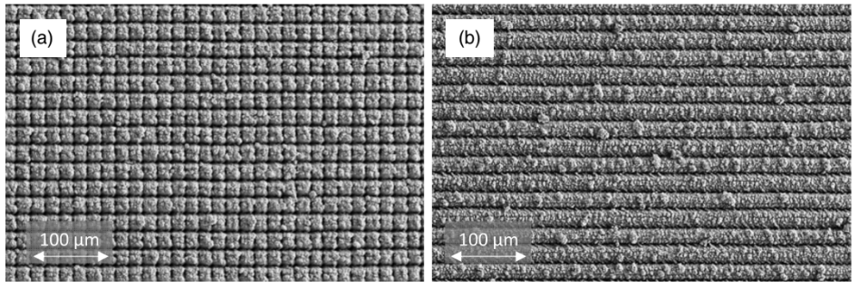
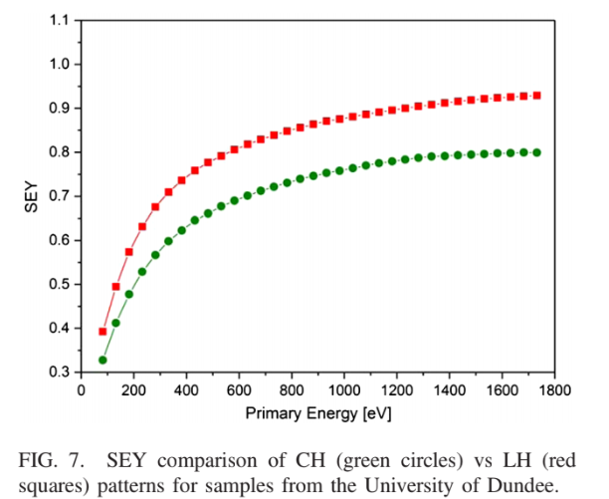
Copper with grooves
‘Sergio Calatroni, Elisa Garcia-Tabares Valdivieso, Holger Neupert, Valentin Nistor, Ana Teresa Perez Fontenla, Mauro Taborelli, Paolo Chiggiato, Oleg Malyshev, Reza Valizadeh, Stefan Wackerow, Svetlana A. Zolotovskaya, W. Allan Gillespie, and Amin Abdolvand, First accelerator test of vacuum components with laser-engineered surfaces for electron-cloud mitigation, Phys. Rev. Accel. Beams 20 (2017), 113201.’
For both cross hatched and line hatched surface, SEY below 1 achieved

Slide 16
Future plan on the eRHIC proposed surface
The eRHIC samples will studied first at Linac lab, best candidate will be studied with the MI-10 in-situ set-up
  measurement from two stands are comparable
  SEY measurement could be made within 5% precision
  Takes 4 hours to measure SEY in Linac Lab
  Takes 0.5 to 1 year to study conditioning effect of the surface
eRHIC group suggested that a surface measurement without contamination could be valuable
  Currently changing sample will temporally expose samples to atmosphere
  A vacuum-to-vacuum sample transport system is under development
    The MI-10 test stand arm could be detached
    If a new arm is built, better HV isolation technique could be applied
    Without building a new arm, a transfer device must be designed

Slide 17
Vacuum-to-vacuum transport of samples
gate valves
vacuum tee
beam pipe
electron gun
pump

Slide 18
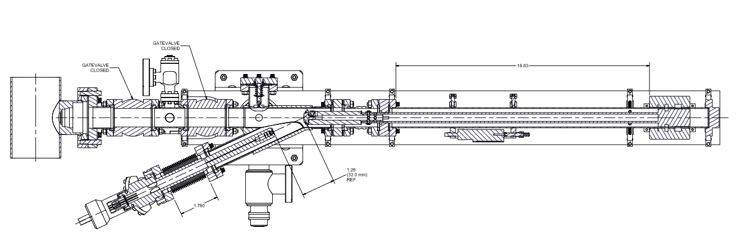
HV measurement technique and improvement to new arm
grounded
Biased
Isolating ceramic
Electron gun
sample
Provide shielding to the device under test:
  Error are mainly caused by leakage current
    Reduce leakage current will reduce error
  Protect the HV device with same voltage shielding (around the red box)
  Potentially increase precision to 1%

Slide 19
Conclusion
POSINST simulation shows that E-cloud heat deposition could be suppressed by low SEY coatings
  Stainless steel cannot be condition to low enough SEY
  TiN barely made the limit, but need conditioning cycles
eRHIC proposed very interesting materials
  a-Carbon could have low enough SEY without conditioning cycles
  Surface grooving could provide below 1 SEY without conditioning cycles
Vacuum-to-vacuum sample transport is plausible
  Detachable arm could be first solution
    Better HV isolation design could apply
  Special transfer device could be another solution
Thanks to: Robert Zwaska, Linda Spentzouris, Yuri Alexahin, Kris Anderson, Robert Ainsworth

Slide 20
Back up slides

Slide 21
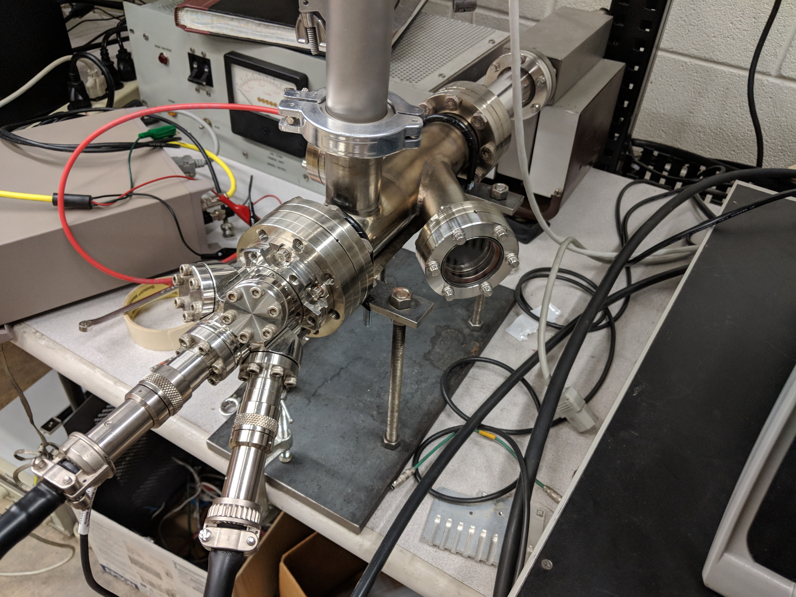
The Linac lab SEY measurement test stand
The Linac Lab test stand share the same measurement principle with MI-10 set up
Primary current (I_{p}): +150V recapture all secondary electron
  +150V leakage current (δ_{p}), 1 data point each energy
Total current (I_{t}): -20V repulse all secondary electrons
  -20V leakage current (δ_{t}), 9 data points each energy

Slide 22
SEY over time
Shut down
Shut down

Slide 23
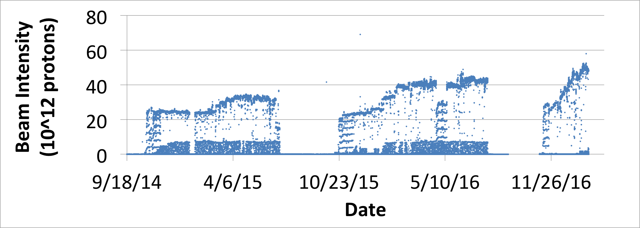
SEY vs Beam Intensity

Slide 24
SEY vs Integrated Beam Intensity

Slide 25
Leakage Current: The Largest Source of Inaccuracy
The bias voltage induced leakage current is the largest source of inaccuracy.
  Signal: 0.5-1.5 nA
  Leakage current: 0.1-30 nA
Leakage currents caused by:
  Moisture in the isolating ceramic
  Non-infinite resistance between cables and surrounding metal (≤1TΩ)
Capacitively induced current from the surrounding environment can cause the leakage current to be unstable.
System introduced to reduce the leakage current
  A Faraday box was installed to isolate the measurement arm
  A Nitrogen system to dry the ceramic
  Isolation of the cables from the faraday box
Leakage current was measured and studied
  Leakage current measurement time exactly matches SEY measurement time
  Simple analysis was performed to calculate the error

Slide 26
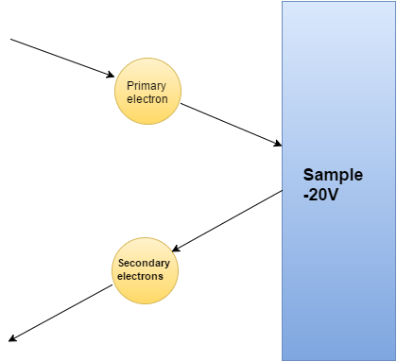
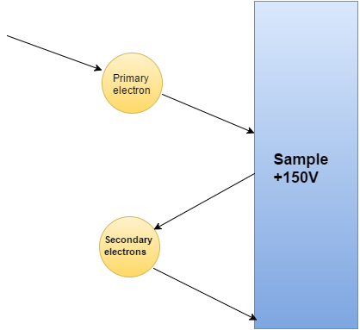
How is SEY measured
Primary current (I_{p}): +150V recapture all secondary electron
  +150V leakage current (δ_{p}), 1 data point each energy
Total current (I_{t}): -20V repulse all secondary electrons
  -20V leakage current (δ_{t}), 9 data points each energy
I_{t}
I_{p}

Slide 27
Effect of leakage current on measurements
Good case
Bad case

Slide 28
How much error does leakage current induce
Measurement error due to variation of leakage current
  Leakage current variation 10-200%
Even with low absolute leakage current,
a large variation still causes a large error
The error depends on I_{p}, higher I_{p} could greatly reduce error
Example: consider the case of I_{p} = 1 nA
Δδ_{p} | 50pA | 100pA | 150pA
ΔSEY | 0.048 | 0.091 | 0.134
1.8SEY | 2.7% | 5.1% | 7.4%
1.3SEY | 3.7% | 7.0% | 10.3%
Δδ_{t} | 50pA | 100pA | 150pA
ΔSEY | 0.05 | 0.1 | 0.15
1.8SEY | 2.8% | 5.6% | 8.3%
1.3SEY | 3.9% | 7.7% | 11.5%

Slide 29
Leakage current over typical measurement period
Good case
Bad case
+150V
0.2% error
+150V
2% error
δ_{p}
δ_{t}
-20V
0.17% error
-20V
3.7% error

Slide 30
Leakage current conclusion
Bad cases are only a small fraction of measurements
  If leakage current are very bad, measurement will be skipped
  Bad case happened mostly during shut downs
  All measurements since last shut down have relative good leakage current (0.1% to 5% leakage current induced error)
More improvements on leakage current
  Increasing I_{p}
    1C/m² dose causes noticeable change in SEY before condition
    Conditioning will increase the limit to 1C/cm²
    1nA I_{p} gives a 0.066C/m² electron dose per measurement
  Multiple measurements are taken if the leakage current is bad
  Use leakage current curve to compensate for systematic leakage current variation when leakage current is bad
  Better shielding for future test stand

Slide 31
SEY curve with error bars

Slide 32
Full heat deposition result
SEY | 1320/1440 |  |  | 660/720 |  |  | 330/360
 | total | locale | E-den | total | locale | E-den | total | locale | E-den
1.1 | 0.01 | 0.6 | 3.90E+06 | 0.01 | 0.3 | 2.90E+06 | 0 | 0.1 | 2.40E+06
1.2 | 0.01 | 0.7 | 7.50E+06 | 0.01 | 0.3 | 4.70E+06 | 0 | 0.1 | 3.80E+06
1.3 | 1.51 | 72.5 | 2.70E+10 | 0.01 | 0.4 | 8.80E+06 | 0 | 0.1 | 8.10E+06
1.4 | 18.27 | 596.4 | 3.60E+11 | 1.61 | 80.3 | 4.90E+10 | 0.21 | 21.1 | 2.30E+10
1.5 | 41.35 | 2041.2 | 6.80E+11 | 9.48 | 473.9 | 2.60E+11 | 1.62 | 54.2 | 9.10E+10
1.6 | 62.31 | 2856 | 9.40E+11 | 16.18 | 808.7 | 4.00E+11 | 4.76 | 237.9 | 1.60E+11
1.7 | 64.62 | 2905.6 | 1.20E+12 | 22.86 | 1122.3 | 5.50E+11 | 6.91 | 329.6 | 2.40E+11
1.8 | 102.09 | 4899 | 1.40E+12 | 32.28 | 1539.1 | 7.30E+11 | 11.21 | 560.1 | 3.40E+11
1.9 | 115.78 | 5540 | 1.60E+12 | 40.28 | 1991 | 8.70E+11 | 14.67 | 707.7 | 4.30E+11
2 | 132.86 | 5960 | 1.90E+12 | 45.75 | 1141.5 | 1.10E+12 | 18.32 | 915.7 | 5.30E+11
2.1 | 161.57 | 4028.4 | 2.30E+12 | 61.01 | 3031.1 | 1.20E+12 | 23.02 | 1151.1 | 6.50E+11
2.2 | 189.05 | 4715.9 | 2.50E+12 | 74.6 | 3709.6 | 1.40E+12 | 28.09 | 1401.8 | 7.40E+11

