Slide 1
Resonance, Space Charge and PS Ripple in Storage Rings
F. Schmidt

Slide 2
Contents
Tune Ripple
Resonance Analysis
Chaos Detection
Coupled Q_{x} + 2 Q_{y} Resonance
FMA versus CMA

Slide 3
Tune Ripple

Slide 4
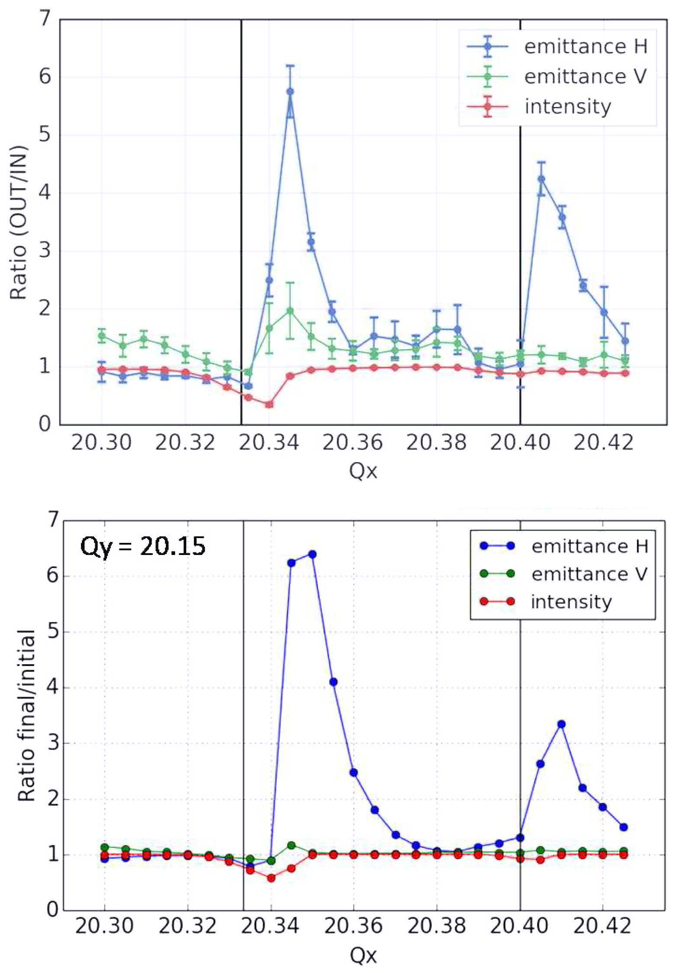
SPS
H. Bartosik &
F. Schmidt
Measurements
Relative emittance growth and
intensity as a function of the
working point in the SPS as obtained
from experimental studies (top) and
from simulations using a frozen SC
model including the tune ripple from
power converters (bottom).
Simulation WITH Ripple

Slide 5
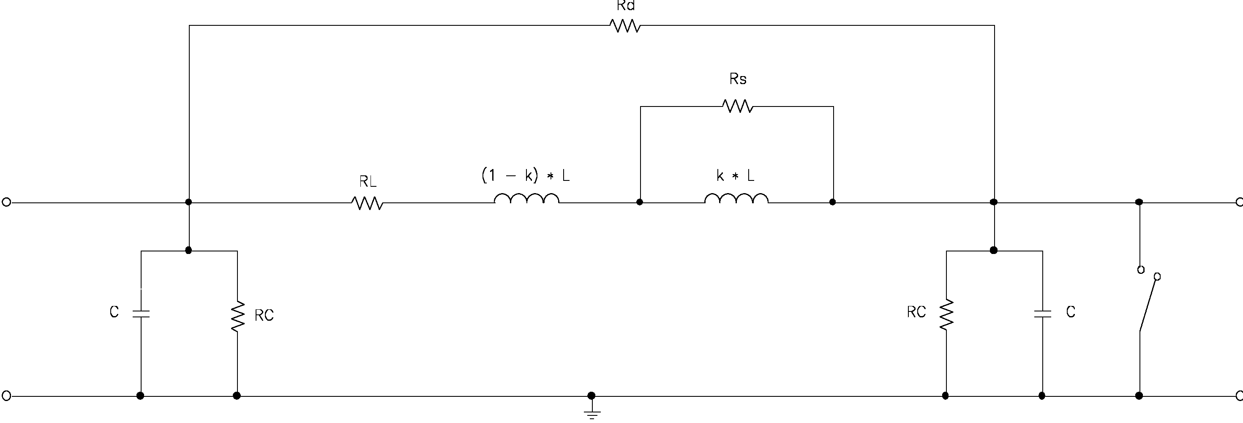
4-Pole Model of a Magnet
Build in for Damping
Vacuum Chamber

Slide 6
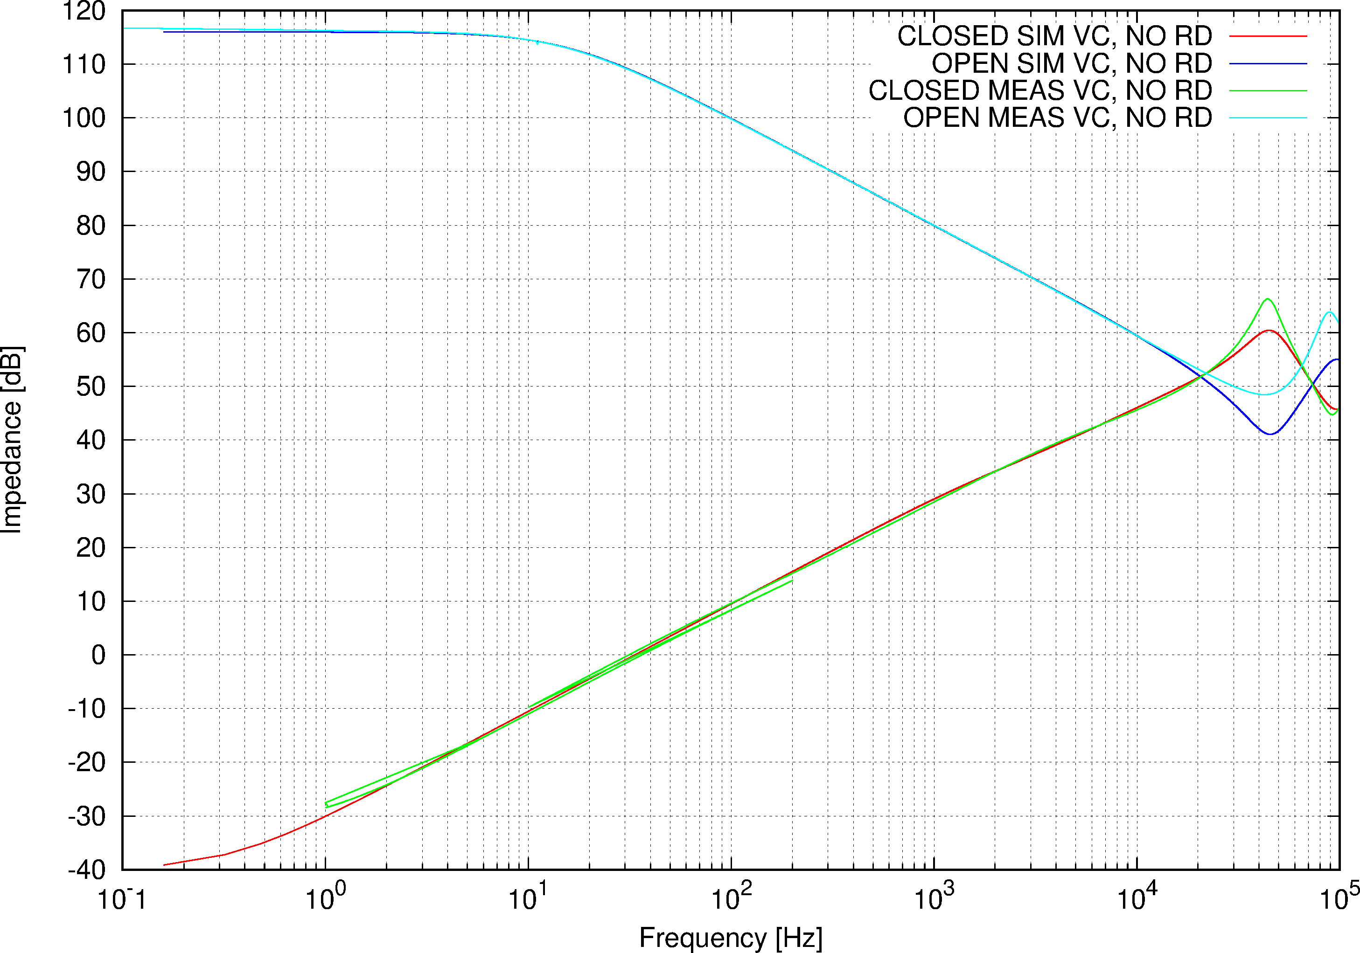
Dipole, VC RD = ∞

Slide 7
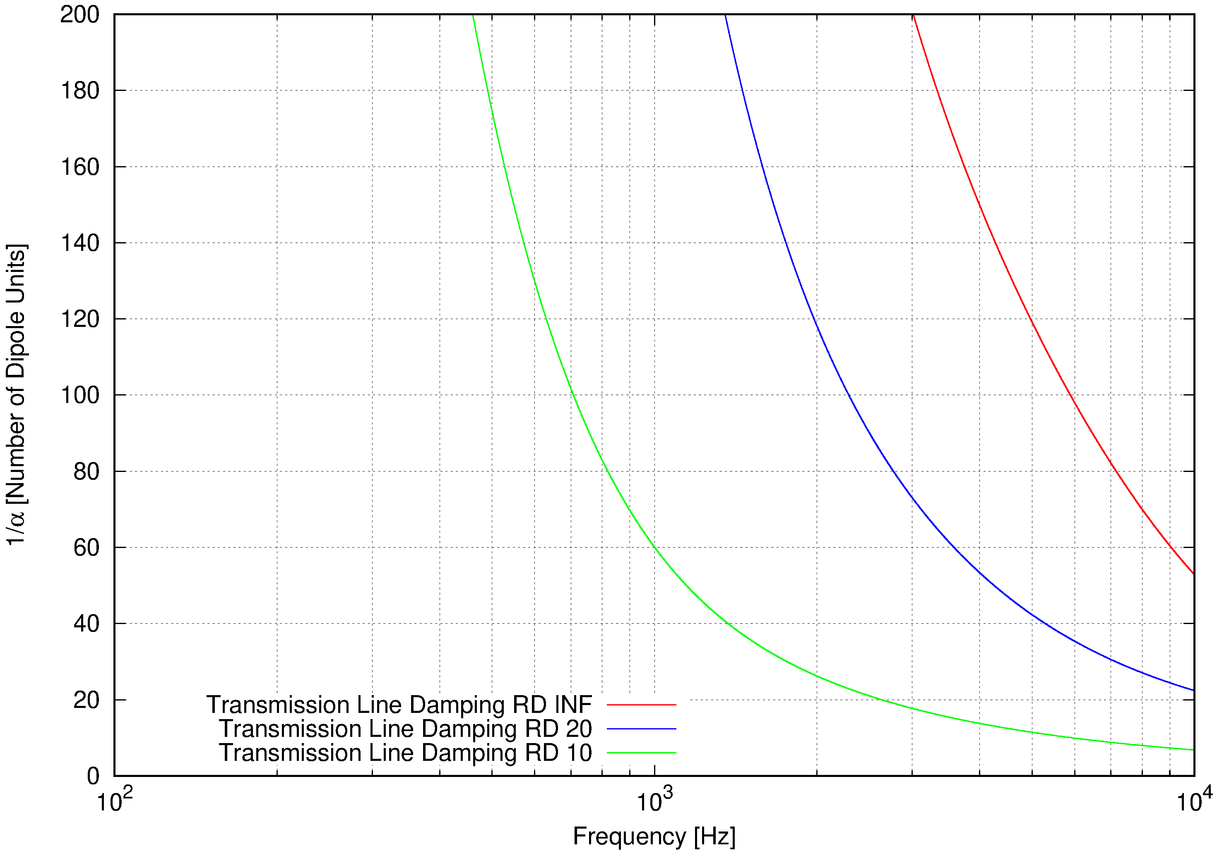
Dipole, VC Damping

Slide 8
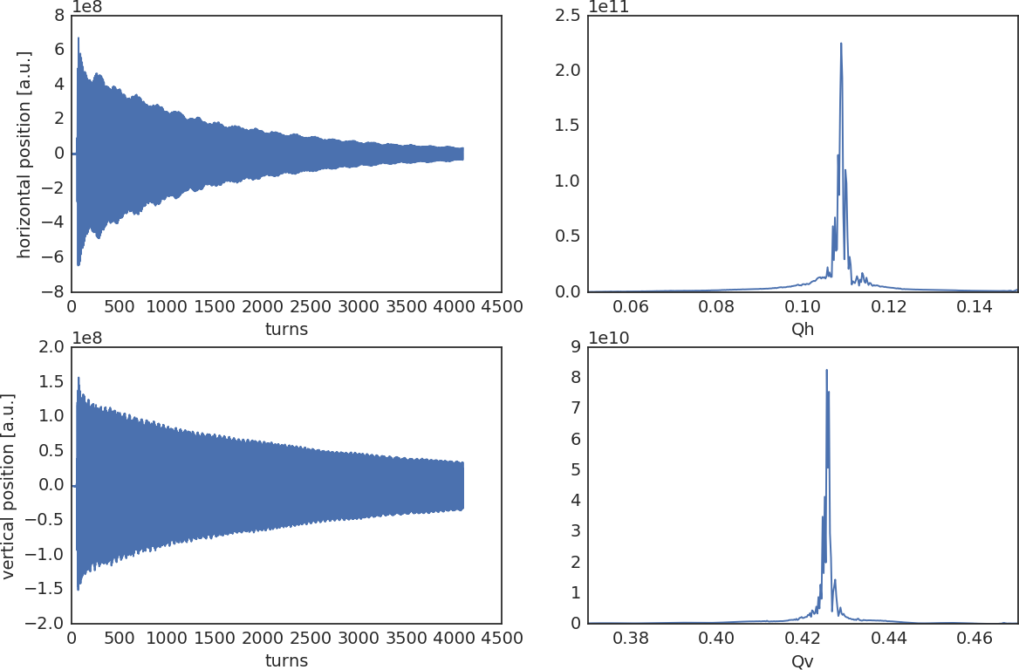
SPS Tune Spectrum 2015

Slide 9
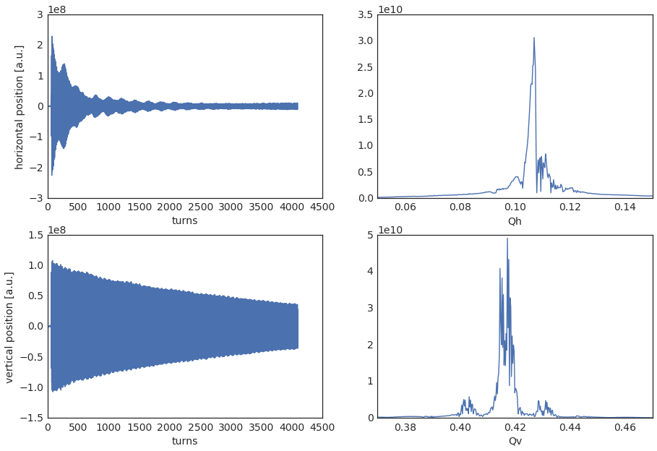
SPS Tune Spectrum 2017
Double Peaks
600 Hz
Sidebands

Slide 10
Resonance Analysis 1/2
Fourier Analysis
J. Bengtsson (1988) LEAR
J. Laskar (~1980)
R. Bartolini, F. Schmidt ➔ NormalForm
- Simulation or Real Data
- 6D
- Space Charge!
- Any Order
- Lines can be related to F (Distortion Function)
- Global & Local(!)
- NO problem with NF convergence at any amplitude ➔ even in chaotic regime some value

Slide 11
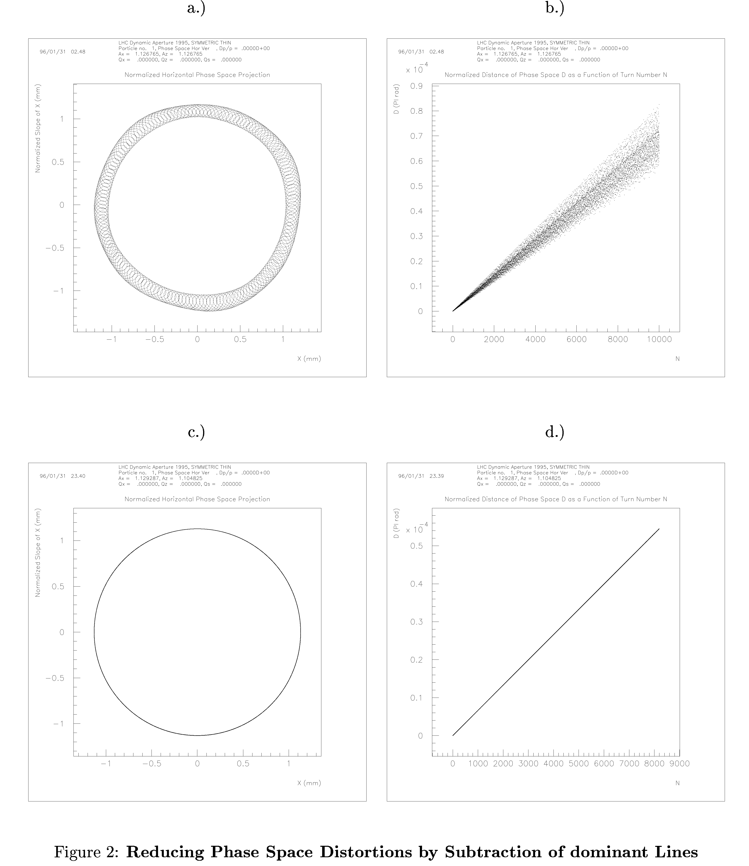
Fourier
Analysis
1/2
Simulation
Horizontal Plane
Bartolini, Schmidt Arcidosso, September 1996, AIP Conference Proceedings 395
Horizontal Plane
Take out Fourier
Lines

Slide 12
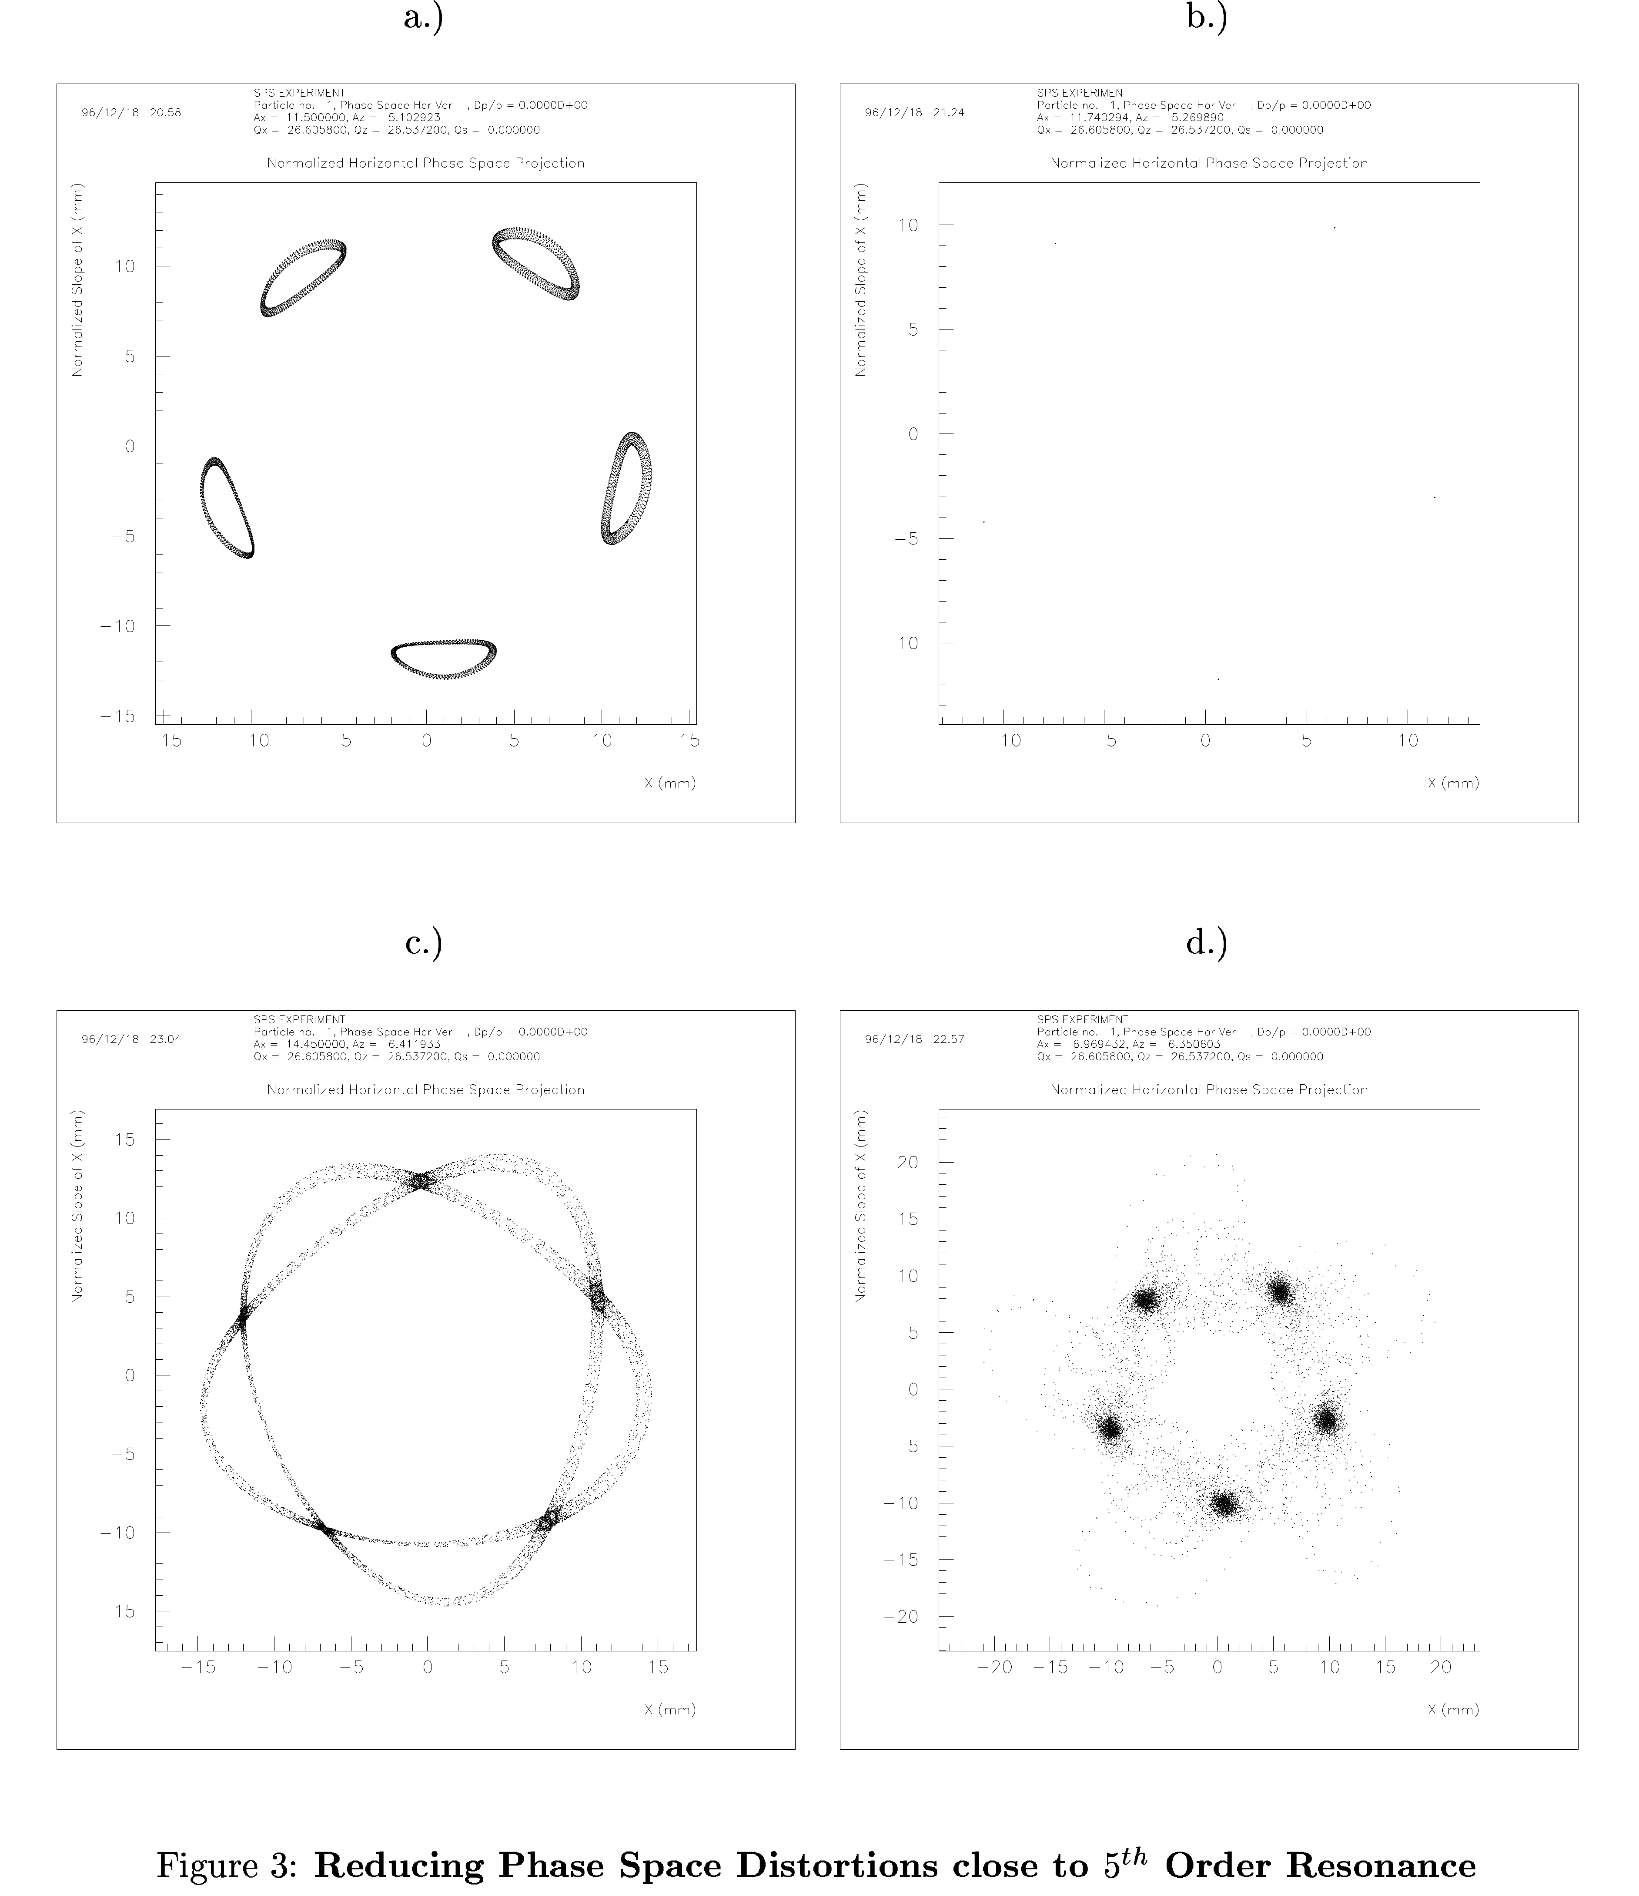
Fourier
Analysis
2/2
Line Reduction
Stable Island
Bartolini, Schmidt Arcidosso, September 1996, AIP Conference Proceedings 395
Line Reduction
Unstable Island

Slide 13
Resonance Analysis 2/2
Tasks
SC Resonance Driving Terms in MAD-X ➔ CERN effort
BB/SC element has to be modified for MAP production
Fast symplectic 3D SC KICK for MAD-X must be accompanied by: (maybe) Slow but “smooth” description for MAP production Y. Alexahin & F. Schmidt
Co-moving transformations to “jump” convergence limit
Issue of “Higher” order “closed” orbit
Leo Michelotti???

Slide 14
Chaos Detection

Slide 15
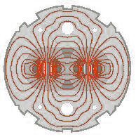
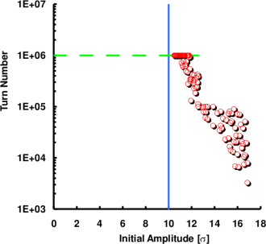
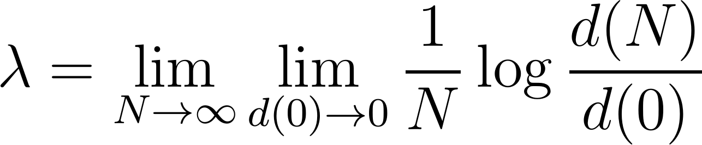
Chaos Criteria
F. Schmidt, thesis 1988
PO-DA Detection ➔ find amplitude with non-zero Lyapunov Exponent:
In practice, the Lyapunov exponent is rarely evaluated directly.
Instead, one follows the evolution of the distance in phase space. Most effectively by using the angular distance that is extremely sensitive to find even weakly chaotic motion.

Slide 16
Dynamic Aperture Scheme
F. Schmidt, thesis 1988
Rapid amplitude growth and loss
Stable Islands in chaotic sea
Fine chaotic layers in stable regime
Mostly stable particle motion
RW-DA
PO-DA

Slide 17
DA in 1D
F. Schmidt, thesis 1988
Close-up

Slide 18
1D close-up
F. Schmidt, thesis 1988

Slide 19
Coupled Q_{x} + 2 Q_{y} Resonance

Slide 20
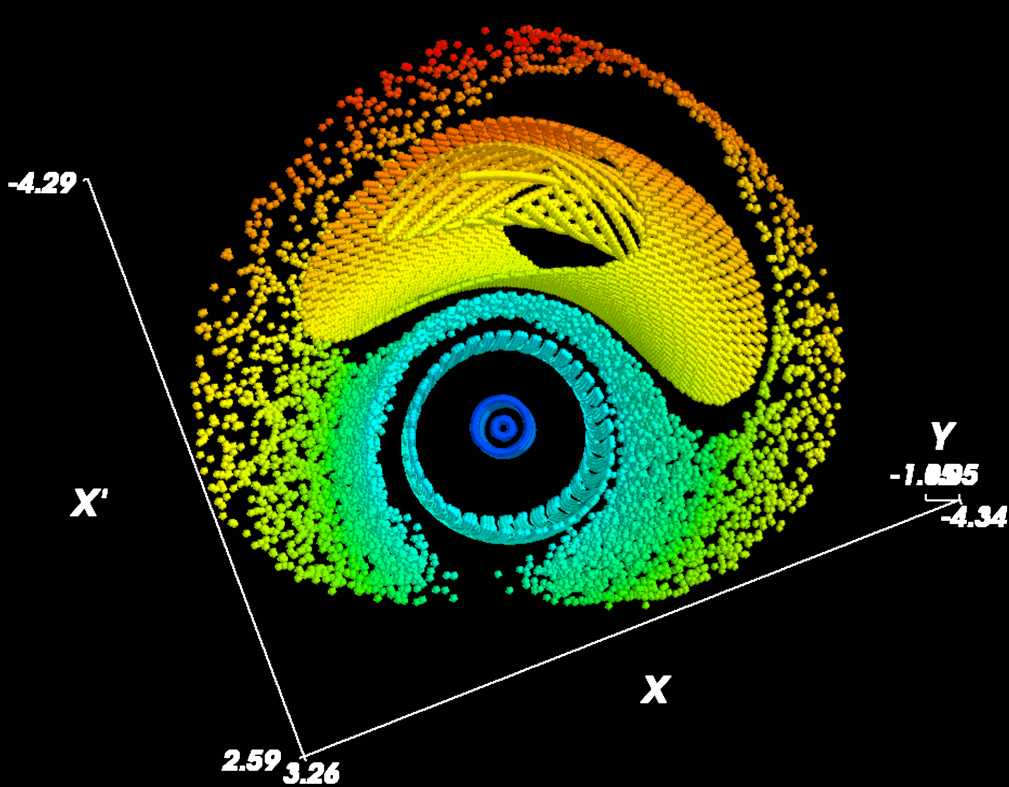
Fix-Line Genrics
Generics of the Qx + 2 Qy = p coupled Resonance
Stable Fix-line
Unstable Fix-line

Slide 21
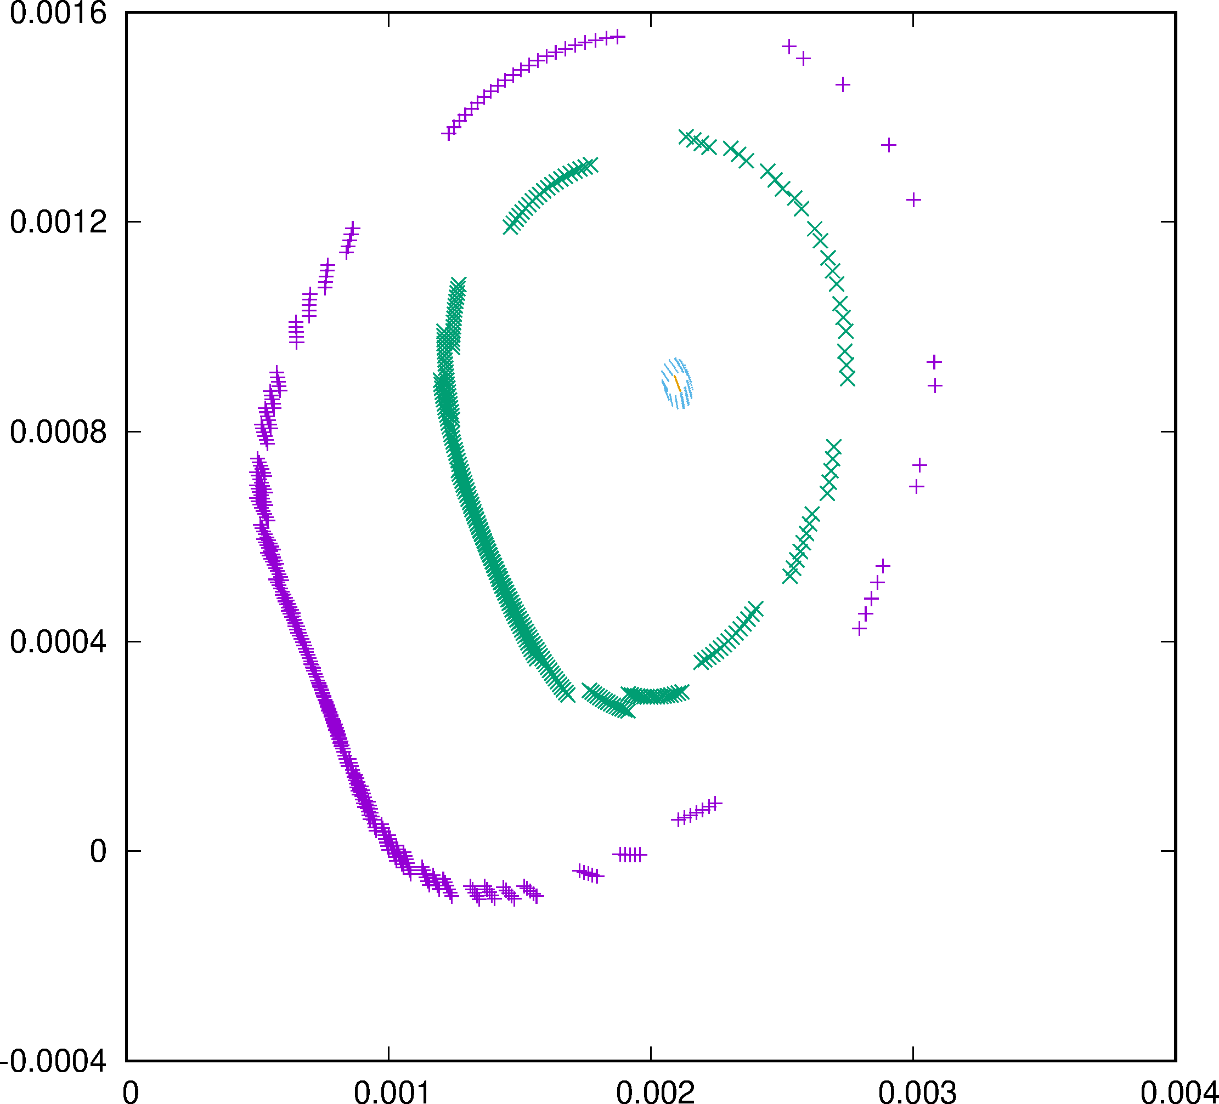
Fix-Line Search
(“Higher” order “closed” orbit)
PY
Fixline Search
Average
“Damping” like in electron machines like LEP (Verdier & Schmidt)
Y

Slide 22
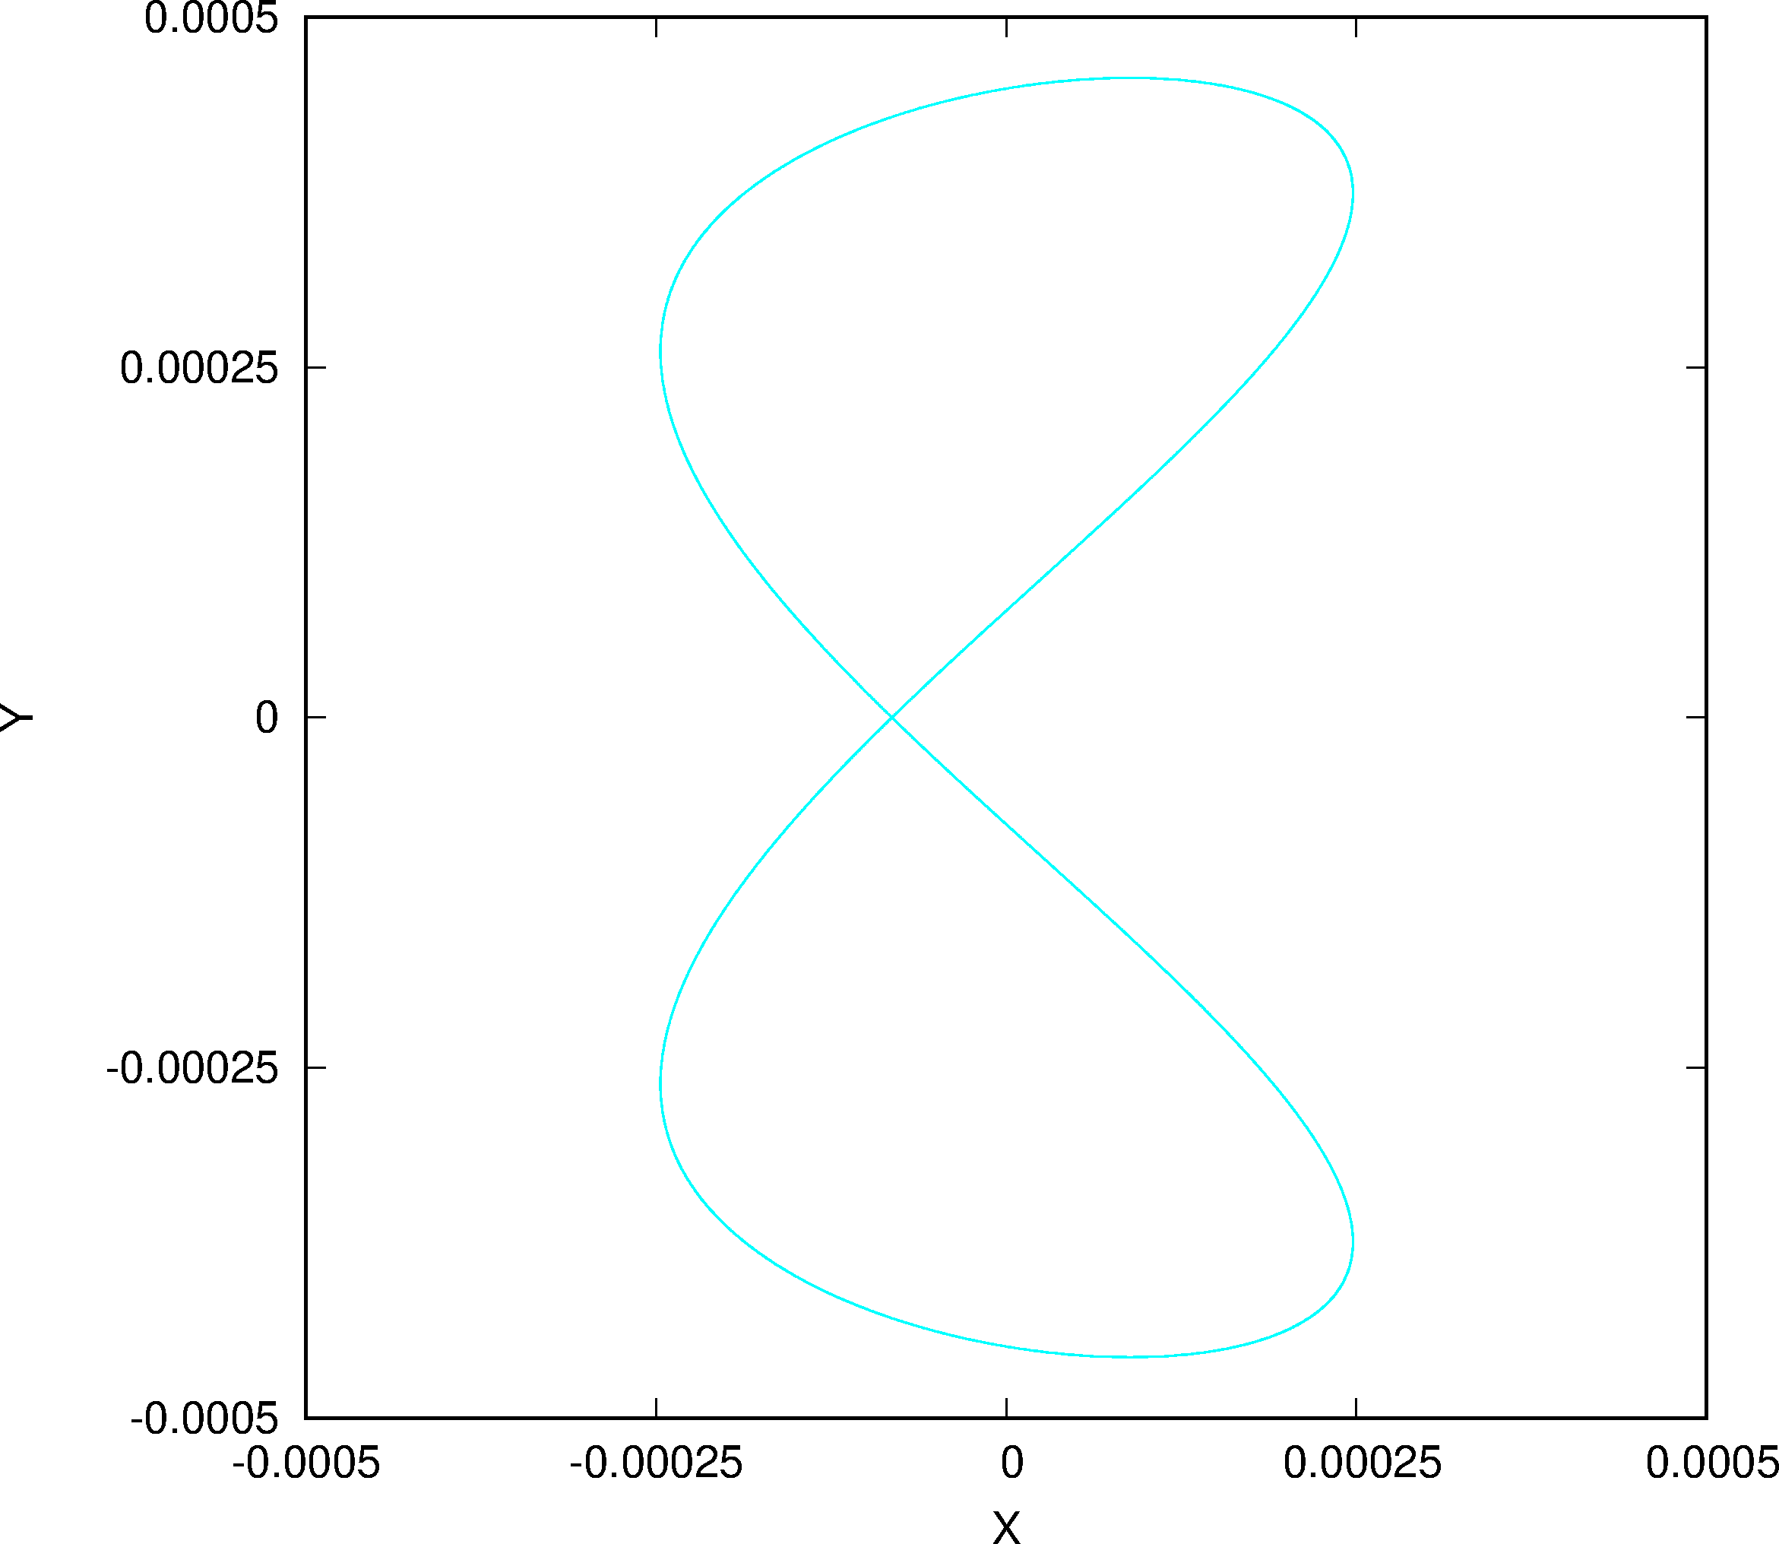
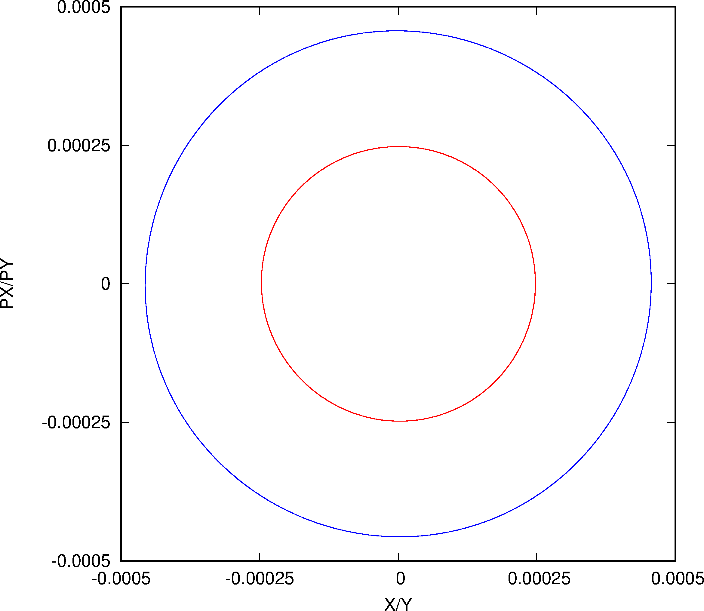
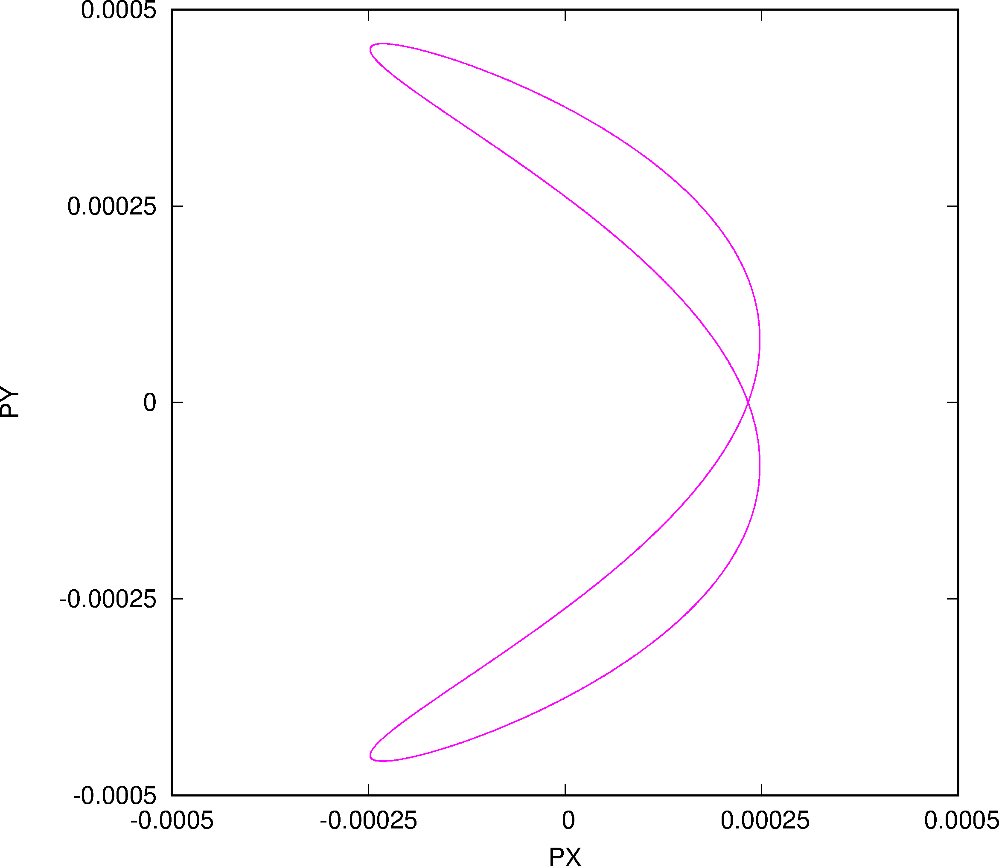
“Fix-Line” Phase Space
V
H

Slide 23
“Fix-Line” Frequency Analysis I
ANALYSIS OF X SIGNAL, CASE: 1
TUNE X = 0.111180834145734
Line Frequency Amplitude Phase mx my
1 0.1111808341457E+00 0.247512794360E-03 0.672457580217E+02 1 0
2 0.3783426764684E-11 0.174249489697E-05 -.457347870401E+02 0 0
3 0.2223616682915E+00 0.110388913387E-05 0.150753314898E+02 2 0
4 -.1111808341460E+00 0.589011814331E-06 0.519872394860E+02 -1 0
5 -.2223616682916E+00 0.532465227870E-06 0.930856270353E+02 -2 0
6 0.1116055036254E+00 0.539366197950E-07 0.101885132342E+03
7 0.1107561645136E+00 0.233487160303E-07 0.324682911396E+02
8 -.3335425024437E+00 0.647694102064E-08 -.150532254600E+03 -3 0
9 0.3335425024345E+00 0.569663731770E-08 -.389777082870E+02 3 0

Slide 24
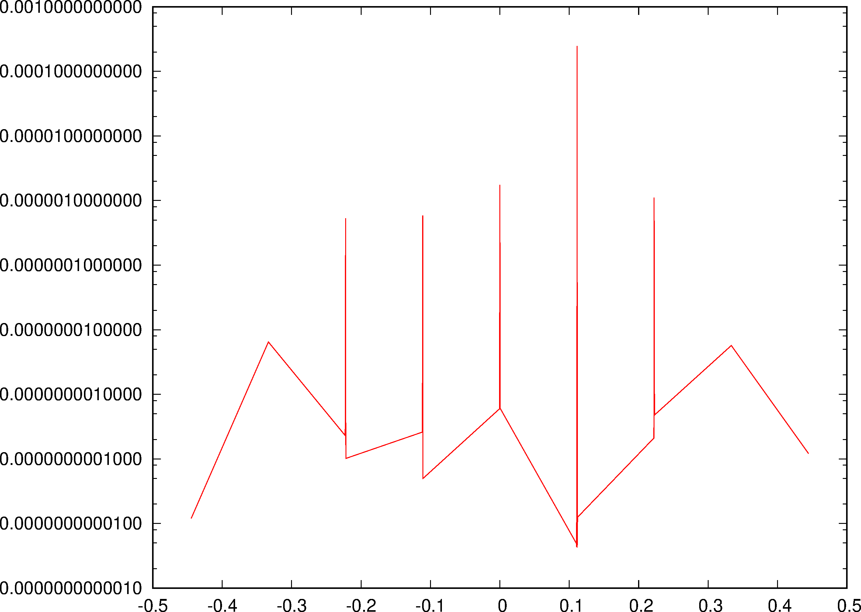
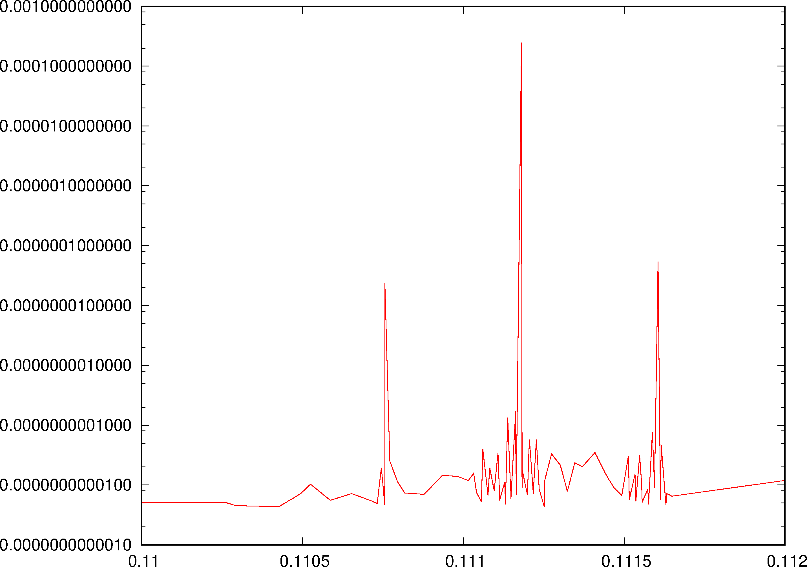
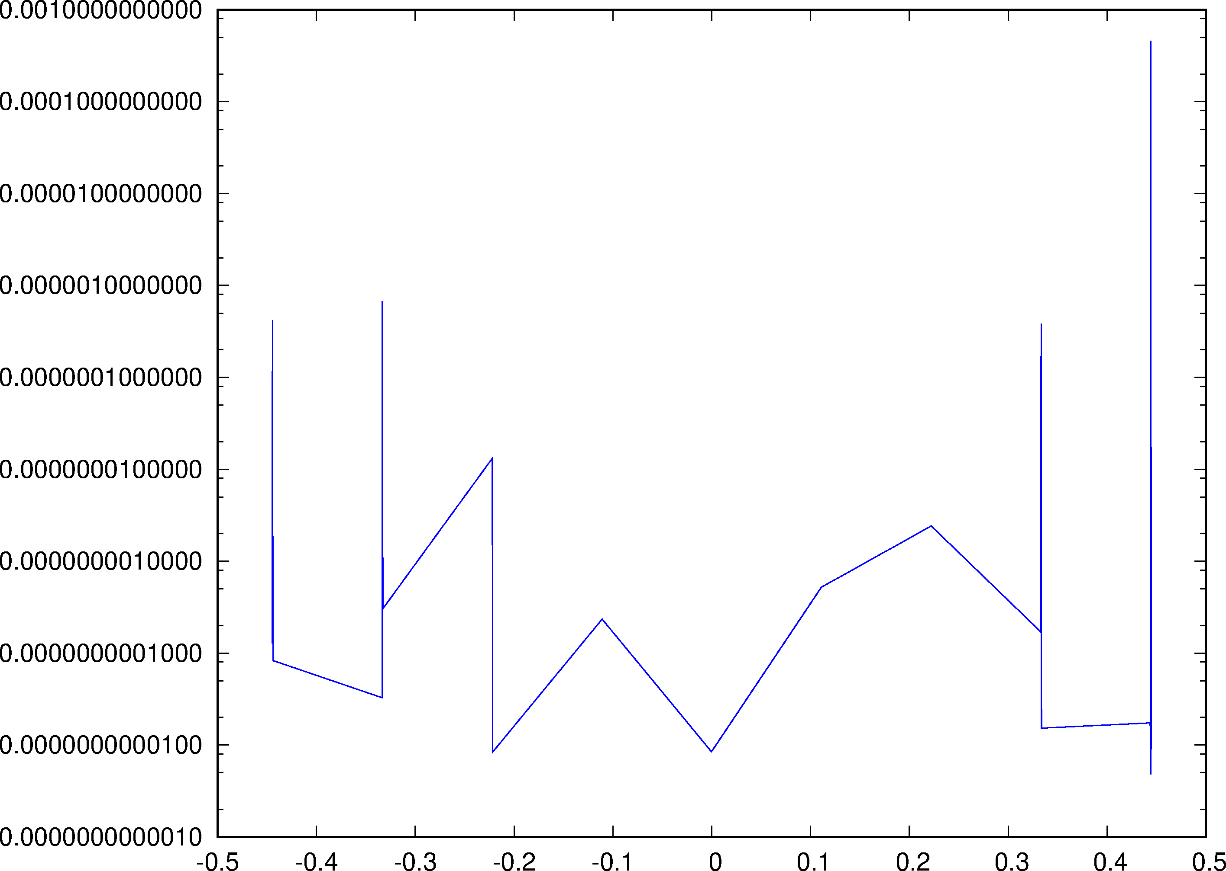
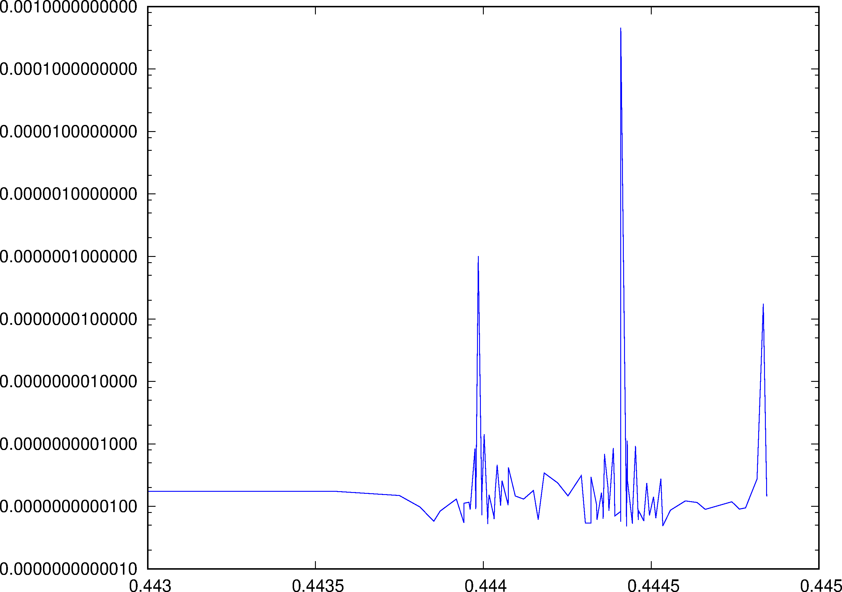
“Fix-Line” Frequency Analysis II
“Tube”
Tune
As Sidebands

Slide 25
FMA Versus CMA
M. Zampetakis & F. Schmidt
CMA: Simulation with the distribution with additional close-by Twin Particles for chaos detection using Sigma/Emittance Ratio Grid.

Slide 26
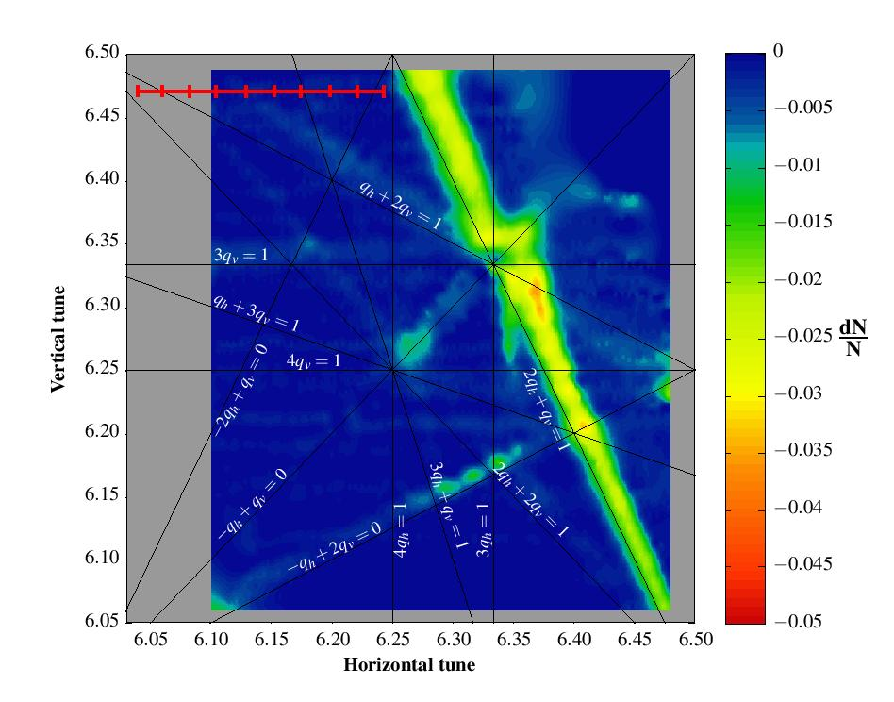
Measurements of the Qx+2Qy resonance
Controlled excitation of the resonance: normal sextupole powered (2A)
10 static measurements of the resonance: for each measurement, Qy fixed at 6.47 and Qx fixed at a value between 6.04 and 6.24.
Observables over 1.1s: beam loss, transverse and longitudinal profiles.
Tune Spread: h= -0.05, y= -0.07

Slide 27
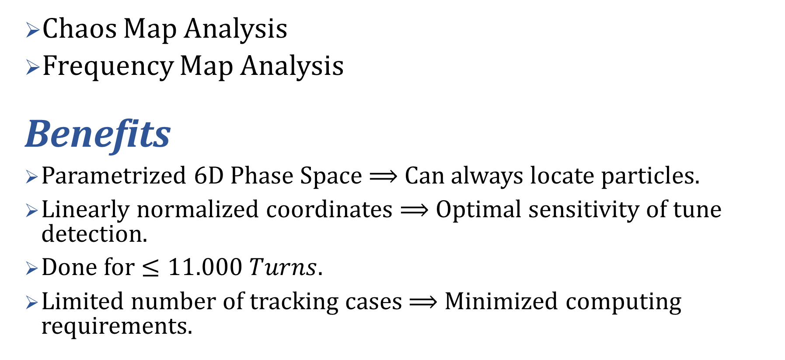
Objectives
Chaos Map Analysis
Frequency Map Analysis
Benefits
Parametrized 6D Phase Space $⟹$ Can always locate particles.
Linearly normalized coordinates $⟹$ Optimal sensitivity of tune detection.
Done for $≤11.000 Turns$.
Limited number of tracking cases $⟹$ Minimized computing requirements.
Compare!

Slide 28
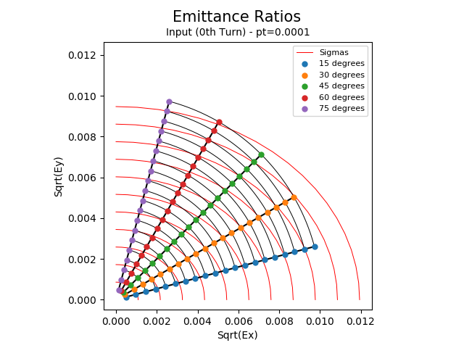
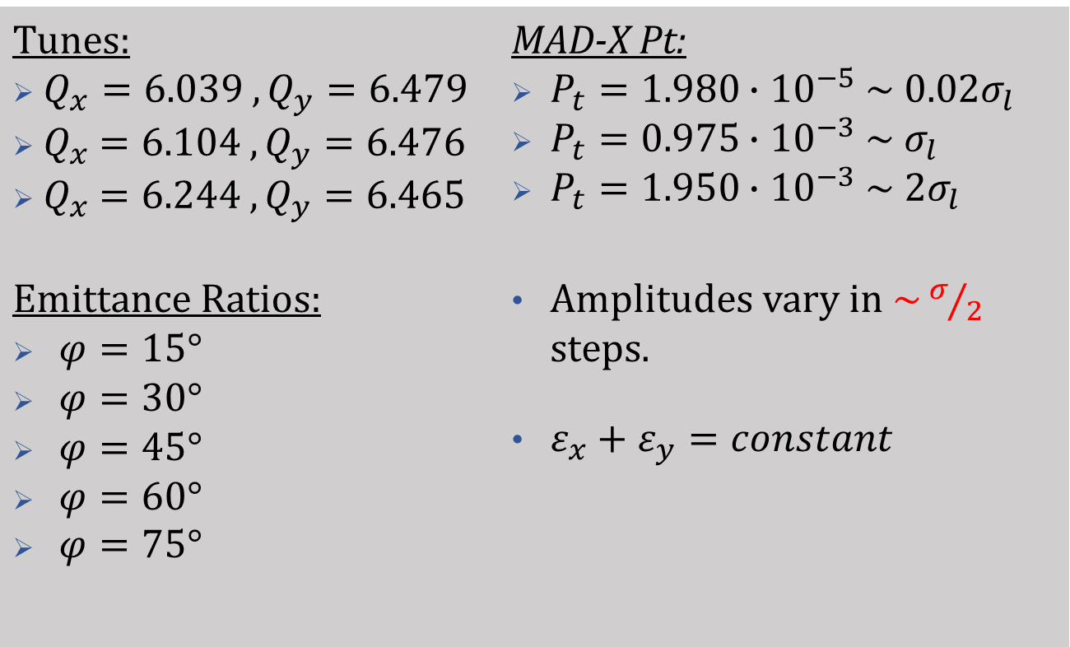
Parametrization of 6D phase space
Tunes: $Q_{x}=6.039 ,Q_{y}=6.479$ ${ Q}_{x} =6.104 ,Q_{y}=6.476$ ${ Q}_{x} =6.244 ,Q_{y}=6.465$ | MAD-X Pt: $P_{t}=1.980∙{10}^{−5} \sim 0.02σ_{l}$ $P_{t}=0.975∙{10}^{−3} \sim σ_{l}$ $P_{t}=1.950∙{10}^{−3} \sim 2σ_{l}$
Emittance Ratios: $φ=15°$ $φ=30°$ $φ=45°$ $φ=60°$ $φ=75°$ | Amplitudes vary in $\sim σ/2$ steps. $ε_{x}+ε_{y}=constant$
1
2
3
4
5
6
7
8
9
10
11

Slide 29
Q244Q465

Slide 30
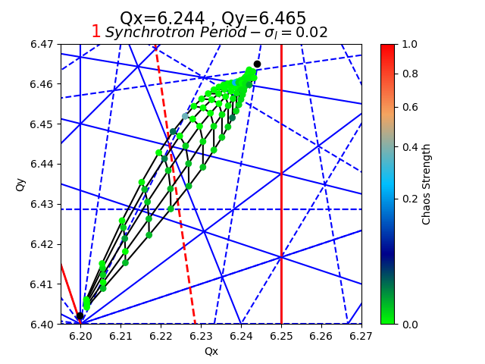

CMA
(1,6)
(1,6)
(1,4)
(1,4)
(2,6)
(2,6)
(7,1)
(7,1)
(8,0)
(8,0)
Systematic
Systematic

Slide 31
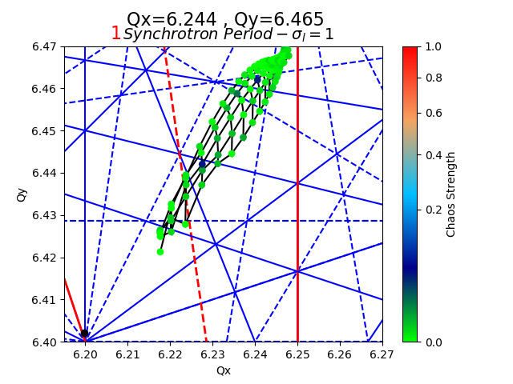
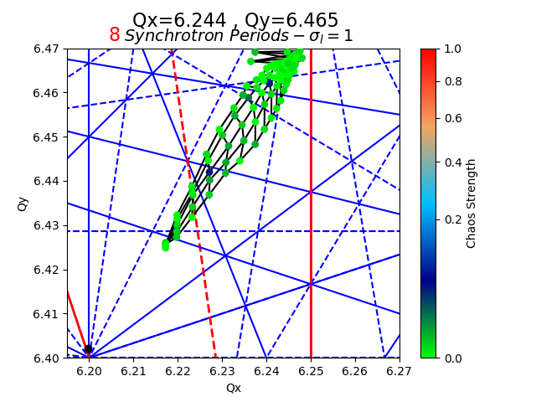
CMA
(1,6)
(1,6)
(1,4)
(1,4)
(2,6)
(2,6)
(7,1)
(7,1)
(8,0)
(8,0)
Systematic
Systematic

Slide 32
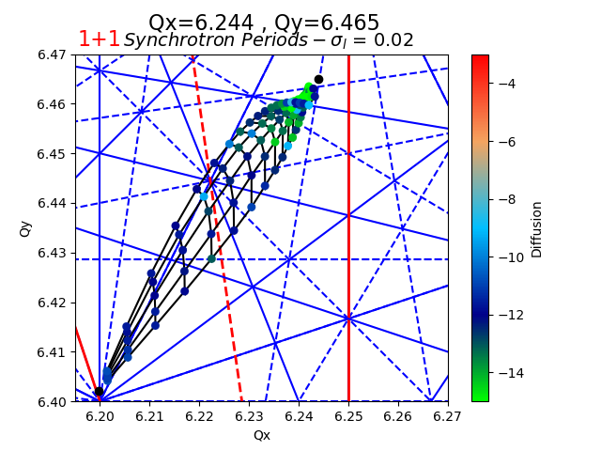
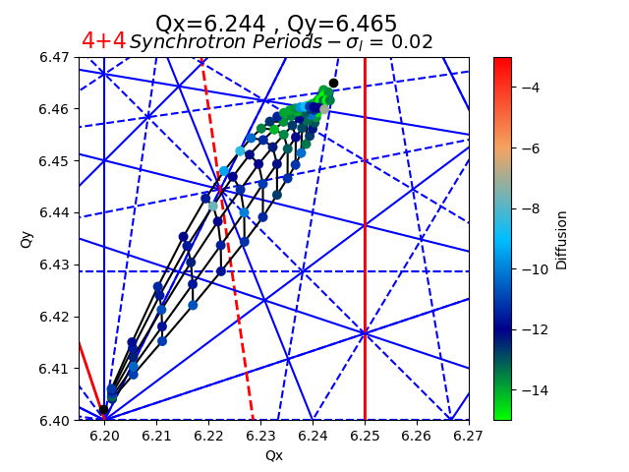
FMA
(1,6)
(1,6)
(1,4)
(1,4)
(2,6)
(2,6)
(7,1)
(7,1)
(8,0)
(8,0)
Systematic
Systematic

Slide 33
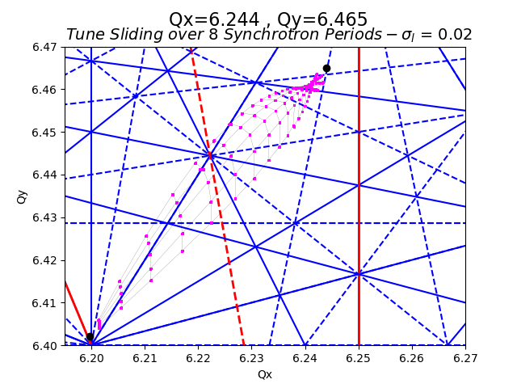
(1,6)
(1,4)
(2,6)
(7,1)
(8,0)
Systematic

Slide 34
Q104Q476

Slide 35
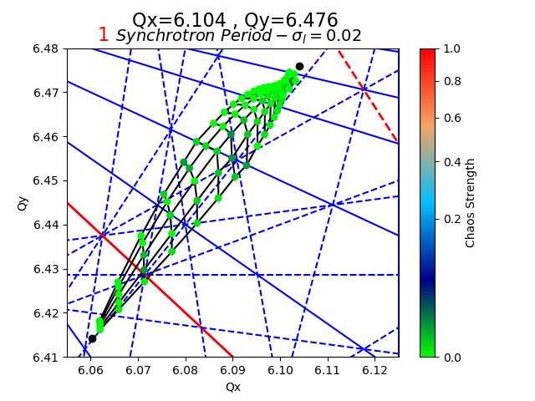

CMA
(2,6)
(1,6)
(2,6)
(1,6)
(1,2)
(1,2)
(3,4)
(3,4)
(4,4)
(4,4)
Systematic
Systematic

Slide 36
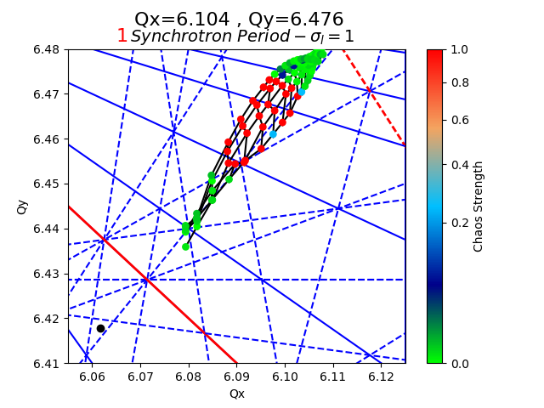
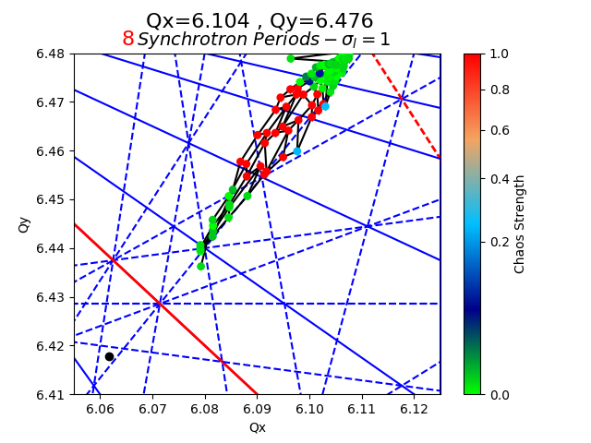
CMA

Slide 37
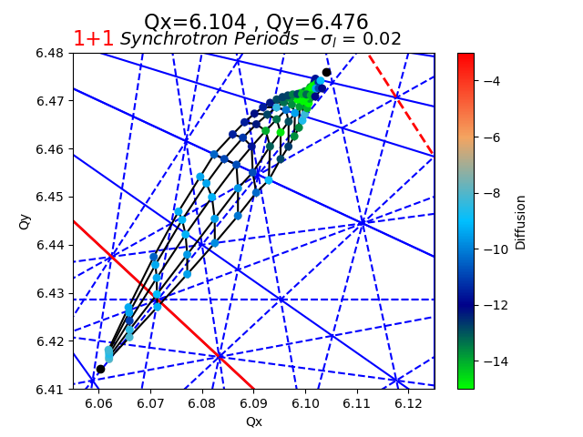
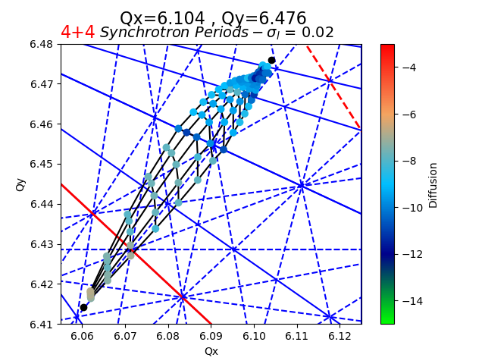
FMA
(2,6)
(2,6)
(1,6)
(1,6)
(1,2)
(1,2)
(3,4)
(3,4)
(4,4)
(4,4)
Systematic
Systematic

Slide 38
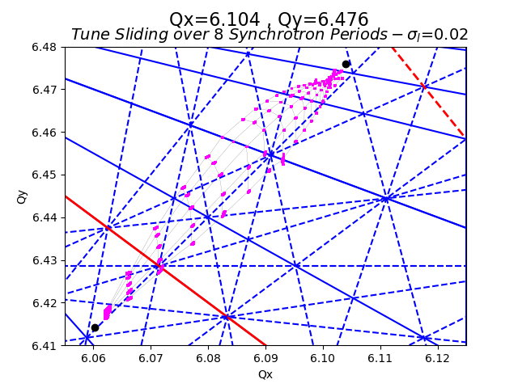
(2,6)
(1,6)
(1,2)
(3,4)
(4,4)
Systematic

Slide 39
Q104Q476 Frozen

Slide 40
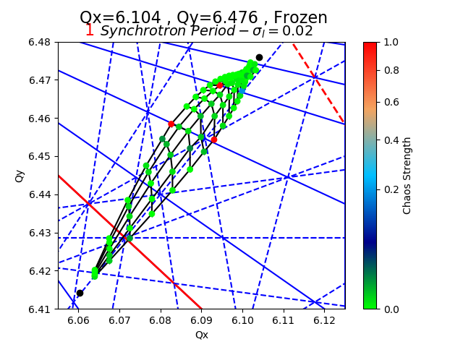

CMA
(2,6)
(1,6)
(2,6)
(1,6)
(1,2)
(1,2)
(3,4)
(3,4)
(4,4)
(4,4)
Systematic
Systematic

Slide 41
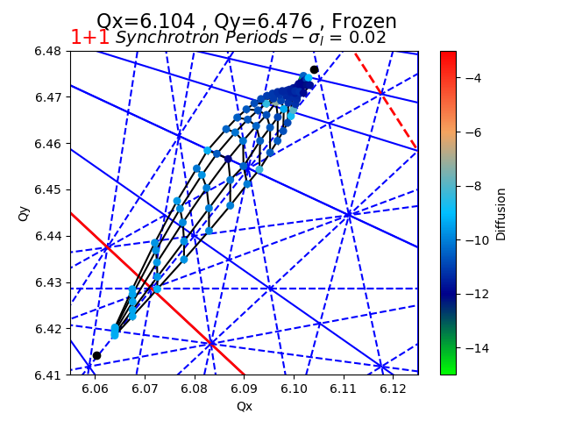
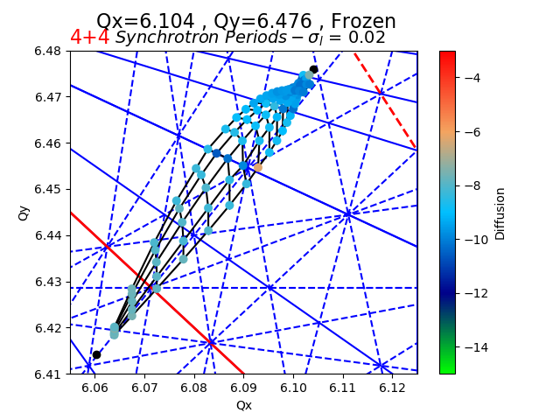
FMA
(2,6)
(1,6)
(2,6)
(1,6)
(1,2)
(1,2)
(3,4)
(3,4)
(4,4)
(4,4)
Systematic
Systematic

Slide 42
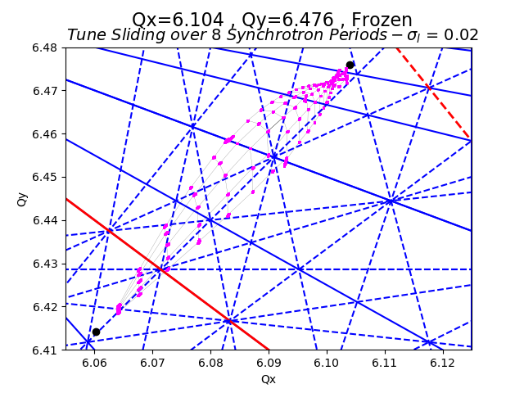
(2,6)
(1,6)
(1,2)
(3,4)
(4,4)
Systematic

Slide 43
Reserve

Slide 44
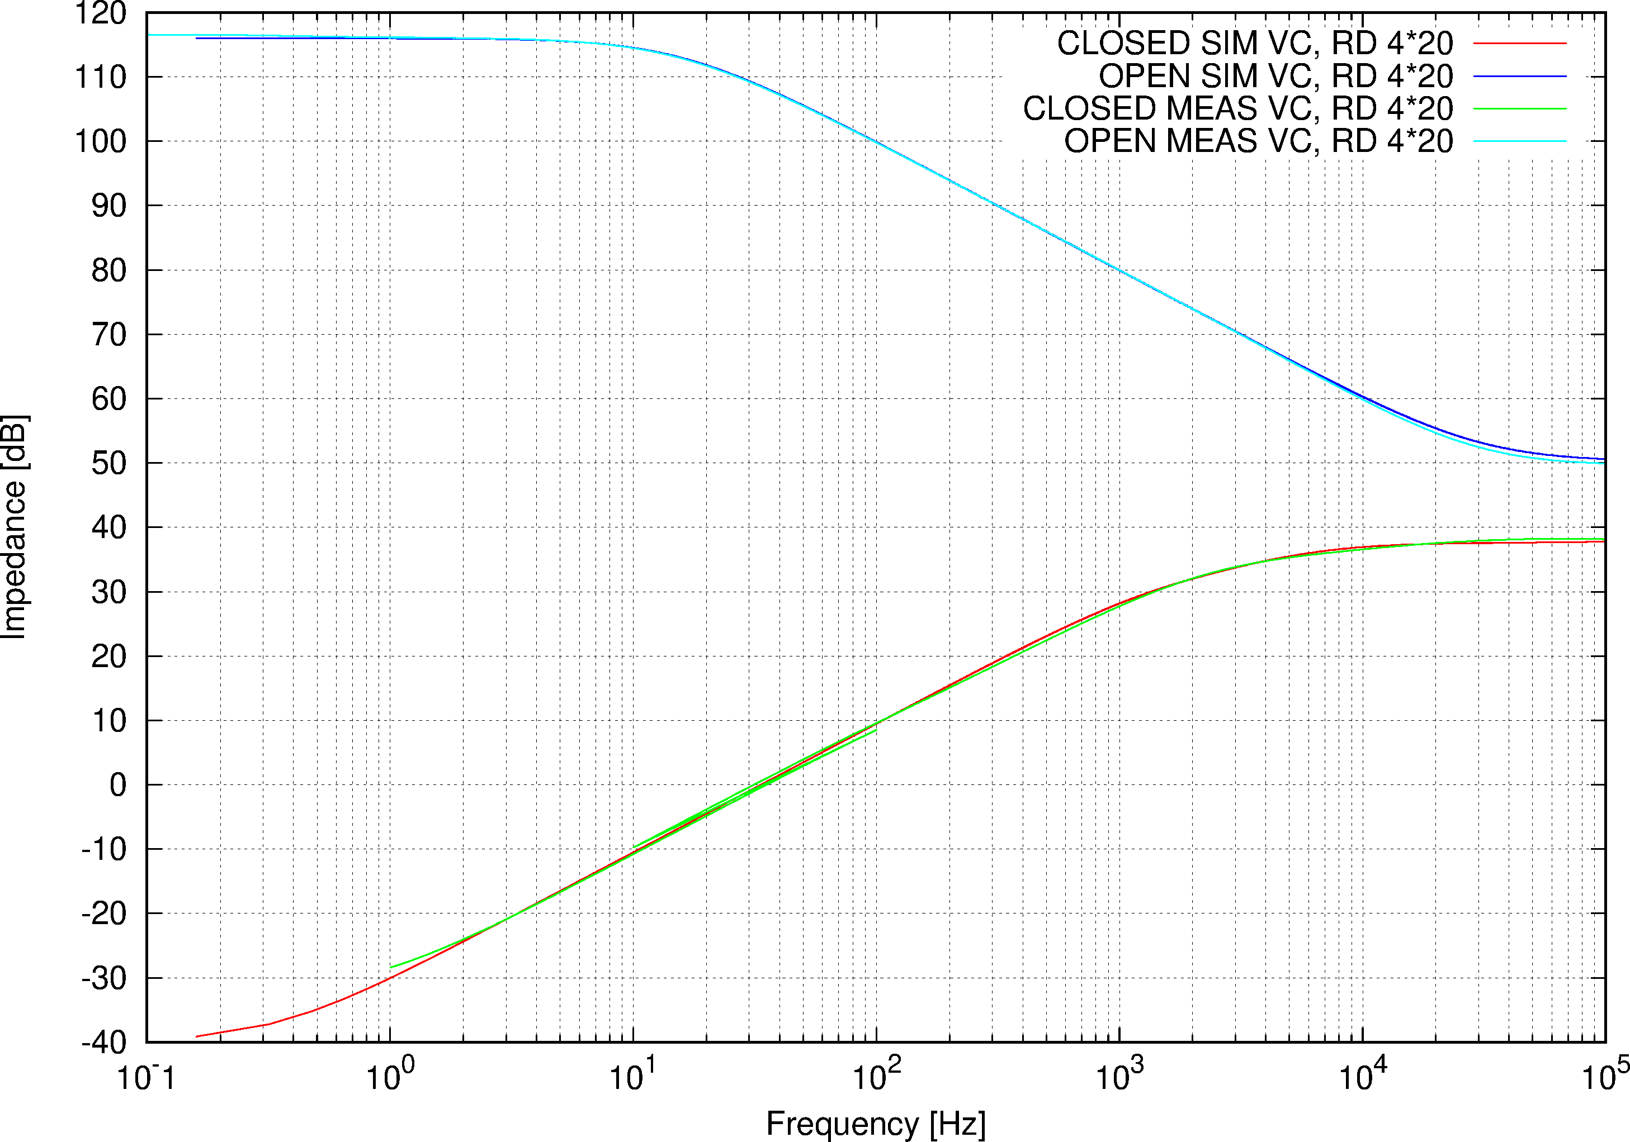
Dipole, VC RD = 4*20 Ω

Slide 45
Resonance Analysis
Analytical Perturbation Method
Lie Alebra
One Turn Map & NormalForm
Fourier Analysis
Tasks

Slide 46
Resonance Analysis I/V
Analytical Perturbation Method
J. Moser (1955)
R. Hagedorn (1957)
A. Schoch (1957)
G. Guignard (1978) ➔ CAS
(Implementation in SixTrack Code (1985) Schmidt)
n₁ Q₁ + n₂ Q₂=p; n₁, n₂, p Integer
Limits:
Close to a resonance
Regard only slowly varying terms

Slide 47
Resonance Analysis II/V
Lie Algebra
Theory: A. Dragt ~1980
Implementation:
- J. Irwin & J. Bengsston (1992) SSC 232
- F. Schmidt: SODD (1999) as a module of MAD-X (2004)
(D & F in first and second order)
- Element by Element (or pairs)
- Radius of Convergence

Slide 48
Resonance Analysis III/V
One Turn Map & NormalForm
A.Dragt, M. Berz & E. Forest ~1988 (Turchetti, Michelotti and Others)
- 6D
- Any Order
- Code for tracking and Maps identical, but…
- Global(!) local difficult through parameters
- Same problem with convergence

Slide 49
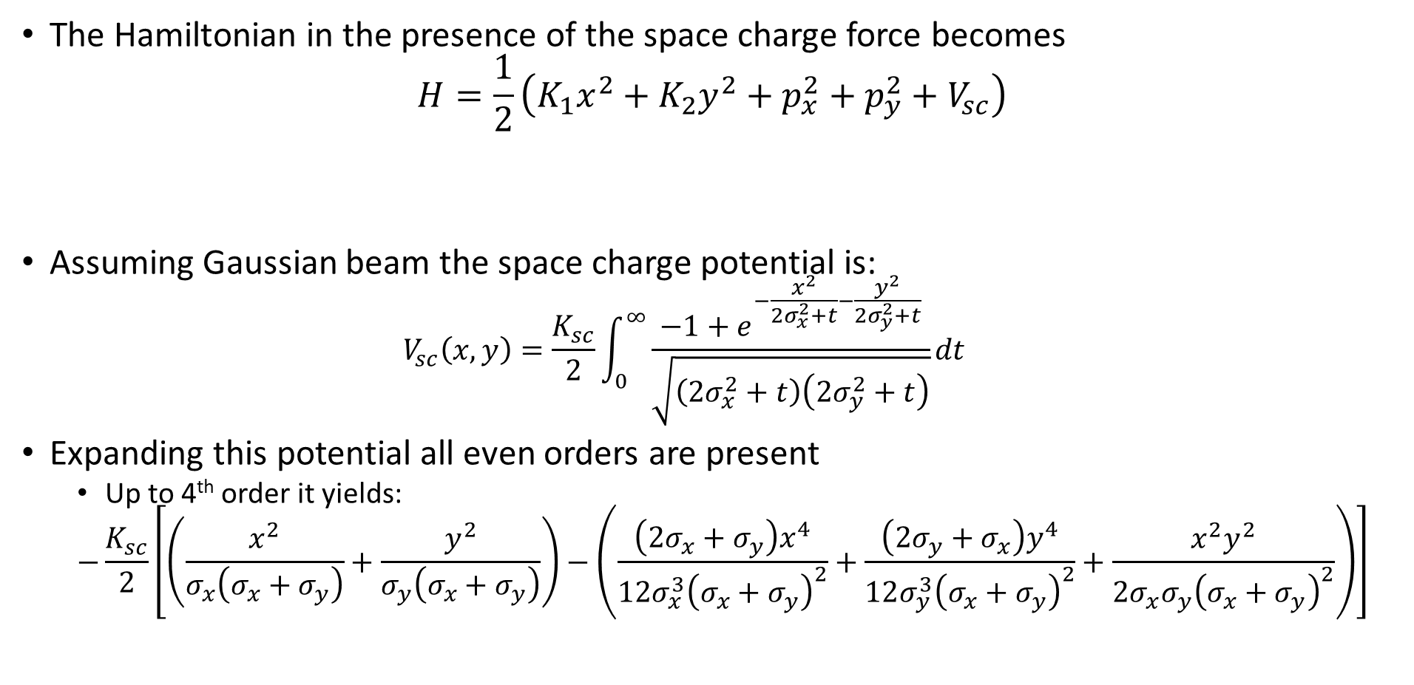
PS III Resonance Driving Terms F. Asvesta
The Hamiltonian in the presence of the space charge force becomes
$$H=\frac{1}{2}\left(K_{1}x^{2}+K_{2}y^{2}+p_{x}^{2}+p_{y}^{2}+V_{sc}\right)$$
Assuming Gaussian beam the space charge potential is:
  $$V_{sc}\left(x,y\right)=\frac{K_{sc}}{2}\int_{0}^{∞}{\frac{−1+e^{−\frac{x^{2}}{2σ_{x}^{2}+t}−\frac{y^{2}}{2σ_{y}^{2}+t}}}{\sqrt{\left(2σ_{x}^{2}+t\right)\left(2σ_{y}^{2}+t\right)}}dt}$$
Expanding this potential all even orders are present
  Up to 4th order it yields:
  $$−\frac{K_{sc}}{2}\left[\left(\frac{x^{2}}{σ_{x}\left(σ_{x}+σ_{y}\right)}+\frac{y^{2}}{σ_{y}\left(σ_{x}+σ_{y}\right)}\right)−\left(\frac{\left(2σ_{x}+σ_{y}\right)x^{4}}{12σ_{x}^{3}{\left(σ_{x}+σ_{y}\right)}^{2}}+\frac{\left(2σ_{y}+σ_{x}\right)y^{4}}{12σ_{y}^{3}{\left(σ_{x}+σ_{y}\right)}^{2}}+\frac{x^{2}y^{2}}{{2σ_{x}σ_{y}\left(σ_{x}+σ_{y}\right)}^{2}}\right)\right]$$
Magnetic fields gradients
Perturbing potential

Slide 50
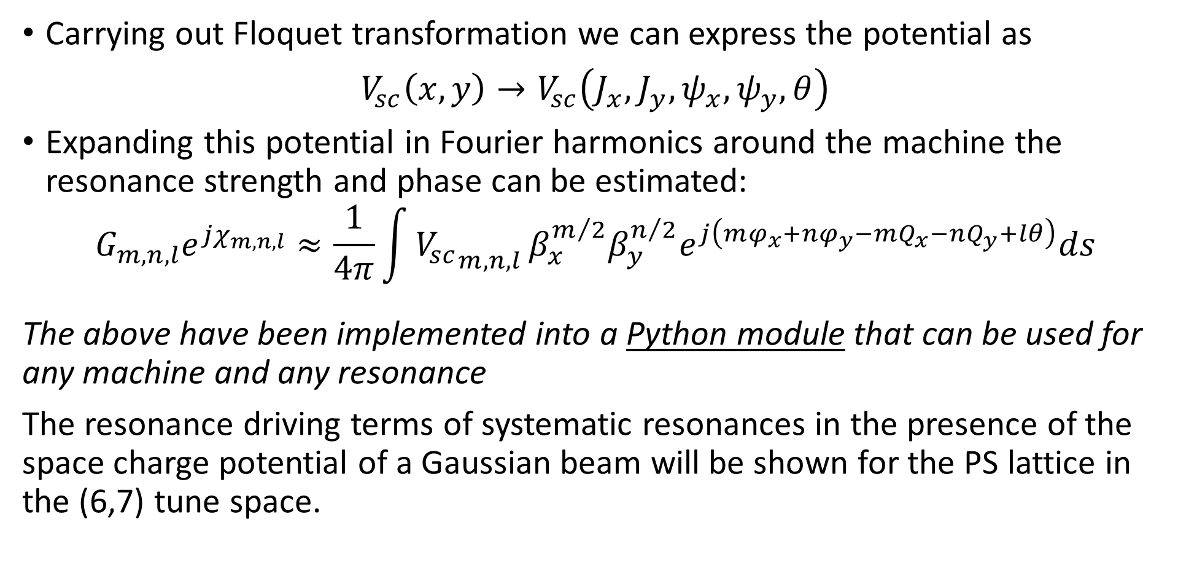
PS IV Resonance Driving Terms F. Asvesta
fggggggff
➔ Plan: New MAD-X Module

Slide 51
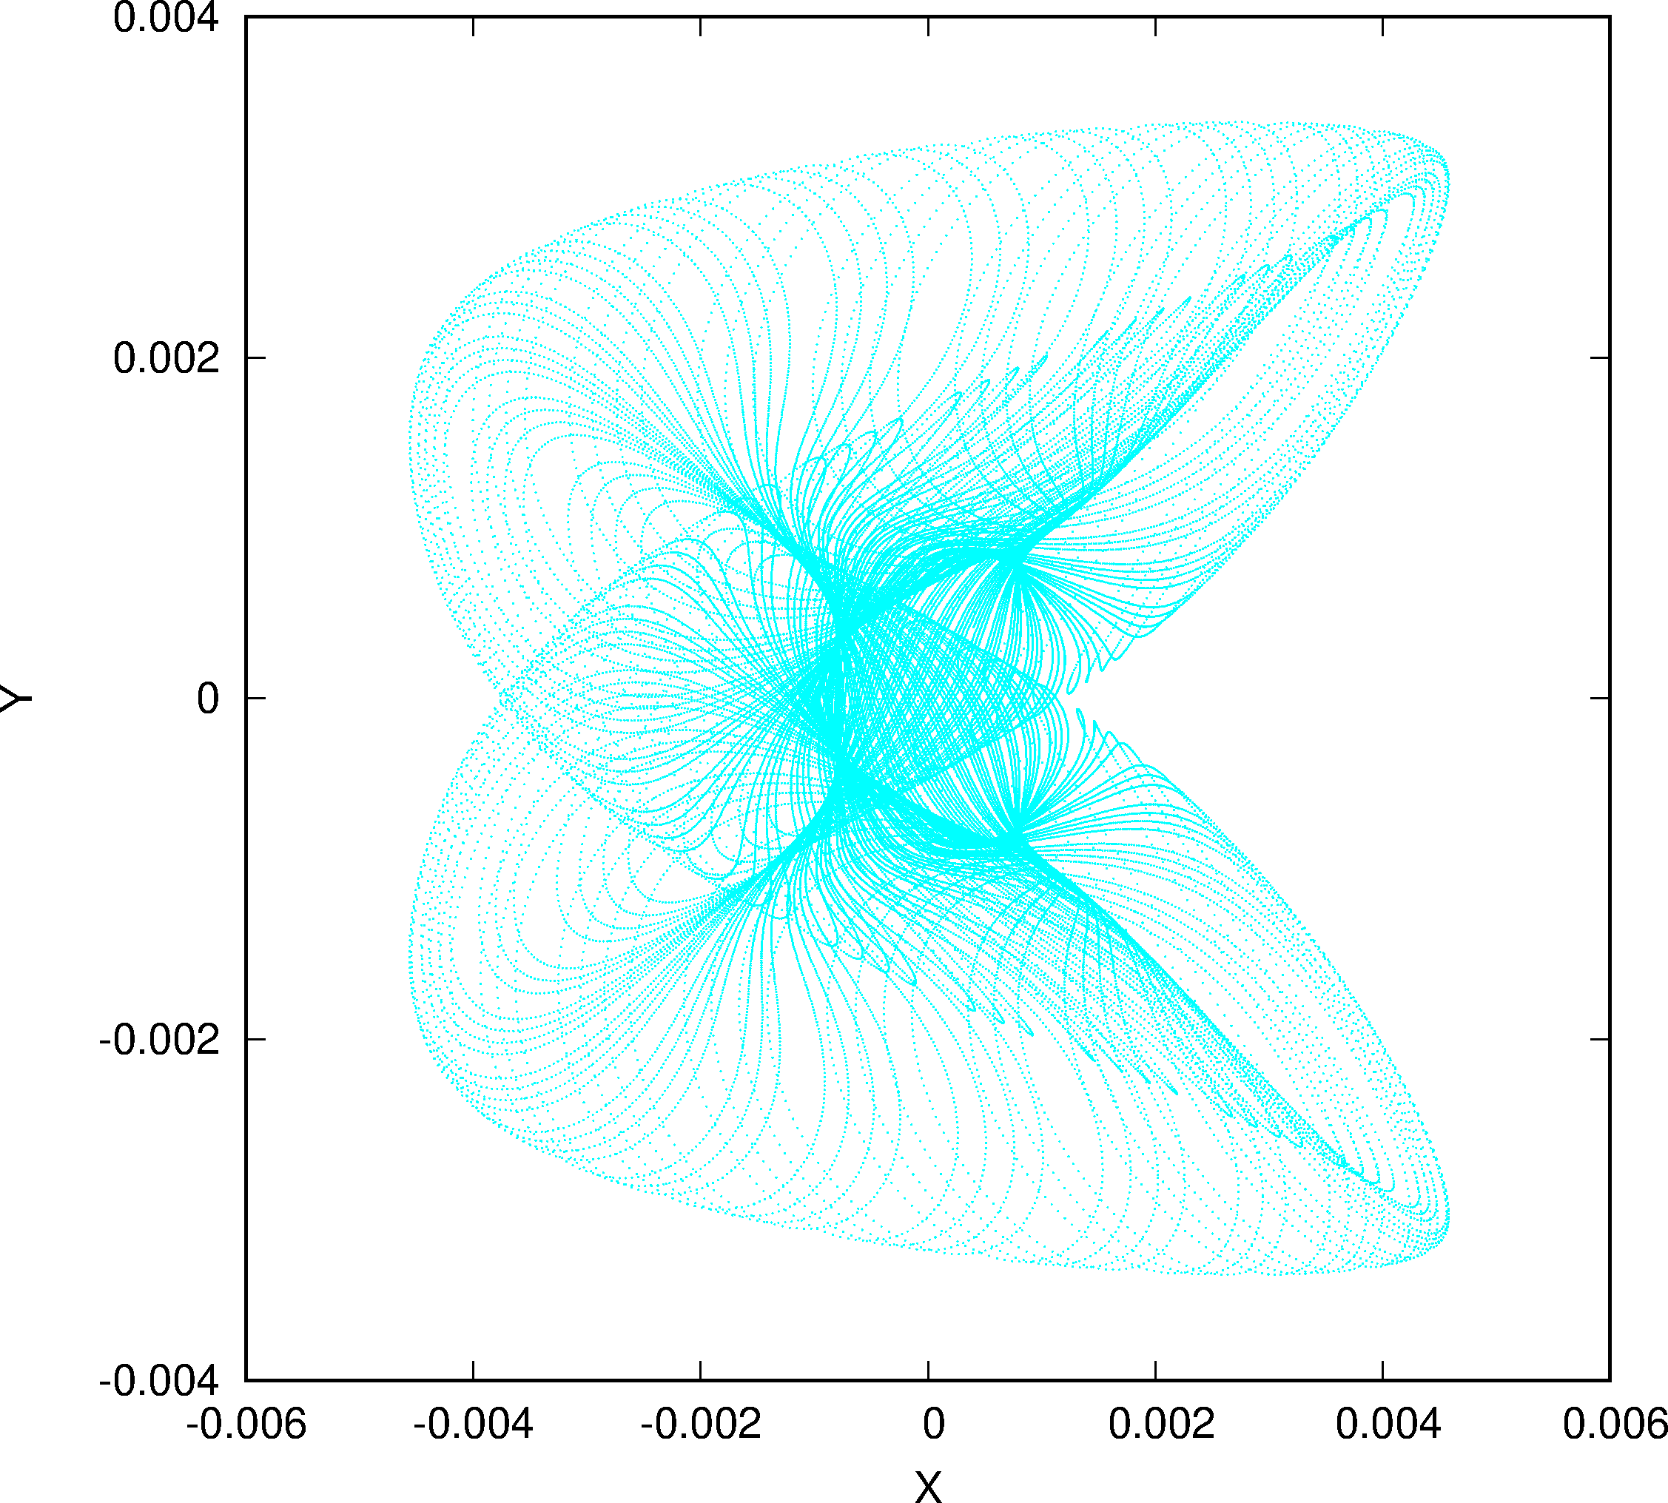
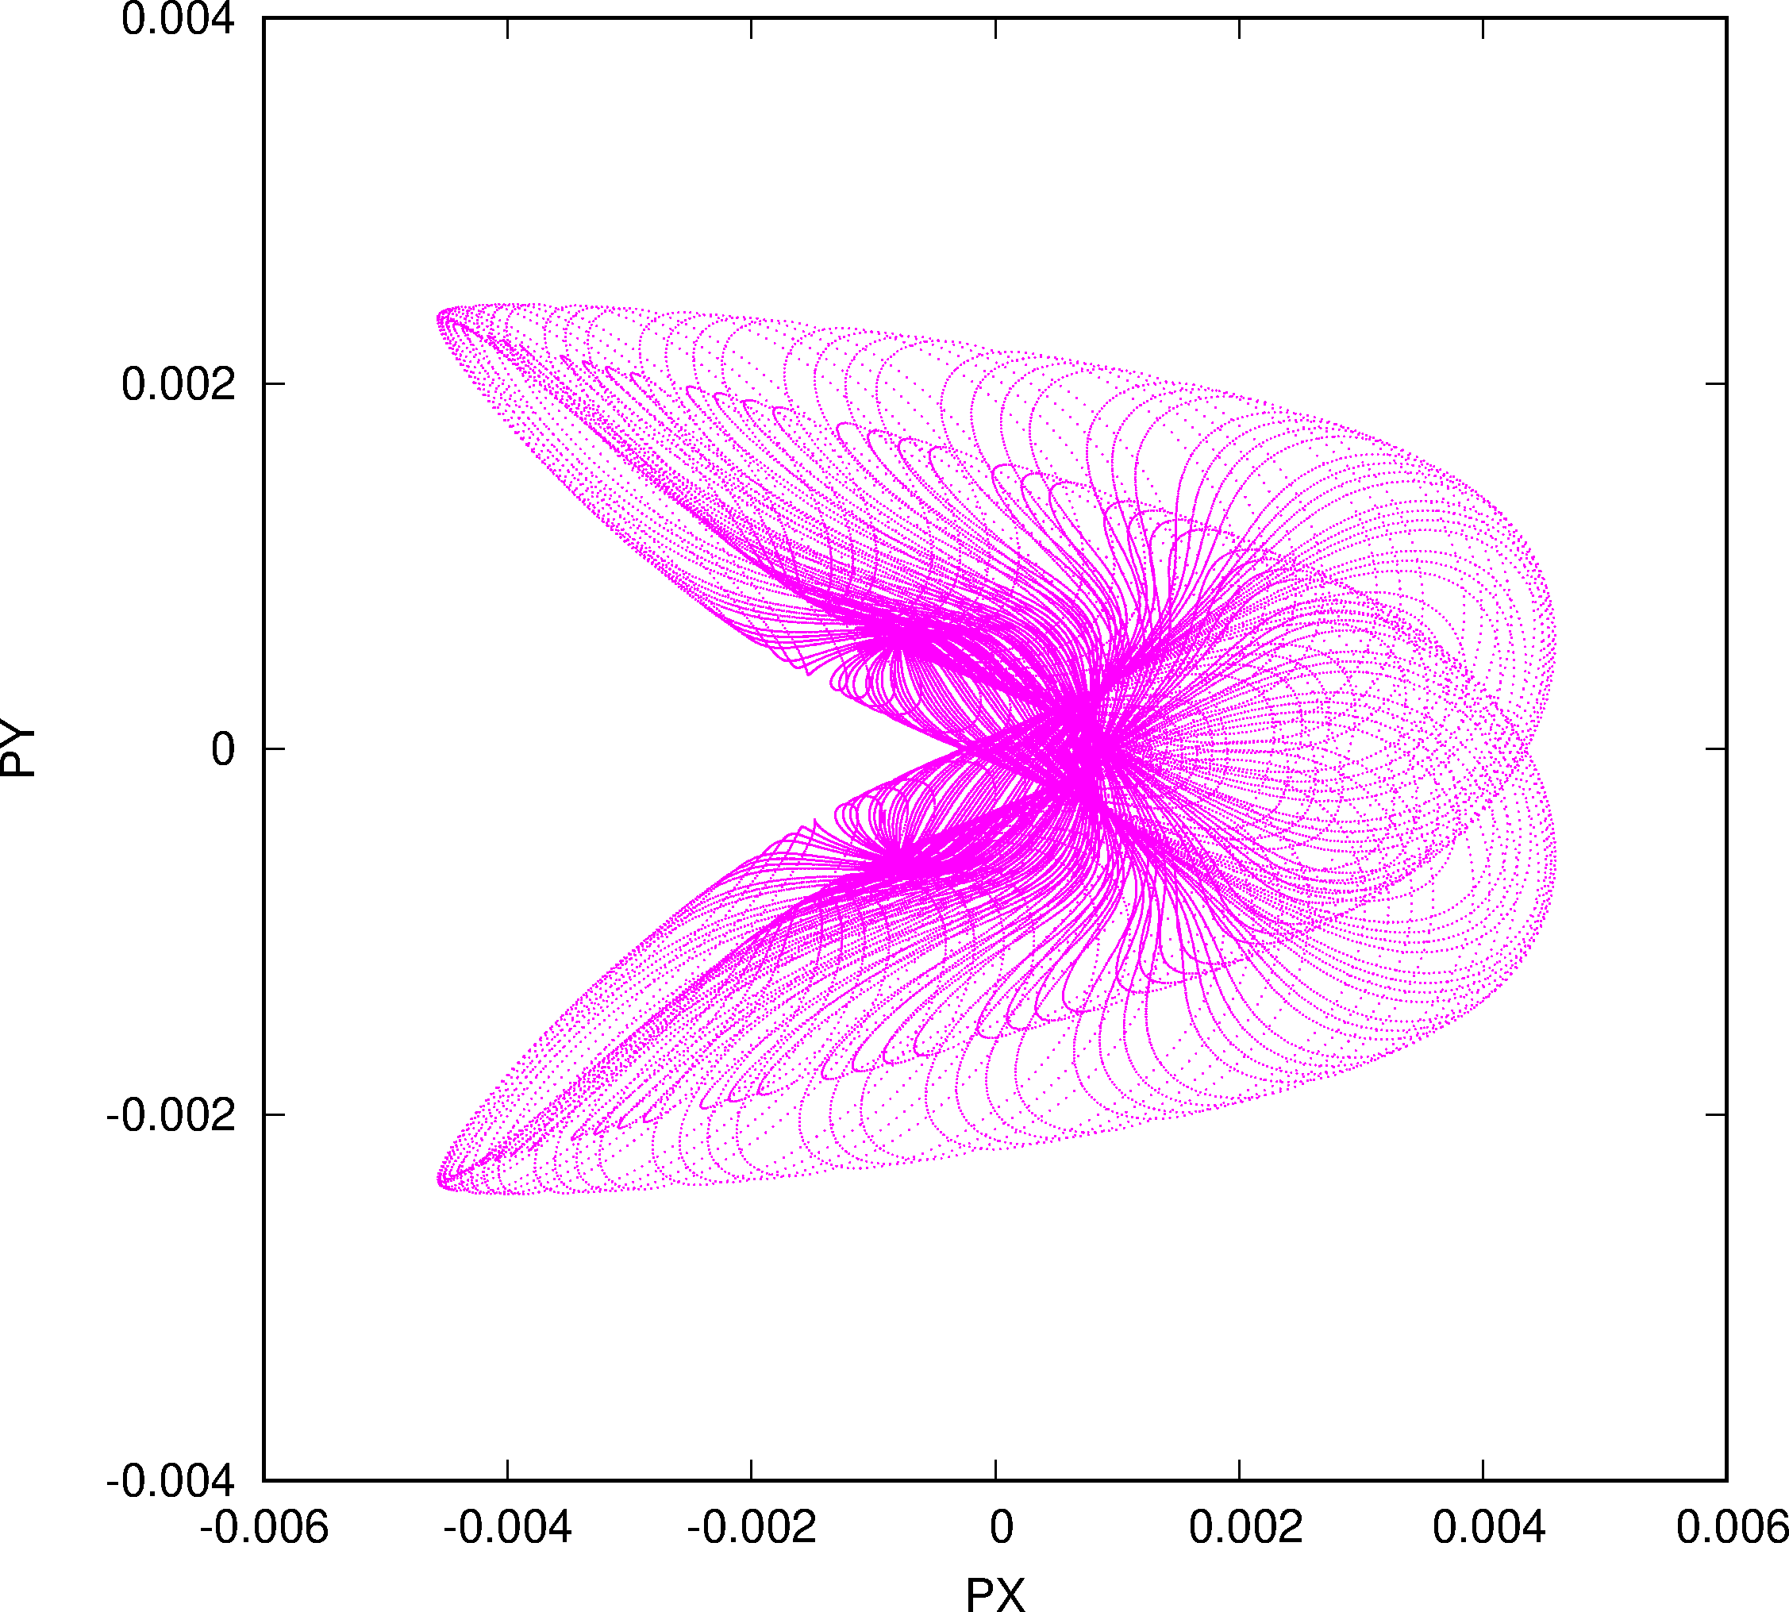
SPS Phase Space of Large Fix-line Structure
Q_{x} + 2 Q_{y} = p

Slide 52
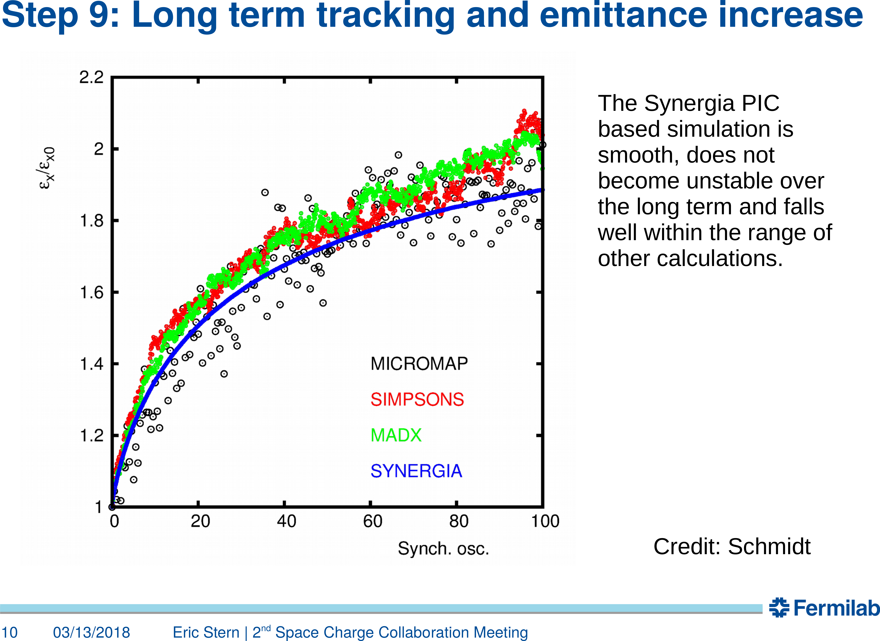
Synergia Bench-Marking I: Long-Term

Slide 53
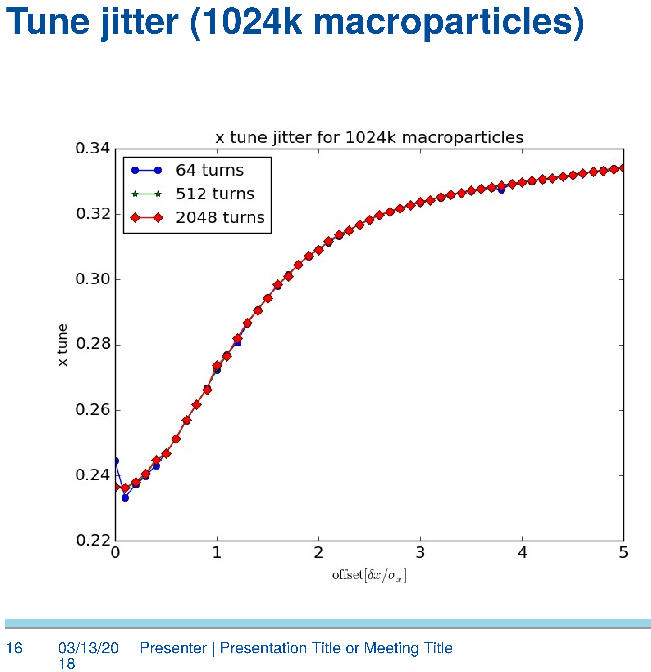
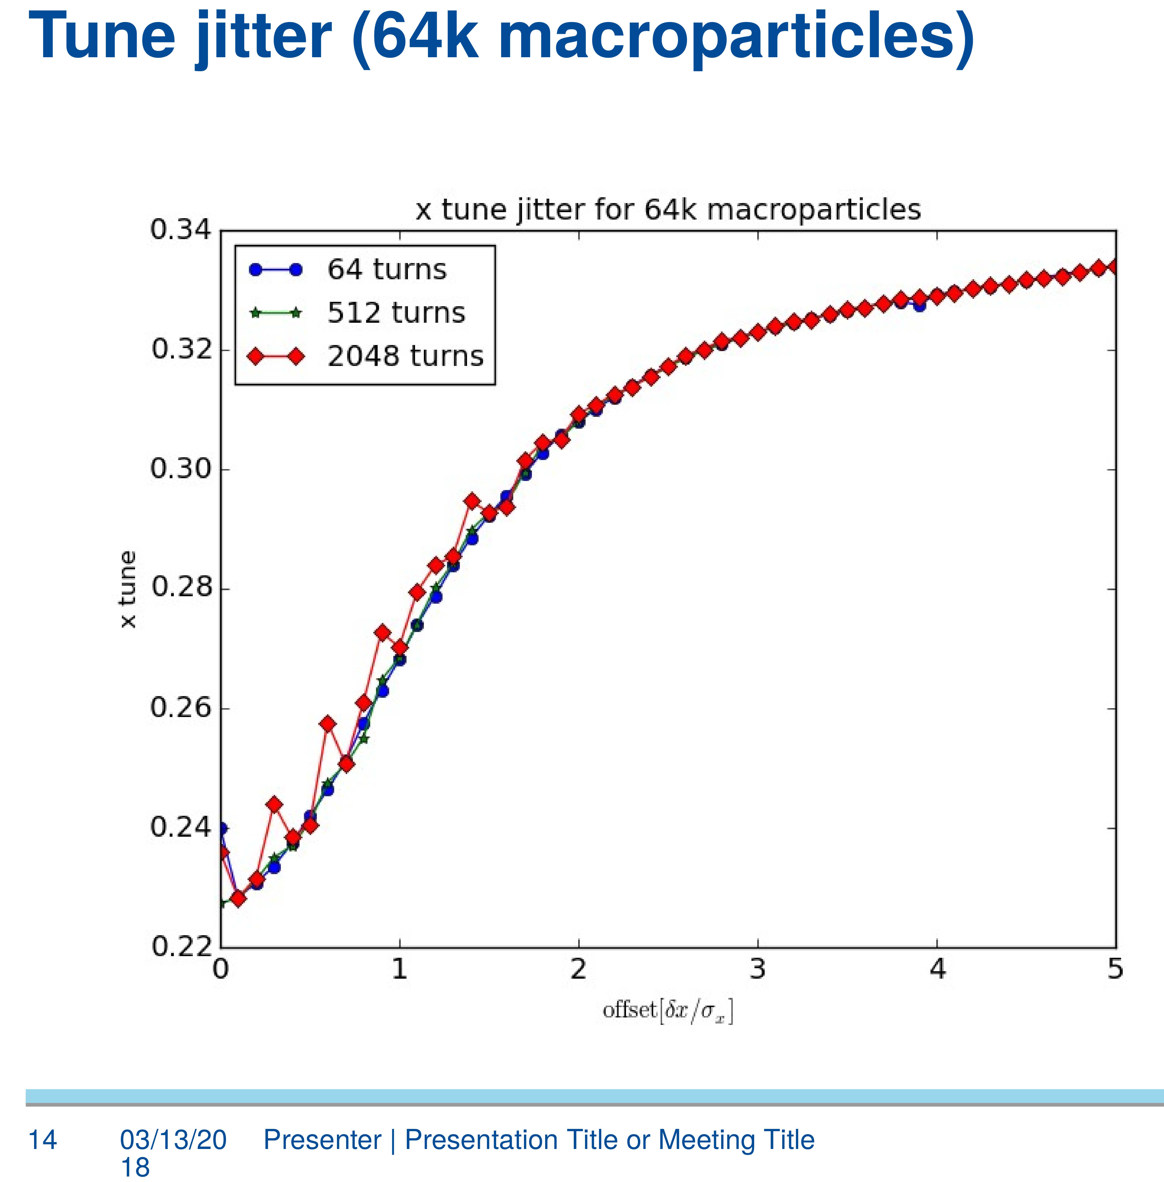
Synergia Bench-Marking II: Tune Jitter

Slide 54
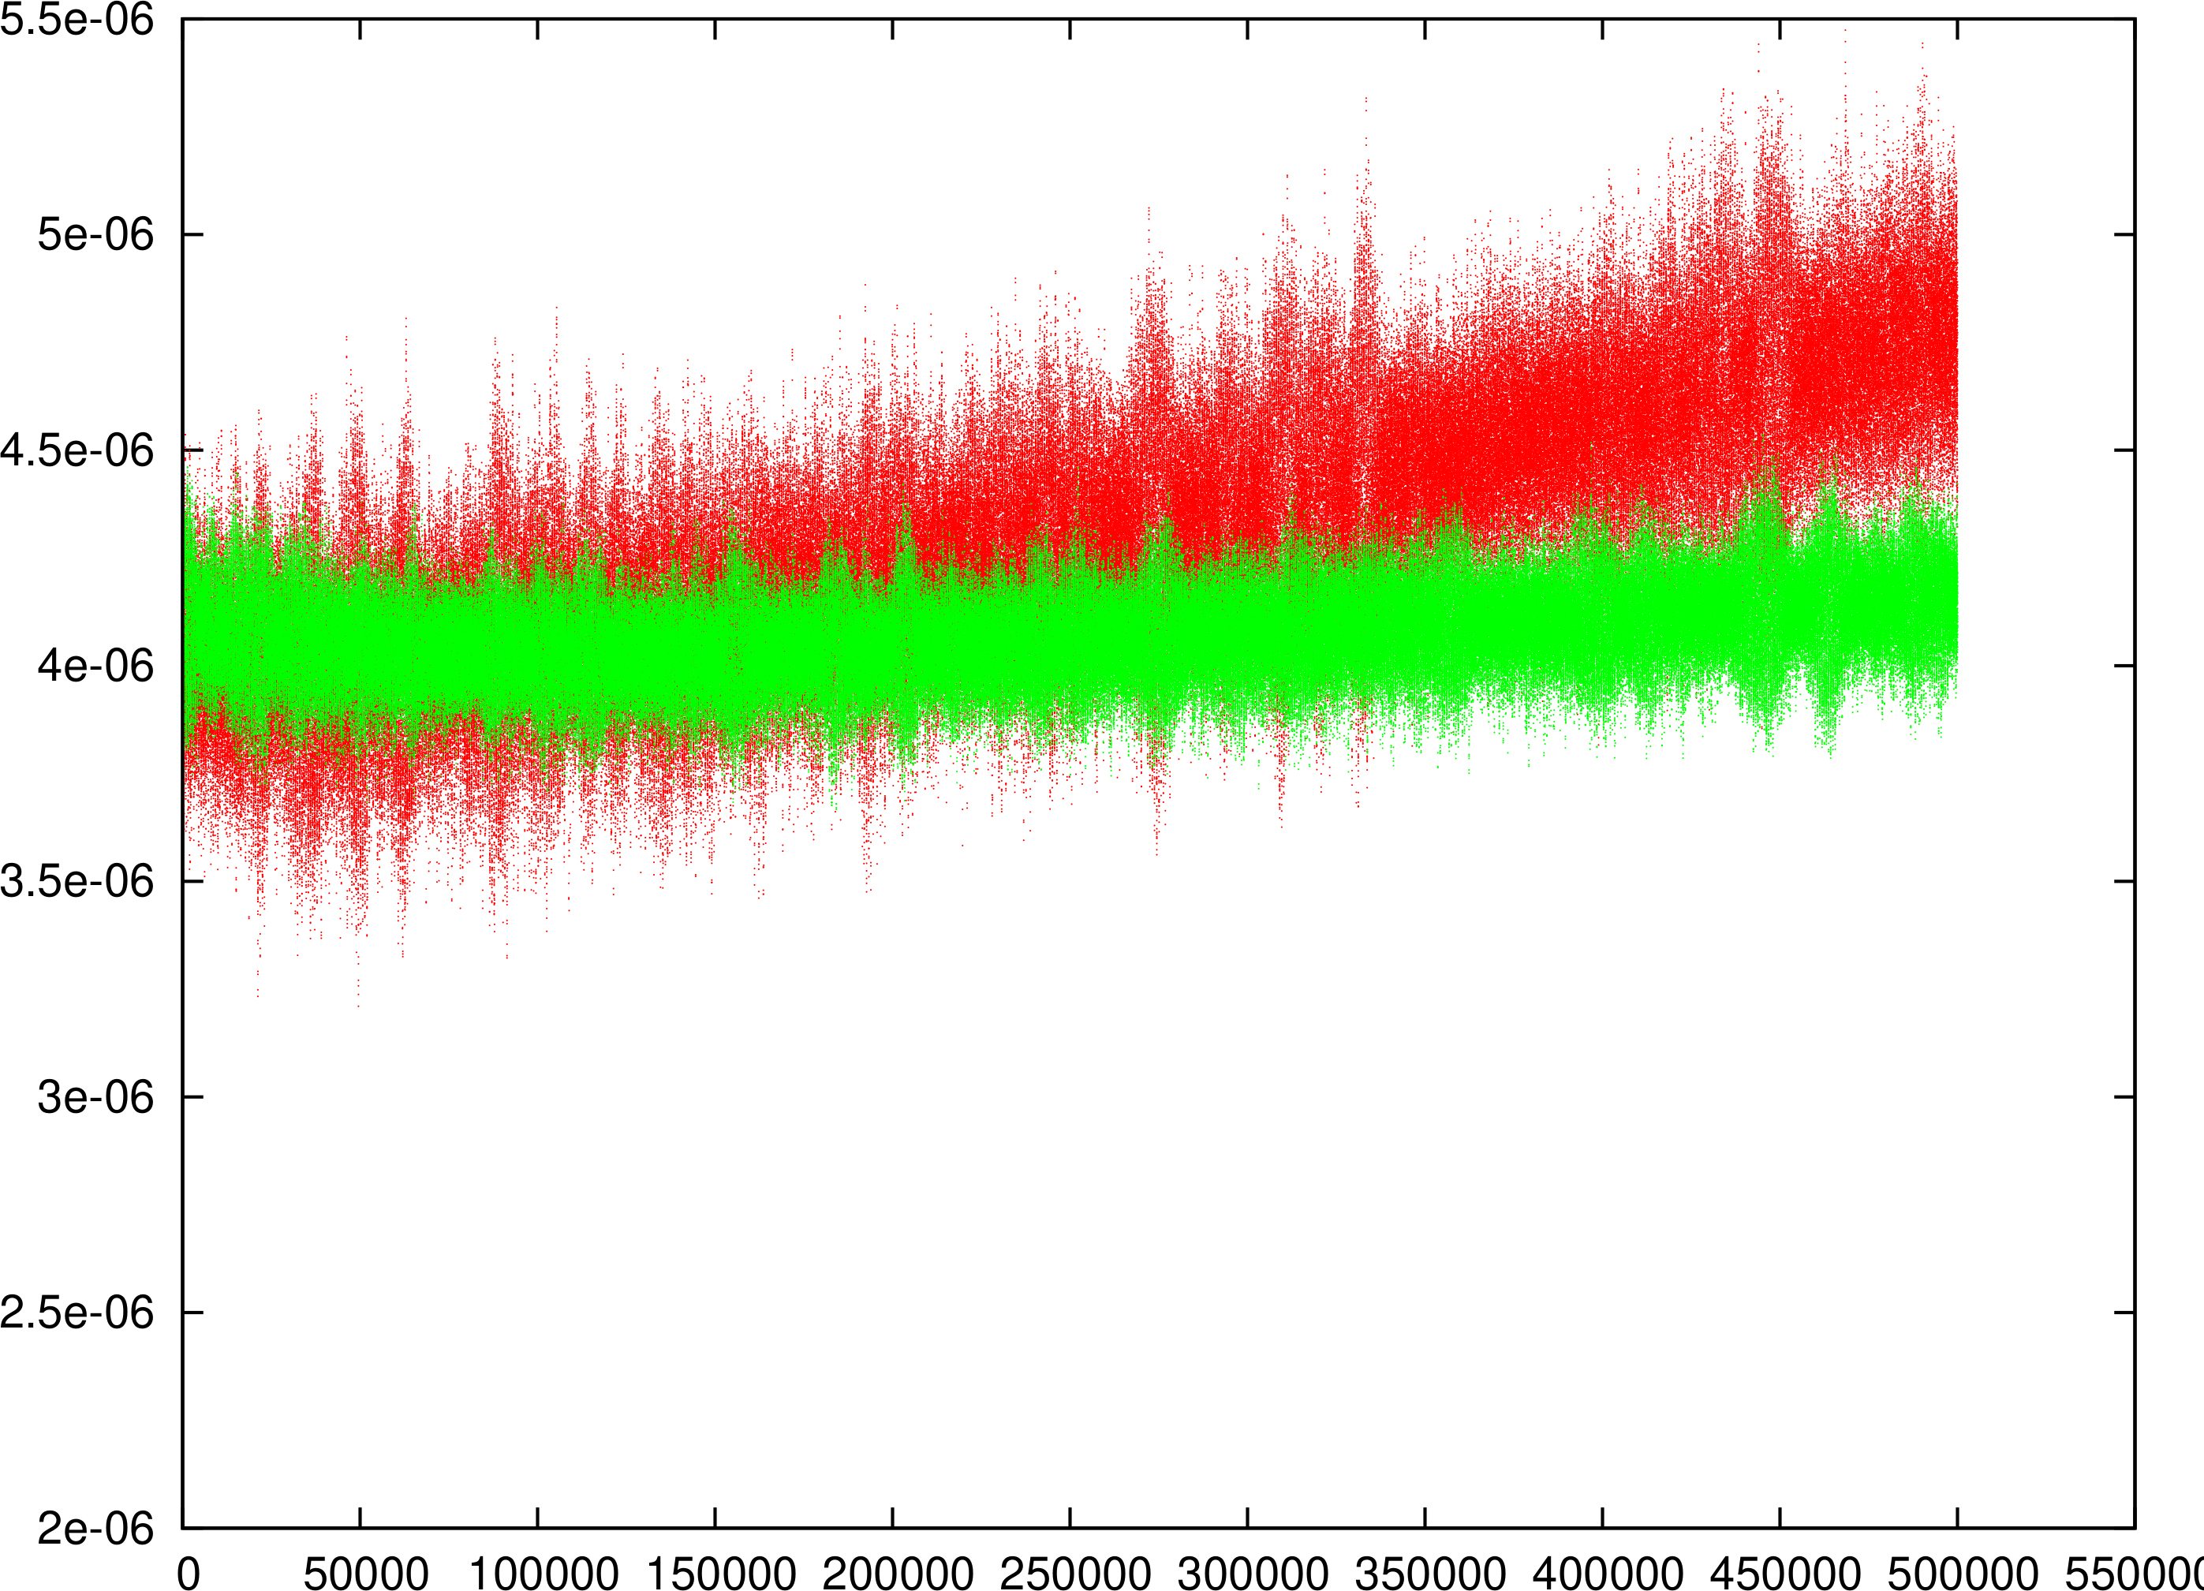
Noise in Adaptive Frozen Mode in MAD-X:
PS 500K Turns
Adaptive Mode only Transverse
Not too small Number of Particles ➔ Artificial Emittance Growth gone!
RED: 1000 Particles
Green: 4000 Particles

Slide 55
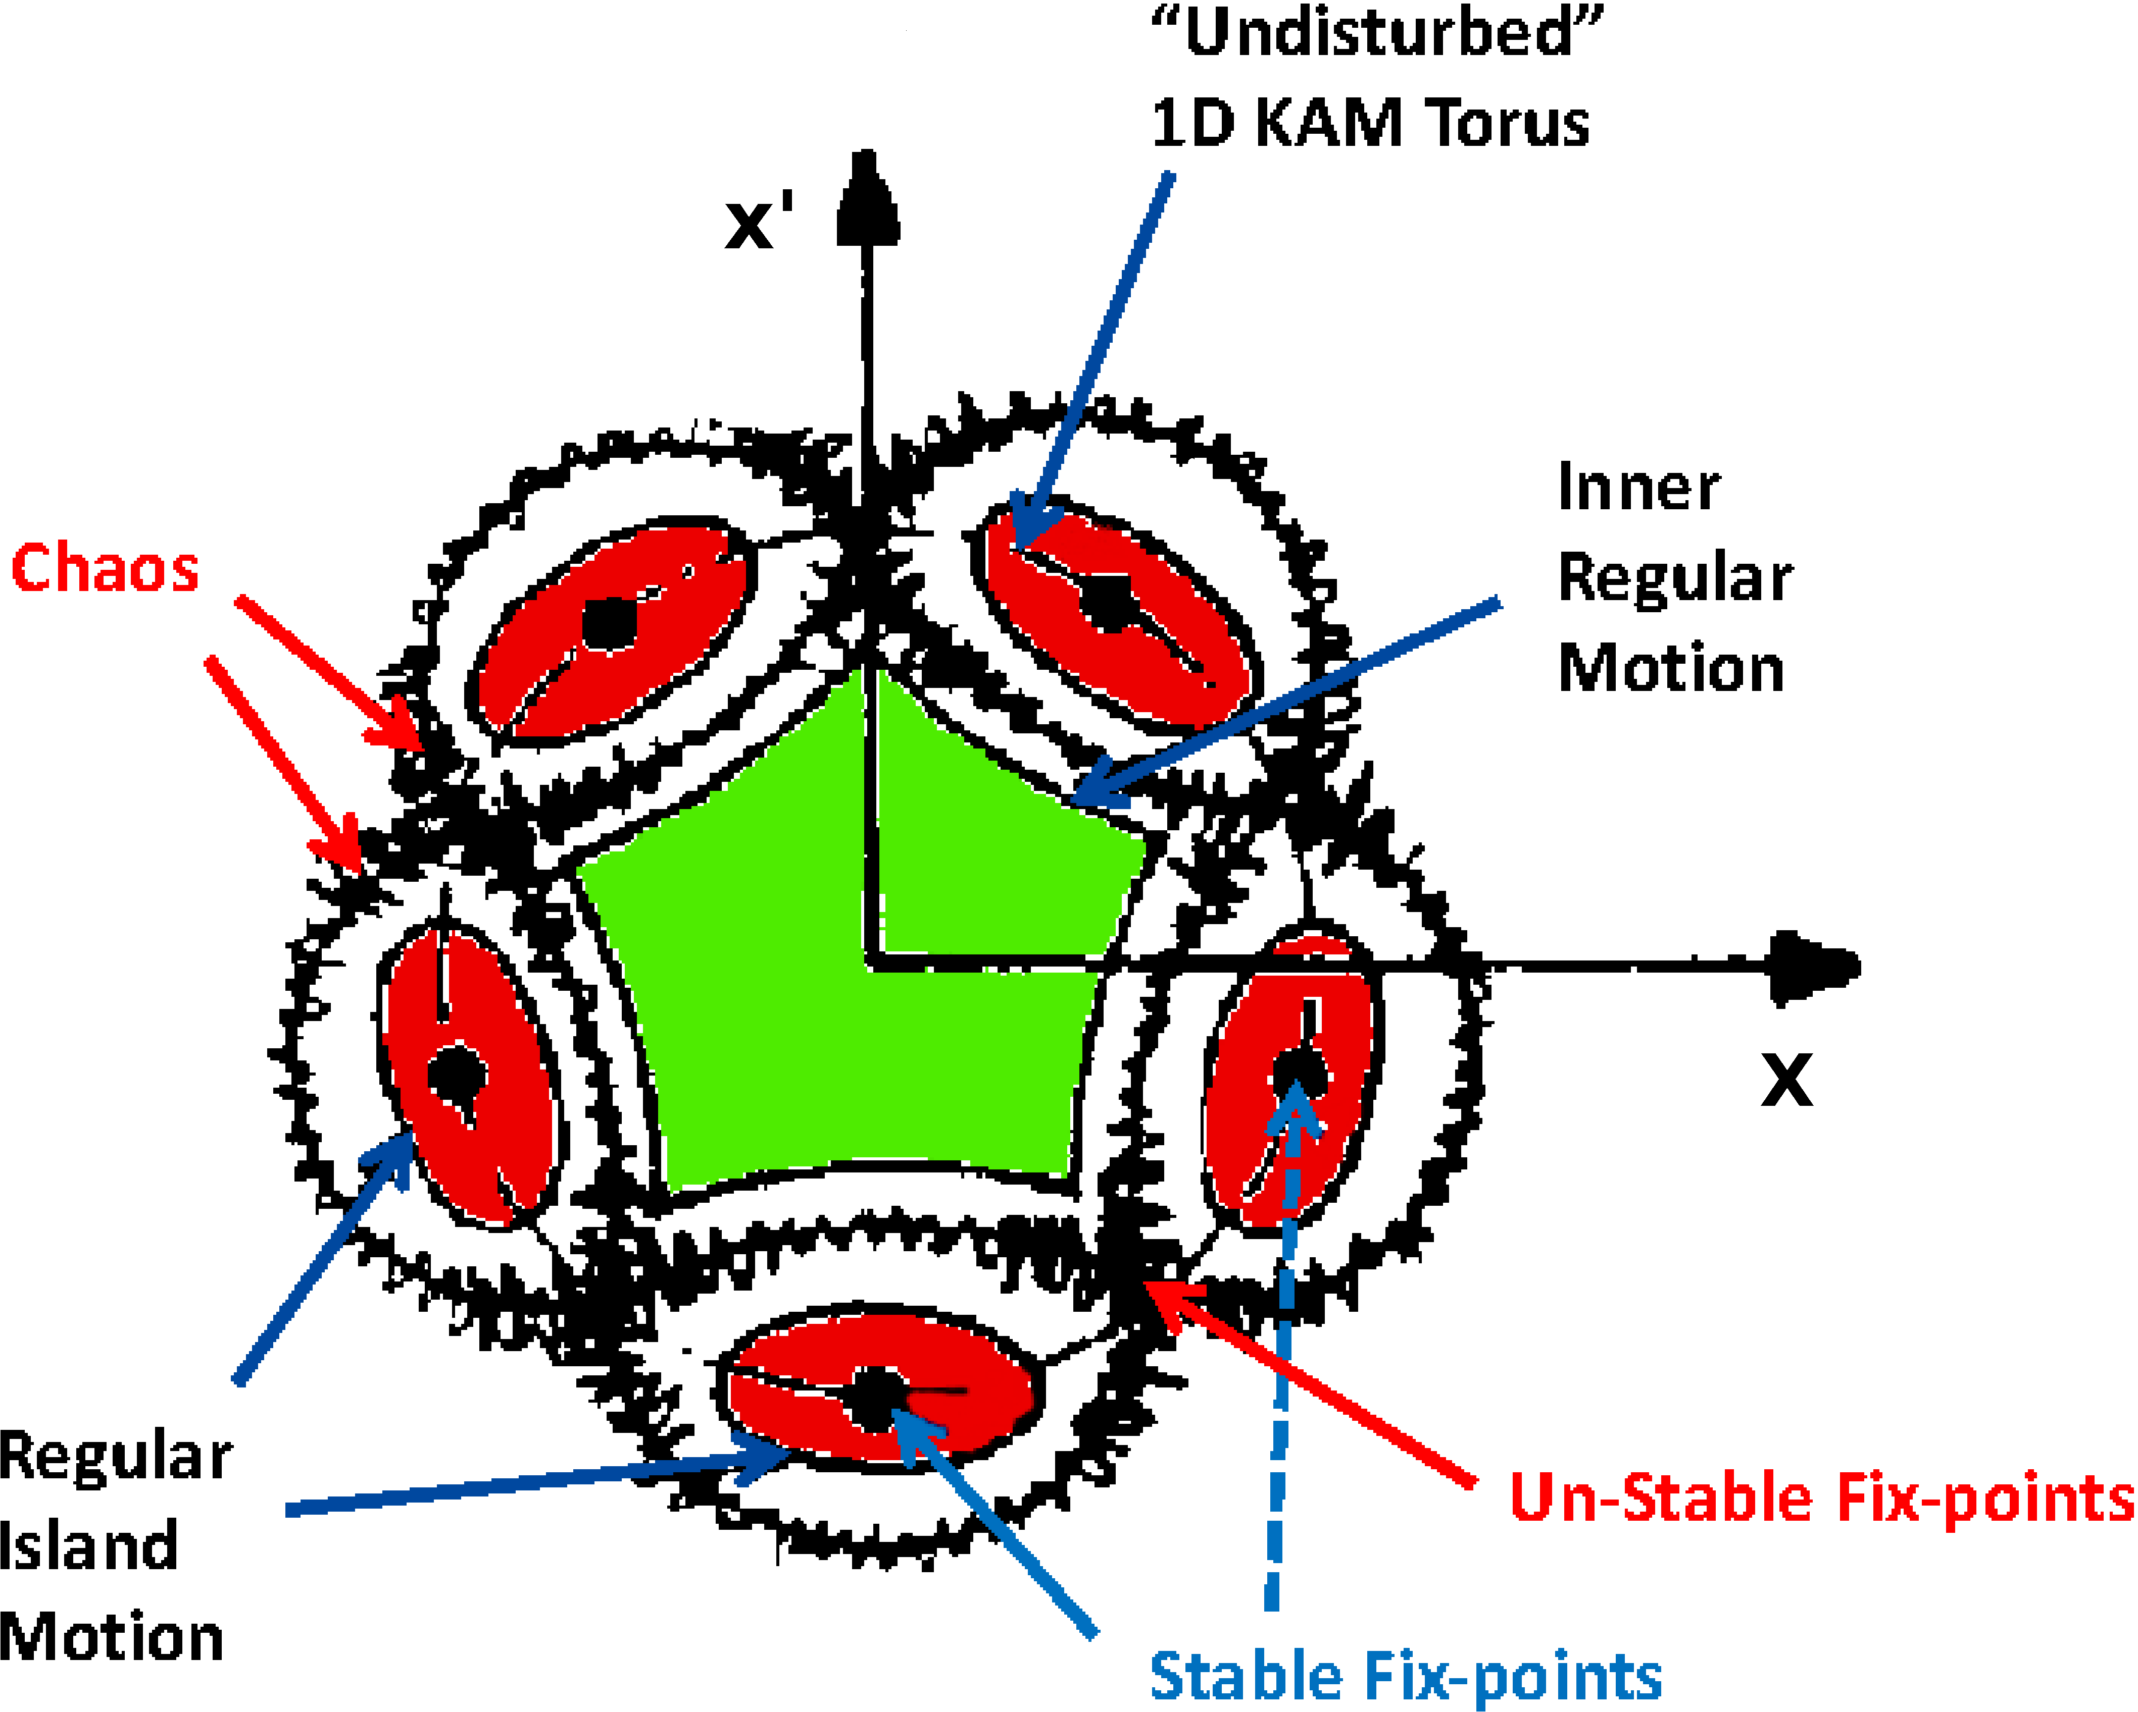
Motivation I: Boring 1D

Slide 56

Motivation II: 2D Resonance Types
“Double” 2D Resonance
Coupled 2D Resonance
Single Resonance ➔ like “Boring 1D”

Slide 57


Motivation III: Double versus Coupled

Slide 58



Motivation IV: Double Resonance, Simulation

Slide 59

Motivation V: 2D Coupled, Theory
Shown are the results at a particular s location. The theory includes a α parameter that controls the rotation of the projections along the machine.

Slide 60


SPS Phase Space Reconstruction BPM1
LSE106
Experiment
Simulation
LSE106

Slide 61

SPS Phase Space Reconstruction BPM1
LSE206
Experiment
Simulation
LSE206

Slide 62


SPS Phase Space Reconstruction BPM14
LSE106
S Location shifted by one Sextant
Experiment
Simulation
LSE106

Slide 63

SPS Phase Space Reconstruction BPM14
LSE206
S Location shifted by one Sextant
Experiment
Simulation
LSE206

Slide 64

Driving Term (1, 2) for the 10 SPS Sextupoles
DT-S
LSE106
LSE424
LSE324
LSE206
LSE524
LSE224
LSE506
Expected negative!
LSE624
LSE124
LSE406
DT-C

Slide 65


Ripple Spectrum 2017
Horizontal
600 Hz
Vertical

Slide 66

Preliminary SPS Experimental Evidence of Fix-Line 2015
R=φ_{x}+2 φ_{y}- N
Ω=φ_{x}+2 φ_{y}

Slide 67

Time Evolution of Motion in the SPS close to Fix-Line 2015

Slide 68

Best Case 2017

Slide 69
Plan of action for the SPS 2018 Fix-Line Experiment
We have first signs in the SPS experiments of the existence of the fix-line structure as expected from theory and simulations.
However, the present level of power supply ripple and potentially drifts does not yet allow to conclude that the particle distribution is locked onto this fix-line structure.
We have started to collaborate with the SPS power supply experts to improve the power supply ripple spectrum down to a level where a stable fix-line can verified beyond any doubt.
Furthermore, we will investigate if we can perform this experiment at an 4 times larger beam energy where the SPS is much better controlled and with a much lower power supply ripple spectrum.
We are confident that we can perform several MDs during the year of 2018 and we hope that we continue to get the support from our external collaborators.

Slide 70

Transmission Line Model

Slide 71


Ripple Spectrum 2017
Horizontal
Vertical

Slide 72

SPS Phase Space Simulation
Reconstruction
LSE106
Direct Tracking
LSE106

Slide 73

Best Case 2015

