Slide 1

Stand 4 Rotating Coil System Review
Introduction & Charge
Guram Chlachidze
June 8, 2018 Fermilab

Slide 2

Introduction
After successful CD-1/CD-3a DOE review in Aug. 2017, HL-LHC AUP is in preparation for CD-2/CD-3b review this summer
Q1/Q3 cryostat assembly with two MQXFA magnets inside will be tested at Fermilab’s Horizontal Test Facility (Stand 4).
MQXFA magnets will be fully tested and measured at BNL
  Quench training, Field quality measurements, endurance test, thermal cycle, etc.
Magnetic measurement systems requirements and design specifications for Q1/Q3 cryo-assemblies horizontal test are described in US-HiLumi-doc-818

Slide 3
Measurement System Requirements
Requirements both for RC and SSW systems are specified
  SSW is already developed and successfully used at KEK (Japan), as well as for LCLS-II and mu2e projects at FNAL (out of the scope of this review).
Horizontal magnetic measurements
are identified:
  Alignment (magnetic axis, field angle)
  Integral field strength and harmonics
  Z-scan of end fields
  Measurements at RT and 1.9 K
Minimum measurements required for
acceptance of the Q1/Q3 cryo-assemblies
  Measurement list will be finalized when the
  acceptance plan is approved
US-HiLumi-doc-818

Slide 4
RC System Review
This is an internal review where the hardware and software solutions for the rotating coil system, and the probe motion system will be discussed
RC and SSW systems for Stand 4 are based on commercially available hardware components (on project budget)
  The probe motion system and cable spooler are funded off-project (Fermi CARD)
RC system software application based on the EMMA framework is funded from both the project and off-project sources

Slide 5
Cryo-assemblies Horizontal Test Schedule
First prototype cryo-assembly test is expected in Jan. 2020
First production cryo-assembly test is expected in Oct.-Nov. 2020
Magnetic measurement systems are also required for the cold-mass assembly in Fall 2019
  Both the RC and SSW systems should be ready by Summer 2019 for commissioning
RC system with limited capabilities is acceptable. Application components are incrementally developed based on available resources.

Slide 6
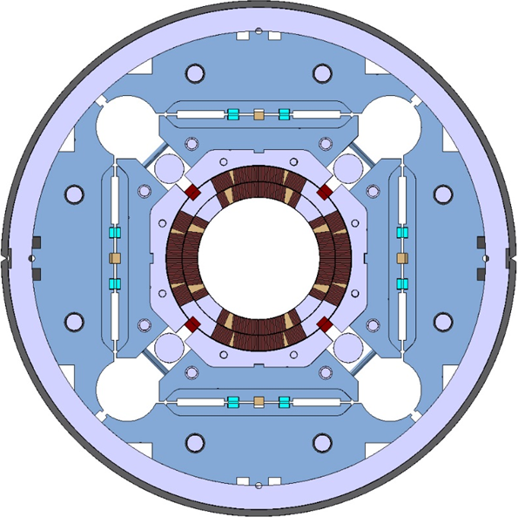
MQXFA Magnet Parameters
Parameter | Unit | MQXFA
Coil aperture | mm | 150
Magnetic length | m | 4.2
N. of layers |  | 2
N. of turns Inner-Outer layer |  | 22-28
Operation temperature | K | 1.9
Nominal gradient | T/m | 132.6
Nominal current | kA | 16.5
Peak field at nom. current | T | 11.4
Stored energy at nom. curr. | MJ/m | 1.2
Diff. inductance | mH/m | 8.2
Strand diameter | mm | 0.85
Strand number |  | 40
Cable width | mm | 18.15
Cable mid thickness | mm | 1.525
Keystone angle |  | 0.4

Slide 7
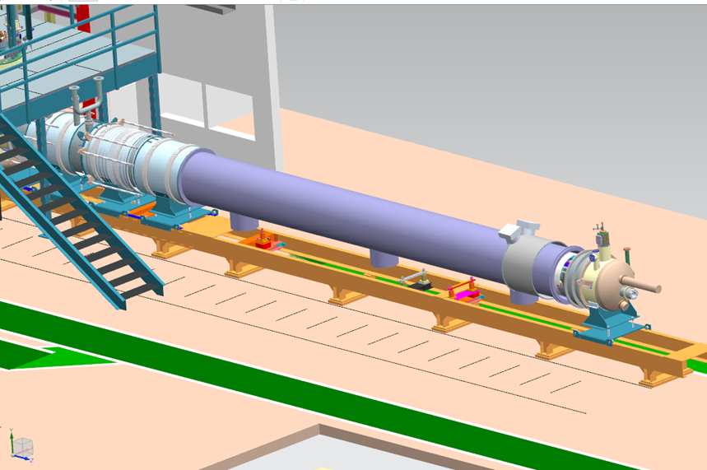
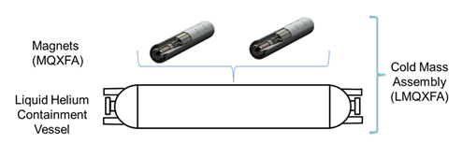
Q1/Q3 Cryo-assemblies Horizontal Test
Two MQXFA magnets in each cryo-assembly
Measurement probe will be inserted from the return end (RE)
  Signal cables will be inserted from the lead end
  The probe position will be measured by the Laser tracker from the RE side
RE

Slide 8
CHARGE to Committee
Review the rotating coil measurement system design, including the probe motion system and the cable spooler.
The reviewers are requested to answer the following questions:
Are the rotating coil measurement system requirements well defined and technically achievable?
Are the rotating coil system hardware and software components adequate for the proposed measurement system requirements?
Are the probe motion and cable spooler hardware adequate for the horizontal magnetic measurements at Stand 4?
Are there any significant risks associated with the rotating coil system development?

Slide 9
AGENDA
Rotating Coil System Review
June 8th, 2018 9:30 am IB1 Conference Room
09:30-09:45 Introduction and charge - Guram
09:45-09:50 RC system requirements & specs - Joe
09:50-10:20 RC measurement concept - Joe
10:20-10:30 DSA-based Integrator – Jerzy
10:30-10:55 RC Software System - Jerzy
10:55-11:20 Probe drive system/Cable spooler - Charlie
11:20-11:30 Risk assessment - Guram
11:30-12:00 Q&A
14:00-14:20 Close-out - George

