Slide 1
Stand 4 Rotating Coil System Review Rotating Coil Software System
Jerzy M. Nogiec
June 8, 2018

Slide 2
Functional Requirements
Control the automatic execution of rotating coil measurements by moving the probe between pre-defined longitudinal measurement positions and taking data at each position.
Provide readout of integrated signals from the probe coils, probe position, probe orientation (laser tracker), and magnet current at all measurement positions.
Implement manual control of the probe motion system and the laser tracker.
Perform field harmonics analysis
Visualize the status and progress of the measurement
Monitor and visualize magnet current and probe position trends
Visualize coil integrated signals (raw data) and calculated harmonics (results)
Archive the raw and reduced data.
Log significant events and errors
Report errors

Slide 3
Concept of HL-LHC Rotating Coil System Software
HL-LHC Rotating Coil System (RotCoil) is designed as an application based on the EMMA framework.
The system is build as a set of components running together with the standard EMMA components.
A dedicated EMMA script will be developed to automate measurements.
System will be developed incrementally, with each subsequent version providing more functionality.
Several existing components from other systems will be reused or reengineered in addition to all EMMA system components.

Slide 4
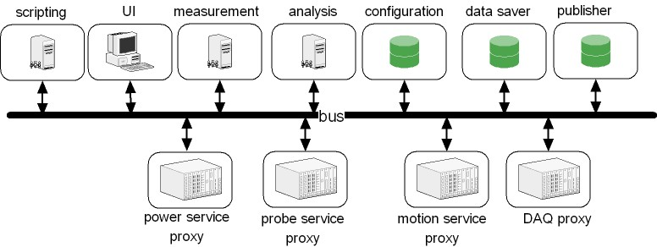
EMMA Framework
It is a component-based framework, where applications are constructed by assembling them from different, loosely coupled, standardized modules.
Its message-oriented architecture is implemented on a publish-subscribe software bus, which supports local and remote communication of components. When a message with a given topic is published on the bus, all the components that have subscribed for that topic (subscribers) are notified.
EMMA can form a distributed system, with local components connected to the bus by message queues and remote components via socket-based TCP/IP.

Slide 5
EMMA System Configuration
; Initial values of system properties
[system]
systemProperty_1 = value_1
systemProperty_2 = value_2
…
; Non-standard (system- specific) components
[components]
component_1 = local:pathToVI ; local component
component_2 = remote:pathToVI ; remote component
…
; Automatic initialization events: topic:event = parameter
[events]
control:init.cmd = NONE
control.component_1:connect.cmd = NONE
…
; Properties of components: property = value
[component_1]
property_1.1 = value_1
property_1.2 = value_2
…
[component_n]
property_n.1 = value_1
property_n.2 = value_2
…
EMMA-based systems are configurable using an INI configuration file.
INI files are simple text files with a basic structure composed of sections that contain properties with their values.
The EMMA INI has multiple sections:
system
components
events
component property sections

Slide 6
EMMA Component
EMMA components execute concurrently and are loosely coupled via message-based interface.
EMMA components are standardized with a defined set of common control commands and based on a common template including a state machine, bus connectivity, and an external decision table.
EMMA components have a dedicated debug view available at run-time.
Each component is characterized by its:
communication interface (input and output messages),
properties
behaviour (actions in response to received events or hardware events).

Slide 7
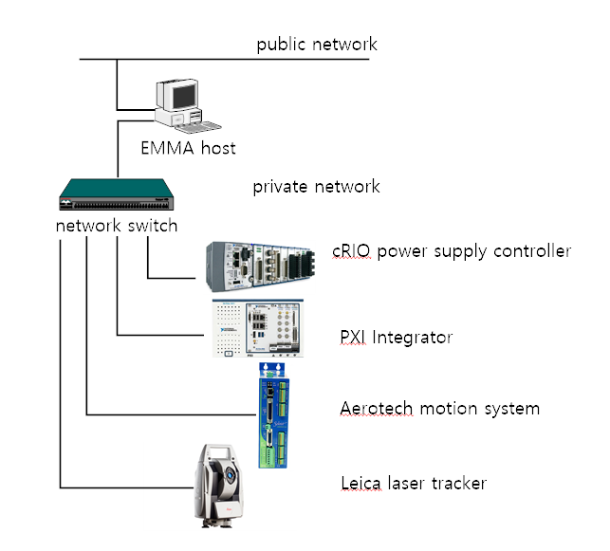
RotCoil Hardware Configuration
NI PXI crate implementing a digital integrator:
Controller with RTOS
NI 4462 DSA cards with 24-bit ADC’s
NI 7854R FPGA card
Aerotech motion controller
Leica AT401 laser tracker system
CompactRIO-based universal power supply controller

Slide 8
RotCoil Measurement Model
RUN
measurements at all positions
1..n
SEQUENCE
multiple rotations at the same position
1..n
STEP
data from a single rotation
The measurement will be conducted by moving a probe to a number of longitudinal positions and taking several rotations of data at each of these positions.

Slide 9
RotCoil Measurement Algorithm
try {
; initialization phase ----------------
start(RUN) ;announce start of new RUN
readParameters() ;read parameters from the parameter file
initializeComponents() ;initialize all components and wait until they are all ready
move (Motion, HOME, absolute) ;move probe to HOME position
read(LTS, referenceTargets) ;shoot reference (stationary) targets
ramp(Current, current, rampRate) ;set current
; measurement phase -------------
for (segment in positionSegments) { ;iterate over linear positions
start(POSITION) ) ;announce start of new POSITION
move(Motion, segment.start, absolute) ;advance probe to the next position
position = segment.start
while (position <= segment.end) { ;iterate over linear positions
move(Motion, segment.step, relative) ;advance probe to the next position
position+=segment.step
read(motion) :get position
getStatus(Motion) ;get state from motion controller
read(Current) ;get curreent from the power control component
getStatus(Current) ;get status from the power control component
read(LTS, measurementTargets) ;shoot measurement targets (probe location)
read(Integrator, rotations) ;read data for a given number of rotations
}
end(POSITION) ) ;announce end of POSITION
}
end(RUN) ) ;announce end of RUN
: termination phase -------------------
ramp(Current, 0, rampRate) ;set current to 0 A
move (Motion, HOME, absolute) ;move probe to HOME position
} catch (Exception) {
report(error)
} finally {
abort(ALL)
}
Measurements are fully automated and, after setup, will not require user interaction.
The automation will be provided by a Python script controlling the motion system and readout components.
The script will contain only the measurement algorithm (no data processing).
The measurement parameters will be read from a parameter file.

Slide 10
RotCoil Measurement Parameters
magic.code = RotCoil_1.0.0
simulation = FALSE
magnet = QUADRUPOLE
measurement = harmonics
current.control = TRUE
Current .value= 1000 ; in [A]
Current.ramp = 10 ; in [A/s]
Move.speed = 0.1 ; in [m/s]
Move.positions = [1, 2, 0.1] [1.5, 9, 0.5] [9.1, 10, 0.1] ;segments [start, end, step]
Integrator.min = -1, -1, -1, -1, -1, -1 -1, -1
Integrator.max = 1, 1, 1, 1, 1, 1, 1, 1
Integrator.encoder.decimation = 1
Integrator.rotations = 10, 10, 10 ; rotations to acquire data at each position
; in each segment
ProbeId = HL-LHC_xyz
The measurement parameters will contain parameters intended to be manipulated by measurers.
Other settings, such as device specific settings, are provided as properties of appropriate components.

Slide 11
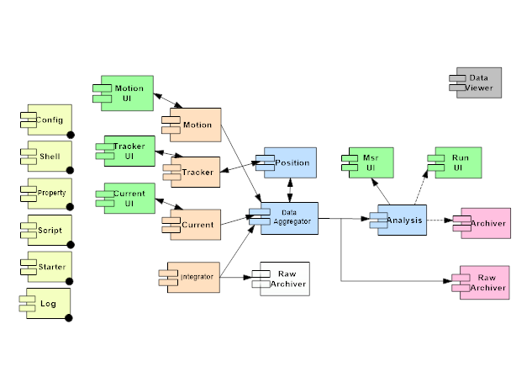
RotCoil Components
Some existing components will be reused or reengineered for RotCoil.
reuse
reengineering

Slide 12
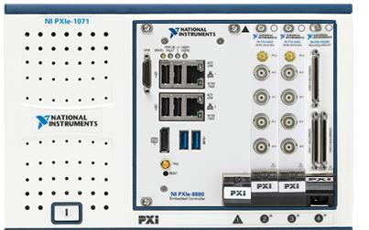
RotCoil Integrator Component
Command | Topic | Action | Reply | Topic
init.cmd | control | Initialize component by setting its properties to their initial values (as specified in the configuration file) and perform any initialization in preparation for performing its core functionality. Connect to the integrator | init.ack | control
read.cmd | control | Acquire and send data for a given number of rotations | read.ack integrator.dat | control data
status.cmd | control | Get status of integrator | IntegratorStatus.dat | control
exit.cmd | control | Clean up and terminate the component Disconnect from the integrator | exit.ack | control
The Integrator component encapsulates the functionality of the PXI-based digital integrator. It will acquire multi-channel data for a given number of probe revolutions.
Communication with the PXI controller will be implemented over Ethernet.

Slide 13
RotCoil Motion Component
Command | Topic | Action | Reply | Topic
init.cmd | control | Initialize component by setting its properties to their initial values (as specified in the configuration file) and perform any initialization in preparation for performing its core functionality. Connect to the controller. | init.ack | control
read.cmd | control | Get current position | read.ack motion.dat | control data
status.cmd | control | Get status | motionStatus.dat | control
move.cmd | control | Move to a new linear position or HOME | move.ack | control
rotate.cmd | control | Start/stop rotation of coils | rotate.ack | control
abort.cmd | control | Abort motion | abort.ack | control
exit.cmd | control | Clean up and terminate the component Disconnect from the controller | exit.ack | control
The Motion component encapsulates the functionality of the probe motion system. It will be used to control the motion system and to monitor its status and probe position. It can also start and stop probe rotation.
Communication with the Aerotech Soloist standalone single axis motor controller will be implemented over Ethernet.

Slide 14
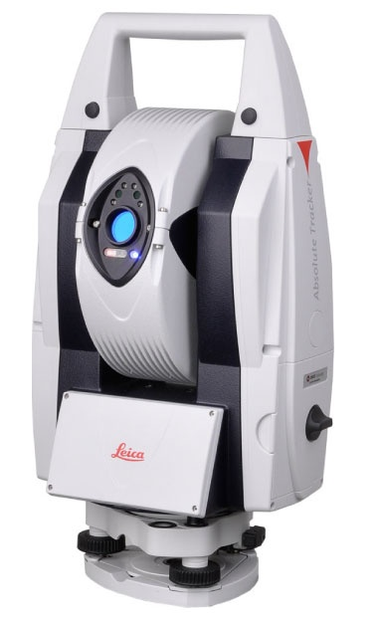
RotCoil Laser Tracker Component
Command | Topic | Action | Reply | Topic
init.cmd | control | Initialize component by setting its properties to their initial values (as specified in the configuration file) and perform any initialization in preparation for performing its core functionality. Connect to the laser tracker | init.ack | control
measure.cmd | control | Measure the position of the reflector (target) | measure.[n]ack tracker.dat | control data
find.cmd | control | Search for a reflector and lock on it | find.[n]ack | control
status.cmd | control | Get laser tracker status | trackerStatus.dat | control
exit.cmd | control | Clean up and terminate the component Disconnect from the laser tracker | exit.ack | control
The Tracker component implements access to the Leica Absolute Laser Tracker AT401 connected via Ethernet. The component will initialize the laser tracker and read the position of multiple targets. There will be two groups of targets:
Reference group, including stationary targets mounted on the magnet or test stand
Measurement group, including two moving targets mounted on the probe

Slide 15
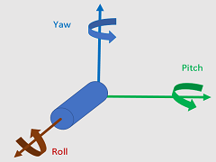
RotCoil Position Component
Script
data
Tracker
Position
Motion
Collaboration diagram for the Position component
The Position component is responsible for obtaining probe position and orientation prior to data acquisition. It uses the location information from the laser tracker.
The Position component transforms probe reflector coordinates obtained from the laser tracker to: distance from HOME, roll, pitch and yaw.
The component also calculates motion system positioning errors.

Slide 16
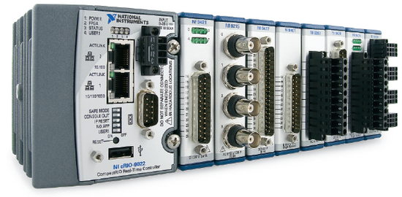
RotCoil Current Component
Command | Topic | Action | Reply | Topic
init.cmd | control | Initialize component by setting its properties to their initial values (as specified in the configuration file) and perform any initialization in preparation for performing its core functionality. Connect to the controller. | init.ack | control
read.cmd | control | Get current | read.ack current.dat | control data
status.cmd | control | Get status | currentStatus.dat | control
ramp.cmd | control | Ramp current to a given value with a given ramp rate | ramp.ack | control
abort.cmd | control | Abort ramp command | abort.ack | control
exit.cmd | control | Clean up and terminate the component Disconnect from the controller | exit.ack | control
The component will control and monitor magnet current.
The component will interact with a universal power supply controller that has been under development by the Instrumentation and Controls Group.
The universal power supply controller is expected to be developed on the CompactRIO platform and to work as a standalone Ethernet device.
The current component will use the universal power supply controller’s API to implement its functionality.

Slide 17
FMS Components: Data Component
Tracker
Position
Motion
Integrator
data
Data
Current
The Data component is a simple data aggregator, which combines all data acquired during each step of the measurement execution.
It is a purely data driven component and, therefore, it responds only to the standard control events.

Slide 18
RotCoil Analysis Component
The Analysis component will perform calculations on the acquired data, including:
Drift corrections
Harmonic coefficients and their averages from multiple rotations
Centering corrections
Corrections for probe orientation (pitch, yaw, roll)
Harmonic coefficients integrated over the length of the magnet
The analysis code has been written in MATLAB language, which can be used to generate C code and create a DLL containing the analysis functions to be invoked from LabVIEW.

Slide 19
RotCoil Archiver Component
The Archiver component will persist (save) the various data records (clusters) sent to it, including the following data:
Header data containing main system and configuration data
Laser tracker positioning data for the reference and measurement targets
Motion system positions
Integrator multi-channel data
Calculated results (rotation harmonics, integrated harmonics)
User generated comments
Measurement quality assessment data
The archiver will save data in the TDM Streaming format, based on the Technical Data Management (TDM) data model. This is a binary-based file format, capable of streaming data to disk at high speeds. In addition, TDMS files also contain a header that stores descriptive information, or attributes, together with the data, so the data is self-describing, like XML. The TDMS files are searchable and can be opened in many common applications, such as Microsoft Excel and OpenOffice.
If required, the TDMS files may be translated into other formats.

Slide 20
RotCoil User Interface Component
The User Interface will be based on the Shell component and will offer several views selectable via tabs, including:
Configuration View, which allows for configuring the system,
Measurement View, which shows data acquired for a single position.
Laser Tracker View, which shows the orientation and position of the probe.
Motion View, which displays the probe position and motion system status and allows for manual control of the probe motion system.
Current Control View, which will allow for controlling current in the magnet and showing its historical trend.
Analysis View, which presents the results of on-line data processing.

Slide 21
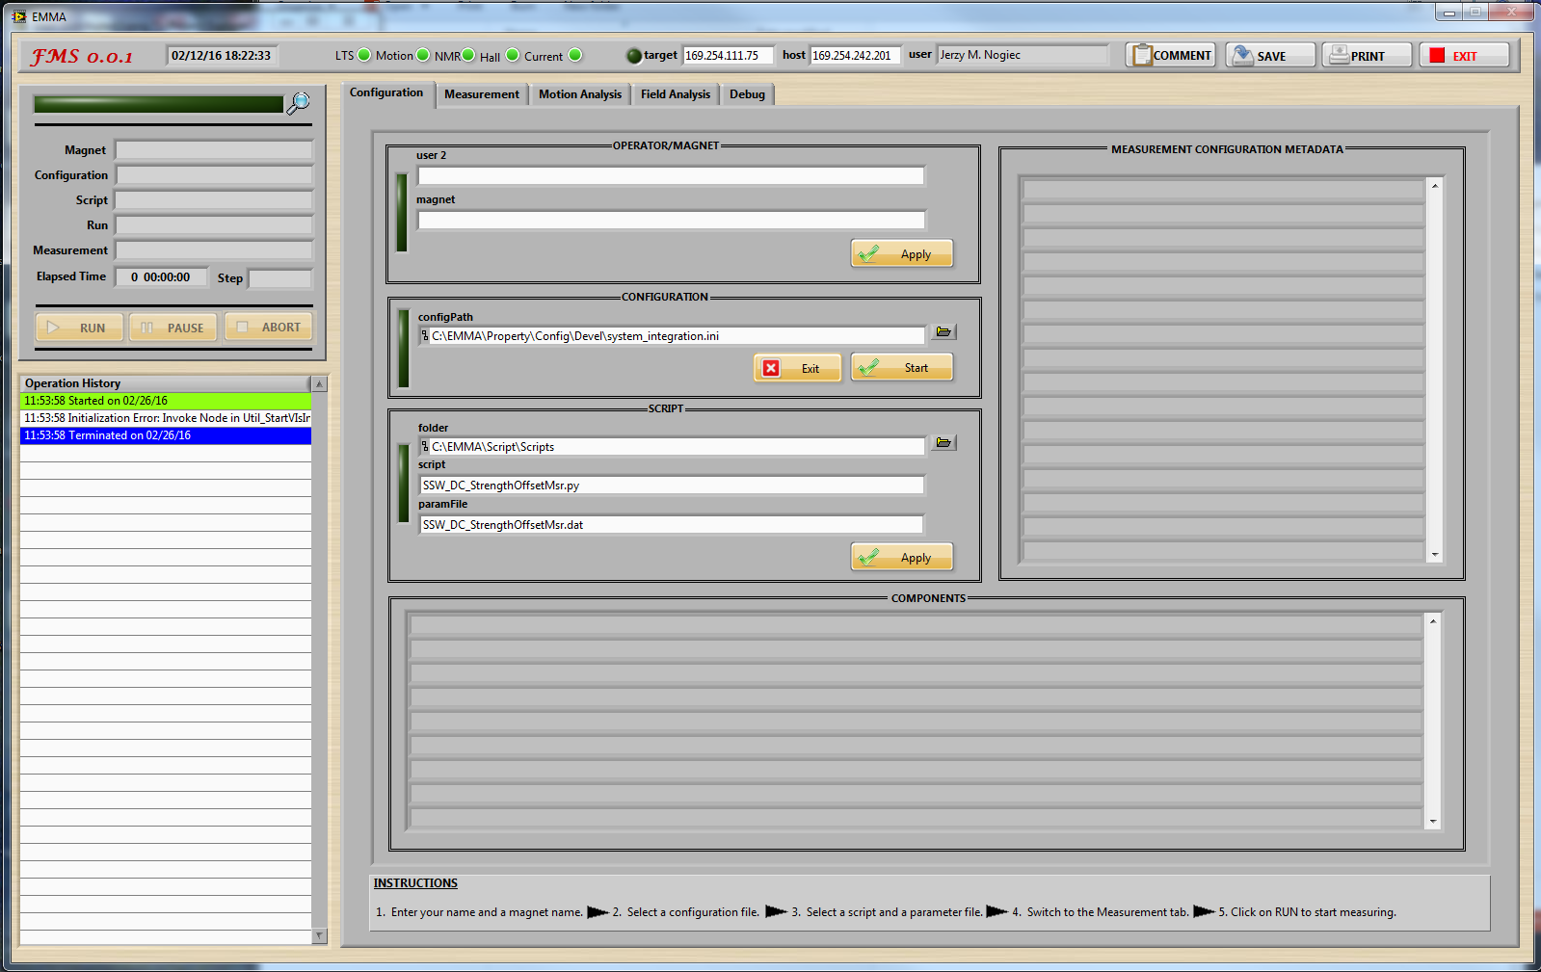
RotCoil UI: Configuration View

Slide 22
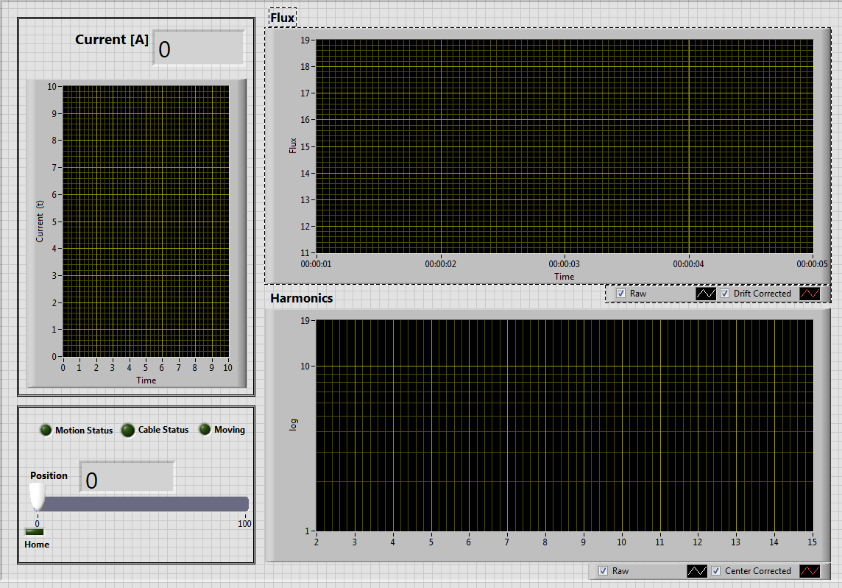
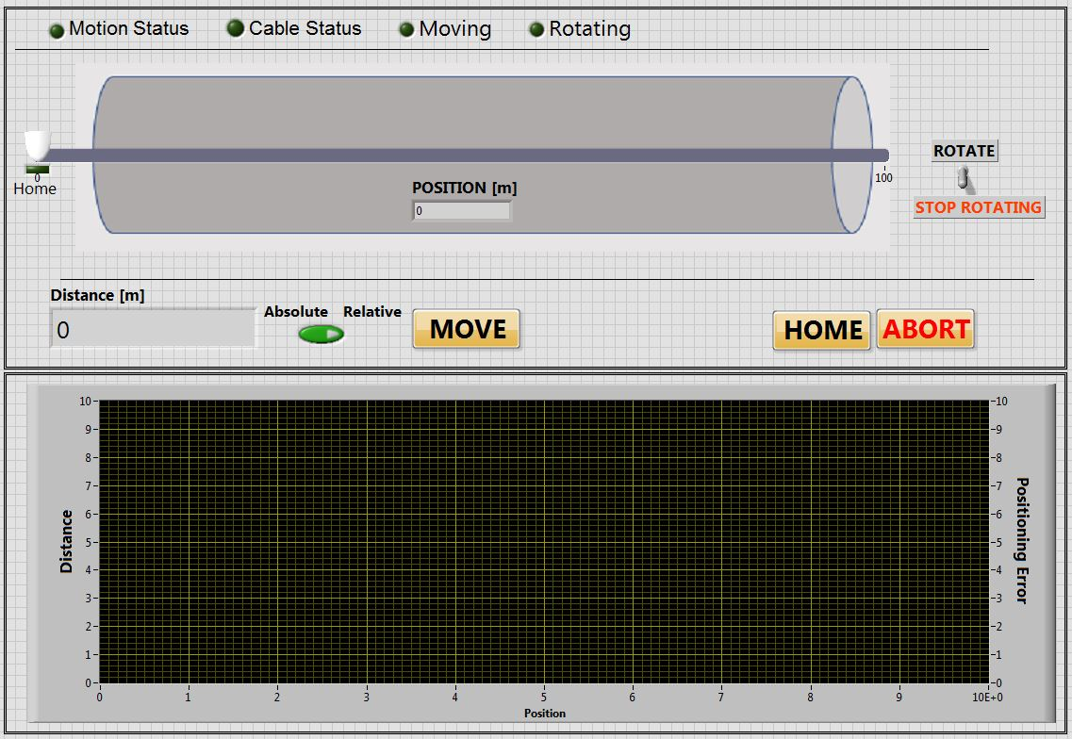
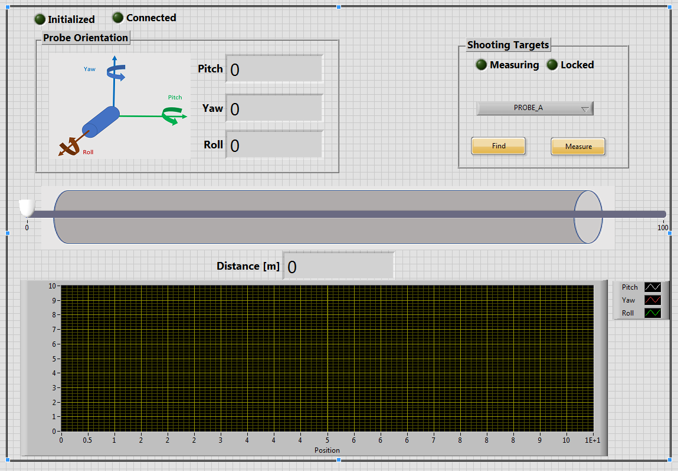
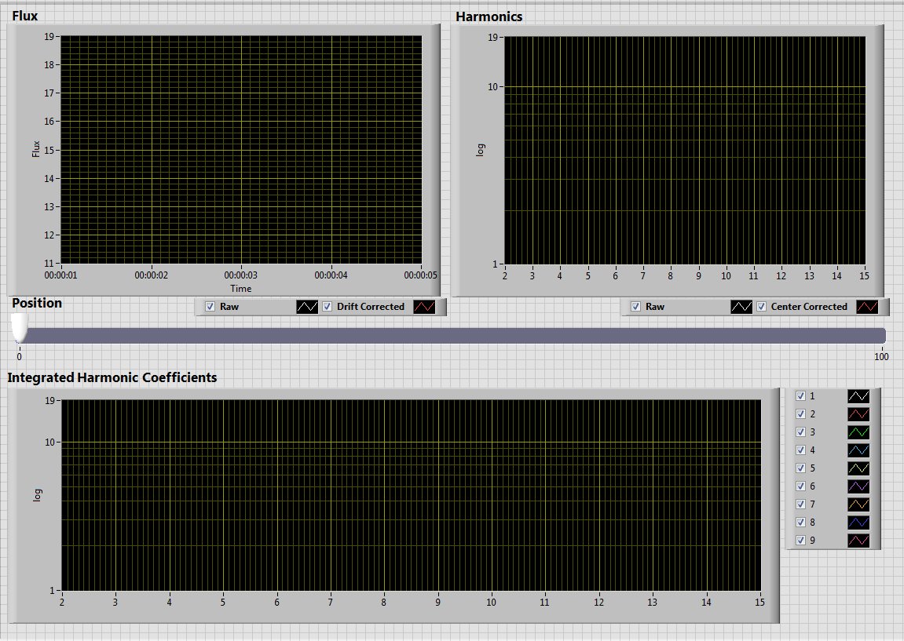
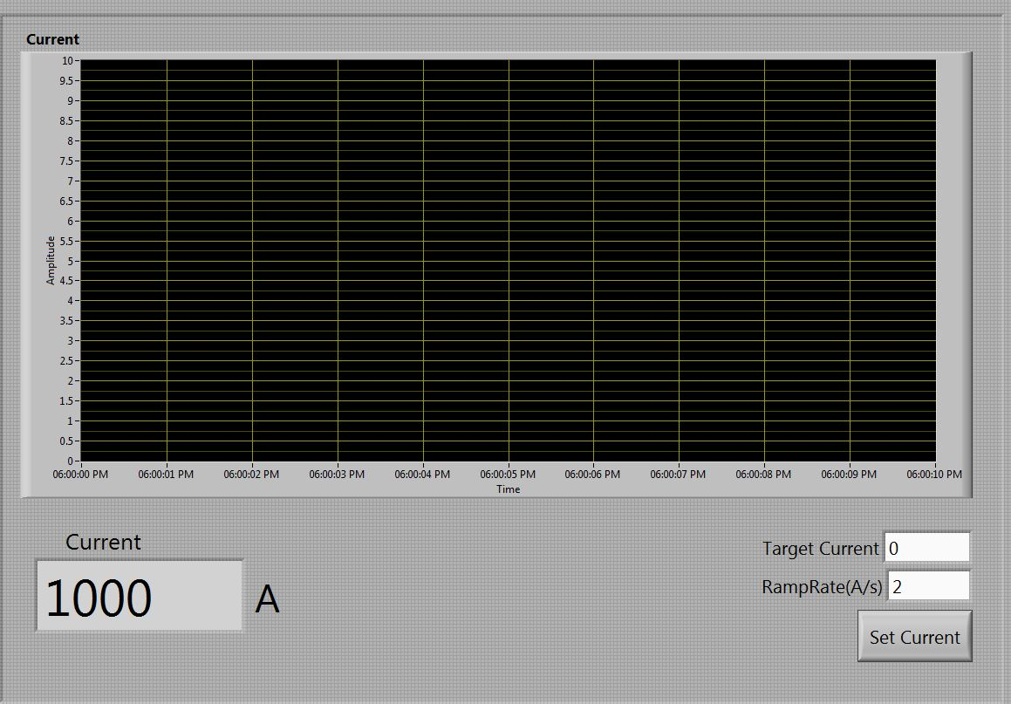
RotCoil UI: Prototype Measurement Views

Slide 23
Software Quality Assurance
The software development will be iterative and incremental.
This project has been assessed as requiring a moderate quality level, which will require specific artefacts documenting the requirements, design, and testing with commensurate with the expected quality.
Techniques improving software quality:
Coding guidelines
Use of revision control system
A template for developing components
Component mini-docs
Reuse of components
Code inspections
Pair programming for code that is especially difficult to develop or test.
Testing:
Component testing
Integration testing
Performance and endurance testing
User acceptance testing

Slide 24
Summary
The rotating coil system is based on the EMMA framework, which is characterized by loosely coupled modules allowing for concurrent, independent development that is ideal for multi-person projects, such as the RotCoil project, and incremental development.
The EMMA-based measurement systems are configurable from components which are integrated via a message-based middleware implemented as a software bus.
The EMMA-based rotating coil system will use a set of specialized components implementing magnetic field measurements based on a rotating coil technique, motion control and probe positioning with the laser tracker. The system will also provide on-line analysis, visualization of raw and calculated data, and data archiving.
Measurements will be automated via a parameterized script, with parameters specifying current, measurement positions and number of rotations per position.
The development will be done incrementally, with each version of the system providing extended functionality.

Slide 25
Backup Slides

Slide 26
EMMA Component: Control Interface
Standard component control events (commands)
Command | Action | Reply
init.cmd | Initialize component by setting its properties to their initial values (as specified in the configuration file) and perform any initialization in preparation for performing its core functionality. | init.ack
pause.cmd | Pause execution of the component | pause.ack
run.cmd | Resume previously paused execution | run.ack
abort.cmd | Abort current activity or function | abort.ack
exit.cmd | Clean up and terminate the component | exit.ack
A component accepts a set of predefined control event messages and responds to them by performing certain actions and/or changing its state. Typically, after completing the requested function, the component sends a reply, an acknowledgment event.
Components are also data driven. Upon receipt of a data event, the component processes its contents and, optionally, sends one or more messages. User interface components display the contents of the received data events, and data saving components archive or persist the received data.

Slide 27
EMMA Component: Properties
Standard EMMA property events
Command | Parameters | Action | Reply | Parameters
set.cmd | [property1= value]+ | Set listed properties to given values | set.ack | None
get.cmd | [property]+ | Return values of listed properties | get.dat | [property1= value]+
state.cmd | None | Return current state of the component | state.dat | state
[contents]+ denotes an array of one or more elements of specified contents.
Each component has a number of properties that can be both modified and read and which alter or influence the execution of the component’s methods by specifying parameters for data acquisition, motion, current control, etc.

Slide 28
EMMA Scripting
Python
script
Script component
software bus
The control script communicates with components via the software bus, directing a sequence of execution that follows a measurement algorithm.
The script coordinates components by sending control events, and does not process any data (orchestration)
The script can also modify component properties.
An EMMA script is not intended to contain measurement parameters, which should be read from a parameter file.

Slide 29
RotCoil UI: Measurement View

Slide 30
RotCoil UI: Motion View

Slide 31
RotCoil UI: Laser Tracker View

Slide 32
RotCoil UI: Current Control View

Slide 33
RotCoil UI: Run View

