Slide 1
Test Stand 4 Upgrade
Motion System and Cable Spooler
Charles Orozco
Test Stand 4 Upgrade Design Review
June 8, 2018

Slide 2
Requirements
Motion System
  Move the probe 40’ in both directions
  No interference with the laser tracker
  Adequate sensors for homing and safety
  External input for interlock
  Axial motion on the order of 5 mm/s
Cable Spooler
  Ability to extend and retract at least 40’ of drive and signal cable
  Maintain tension such that the cable does not bunch
  Automatic actuation as the probe is driven along the warm bore
  Interlock with the motion system for E-stop should the spooler fail
Both systems must have comparable and variable speeds

Slide 3
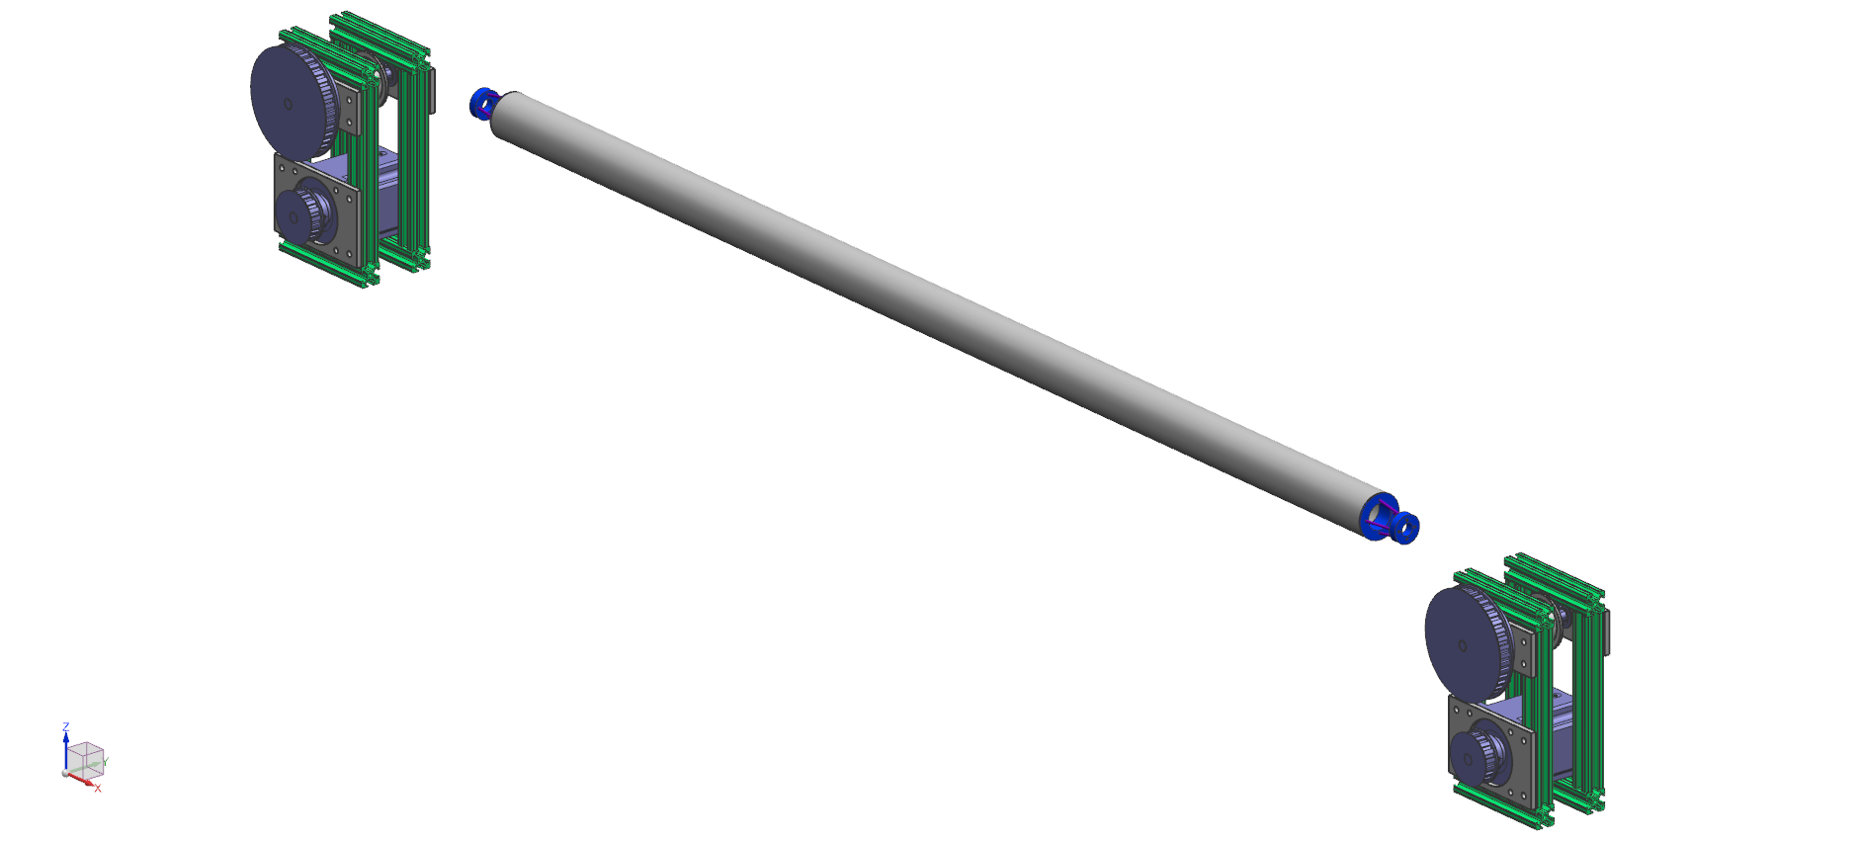
Motion System

Slide 4
Motion System
Non-metallic cable affixed to each end of the probe
One end is actuated with a stepper motor
  Aerotech SM280-VT2
The other end has constant tension applied via a DC motor
Switches at each end prevent the probe from leaving the warm bore and provide for a home position

Slide 5
Installation Area

Slide 6
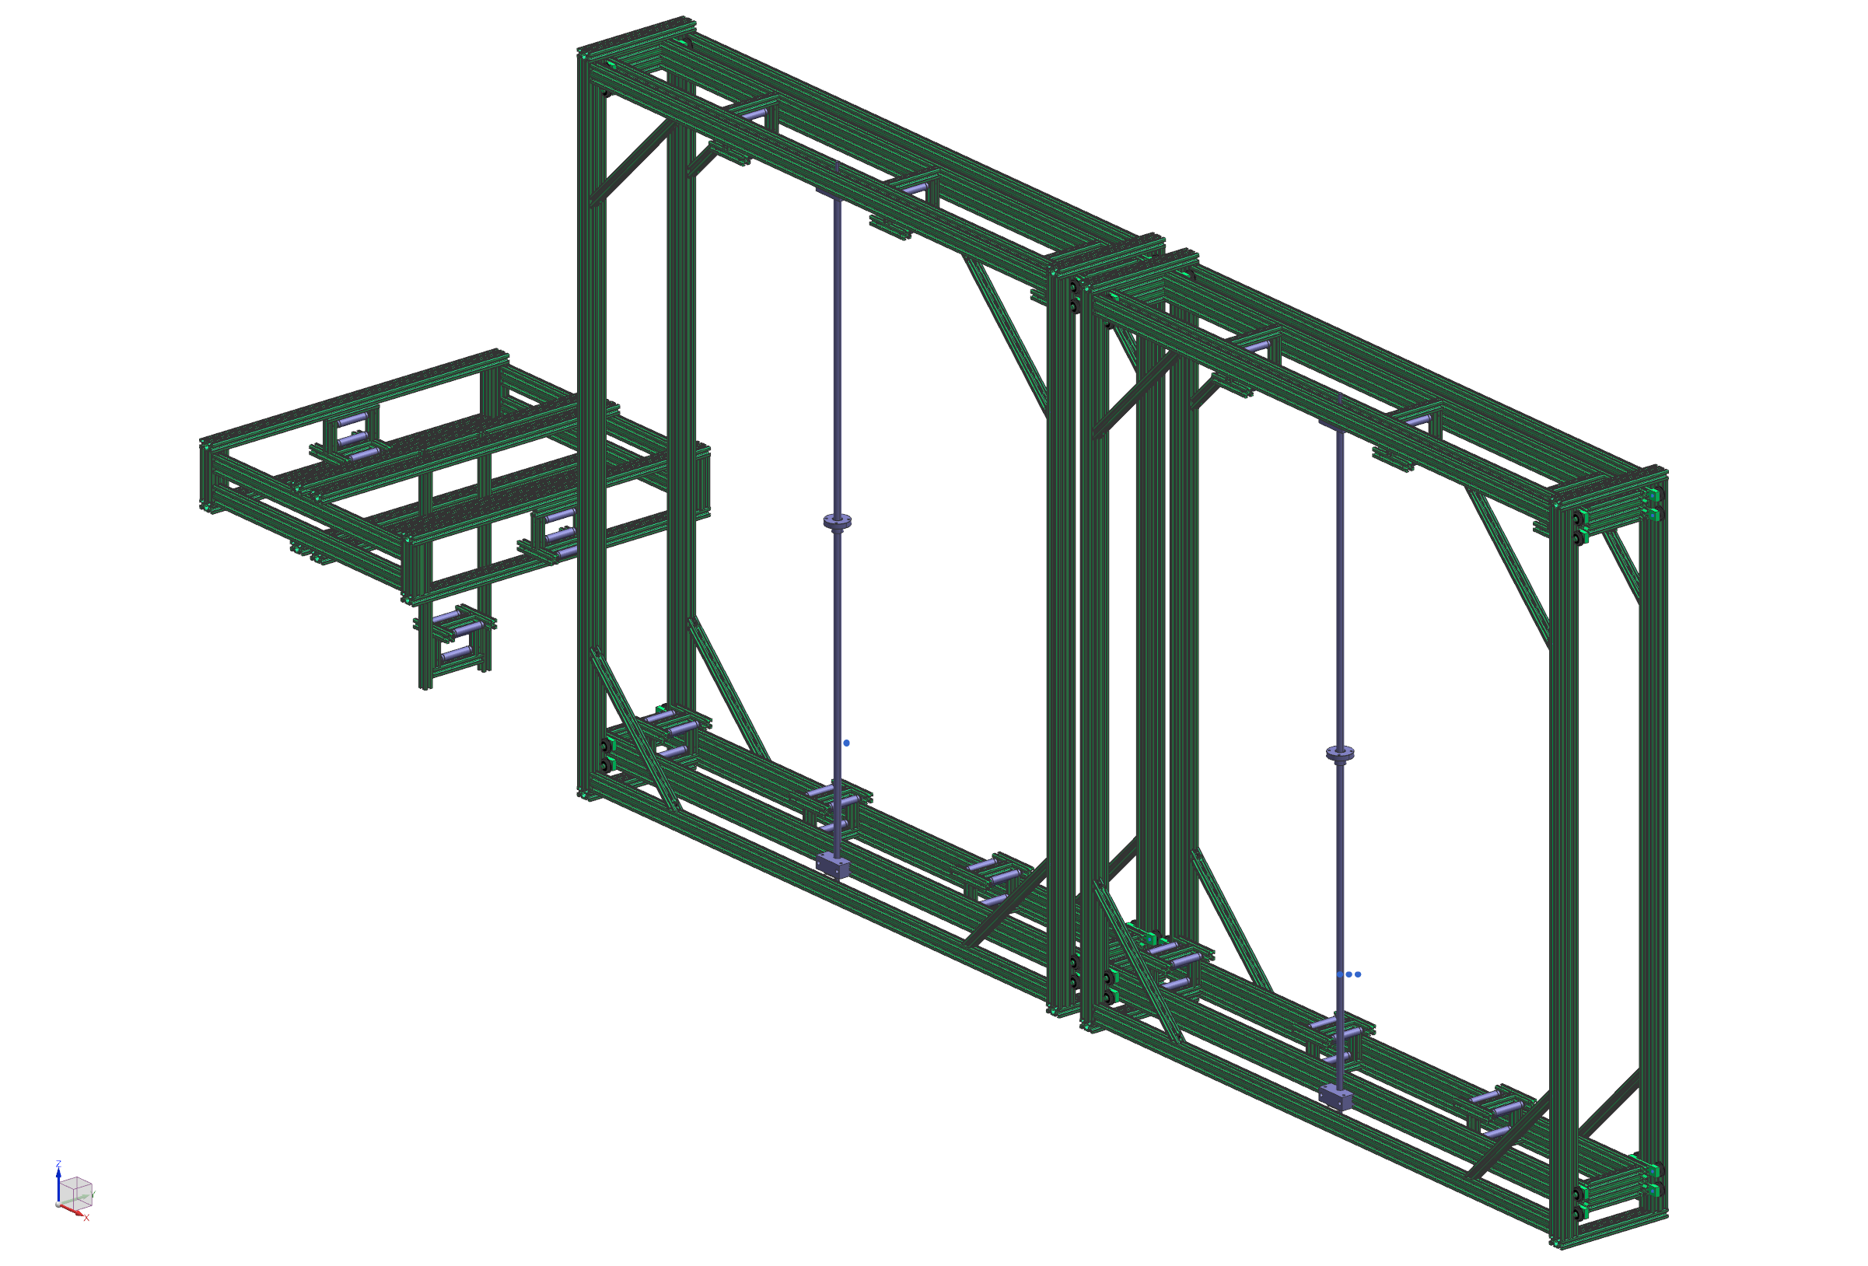
Cable Spooler

Slide 7
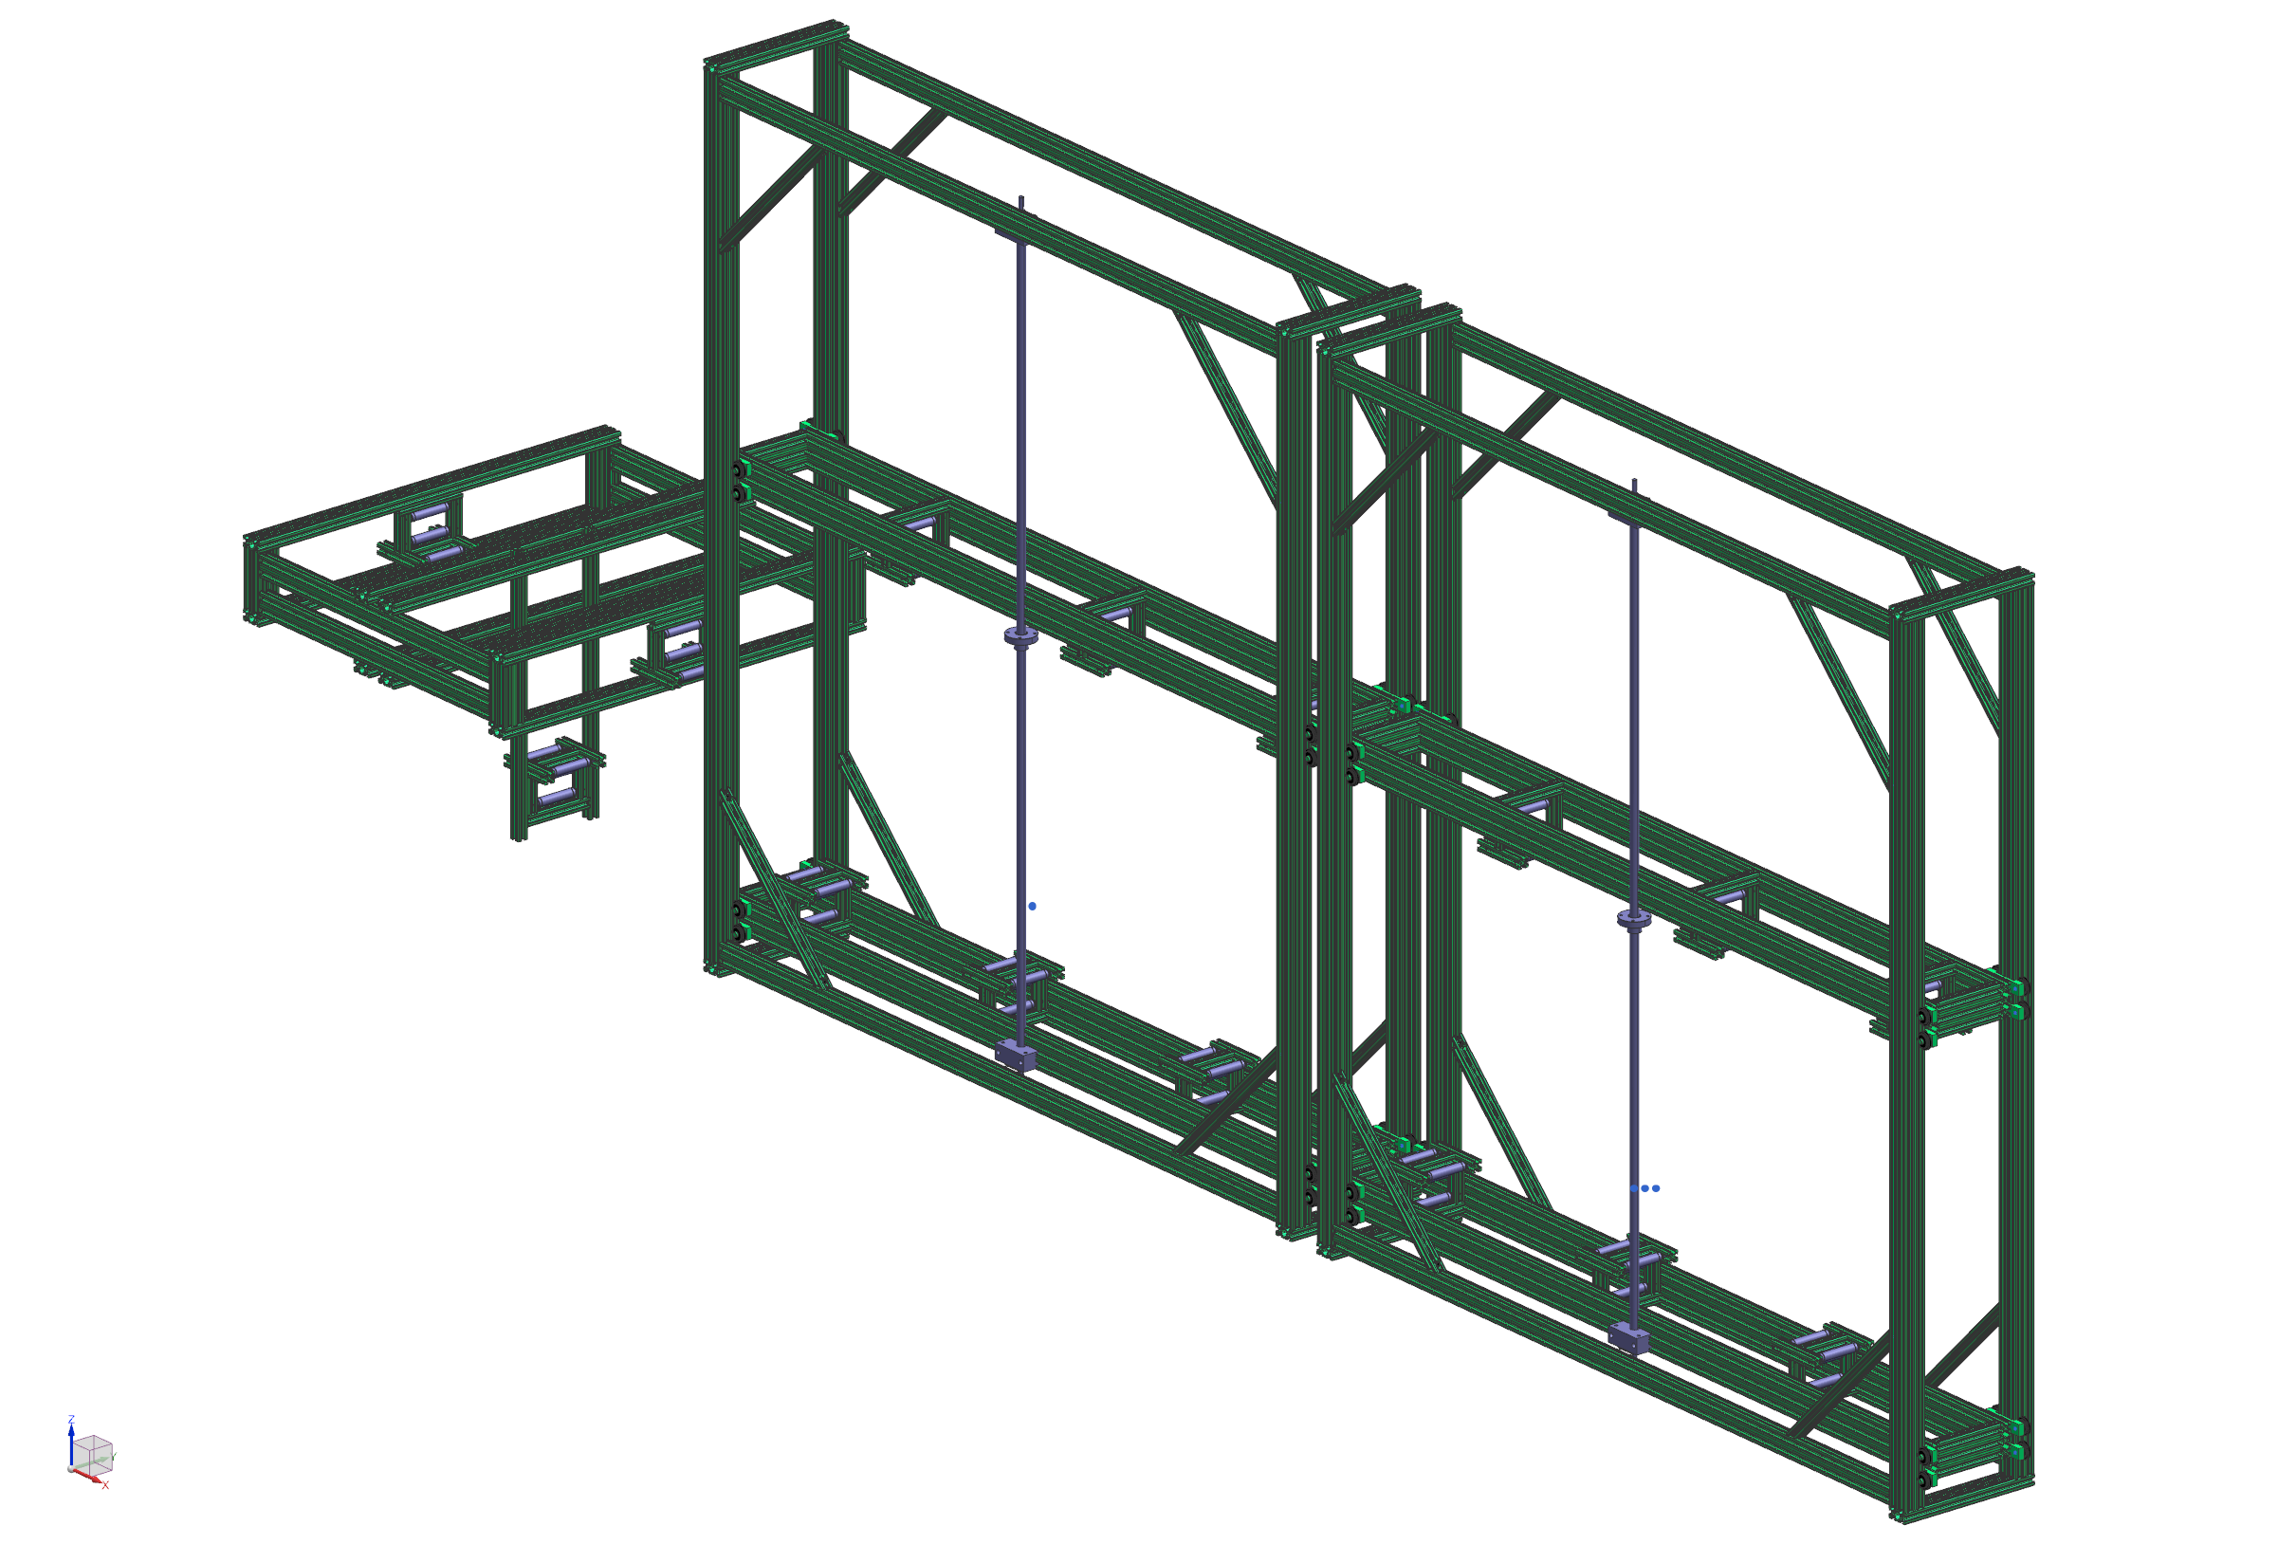
Cable Spooler

Slide 8
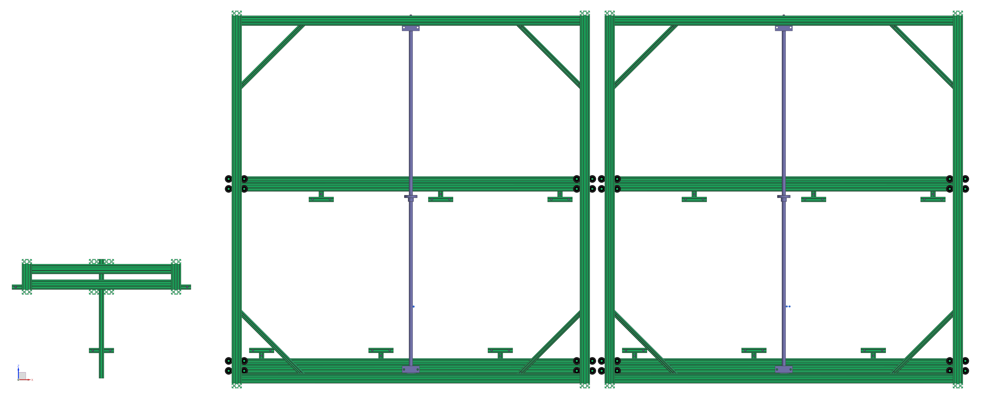
Cable Spooler

Slide 9
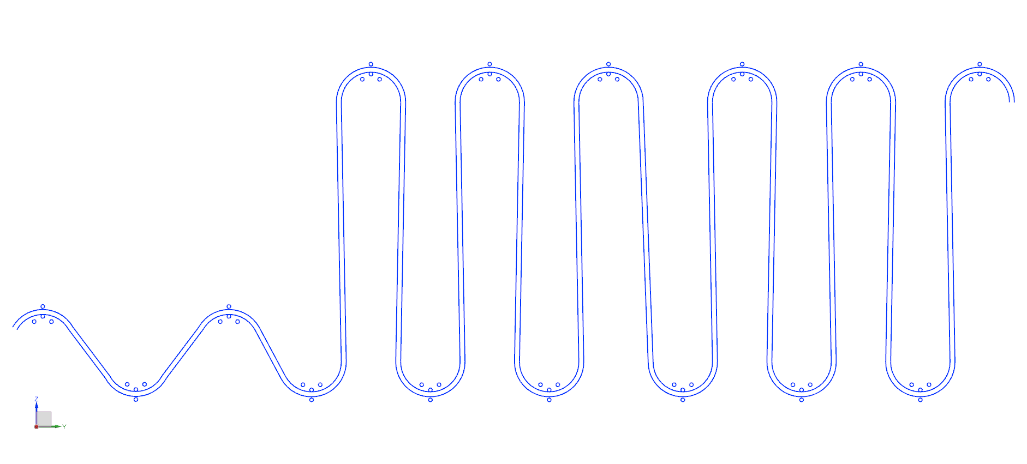
Cable Routing
From the open configuration to the closed configuration, at least 50 feet of cable is released. This meets the requirement of at least 40 feet of cable runout.

Slide 10
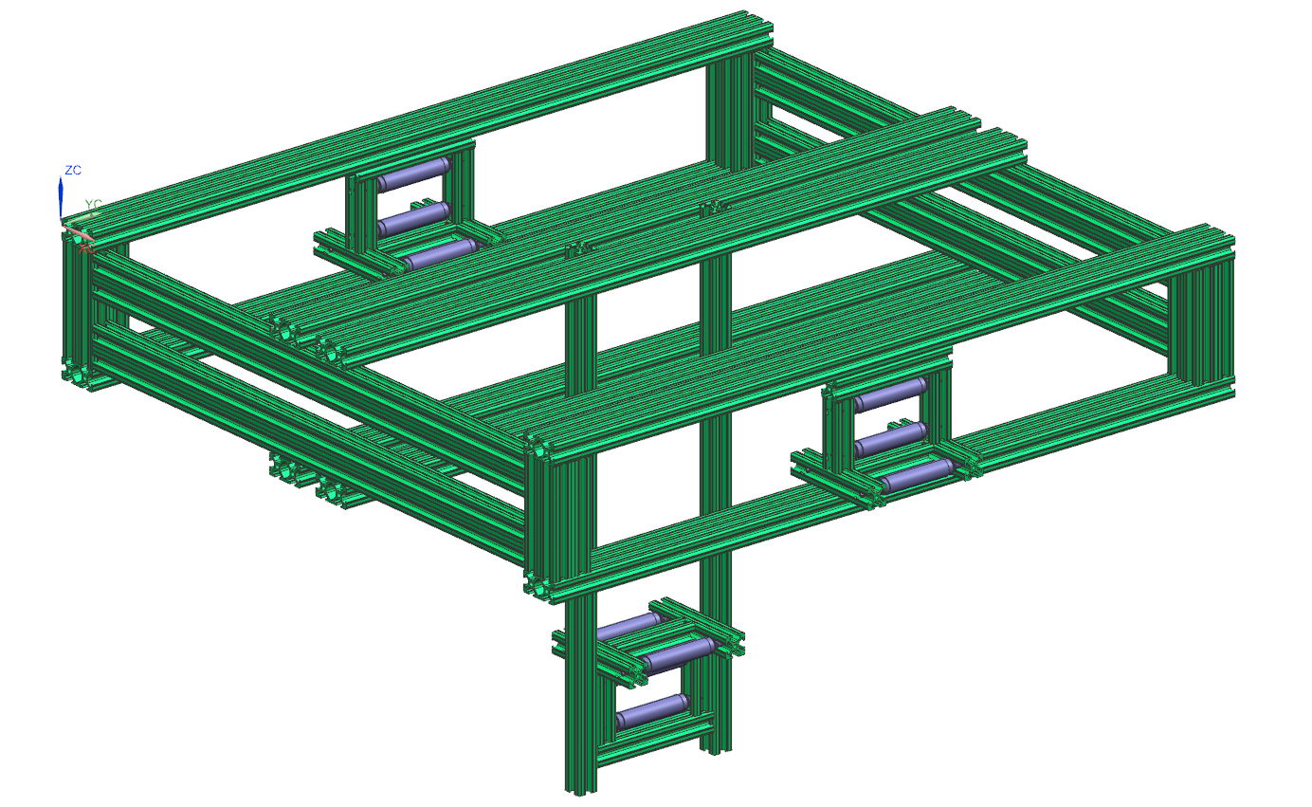
Cable Spooler – Tensioner

Slide 11
Cable Spooler – Tensioner
An optical sensor will provide feedback on the location of the moving cable capture device
The optical sensor will control when the spooler opens and closes
Roughly two feet of travel, though the cable will be kept in a narrower band during normal operation

Slide 12
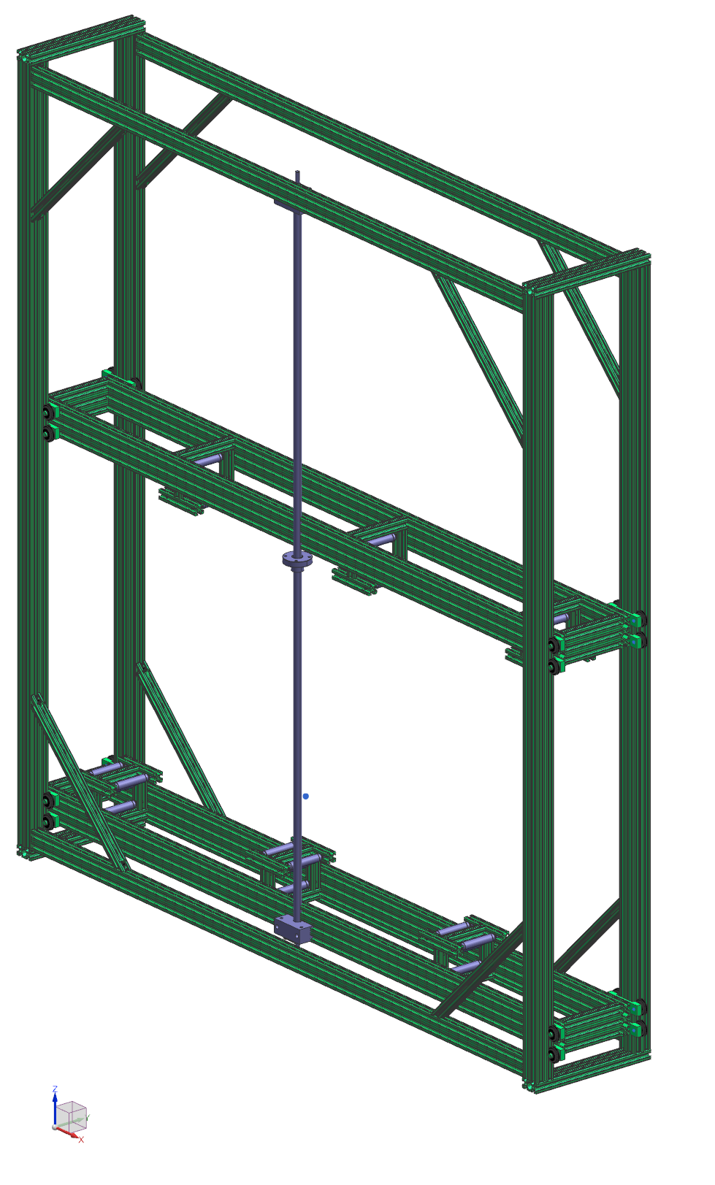
Cable Spooler – Section

Slide 13
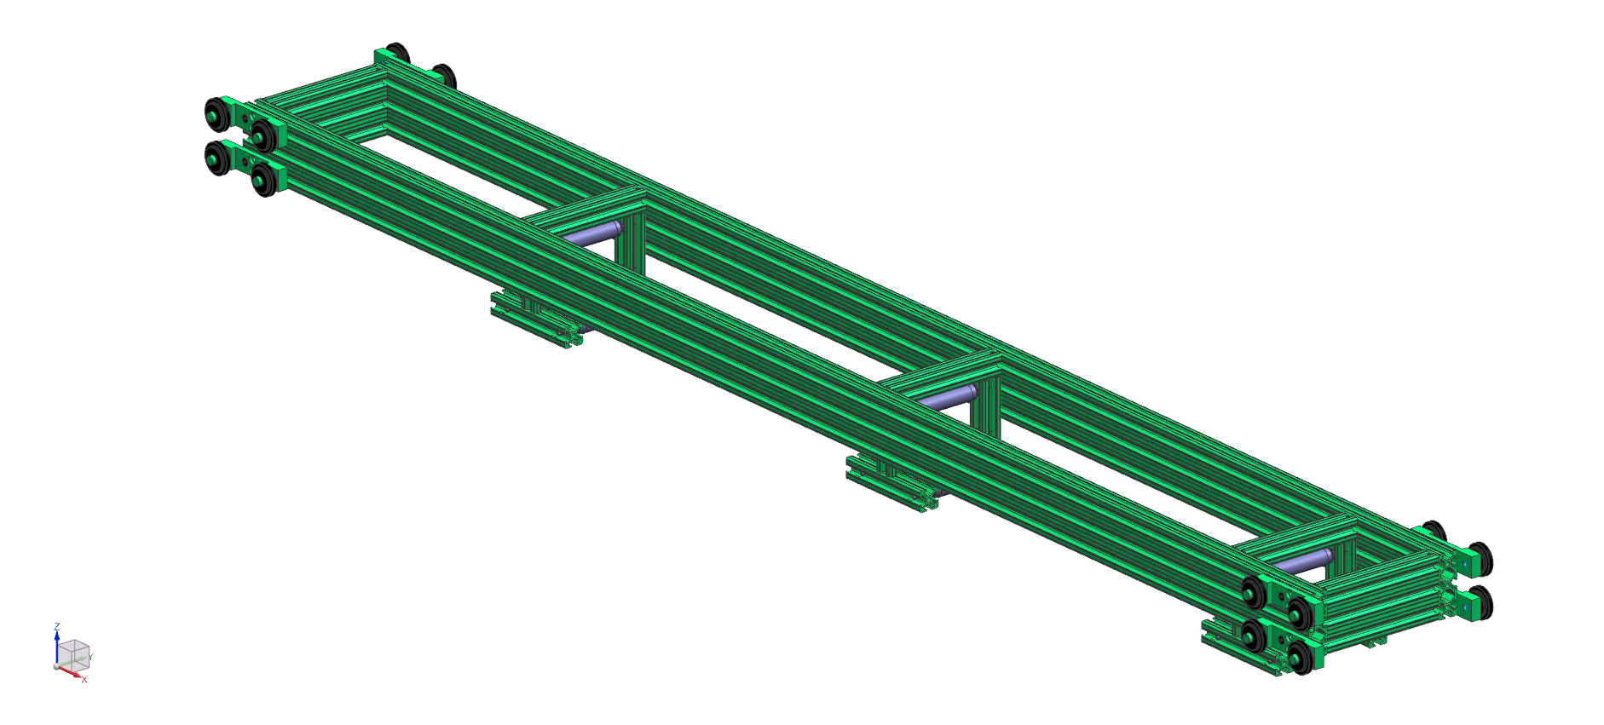
Cable Spooler – Stage

Slide 14
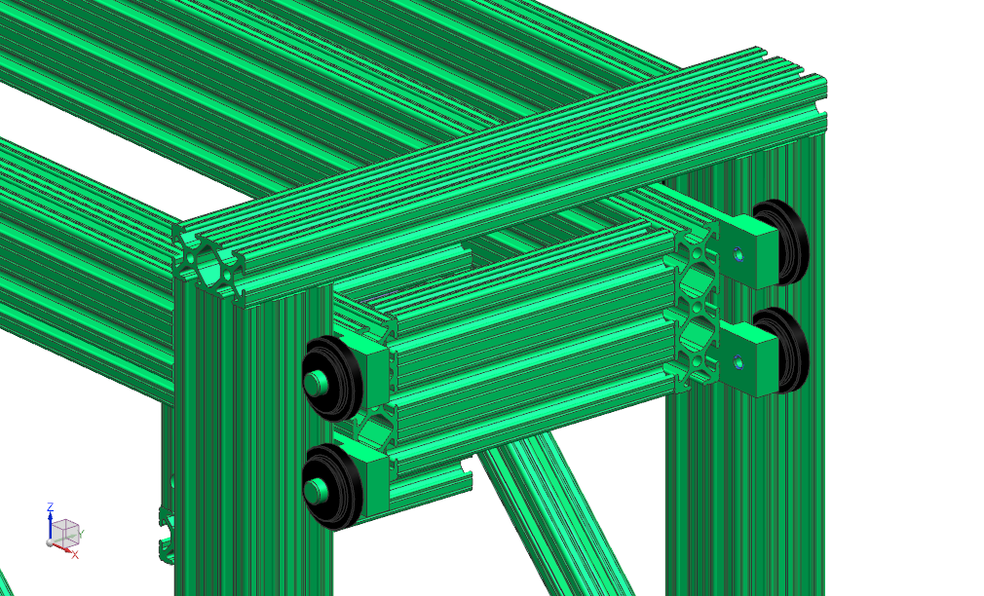
Cable Spooler – Riding the Rails

Slide 15
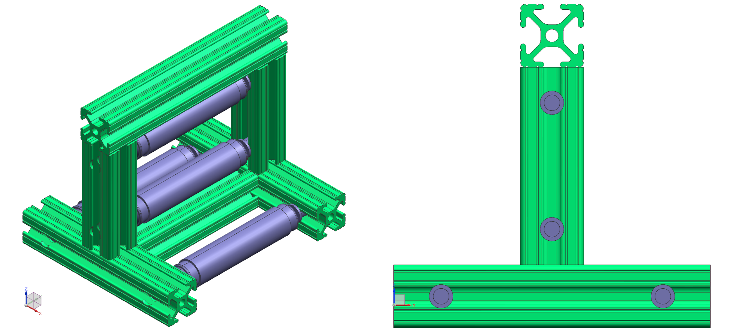
Cable Spooler – Cable Capture Device

Slide 16
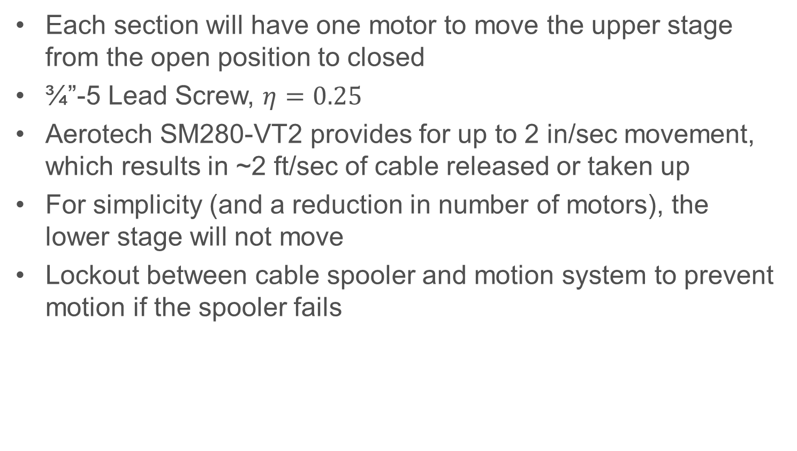
Cable Spooler – Actuation
Each section will have one motor to move the upper stage from the open position to closed
¾”-5 Lead Screw, $η=0.25$
Aerotech SM280-VT2 provides for up to 2 in/sec movement, which results in ~2 ft/sec of cable released or taken up
For simplicity (and a reduction in number of motors), the lower stage will not move
Lockout between cable spooler and motion system to prevent motion if the spooler fails

Slide 17
Summary
Motion System
  Meets the design requirement of moving the probe at least on the order of 5 mm/s while avoiding interfering with other critical components
Cable Spooler
  Meets the design requirement of managing the probe’s drive and data cables using a safe and automated process

