Slide 1
Window temperature rise, 325 MHz coupler
S. Kazakov
05/31/2018

Slide 2
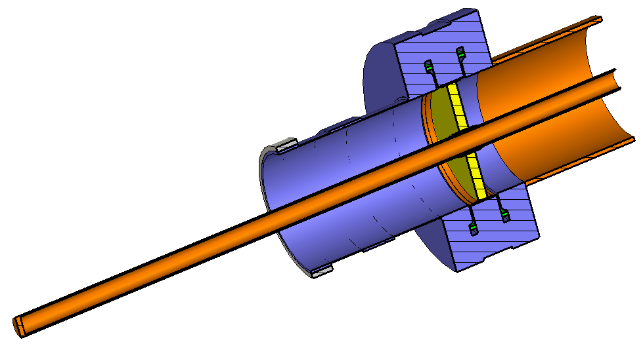
Boundary conditions and losses in ceramics.
Loss tangent of ceramics is 5E-4. Total loss in ceramics is ~ 2W (for 10 kW, TW)
Boundary conditions around are adiabatic: dQ = 0
9.4 kW, TW
90 K
Emis. = 0.1
5W/(K*m2)
35 W/(K*m2)
Emis = 0.8

Slide 3
Simulation and measurements
Temperature at window flange
 | P = 0 | P = | dT
Simulation | 276.3 | 283.7/ 4.7 kW, TW | 7.4
Measured | 276 | 283.3 / 2.2 kW, full Rf. | 7.3

Slide 4
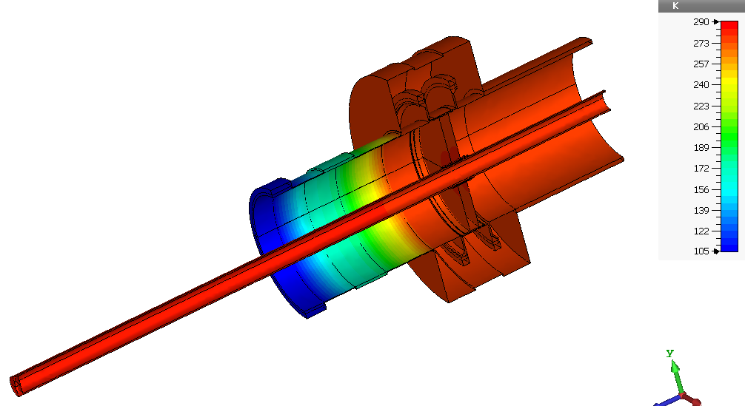
P = 0 kW

Slide 5
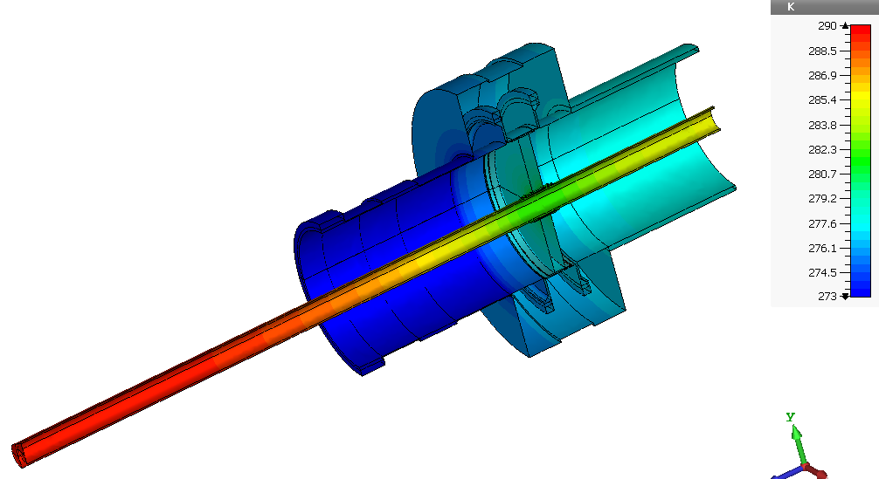
P = 0 kW

Slide 6
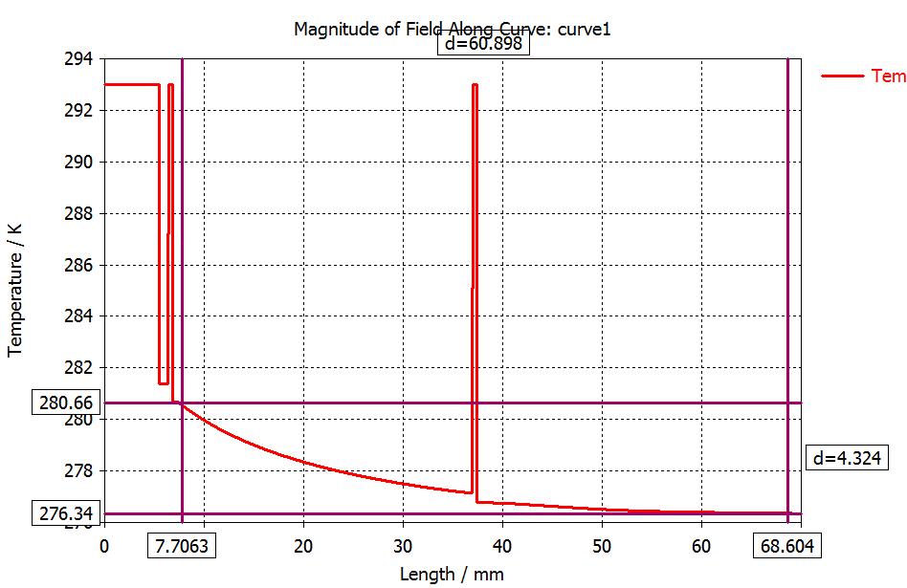
Temperature along radius in the ceramics, P = 0 kW
Average window temperature ~ 277.5K

Slide 7
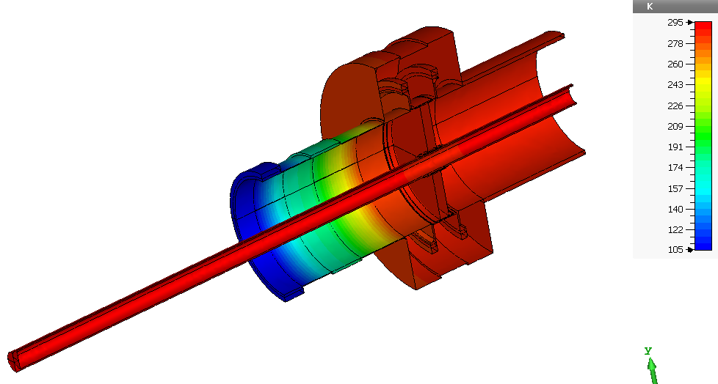
P = 4.7 kW

Slide 8
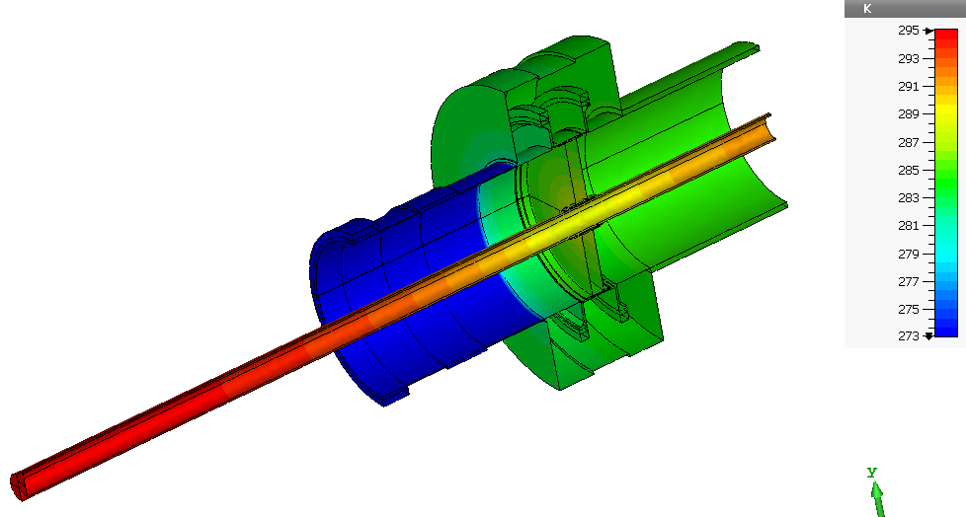
P = 4.7 kW

Slide 9
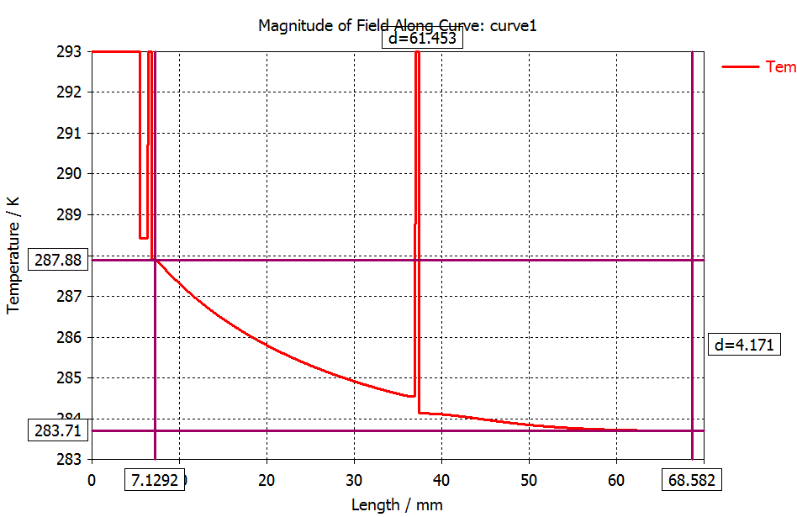
Temperature along radius in the ceramics, P = 4.7 kW, TW
Average window temperature ~ 285.0K
Window temperature rise dT ~ 7.5 K

