Slide 1
CM03 BPM Studies N4
Andrei Lunin, Genfa Wu (Fermilab)
LCLS-II Cryomodule Transportation Review
June 12, 2018

Slide 2
CM03 BPM Test N4
CM03 BPM assembly at IB4 (03/12/2018)
 | BPM Flanges
 | Green | Blue | Red | Yellow*
Current Torque, N-m | - | - | - | 14
New FF torque, N-m | 13.5 | 13.5 | 13.5 | -
* Wepek seal, replaced DESY Ti-grade5 studs after 1st thermal cycle.
Goals: a) repeat the JLaB BPM assembly as close as possible
b) verify the Yellow Flange (replaced bolts-to-studs) with multiple cryo-cycles
GREEN, BLUE and RED Flanges assembled with Wepek seals,
Ti-grade2 bolts and followed to the JLaB torque sequence (in two steps) with 13.5 N-m final torque
Next: to perform slow 70K thermal cycles and a vibration test

Slide 3
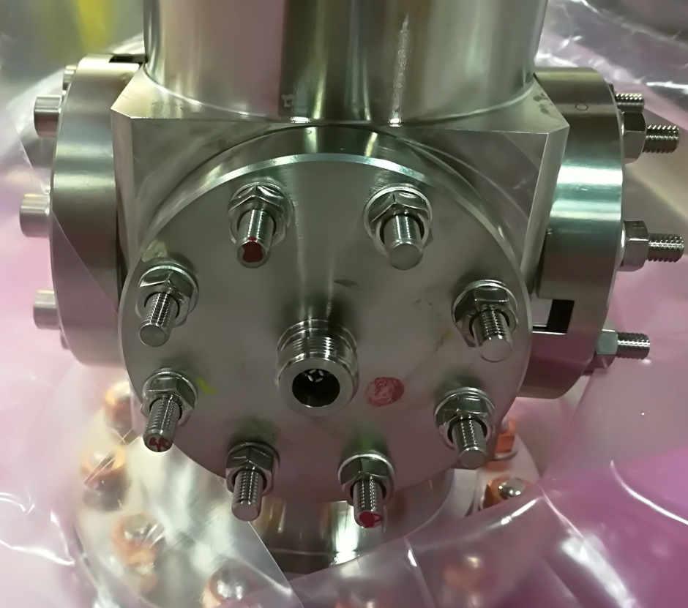
CM03 BPM Test N4
Bolts replacement sequence
Stud #
8
3
1
5
6
2
4
7

Slide 4
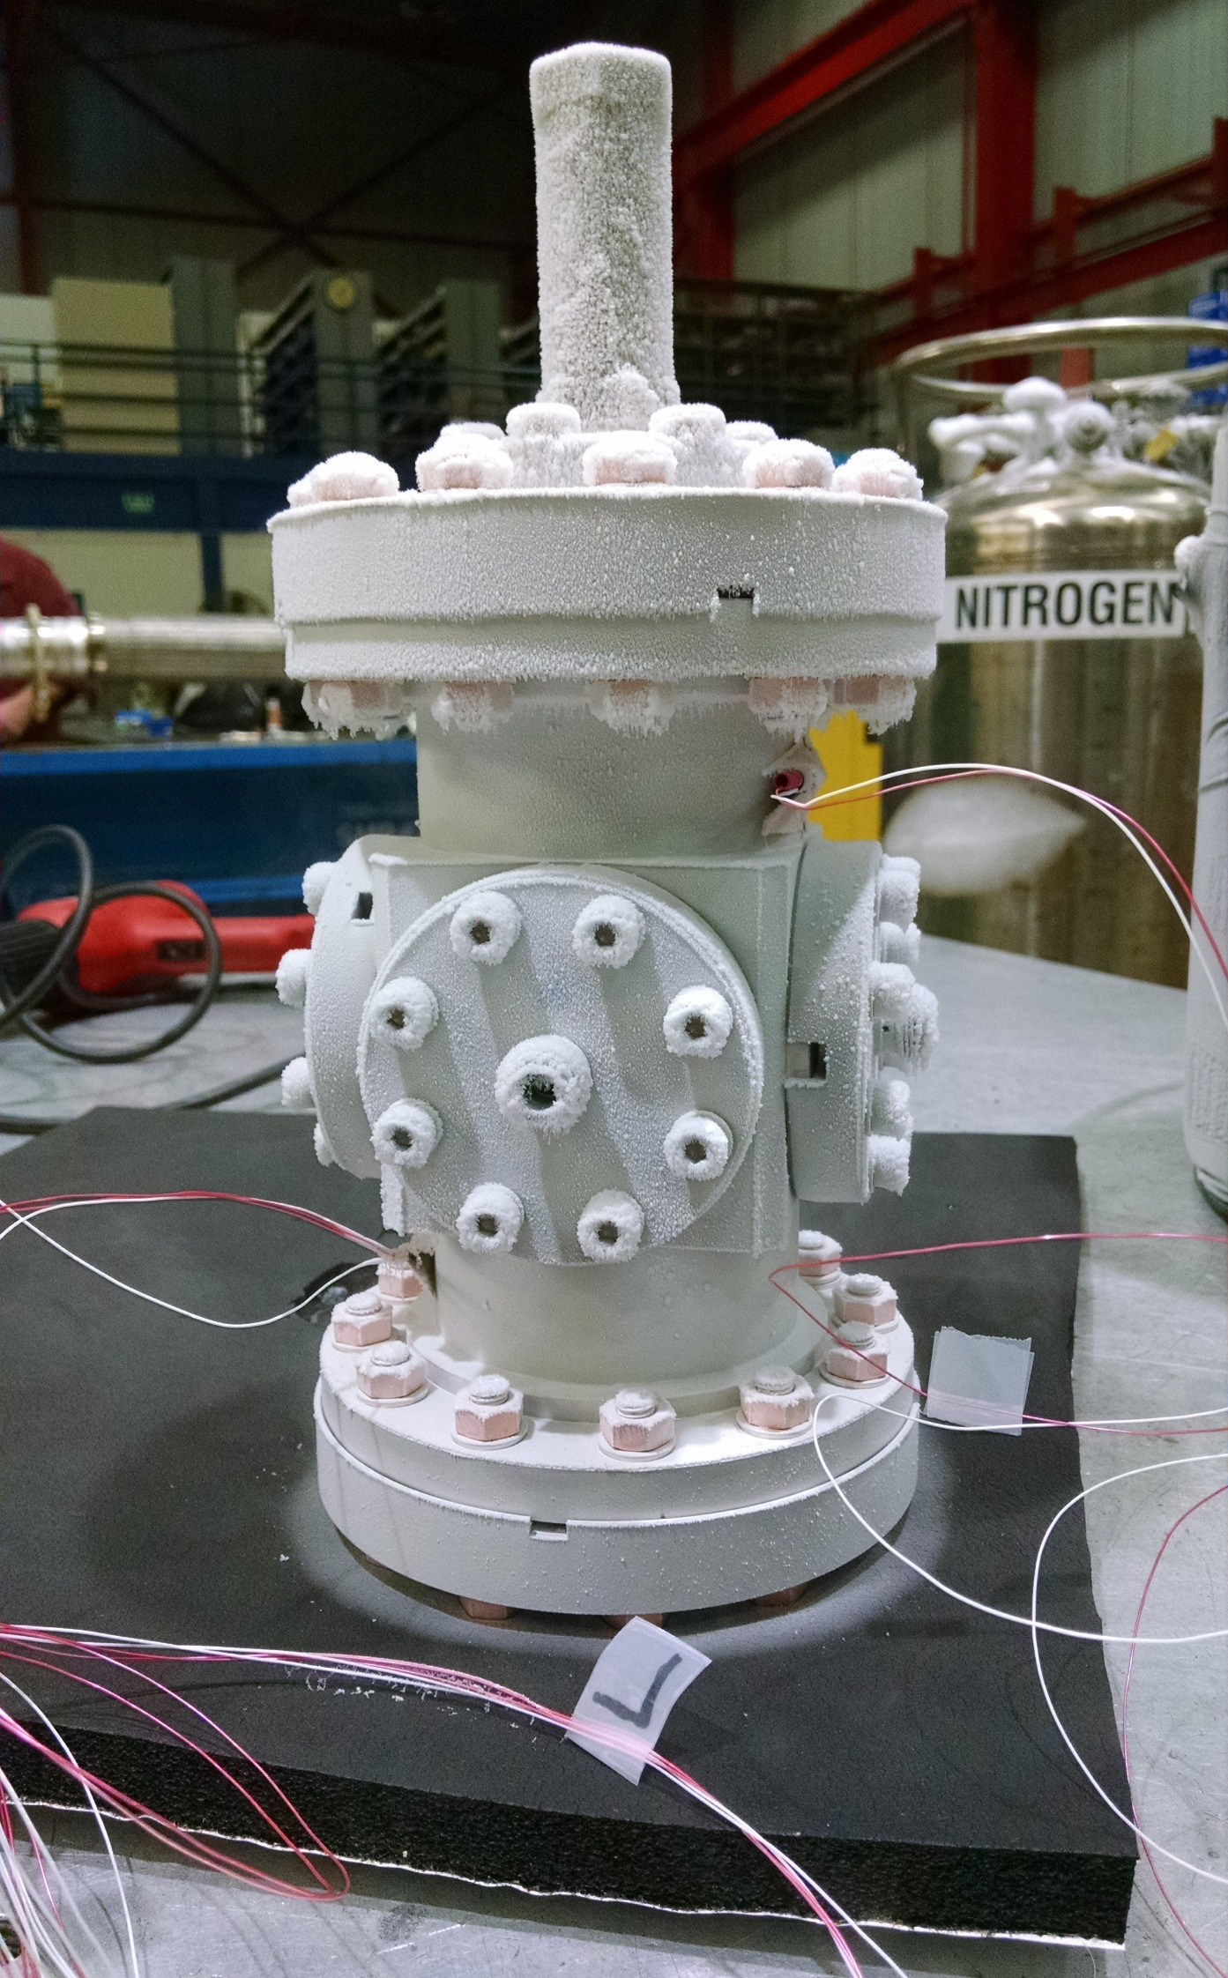
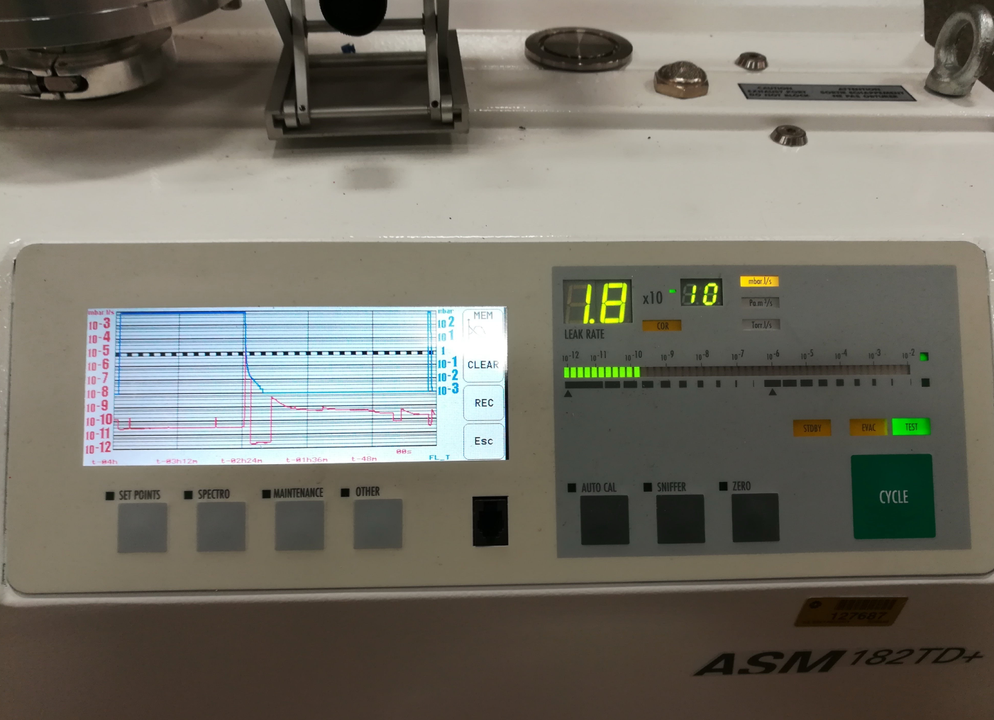
CM03 BPM Test N4 Thermal Cycles
19/03/2018 - BPM passed the 70K thermal cycle N1
  leak tight (< 2e-10 mbar-l/s)
20/03/2018 - BPM passed the 70K thermal cycle N2
  leak tight (< 2e-10 mbar-l/s)

Slide 5
CM03 BPM Vibration Test
05/01/2018 - BPM Vibration Testing @Solution Engineering
Parameters of Vibration Testing
  Frequency range: 5..20 Hz
  Max amplitude: ± 3 mm ()
  Max acceleration: 2.5g
  Random changing frequency (every 3 min) applied for 24 h continuous run

Slide 6
CM03 BPM Test N4 Final Results
Outcome of the Vibration Test (05/01/2018)
There were 13 checks made on the BPM’s over the duration of testing.
At check #1 a suspicious alignment was noticed on a line between the bolts labeled 2 and 3.
No change was noticed during subsequent checks.
No misalignments were observed during any of the scheduled checks or at the end of the test
The BPM is leak tight after the test (05/14/)2018
Torque, N-m | BPM Flanges
 | Green | Blue | Red | Yellow
Original | 13.5 | 13.5 | 13.5 | 14
After the Test (# of loosen bolts) | 12.1 (3) | 12.1 (3) | 12.1 (5) | 12.1 (1)
A minor torque loosening was observed after the Vibration Test
The BPM remained leak tight
Studs/nuts show less loosening compare to the Ti grade2 bolts

