Slide 1
Titanium M6 Fastener Torque Testing
Peter Owen
June 12, 2018

Slide 2
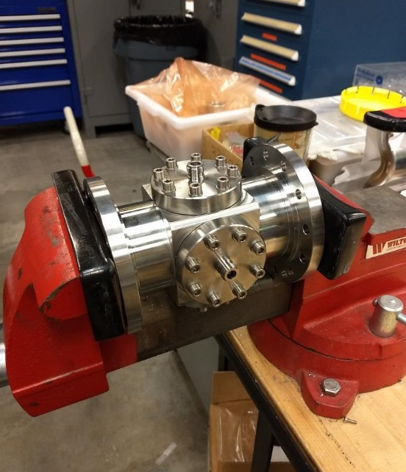
Test Setup
Started with 32 new fasteners, four new gaskets, four production feed-throughs, and washers
All fasteners and gaskets labelled
BPM housing held in vice for torqueing
Began each feed-through at 105, 110, 115, & 120 in-lbs
Removed each bolt and gasket to measure deformation between torques
Increased torque in 5 in-lb increments
Tightened one flange up to 175 in-lbs, other three flanges up to 150 in-lbs
Tests carried out in February 2018 by myself and Danny Forehand

Slide 3
Bolt Extension Results
Each color represents one of four flanges
Each data point is average of the eight bolts on each flange measured
BPM Fastener Investigation, 6/12/2018

Slide 4
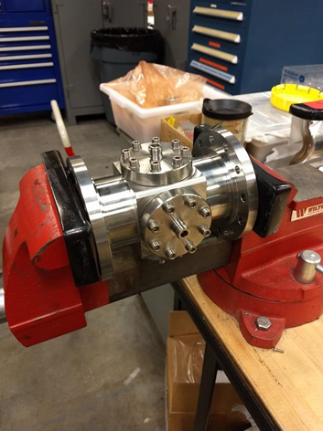
Gasket Crush Test
Same setup with three new gaskets and three new sets of fasteners
Lower amounts of crush may be due to fewer stress cycles
Torque (in-lb) | Bolt Strech | Gasket Crush
120 | < 0.002” | 0.008 – 0.010”
145 | 0.003 – 0.009” | 0.010 – 0.012”

Slide 5
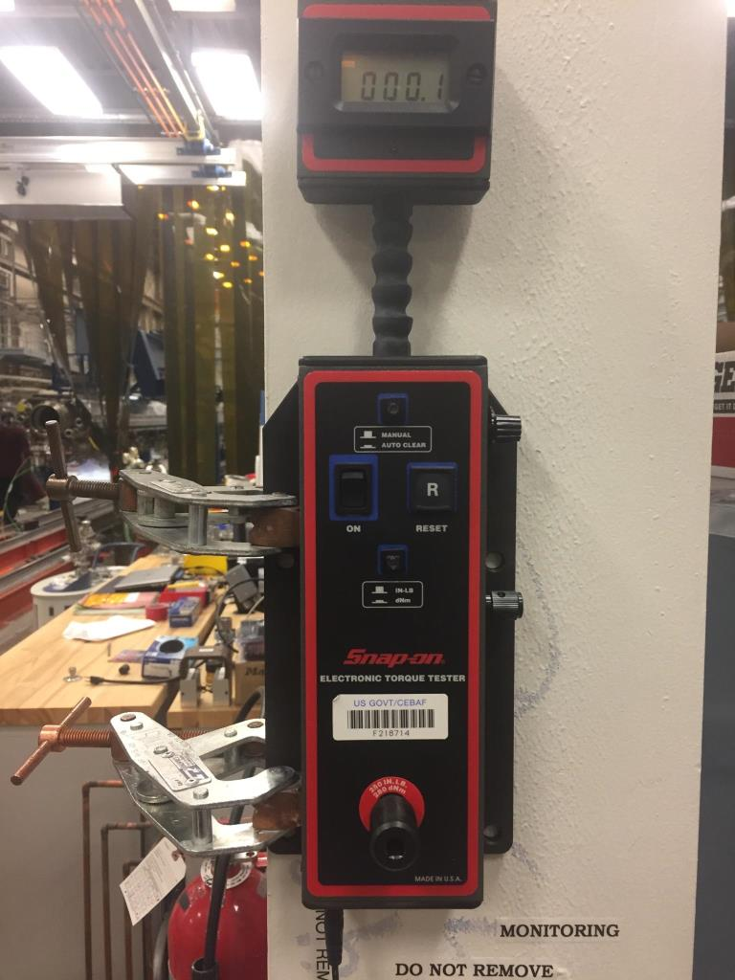
Torque Wrench Details
Wrench setting (in-lb) | Applied (Real) torque (in-lb) | Error
60 | 56 | 6.6%
120 | 116 | 3.3%
175 | 169 | 3.4%
Torque wrench tested with Snap On electronic torque tester immediately after testing finished
BPM Fastener Investigation, 6/12/2018

Slide 6
Conclusion
One bolt broke at 150 in-lbs
Two bolts broke at 175 in-lbs
Some bolt stretching at all torque settings
“Significant” stretching above 130 in-lbs
The exact torque applied to bolts is critical such that bolts remain tight, but do not deform excessively

