Slide 1
CM03 BPM Studies N5
Andrei Lunin, Genfa Wu (Fermilab)
LCLS-II Cryomodule Transportation Review
June 12, 2018

Slide 2
CM03 BPM Test N5
CM03 BPM assembly at MP9 (05/30/2018)
 | BPM Flanges
 | Green (A) | Blue (B) | Red (C) | Yellow (D)*
Current Torque, N-m | - | - | - | 14
New FF torque, N-m | 12 | 12 | 12 | -
* Wepek seal, replaced DESY Ti-grade5 studs (after 3 thermal cycles & 1 vibration test)
Goals: a) repeat the CM06 BPM assembly as close as possible
b) verify the Yellow Flange (replaced bolts-to-studs) with multiple cryo-cycles and vibrations
GREEN, BLUE and RED Flanges assembled with Wepek seals,
Ti-grade2 bolts and NO washers repeating the CM06 torque sequence (4-8-12) with the 12 N-m final torque
Next: to perform slow 70K thermal cycles and a vibration test

Slide 3
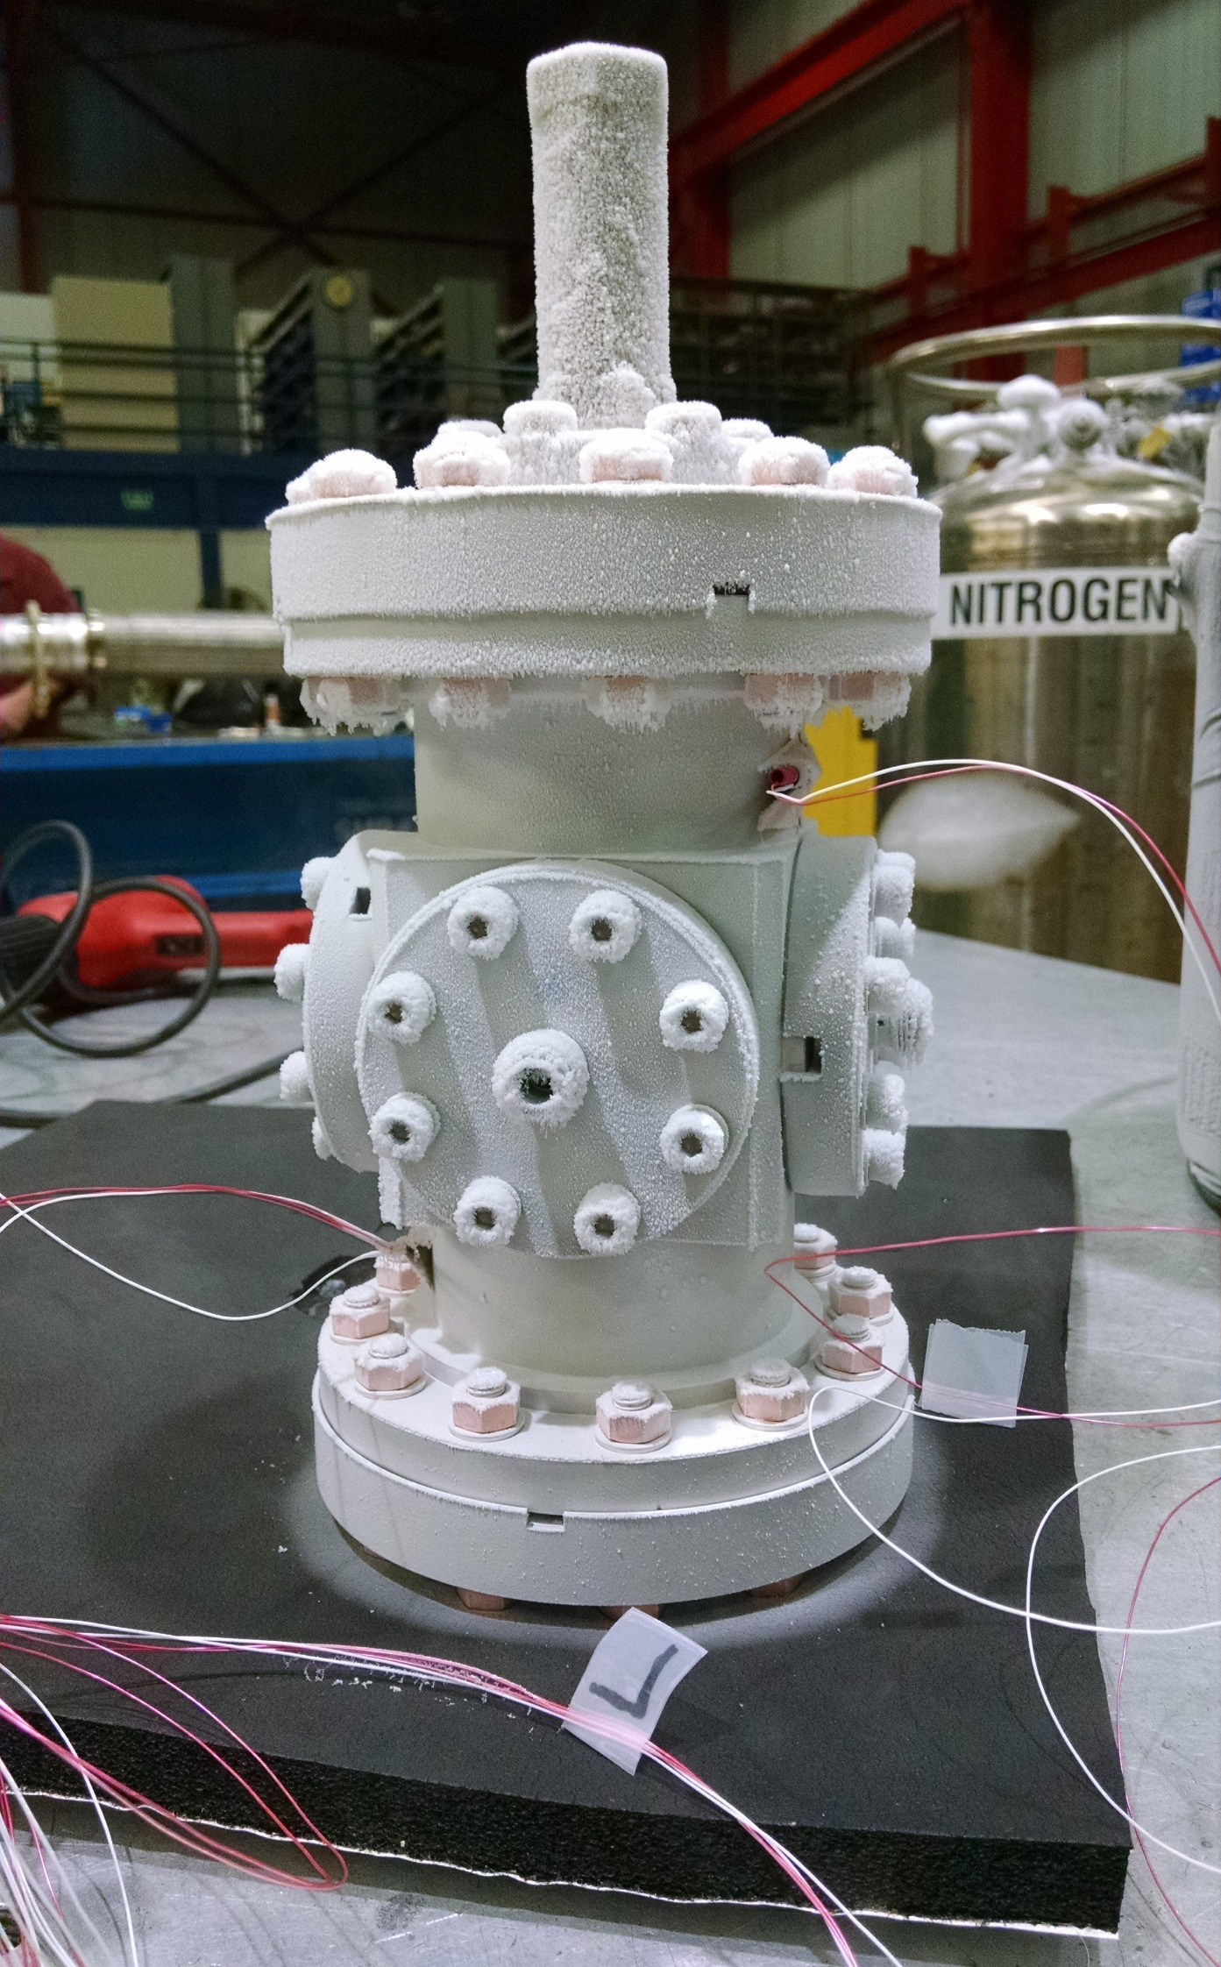
CM03 BPM Test N5 Thermal Cycle
05/31/2018 - BPM leak tested at IB4 (before the 70K thermal cycle)
  The C Flange has a minor leak (< 2e-7 mbar-l/s)
06/04/2018 - BPM passed the 70K thermal cycle

Slide 4
CM03 BPM Vibration Test
06/07/2018 - BPM Vibration Testing @Solution Engineering
Parameters of Vibration Testing
  Frequency range: 5..20 Hz
  Max amplitude: ± 3 mm (vertical)
  Max acceleration: 2.5g
  Random changing frequency (every 3 min) applied for 24 h continuous run

Slide 5
CM03 BPM Test N5 Final Results
Outcome of the Vibration Test (06/08/2018)
Torque, N-m | BPM Flanges
 | Green | Blue | Red | Yellow
Original | 12 | 12 | 12 | 14
After the Test (# of loosen bolts) | 11 (8) | 11 (8) | 11 (8) | - (-)
No Ti-grade2 bolts fell out or unscrewed.
The torque reduction is minimal for all the Ti-gr2 bolts with NO washers.
The CM06 vibration was likely much worse than that in the 1-D vibration test.
The Yellow Flange (replaced bolts-to-studs) after 3 thermal cycles and following vibration test remained leak tight and with minimal torque loosening.
Under normal circumstances, the BPM should survive the transportation in a proper secured cryomodule.

