Slide 1
LCLS-II Cryomodule Shipping Requirements
Brian Hartsell
Shipping Review
June 12th, 2018

Slide 2
General Shipping Configuration & Procedure
Procedure from a high level:
Electrical and RF checks
Beamline vacuum monitor installed
Adapters installed into HGRP
Transport caps installed
Pull vacuum and leak check transport caps, backfill with dry nitrogen
Install cryomodule on transport frame loaded on trailer
Close trailer tarp

Slide 3
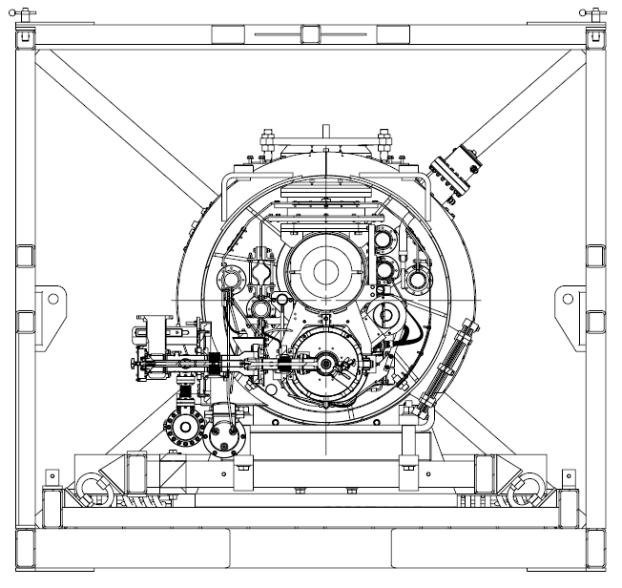
Shipping Configuration – Vacuum systems
Insulating vacuum – positive pressure of dry nitrogen, not monitored. 7 psig relief installed.
Coupler vacuum – under vacuum, not monitored
Beamline (cavity string) vacuum – under vacuum, monitored and logged throughout transport

Slide 4
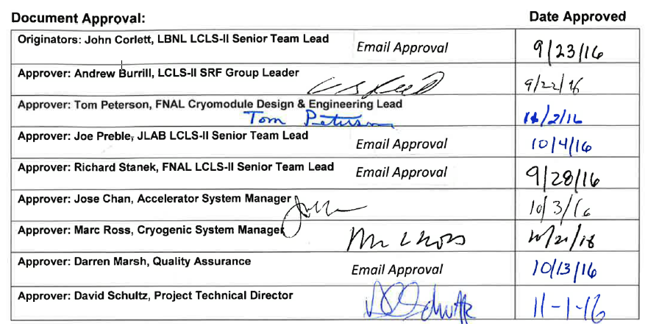
Shipping Requirements
Shipping requirements are governed by cryomodule acceptance criteria at SLAC (LCLSII-4.1-PP-0703-R1):

Slide 5
Shipping Requirements
Upon arrival at SLAC:
Insulating vacuum is pumped down and leak checked before removing the transport caps.
Requirement: insulating vacuum leak rate < 1E-5 torr-liter/second.
Pressure of beamline and coupler vacuum will be read.
Requirement: beamline and coupler pressure both < 1E-5 mBar.
All shock log devices will be read.
Requirement: no shocks over 1.5g
Visual inspection
In general, no mechanical damage or deformation.
Cryomodule alignment will be checked relative to measurements at originating lab:
Requirement: cryogenic piping flange locations within ±2 mm
Requirement: Gate valve and mounting post fiducial locations within ±0.2 mm.
Cavity RF and electrical checks:
Requirement: ≤±10 kHz cavity frequency shift, all electrical connections functional

Slide 6
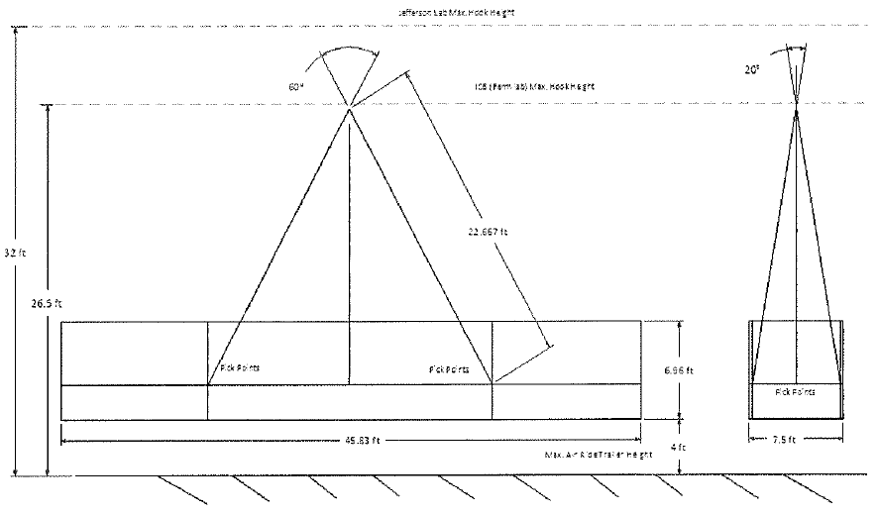
Shipping frame requirements
The shipping frame will:
Serve as a shock attenuator between the trailer and the cryomodule.
Protect the cryomodule from damage.
Provide the ability to lift the cryomodule with a crane inside a protective frame.
Each frame (3 in total) has been load tested and reviewed as a below the hook lifting fixture.

Slide 7
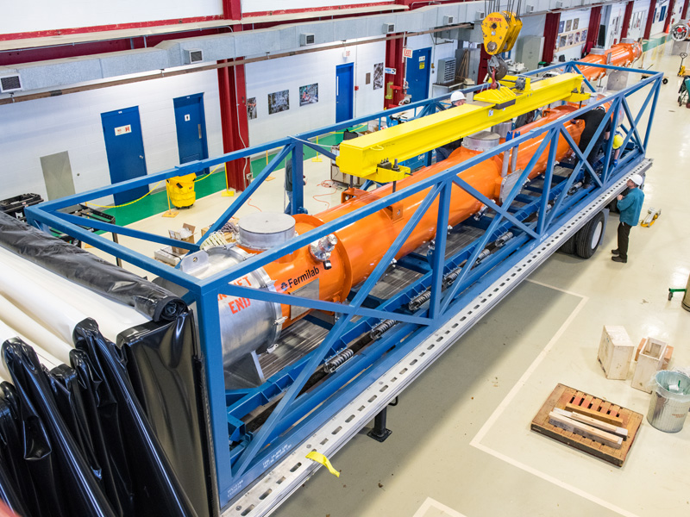
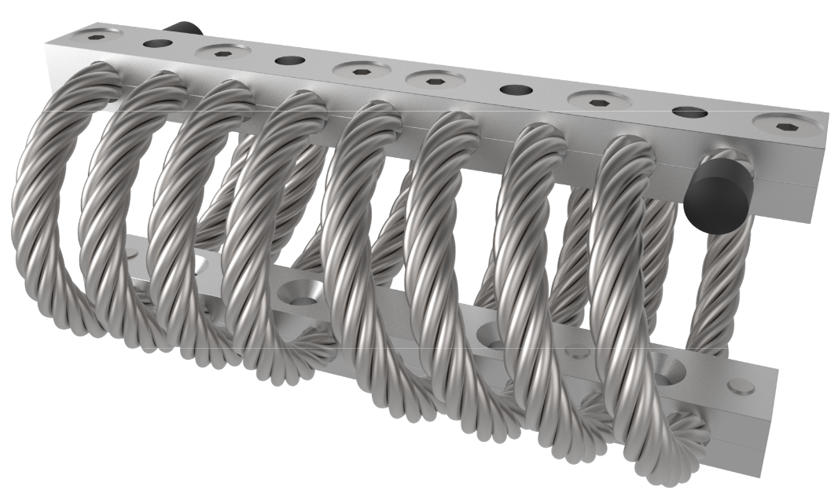
Shipping frame overview
The shipping frame is comprised of two weldments, commonly referred to as the inner and outer frames.
These frames are separated by wire rope isolators.
Space for 38 isolators, 32 currently in use.
Natural frequency of the system is ~10 Hz in the gravity direction.

Slide 8
Summary
A specification is in place that governs the transport criteria and gives expectations for the condition of a cryomodule arriving at SLAC.
A transport frame was designed to attenuate shocks and provide a protective cage around the cryomodule for both transport and lifting.

