Slide 1
Cryomodule Shipping
Overview of Observations
Tom Peterson
12 June 2018

Slide 2
Outline
Two sets of shipping problems were uncovered with delivery of F1.3-06 to SLAC and its return to Fermilab – loose hardware and two cracked bellows
Status just prior to discovery of bellows problem – QC and fastener remediation
Cracked bellows – and other observations from F1.3-06 after return to Fermilab
Alignment shift with F1.3-06 shipping
Design and shipping considerations

Slide 3
F1.3-06 – Summary of Observations as of Early April
When F1.3-06 arrived at SLAC in January, it was found that the beamline vacuum had been vented
  Suspected source of the beamline vacuum loss was that the BPM (after transport) had loose/missing feedthrough flange bolts
In addition, some loose hardware was found on the bottom of the thermal shield (mechanical fasteners)
Data from shock loggers showed relatively few excursions above the 1.5g shock specification
  Data gathered on low frequency vibrations was limited
Disassembly and further leak checking at SLAC was not practical, and so full examination had to wait until F1.3-06 was returned to FNAL

Slide 4
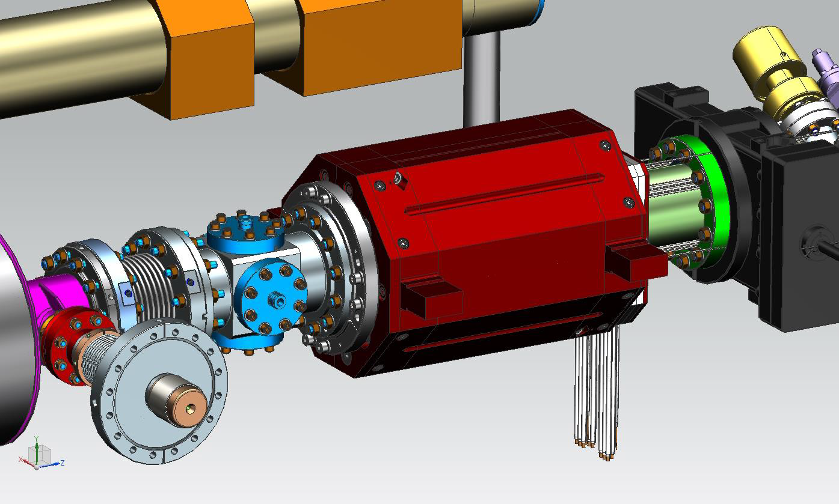
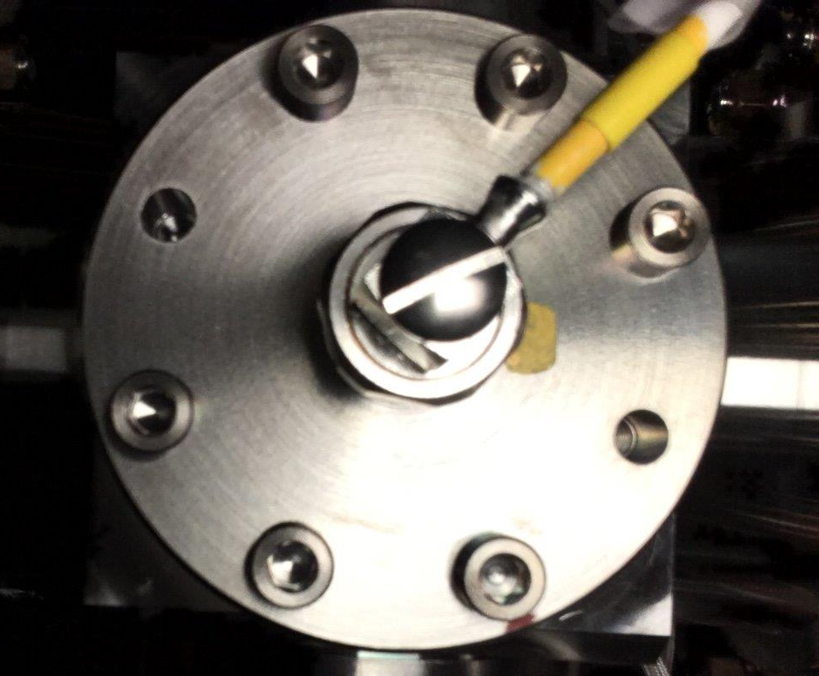
LCLS-II-4.5-ES-0403, Cold Button Beam Position Monitor

Slide 5
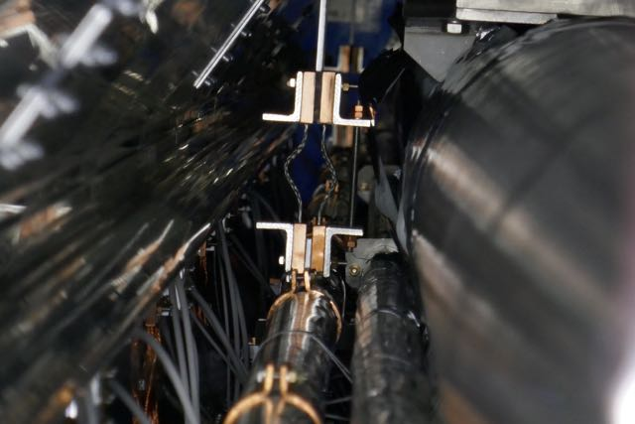
Source of 5 bronze nuts and one threaded stud was one of these support rods plus one nut from another.
Missing support rod for Line D and four bronze nuts at center post. All were found on the thermal shield bottom near this
location. These bronze nuts are double-nutted top and bottom. Nevertheless, those reachable at the downstream support post were also loose. Line D
is fully supported by other G-10 supports of a different design. This missing rod would probably not appear as a
functional problem.

Slide 6
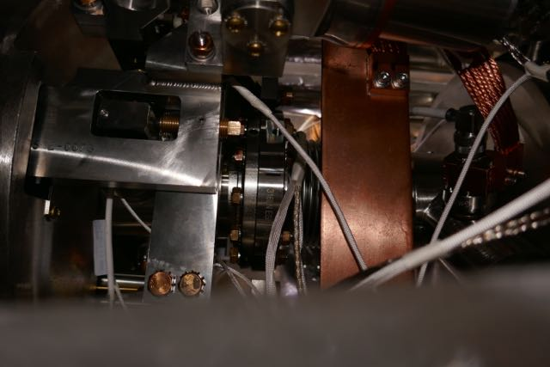
Cavity interconnect and tuner
Cavity beam tube interconnects and tuners were all inspected via the tuner access ports. Bolts reachable were in place and hand tight except
Some supports for small rods which, I am told, are only need during installation. No other visible problems.

Slide 7
Project response to cryomodule fasteners issues
  Cryomodule design review commissioned by Project Director
    Design comparisons with EU-XFEL designs
    Reviews of LCLS-II drawing revisions, travelers, specifications to ensure no design problems have been missed
  Cryomodule QA/QC review commissioned by Project Director
    Review of QA/QC practices, travelers, specifications and documentation to ensure assembly is consistent with design
  Jefferson Lab and Fermilab each conducted independent QA/QC reviews
  The SLAC reviews provided recommendations which were used to establish conditions for production restart and actions to be taken at the partner labs
    Repair of existing cryomodules including BPM seal bolt replacement
    Resumption of production of new cryomodules
    Study of vibration in transportation– possible adjustments for transportation frame
  A spreadsheet listing all fasteners specifies methods for ensuring the quality of each joint.
  The design is sound. We understand how to fix the beamline vacuum seal issue, tighten and replace loose fasteners, and ensure fastener integrity.

Slide 8
The rough ride continues
F1.3-06 returned to Fermilab on April 8
On April 23 we learned that a leak check of the cavity string revealed leaks other than the likely BPM seal leaks.
Cracks were found in two bellows
  Inner coupler bellows of cavities 4 and 5
  Subsequent leak checking showed these to be the only leaks other than the BPM bottom flange where bolts had come loose.
  We do not know whether bellows cracking occurred on the first trip (to SLAC) or on the return trip (to Fermilab).

Slide 9
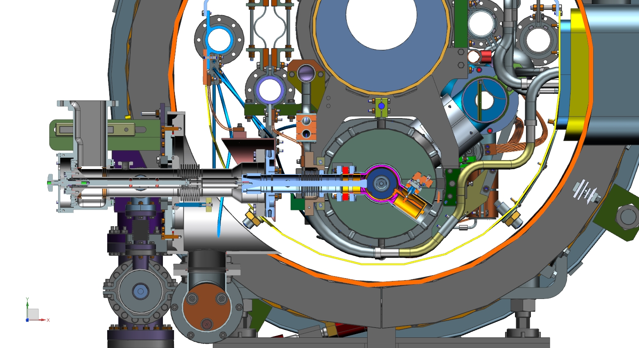
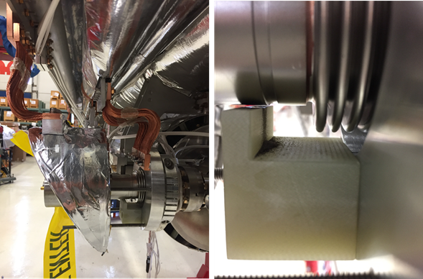
LCLS-II Cryomodule – inner coupler bellows failure

Slide 10
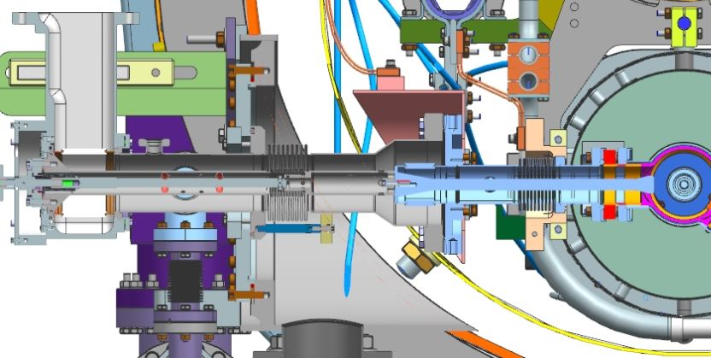
CAD model cross section at RF power coupler
Coupler tuning mechanism is anchored to the vacuum vessel and restrains the cold part of the coupler in the coupler axial direction. Relative motion of cavity string and coupler are taken via the inner coupler bellows.
Inner and outer bellows have supports underneath which limit downward motion. Normally about 1 mm clearance.

Slide 11
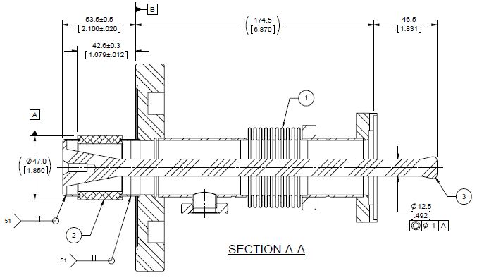
RF power coupler cold end assembly
Cracked inner bellows
convolution here
3:00 o’clock
(side)

Slide 12
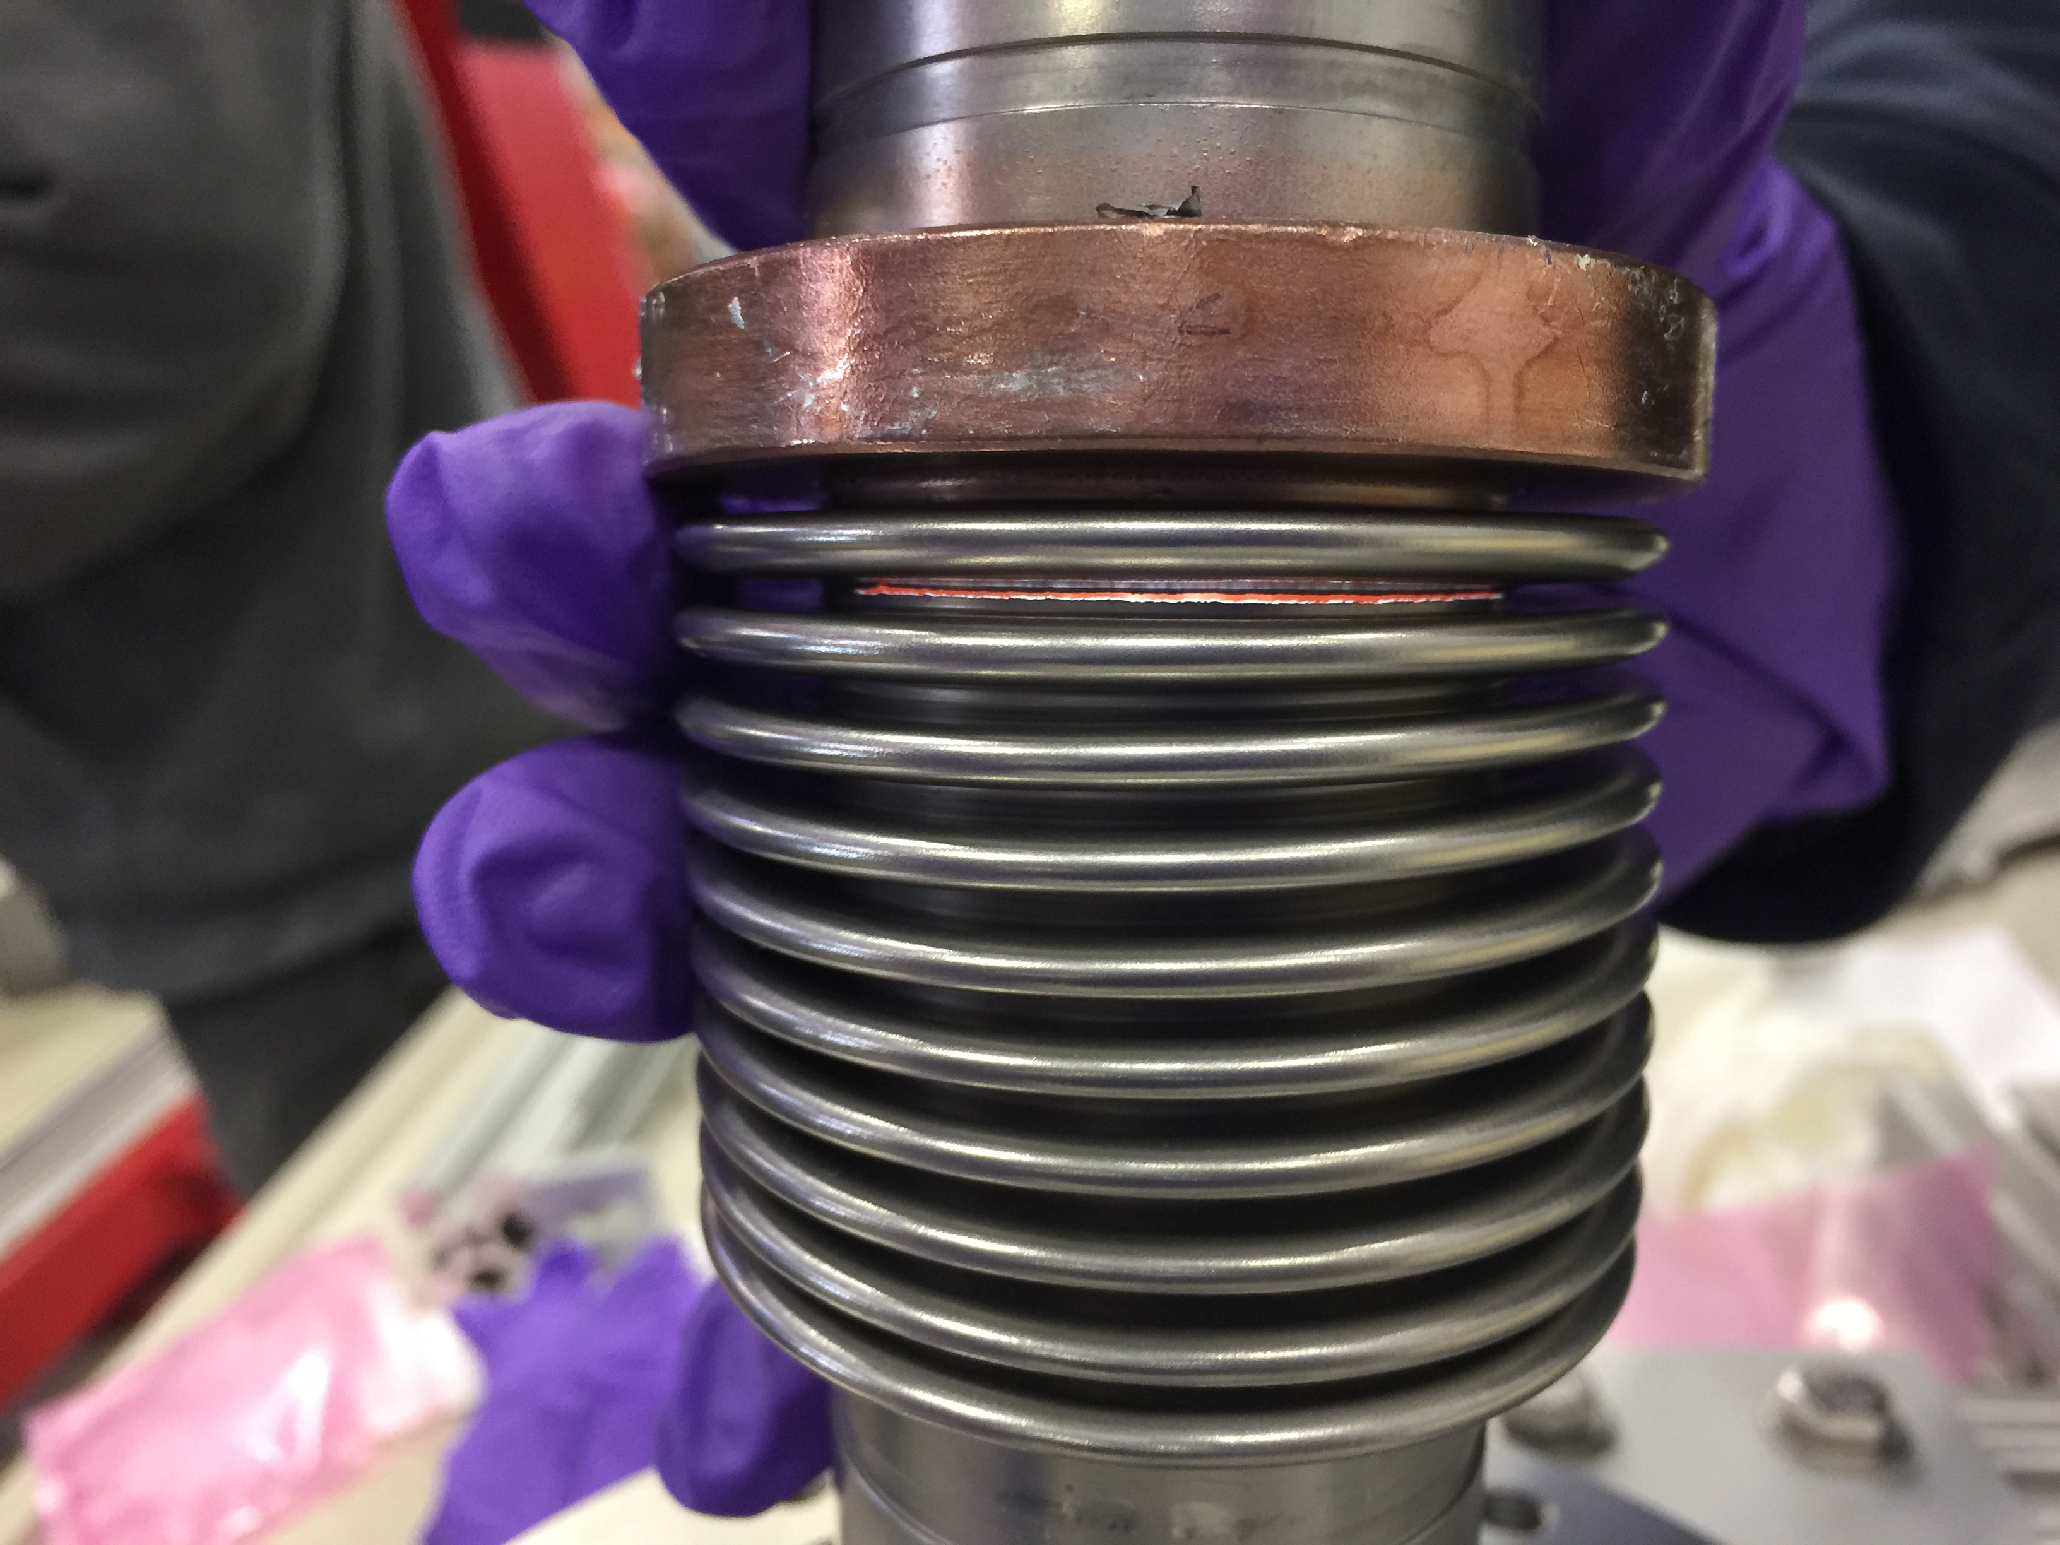
One of two cracked inner coupler bellows
  We do not know when these
  other leaks opened up,
  during shipment to SLAC or
  during travel back to FNAL.
  SEM examination:
  “The material at the fracture
  location experienced
  multiple bending stress
  cycles at or above the yield
  strength, work hardening
  locally and eventually failing
  in a brittle manner.”

Slide 13
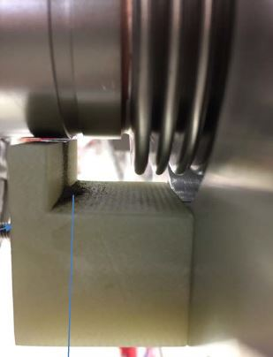
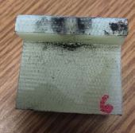
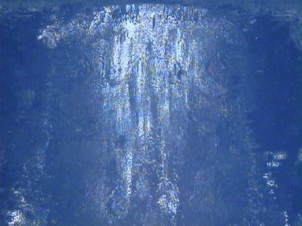
G-10 support block observations
Abrasion on G-10 block indicates motion of at least several mm and parallel to coupler axis, perpendicular to cavity string axis. This would correspond to the cavity string swinging side-to-side.
It appears that bellows cracked due to occasional large motion of cavity string relative to the vacuum vessel.
Black dust on all 8
G-10 blocks

Slide 14
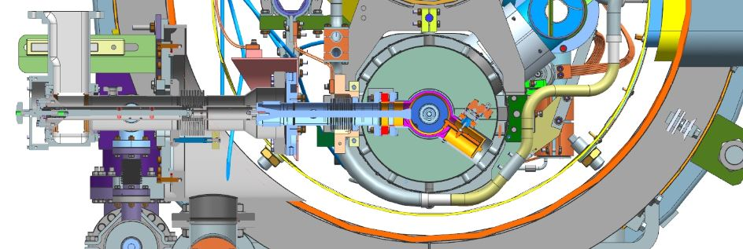
Thermal shield vibration – another “noise” source
In addition to the above described motions, the thermal shield showed signs of shock loading and bumping against the vacuum vessel.
  Thermal shield motion is anticipated and bumpers are provided to limit thermal shield motion.
Thermal shield motion could induce vibration in other parts of the cold mass system.
Although no damage has been attributed to thermal shield motion, further constraining thermal shield motion for shipment might be prudent.
Bumpers to limit thermal shield travel. We can see marks from their bumping the vacuum vessel during shipping.

Slide 15
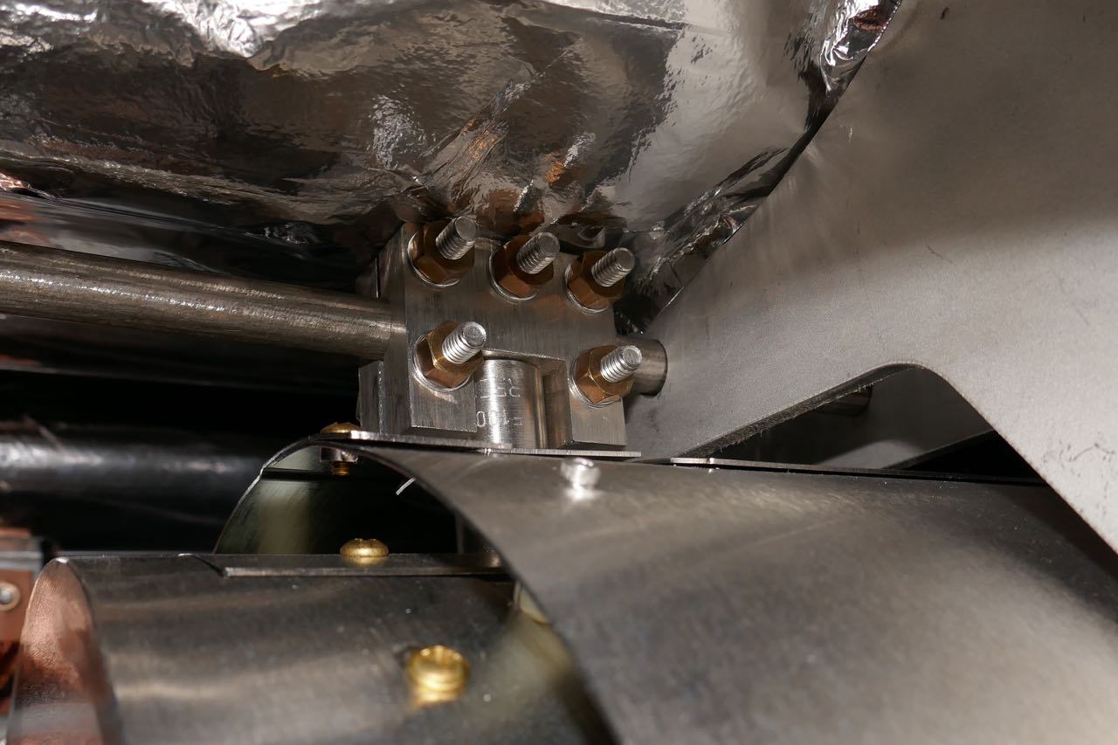
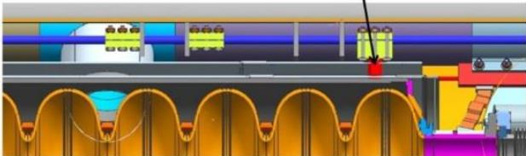
Motion in the cryomodule axial direction
Given the observation of bellows cracks at 3:00/9:00 o’clock, my first impression was that motion was likely in the cryomodule axial direction.
However, wear marks on the G-10 coupler support blocks indicate motion in the direction of the coupler axis, at least when in contact with the G-10.
Nevertheless, to complete the description of this possibility if it were to occur:
  Motion in the cryomodule axial direction could result from play in various parts of the invar rod clamping assemblies, both at the cavities and at the central invar rod anchor.
  Play at this latter location would result in the cavity string free to move axially as a unit.
  Observation of the invar rod clamps upon return of F1.3-06 to Fermilab did not indicate problems with invar rod clamps.
Clamps holding invar rod
Cavity post in clamp

Slide 16
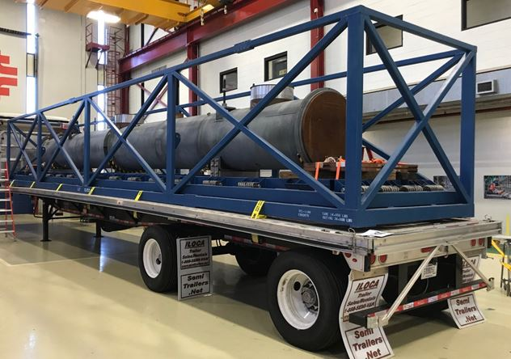
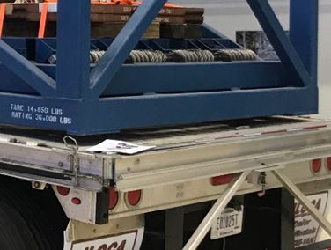
Trailer camber and shimming – possible vibration source
The upward front-to-back camber of the shipping trailer results in the shipping frame only contacting the trailer in the middle.
  This problem was recognized and shims were placed under the front and back of the shipping frame for cryomodule shipments.
  However, flexing of the trailer may still provide motion or shocks due to the center of the trailer carrying the load or loss of contact at the center with all the load on the shims.
  The result could be a source of vibration.

Slide 17
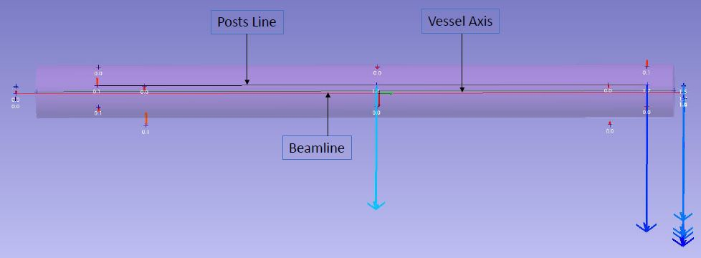
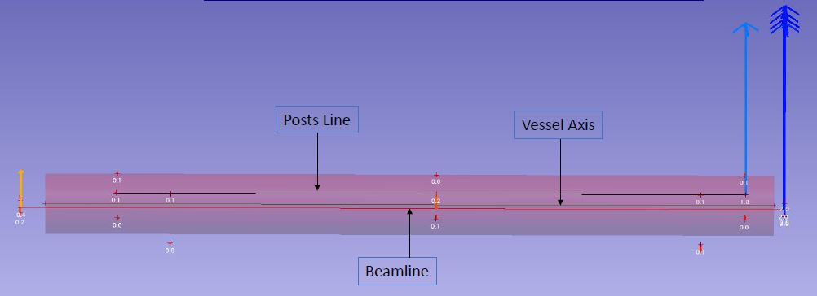
F1.3-06 post-shipment survey results – X (lateral) offset
+1.5 mm
at down-stream
end at SLAC
-2.0 mm
at down-stream
end upon return
to Fermilab.
These data
indicate
inadequate
support of the
cold mass
during shipping.

Slide 18
Summary: motion which exercises the inner coupler bellows
If the shipping support end caps allowed cavity string lateral motion or displacement.
  Cavity string side motion relative to the vacuum vessel would be taken by the coupler inner bellows.
  An offset, misalignment, or stretch of the bellows could result in enhanced stresses within the bellows when combined with motion.
Other lateral play in the cavity string support path
  The posts through support arms and roller bearings are quite stiff.
  The 300 mm HGRP is flexible enough to allow some motion at string center.
  Rocking motion (especially at center) is possible when support posts are not tied down.
(Less likely the problem) Axial motion due to invar rod support clamps slipping
(Less likely the problem) The mass between two bellows (which includes a lot of stuff with the 45 K flange, center conductor, etc.) may oscillate laterally relative to the coupler axis.
  This is not known to be different from Eu-XFEL but could have contributed to the wear marks on the G-10 and/or to bellows fatigue.
  Motion could be up, down to the supports, or in the cryomodule axial direction.
  The assembly may have a low natural frequency activated by shipping, and/or motion driven also by the thermal shield movement.
  Wear marks indicate motion along the cavity axis, not motion lateral to the coupler.

Slide 19
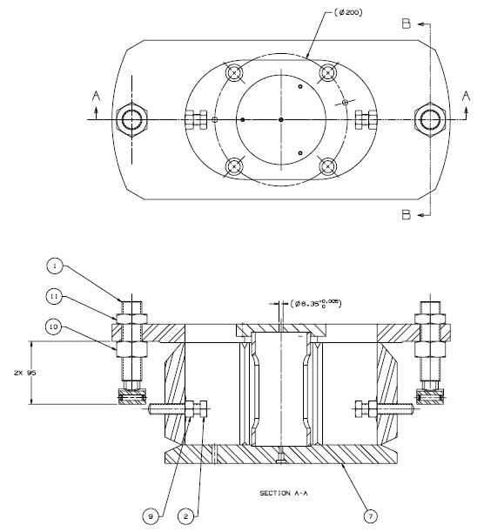
Design and materials considerations
Analysis of bellows failures
  We have two independent reports
  Evidence points to repetitive motion but low (<2 Hz avg) frequency
  So relatively large amplitude
Check of support post alignment bolts (sliding support shown at left)
  This area is easily accessible after shipping
  Wear seen on F1.3-06, some of which naturally occurs with thermal contraction from cold testing
  Other wear marks appear to be from post motion

Slide 20
Recent shipping tests and shipping considerations
Shipping tests:
  A short shipping test of J1.3-07 was done, April 27-28.
    Configuration: what we have now. This cryomodule was not yet upgraded per the new fastener requirements. Included Ti grade 2 bolts (but with washers) on the BPM fasteners.
    Careful installation of shipping end caps and plugs for restraint of the cold mass.
  Vacuum remained good. Little wear on G-10 support blocks. A few loose fasteners in locations we know need attention. Analyses of shipping test data will be presented.
Thermal shield bracing for shipping (under consideration)
Review of shipping configuration
  Review and improve shipping caps fit and plug fit into the 300 mm pipe
  Ensure adequacy of lateral constraint of motion
  Comparison with Eu-XFEL shipping constraint design
  Comparison with shipping scheme for 3.9 GHz cryomodule delivered to FLASH
  Check/improve frame mounting on trailer
Successful shipping of ~100 Eu-XFEL cryomodules and of the JLab prototype cryomodule, combined with the understanding of the F1.3-06 shipping issues gained from that shipment and our shipping tests and studies, provide the information we have now to resolve these problems.

Slide 21
Acknowledgements
Thanks to many people in the LCLS-II collaboration for slides, images, and information in this presentation.

Slide 22
Additional slides

Slide 23
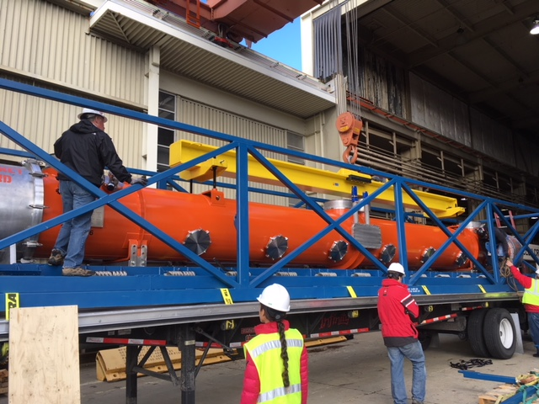
F1.3-06. First cryomodule shipped to SLAC.
Arrival 19 Jan 2018

Slide 24
Cryomodules summary – major problem in January
  Cryomodule production lines halted in January due to beamline vacuum loss and loose hardware found in the first cryomodule shipped, upon arrival at SLAC
    Delay in CM production, testing and delivery to SLAC
  Cryomodule production status at the time of production stop
    Jefferson Lab – 6 complete assemblies, 5 in assembly, of 19+2 total
    Fermilab – 7 complete assemblies, 5 in assembly, of 17+2 total
    19 cavity strings need rework
  Project response at SLAC and both partner labs has been swift and effective.

Slide 25
F1.3-6 Fastener Issues and Responses
For BPM, Grade 2 Ti socket head cap screws (SHCS) used as opposed to Grade 5 Ti stud/SS nut combination as used on EU-XFEL (Design and QC issue)
  Design has been changed to match EU-XFEL
  Existing production CMs will be retrofit with Grade 5 Ti stud/SS nut fasteners
For F1.3-06 BPM, SHCS were installed without washers (QC issue)
  This is the only BPM found to not have washers
  Since this CM will be totally rebuilt, washers will be added
Fasteners on UCM were not all installed by the vendor per spec’s (vendor QC issue)
  Developed fastener spreadsheet listing critical parameters including torque
  Procedures updated to add additional QC steps and fastener requirements
  Fasteners on all CMs will be checked for correct torque/use of Loctite as required
Transportation is being closely reexamined
  Additional instrumentation has been added to capture vibration spectra
  Three additional transport tests performed (concrete CM, F1.3-06 return trip, and J1.3-07) – data being analyzed
    Test results will drive changes to transport fixture and transportation specifics
Commissioned both Design and QA/QC Reviews (project & internal)
  Project Design Review compared EU-XFEL designs to LCLS-II
  Project QA/QC Review focused on travelers, specifications and documentation
  Internal QA/QC review focused on Fermilab process improvements
  Review recommendations used to establish conditions for restart

Slide 26
Cryomodule Assembly/Test Status
Cryomodule production status at the time of production stop
    JLab – 7 complete assemblies, 4 in assembly, of 19+2 total
    FNAL – 7 complete assemblies, 5 in assembly, of 17+2 total
Following implementation of corrective actions:
    Both labs have been given approval to restart
    Retrofit of existing CMs and assembly of new CMs will proceed in parallel (extra staff added as required)
  CM testing drives completion so to reduce schedule delays
    Minimal retest of retrofit CMs
    Fully incorporate LERF capabilities
    Decrease install / removal duration

Slide 27
F1.3-6 New Issue and Responses
Issue: In addition to the (likely) BPM leak, a major crack/tear was found on two cold coupler bellows of F1.3-6 upon return to Fermilab in April.
  Cav4 and Cav5 coupler bellows both leak – the rest of the cavity string is leak tight.
  Same location of cracks on both bellows (3 or 9 o’clock)
  G-10 supports (for all cold couplers) showed signs of excessive rubbing from unanticipated motion
  PEEK support on warm coupler also showed wear.
Shipping of J1.3-1 (JLab to FNAL, cold test, back to JLab) did not result in vacuum leaks.
Response: Investigation of coupler support, use of temporary shipping restraints and/or modifications to shipping frame/transport
  Damage to F1.3-6 coupler bellows likely due to inadequate restraint of upper cold mass by transport caps.
  Results from latest J1.3-7 shipping tests will be incorporated into whatever changes are proposed.

Slide 28
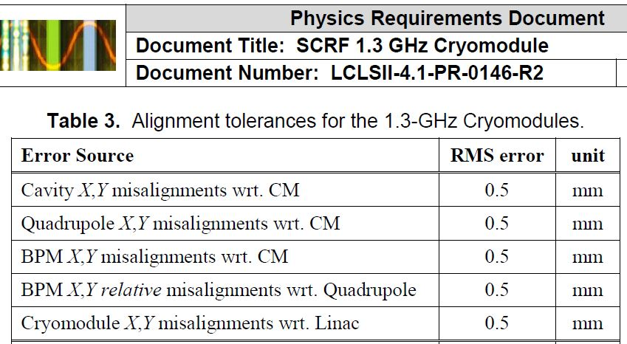
Alignment requirements
Cavity strings are aligned at the partner labs, and data referenced to vacuum vessel fiducials provide cavity positions with respect to the vacuum vessel. Tunnel alignment sets vacuum vessel position so as to place cavities, quad, and BPM on the beamline. Thus, offsets during shipping result in errors regarding our knowledge of cavity position and should be small, (e.g., tenths of a mm).

Slide 29
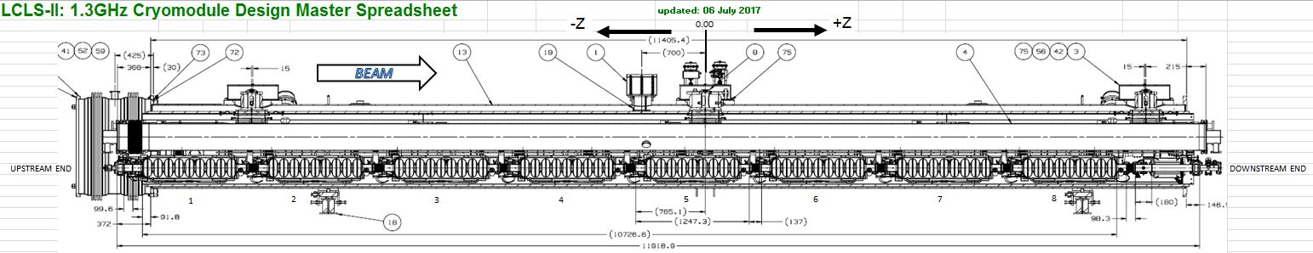
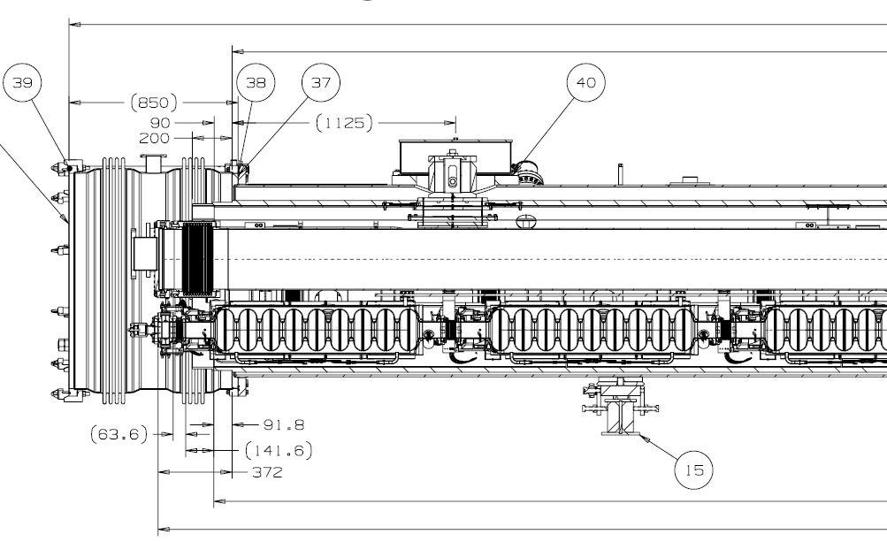
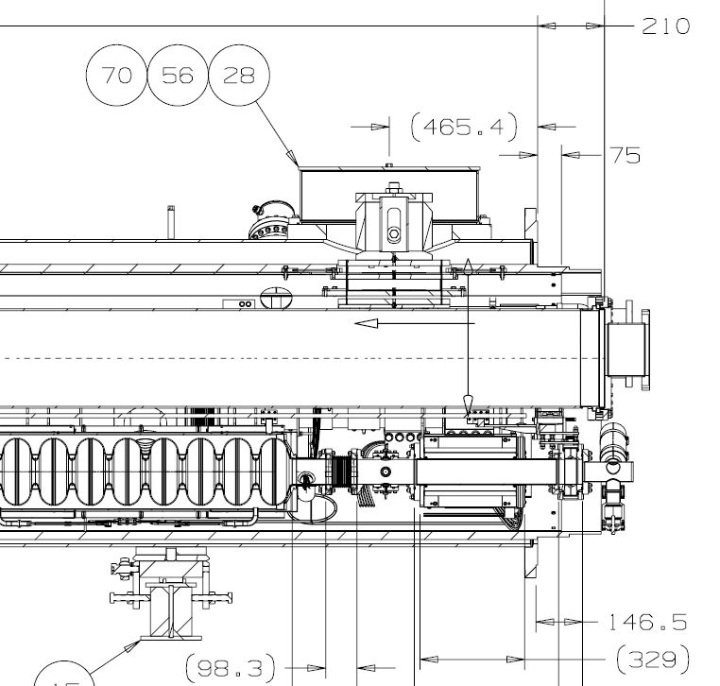
Cryomodule structure

Slide 30
Some dimensions,
for reference

