Slide 1
LCLS-II Cryomodule Transport Improvements
Brian Hartsell
Shipping Review
12 June 2018

Slide 2
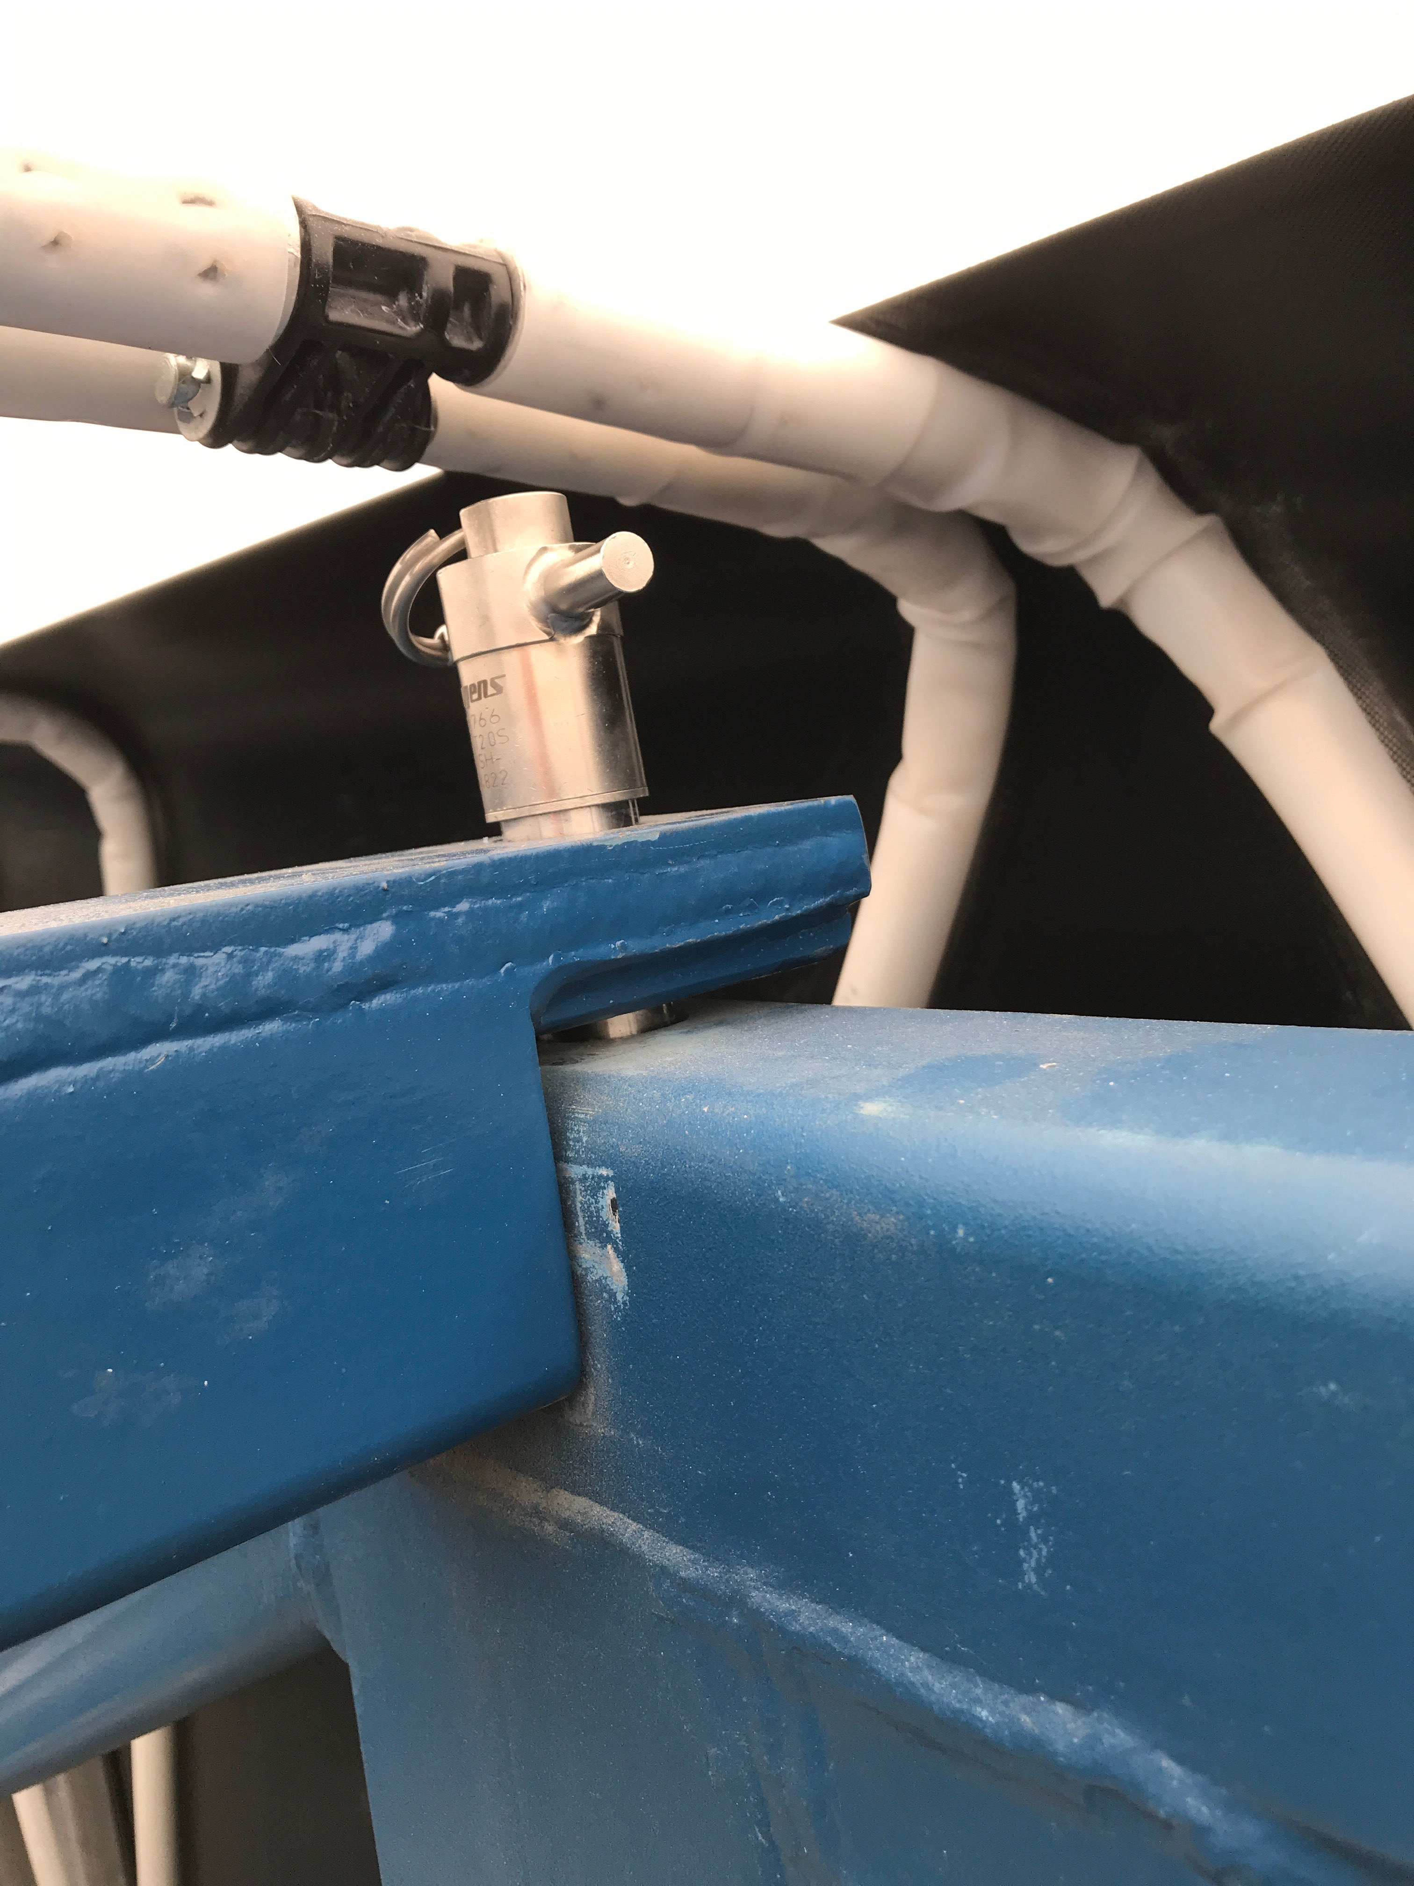
Frame upper truss
The upper truss is held in place by pins, which allow the truss to rise vertically off the frame. The truss resonates for a very long time after a shock, ~10 seconds to the touch.
Will add some padding to the six contact points.

Slide 3
Frame to trailer shimming
Transportation experts were consulted and we determined the frame should be shimmed only at the ends. It should be shimmed high enough that the central portion of the frame never touches the trailer.
Preliminary FEA has been run on the frame in this configuration and stresses appear acceptable. This is not unexpected – the frame is designed as a lifting fixture with safety factor > 4 to yield.

Slide 4
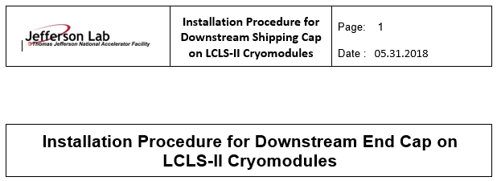
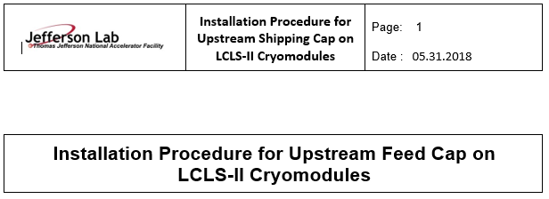
Procedure unification
Previously, Fermilab and Jefferson Lab had their own procedures to prepare a cryomodule for shipment. Naeem has started creating one procedure for the two labs to follow to avoid inconsistencies.
This will also include the method of fixing the frame to the trailer, including shims and straps.

Slide 5
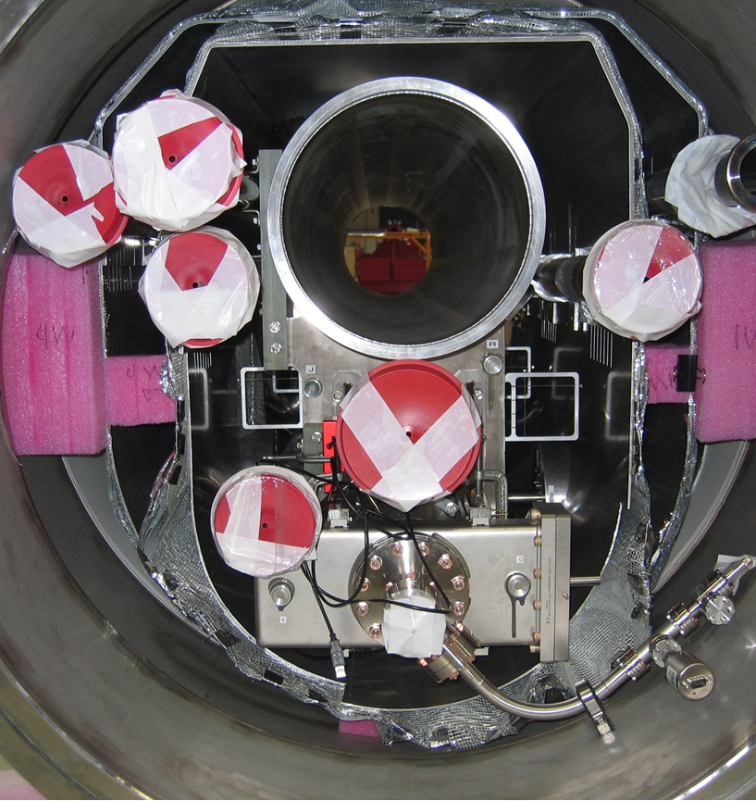
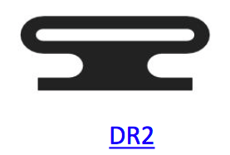
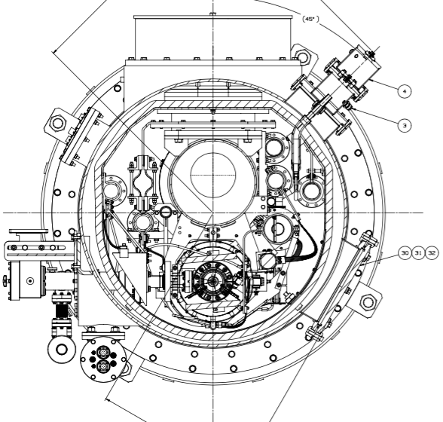
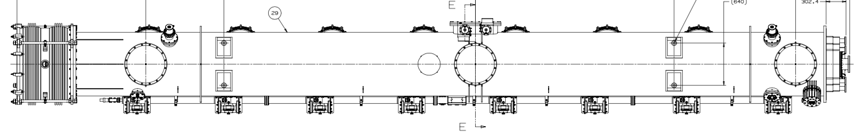
50K Shield Restraint
The 50K shield needs to be restrained from movement, especially in the central portions where there are no seismic restraints. Options we have considered:
Foam, similar to FLASH 3.9 GHz Cryomodule (right)
  Must also be installed in center of cryomodule
Additional seismic restraints
Inflatable seals

Slide 6
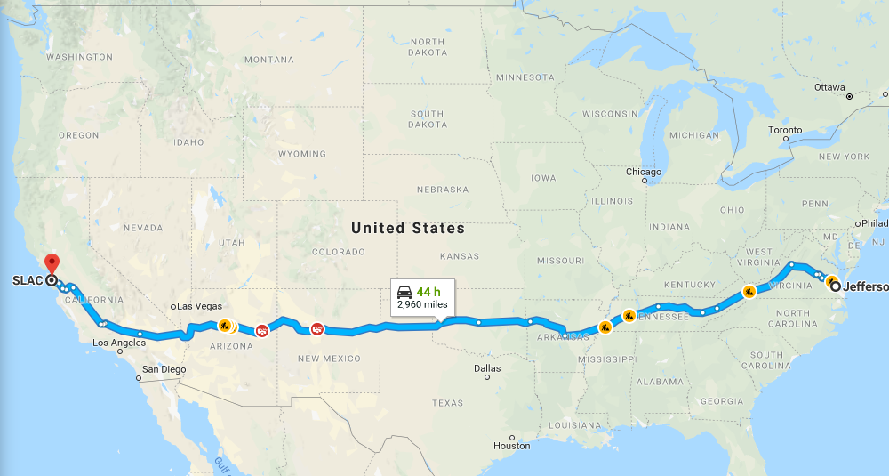
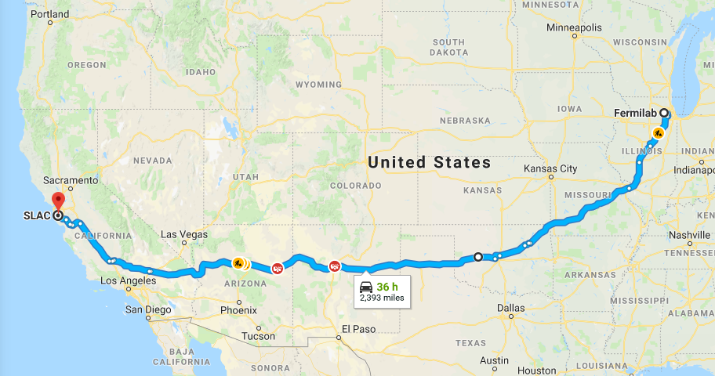
Transport route
Unify the transport route. Current thoughts:
  JLab to use the ‘southern’ route.
  Fermilab to join this route as directly as possible.
Limit the speed of transportation to a speed that is possible on all roads.
  Minimum on most interstates appears to be 45 mph, with 55 mph possibly in some sections.
Limit the route to major highways/interstates only and enforce this.
These changes most likely require changes to the shipping contract.

Slide 7
Instrumentation
Until we have confidence that accelerometers can tell the whole story, displacement logging will be carried out across the cavity 4 coupler bellows and from the cold mass to the vessel.
  Current plan is to use dial indicators capable of logging and a laser displacement measurement device with a laptop to log data.
Other instruments will be kept: SAVER9X, GP1, Slam Sticks, X2s, and the Arch systems monitor.
  Slam sticks on US CGV, DS CGV, and across cavity 4 coupler bellows.
  X2s on axle side inner and outer frame
  GP1 at least on DS CGV and outer frame
  Arch systems shock logger on DS CGV
Beamline vacuum levels will be monitored and logged
We are working on a method to both power and feed signals out where needed through the tuner access ports for cavities 2, 5, and 8.

Slide 8
Summary
In addition to the transport system design modifications shown, we plan to:
  Restrain the transport frame upper truss
  Shim the frame on the ends, not touching in the center
  Create one cryomodule shipping procedure to use between the two labs
  Restrain the 50K shield
  Unify the shipping route as much as possible and enforce this route.
  Limit truck speed to reduce shocks.
Instrumentation will stay with a similar layout to the J1.3-07 Bristol test with the addition of displacement measurements.

