Slide 1
LCLS-II Shipping System Concept
Naeem Huque
Shipping Review
June 12th, 2018

Slide 2
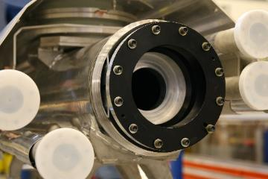
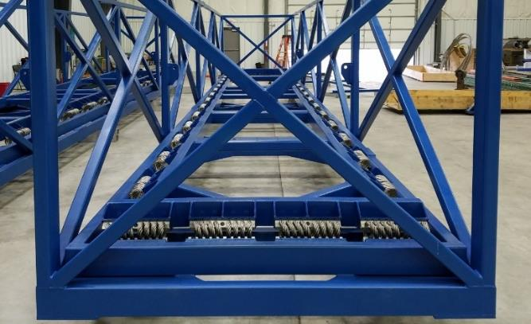
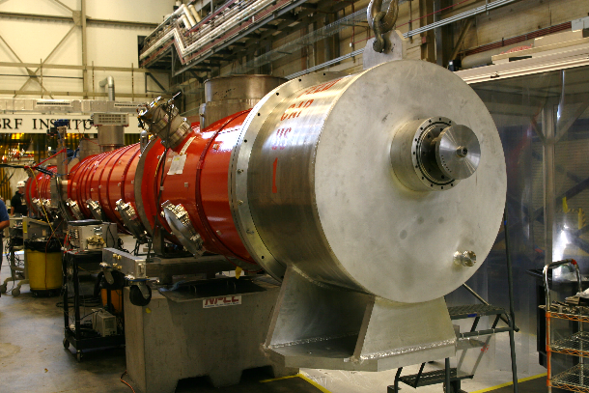
Introduction
The LCLS-II Shipping System was based on the system that successfully transported 100 CMs from Saclay to DESY
Adjustments to the XFEL design were required for several reasons
The system is made of the following major components:
  Shipping Frame (bottom left)
  Shipping Caps (bottom right)
  GHRP Inserts (right)
  Trailer with Air-Ride Suspension

Slide 3
Procurement Considerations
The XFEL Shipping Frame and Shipping Caps were designed and built by RI and Babcock-Noell respectively
The designs and specifications were proprietary to RI and BN, and could not be replicated in the US
Modifications to the XFEL design would have been necessary anyway for use with LCLS-II cryomodules
Due to the cost of procuring the equipment from Germany, it was decided (February 2015) that a new system (loosely based on XFEL) would be designed at FNAL
In addition to cost, designing and building the parts in the US would lead to greater control in fabrication, and allow small changes to be implemented in an smoother manner
The parts would then be fabricated for a lower price in the US
The FNAL design was between February 2015 and March 2016, and a contract was awarded to AES in May, 2016

Slide 4
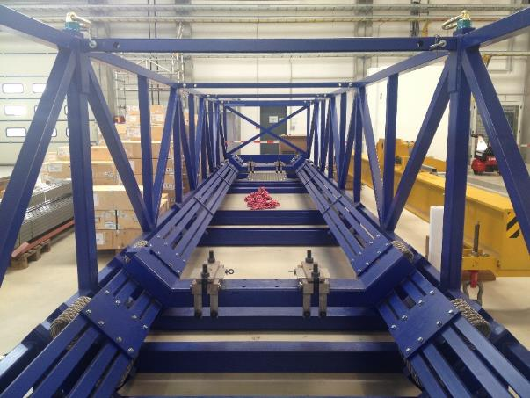
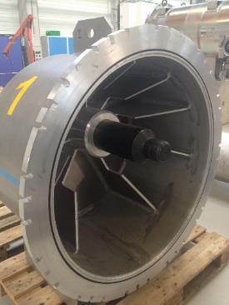
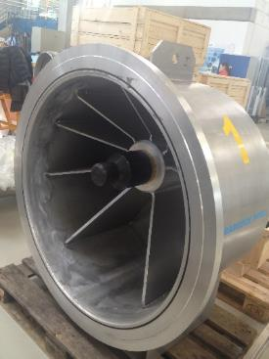
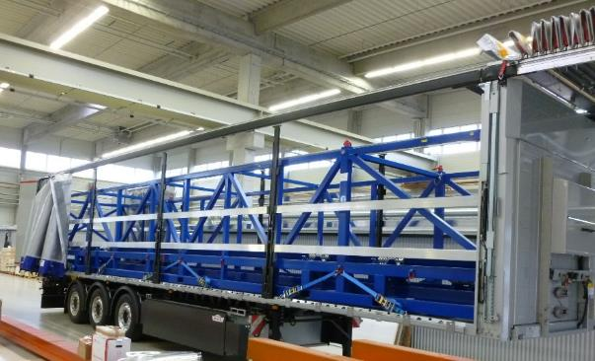
XFEL Shipping System
XFEL Shipping System Components:
  Shipping Frame (Right)
  Trailer with custom roof (Bottom Right)
  Downstream Shipping Cap (Bottom Center)
  Upstream Shipping Cap (Bottom Left)

Slide 5

XFEL and LCLS-II Comparison: Shipping Frame
The LCLS-II shipping frame was designed to carry both the 1.3 GHz and 3.9 Ghz cryomodules
The Frames use helical coil springs of different sizes:
  XFEL: Ten Sebert G7 1300-06 and ten G7 1300-08
  LCLS-II: 38 IDC M28-525-08 (of which 32 are used for operation)
The springs are oriented at 45 degrees to cover two axes of compression
After a conversation with the spring manufacturers (IDC), the FNAL design team determined that the springs would be more effective if installed in the current LCLS-II frame style, over that used by XFEL

Slide 6

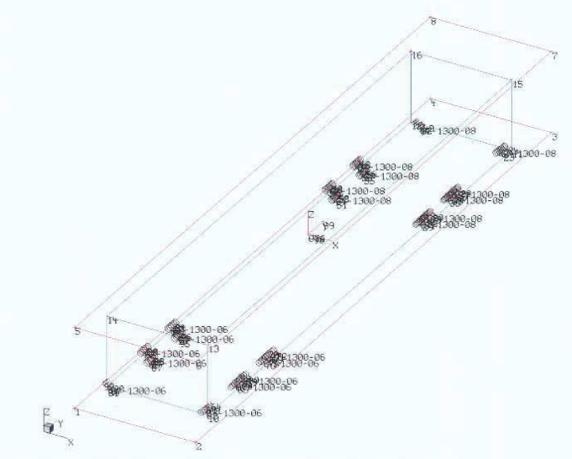
XFEL and LCLS-II Comparison: Shipping Frame
XFEL
Stiffer springs are used on the magnet end of the frame
LCLS-II
Springs are identical, evenly spaced, and symmetrical
Stiffer springs
The current LCLS-II design will not allow the same spring layout as XFEL

Slide 7
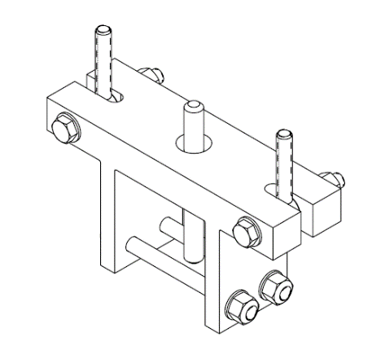
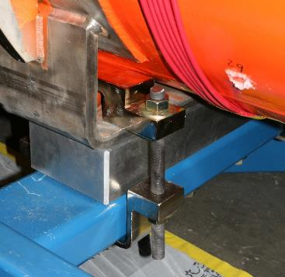
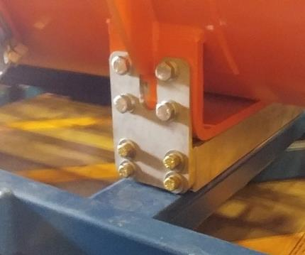
XFEL and LCLS-II Comparison: Cryomodule Clamps
Four such clamps are used to hold the CM to the Shipping Frame
XFEL had a clamping system especially designed for the shipping frame (Top Image)
The FNAL design changed it to a simpler and cheaper system (Center Image)
  There were several instances of the clamps becoming loose after shipments, allowing the CM to move
  The installation process for the clamps was very difficult and non-ergonomic
A second iteration of the clamping system (Bottom Image) was introduced; it made use of the seismic restraint holes on the CM that were not present at the time of the original shipping system design
  The new clamps were successfully used on J1.3-07

Slide 8
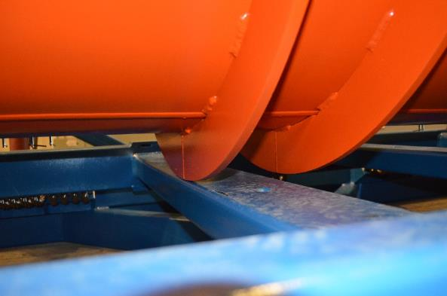
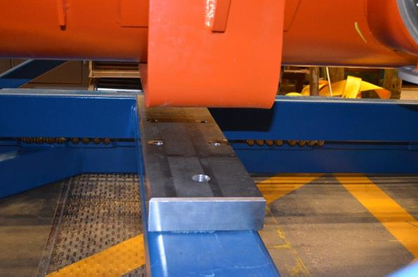
LCLS-II Shipping Frame Design Evolution
The first fit-test of a vacuum vessel on the LCLS-II shipping frame found interference at a stiffening rib (left image)
  The clearances were based on the XFEL shipping frame, but the LCLS-II design had not taken the different clamps into account
A 2.5” thick aluminum spacer (right image) was used to raise the installed CM and avoid the interference
The spacer was eventually to 4.5” in thickness to ensure clearance from instrumentation tees on the coupler vacuum line

Slide 9
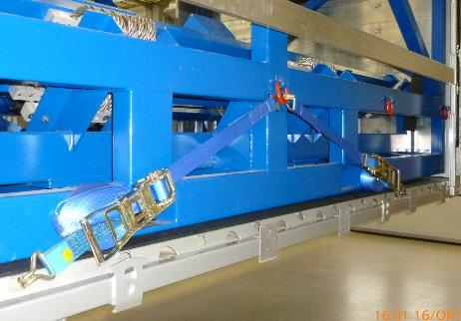
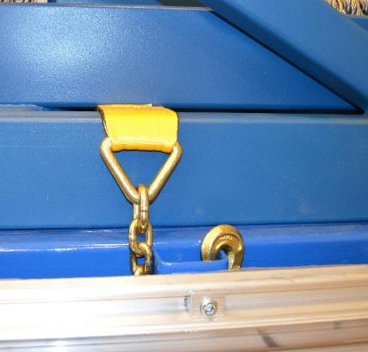
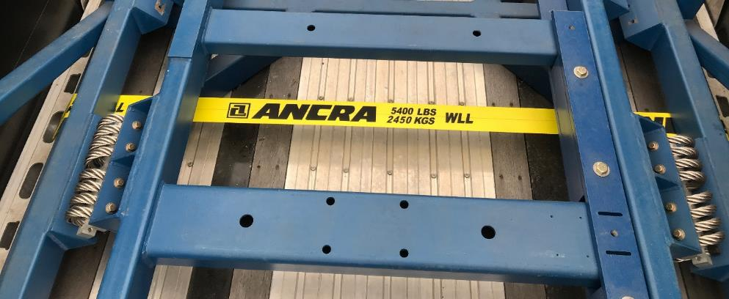
LCLS-II Shipping Frame Strapping
The XFEL shipping frame was attached to the trailer using straps and features on the shipping frame member. The LCLS-II design does not have these features.
JLab and FNAL used different strapping techniques
The JLab version was successfully used for the three pCM trips
  On one occasion, one of the 8 straps was found to have come loose
The FNAL version was used on the F1.3-06 outbound trip
  Several straps came loose periodically during the trip
  Straps were found to be damaged from abrasion

Slide 10
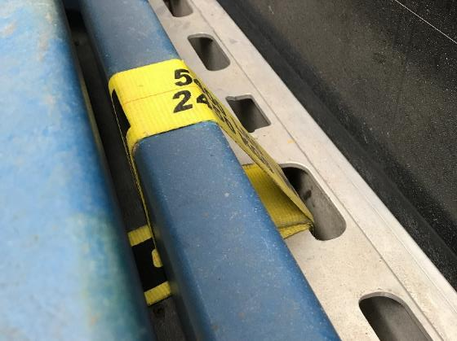
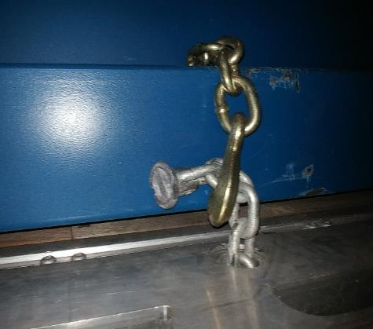
LCLS-II Shipping Frame Strapping
The final JLab strap configuration is shown below (left)
  The steel chain links are in contact with and holding down the steel frame, protecting the straps from wear
  The style was used in the J1.3-07 road test and lead to lower shocks being recorded on the shipping frame
The FNAL version is shown below (right)
  They style was recommended by a shipping consultancy company
  It was successfully used on the F1.3-06 return trip to FNAL without loosening or damage to straps
The final version to be used for shipping to SLAC is TBD

Slide 11


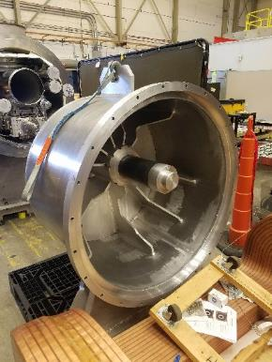
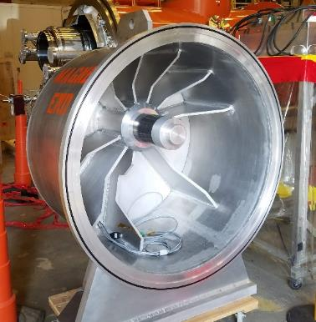
XFEL and LCLS-II Comparison: Shipping Caps
The LCLS-II shipping caps are based on XFEL shipping caps
The first LCLS-II iteration of the caps had only the flanges and gussets different from the XFEL design
The LCLS-II spindles were made from hollow aluminum, as opposed to solid steel for XFEL
The gussets were changed to accommodate LCLS-II piping and vacuum gauges
The modified flanges were an FNAL design decision
XFEL
Downstream (left) and Upstream (right) caps..
LCLS-II
Downstream (right) and Upstream (left) caps

Slide 12
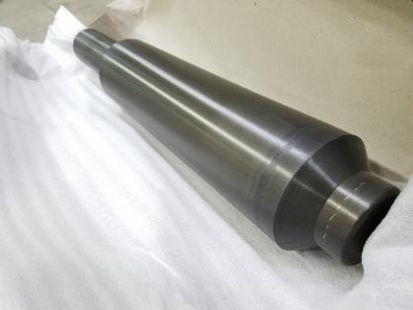
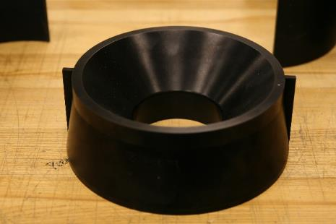
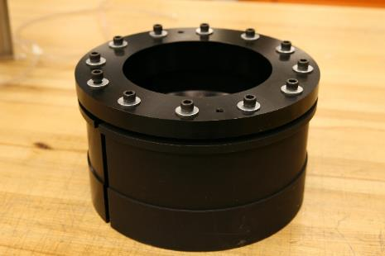
XFEL and LCLS-II Comparison: HeGRP Inserts
The HeGRP inserts (right) were designed at FNAL based on JT files of the BN model
The inserts use a “reverse collet” mechanism to hold on to the ID of the 300mm pipe
They are designed to allow the spindle in the shipping cap to impart an axial force on the pipe
The inserts used the tapered Center Ring (center) and Spindle (left)
This did not fit in the HeGRP pipes in the LCLS-II upper cold masses due to the a weld bead that deformed the ID of the pipe
This deformation is present in different degrees on all the 300mm pipes
XFEL faced a similar problem with their first iteration of insert design

Slide 13
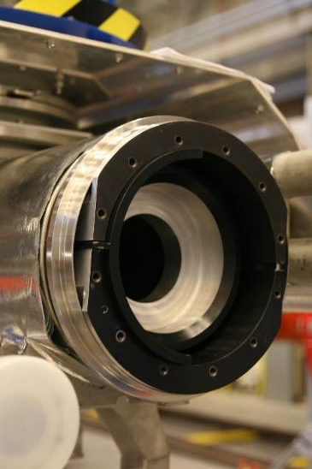
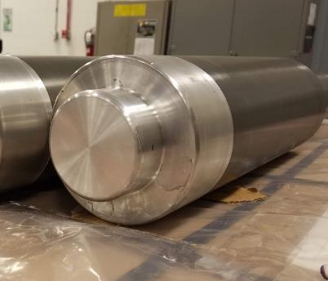
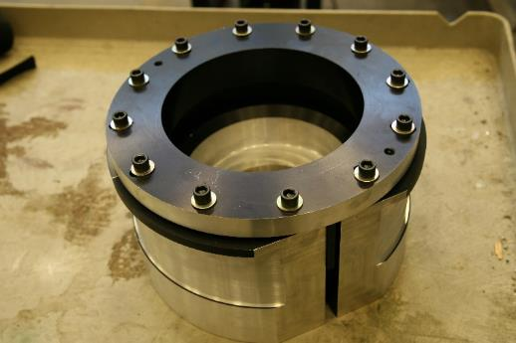
XFEL and LCLS-II Comparison: HeGRP Inserts
JLab staff visited DESY to look at and replicate XFEL parts and procedures
It was found that the inserts and shipping caps would not work together due to the different flanges on the LCLS-II shipping caps
The FNAL design for the shipping cap spindle and the HeGRP Insert were changed to work with the new flanges; time constraints would not allow the shipping cap flanges to be changed
  The taper in the spindle was replaced with a step (left)
  The taper in the centering ring was also replaced with a step (right)
  The OD of the insert was machined as per XFEL dimensions (center)

Slide 14
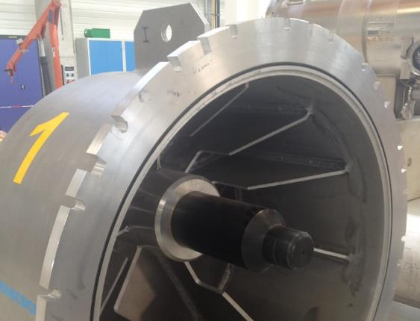
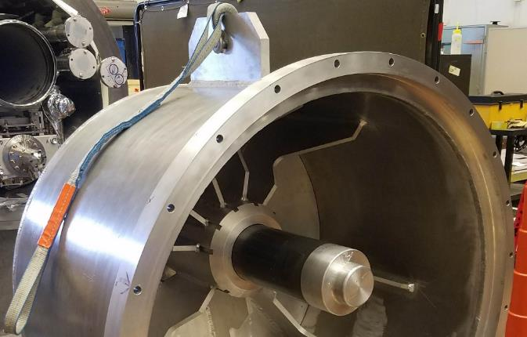
XFEL and LCLS-II Comparison: Shipping Caps
The LCLS-II shipping cap (right) has a socketed connection to the vacuum vessel flange; the upstream cap is used as an example here
The XFEL caps (left) have a flat surface with slotted holes
The features on the XFEL caps allow it to float on the plane of the vacuum vessel flange when centering the tapered spindle
The socket on the LCLS-II cap does not allow the freedom to float.
In conjunction with 300mm pipes that are deformed and out of position, there was no simple way to allow the tapered system to work without extensive redesign and machining.

Slide 15
XFEL and LCLS-II Comparison: HeGRP Inserts
The new HeGRP Insert caps and Spindle still applied an axial load on the 300mm pipe as per the original XFEL intent
The setup was successfully used for three shipments of the JLab pCM (~2600 miles) and a shipment of the JLab J1.3-07 (~800 miles)
The system’s only failure (F1.3-06) is attributed to improper installation of the inserts; this underlines the need for a procedure that is consisted and adhered to
Reverting to the XFEL tapered design should also be equally successful, while adding minimal risks

Slide 16
LCLS-II Shipping Trailer
Identical trailers equipped with the same air-ride suspension system (Hendrickson INTRAAX AANT 23K) were purchased at each lab
The crane at SLAC’s Sector 10 does not have the weight capacity to lift both the shipping frame and cryomodule at the same time
The trailers are fitted with custom sliding curtain sides and roof that allows the curtain to be slid beyond the forward or aft of the trailer, allowing full access to the trailer bed; this allows a cryomodule to be taken out of the trailer without taking the latter off the shipping frame.
A regular curtain-side trailer does not allow full access to the trailer bed and would not be usable at SLAC
The ability to extend the curtain side in either direction of the trailer allows for extra flexibility when loading in tight spaces such as JLab’s high bay

Slide 17
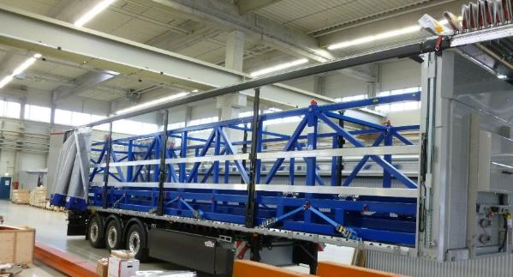
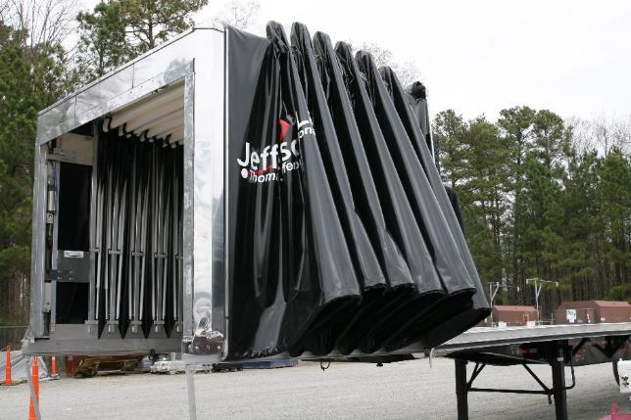
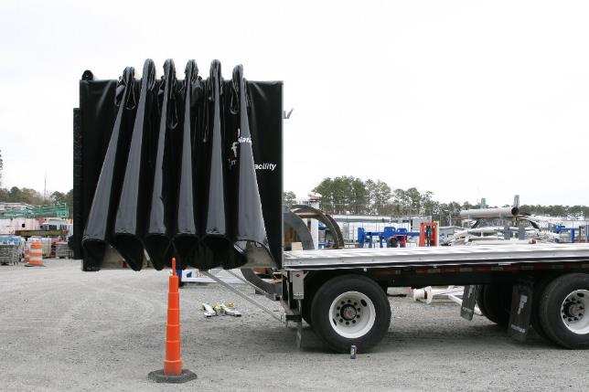
LCLS-II Shipping Trailer
The trailers used at XFEL were modified and owned by the shipping company (top)
The LCLS-II trailer is shown below with the roof opened on the tractor side (left) and aft side (right)

Slide 18
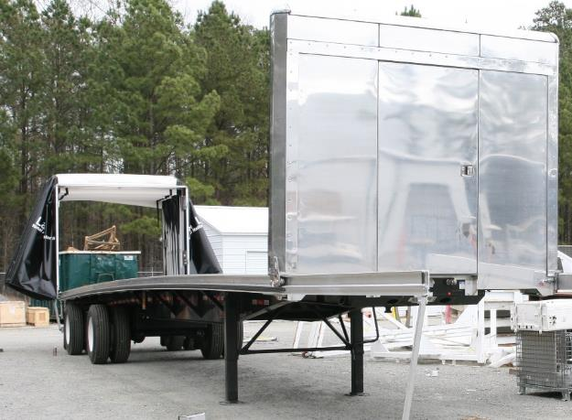
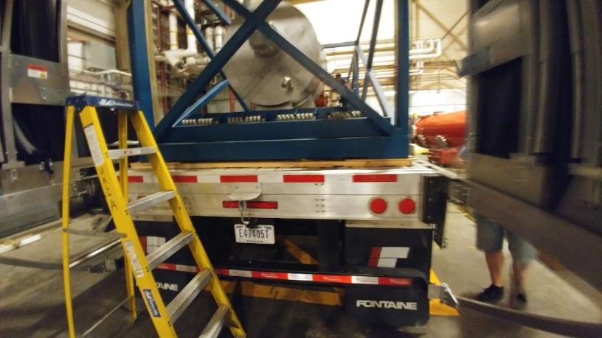
LCLS-II Shipping Trailer Shimming
The trailer bed has a built in camber, which is common among flatbed trailers (left)
The camber is designed to be flattened by the load on the trailer
The shipping frame and cryomodule is not enough to flatten the trailer, and gaps between the frame and the trailer bed can be found after loading
Extensive shimming (right) to fill these gaps has been found to limit the shipping frame movement relative to the trailer and reduce shocks by a factor of two

Slide 19


FNAL – SLAC Cryomodule Shipping Routes
Both a Winter (top) and a Summer (bottom) route from FNAL was proposed
The Winter route, though longer, would avoid areas that may experience dangerous road conditions due to snow and ice
Specifying the same route for all shipments is currently being considered

Slide 20
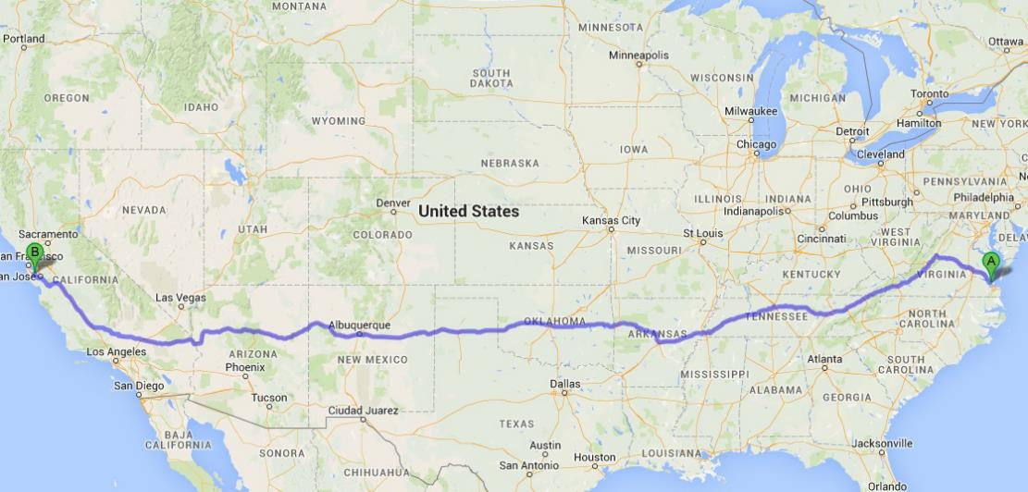
JLab – SLAC Cryomodule Shipping Routes
A single, general route is planned for shipments from JLab to SLAC
The first segment of the route has been covered during the J1.3-01 and J1.3-07 shipping tests
A proposal to combine the two routes to the greatest extent possible is also being considered

Slide 21
Conclusion
The shipping system designed for LCLS-II is based on that used at XFEL but has a number of differences
Design verification work at JLab has determined that the LCLS-II system is capable of safely transporting as well as its XFEL counterpart
The system’s only failure hinged on the improper installation of the equipment
Adding components of the XFEL design (e.g. tapered spindles and inserts) will further improve the LCLS-II shipping system, while reducing the risks for future shipments

