Slide 1
LCLS-II Cryomodule Shipping System Testing
Naeem Huque
Brian Hartsell
Shipping Review
June 12th, 2018

Slide 2
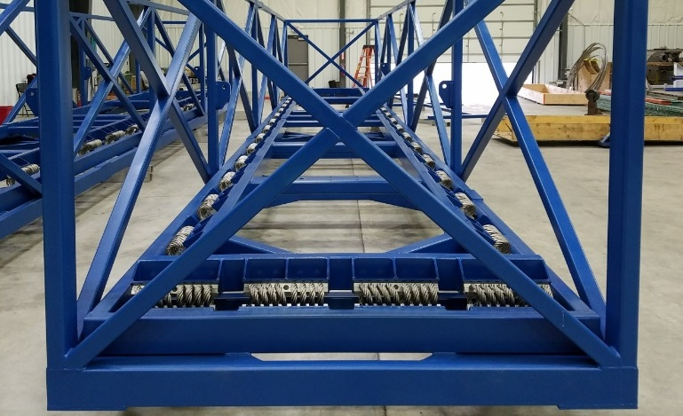
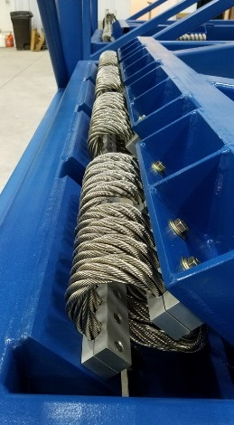
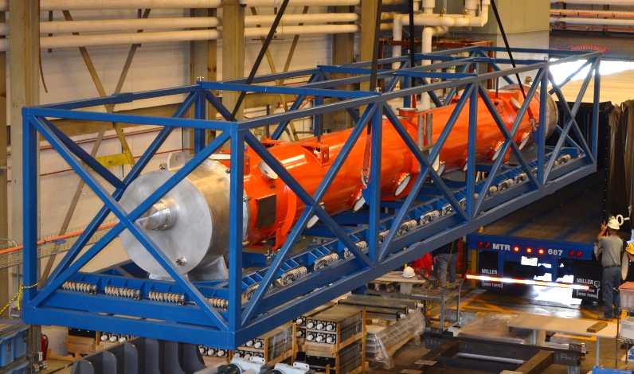
Introduction
The cryomodule shipping system has been used successfully during several test trips and inter-lab trips
Accelerometers and vibration recording devices were installed on the cryomodules during shipment
RF checks, alignment checks and cryomodule performance tests (JLab pCM) were carried out before and after the trips
One failure was recorded between FNAL and SLAC; this was due to improper installation of the cryomodule in the shipping system

Slide 3
Cryomodule Transportation Summary
Test | Date | Distance
J1.3-01 (tuning and frame verification) | February, 2017 | 150 miles
J1.3-01 JLab to Bristol round trip | March, 2017 | 780 miles
J1.3-01 JLab to Fermilab | August, 2017 | 900 miles
J1.3-01 Fermilab to JLab | November, 2017 | 900 miles
F1.3-06 Fermilab to SLAC (failed) | January, 2018 | 2150 miles
F1.3-06 SLAC to Fermilab | April, 2018 | 2150 miles
J1.3-07 JLab to Bristol round trip | April, 2018 | 780 miles
Cumulative Mileage
J1.3-01 | 2730 miles
F1.3-06 (failed) | 4300 miles
J1.3-07 | 780 miles

Slide 4
Instrumentation
The JLab pCM tests used a SAVER9X accelerometer and GP1 accelerometers
In addition, J1.3-07 and the F1.3-06 return trip also used Slamsticks (SS) and X2s
The table below shows a summary of the different devices
The sensors provide a wide array of shock and continuous vibration data
 | X2-2 | SS-X | SAVER 9X | GP-1 | Geophone
Measures | Acceleration | Acceleration | Acceleration | Acceleration | Velocity
Sampling | Continuous, 512 Hz | Continuous, 1000 Hz | Shock only | Shock only, 100Hz per event | Continuous, ~2 kHz
Range (+/- g) | 1.2-2 | 25 | 5 | 2.5-10 | N/A
ADC bit depth | 15 | 16 | 16 |  | 16/24
Resolvable disp @ 5Hz, um | 2.4 | 15.2 | 3 |  | 0.03
Resolvable disp @ 10Hz, um | 0.7 | 3.8 | 0.8 |  | 0.016

Slide 5
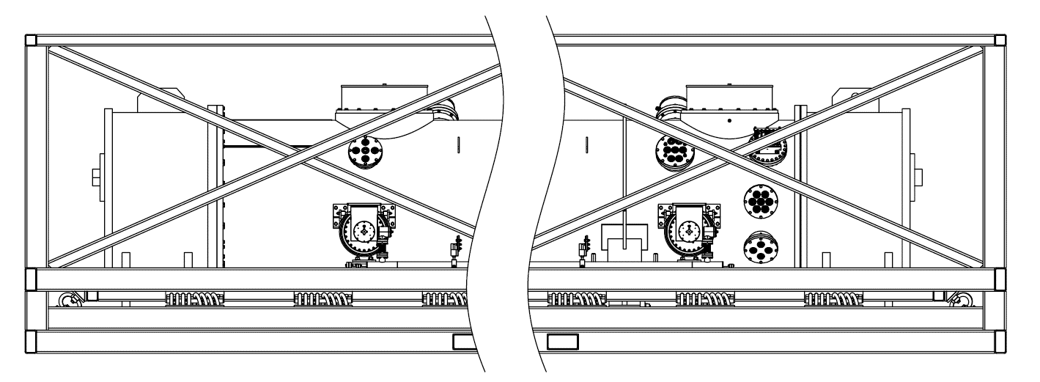
JLab pCM and J1.3-07 Instrumentation
JLab shipments mainly used the original combination of SAVER9X GPS and GP1 units
Triaxial sensors were installed on the Outer Frame (connected to the trailer) and the Inner Frame (isolated by the springs)
The sensors would record 1s of data at any time the sensor records a shock over 1.5g; the 1s is split by 0.5s before the event and 0.5s after
PCB Accelerometer
(On Inner Frame)
PCB Accelerometer
(On Cavity 8 Beamline, J1.3-07 only)
GP1
(On Gate Valve)
SAVER 9XGPS
(Shipping Cap, J1.3-07 only)
GP1
(On Gate Valve)
GP1
(On Inner Frame)
PCB Accelerometer
(On Cavity 1 Coupler Waveguide)
GP1
(On Outer Frame)
PCB Accelerometer
(On Cavity 8 Coupler, J1.3-07 only)
SAVER 9XGPS
(On Outer Frame)

Slide 6
pCM Road Test Summary
The JLab pCM was transported to Bristol, VA and back to JLab; a total distance of ~780 miles
The shipping frame and cryomodule were fitted with accelerometers and geophones.
Beamline vacuum was not actively pumped, but was actively monitored and logged; gate valves on both ends were open
The positions of the Gate Valves, Support Posts and Cavity Flanges were recorded against fiducial points on the vacuum vessel
The insulating vacuum space was pressurized to 1050 mBar
All measurements would be repeated after the completion of the road test
The pCM was also tested in the CMTF to determine any degradation in performance

Slide 7
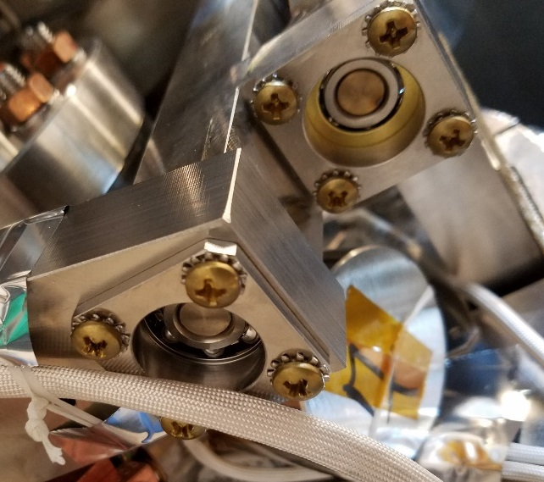
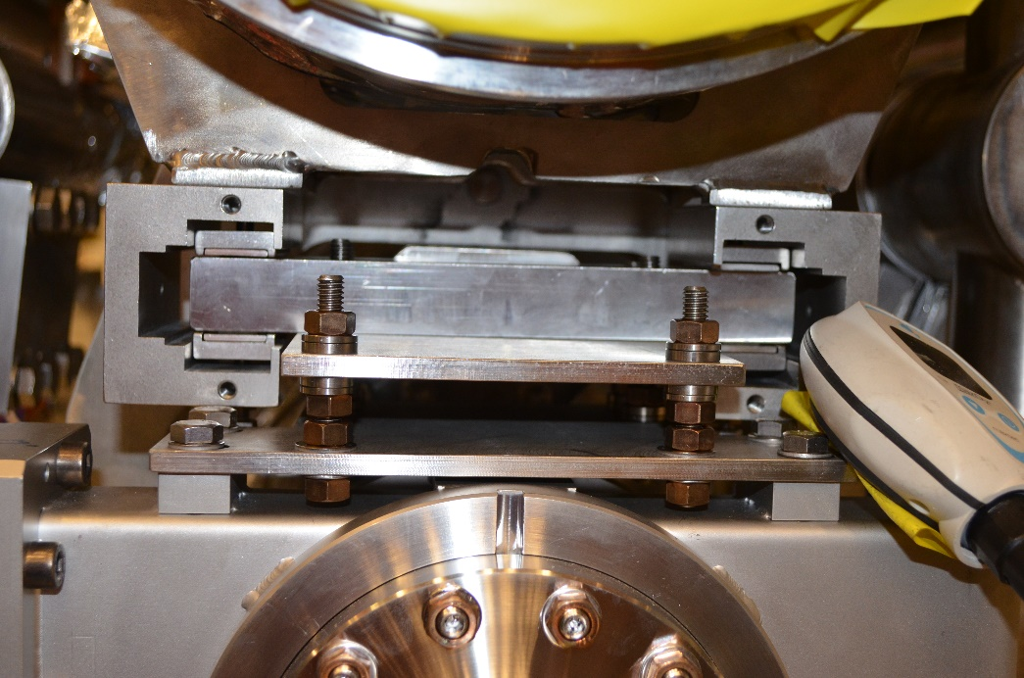
pCM Road Test Mechanical Issues
A brass screw from the Cavity 1 tuner dislodged during the road trip. The other three screws from the same housing were found to still be torqued to spec. It is surmised that the one screw had not been torqued
A needle bearing from the downstream gate valve became dislodged during the road test
The Kapton tape used on the limit switch leaf of Cavity 4 became detached due to contact with the contact screw
Steps were taken to remedy these issues for the next trip
Needle bearing shown in the red circle was dislodged
Circled fastener was dislodged; the remaining fasteners seen in the photo remained torqued to the specified 17 in.lbs

Slide 8
pCM Road Test Shocks
The shocks on the Outer Frame (seen by the trailer itself) are compared to the shocks on the Inner Frame (to which the cryomodule is attached)
The three highest shocks in each of the three axes are compared here; these shocks did not simultaneously occur at a single event
With one exception, the shocks were attenuated between 60% - 80%
At five instances, the shock on the Inner Frame exceeded the spec of 1.5g
The largest shocks were found to have occurred as the truck entered or left weigh stations
The shipping frame was found to attenuate shocks as per design
Spec = 1.5g

Slide 9
pCM Road Test Cavity Alignment
Points on the cavity flanges were measured through the tuner access ports
Not all cavities were accessible.
Position changes in the Horizontal and Vertical planes were very small
The downstream cavities saw a significant deviation in the longitudinal axis, towards the back of the trailer (-ve)
The absence of support bearing stops could have contributed to this shift
The error bars are +/- 0.18mm (calculated from comparing fiducial positions from Cantilever Fixture and final assembly)
No serious positional deviations were found for the cavity flanges

Slide 10
pCM Road Test Fiducial Positions
The SLAC acceptance document specified a maximum of +/- 0.2mm [x, y, z] change in the gate valve and support post fiducial positions after shipping.
These measurements are to be repeated for each cryomodule, before and after the trip to SLAC
Two positions were found to be out of spec
Change in position of the downstream Gate Valve in the longitudinal [z] direction matches that found with the cavities
Nearly all measurements were within spec; modifications were planned to limit movement further
Alignment Changes After Road Test
Gate Valve Fiducials
 | dX (mm) | dY (mm) | dZ (mm)
Specification | ± 0.20 | ± 0.20 | ± 0.20
Upstream | -0.02 | -0.38 | -0.19
Downstream | -0.05 | 0.04 | -0.44
Error | ± 0.10 | ± 0.10 | ± 0.10
Support Post Fiducials
 | dX (mm) | dY (mm) | dZ (mm)
Specification | ± 0.20 | ± 0.20 | ± 0.20
Upstream | 0.03 | -0.08 | -0.11
Centre | -0.06 | -0.11 | 0.13
Downstream | 0.15 | 0.24 | -0.05
Error | ± 0.10 | ± 0.10 | ± 0.10

Slide 11
pCM Road Test Beamline Vacuum
As per the SLAC acceptance document, the beamline vacuum should be better than 10⁻⁷ mBar (1.33 x 10⁻⁷ torr) at departure and better than 10⁻⁵ mBar (1.33 x 10⁻⁵ torr) at arrival
The plot below shows the beamline vacuum during the trip; the only fluctuations are due to the temperature of the gauges
The beamline was found to be leak-tight after the road test
JLab to Bristol
Bristol to JLab

Slide 12
pCM Road Test Cryomodule Performance
The Jlab pCM was tested in the CMTF after the road test
There was no appreciable change in maximum cavity gradients (shown below)
There were no additional sources of field emissions
All cavities could be tuned back to 1300.000 MHz
The beamline vacuum, waveguide vacuum and insulating vacuum were all intact
Cavity 5 was not brought up to full gradient prior to the road test
The Road Test was considered a success, and future cryomodule shipments using this shipping system were authorized

Slide 13
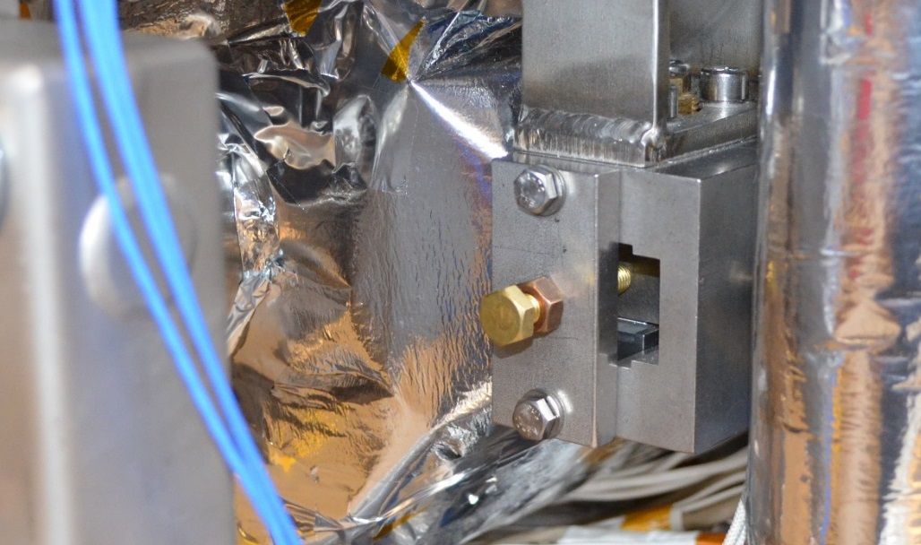
pCM Road Test Lessons Learned
The following configuration changes were to be implemented:
  Stoppers were added to the Gate Valve and cavity lug supports to keep needle bearings from falling out during transport
  Cavity tuners are no longer positioned to have the limit switch engaged to avoid any possible damage to limit switch leafs
  The clamp threaded rods (1-8 UNC) were switched from Grade-8 steel to 18-8 Stainless Steel, and the torque was changed from 100 ft.lbs to 120 ft.lbs
  A check of tuner screw torques after assembly has been incorporated into the tuner installation procedure
Stopper installed on Gate Valve support, and also on all cavity lugs

Slide 14
pCM JLab to FNAL Trip
The pCM was sent to ~900 miles from JLab to FNAL after implementing the aforementioned changes
Some other differences from the road test were:
  There was no active monitoring of the beamline vacuum gauges
  Alignment measurements prior to shipping were limited to Gate Valve and Support Post fiducials
The trip was to emulate the configuration to be used when sending cryomodule to SLAC

Slide 15
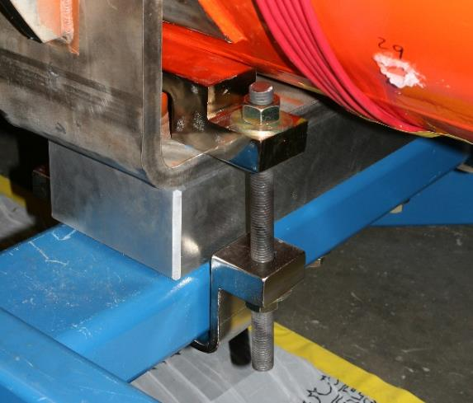
pCM JLab to FNAL Mechanical Issues
Four out of the eight threaded rods from the clamps that fix the cryomodule to the shipping frame were found to be loose
Three of these were located on the shipping frame closest to the front end of the trailer; these parts are liable to have experienced more vibrations as they were above the truck wheels
One ratchetting strap was found to have come loose, possibly due to having not been locked correctly
The pCM may have been able to move relative to the shipping frame during this trip
1-8 UNC Threads used on Cryomodule clamps during shipping

Slide 16
pCM JLab to FNAL Shocks
There were a total of 39 events where the shock on the Inner Frame was higher than 1.5g
The largest Inner Frame shock was 2.85g
These were all in the vertical (Y) axis
The five largest shock events are shown below
Some events show no attenuation, and instances where the Inner Frame shock is higher than the Outer Frame
The shocks recorded on the accelerometer were likely exaggerated due to the cryomodule being loose on the frame
Spec = 1.5g

Slide 17
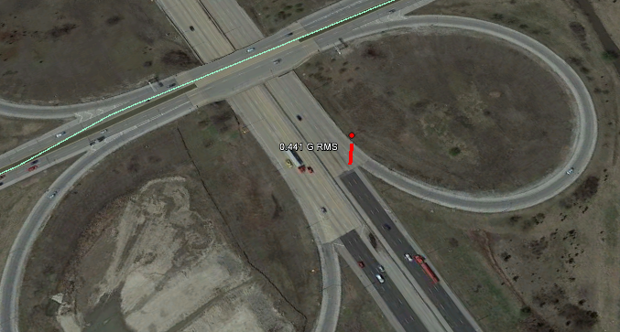
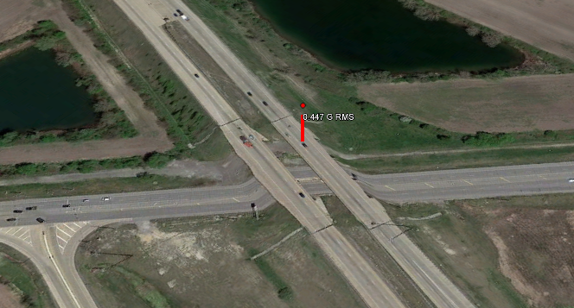
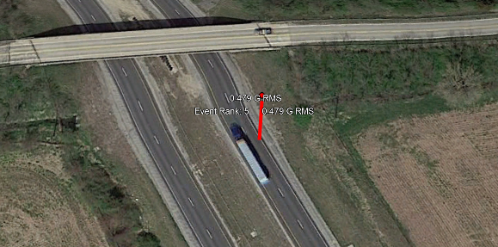
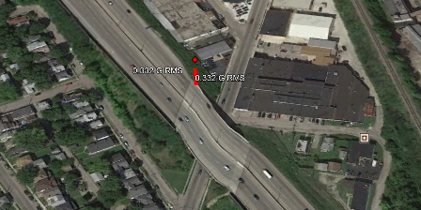
pCM JLab to FNAL Shocks cont.
From the GPS data, it seems that the large shocks were associated with road features, especially on-ramps and overpasses
On the road test, the largest shocks were associated with weigh stations
Event 1
Event 2
Event 4
Event 5

Slide 18
pCM JLab to FNAL Fiducial Positions
Gate Valve and Support Post Fiducials were checked prior to shipment to FNAL
The upstream Gate Valve still has a change that is beyond the +/- 0.2mm specification (see Back-up Slides)
The longitudinal shift in position seen in the Road Test is no longer as pronounced following the addition of the needle bearing stoppers
No excessive damage or movement is noted
No serious deviations in alignment were noted
Alignment Changes After JLab to FNAL Trip
Gate Valve Fiducials
 | dX (mm) | dY (mm) | dZ (mm)
Specification | ± 0.20 | ± 0.20 | ± 0.20
Upstream | 0.433 | -0.010 | -0.134
Downstream | 0.178 | -0.010 | 0.251
Error | ± 0.10 | ± 0.10 | ± 0.10
Support Post Fiducials
 | dX (mm) | dY (mm) | dZ (mm)
Specification | ± 0.20 | ± 0.20 | ± 0.20
Upstream | 0.056 | -0.039 | -0.079
Centre | -0.051 | -0.039 | 0.081
Downstream | -0.154 | -0.039 | 0.237
Error | ± 0.10 | ± 0.10 | ± 0.10

Slide 19
pCM JLab to FNAL Cryomodule Performance
The pCM was tested in the CMTS at FNAL
Cavities all reached 16 MV/m
Cavity 8 was not tested due to a coupler issue
No new sources of field emission were discovered
The beamline, waveguide and insulating vacuum spaces were intact and to spec
All cavities could be tuned to 1300.000 MHz
Despite seeing high shock loads, the pCM performed at an acceptable and unchanged level in the CMTS at FNAL – excluding the effects of the fast cooldown
The trip to FNAL was considered a success

Slide 20
pCM JLab to FNAL Trip Lessons Learned
The following changes were made to the shipping configuration for the return trip:
  The Gate Valves were closed to protect against any possible leaks in the right-angle valve
  The threaded rods in the clamps were torqued to their proof value of 290 ft.lbs, and green Loctite was applied to the threads
  An extra procedural step to confirm the ratchet strap installation was implemented

Slide 21
pCM FNAL to JLab Trip
The JLab pCM was shipped back to Jlab at the end of testing
Alignment measurements were not taken prior to the trip
Beamline vacuum was not actively monitored
The positive pressure on the insulating vacuum space was increased to 5 psig to ensure that the nitrogen would remain under positive pressure despite any temperature changes

Slide 22
pCM FNAL to JLab Shocks
The four GP1 units had been damaged in a previous non-LCLSII operation and did not record realistic data for the trip
The PCB satellite on the Inner Frame was not installed properly and did not provide good data
Only the accelerometer on the Outer Frame and Cavity 1 coupler waveguide could be used
All shocks on the coupler were below 1.5g
The improved constraint via the cryomodule clamps and straps lead to lower shocks on the cryomodule
Spec = 1.5g

Slide 23
pCM FNAL to JLab Summary
No loosened threaded rods were found on the shipping frame clamps on arrival at Jlab
The positive insulating vacuum space pressure was still intact
The shock data available showed far lower shocks on the pCM, and lower shocks on the trailer in general
The beamline vacuum was maintained, and a subsequent leak check found no leaks
The trip was considered a success

Slide 24
pCM FNAL to JLab Lessons Learned
A step to test the accelerometers and their installation should avoid any system failures as was experienced here

Slide 25
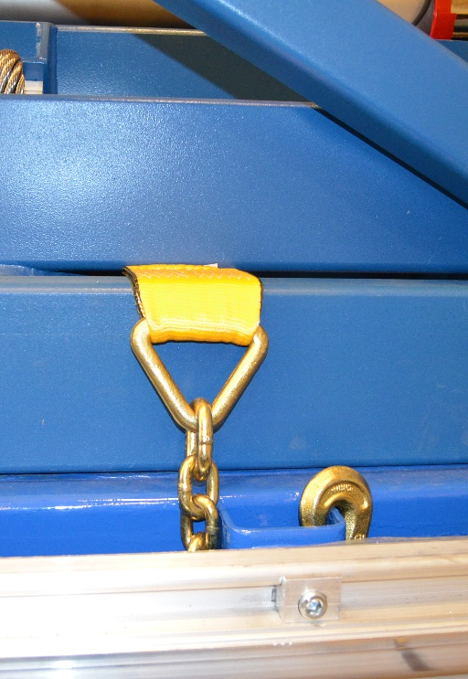
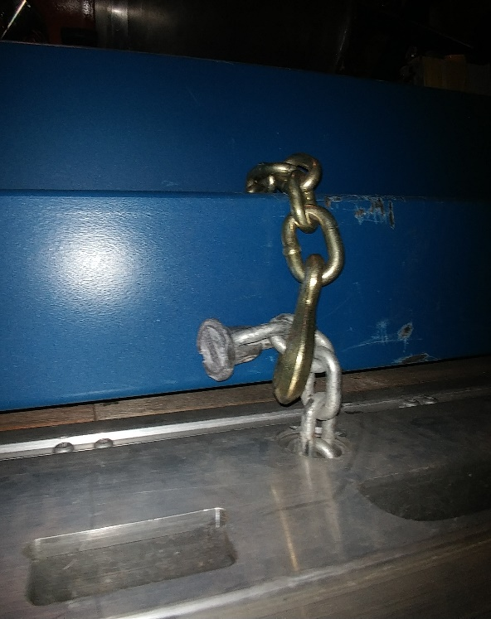
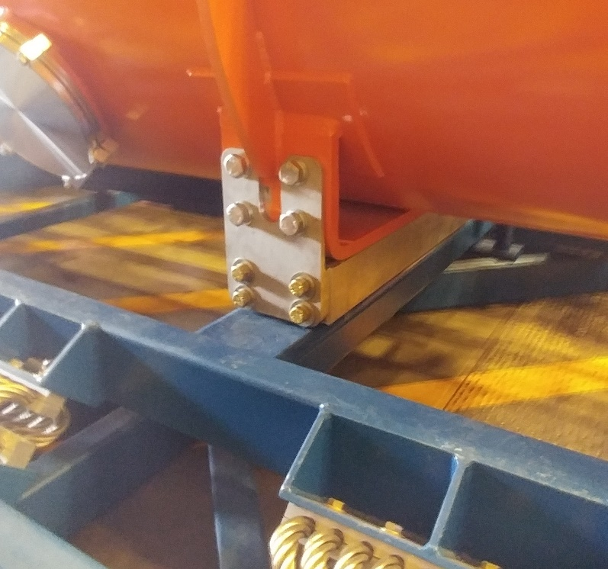
Improvements to Shipping Configuration
The clamping system has been replaced with new plates that mate to the seismic restraint holes. This will allow for easier installation and more fastening points
Gate Valves will remain open during shipping to actively monitor the beamline vacuum throughout each trip
Loctite will be applied to all brass tuner screws during tuner installation
Extra shimming was added to stabilize the shipping frame on the trailer
The method for strapping the frame on to the trailer was improved
Old (left) and new (right) strapping configuration
New clamping plates

Slide 26
F1.3-06 Fermi to SLAC
  We already know the story of F1.3-06’s condition upon arrival.
  Three GP1 shock log devices were installed for the Fermi to SLAC trip. These monitor for shock at 100Hz, log the maximum shock seen during a 30 second window, and log 1 second of data before and after a shock event over the threshold.
  SAVER 9XGPS was installed, but not properly turned on.
  Beamline pressure was not logged.
  Note that the frame was shimmed to the trailer for this transport.
  Coordinate system for the F1.3-06 plots:
      X – beam left/right, Y – beam up/down (gravity), Z – cryomodule axis

Slide 27
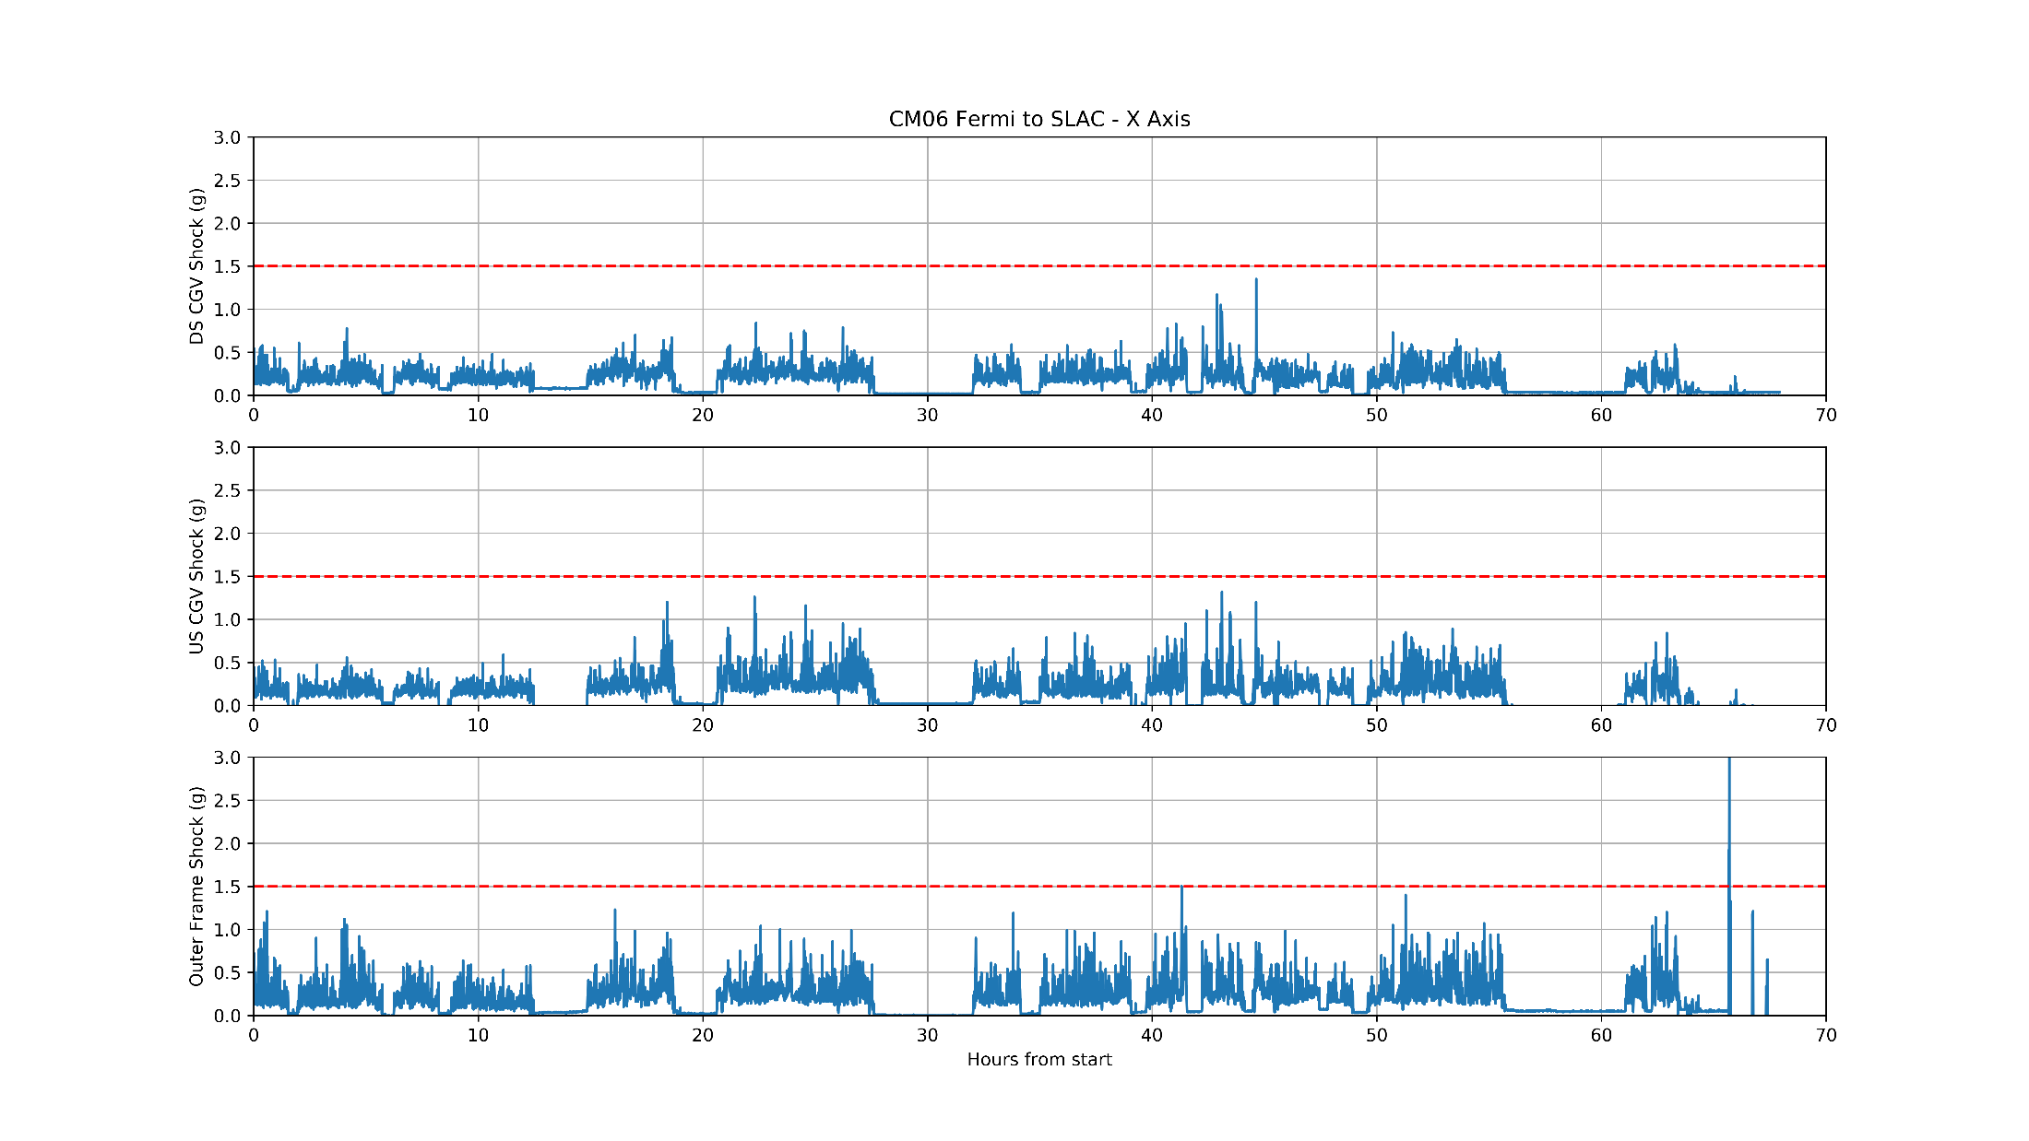
F1.3-06 Fermi to SLAC
  No events over spec in X axis.

Slide 28
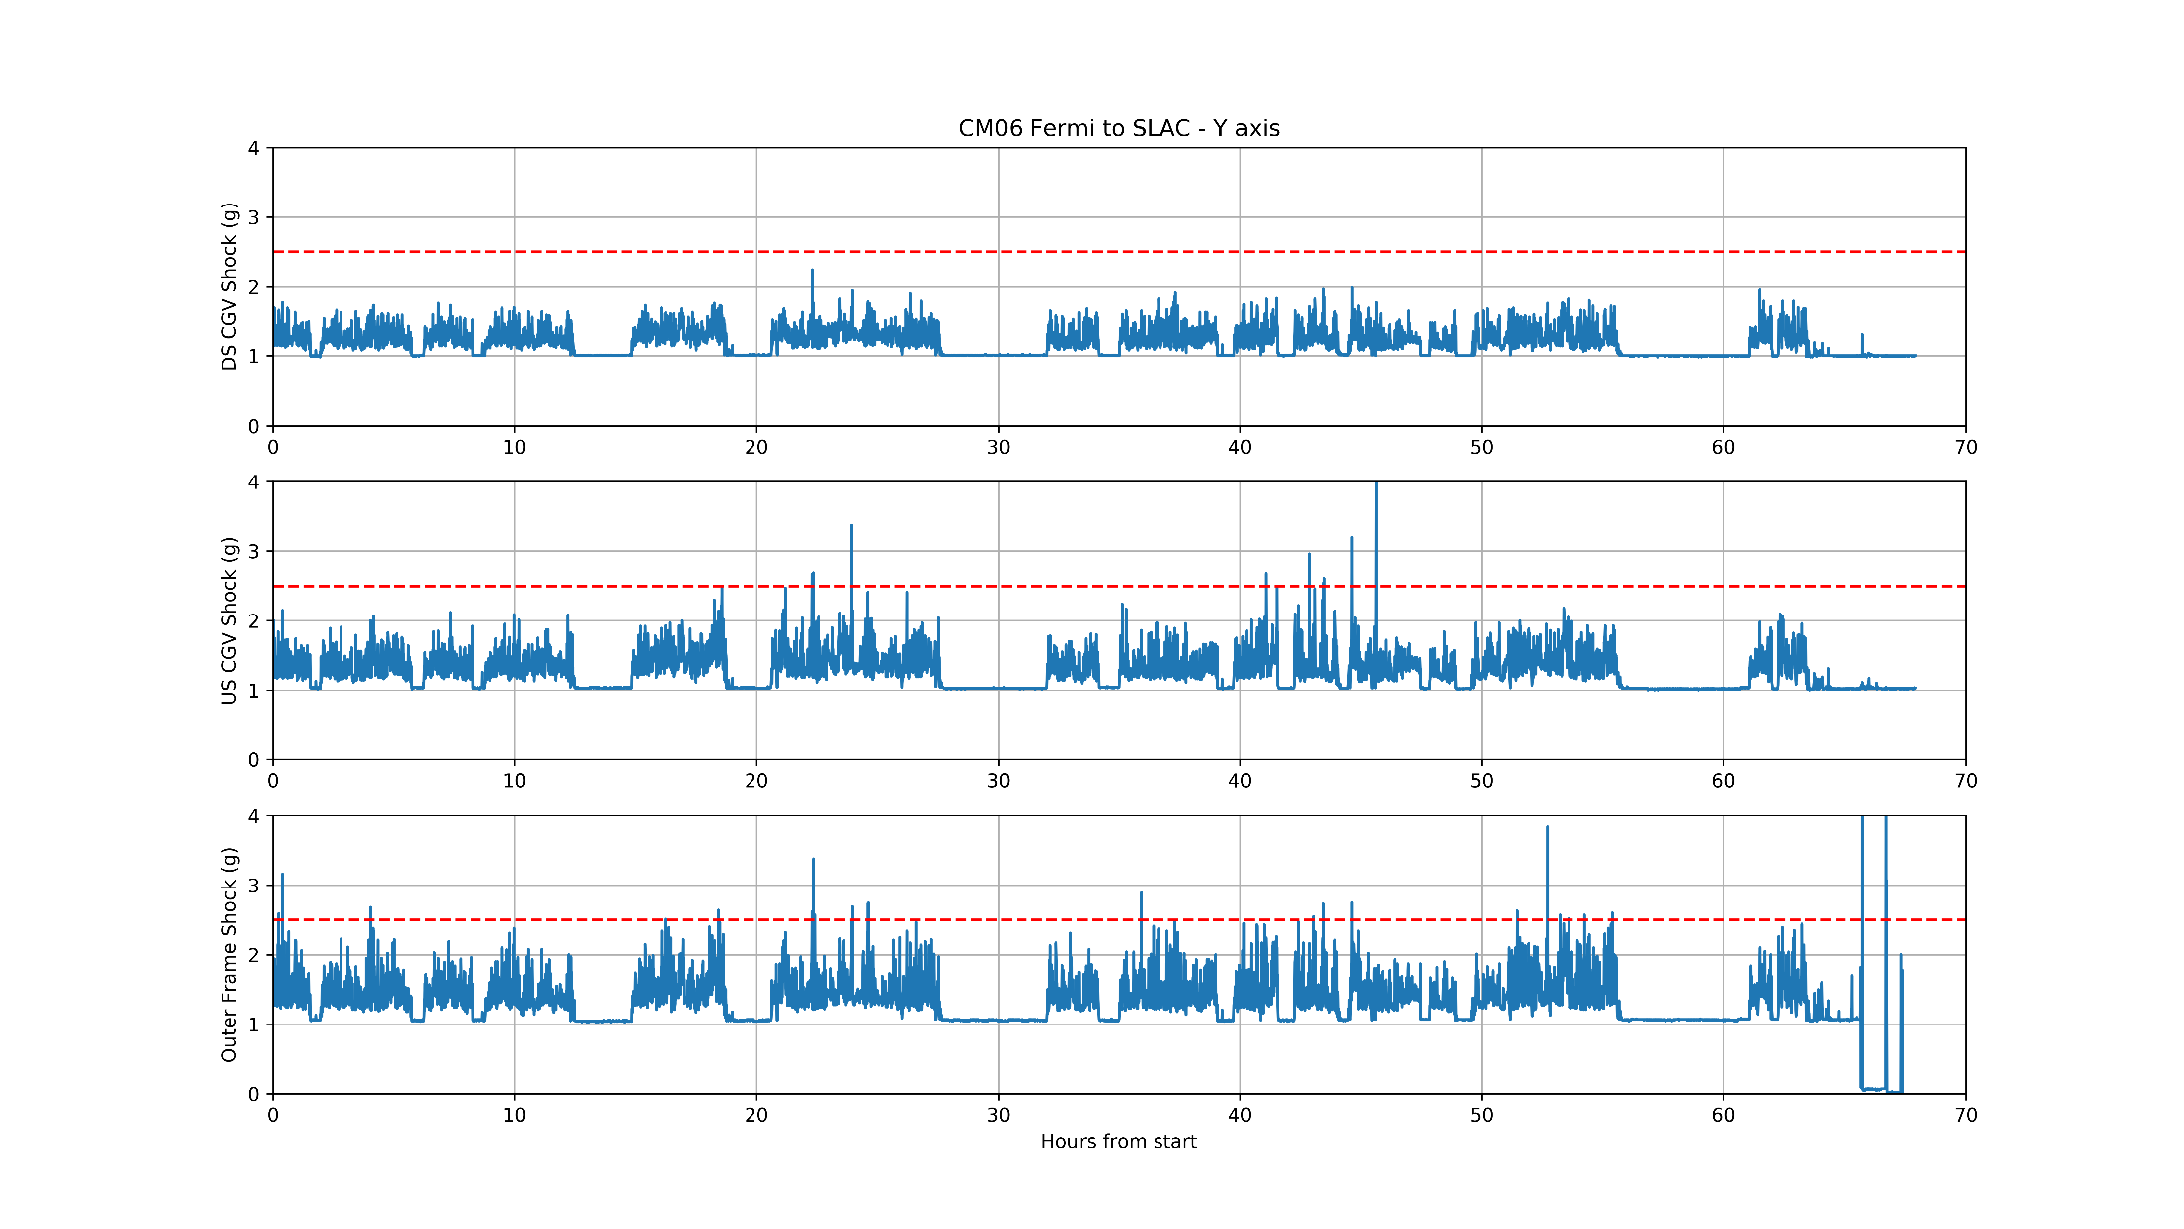
F1.3-06 Fermi to SLAC
  9 events over 1.5g on the US cold gate valve, 24 events on frame.
    An ‘event’ is the maximum value recorded over a 30 second span.

Slide 29
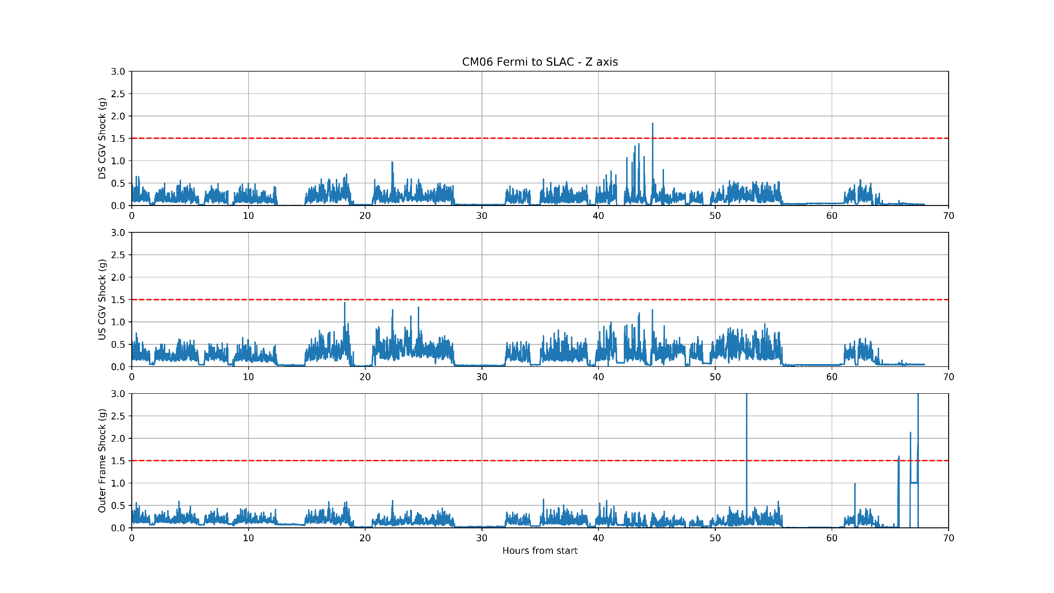
F1.3-06 Fermi to SLAC
  One event over 1.5g on the DS cold gate valve

Slide 30
Working toward F1.3-06 return to Fermilab
  Originally trying to answer the question: “What happened during transport to loosen the BPM fasteners?”
  Used additional instrumentation to continuously monitor the vibration environment, not just sample during shock or periodic sampling. This will help determine the ‘steady state’ vibration environment, not just what happens during an instantaneous shock.
  Use many independent systems so that one system failure does not jeopardize the mission.
  Use the full suite of instruments available to us for comparison and cross checking:
    GP1 devices
    SAVER 9XGPS
    Accelerometer based self-contained vibration logging devices, continuous logging at ~500Hz to capture vibration in the range of ~2-250 Hz. Can log for whole duration of trip to SLAC and more with external power source.
      Slam Stick-X
      GCDC X2-2
    Geophones for the initial trips to validate Slam Stick and X2 data.

Slide 31
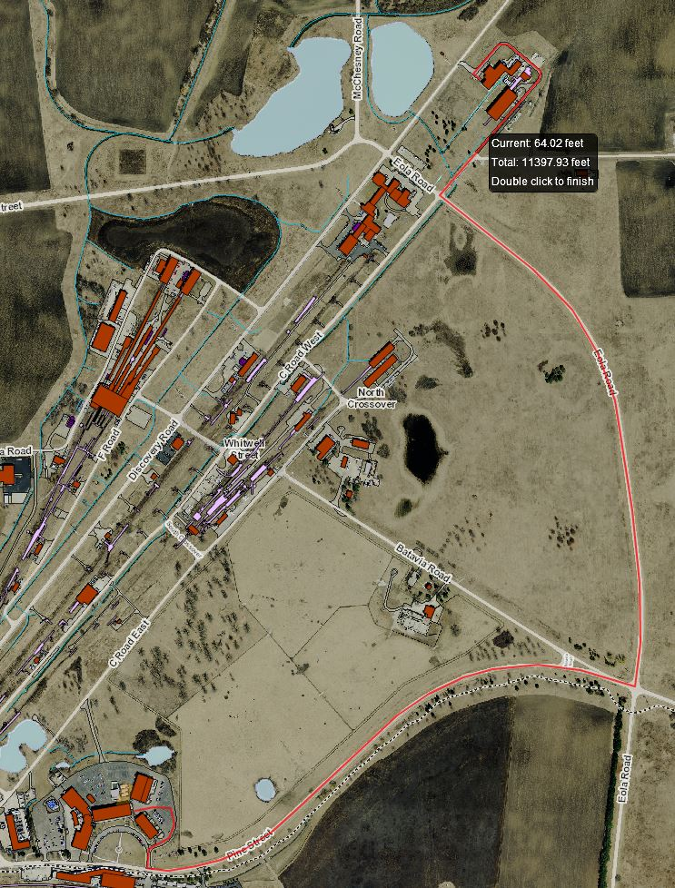
F1.3-07 as a test bed
  F1.3-07 was transported from FNAL CMTF (test facility) to ICB (assembly facility).
  Test goals:
    Verify new instrumentation captures data as expected.
    Validate new instrumentation (Slam Stick, X2) against geophones.
    Get initial data on resonant modes excited by low speed transport.
    Further verify frame tuning for low speed transport.

Slide 32
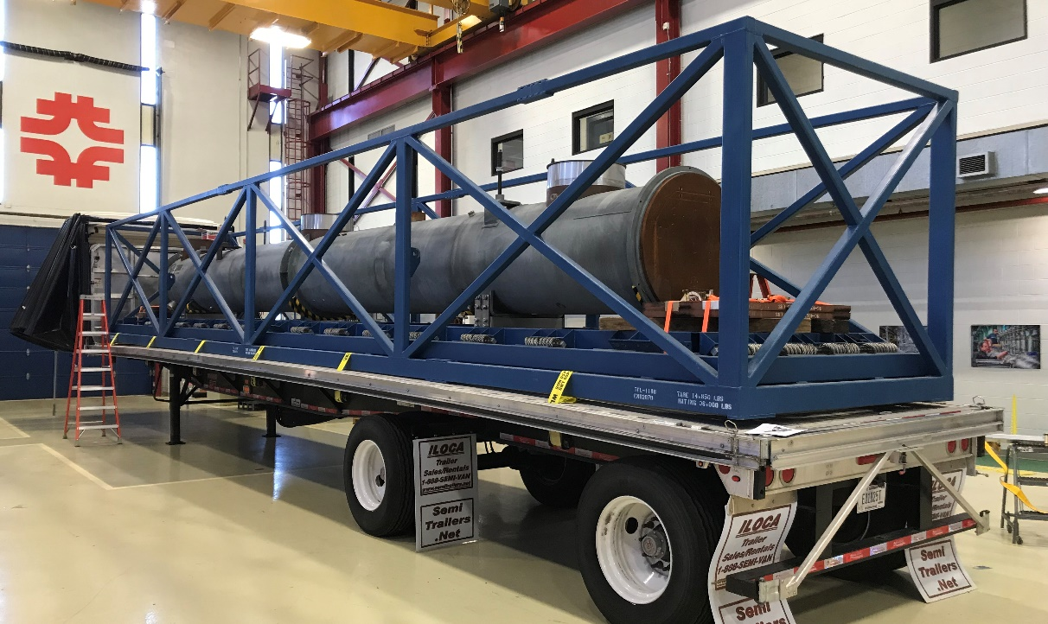
Concrete cryostat
  Instrumented the frame and dummy XFEL cryostat (‘concrete cryostat’) for the frame return trip to SLAC to get a general feeling of the vibration spectra introduced into the cryomodule from a road trip.
    The pendulum effects of the cold mass will not be captured, but this still provided useful data.
  Data from F1.3-06 transport to SLAC is only from shock events, which may not be indicative of general ‘steady state’ environment.
  Test goals:
    Provide a real world longevity test for new sensors.
    Determine vibration spectra at the ‘tophats’, the point of energy entering the cold mass.

Slide 33
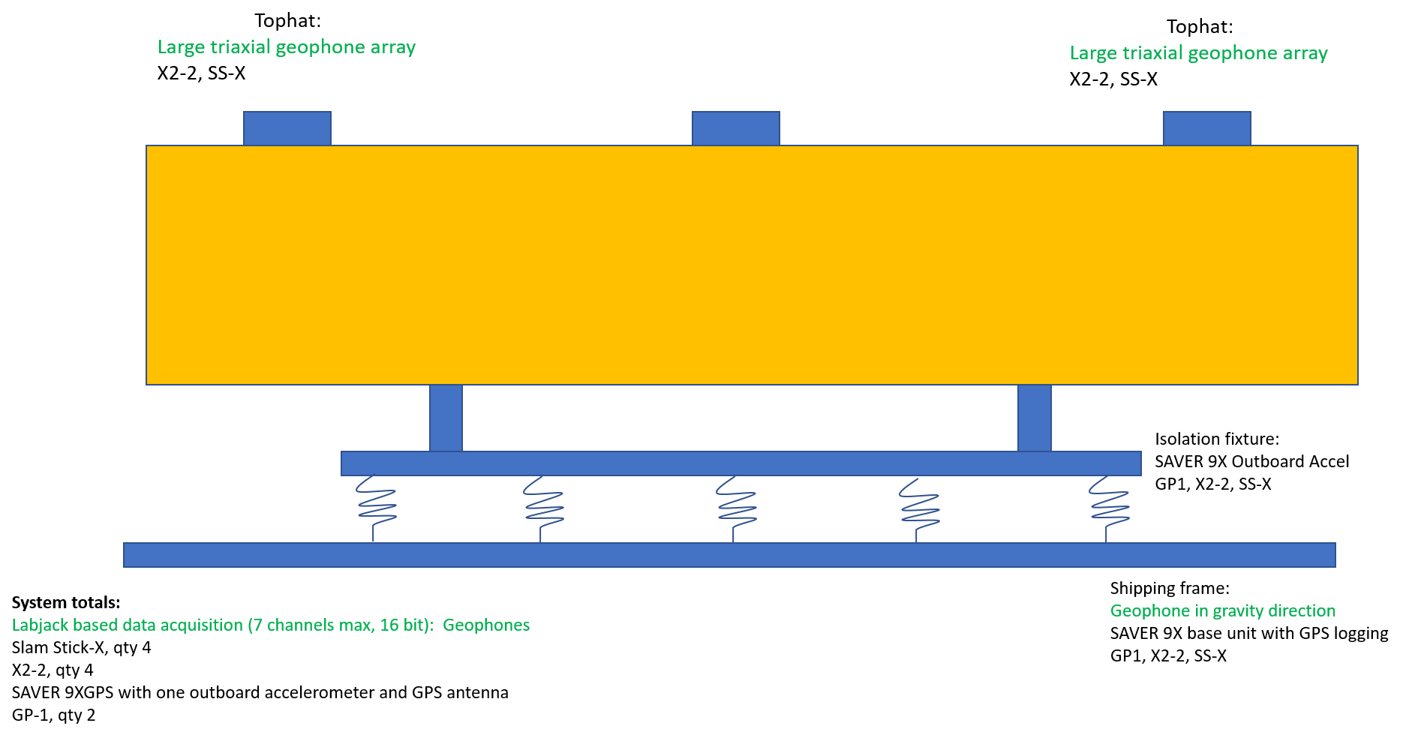
Concrete cryostat instrumentation layout

Slide 34
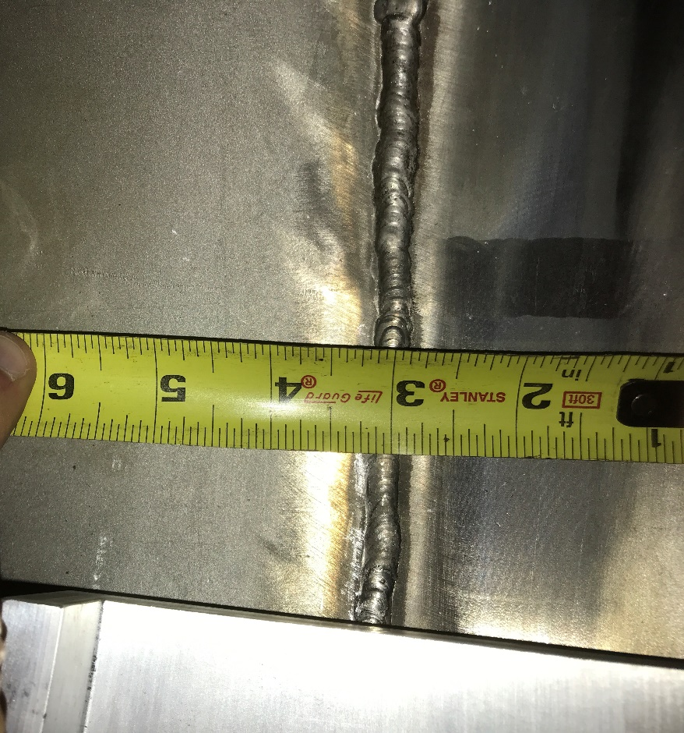
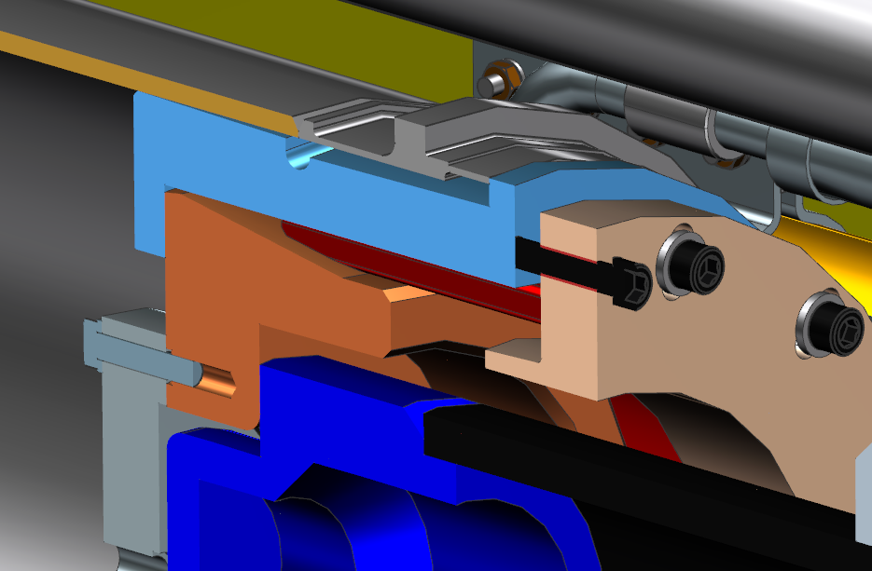
F1.3-06 SLAC to Fermilab
  Test goals:
    Determine truck-frame-cryomodule interaction
    Determine resonant modes excited during transport
  This data would be used to:
    Tune shipping frame parameters if needed.
    Shaker test critical components with accurate displacement and frequency.
    Determine where excessive vibration is being observed and remedy.
  Shipping configuration:
    Beamline at atmosphere, coupler vacuum as-found, insulating vacuum at atmosphere.
    Upstream HGRP adapter machined to clear the HGRP weld.

Slide 35
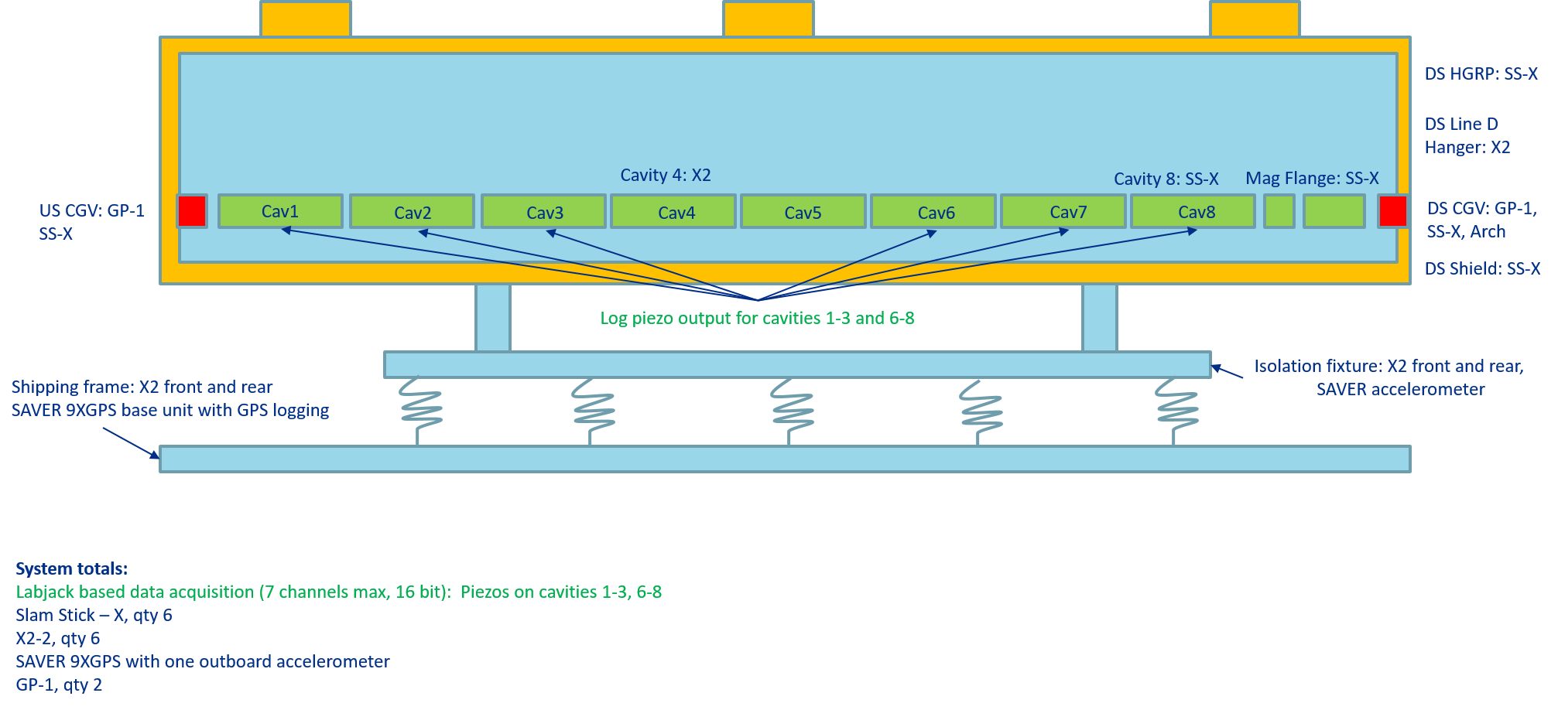
F1.3-06 Return Trip Instrumentation

Slide 36
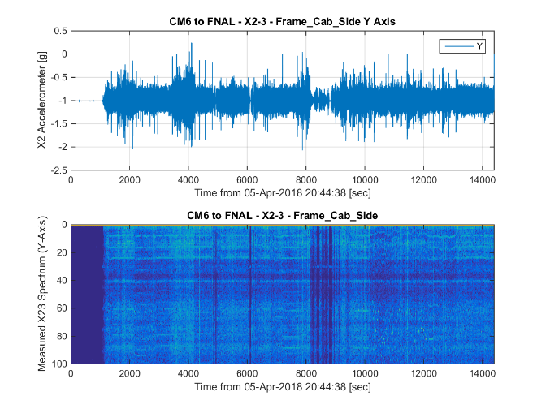
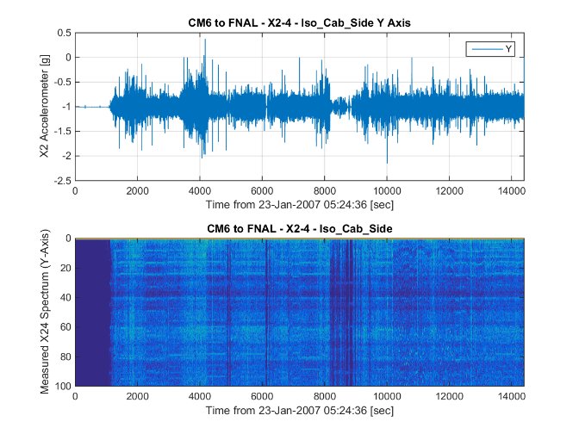
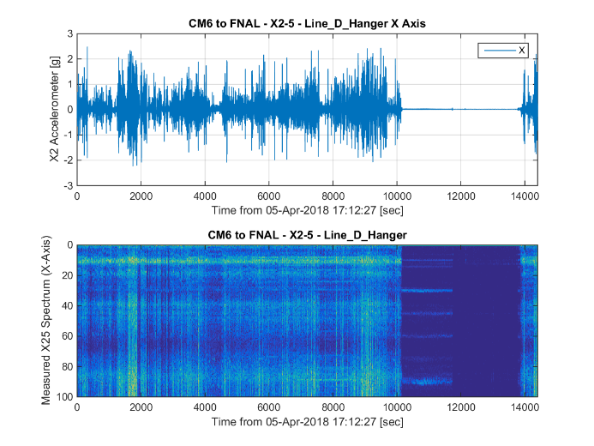
F1.3-06 Return Data
Quick summary, more to come:
Transport fixture natural frequency found to be ~10Hz. This was calculated at 9.6 Hz.
No obvious differences between front (connection to cab) and rear (air ride system) of the trailer.
Frame isolation is approximately 40-50% during shock, no isolation during ‘steady state’.
Cold gate valves don’t appear to have higher shock or steady state values.
Data from cavities 4 and 8 are about equal to cryostat with slightly more movement in Z, the beamline axis.
Line D hanger also showed larger vibration levels, only in the X axis.
50K shield showed large shock levels.

Slide 37
F1.3-06 Conclusions
  F1.3-06 experienced shocks greater than the 1.5g specification on the trip to SLAC.
  Instrumentation was selected to continuously log the vibration environment for F1.3-06’s return to Fermilab.
    This instrumentation was tested and compared to other measurements before use.
    Instrumentation was implemented for the concrete cryostat transport and will be used for all cryomodule transports going forward.
    Data from these instruments will be shown in Jeremiah’s talk later today.
  Data was successfully taken for the F1.3-06 return trip and analysis will be shown later.

Slide 38
J1.3-07 Road Test
J1.3-07 was shipped 780 miles to Bristol, VA, on the same route as the initial road test of J1.3-01
The cryomodule and shipping frame were fitted with the usual SAVER9X and GP1, and additionally with Slamsticks and X2s for continuous vibration measurements
Gate valve and support post fiducial positions were measured prior to shipping
Beamline vacuum was actively monitored
The insulating vacuum space was pressurized to 1050 mBar as per the original road test
Shipping system improvements were implemented for this trip

Slide 39
J1.3-07 Road Test Mechanical Issues
The tuner stop rod from the Cavity 2 tuner was found to have come off
  After reviewing the installation with the assembly crew, it was found that a misinterpretation of the tuner installation procedure had resulted in the set screw for the bottom stop rod not being installed
  Techs had been using Loctite on the stop rod threads; Cavity 2 stop rod did not have Loctite.
  Other stop rods with Loctite remained in place
  Other cavity strings have been partially disassembled and reworded to ensure that the set screws are in place

Slide 40
J1.3-07 Road Test Alignment
Almost all fiducial measurements were found to be within spec
Gate Valve Fiducials
 | dX (mm) | dY (mm) | dZ (mm)
Specification | ± 0.20 | ± 0.20 | ± 0.20
Upstream | 0.01 | 0.07 | 0.14
Downstream | -0.05 | -0.11 | -0.13
Error | ± 0.10 | ± 0.10 | ± 0.10
Support Post Fiducials
 | dX (mm) | dY (mm) | dZ (mm)
Specification | ± 0.20 | ± 0.20 | ± 0.20
Upstream | 0.07 | 0.00 | -0.03
Centre | 0.06 | 0.03 | 0.00
Downstream | -0.10 | -0.09 | 0.38
Error | ± 0.10 | ± 0.10 | ± 0.10
Cavity Flange Position
 | dX (mm) | dY (mm) | dZ (mm)
Cavity 2 (US) | -0.10 | -0.11 | -0.01
Cavity 3 (US) | -0.07 | -0.12 | 0.07
Cavity 4 (US) | -0.13 | -0.18 | 0.02
Cavity 5 (US) | -0.15 | -0.24 | -0.14
Cavity 6 (US) | -0.08 | -0.01 | -0.17
Cavity 7 (US) | -0.11 | 0.09 | -0.37
Cavity 8 (US) | -0.23 | 0.08 | -0.49

Slide 41
J1.3-07 Road Test Summary
The beamline vacuum was found to be intact
Cavity passband frequencies were within acceptable bounds
The maximum shock on the Outer Frame was found to be 2.1g, which is far lower than the initial road test (3g – 4g). This is likely due to the frame being better held to the trailer bed (shims) and the cryomodule being fixed on the shipping frame with the new clamps.
All shocks on the cryomodule were lower than the 1.5g spec (SAVER9X Data)
The test was successful, and the shipping system was considered validated (at the time)

Slide 42
Conclusion
The JLab pCM has covered a distance comparable to a trip from JLab to SLAC without any damage or loss in performance
Improvements to the shipping system were implemented for J1.3-07 shipping test, which was successfully completed with better results
Despite seeing large shocks, there was no serious damage or deformation to the pCM
All other shipping acceptance criteria were met for all of the trips

