Slide 1
Cryomodule Shipping Motion
Modeling and analysis
Tom Peterson and Vishy Ravindranath
12 June 2018

Slide 2
Analysis
A look at the kinematics of possible cryomodule cold mass motion during shipping
Some ANSYS modeling results
Conclusions

Slide 3
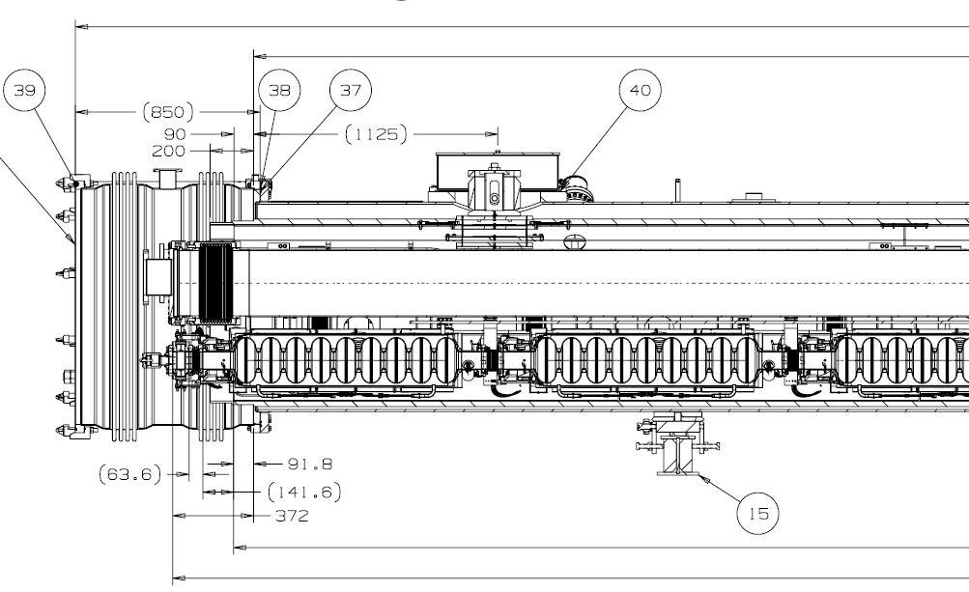
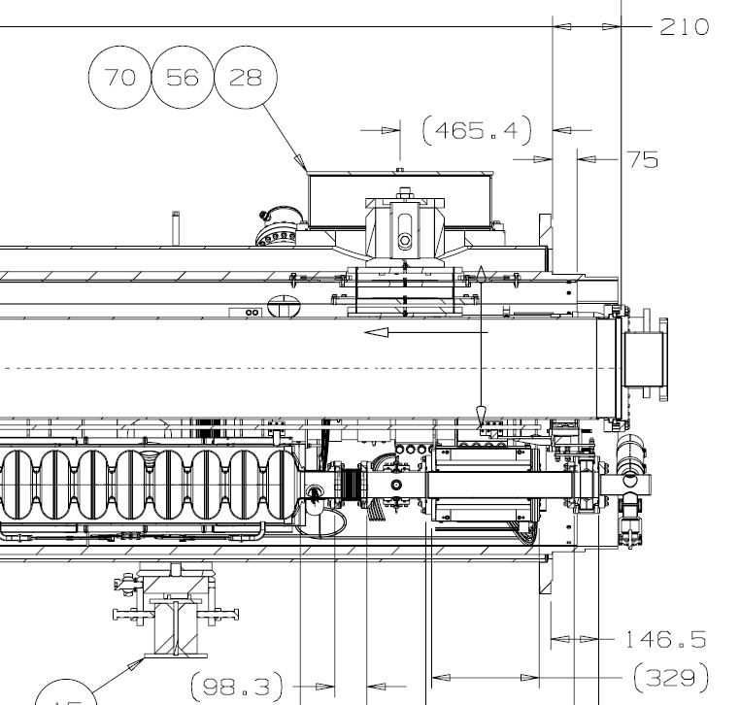
Cryomodule structure

Slide 4
Some dimensions,
for reference

Slide 5
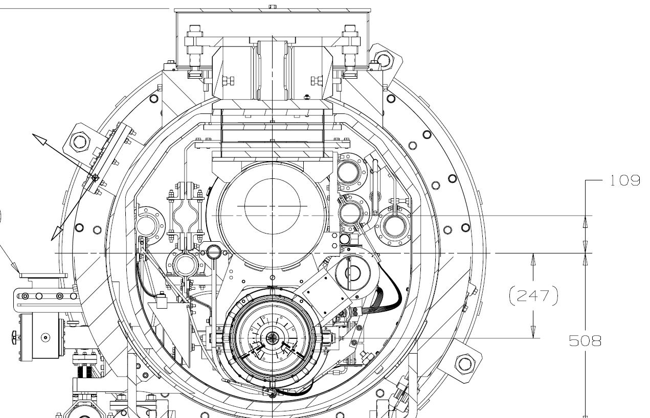
Cavity motion which could result from support motion
Cold mass was not
locked down at the
top. Rests here
on vertical
alignment
bolts.
Ratio of cavity motion
to support bolt lift is
about 1.6. Cavity
motion up at about a
17 degree (0.3 radian)
angle.
Motion in the direction shown would lift the G-10 support block into contact with the coupler.
~476 mm
~774 mm

Slide 6
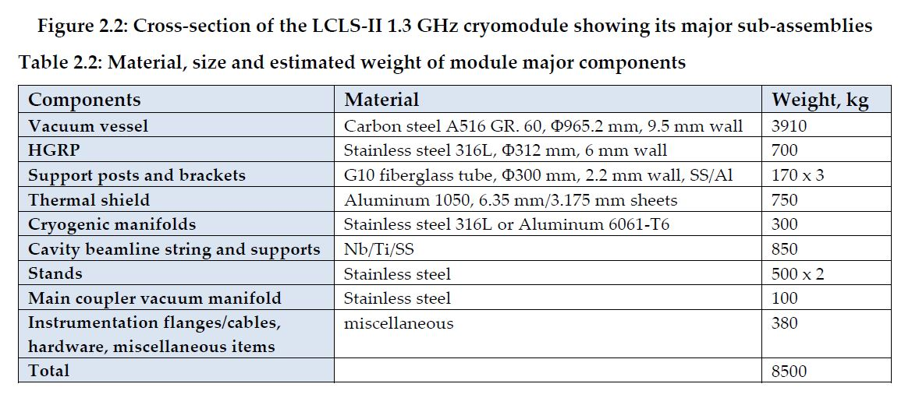
Cryomodule cold masses and distribution
Total cold mass weight on support posts is 3110 kg from the above list. Suppose half of that is on the center post, so 1555 kg. And suppose the center of mass is at the invar rod. Weight distributions of cold mass look like it could be higher than that, so this is conservative in terms of lifting and tie-down moments.

Slide 7
Simplified model
Consider rotation at this point. Balance moments CC due to mass and CW due to acceleration.
Moment due to mass
= 370 kg-m
~238 mm
Select invar rod as approximate center of mass. Mass times lever arm = 883 kg-m.
So we need 0.42 g to begin to rock.
1555 kg
~616 mm
~568 mm
1555 kg x accel

Slide 8
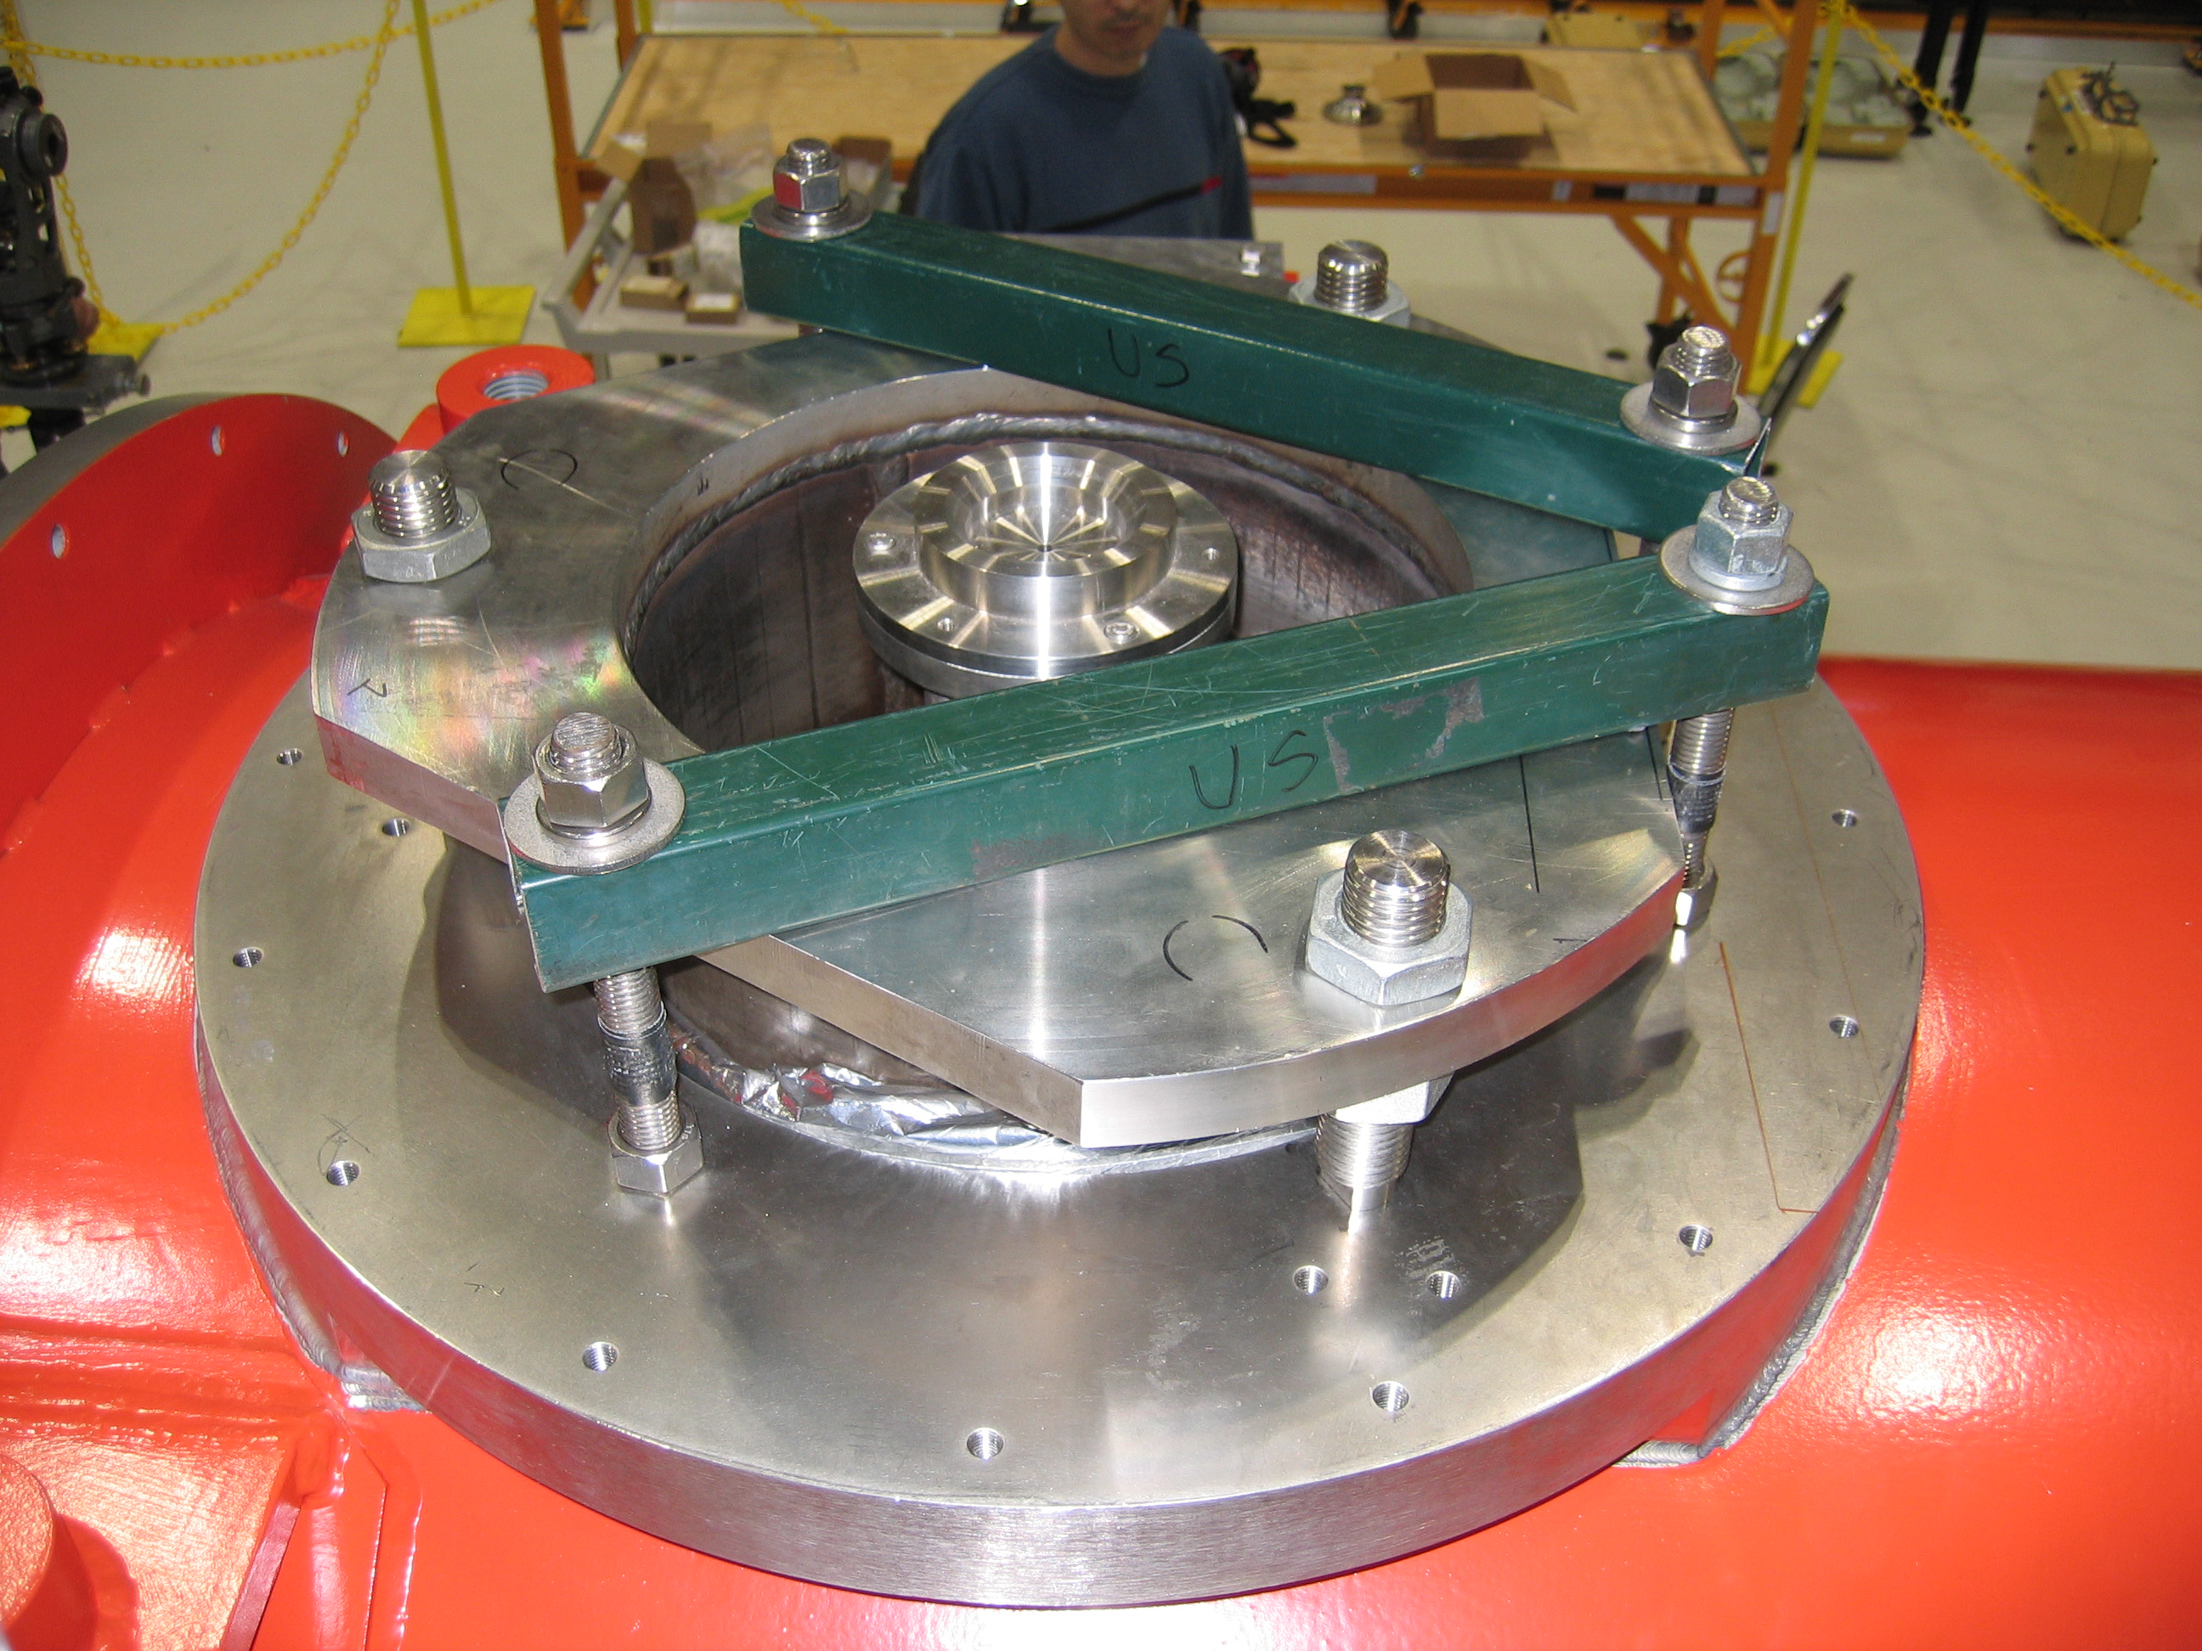
3.9 GHz shipping – center post tie-down
Next consider a tie-down
like this on the center post. (Image of Fermilab 3.9 GHz cryo-module for FLASH), tie-down for shipping to DESY.)

Slide 9
Tie-down added
Consider rotation at this point. Balance moments CC due to mass and CW due to acceleration.
Moment due to mass
= 370 kg-m
~120 mm
~238 mm
Load at tie-down
= ~8000 kg
= 17500 lbf
Select invar rod as approximate center of mass. Mass times lever arm = 883 kg-m.
1555 kg
~616 mm
~568 mm
1555 kg x 1.5

Slide 10
End constraint on 300 mm pipe, no tie-down
Consider rotation at this point. Balance moments.
Moment due to mass
= 370 kg-m
~238 mm
Select invar rod as approximate center of mass. Check flexing of 300 mm pipe.
1555 kg
~616 mm
~568 mm
1555 kg x accel

Slide 11
Flexibility of 300 mm pipe
Consider lateral loads flexing the 300 mm pipe with ends simply anchored (rotation but not displacement at the pipe ends).
Mass carried by the 300 mm pipe is its own mass (700 kg) plus cavity string mass (850 kg) = 1550 kg.
Just to judge pipe flexibility, calculate pipe center offset with a uniformly distributed 155 kg load on the pipe (0.1 g net lateral acceleration).
Center post prevents downward motion, but assume lateral motion due to rocking at center post.
Suppose center post constrains up to 0.4 g, above which it permits lateral motion, and we have 0.5 g total, so a net side load of 0.1 g.
The result is 0.11 inches (3 mm) displacement at the center of the 300 mm pipe.
This would correspond to 5 mm lateral displacement at cavity center.
I am not predicting this amount of displacement. This just illustrates that, on the level of mm of motion, 300 mm pipe stiffness will not limit motion very much at the center when the central post is free to rotate and allow lateral rocking motion.

Slide 12
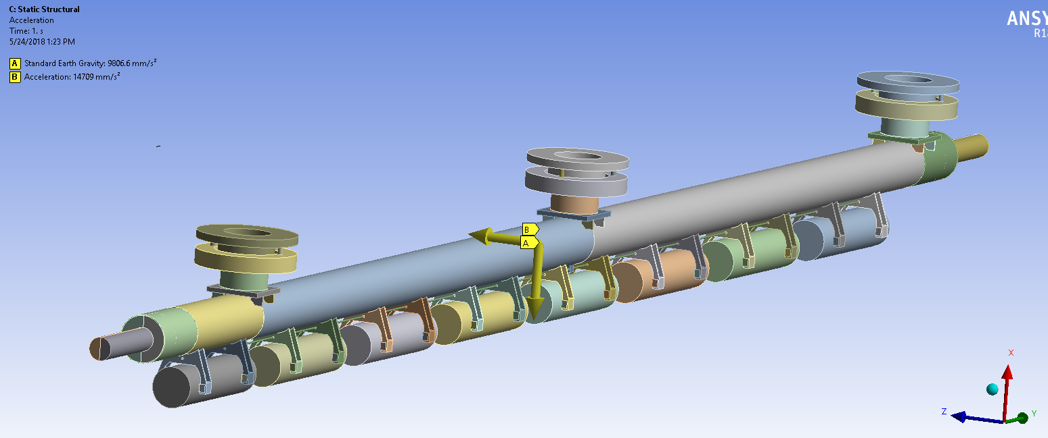
STATIC ANALYSIS (Transverse Acc = 1.5xG)
1.5 x G
FIXED END
FIXED END
Self Weight
Loads assumed for the analysis:
Transverse Load of 1.5 x G
Self-Weight

Slide 13
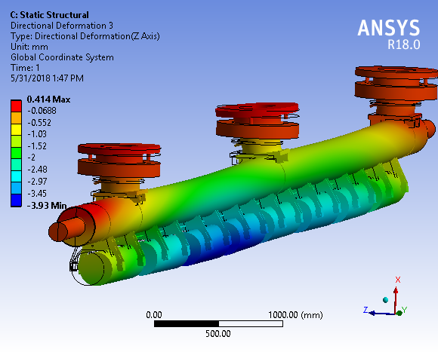
Case 1: (a) HGRP END CLAMP. = FRICTIONLESS (b) HGRP POSTS = FREE
(a) Max Transverse Displacement with thermal shield free to rotate = 4 mm
(b) Max Transverse Displacement with thermal shield fixed = 3.3

Slide 14
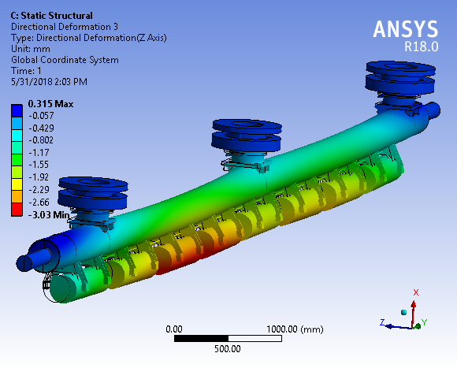
Case 2: (a) HGRP END CLAMP = FRICTIONLESS (b) HGRP POSTS = CLAMPED
Max Transverse Displacement = 3 mm

Slide 15
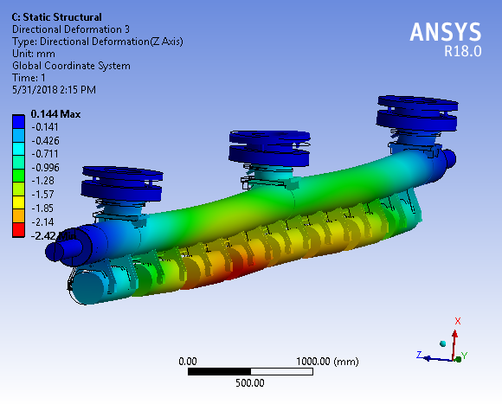
Case 3: (a) HGRP END CLAMP = BONDED
(b) HGRP POSTS = FREE
Max Transverse Displacement with thermal shield free to rotate = 2.4 mm
Max Transverse Displacement with thermal shield fixed = 2.1
(Note: Thermal shield may induce some cavity string motion either via strain applied to the support posts or directly via various thermal intercept and cable connections. This analysis looks at support post strain.)

Slide 16
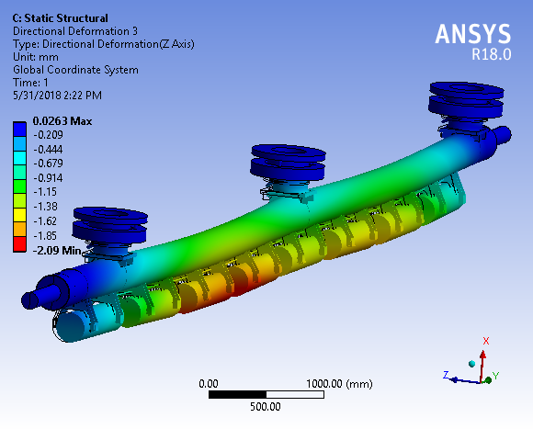
Case 4: (a) HGRP END CLAMP = BONDED (b) HGRP POSTS = CLAMPED
Max Transverse Displacement = 2 mm

Slide 17
SUMMARY
PART-II: STATIC ANALYSIS (1.5 X G TRANSVERSE ACC.)
 | A. HGRP END CLAMP | B. HGRP TOP POSTS | DISPLACEMENT
CASE1 | FRICTIONLESS | FREE | 4 mm (with Shield free to rock) 3.3 mm (with Shield fixed)
CASE2 | FRICTIONLESS | CLAMPED | 3
CASE3 | BONDED | FREE | 2.4
CASE4 | BONDED | CLAMPED | 2.1
Clamping the top plate helps reduces the transverse CM displacement (axial bellow motion) = 25%
Fixing the rotation of the thermal shield reduces the CM displacement (axial bellow motion) = 18%

Slide 18
Conclusions
ANSYS model and simple kinematics analyses are consistent
Lateral constraint alone on 300 mm pipe ends allows about 4 mm lateral motion of center cavities
We benefit somewhat from each additional constraint
Tight constraint on 300 mm pipe ends including no rotation
Tie down at least the center support post (end post constraint helps prevent 300 mm pipe motion when end plug fails to do so, so provides a backup support)
Limit thermal shield lateral motion
Conclusion: apply all of the above
Eu-XFEL-style plugs for secure constraint of the 300 mm pipe.
Tie down at least the central support post for additional constraint at the center of the 300 mm pipe. (Option: Tie down the other posts to limit vertical motion of end posts while allowing them to slip axially.)
Limit thermal shield motion to reduce potential contributions to motion.

Slide 19
Reference slides

Slide 20
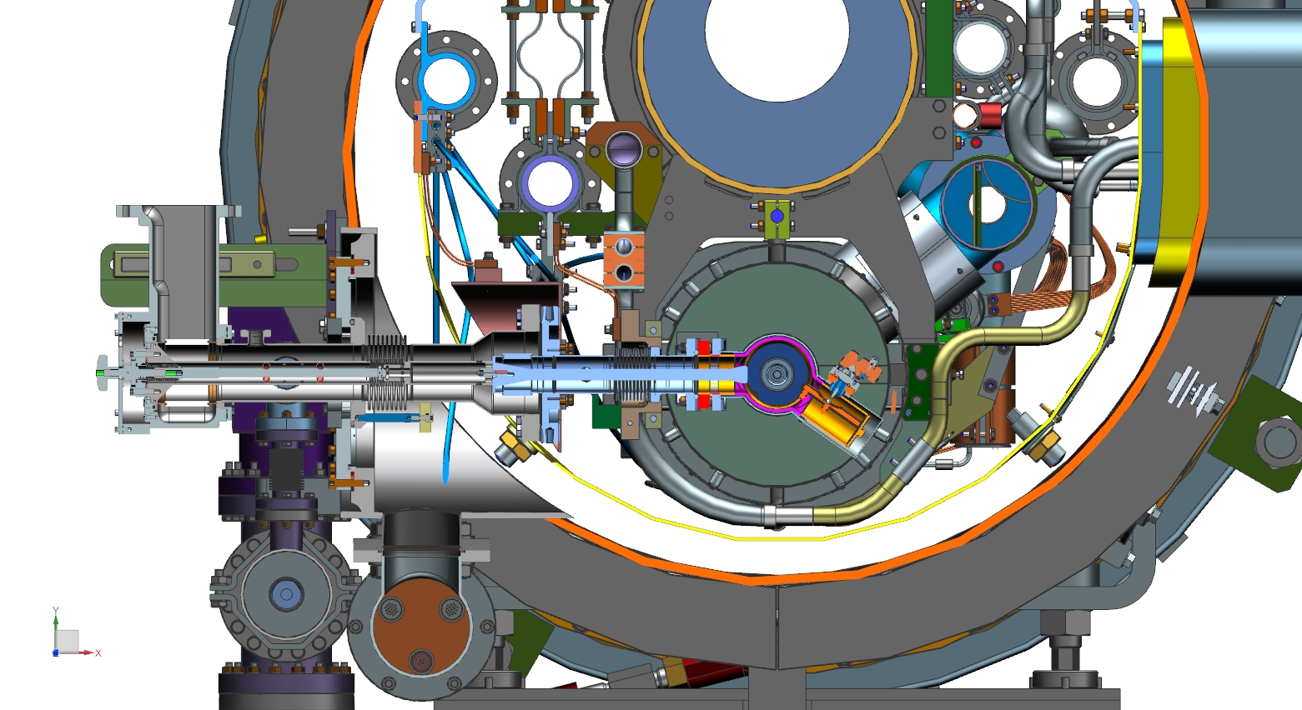
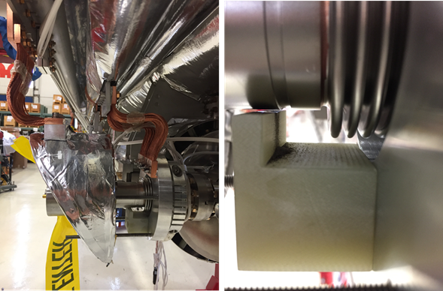
LCLS-II Cryomodule – inner coupler bellows failure

Slide 21
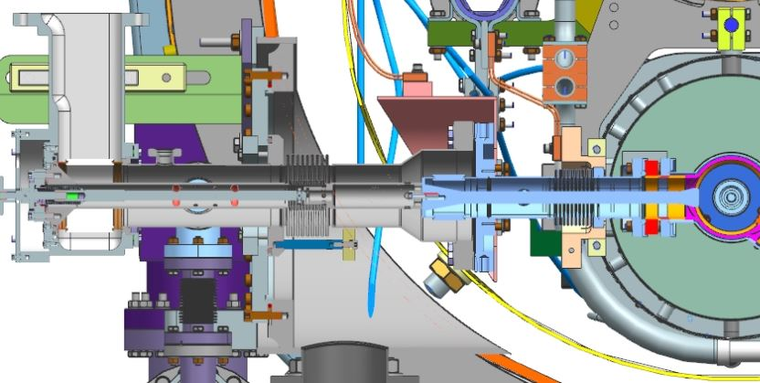
CAD model cross section at RF power coupler
Coupler tuning mechanism is anchored to the vacuum vessel and restrains the cold part of the coupler in the coupler axial direction. Relative motion of cavity string and coupler are taken via the inner coupler bellows.
Inner and outer bellows have supports underneath which limit downward motion. Normally about 1 mm clearance.

Slide 22
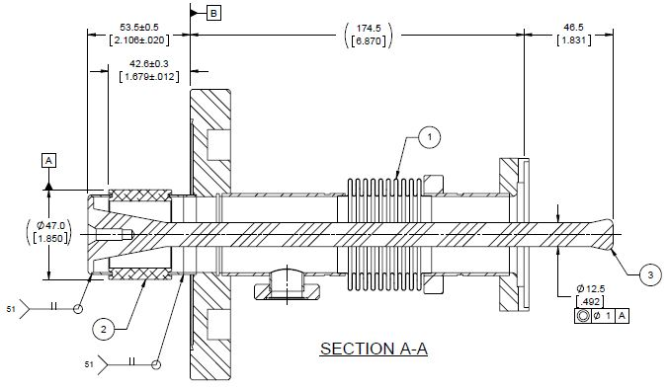
RF power coupler cold end assembly
Cracked inner bellows
convolution here

Slide 23
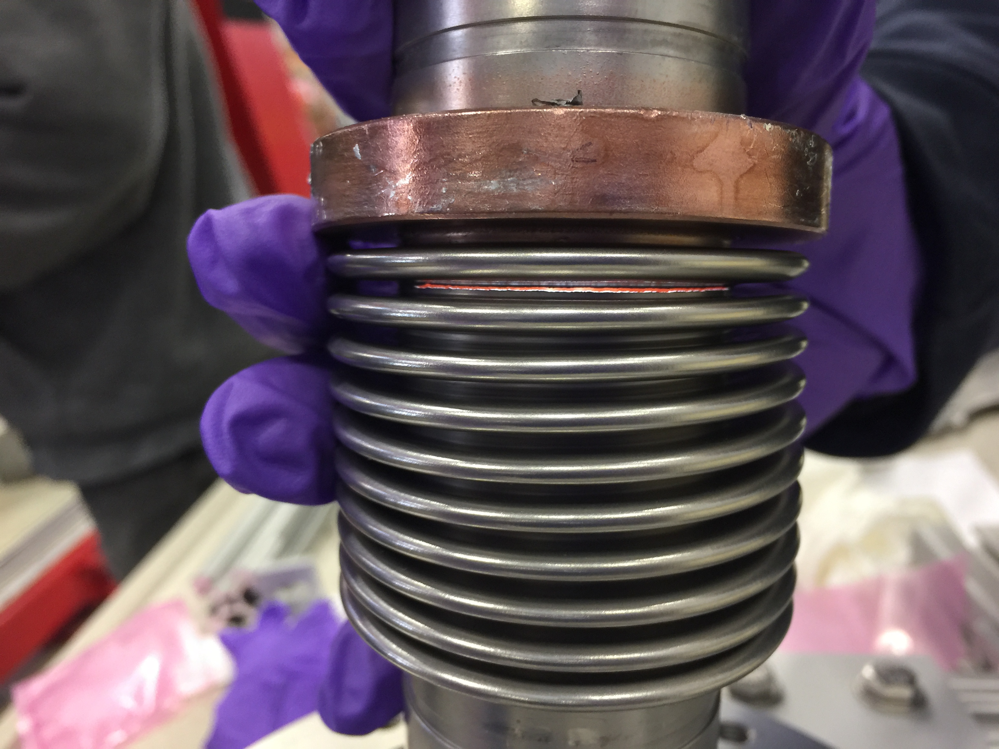
One of two cracked inner coupler bellows
We do not know
when these other
leaks opened up,
during shipment
to SLAC or during
travel back to
FNAL.

Slide 24
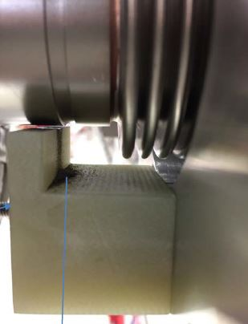
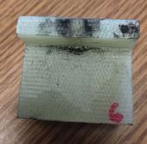
G-10 support block observations
Abrasion on G-10 block indicates motion of at least several mm and parallel to coupler axis, perpendicular to cavity string axis. This would correspond to the cavity string swinging side-to-side.
It appears that bellows cracked due to large and/or frequent motion of cavity string relative to the vacuum vessel.
Black dust on all 8
G-10 blocks

Slide 25
Hold-down bolt tension and strength
Imagine two bolts 120 mm to the left of center on the post, holding down a unistrut (or equivalent) clamp. This provides a counterclockwise moment in addition to the weight.
With a 1.5 g lateral acceleration, we need 8000 kg or 17,500 lbf downward holding force on that clamp.
Spread this load over two bolts, 8750 lbf each, and allow about ¼ ultimate strength to avoid fatigue issues, say 30,000 psi stress.
We need a stress area of 0.28 in² so between 5/8 inch (0.23 in² stress area) and ¾ inch (0.33 in² stress area) bolts.

Slide 26
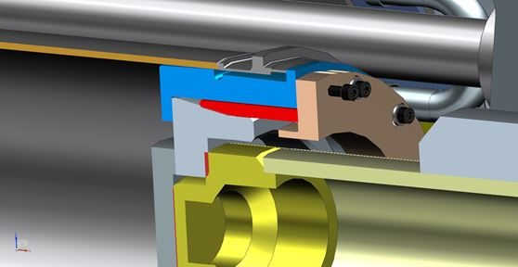
Cryomodule shipping end caps
Initial shipping constraint design goal was to support the cold mass against axial load, for which only the central support post provides support
End support posts are free to move axially for thermal contraction
Try not to overload the support posts by applying a downward or lateral load via these shipping constraints
However, the cold mass is free to rock sideways from the top if not laterally constrained
An interference was noted in F1.3-06 between the shipping end caps and the new cavity #1 gate valve support. There is some evidence that for this or other reasons, shipping caps might not have been fully engaged.
The image shows the 300 mm pipe
with shipping plug insert, downstream
end.
The LCLS-II shipping end plugs differ
somewhat from those for Eu-XFEL due
to slightly different vacuum flange
design.

Slide 27
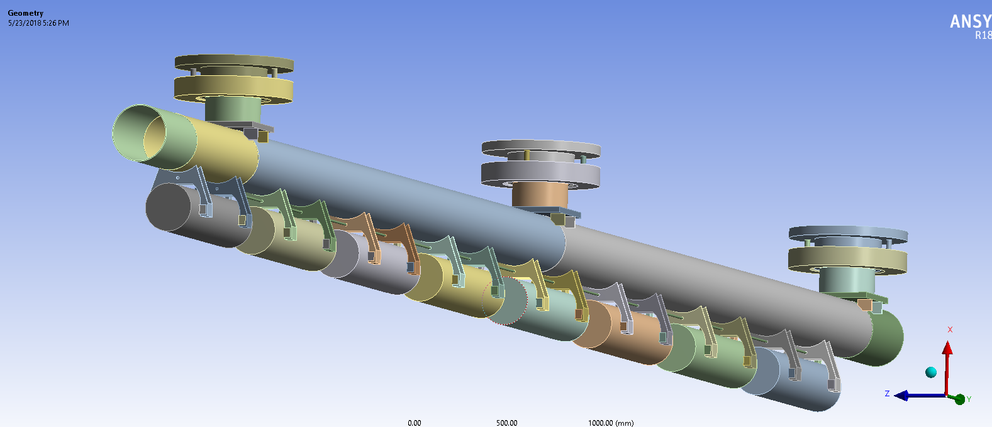
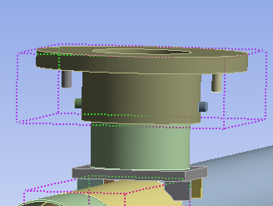
BOUNDARY CONDITIONS-GENERIC (COMMON TO ALL CASES CONSIDERED)
G-10 Post
HGRP
CAVITY
References for G-10 Modulus Assumption:
LCLSII-4.5-EN-0430-R0, “Stress Analysis of LCLS-II Cryomodule for Seismic Load
http://materialdatabase.magnet.fsu.edu/G10.htm
 | Modulus
Young’s Modulus for G-10 | 20 GPa

Slide 28
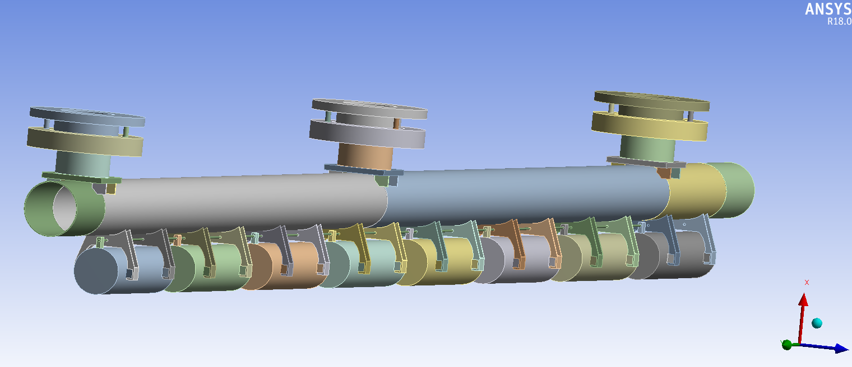
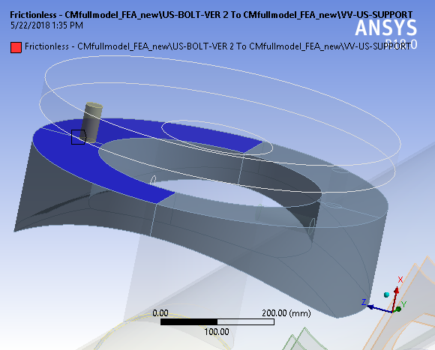
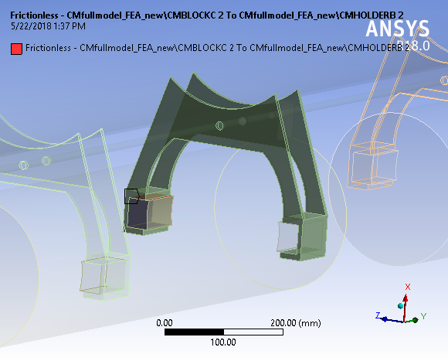
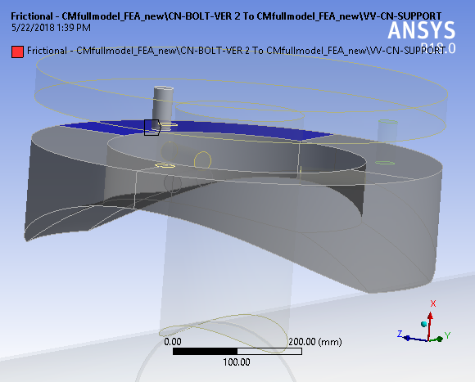
BOUNDARY CONDITIONS-GENERIC (COMMON TO ALL CASES CONSIDERED)
Boundary Conditions
 | Frictionless Contact Bolts and End Vacuum Vessel Flanges Cavity Holder and the Welded Blocks
 | Frictional Contact Bolts and the Center Vacuum Vessel Flange.
Fixed Vac Flange
Fixed Vacuum Vessel Flanges

Slide 29
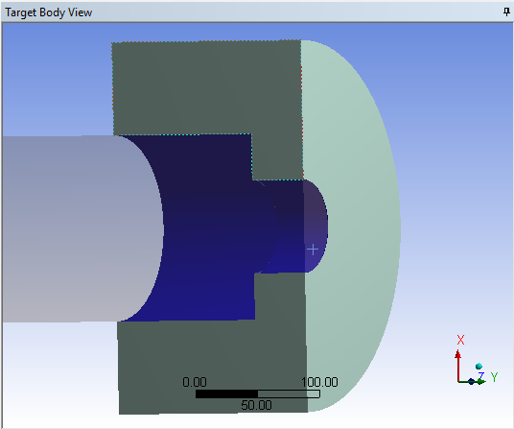
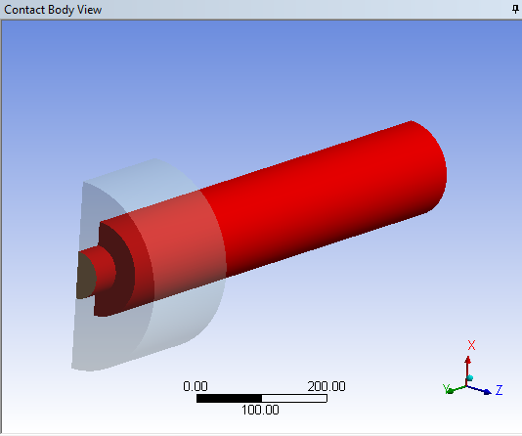
BOUNDARY CONDITIONS: CASES
FIXED END
FIXED END
 | A. HGRP END CLAMP | B. HGRP TOP POSTS
CASE1 | FRICTIONLESS | FREE
CASE2 | FRICTIONLESS | CLAMPED
CASE3 | BONDED | FREE
CASE4 | BONDED | CLAMPED

Slide 30
PART-III: MODAL ANALYSIS

Slide 31
Case 1: (a) HGRP END CLAMP. = FRICTIONLESS (b) HGRP POSTS = FREE
MODE 1 = 8 Hz
MODE 2 = 15 Hz
MODE 3 (FOR COLD MASS) = 19 Hz
MODE 4 (FOR COLD MASS) = 24 Hz

Slide 32
Case 2: (a) HGRP END CLAMP = FRICTIONLESS (b) HGRP POSTS = CLAMPED
MODE 1 = 8 Hz
MODE 2 = 15 Hz
MODE 3 (FOR COLD MASS) = 19 Hz
MODE 4 (FOR COLD MASS) = 24 Hz

Slide 33
Case 3: (a) HGRP END CLAMP = BONDED
(b) HGRP POSTS = FREE
MODE 1 = 8 Hz
MODE 2 = 17 Hz
MODE 3 (FOR COLD MASS) = 20 Hz
MODE 4 (FOR COLD MASS) = 24 Hz

Slide 34
Case 4: (a) HGRP END CLAMP = BONDED (b) HGRP POSTS = CLAMPED
MODE 1 = 8 Hz
MODE 2 = 17 Hz
MODE 3 (FOR COLD MASS) = 20 Hz
MODE 4 (FOR COLD MASS) = 24 Hz

Slide 35
MODAL ANALYSIS SUMMARY
CASES |  | MODE-1 | MODE-2 | MODE-3 | MODE-4
CASE-1 | HGRP END: FRICTIONLESS HGRP POSTS: FREE | 8 Hz | 15 Hz | 19 Hz | 24 Hz
CASE-2 | HGRP END: FRICTIONLESS HGRP POSTS: CLAMPED | 8 Hz | 15 Hz | 19 Hz | 24 Hz
CASE-3 | HGRP END: BONDED HGRP POSTS: FREE | 8 Hz | 17 Hz | 20 Hz | 24 Hz
CASE-4 | HGRP END: BONDED HGRP POSTS: CLAMPED | 8 Hz | 17 Hz | 20 Hz | 24 Hz

