Slide 1
Transportation Environment:
Vibration Data
Jeremiah Holzbauer/Chris Adolphsen
LCLS-II Transportation Readiness Review
June 12, 2018

Slide 2
Charge Question
2) Examine evidence showing performance to date (success and failure), and:
-Is the project-team’s interpretation of shipping-failure events (chiefly the loss of beamline vacuum F1.3-06) justified by the facts?
-Are there possible failure-modes that have been overlooked?

Slide 3
Outline
F1.3-06 Transport to SLAC
  GP1 Sensors
    Displacement and Shock Event Data
F1.3-06 Transport to FNAL
  Enhanced sensor package
    Continuous monitoring by commercial tri-axial accelerometer packages
    Sensors mounted to measure trailer-isolation frame relationship and cryomodule internal motion (focusing on CGVs, BPM/Magnet assembly)
J1.3-07 Road Test to Bristol (4/27/2018)
  Some accelerometers moved to coupler and cavity to determine relative motion
Summary

Slide 4
F1.3-06 Transportation to SLAC - Overview
F1.3-06 was transported to SLAC (Jan 16-19, 2018), and found to have several mechanical failures (BPM bolts and coupler bellows)
SENSR GP1 accelerometers were the main sensors during transport, attached to base frame and both beamline gate valves
Data recorded was 2 second captures at 100 Hz with data filtered at 45 Hz
Only a total of 10 events were captures, two on the Upstream Cold Gate Valve and 8 on the Transportation Frame
  Largest shocks on Frame did not trigger CGV sensors

Slide 5
F1.3-06 to SLAC – US CGV Motion

Slide 6
F1.3-06 to SLAC – US CGV High Frequency Motion

Slide 7
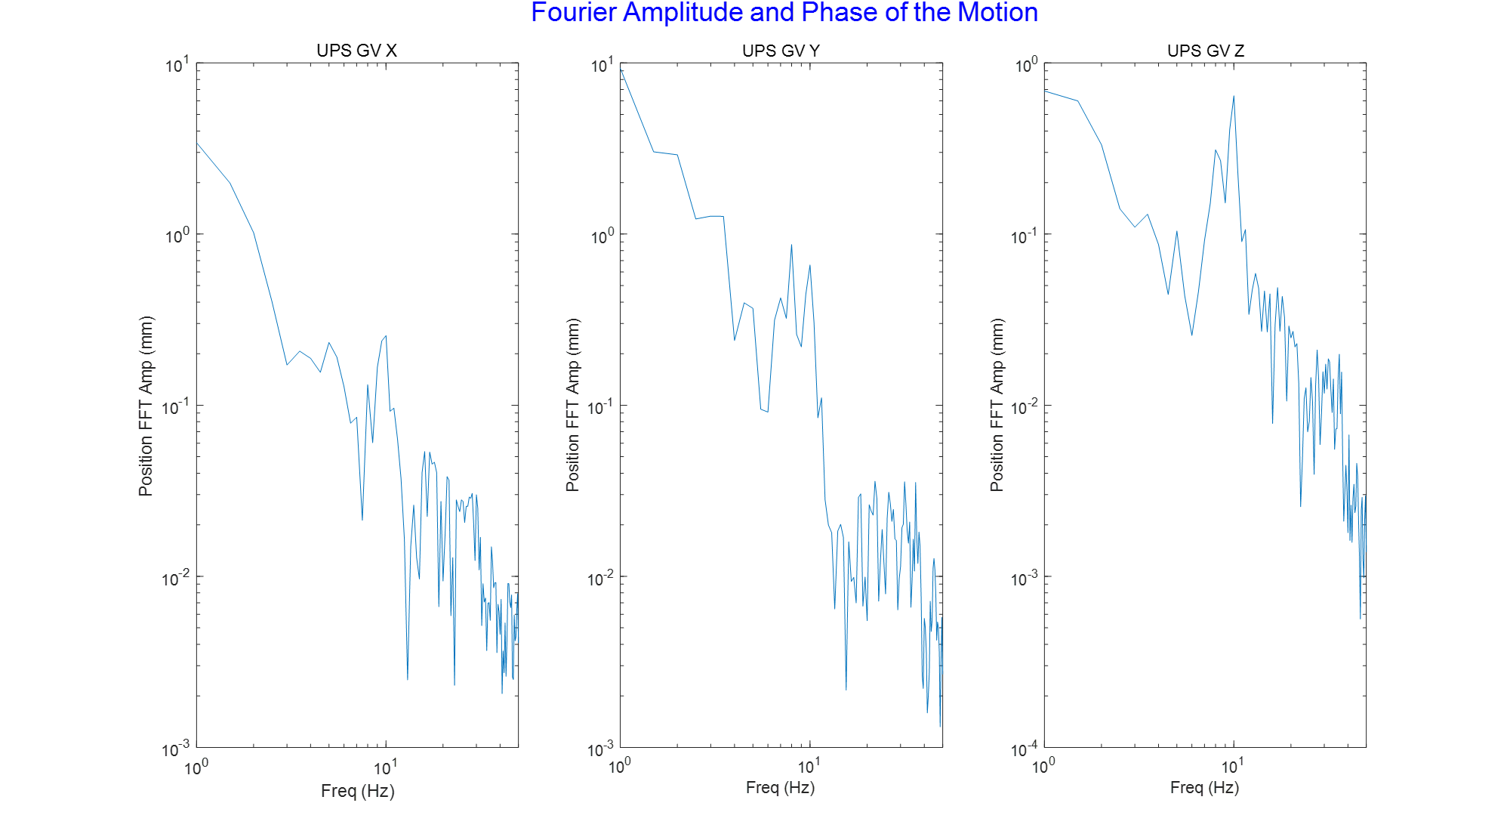
F1.3-06 to SLAC – US CGV Motion Spectrum

Slide 8
F1.3-06 to SLAC – Frame Large Event Motion

Slide 9
F1.3-06 to SLAC – US CGV High Frequency Motion

Slide 10
F1.3-06 to SLAC – US CGV Motion Spectrum

Slide 11
F1.3-06 Transport to SLAC Summary
Limited sensors
Relatively small numbers of large shocks detected due to low bandwidth and high trigger threshold
Shocks observed do show occasional sizable motion
Spectra showed sizable motion around 9-10 Hz

Slide 12
F1.3-06 Return to FNAL from SLAC
Additional sensors were installed for the return trip to give a more comprehensive picture of the vibration environment
This included sets of two different commercial sensor packages (SSX and X2 sensors, both with tri-axial accelerometer packages)
Sensors were captured at a higher frequency in one hour files, allowing gathering long term statistics
Sensor performance was verified during a short, on-site transport of F1.3-07 after testing at FNAL, cross-checking sensors with known geophones

Slide 13
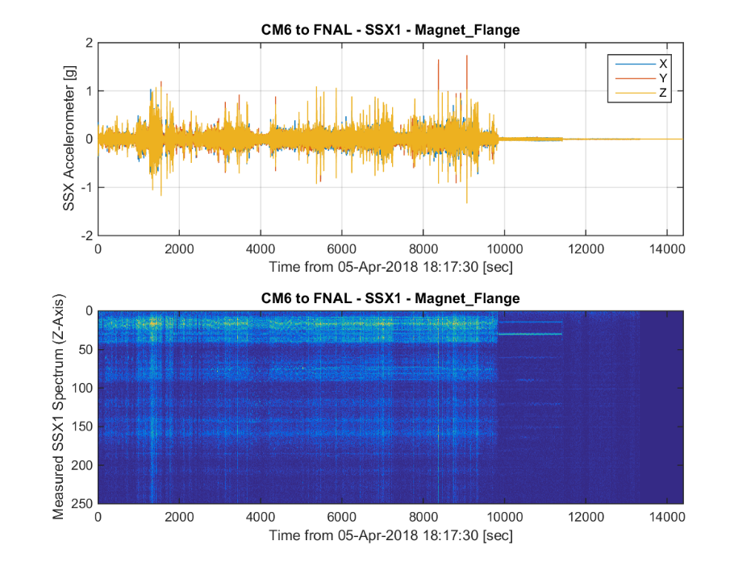
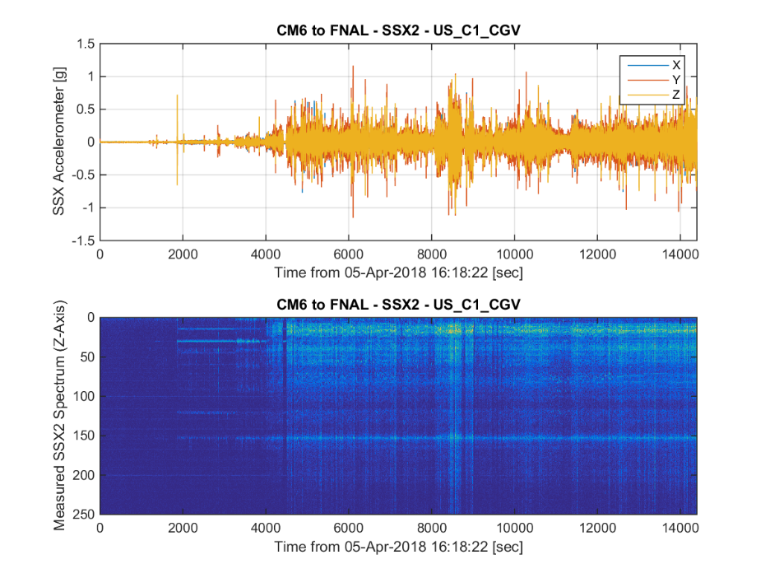
F1.3-06 Cold Mass Motion (SLAC to FNAL)
Cold mass sensors didn’t show routine shocks larger than ~1.5 g
Spectral contributions indicate motion around 10 Hz, in line with first shipment to SLAC

Slide 14
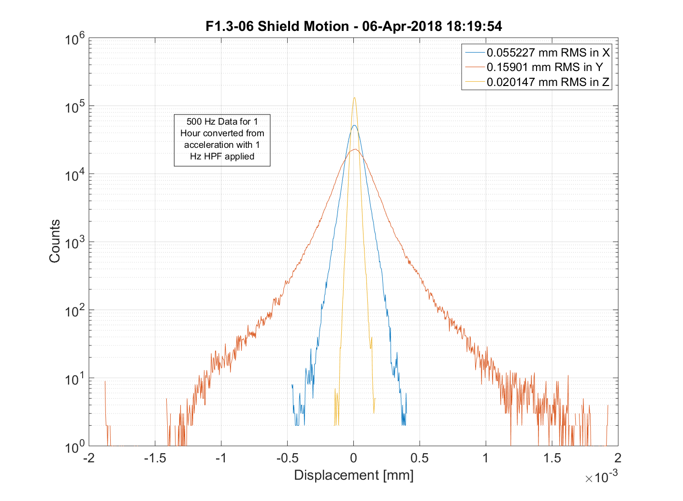
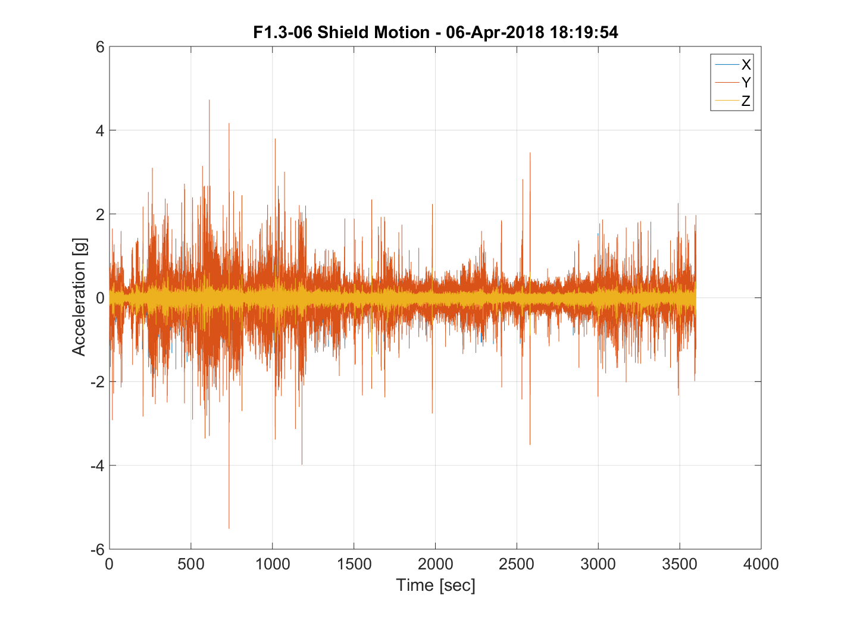
F1.3-06 50K Shield Vibration (SLAC to FNAL)
Larger motion was seen on some internal sensors on the cryo systems, like shield and cryo line support
Spectral contributions indicate motion around 10 Hz, in line with first shipment to SLAC

Slide 15
F1.3-06 Conclusions
Transport to SLAC:
  Few shocks were observed during the full transport, but the GP1 sensor filters at a relatively low frequency, thus reducing the peak measured shocks
  The (few) observed shocks are relatively large and integrate to large motion, but it’s unclear what the long-term vibration environment was like
  Due to limited data from FNAL to SLAC trip, we do not have a ‘smoking gun’ that shows that the relative motion was much worse during this trip than the others
Transport to FNAL:
  Coupler problem had not been identified yet, so sensors were mostly placed to diagnose BPM package vibration
  Cold string sensors (CGVs, cavity tuner arms, etc.) didn’t observe concerning levels of shocks
  Shield and Line D Hanger saw shocks factor 2-3 higher than 1.5 g

Slide 16
J1.3-07 Road Test to Bristol
J1.3-07 was assembled in the standard configuration (similar to F1.3-06 return trip) and driven several hours from Newport News, then returned the next day
Coupler bellows damage had been identified at this point
Similar sensor packages were used, but two sensors were moved to monitor cavity 4 tuner arm motion and cavity 4 coupler inter-bellows section motion
Events shown are 10 second grabs of synchronized events of note during transport

Slide 17
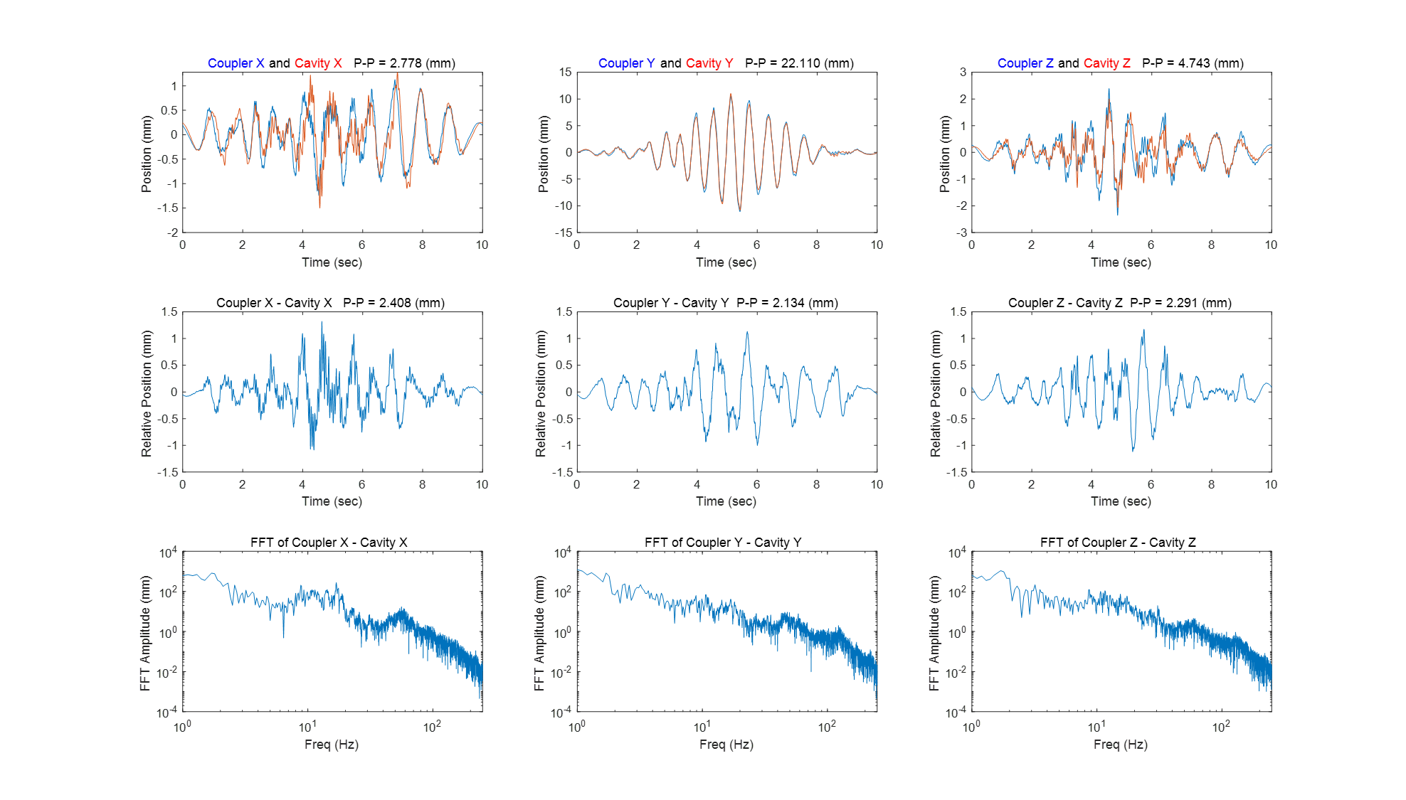
J1.3-07 Road Test – Event 1

Slide 18
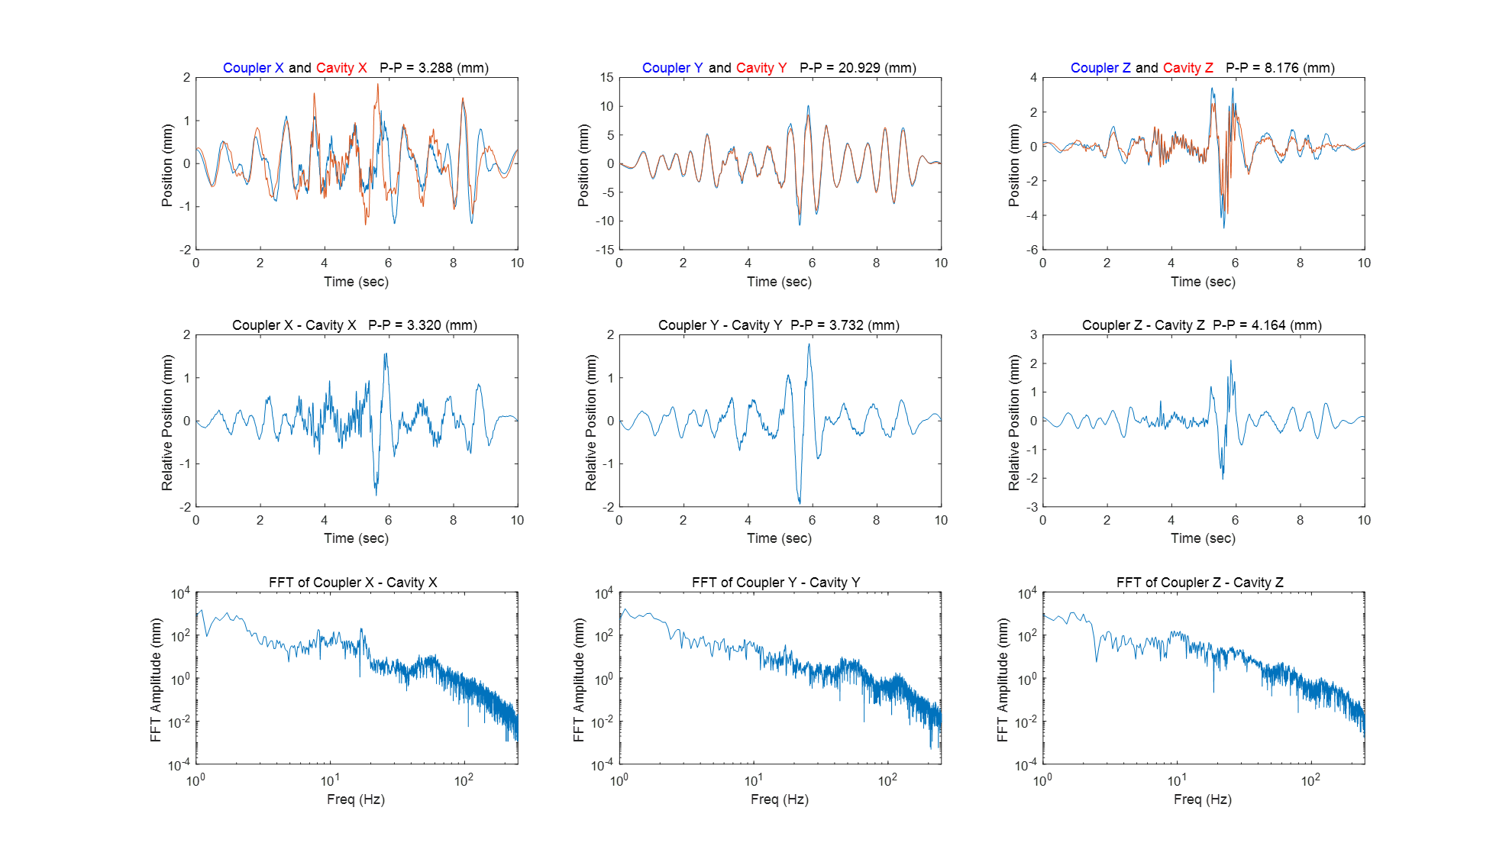
J1.3-07 Road Test – Event 2

Slide 19
J1.3-07 Event Comments
The Y motion is the largest with 21-35 mm peak to peak values – the cavity and coupler sensors track well - up to 90% of the motion is common
The X and Z motion varies from 2 to 10 mm peak to peak – the cavity and coupler sensors track typically at the 50% level in Z and less in X (note the push rod constrains the coupler flange in this direction so the relative motion is the cavity oscillating against the warm coupler/cryostat).
The Fourier spectrum of the coupler and cavity motion and their difference shows broad peaks at 10 Hz (probably the isolation frame response and cold mass oscillations), 17 Hz (?) and 60 and 120 Hz (perhaps due to the coupler bellows). The 10 and 17 Hz relative motion is generally at the 100 um level and the 60 and 120 Hz motion is too small to be seen in the plots
The main differences in all three dimensions vary at 1-2 Hz, which is probably related to the air ride system. The peak to peak differences are typically 2-4 mm

Slide 20
J1.3-07 Road Test Vibration Distribution
- For these generally low amplitude, low frequency variations, X and Z behave similarly and are about 5x smaller than the Y rms motion.
- However, in terms of shock, X is different from Y and Z in that the coupler experiences about twice the peak and mean shock than the cavity. Likely the cold mass is absorbing the lateral shocks as it appears to have a 10 Hz resonant frequency while the coupler, being tied to the cryostat, sees the shock more directly. The air ride system seems to absorb much of the Y and Z shocks.

Slide 21
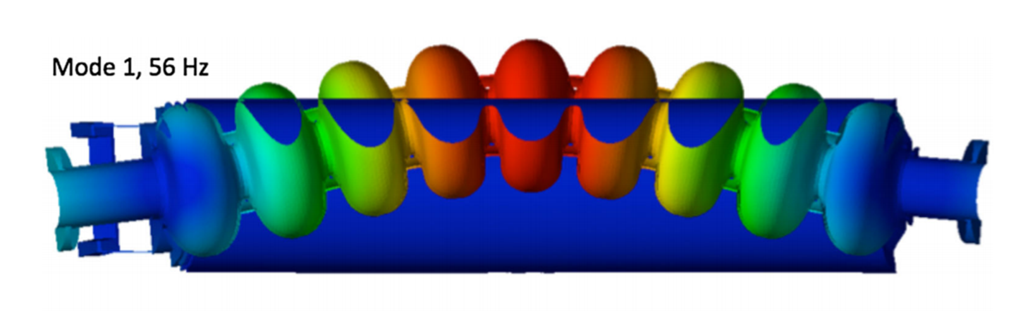
J1.3-07 Road Test - Overall Modes
Average 10 sec slices over 1 hour
Air Ride
Cavity to Vac Vessel Modes ?
Red curve is resonance response:
Freq = 10 Hz
Q = 2.5
Coupler Modes
X data seems to indicate that the cold mass oscillates laterally at 10 Hz.

Slide 22
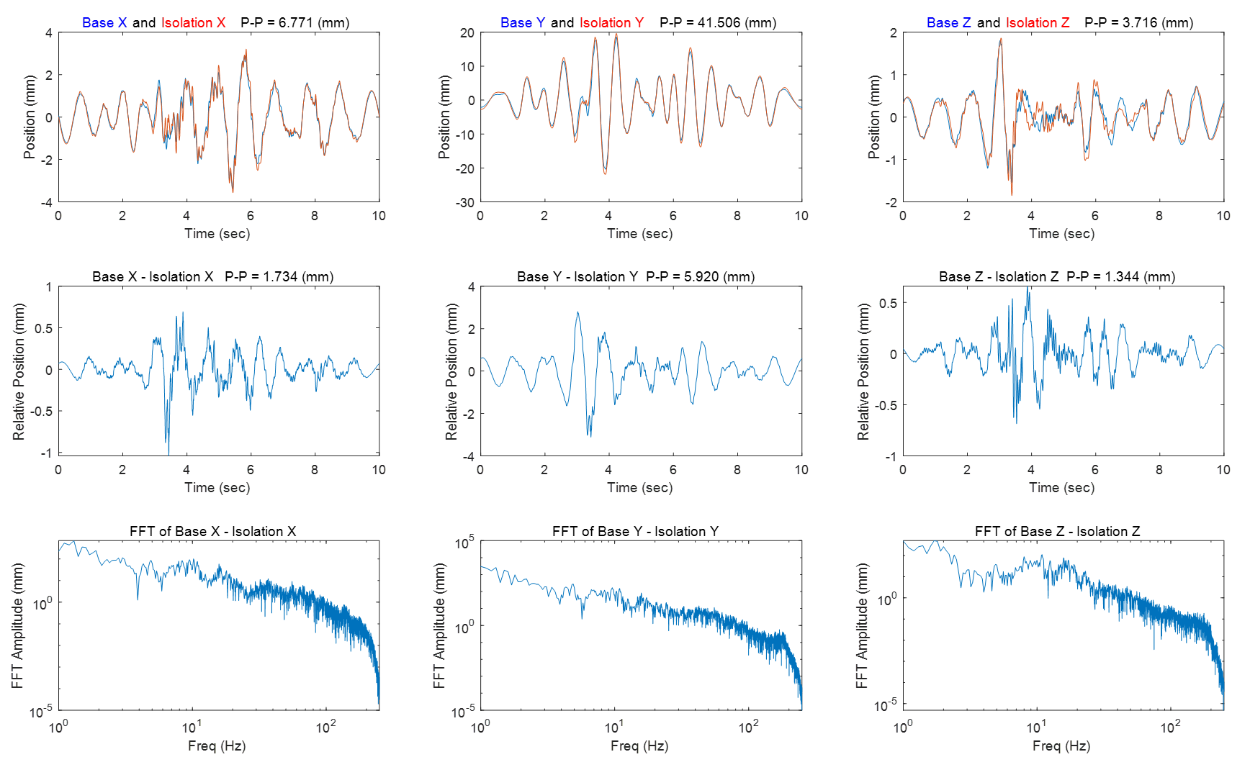
J1.3-07 Isolation Frame Performance
The lower frequency air ride system likely effective vertically but lateral shocks similar in magnitude as remaining vertical ones – probably due rocking motion given the height of the trailer bed (~ 6 ft) – a low ride trailer may be better, but would bring its own complications
The Isolation Frame does not seem to do much to suppress <20 Hz motion

Slide 23
Base Frame to Isolation Frame Transfer Function
Red = 12 Hz,
Q = 3.3 Resonance
Response
Do not see expected 6 Hz response of isolation system ?

Slide 24
Summary
Resonances have been identified in the system, including:
  ~1.5 Hz for Air Ride System
  ~10 Hz for the Isolation Frame in Z and Cold Mass in X
  ~50-60 Hz for cavity/coupler modes
  ~90-100 Hz modes for coupler
The cavity/coupler differential motion peaks to 3-4 mm in all three dimensions with the steady state motion a factor of 3 lower
F1.3-06 to SLAC transport had minimal instrumentation, but what does exist indicates there were not many extreme events (e.g. Y motion > 100 mm)
Changes to Line D hangers and proposed shield shipping support will likely eliminate the large shocks observed
Lower transport speed and better control of transportation route will improve vibration levels, but effects of lower speed on shocks should be considered

