Slide 1
Accelerator Division Status
Duane Newhart
All Experimenters’ Meeting/Lab Status Meeting
04 June 2018

Slide 2
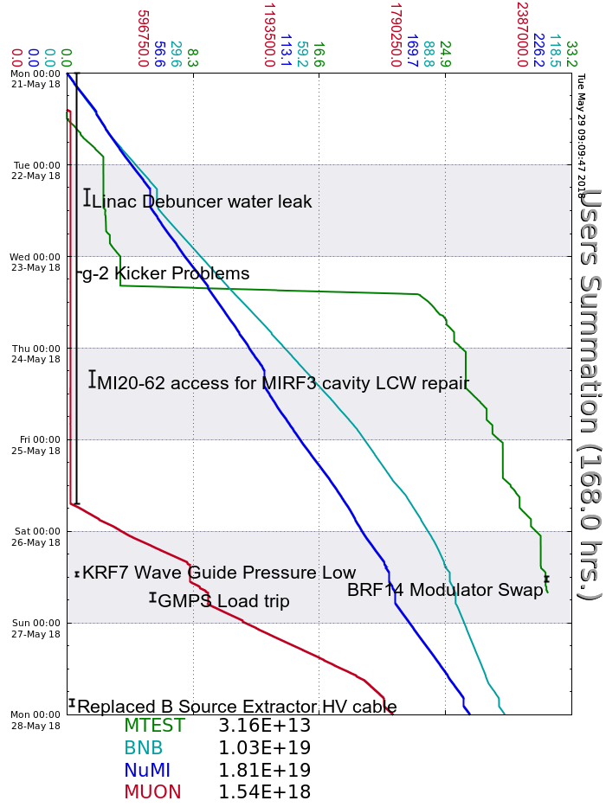
Accelerator Operations Summary
From: May 21, 2018 (0000 hours)
To: May 28, 2018 (0000 hours)
Calendar Week # 21
NuMI Weekly Integrated Intensity 1.81 E19 protons
Beam Hours To NuMI 145.3 hours
BNB Weekly Integrated Intensity 9.60 E18 protons
Beam Hours To BNB 151.9 hours
Muon Weekly Integrated Intensity 1.54 E18 protons
Beam Hours To Muon 48.0 hours
MTest Weekly Integrated Intensity 3.16 E13 protons
Beam Hours To MTest 51.8 hours
MCenter Weekly Integrated Intensity 0.00 E12 protons
Beam Hours To MCenter 0.0 hours

Slide 3
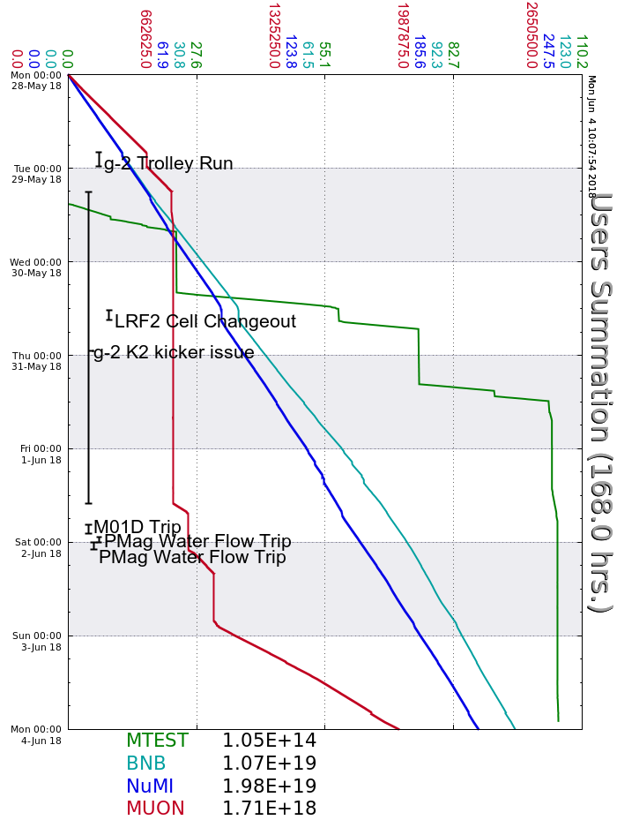
Accelerator Operations Summary
From: May 28, 2018 (0000 hours)
To: June 04, 2018 (0000 hours)
Calendar Week # 22
NuMI Weekly Integrated Intensity 1.98 E19 protons
Beam Hours To NuMI 156.3 hours
BNB Weekly Integrated Intensity 1.04 E19 protons
Beam Hours To BNB 157.4 hours
Muon Weekly Integrated Intensity 1.71 E18 protons
Beam Hours To Muon 65.2 hours
MTest Weekly Integrated Intensity 1.05 E14 protons
Beam Hours To MTest 30.5 hours
MCenter Weekly Integrated Intensity 0.00 E12 protons
Beam Hours To MCenter 0.0 hours

Slide 4
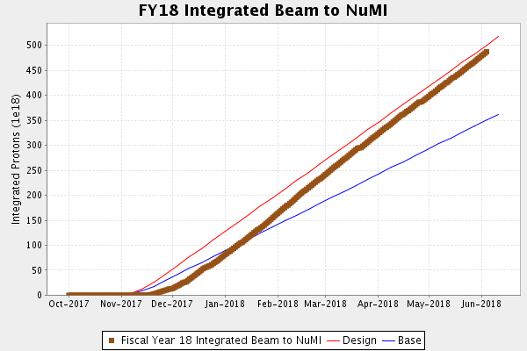
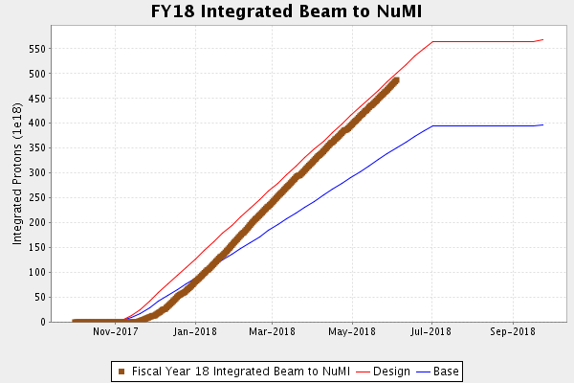
NuMI Operation

Slide 5
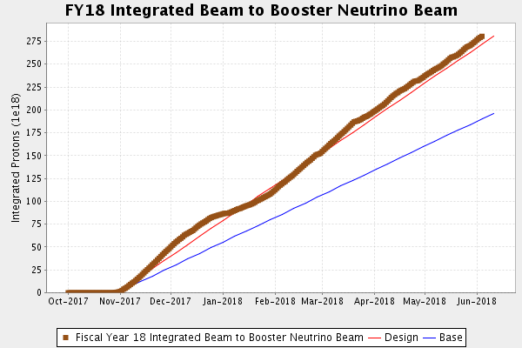
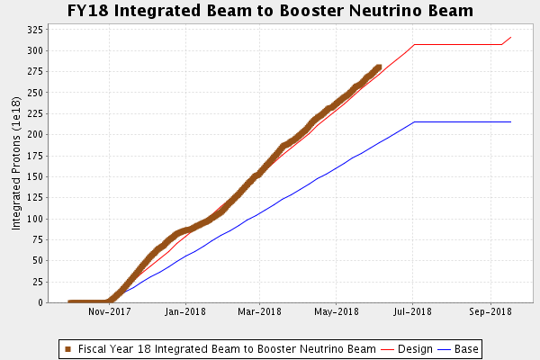
BNB Operation

Slide 6
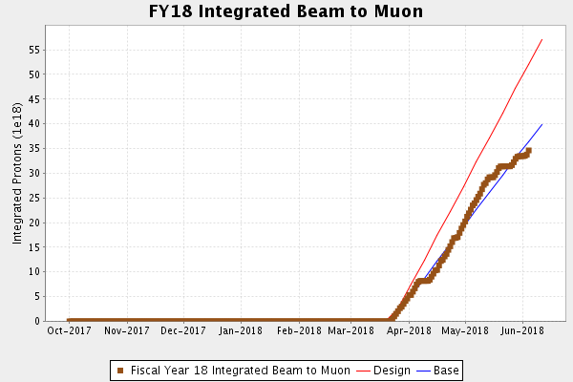
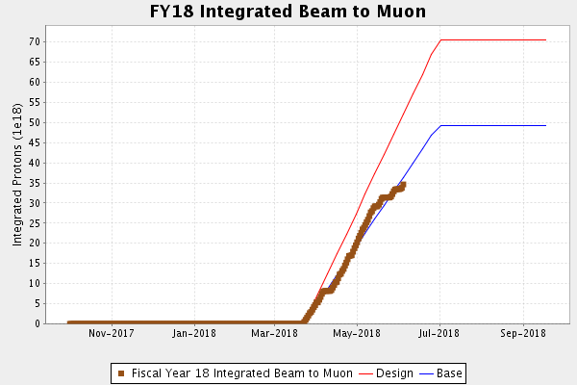
Muon Operation

Slide 7
Complex Status
LINAC
  Running well
  Addressing gallery cooling
Booster
  Running well
  Fighting a bi-model loss pattern related to GMPS regulation
MI/RR
  Running well
NuMI
  Monitoring NuMI target (TA-02) helium leak
Booster Neutrino Beamline (BNB)
  Taking beam
Switchyard
  Meson Test operating
Muon Campus
  G-2 taking beam
    Kicker issues trough the week
General
  Items on the horizon
    MI40 abort line spool-piece
    TLG reboot
    Summer Shutdown starts July 9
      Beam off on July 7 for cooldown

Slide 8
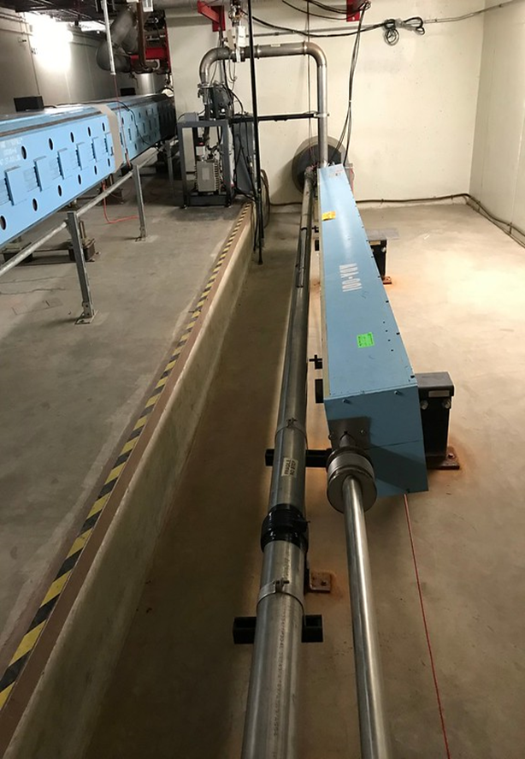
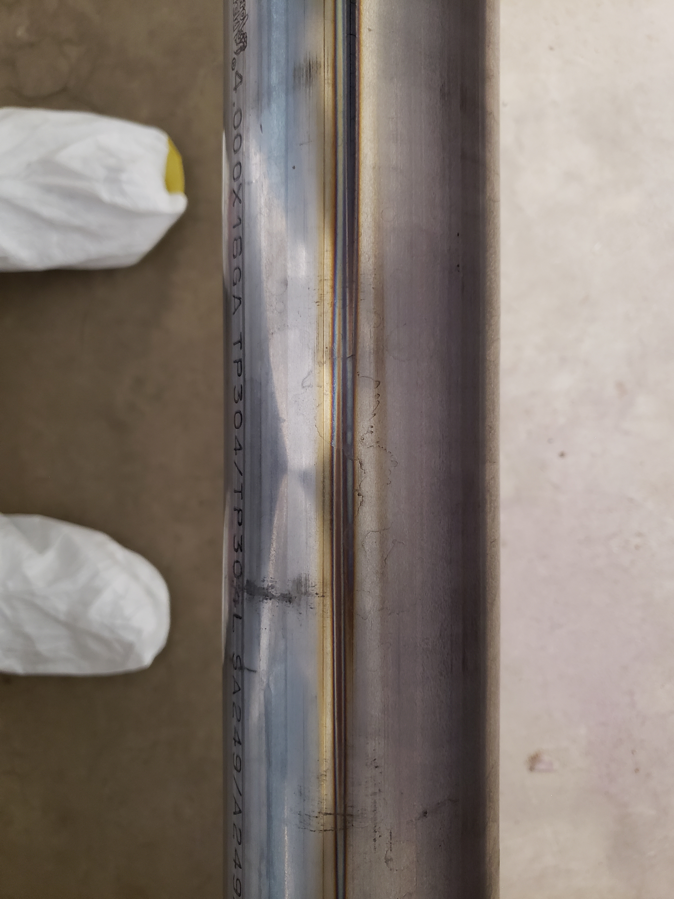
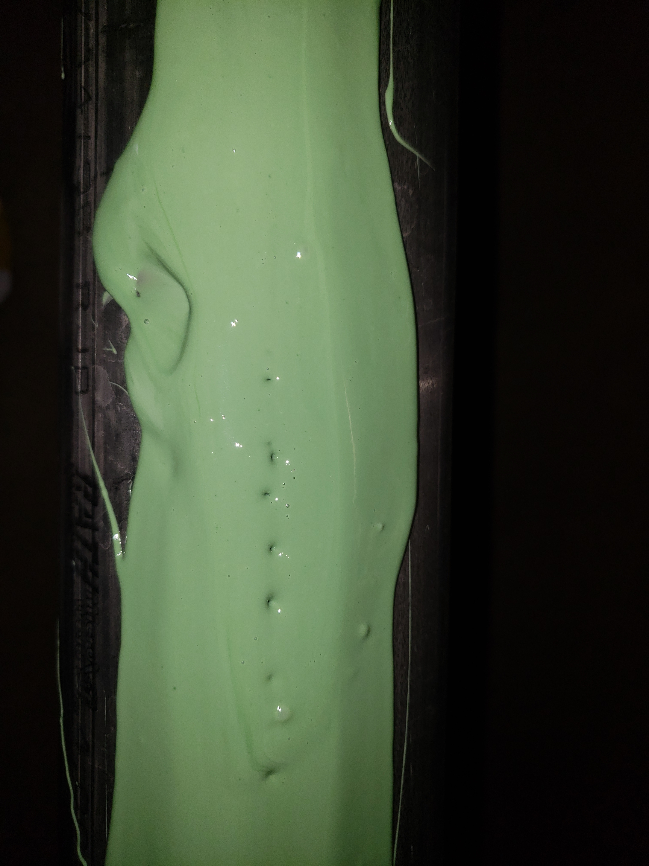
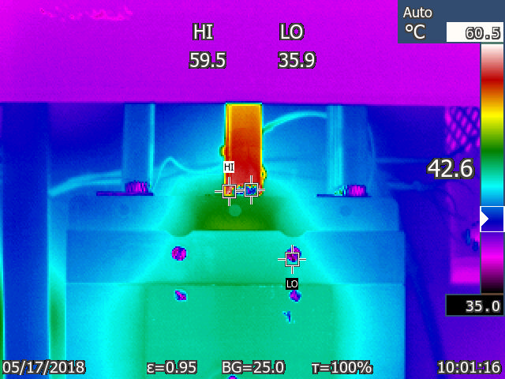
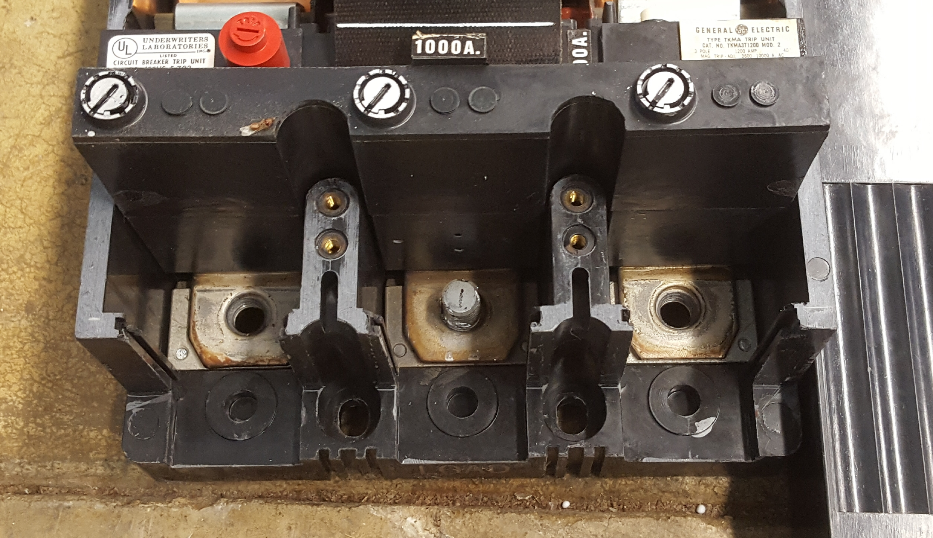
Complex Status
LINAC
  Klystron RF cooling skid controller repair
  LRF5 Marx connected
    Mod Surge resistor failed/replaced
Booster
  Tuning continues
  Fighting a bi-model loss pattern
MI/RR
  Tuning continues
  MI40 abort vacuum
    Leak found and epoxied
  LAM41 breaker inspection/repair
  LAM42 inductance measurement
NuMI
  Monitoring NuMI target (TA-02) helium leak

Slide 10
Complex Status
Booster Neutrino Beamline (BNB)
  Sump discharge line break
    Off much of Thursday
Switchyard
  Meson Test operating
Muon Campus
  G-2 not taking beam
    Kicker issues developed over the weekend
General
  Items on the horizon
    MI40 abort line spool-piece
    TLG reboot

Slide 11
PIP-II Injector Test & FAST/IOTA Status
PIP-II Injector Test
  Shutdown for Cryogenic Transfer Line (CTL) installation
  Testing SSR1 cavity with low power coupler at MDB
FAST/IOTA
Transformer PMs on June 1st
  Generator started but transfer switch failed
    Closed manually
    Restored power to vacuum system
Bakeout of the injection lambertson continues
Cryo plant cooldown is scheduled to begin on June 15th. Beam operations are schedule to begin in July.

Slide 12
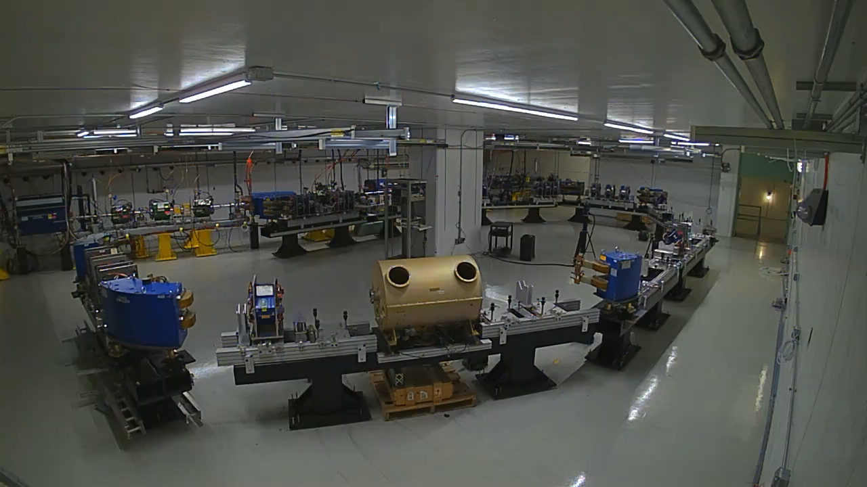

Slide 13
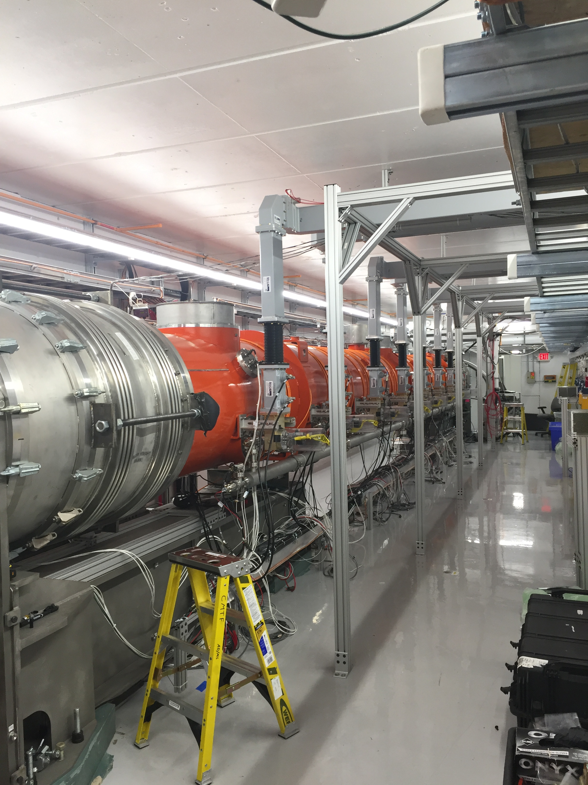
CMTS1 Status
Cryo plant restart
  Tomorrow
LCLSII Cryomodule F1.3-08
  Arrived last Friday
  Prepping for install and testing
  Cooldown (~2 weeks)

Slide 18
Schedules and Links
Schedule can be accessed from the Operations Department Home Page
  Schedules -> Operations Schedule
Direct link to schedule
  http://www-ad.fnal.gov/ops/schedule.html

