Slide 1
Response to Kephart Review Recommendations
Brendan Kiburg
FY18 Muon g-2 Shutdown Mini-Review
June 13, 2018

Slide 2
Response to Kephart Review Recommendations
1. Protect the magnet against events leading to quenches (e.g compressor trips)
A suite of cryo responses have been designed to reduce the possibility of magnet quenches. We have successfully utilized the Wet-Engine-Off-Cryo-Response to detect situations where insufficient helium cooling is available, adjust the flows to maintain superconducting conditions while the magnet immediately begins slow energy.
We have developed the Compressor Trip Cryo Response to supply the continuous flow of cold helium during the magnet rampdown in the event of power loss of the A0 compressor house. These critical components are being installed during the FY18 shutdown
2. Explore use of safety rated PLC’s for critical functions.
We have investigated the use of these PLCs with PPD controls. One observation is that it is not trivial to integrate into our existing systems. We have developed alarms to monitor the communications and identify when the controllers have critical errors. All critical components of the Seimens PLC have hot spares

Slide 3
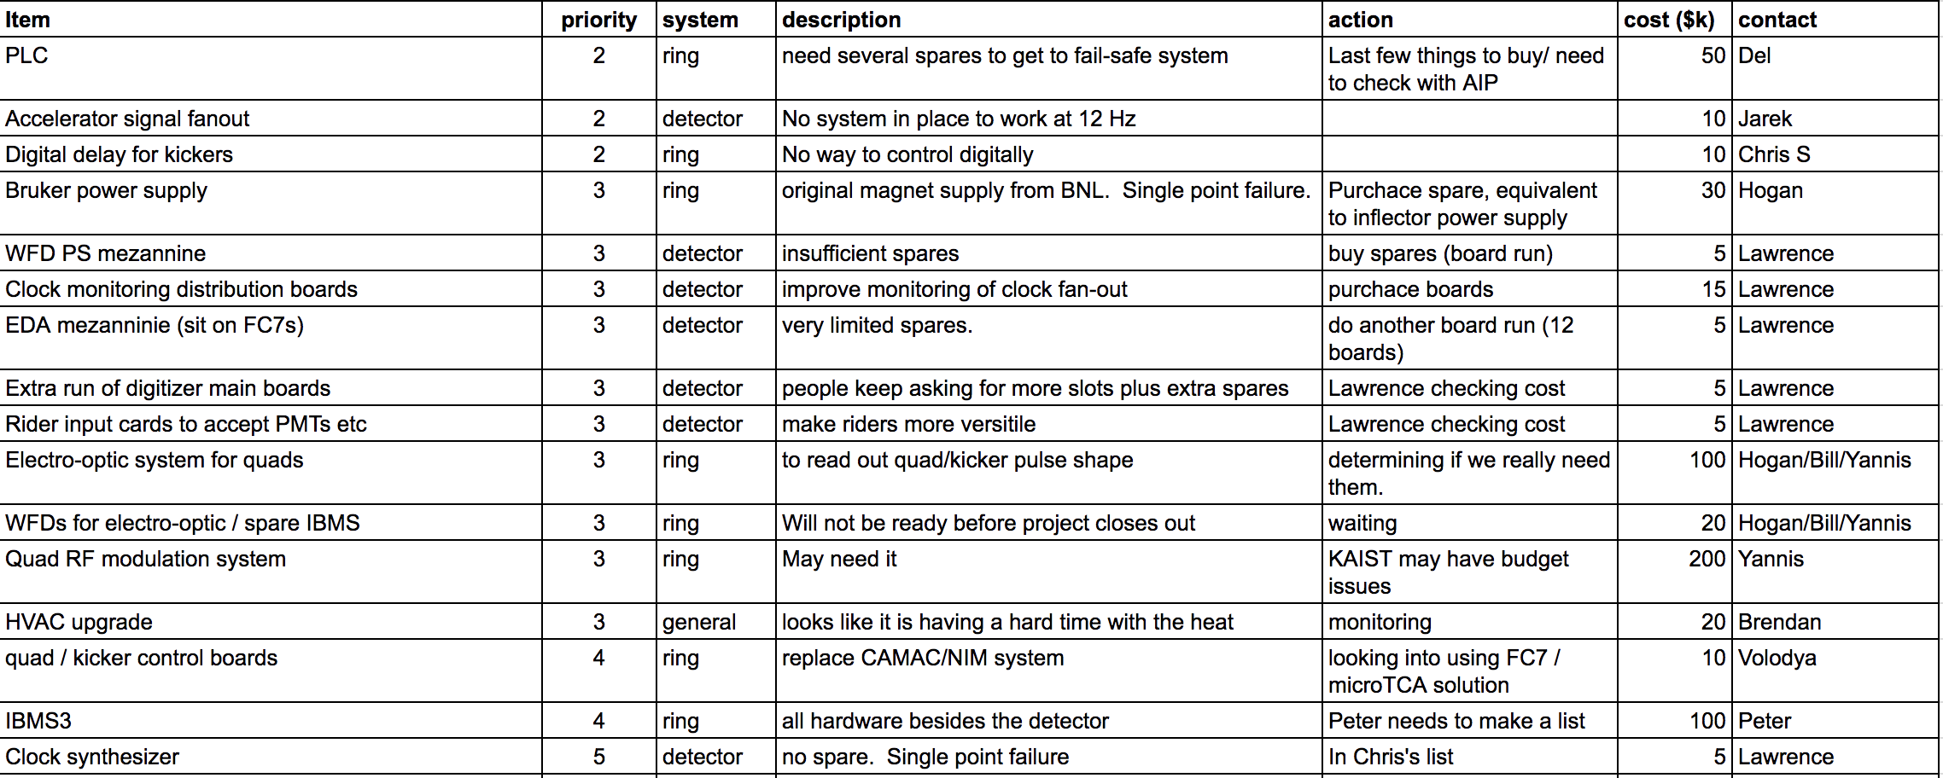
3. Create written agreements with supporting lab organizations and collaborating institutions that clearly spell out operations responsibilities and commitments.
High-level summaries of the collaboration institutional responsibilities are documented in the EOP. Several SOWs and SOCs exist with institutes that spell out commitments on some of the more critical items.
4. Create a prioritized list of spares and associated costs.
We have purchased necessary spares for the control system. We are working on purchasing the associated spares for the storage ring vacuum system, which will continue into FY2019. The operational experience in FY18 has helped identify the prioritization of critical spares, as they pertain to kicker, quad and electronics systems. The experiment maintains a spreadsheet with bottom up estimates of prioritized spares for each fiscal year.
Notes:
https://docs.google.com/spreadsheets/d/1HjRf3aStE58Y38vRv_GIVCaM7q9Bmo5riMNBaI9kdlo/edit#gid=2038140755

Slide 4
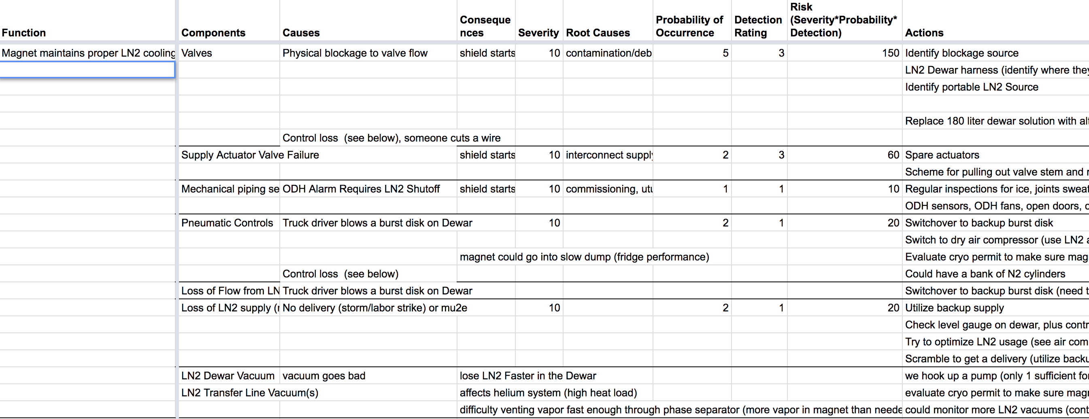
5. Negotiate with lab for funds sufficient to implement a full flow He purifier for g-2 and mu2e.
We currently employ a mobile purifier. PPD engineering has been negotiating with the lab for the funds needed to implement the full flow helium. Initial efforts targeted AIP contingency, but this funding stream was insufficient. Division discussions have resumed. TD-informed estimates of 300k M&S and 150 FTE-days (engineering, tech, trade, etc) have been thoroughly developed.
6. Perform a comprehensive FMEA for various single point failures and consequences. Develop mitigations.
An FMEA was performed by PPD scientists, mech engineers, and controls experts to identify the most vulnerable single point failures. Cryogenic mitigation responses were developed. Remaining items are prioritized and are being addressed as we enter FY2019. Constant re-evaluation of problems based on operational experience informs revised prioritizations.

Slide 5
7. The committee recommends that the lab should support 24/7 operations of the experiment until g-2 achieves stable operations
The lab has supported 24/7 operations of the experiment. We are still working to perform necessary steps to achieve stable operations.
8. In parallel, the experiment should develop a plan and associated costs to reduce or eliminate the need for 24/7 technical coverage.
PPD engineering has thoroughly reviewed, organized and documented the 48 specialized procedures of the 24/7 operations team that augment their operational monitoring tasks in an effort to document their responsibilities and enable consolidation if required.
Bob Sanders has retired, and Jerry Makara now supports the cyrogenic supply system for our magnets, working with us on the daily operation and maintenance of that system. Jerry also provides input for the operation of the magnets.

