Slide 1
Shutdown 2018- Inflector
K. Badgley
FY18 Muon g-2 Shutdown Mini-Review
June 13, 2018

Slide 2
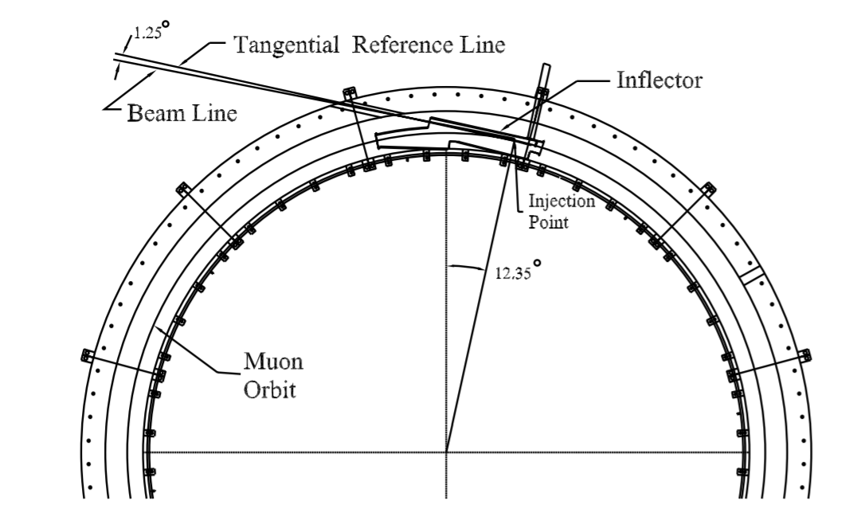
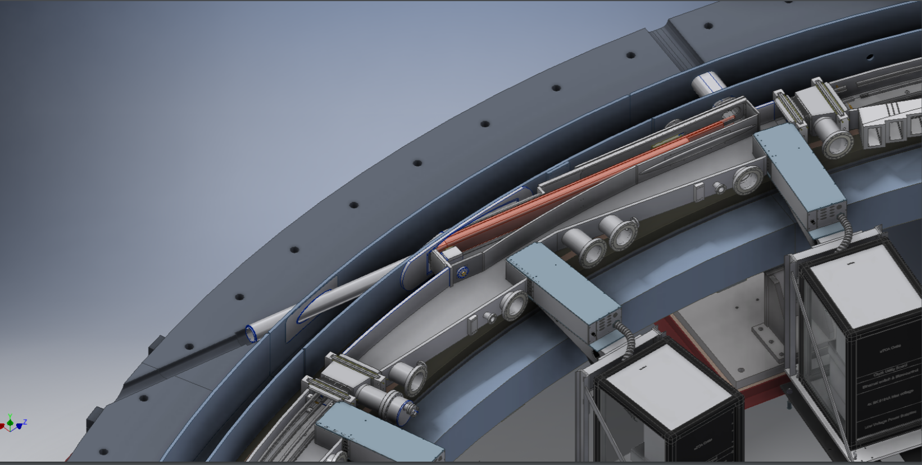
Magnet leads and Cryogenic line
Beam Line
Jarek Kasper

Slide 3
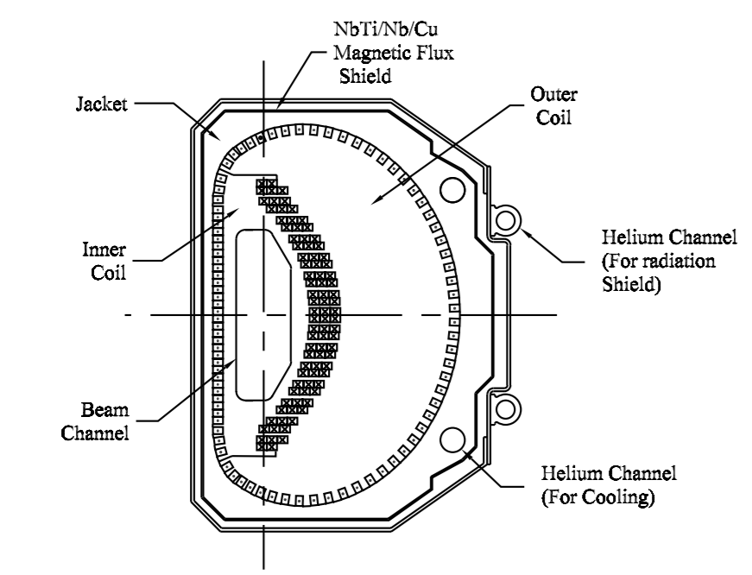
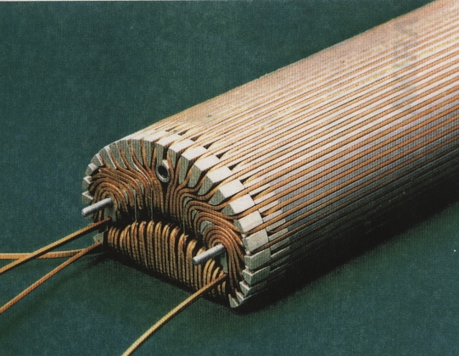
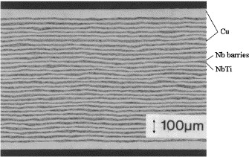
Existing Inflector Anatomy

Slide 4
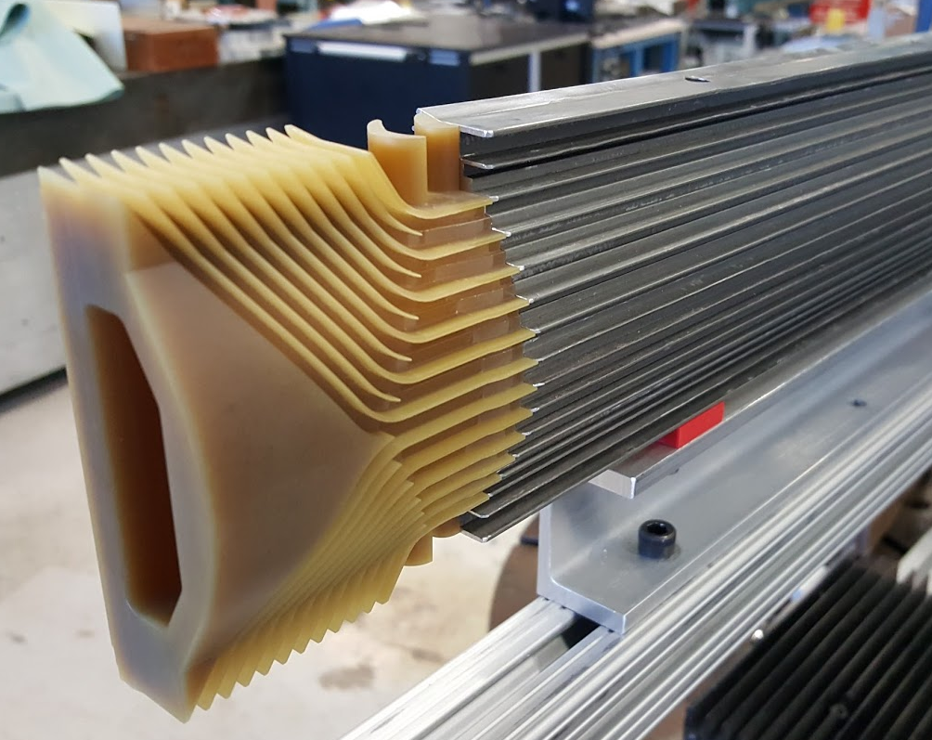
Open End Inflector Anatomy
Thermal shield
Cross section is identical
Outer coil slightly shorter but same endcap winding design
Two new inner coil endcaps
Inner Coil
Outer Coil
Superconducting shield

Slide 5
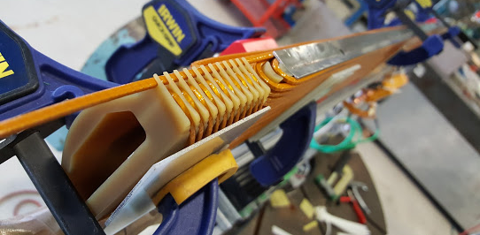
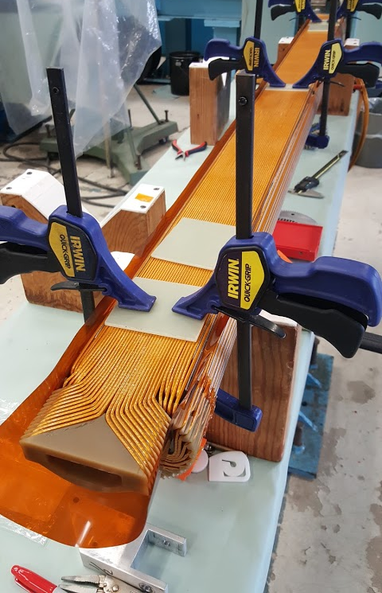
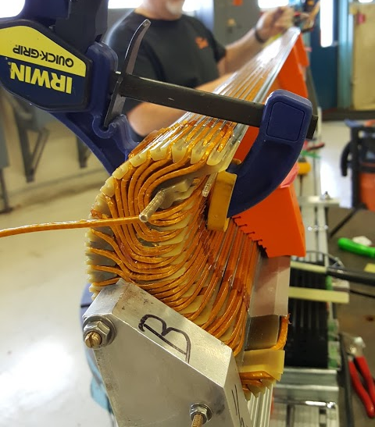
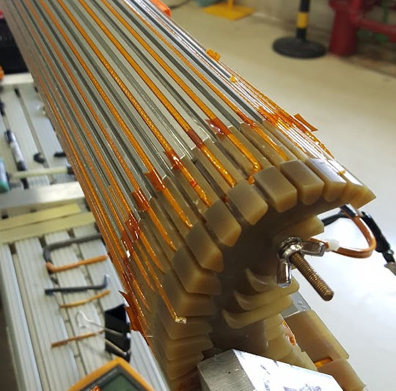
State of the magnet
Inner and double layer outer coil wound
Coils electrically isolated with a sheet of Kapton

Slide 6
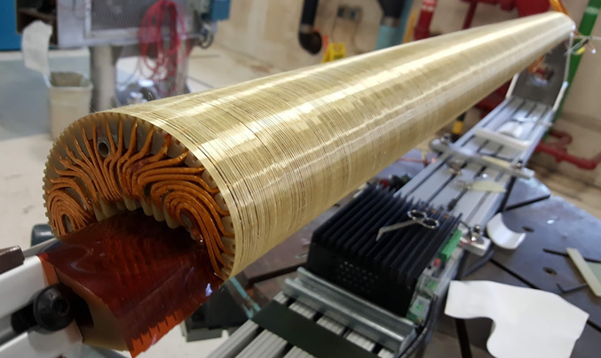
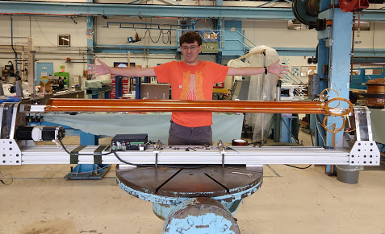
State of the magnet
Coils wound together with Kevlar
Coil package wrapped with Kapton

Slide 7
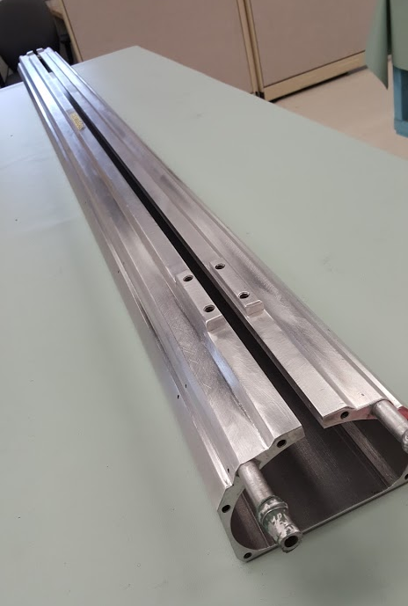
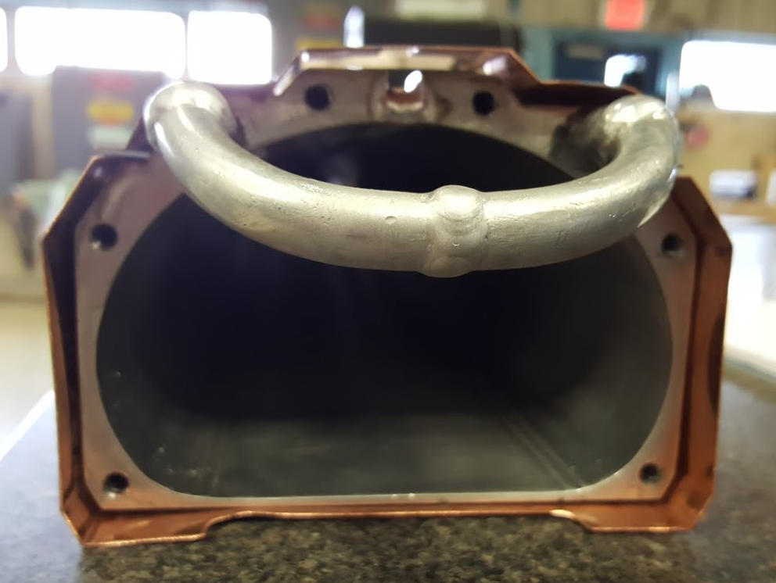
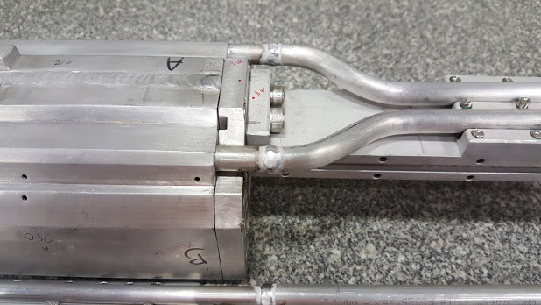
State of the magnet
Case re-welded
Cooling pipes welded
Initial leak check performed

Slide 8
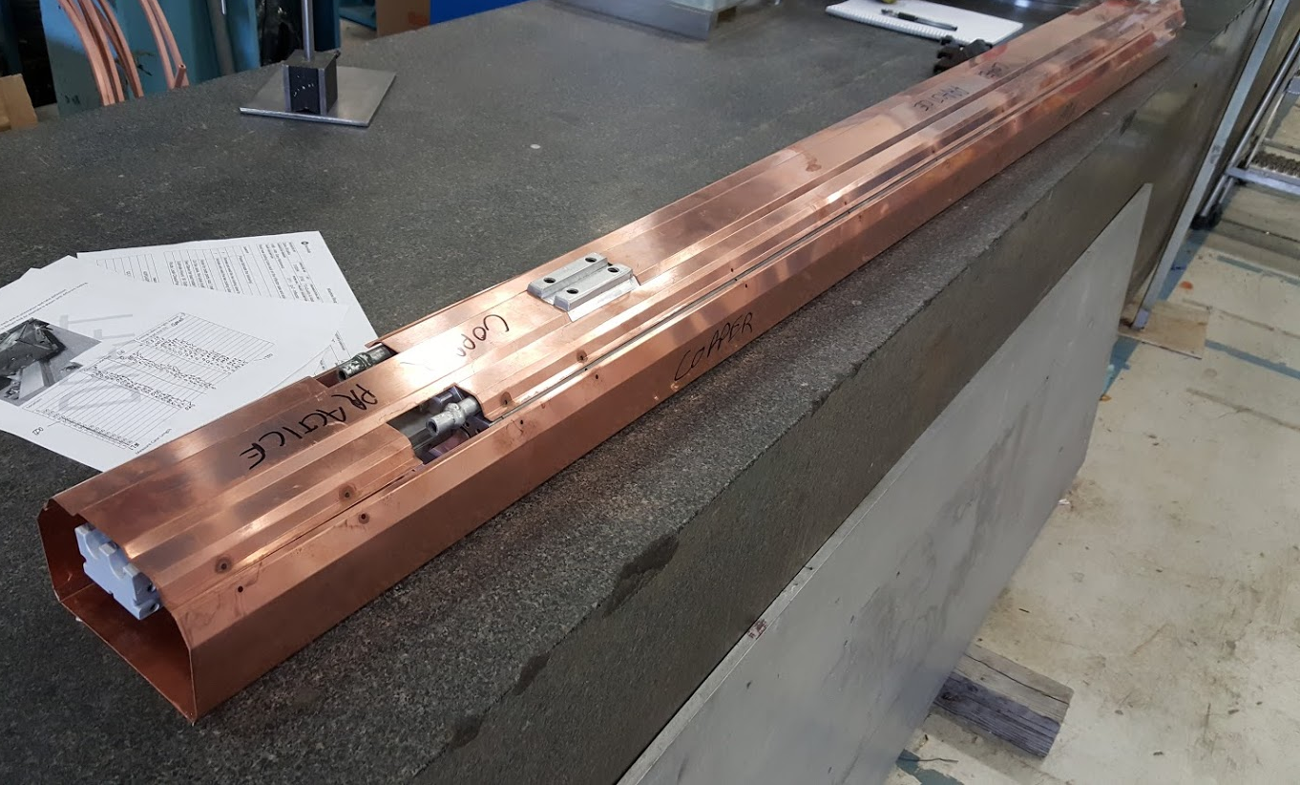
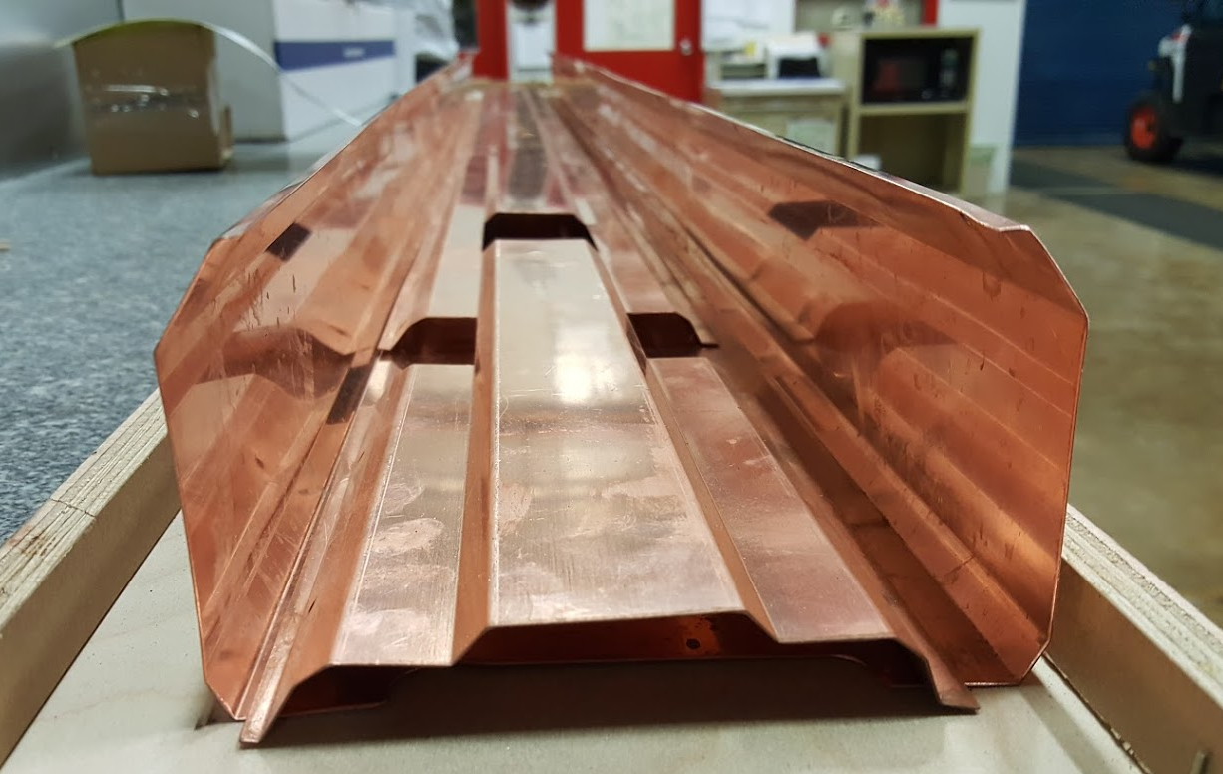
State of the magnet
A practice bend was made of the superconducting shield by our vendor
17 Cernox temperature sensors purchased
2 hall probes purchased
Voltage tap and instrumentation wire on hand

Slide 9
Remaining Fabrication Work
Insert coils into cold mass
Vacuum impregnate cold mass
Make inner coil/outer coil splice
Install superconducting shield
Voltage tap and Instrumentation
Wrap cold mass with MLI
Install thermal shield

Slide 10
Quality Control
Shorts to ground were continuously monitored during the winding process
Use of non-metallic endcaps
A 200 V high pot was performed on both inner and outer coils, this is well above the ~10 V expected to develop during a quench
Remaining Tests:
Leak check, cold shock, and pressure tests performed on cooling pipes
Cold shock of cold mass with superconducting shield (check for delamination and shorts)
Final high-pot to ~100 V
Warm magnetic field measurements

Slide 11
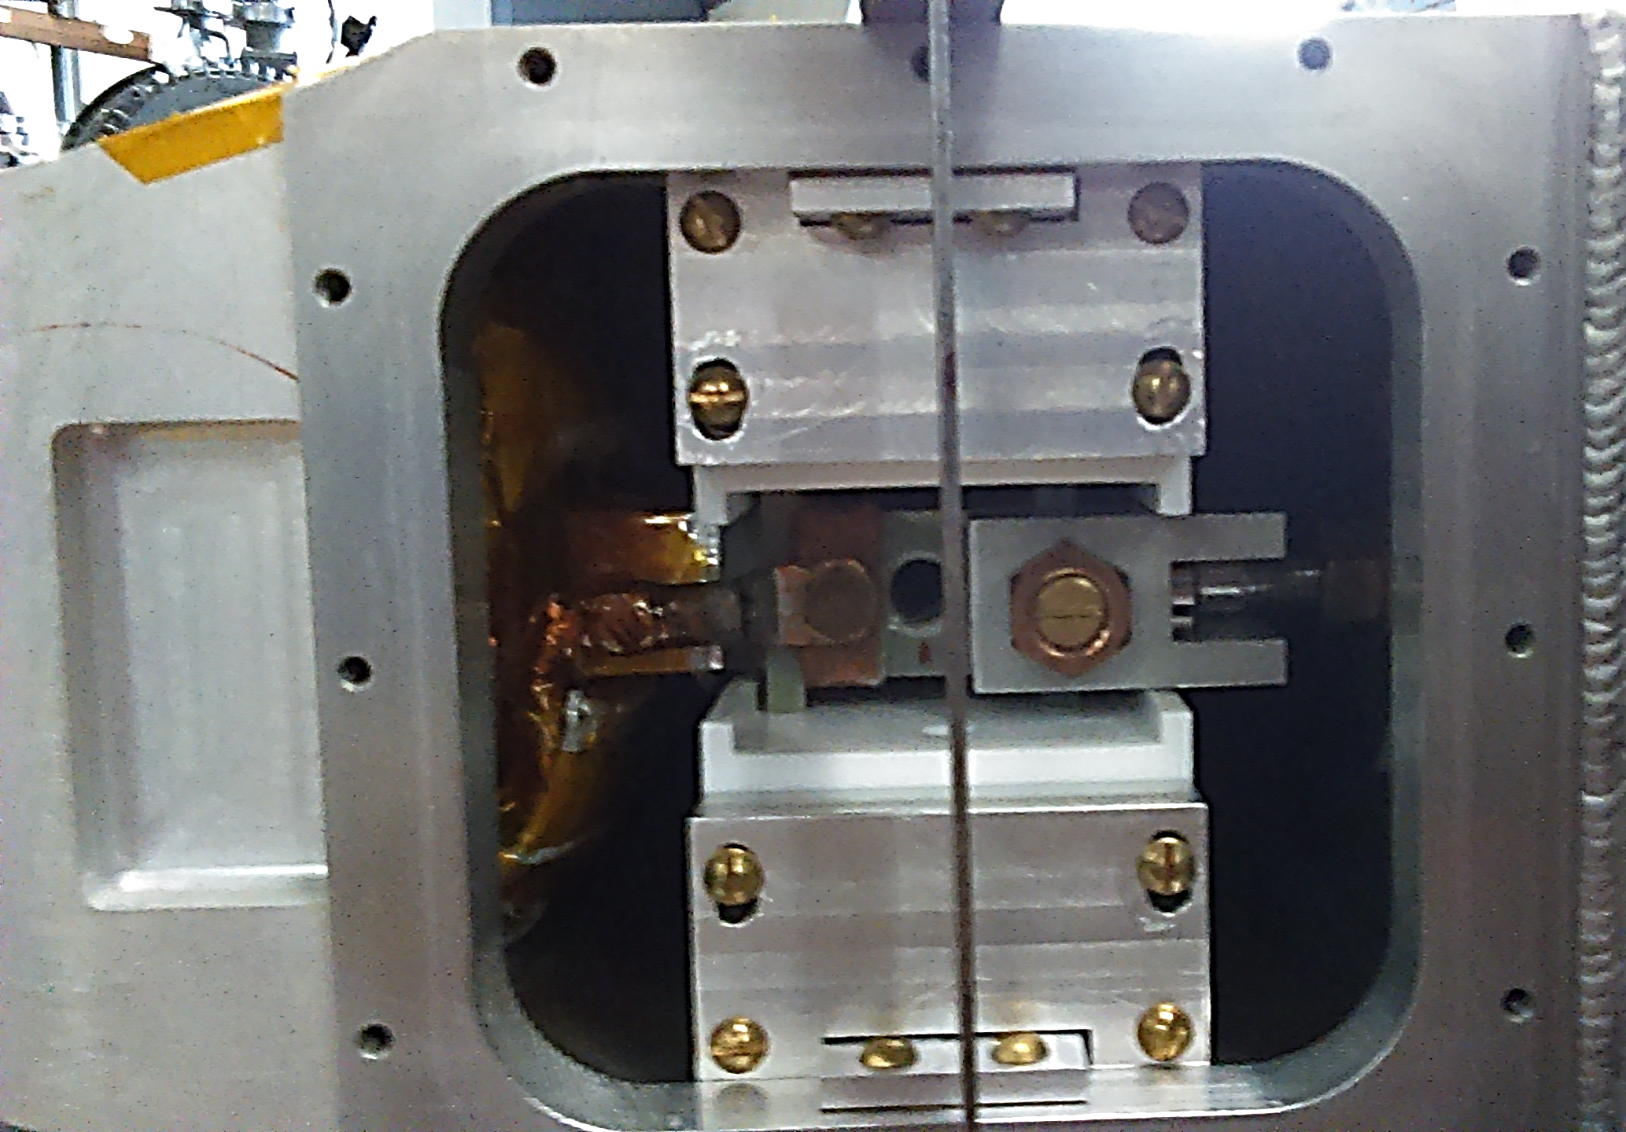
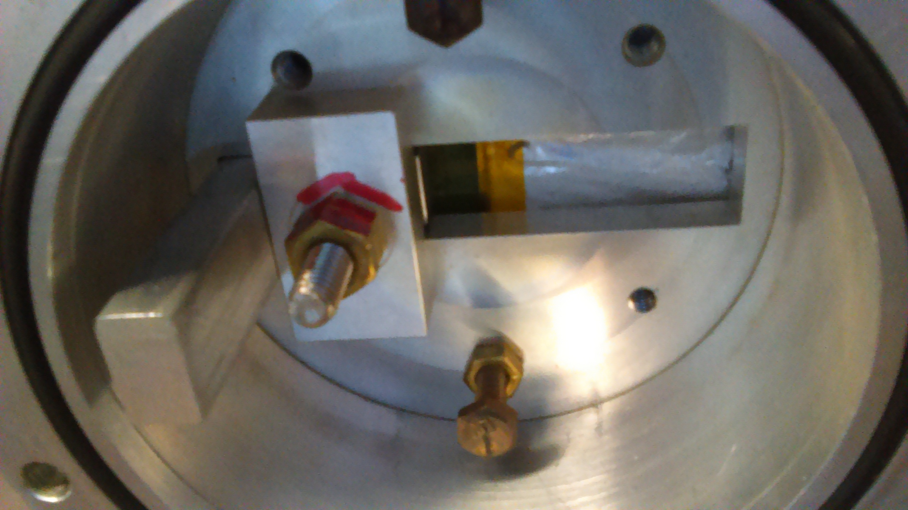
Angle Adjustment
Inflector has two adjustment knobs, radial and axial
E821 had plans for adjusting the inflector angle (radial knob) from the beam vacuum chamber, but the design was not implemented
During the removal/install, we would like to modify the mount to allow for this adjustment
Jarek Kasper
$$≠$$

Slide 12
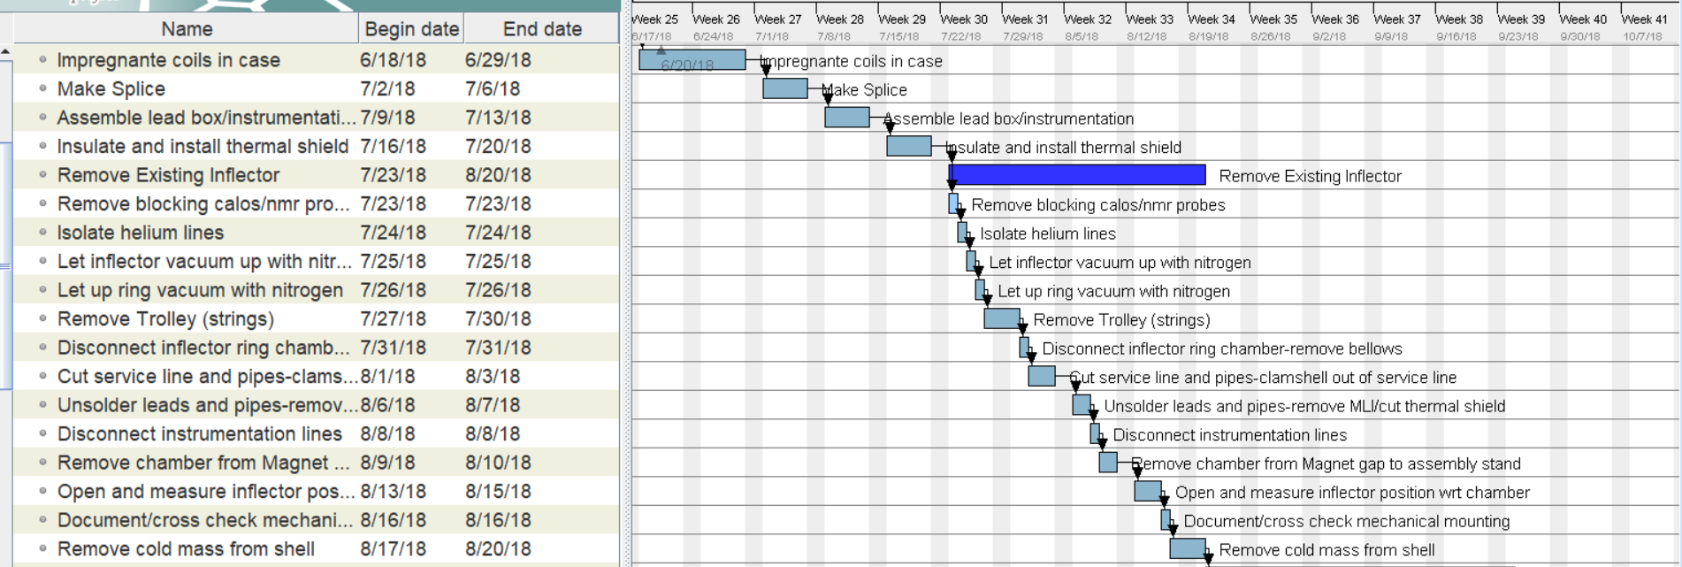
Removal Schedule

Slide 13
Installation and Testing Schedule

Slide 14
Shutdown Schedule
Shutdown
Mu2e Cryo Work
Collab Meeting
First muons to MC-1
Magnet Fabrication
100% beam ready
HAB Install and Test
Old Out
Issues?
New In and Test
New Out
Dec: Old In
HAB Testing
Incorrect external field
Safe at full current?
Untested quench detection system
No cooling of thermal shield

Slide 15
Shutdown Schedule with Direct Insertion
Shutdown
Mu2e Cryo Work
Collab Meeting
First muons to MC-1
Magnet Fabrication
100% beam ready
Old Out
Issues?
New In and Test
New Out
Old in and Test

Slide 16
Inflector Team
Scientists
Engineers
Karie Badgley (FNAL)
Hogan Nguyen (FNAL)
Vladimir Kashikhin (FNAL)
Nathan Froemming (Wash/NIU)
Diktys Stratakis (FNAL)
Many Others …
Del Allspach – Lead Engineer
Jake Kintner
Steve Krave – Remaining TD work
Steve Chappa – Power Supply
Walt Jaskierny – Quench Detection
Erik Voirin
And the PPD controls group
Technicians
John Nadjzion – Machining/Crane operation
Kelly Hardin - Leak Checking
Allen Rusy – Lead soldering

Slide 17
PPD Resources Required
Design and implement inflector adjustment
Engineering and drawings: 15 Mech. Engr. FTE days
Fabrication, Installation, Welding, Machining: 20 FTE days
New inflector piping safety test and documentation
4 Mech. Engr. FTE days
2 Mech. Tech. FTE days
Inflector removal and installation oversight
5 Mech. Engr. FTE days
30 Mech. Engr. FTE days
1 week of Alignment
Survey Check of Inflector Chamber
M&S purchases:
Isolators, parts ($10K)

Slide 18
Removal risk for existing inflector
Cutting into the service line
Unsoldering the superconducting leads
Instrumentation disconnect

Slide 19
Summary
Magnet Fabrication
The new inflector is largely complete
All materials and parts have been purchased
Direct Insertion Testing
Testing the magnet in the g-2 ring would be the safer option, external field, quench detection, known power supply…
Eliminates the installation and removal time from HAB
HAB does not mitigate all risks
Schedule
New inflector can be installed in the summer shutdown, and if needed, removed and replaced with minimal beam time loss

Slide 20
Bonus

Slide 21
Risk table
1* Risks specific to the HAB test | Special Risks at HAB Test | Mitigated Risks by HAB test before installation at MC-1 | Remained Risks even with HAB Test before the installation
2* Risks relevant to the installation at MC-1 that could be mitigated full or in part
3* Remaining risks (full or partial) that would remain after HAB tests
 | 1* | 2* | 3*
Magnet Cold Mass
Lorentz force on the thin wall of cold mass Al case (with no external field) | Yes | N/A | N/A
Thermal contraction Superconductor-Al-SC shield | No | Yes | No
Efficiency of thermal shield insulation | No | Yes | No
Cold mass and thermal shield cooling pipes pressure/leaks | No | Yes | No
Electrical coil shorts to the ground/case | No | Yes | No
Turn to turn shorts | No | Yes | No
Conductor/leads motion under the field | No | Partial | Partial
HAB Tests
Long term reliability | No | Partial | Partial
Peak current test** | Yes | Partial | Partial
Quench training up to peak current** | Yes | Partial | Partial
External field verification | No | Partial | Partial
Current leads fringe field verification | No | Partial | Partial
HAB Test Stand
Cold mass mechanical support structure | Yes | N/A | N/A
Instrumentation | Yes | N/A | N/A
Monitor probes and gages during cold tests | Yes | N/A | N/A
Leakage current to the ground | Yes | Yes | No
Quench protection | Yes | No | No
Power supply | No | No | No
Safety issues | No | No | No

Slide 22
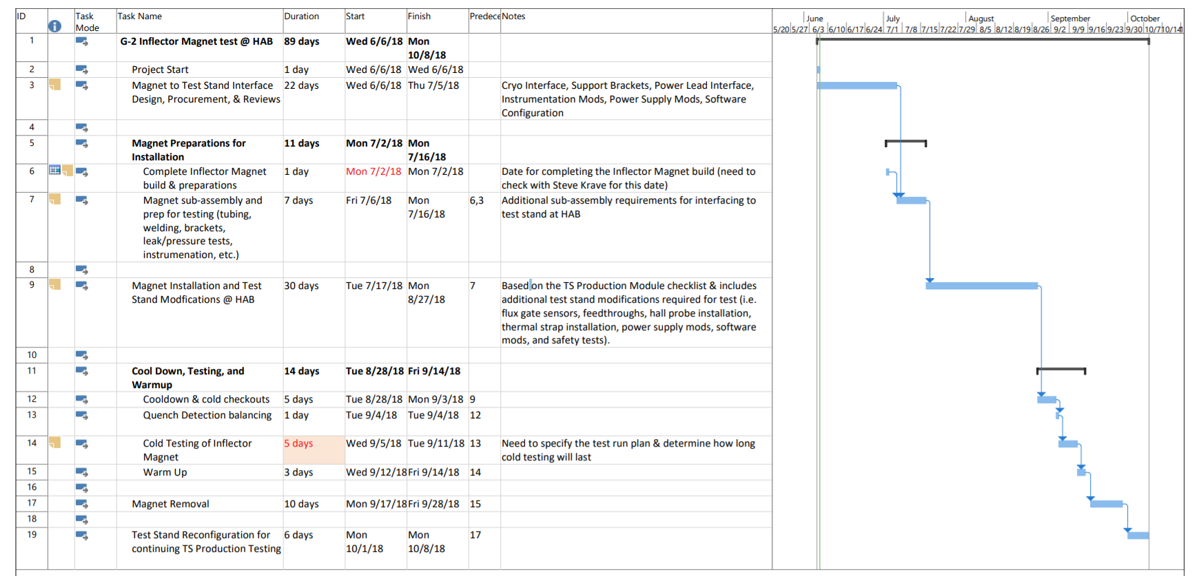
HAB Schedule

