Slide 1
Quad Operations Reliability Improvements for the Summer 2018 Shutdown
Hogan Nguyen
For the Quad Team
June 9th 2018

Slide 2
Quads were tested up to
25.4 KV (“high n”) in October 2017,
before physics run.
For various reasons, quads could
only operate reliably
between 15 kV-20.4 kV
Quads operations inefficiency
resulted in ~ 10% loss
in statistics

Slide 3
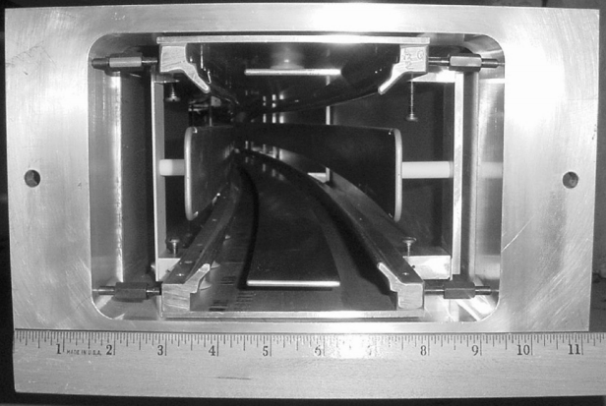
+HV
Storage Ring Component Layout
-HV
-HV
+HV
4 Electrostatic Quadrupole Stations
inside Storage Ring Vacuum
Electrostatic Plates to provide $±$HV

Slide 4
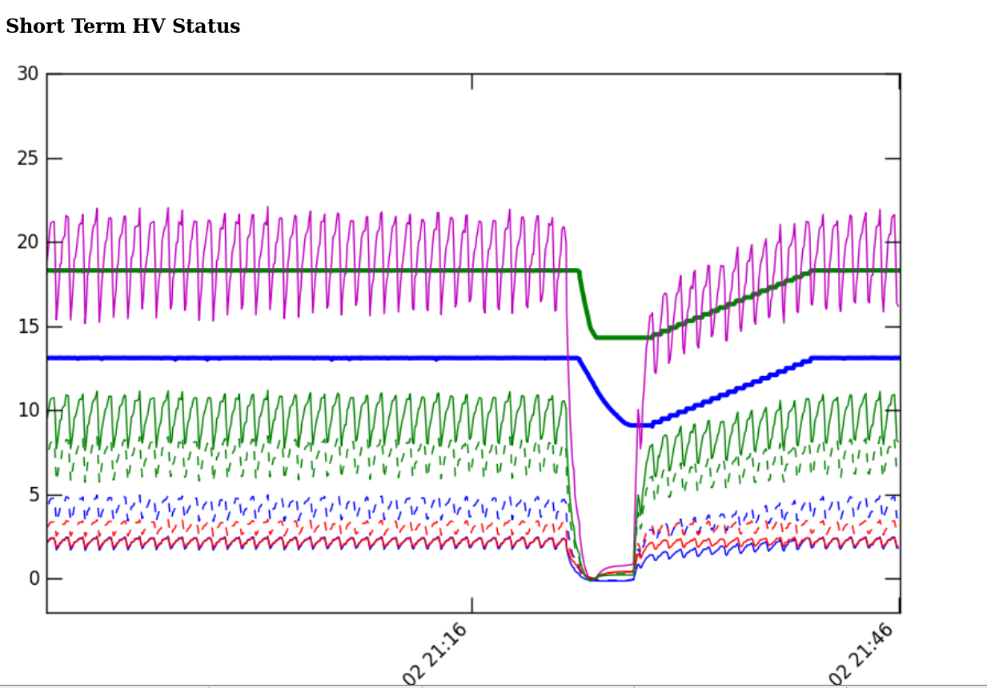
Quad Spark
Quad Recovery
Typical Quad Spark
and 15 minute recovery
Good spark rate is < 1 per shift
However, there were occasions
of frequent sparking, requiring
lowering the HV and long
reconditioning

Slide 5
Quad Operations
Reliability
Dependence on
Other Systems
Storage Ring Vacuum Quality
Kicker Operations
Impact on
Fixed Probes
TDR Spec is < 1e-6 Torr
Sparks are more likely to
Happen with worse vacuum
Have to run at lower field
Index to prevent frequent
sparking
Sparks in Q2 correlated
With K2 and K3 Operation
Improves with better
vacuum and Kicker conditioning
HV Pulsers are causing noise
on certain NMR probes.
Affected magnetic field
stabilization system.

Slide 6
Quad Operations
Reliability
Known Flaws
HV Pulser Reliability
HV Lead Placement
Control Electronics
Vibrations
Commercially Built Pulsers had occasional trips.
Most were resettable by software. Some required control access to fix.
Downtime
In-Vacuum HV leads
were too close to the
ground plane, leading to
too high electric fields.
Excessively long conditioning
and spark recovery time.
Insufficient
Supports for
Long HV Leads
Mechanical
Vibrations from
Electrostatics
Utilized CAMAC/NIM
(Due to lack of time
Before physics run)
Awkward interface
To DAQ and Online
Monitoring

Slide 7
Quad Operations
Reliability
Improvements
HV Pulser Reliability
HV Lead Placement
Control Electronics
Vibrations
In discussion with Electrical
Engineering Vendor to make corrections
Resurvey all leads and realign if
Necessary.
More margin against sparking
and long recovery time.
Add additional Supports
to move off resonance
Frequency.
Allow for more optimal
conditioning scheme
Upgrade to
State-of-the-Art
Electronics from
Boston University

Slide 8
HV Lead Placement
+HV
Q4 Long has history of requiring excessive recovery
Time and difficulty reaching higher voltage.
Partial Optical Survey Of “Q4 Long” Quadrupole
In March 2018 showed incorrect Lead Placement.
-HV
-HV
+HV
1 cm Minimum Distance Required
Between HV Components and Ground Plane
72” Long HV Leads
Vibrated due to
Electrostatics

Slide 9
Ground Plane
Optical Survey
Of Q4 Long
showed incorrect
lead placement
We will resurvey
all Quads and
realign leads
Note the Difference
In Angular Size of
The tubes.
+HV Lead
-HV Lead

Slide 10
Quad HV feedthrough extension
72” Long
HV Leads
Add Internal Horizonal Support to prevent lead vibrations from
electrostatics
6° bend
36 in
R ~ 585.8 cm
B < 0.01 T

Slide 11
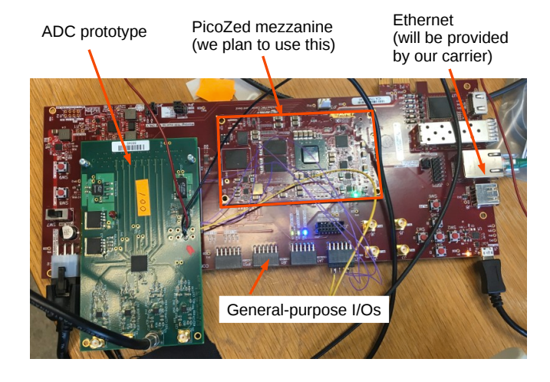
Electrostatic Quadrupoles Control Electronics Upgrade
Due to lack of time
and resources, Quad
System relied on
CAMAC/NIM for
Spark Detection, fast logic and other timing controls.
Will Upgrade to
modern Electronics
built by Boston University.

Slide 12
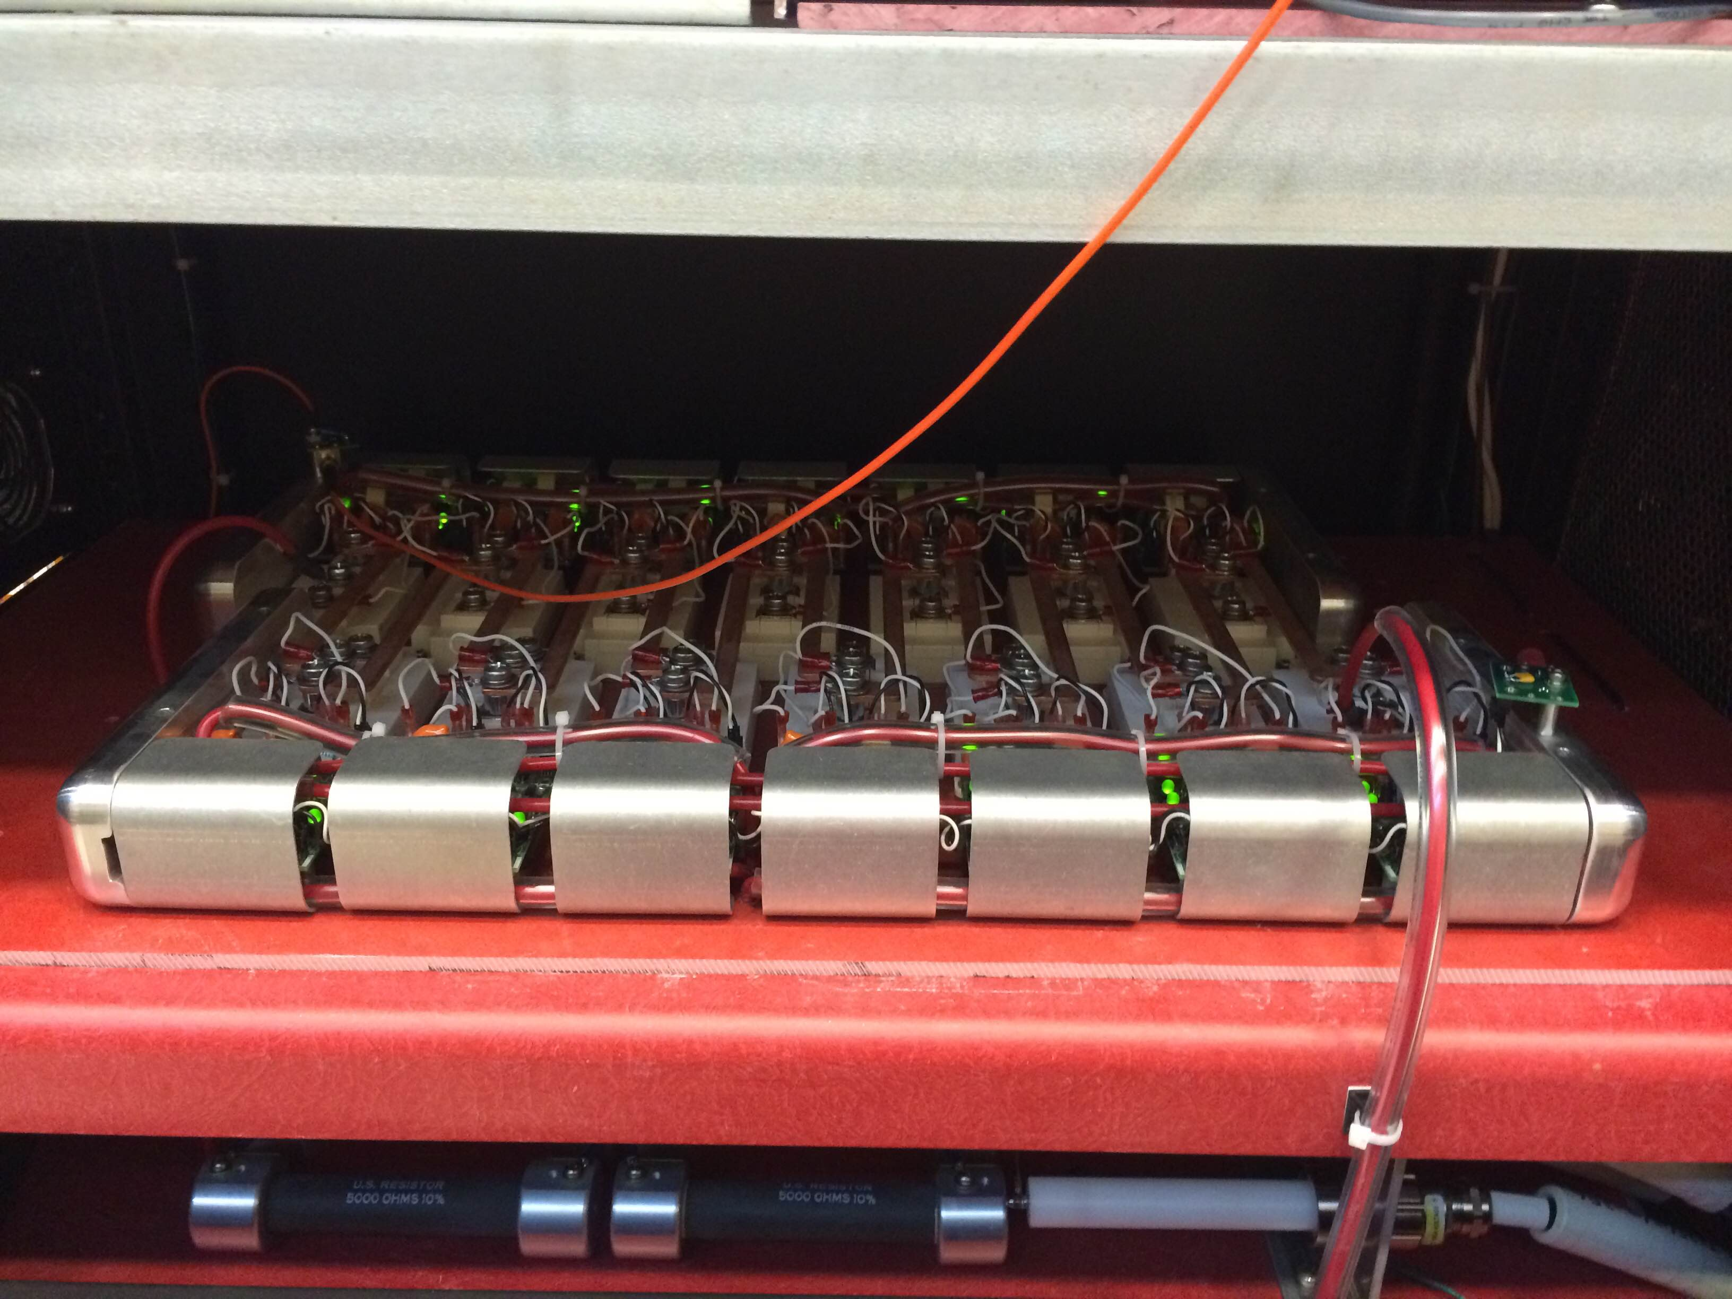
HV Pulsers
New purchase from API, and utilizes IGBT technology for HV switching
Worked Reliably but had occasional failures:
- failed power resistors
- fault-checking electronics failed
- Arc-fault detection logic glitches
We are working with the
Electrical Engineering
Vendor to debug and
implement fixes

Slide 13
Quad Science Team
Mechanical Technicians
Volodya Tishchenko – Head (BNL)
Jason Crnkovic – Head of Operations (BNL)
Bill Morse (BNL)
Nam Tran (BU)
Lee Roberts (BU)
Hogan Nguyen (FNAL)
Erik Ramberg (FNAL)
Yannis Semertzidis (KAIST)
Selcuk Haciomeroglu (KAIST)
On Kim (KAIST)
Many Others …
John Nadjzion - Machining
Kelly Hardin - Leak Checking
Most Shutdown Tasks are Light
Mechanical work and can be
done primarily with Physicists.
John Nadjzion (MT) needed for
parts fabrication and making
vacuum connections

Slide 14
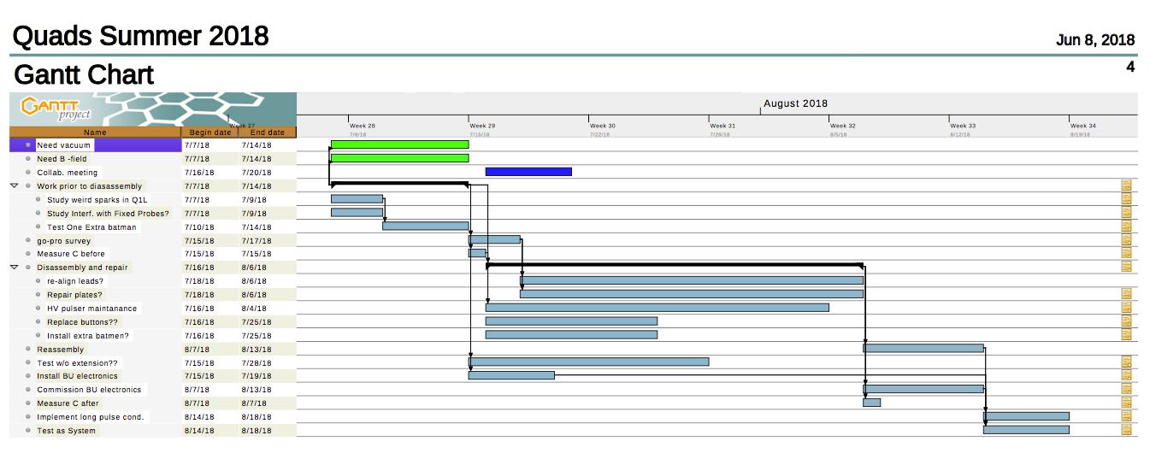
Schedule optimized
for Quad work …

Slide 15
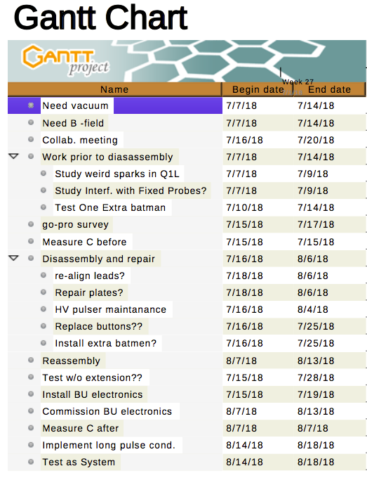
Schedule optimized
for Quad work …

Slide 16
PPD Resources Required
4 weeks mechanical technician
HV Lead Bending
Small Parts/Tooling fabrication
Vacuum Connections and Leak Check
Macor Machining (MAB group)
Occasional crane operations
2 weeks of Alignment
Survey Check of Quad Plates
M&S purchases:
Macor Blanks ($3K)
Aluminum Tubing ($1K)
Aluminum Gaskets
EE Vendor to improve Pulser Operation
($10K Contract In Place)

