Slide 1
PIP-II and proton opportunities
Paul Derwent
MUSE Network General Meeting
24 October 2018

Slide 2
“P5 Report”
The Particle Physics Project Prioritization Panel (P5) advises the US Department of Energy (DOE) Office of High Energy Physics on research funding priorities in high energy physics
After a lengthy process, the panel released a report in May, 2014. Top priorities for Fermilab:
  Support the LHC and its planned luminosity upgrades
  Pursue the g-2 and Mu2e muon programs*
  Focus on a high energy neutrino program to determine the mass hierarchy and measure CP violation.
    Will ultimately require a “multi-megawatt” beam at 60-120 GeV
  Continue at least R&D toward a future linear e⁺e⁻ collider (ILC)

Slide 3
“P5 Report”
The Particle Physics Project Prioritization Panel (P5) advises the US Department of Energy (DOE) Office of High Energy Physics on research funding priorities in high energy physics
After a lengthy process, the panel released a report in May, 2014. Top priorities for Fermilab:
  Support the LHC and its planned luminosity upgrades
  Pursue the g-2 and Mu2e muon programs*
  Focus on a high energy neutrino program to determine the mass hierarchy and measure CP violation.
    Will ultimately require a “multi-megawatt” beam at 60-120 GeV
  Continue at least R&D toward a future linear e⁺e⁻ collider (ILC)

Slide 4
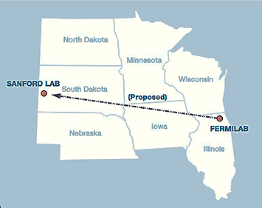
Fermilab Program Goals
Fermilab’s goal is to construct & operate the foremost facility in the world for particle physics research utilizing intense beams.
Neutrinos
  MINOS+, NOvA @700 kW
  LBNF @ multi-MW
  Short Baseline Neutrino @ 10’s kW
Muons
  Muon g-2 @ 17-25 kW
  Mu2e @ 8-100 kW
Longer term opportunities
This requires more protons!
(and this statement tends to be time invariant)
“Upgrade the Fermilab Proton Accelerator Complex to produce higher intensity beams. R&D for the Proton Improvement Plan II (PIP-II) should proceed immediately, followed by construction, to provide proton beams of > 1 MW by the time of the first operation of the new long-baseline neutrino facility” – Recommendation 14, P5 report
Notes:
I think the theme is summarized by the statements in RED. Just documenting our current model of how to get there, and point out R&D being done by PIP-II and other places where we would benefit from it (GARD supported)
PIP-II approach supports the first 100 kt MW years of the P5 target of 600.

Slide 5
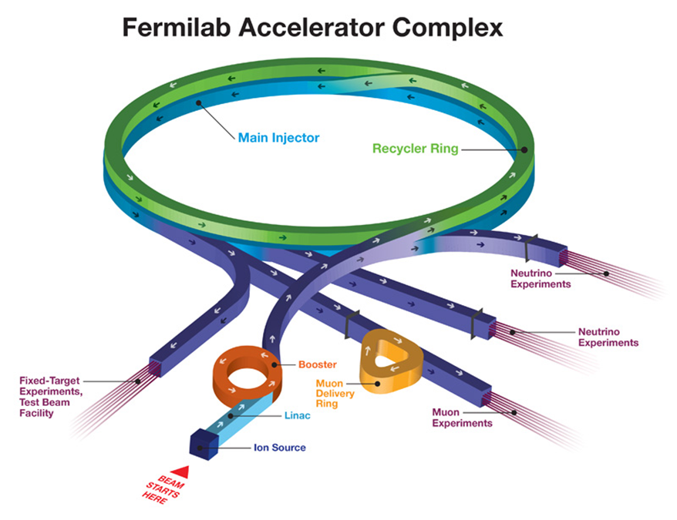
The Fermilab Accelerator Complex Today
The Fermilab complex delivers protons for neutrino production at both 8 and 120 GeV, with a present capability:
  8 GeV: 4.6×10¹² protons @ 15 Hz = 88 kW
  120 GeV: 5.0×10¹³ protons @ 0.75 Hz = 715 kW
Present limitations
  Booster pulses per second
    The Booster magnet/power supply
    system operates at 15 Hz
  Rings Beam Loss
    Higher Power operation is all about controlling beam loss
  Target systems capacity
    Limited to ~800 kW
Notes:
Beam Loss:
Radiological controls: personnel safety, ground water
Radiological activation: maintenance ALARA
Radiological activation: component performance / degradation (cables and electronics)

Slide 6
Experimental Program
At 8 GeV
  Neutrinos (Booster)
    ANNIE
    MicroBooNE
    MiniBooNE
    MITPC
    SciBath
    ICARUS (future)
    SBND (future)
  Muons (Recycler & Muon Rings)
    g-2
    Mu2e (future)
At 120 GeV
  Neutrinos
    MINOS+
    MINERvA
    NOvA
    DUNE (future)
  Fixed Target
    SeaQuest
    LArIAT
    Test Beam Facility
Notes:
15 Hz out of Booster, have to balance distribution between the different programs
9 Hz to NOvA now, 5 Hz limit for BNB due to horn power supply

Slide 7
Strategy for the next ~10 years
Proton Improvement Plan (PIP)
The near-term goal is to double the Booster beam repetition rate to 15 Hz, while addressing reliability concerns
  Required for simultaneous operations of NOvA, g-2, Mu2e, SBN
  700 kW to NOvA: 4.9e13 @ 120 GeV @ 0.75 Hz
Design Criteria
  15 Hz beam operations at 4.2×10¹² protons per pulse (80 kW)
  Linac/Booster availability > 85%
  Residual activation at acceptable levels
  Useful operating life for the Linac through 2023 and the Booster through 2030
Scope
  15 Hz Capability:
    RF upgrades, cavity refurbishment
    Power and water distribution
  Reliability: >85% uptime, reduce operational risk
    Drift Tube Linac RF replacement ⇒200 MHz klystrons/modulators
    Additional Booster RF cavities
    Power and water distribution
  Beam Quality and Losses: RFQ, dampers, collimators/absorbers
    To maintain activation at current levels or lower
Execute over the years 2011 – 2019
Notes:
Goals at start in 2011
Achieved 15 Hz in 2016
Running 15 Hz at 4.6 or higher!

Slide 8
Progress: Beam through Booster
Enable Recycler pre-stacking

Slide 9
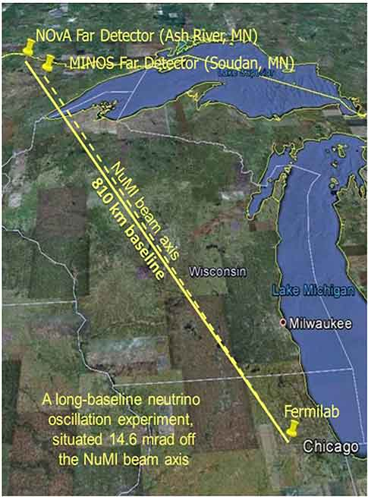
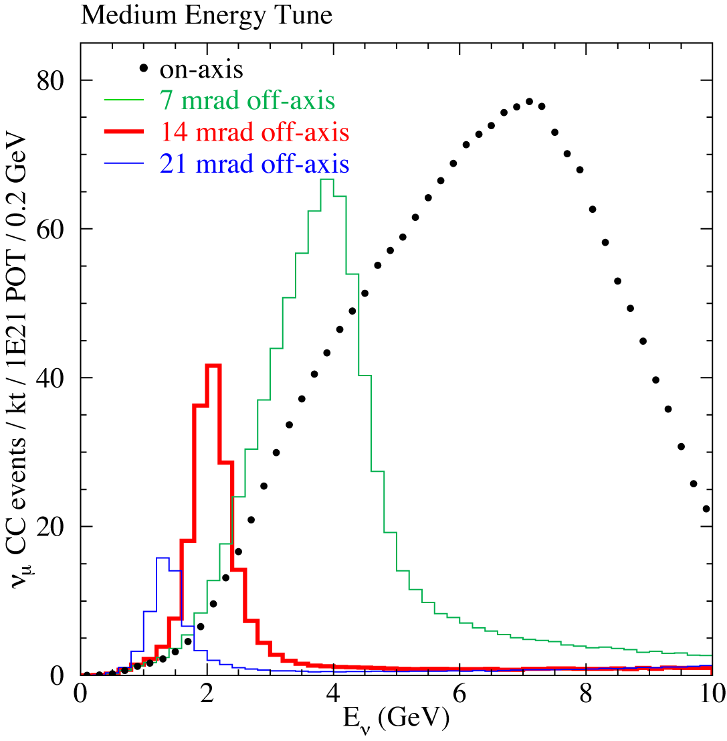
Current ν Program: NuMI➔MINOS+NOνA
The “Neutrinos from the Main Injector” (NuMI) line uses 120 GeV neutrinos from the Main Injector to produce neutrinos, which are detected in
  MINOS: 725 km away in the Soudan
  Mine in Minnesota
  NOνA: 810 km away in Ash River,
  Minnesota, 14.6 mrad off axis
    Produces narrower energy spread

Slide 10
Current Program: g-2, Mu2e
g-2 :
  4 Booster batches (4e12 at 8 GeV) every 1.4 seconds to Recycler
  Adiabatically rebunch 53 MHz to 2.5 MHz
    ~125 nsec width
  16 extractions of protons -> 3.094 GeV muons to Delivery Ring
  Circulate 5 turns (protons & muons separate in time), then to g-2 ring
  15 kW
Mu2e:
  2 Booster batches (4e12 at 8 GeV) every 1.4 seconds to Recycler
  Adiabatically rebunch 53 MHz to 2.5 MHz
  8 Extractions of protons
    Slow spill from Delivery Ring
    7.3 kW

Slide 11
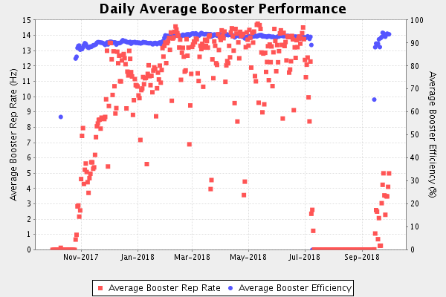
Previous Year Delivery
Regular operation at 15 Hz

Slide 12
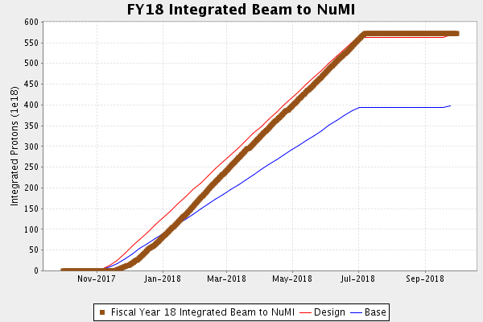
Previous Year Delivery
Power and Uptime to meet Proton on Target goals

Slide 13
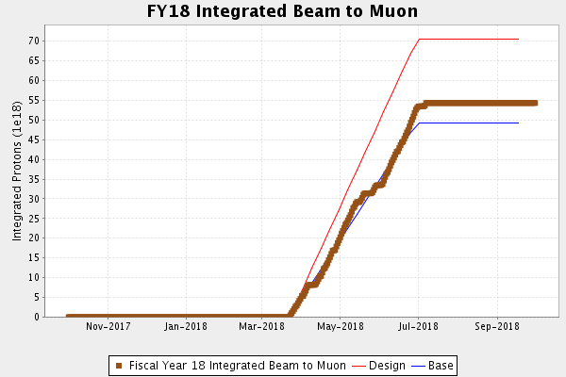
Previous Year Delivery
g-2 has approached total positrons from BNL operation

Slide 14
STATISTICS in Neutrino Experiments
Neutrino Events/Unit Time =
Neutrino Flux x
Neutrino Cross-section/Nucleon x
Number of Nucleons
BEAM = Protons/year +
Target/horns, Beam Energy
PHYSICS!
Detector = Mass +
Efficiency
Neutrino Experiments Need : Mass * Power * Time
We want to achieve our physics goals in a timely manner!
Notes:
You might point out that the neutrino flux is pretty much proportional to protons/time x proton energy = beam power

Slide 15
From DUNE CDR – May 2015

Slide 16
DUNE Physics Goals
40kT with 1.2 MW is a 20 year program
Notes:
It would make more sense if the left column of this table was 120 kT-MW-years since that is the P5 recommendation.
This table is basically the statement of need for LBNF based on the P5 report. This needs to feed directly into PIP-II design criteria.

Slide 17
Strategy for the next ~10 years
Proton Improvement Plan-II (PIP-II)
The longer-term goal is to increase the beam power delivered from the Main Injector by an additional 50% and to provide increased beam power to the 8 GeV program, while providing a platform for the future
Strategy
  Increase the Booster per pulse intensity by 50%
    Requires increase in injection energy to ~800 MeV
  Modest modifications to Booster/Recycler/MI
Design Criteria
  Deliver 1.2 MW of beam power at 120 GeV, approaching 1 MW down to 60 GeV, at the start of LBNF operations
  Support the current 8 GeV program, including Mu2e, g-2, and the suite of short-baseline neutrino experiments
  Provide an upgrade path for Mu2e
  Provide a platform for extension of beam power to LBNF to >2 MW
  Provide a platform for extension of capability to high duty factor/higher beam power operations
  At an affordable cost to DOE
Execute over 2015 – 2026
Notes:
Injection energy increase: keep space charge effects at ~same as currently

Slide 18
PIP-II Technical Approach
Construct a modern 800-MeV superconducting linac, of Continous Wave (CW) RF components, operating initially in pulsed mode
  Ameliorate space-charge forces at Booster injection, allowing an increase Booster/Recycler/Main Injector per pulse intensity of ~50%, while preserving transverse & longitudinal emittance at current levels
  Allow for multiple destinations of SCL beam in addition to Booster / Long Baseline program
Accompanied by modifications to Booster/Recycler/Main Injector to accommodate higher intensities and higher Booster injection energy
Increase Booster repetition rate to 20 Hz
  Maintain 1 MW down to 60 GeV or,
  Provide factor of 2.5 increase in power to 8 GeV program
Described in the Conceptual Design Report
  http://pip2-docdb.fnal.gov/cgi-bin/RetrieveFile?docid=113&filename=PIP-II_CDR_v.0.1.pdf&version=8

Slide 19
PIP-II
Formal Department of Energy Project in the Office of High Energy Physics
  Critical Decision 0: Mission Need Statement
    Office of Science Approval October 2015
    Energy Systems Acquisitions Advisory Board November 2015
  Critical Decision 1: Selection of Alternative
    Energy Systems Acquisitions Advisory Board July 2017
  Preparing for Critical Decision 2: Approve Performance Baseline
    FY19
  Vigorous program to address technical, cost, and schedule risk underway
  Anticipate construction start in 2020, with completion in 2026 time frame

Slide 20
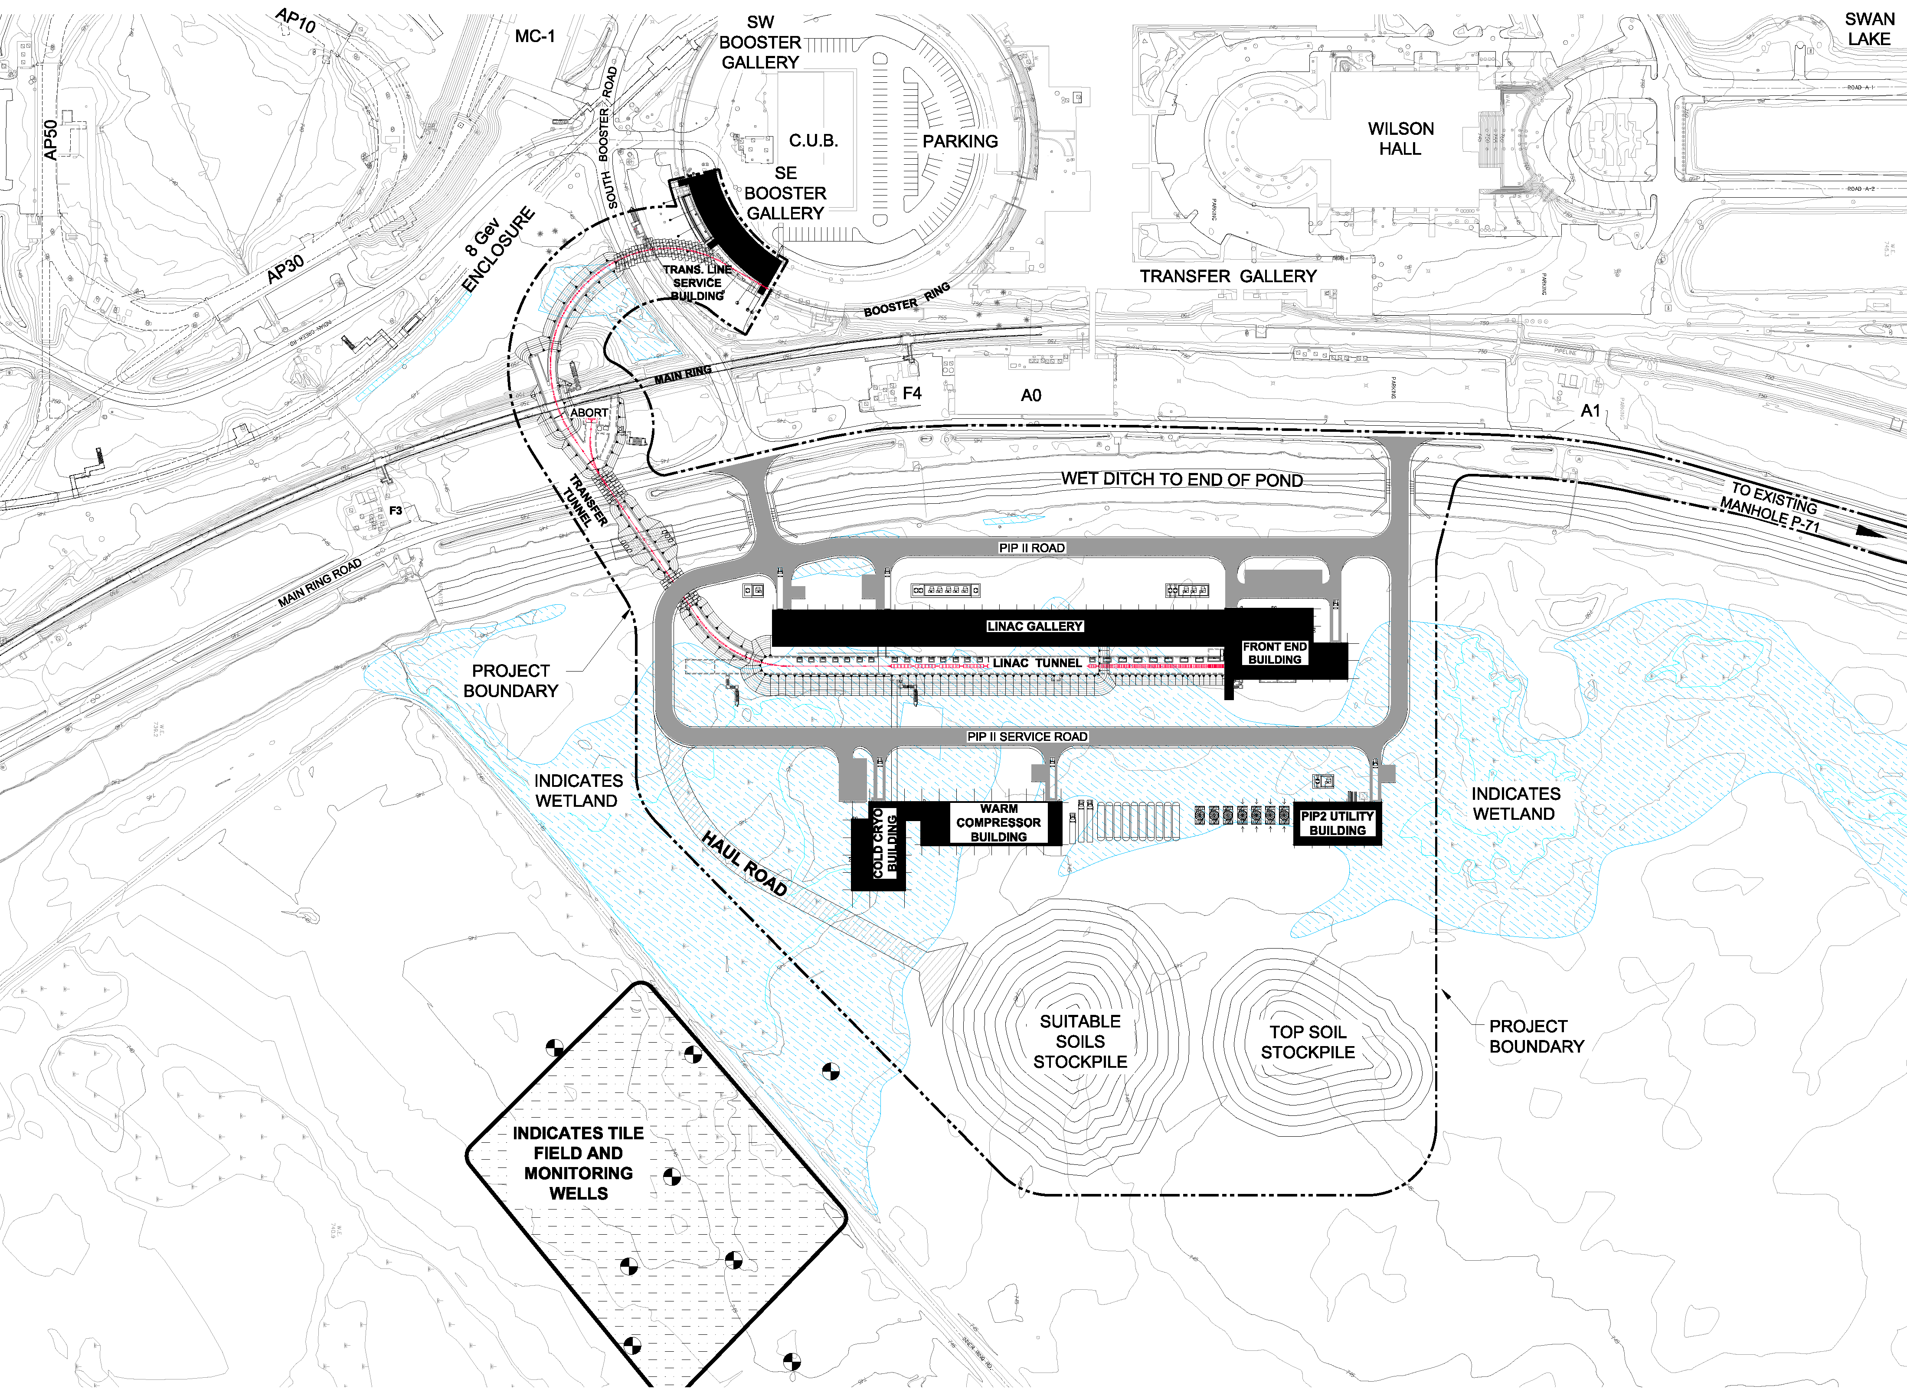
PIP-II Technical Approach/Site Layout

Slide 21
Performance Goals
Performance Parameter | PIP | PIP-II
Linac Beam Energy | 400 | 800 | MeV
Linac Beam Current | 25 | 2 | mA
Linac Beam Pulse Length | 0.03 | 0.54 | msec
Linac Pulse Repetition Rate | 15 | 20 | Hz
Linac Beam Power to Booster | 4 | 17 | kW
Linac Beam Power Capability (@>10% Duty Factor) | 4 | ~200 | kW
Mu2e Upgrade Potential (800 MeV) | NA | >100 | kW
Booster Protons per Pulse | 4.3×10¹² | 6.5×10¹²
Booster Pulse Repetition Rate | 15 | 20 | Hz
Booster Beam Power @ 8 GeV | 80 | 166 | kW
Beam Power to 8 GeV Program (max) | 32 | 83 | kW
Main Injector Protons per Pulse | 4.9×10¹³ | 7.5×10¹³
Main Injector Cycle Time @ 60-120 GeV | 1.33** | 0.7-1.2 | sec
LBNF Beam Power @ 60-120 GeV | 0.7** | 1.0-1.2 | MW
LBNF Upgrade Potential @ 60-120 GeV | NA | >2 | MW
**NOvA operations at 120 GeV
Notes:
Key ones to call out: Protons per Pulse, Repetition Rate -> 2x flux through Booster but want to keep total power loss at same scale!

Slide 22
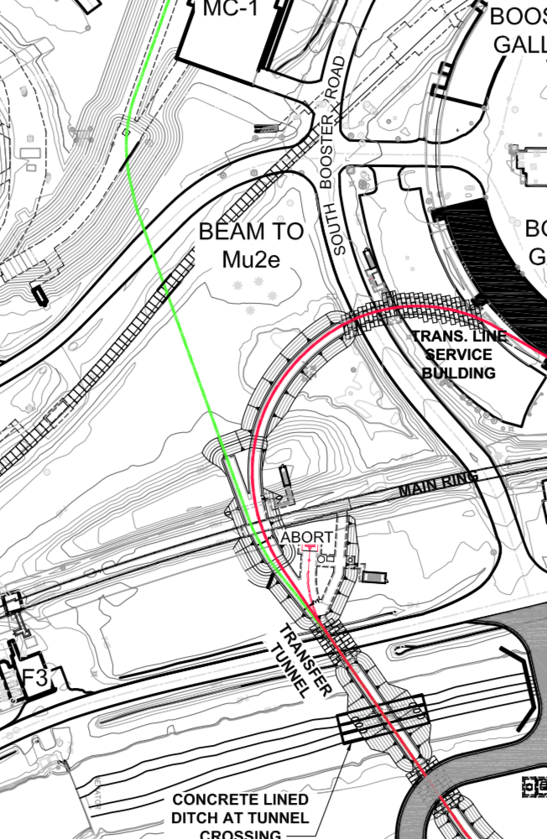
PIP-II Components
Linac-to-Booster transfer line
  3-way beam split to: (1) Beam
  dump, (2) Booster & (3) Mu2e-II
  Mu2e stub off enclosure
  Design Optics to transport 800 MeV H- to M4

Slide 23
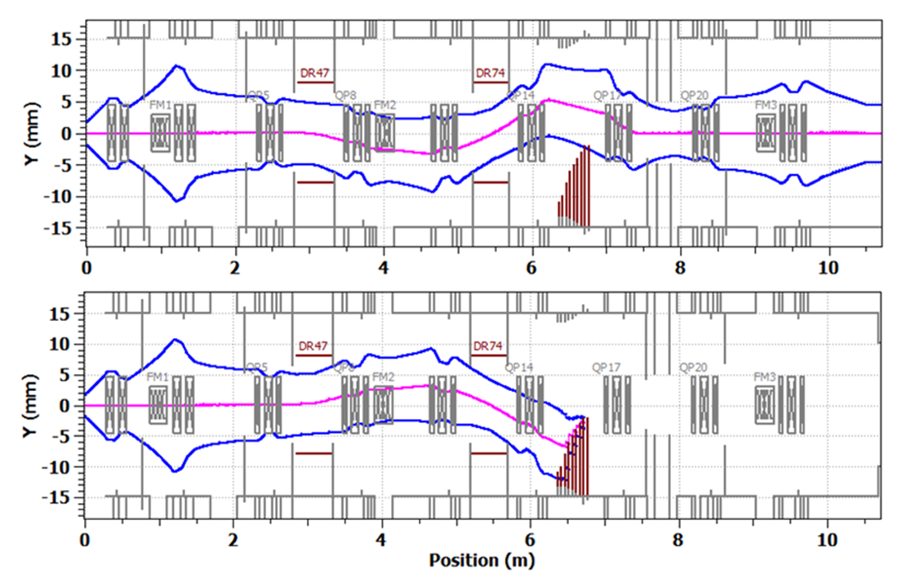
Unique feature of PIP-II: flexible bunch structure
“Bunch-by-bunch selection” in MEBT allows removing un-wanted bunches
  Effective injection into the Booster
  With an RF separator at the end of the linac, possibility to deliver beam quasi-simultaneously to different users with very different time structure
The selection scheme is being tested at PIP2IT
  Chopping system: Two kickers working in sync and absorber.
  6σ separation at absorber
Simulated 3σ envelopes of passed (top) and removed (bottom) bunches – 99.9%

Slide 24
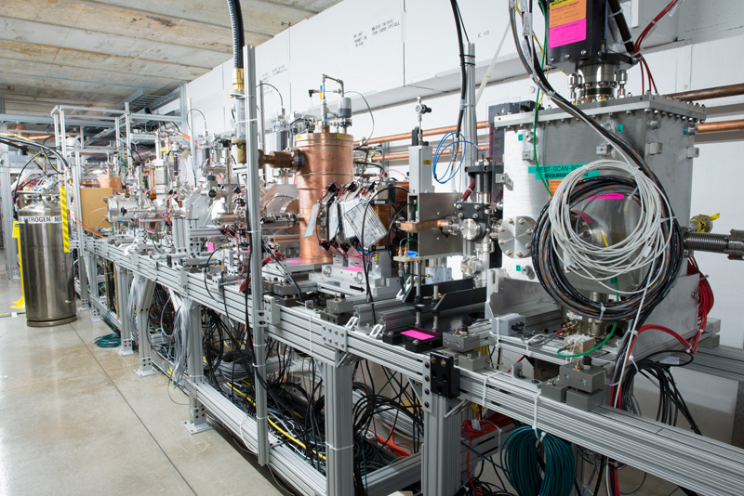
PIP2IT at CMTF

Slide 25
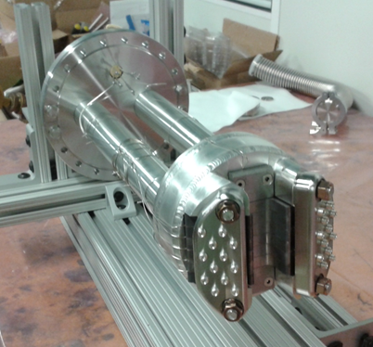
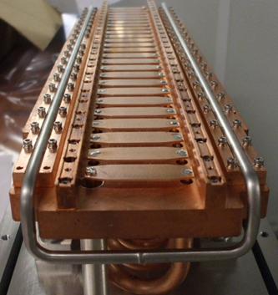
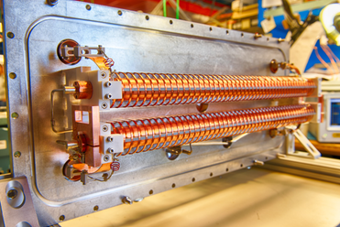
Chopping system
Two kickers working in sync and absorber
Since a CW-compatible kicker capable of providing an arbitrary pattern was beyond state-of-the-art, two kicker versions were developed, “200 Ohm” and “50 Ohm”
  Both are installed and characterized with beam
Absorber prototype has been developed and tested at full power density with an electron beam and at 7x CDR parameters at PIP2IT
50 Ohm kicker
¼ length absorber prototype
200 Ohm kicker

Slide 26
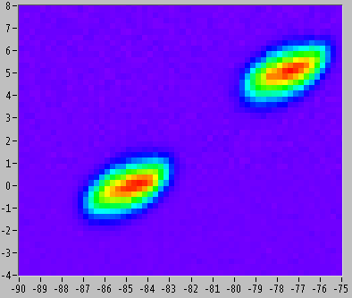
It does work!
Single 200 Ω chopper:
  See beam separation in transverse plane
  Insert scraper, measure time structure with Resistive Wall Current Monitor
    Understood at the 0.2% level (reflections, noise)
For project, specification is only 10⁻⁴ extinction… we think it can do much better
Emittance Scanner
‘Missing’ bunches
Angle (mrad)
Position (mm)

Slide 27
Time Structure for Mu2e
Fundamental Time Structure set by 1st bunching device
  162.5 MHz Radio Frequency Quadrupole
  6.15385 nsec
  <10 psec width at 800 MeV
Select 162.5 MHz bunches : populated or empty
  Populate: 1 every 4 (24.6 nsec) for 130 nsec – 1.15e9 H⁻
  Followed by 234 ‘empty’
  1.6923 μsec pulse spacing
20 Hz Booster program: DUNE/SBN
  1.1% duty factor
  Mu2e-II can use other 98% duty factor
  6.6e15 H⁻ / second
  85 kW

Slide 28
DUNE Physics Goals
40kT with 2.4 MW is a 10 year program
Notes:
It would make more sense if the left column of this table was 120 kT-MW-years since that is the P5 recommendation.
This table is basically the statement of need for LBNF based on the P5 report. This needs to feed directly into PIP-II design criteria.

Slide 29
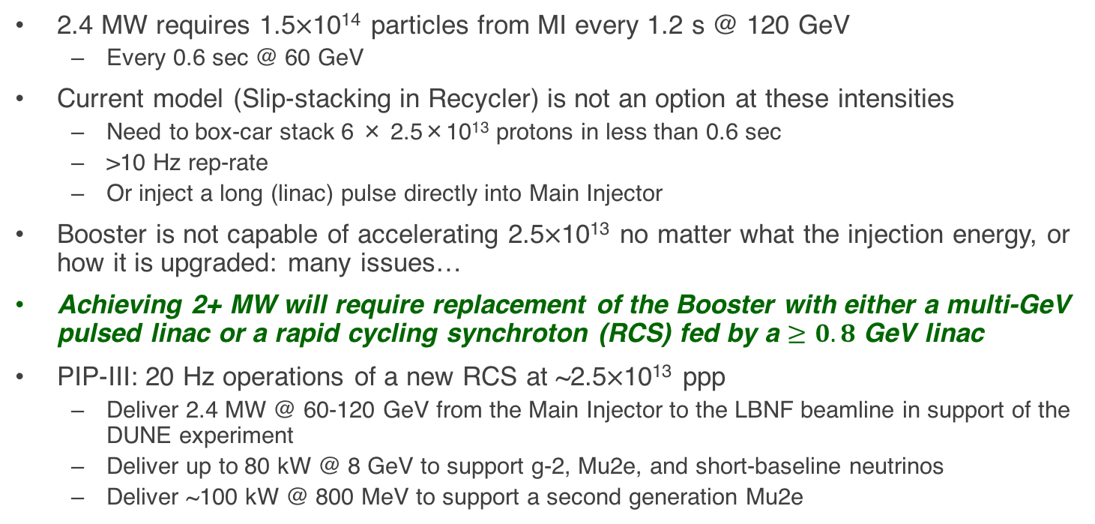
PIP-III (~203x)
2.4 MW requires 1.5×10¹⁴ particles from MI every 1.2 s @ 120 GeV
  Every 0.6 sec @ 60 GeV
Current model (Slip-stacking in Recycler) is not an option at these intensities
  Need to box-car stack 6 × 2.5×10¹³ protons in less than 0.6 sec
  >10 Hz rep-rate
  Or inject a long (linac) pulse directly into Main Injector
Booster is not capable of accelerating 2.5×10¹³ no matter what the injection energy, or how it is upgraded: many issues…
Achieving 2+ MW will require replacement of the Booster with either a multi-GeV pulsed linac or a rapid cycling synchroton (RCS) fed by a $≥0.8$ GeV linac
PIP-III: 20 Hz operations of a new RCS at ~2.5×10¹³ ppp
  Deliver 2.4 MW @ 60-120 GeV from the Main Injector to the LBNF beamline in support of the DUNE experiment
  Deliver up to 80 kW @ 8 GeV to support g-2, Mu2e, and short-baseline neutrinos
  Deliver ~100 kW @ 800 MeV to support a second generation Mu2e
Notes:
Booster issues: radiation shielding, impedance (no beam pipe in laminated magnets -> >200 kV loading at transition)

Slide 30
Replacing the Booster: Linac or RCS?
8 GeV pulsed linac:
  Pros:
    Lots of power at 8 GeV and/or lower energies
      Full Main Injector power at lower energies.
      Short baseline neutrinos
      Rare K decays, etc.
  Cons:
    Potential 8 GeV users want short bunches, so
    must keep Recycler, which complicates things
    and has worries about long term viability.
    Charge stripping makes H⁻ injection at 8 GeV is a very big deal:
      Weak magnets, extended optics in the beam transport
      Even black body radiation stripping a problem -> cooled beam pipe
RCS
  Pros:
    Demonstrated performance (J-PARC)
    Can eliminate Recycler (and associated risks and inefficiencies)
    Option of increasing MI injection energy
  Cons:
    Limited protons at 8 GeV.
    Main Injector power falls off at lower beam energies.

Slide 31
Comparison of Parameters*
~6x record Booster ppp
~4x record Main Injector ppp

Slide 32
RCS Comparisons
achieved
Too big for “ordinary” synchrotron

Slide 33
PIP-III (~203x)

Slide 34
Summary
Fermilab’s goal is to construct & operate the foremost facility in the world for particle physics research utilizing intense beams.
Neutrinos
  NOvA @700+ kW
  DUNE @ multi-MW
  SBN @ 10’s kW
Muons
  Muon g-2 @ 15-25 kW
  Mu2e @ 8-100 kW
Longer term opportunities
Multi Stage Plan
  PIP -> PIP-II -> PIP-III
  700 kW -> 1.2 MW -> 2+ MW Long Baseline Program
  Continue to support Short Baseline and Muon Programs

