Slide 1
Gain Systematics
Matthias Smith
MUSE General Meeting
22 Oct 2018

Slide 2
Motivation for Gain Corrections
Use an energy cut to create standard “wiggle” plot
Gain fluctuations smear this cut with possible systematic effects
Rate dependent effects are anticipated which can cause early to late phase changes
Goal: 𝝳G/G < 10^-3 over 700 μs fill

Slide 3
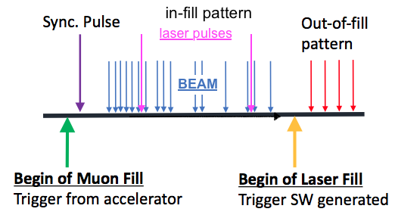
Laser Gain Correction Philosophies
⍵_{a} Wiggle Plot
Out-of-fill
Why? To correct the long-term gain variation (mostly temperature dependence of the SiPMs)
How? By firing the laser between fills
In-fill
Why? To correct systematic gain shifts while positrons are present
How? By firing the laser within fills
Double Pulse
Why? The SiPM gain drops after one pulse, so next could have lower energy
How? Separate DAQ mode to systematically vary E1, E2, dt

Slide 4
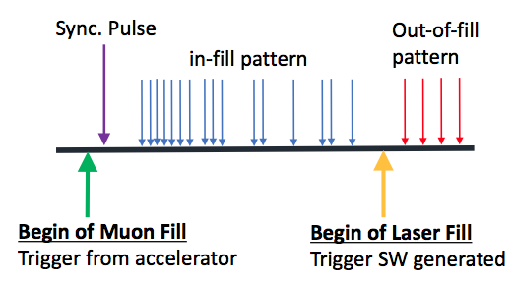
Out-of-fill Correction
It corrects SiPM’s gain fluctuations due to temperature variations using the out-of-fill pulses
A correction factor for each of the 1296 calorimeters channels per subrun:
EOF
Correction every subrun
Avg. SiPM response to
oof laser pulse
Laser fluctuations monitored
with the SMs
NEW!
Correction wrt reference Run (same run used for energy calibration, 14395 for Run1 )

Slide 5
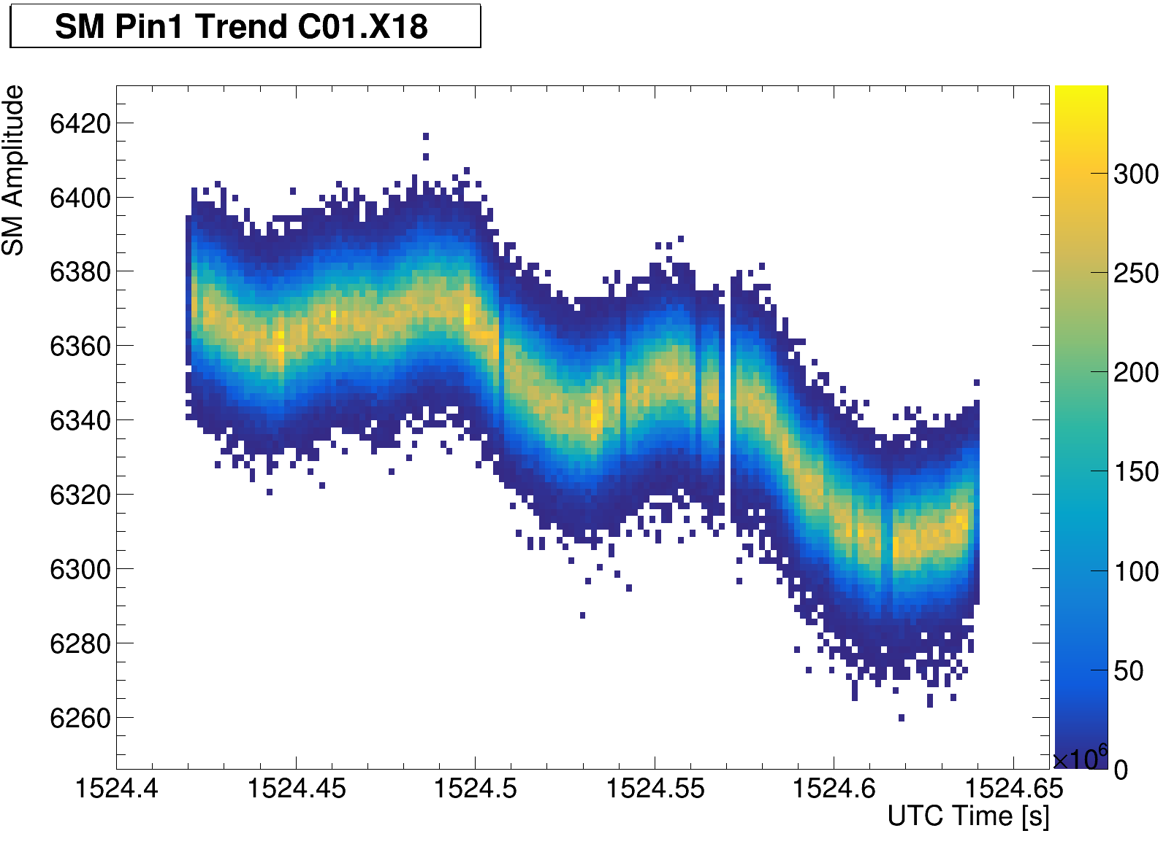
Out-of-fill Correction Diagram
<Source Monitor>
<SiPM>

Slide 6
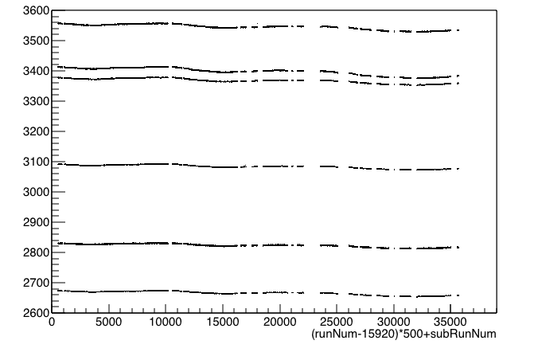
Out-of-fill Correction for 60h Dataset
Variation of the laser pulse amplitude:
SM (subrun)
Each of the
6 lasers is
monitored
Subruns of 60h dataset

Slide 7
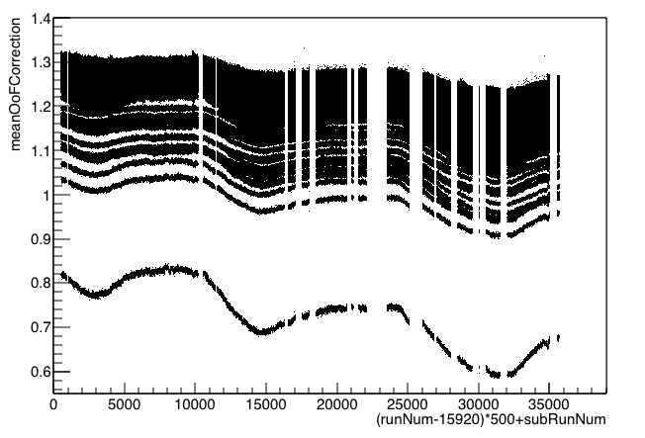
Out-of-fill Correction for 60h Dataset
The corrections wrt run 14395:
$$\frac{G(subrun)}{G0}$$
All calo channels
C^{OOF} (subrun)
Subruns of 60h dataset

Slide 8
In-fill Gain Correction
Measure using laser pulses mixed with positrons in subset of fills
Tunable Parameters
Prescale rate
Number of pulses per fill
Pulse Separation
Timing shift between subsequent probe pulses
Carves out gain function for any needed in-fill gain times and granularity

Slide 9
In-fill Gain Correction Procedure
Build using laser data
Find algorithm to model function
Apply model to data

Slide 10
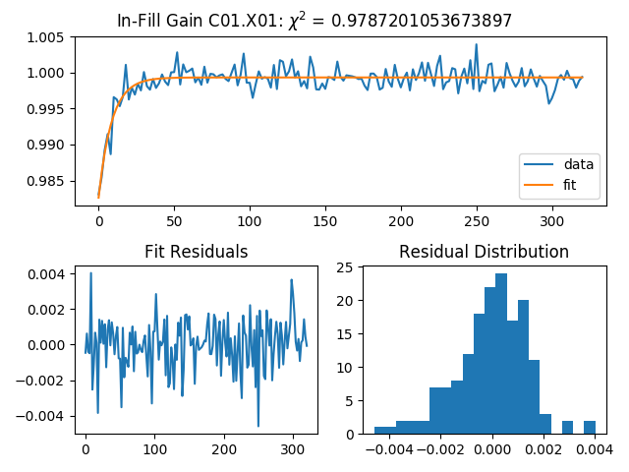
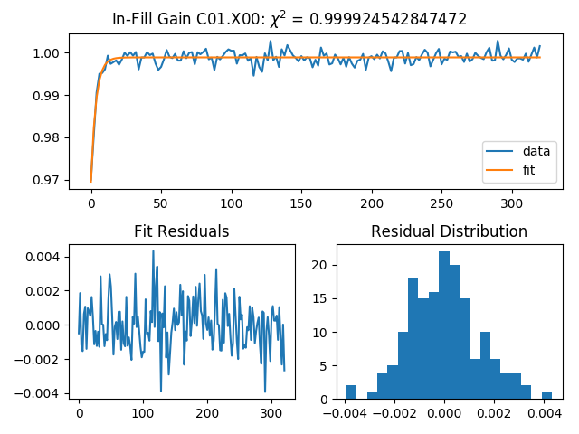
Modeling the In-fill Gain Function
Exponential decay
f(t) = g (1 – a exp[(t-t0)/tau])

Slide 11
In-fill Gain Function Stability
Built the in-fill gain function for two different datasets
Functions similar but not identical
Must be modeled separately for each set of stable configurations
Preliminary

Slide 12
Short-time Double Pulse Early Results
Goal to build per crystal function
G(E1, E2, Δt)
Summary Plots
Raw Data
Lognormal Fcn Fit

Slide 13
Short-time Double Pulse Further Analysis
Paolo Girotti analyzing datasets
Data from March, new data in October
Preliminary
Preliminary

Slide 14
Long-time Double Pulse Preliminary Result
Being analyzed by Elia Bottalico

Slide 15
Summary
Monitor and model systematic gain changes at different time scales
Out-of-fill Gain Correction model implemented
Achieves long timescale goal of < 1%
In-fill Gain Correction model implemented
Able to model to gain fluctuations to ~0.05% for 60h dataset
Work for double-pulse corrections is ongoing

