Slide 1
CRT: Electronics and DAQ status
C. Mariani
Virginia Tech

Slide 2
Rack –
all components in
routing for cables defined
power supplies (1xHV and 2xLV) installed and tested
All rack assembly completed by end of this week
Ready for electronic review
Integration with timing – to be started
Electronics ready to be installed
Cables – being prepared, complete the downstream by end of this week
Test Stand for module testing ready

Slide 3
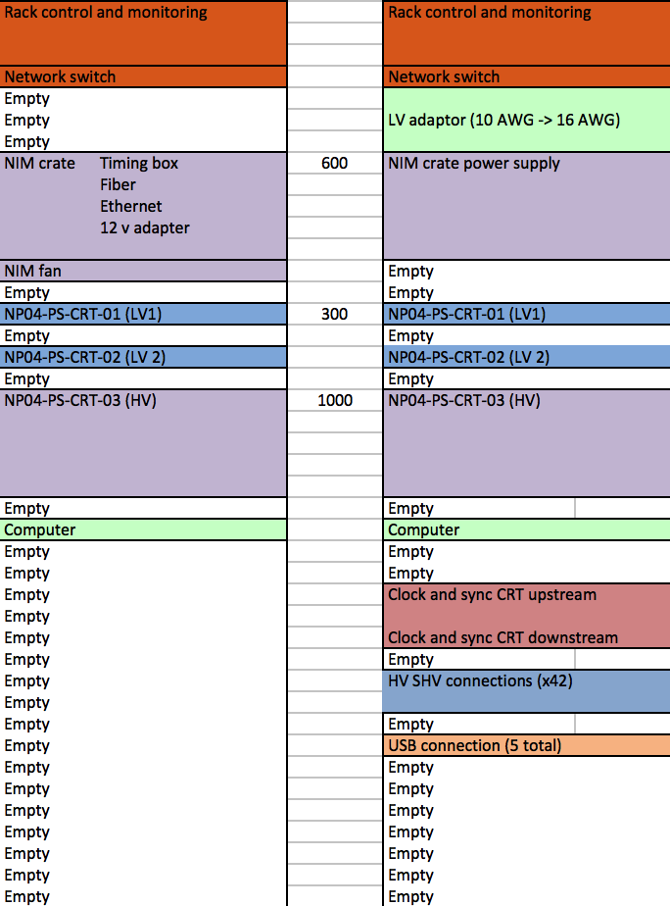
CRT Rack

Slide 4
CRT cabling
Test individual modules
We will cable one frame (4 modules) at the time and then installed the frame vertically
Test the frame before moving and installing it
Commission the system at the end of installation (downstream + upstream)

Slide 5
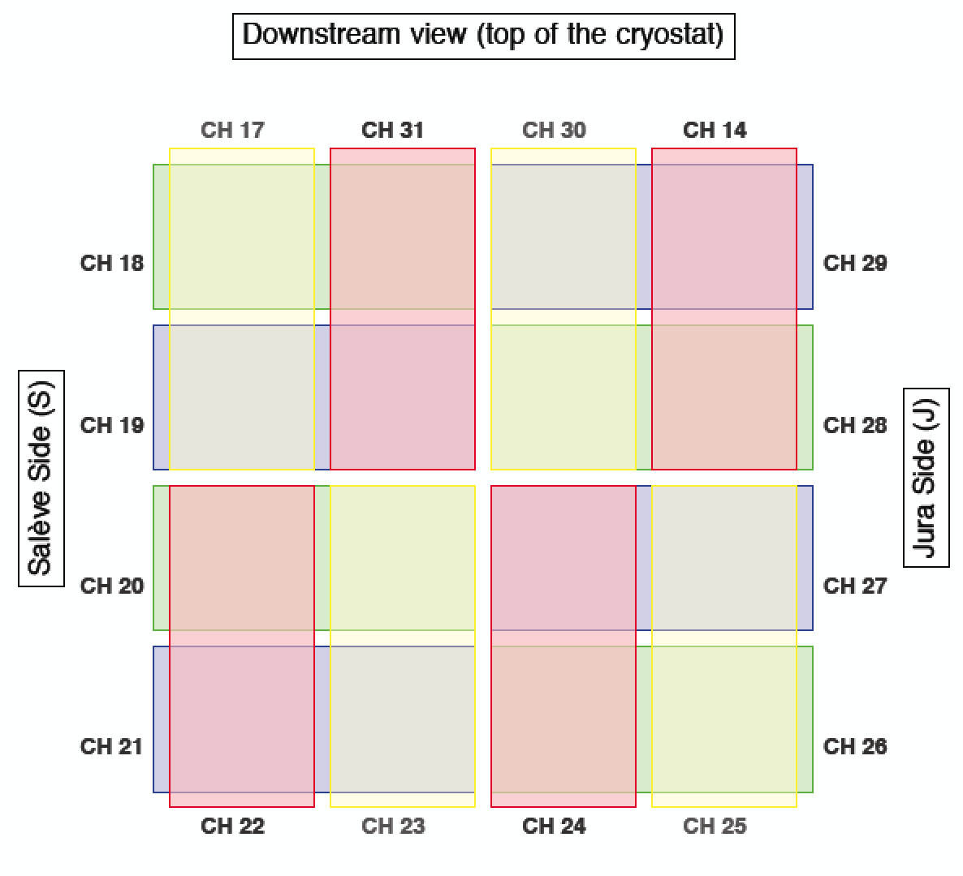
USB 3
1
CH 16
CH 31
CH 30
2
USB 22
3
4

Slide 6
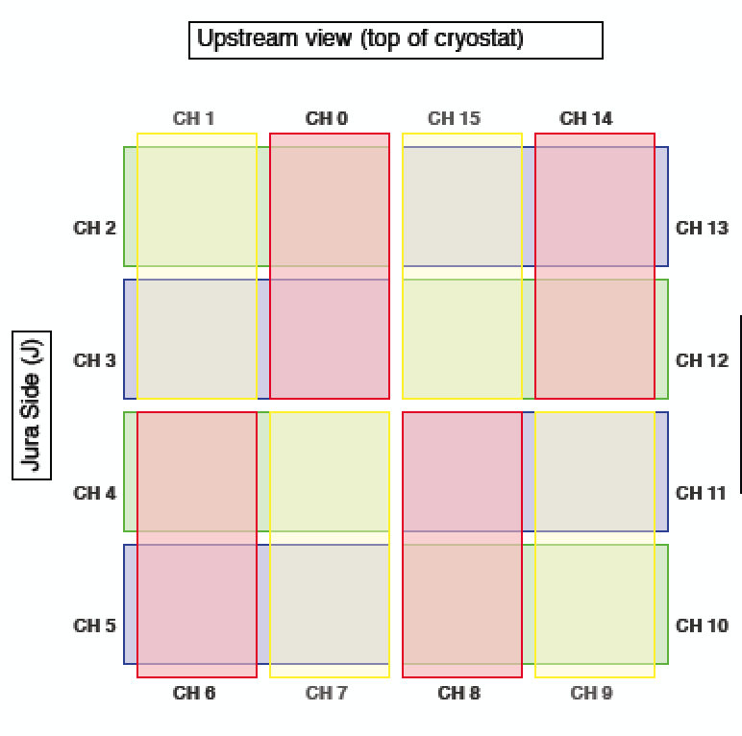
USB 13

Slide 7
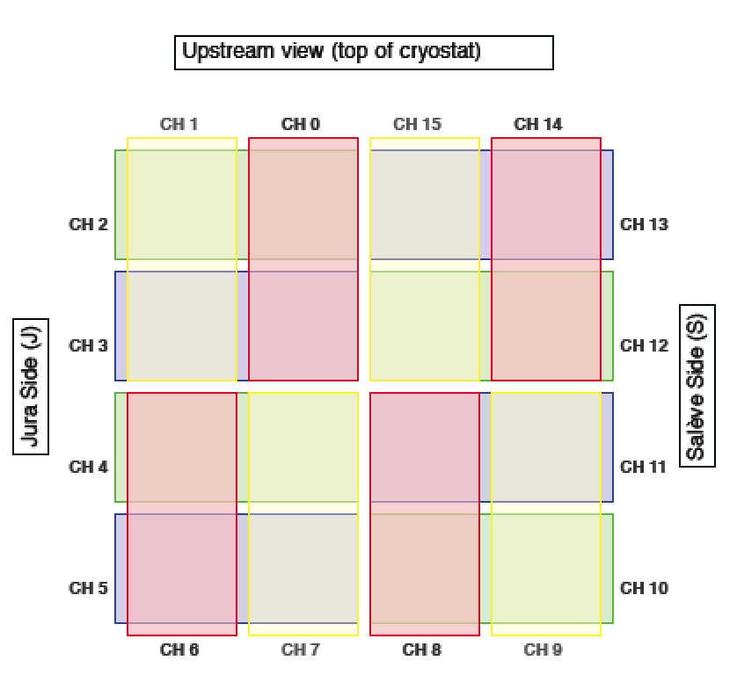
USB 14

Slide 8
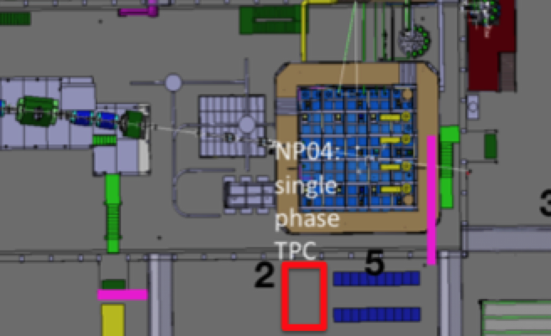
CRT cable routing (cont’d)
8 RG58
8 RG58
16 RG58
16 RG58
2 CAT6
2 Gauge 10 cables
2 Gauge 16 cables
8 SHV
16 RG58
2 CAT6
2 Gauge 10 cables
2 Gauge 16 cables
8 SHV
32 RG58
4 CAT6
4 Gauge 10 cables
4 Gauge 16 cables
16 SHV

Slide 9
Summary
Electronics and Rack- 100% ready
DAQ internal of CRT – 100% ready
CRT computer – G. Savage – 90% ready
Timing Integration – 50% done
CRT Online Monitor – A. Olivier
CRT Slow Control – S. Henry
CRT ArtDAQ and RC interface – M. Strait

