Slide 1
FCC Workshop SRF summary
Martina Martinello
12 Jun 2018

Slide 2
SRF talk at the FCC week
2 plenary talks:
“SRF R&D overview” by Anne-Marie Valente-Feliciano (Jlab)
“Summary SRF” by Erk Jensen (CERN)
4 SRF sessions (1 full day):
Directions for R&D (5 talks)
Cavity Technology (5 talks)
Studies (4 talks)
Innovation (4 talks)

Slide 3
M. Benedikt, FCC 2018

Slide 4
FCC-ee RF staging scenario
M. Benedikt, FCC 2018

Slide 5
SRF technology for FCC-ee
SRF cavities for FCC-ee:
Technology comparison for FCC-ee:
Bulk Nb (N-doping): high-Q at medium field
Nb₃Sn/Nb: higher Tc
Nb/Cu: cheaper technology
Nb₃Sn/Cu: higher Tc and cheaper
FCC-ee Higgs & top
FCC-ee W
S. Aull, FCC 2017

Slide 6
SRF technology for FCC-ee
Bulk Nb (N-doping)
Nb₃Sn/Nb
Nb/Cu
Nb₃Sn/Cu
Alternative fabrication methods

Slide 7
SRF technology for FCC-ee
Bulk Nb (N-doping)
Nb₃Sn/Nb
Nb/Cu
Nb₃Sn/Cu
Alternative fabrication methods

Slide 8
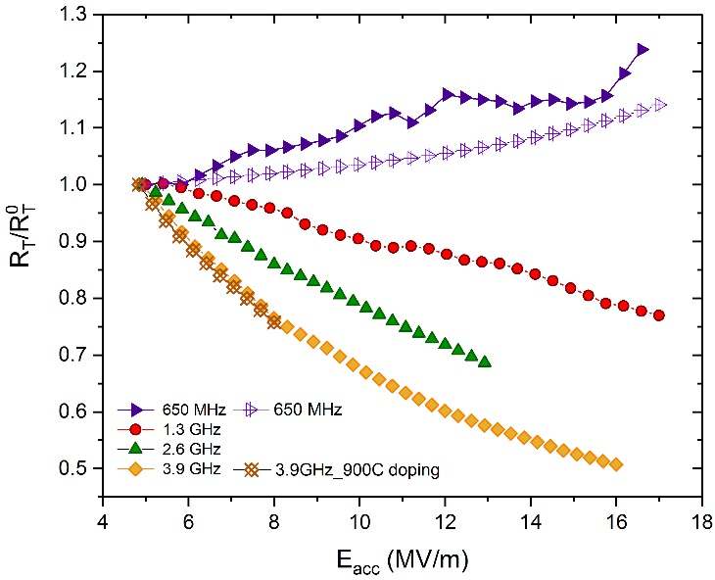
Frequency dependence of Nb SRF cavities
N-doping
N-doping
120C baking
f₀=1.3 GHz
New frequency-dependence studies show that anti-Q-slope typical of N-doping cavities is absent at 650 MHz
Doping need some optimization for low frequencies
N-doping still very promising for 800 MHz cavities
M. Martinello et Al., FCC 2018

Slide 9
Frequency dependence of Nb SRF cavities
P. Sha et Al., FCC 2018

Slide 10
Frequency dependence of Nb SRF cavities
F. Marhauser et Al., FCC 2018

Slide 11
Frequency dependence of Nb SRF cavities
F. Marhauser et Al., FCC 2018

Slide 12
SRF technology for FCC-ee
Bulk Nb (N-doping)
Nb₃Sn/Nb
Nb/Cu
Nb₃Sn/Cu
Alternative fabrication methods

Slide 13
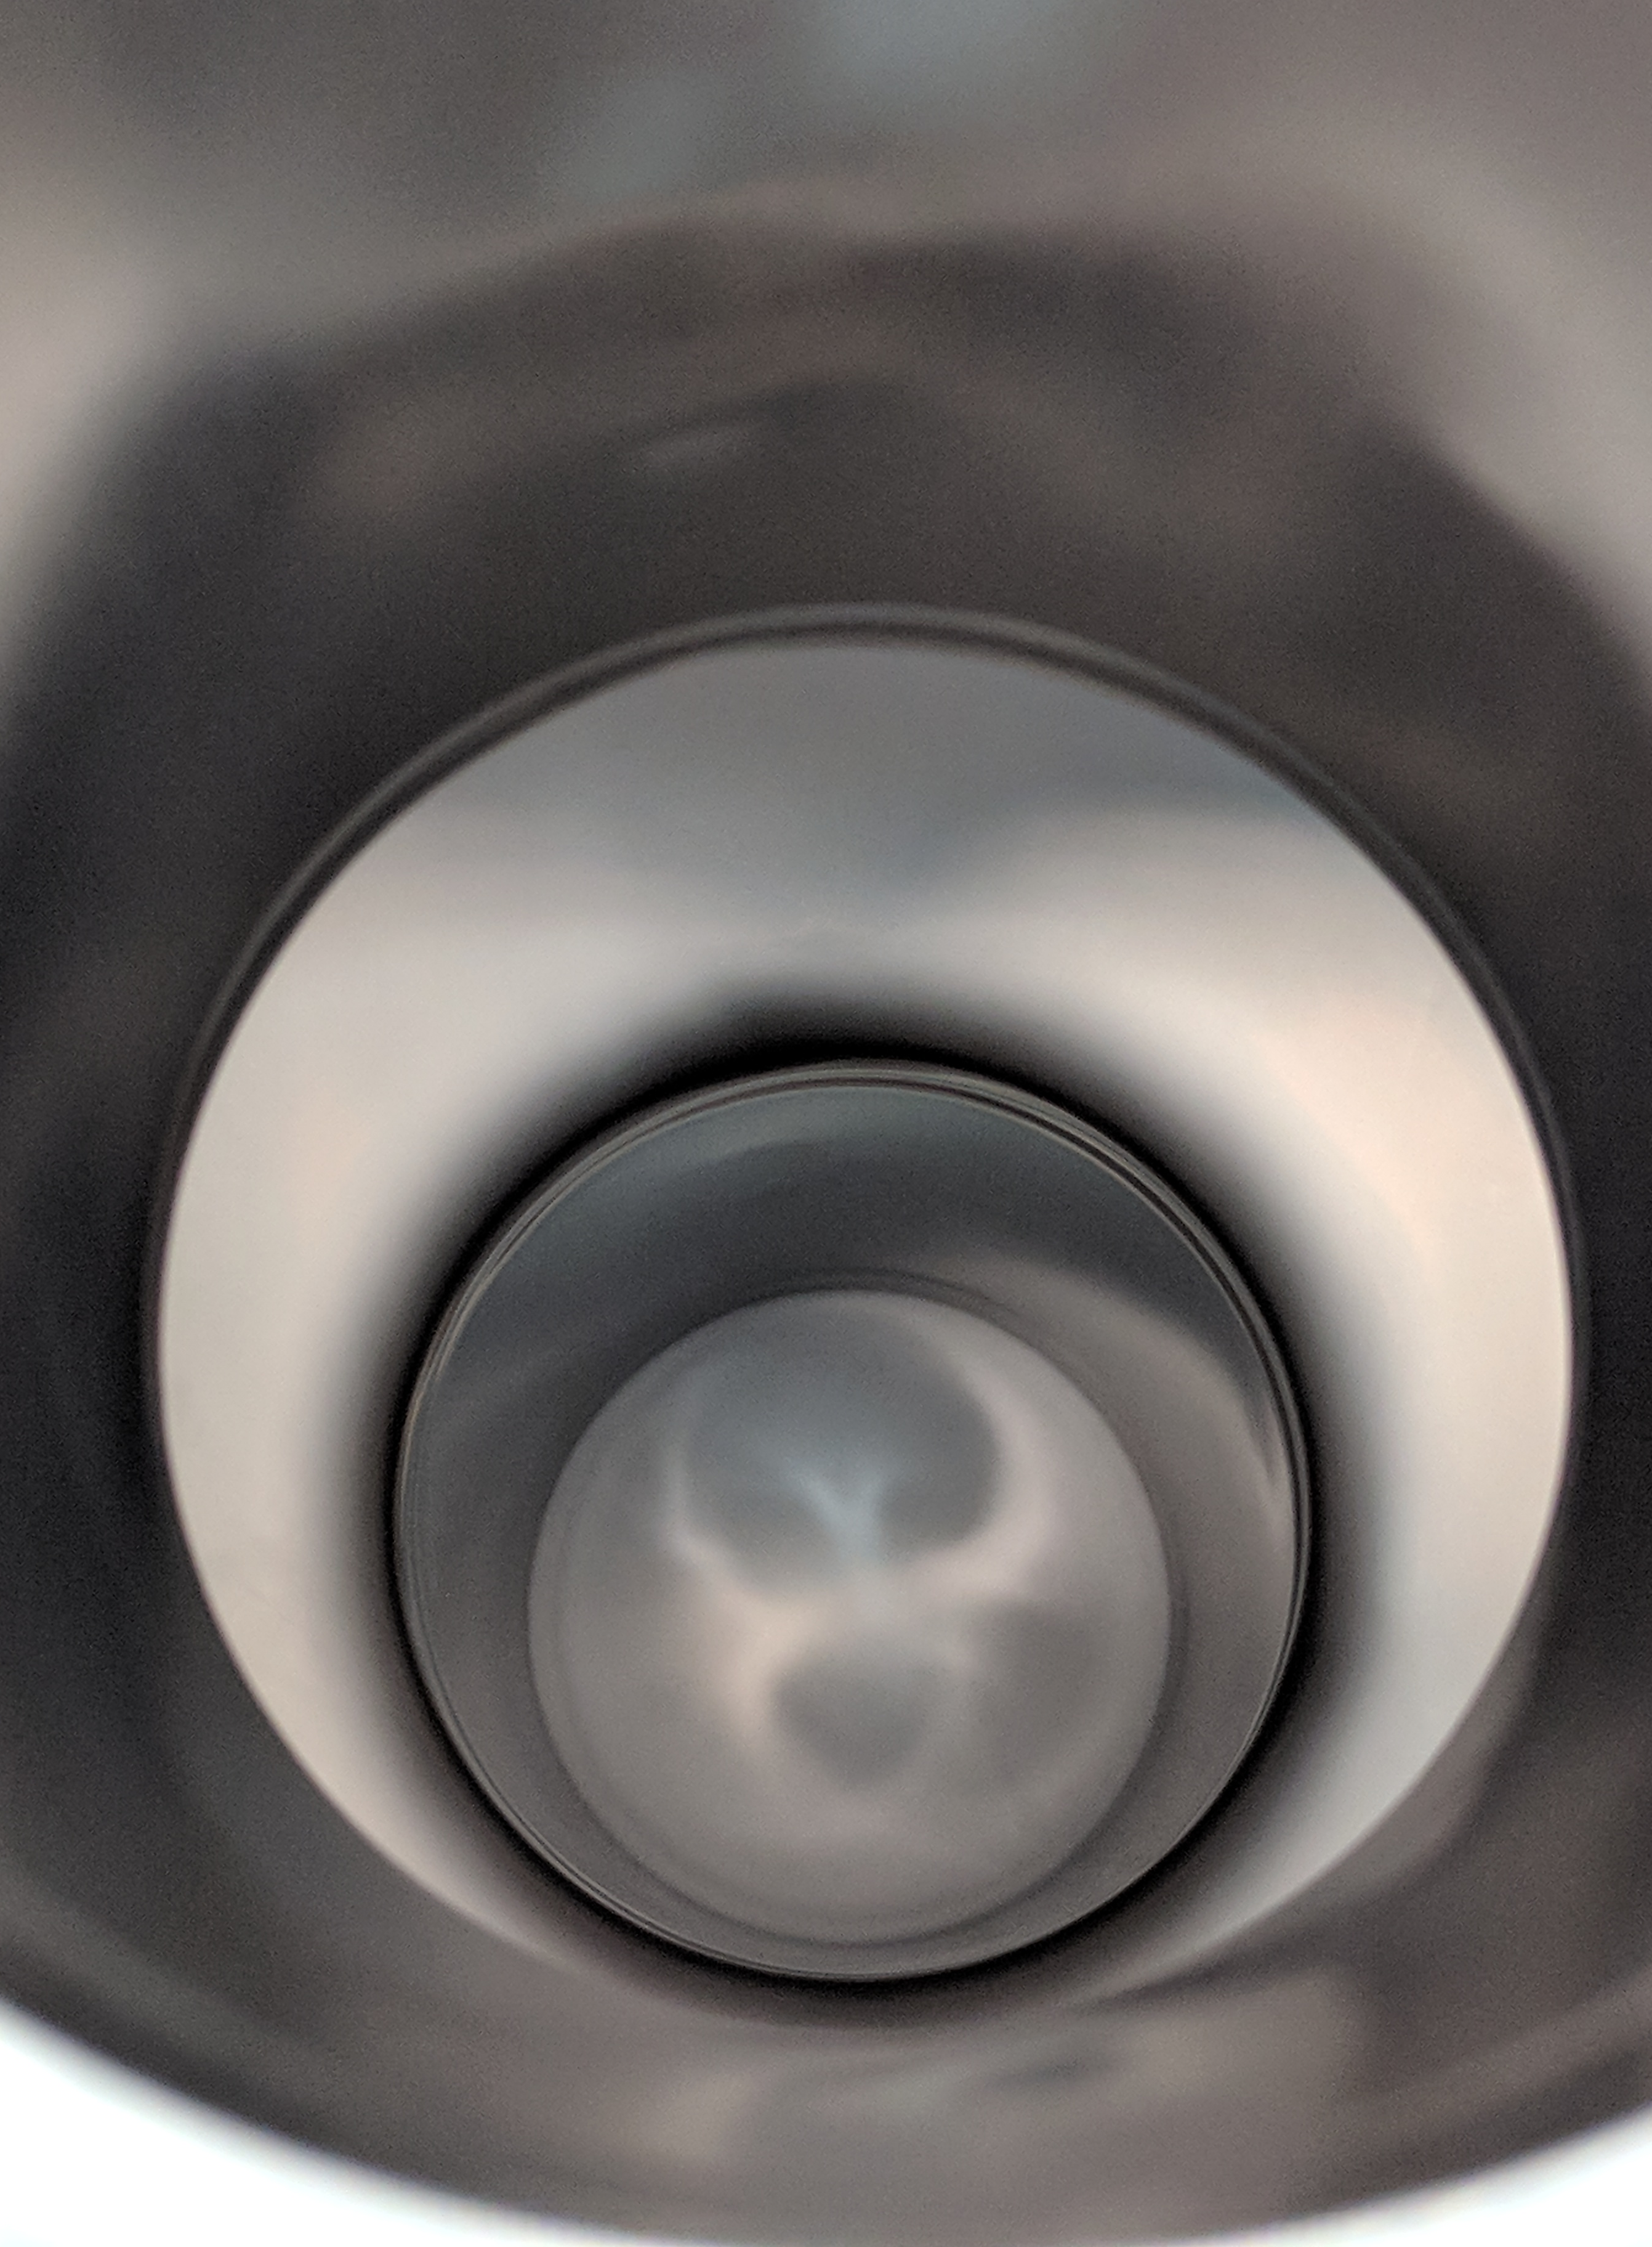
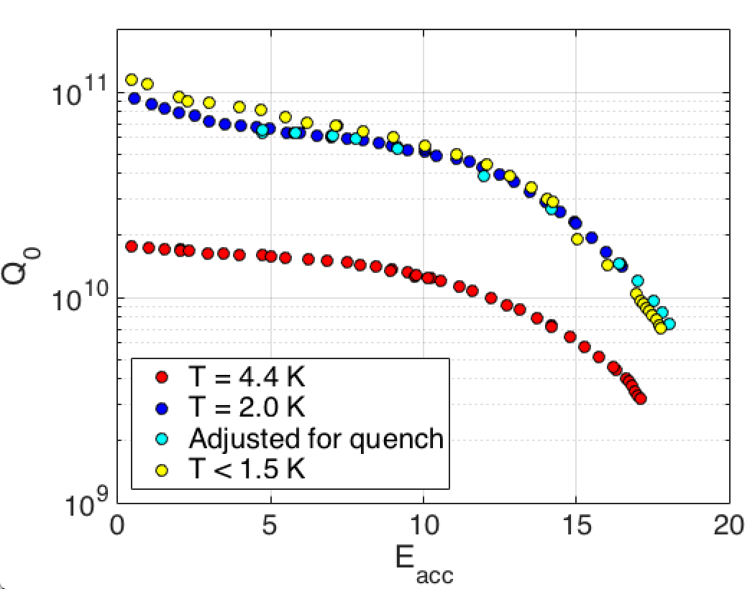
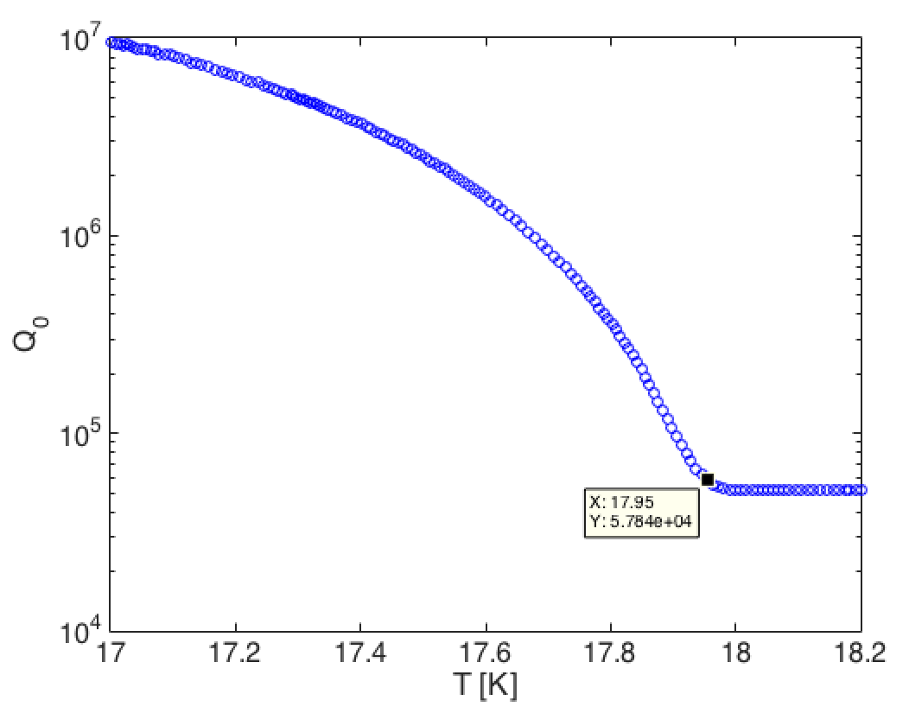
Nb₃Sn Coatings for High Q₀
Courtesy of S. Posen
With a critical temperature of 18 K, Nb₃Sn at 4.4 K can have similar Q₀ to Nb at 2.0 K
Cryogenic plant at 4.4 K vs 2.0 K: efficiency is 3-4 times better, capital costs are smaller, higher reliability…
In last ~5 years, substantial improvements to Nb₃Sn cavity performance under Cornell program
New Fermilab program now achieving good performance on 1-cell 1.3 GHz cavities—larger cavities to be coated soon
Cavity surface – matte gray
New results March 2018
T_{c} ~ 18 K

Slide 14
Summary on SRF technology for FCC
Technology comparison for FCC-ee (400/800 MHz SRF Nb cavities):
N-doping: high-Q at medium field
Best technology for 2 K operation
Suitable for operation at 10 and 20 MV/m
Mature technology already applied to cryomodules production and fully transferred to industry
Nb₃Sn: higher Tc
Best technology for 4.5 K operation at 10 MV/m
Need to improve quench field to be suitable for operation at 20 MV/m (potential for operation at very high gradient → 80 MV/m)
Not yet implemented to cryomodules production
M. Martinello et Al., FCC 2018

Slide 15
SRF technology for FCC-ee
Bulk Nb (N-doping)
Nb₃Sn/Nb
Nb/Cu
Nb₃Sn/Cu
Alternative fabrication methods

Slide 16
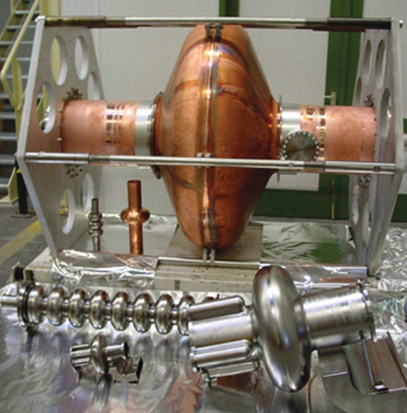
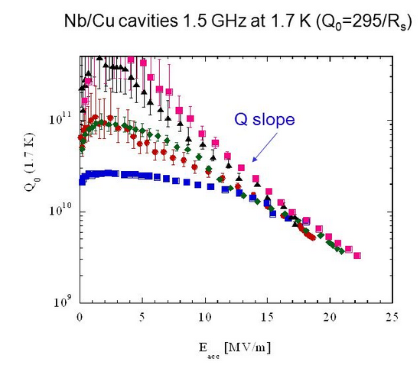
Nb/Cu thin film technology
Nb/Cu technology is cheaper therefore particularly attractive for low frequency cavities
Nb/Cu cavities affected by Q-slope problem

Slide 17
Nb/Cu thin film cavities at CERN
25 Nb/Cu Quarter Wave Resonators for HIE-ISOLDE. Thin film deposition via diode sputtering
Recently measured 2 cavities with the best performance ever obtained for HIE-ISOLDE cavities
Improvement given by the seamless copper substrate
G. J. Rosaz et Al., FCC 2018

Slide 18
Nb/Cu thin film cavities at CERN
25 Nb/Cu Quarter Wave Resonators for HIE-ISOLDE. Thin film deposition via diode sputtering
Recently measured 2 cavities with the best performance ever obtained for HIE-ISOLDE cavities
Improvement given by the seamless copper substrate
G. J. Rosaz et Al., FCC 2018

Slide 19
Nb/Cu thin film cavities at CERN
Looking back at LHC cavities, spun cavities show the best performances
The substrate matter!! More investigation is on-going
G. J. Rosaz et Al., FCC 2018

Slide 20
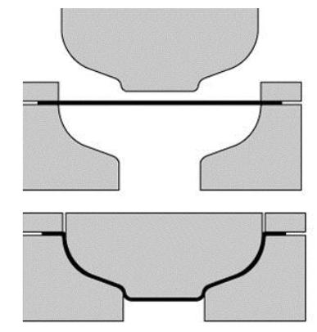
Nb/Cu thin film cavities at CERN
Looking back at LHC cavities, spun cavities show the best performances
The substrate matter!! More investigation is on-going
SPINNING
DEEP DRAWING

Slide 21
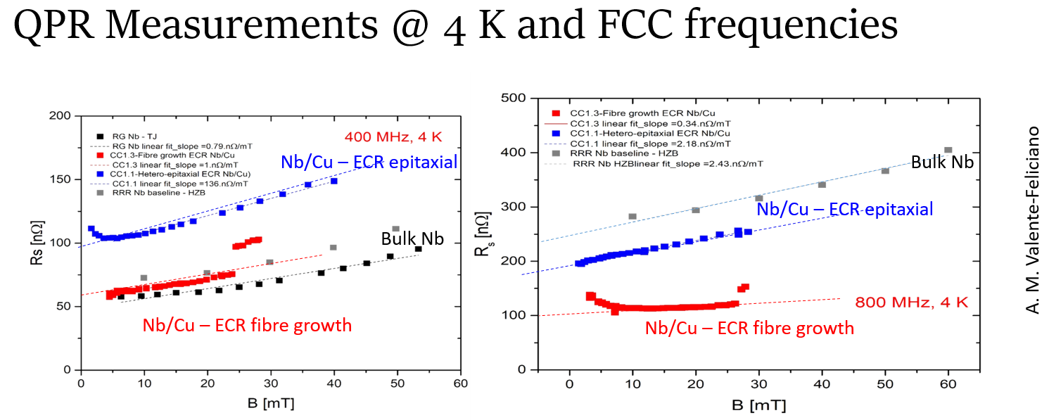
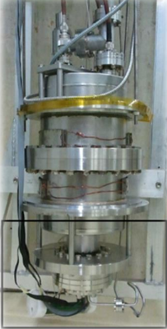
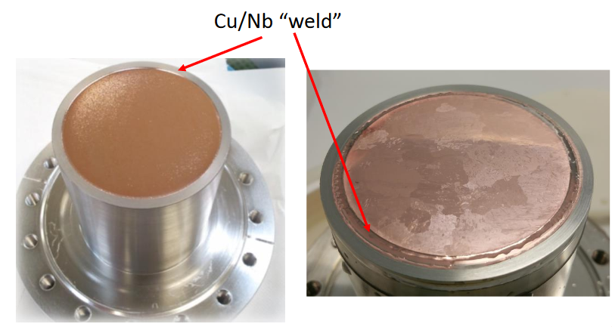
Nb/Cu thin film cavities at Jlab
A.M. Valente-Feliciano et Al., FCC 2018
M. Arzeo et Al., FCC 2018

Slide 22
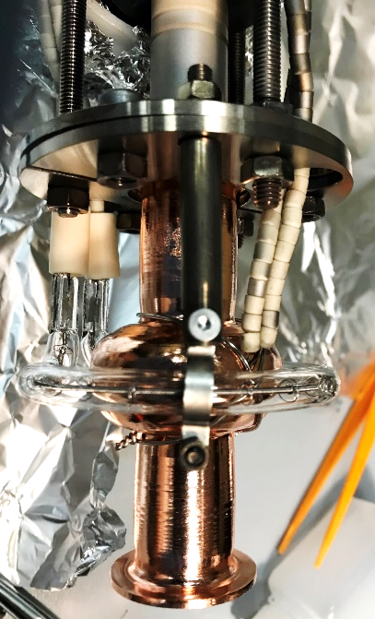
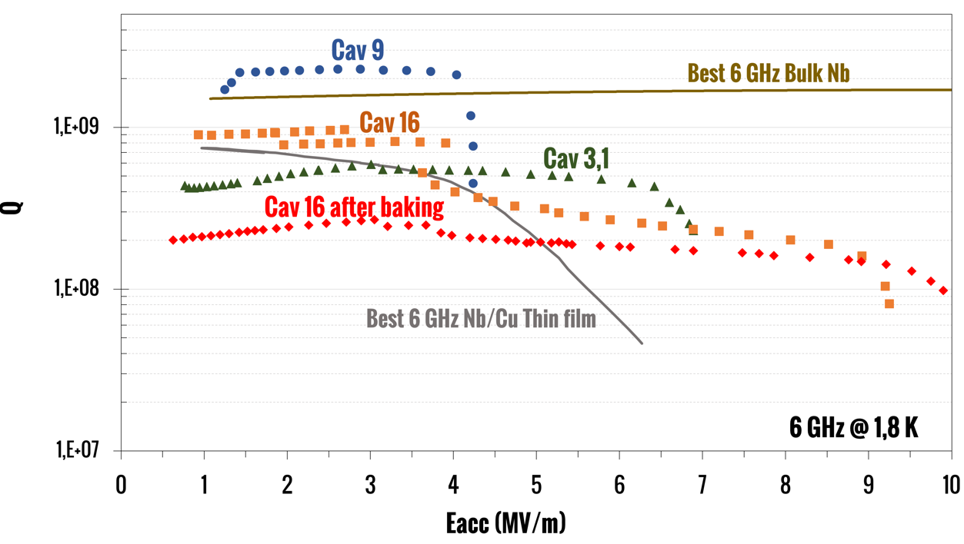
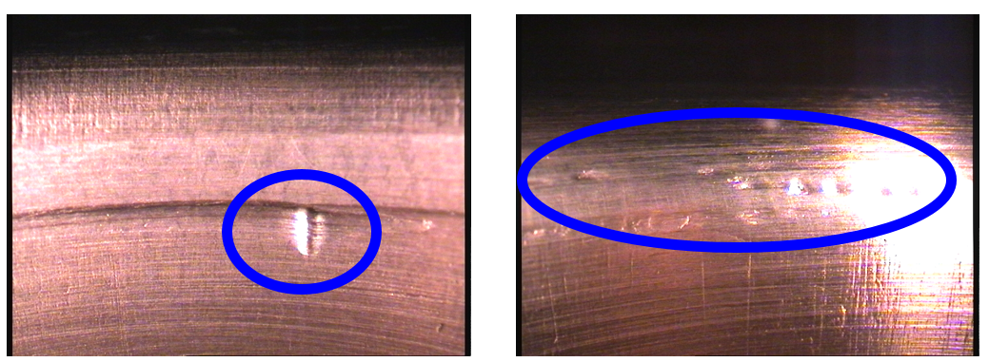
Nb/Cu thin film cavities at INFN/LNL
Nb/Cu coating on 6 GHz spun Cu cavities
Nb deposited via magnetron sputtering
Many parameters investigated: thick vs thin films, multilayer/single shot deposition, pressure, etc.
Some defects remain even after mechanical grinding
C. Pira et Al., FCC 2018

Slide 23
SRF technology for FCC-ee
Bulk Nb (N-doping)
Nb₃Sn/Nb
Nb/Cu
Nb₃Sn/Cu
Alternative fabrication methods

Slide 24
Nb₃Sn/Cu thin film deposition at CERN
K. Ilyina-Brunner et Al., FCC 2018

Slide 25
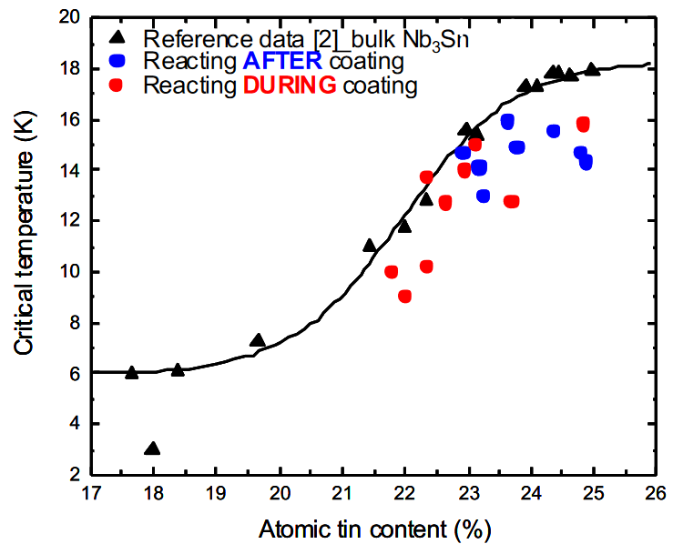
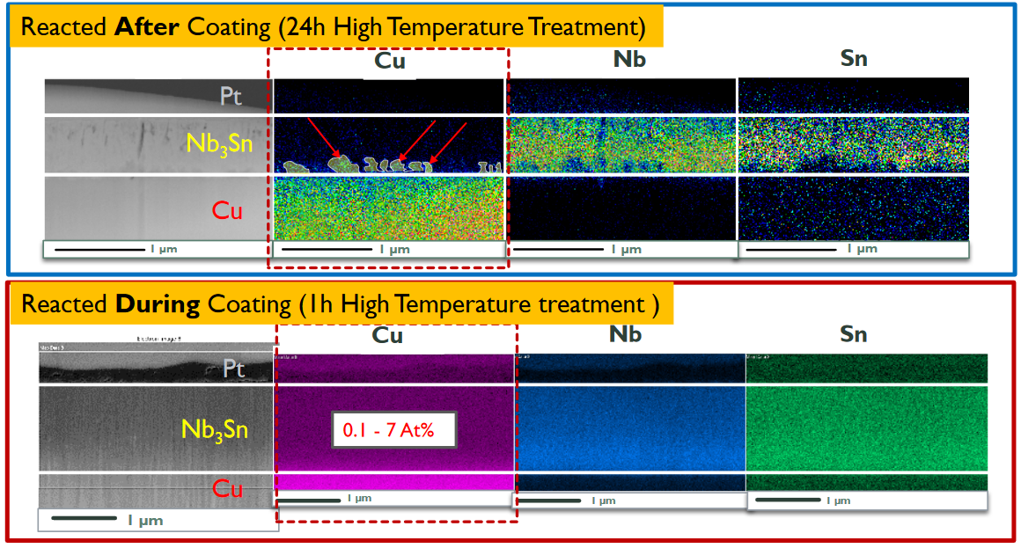
Nb₃Sn/Cu thin film deposition at CERN
Tc suppressed with both annealing after coating and during coating
Cu inter-diffusion observed in both cases
Film cracking after annealing observed
Intermediate layer approach proposed to solve these issues
K. Ilyina-Brunner et Al., FCC 2018

Slide 26
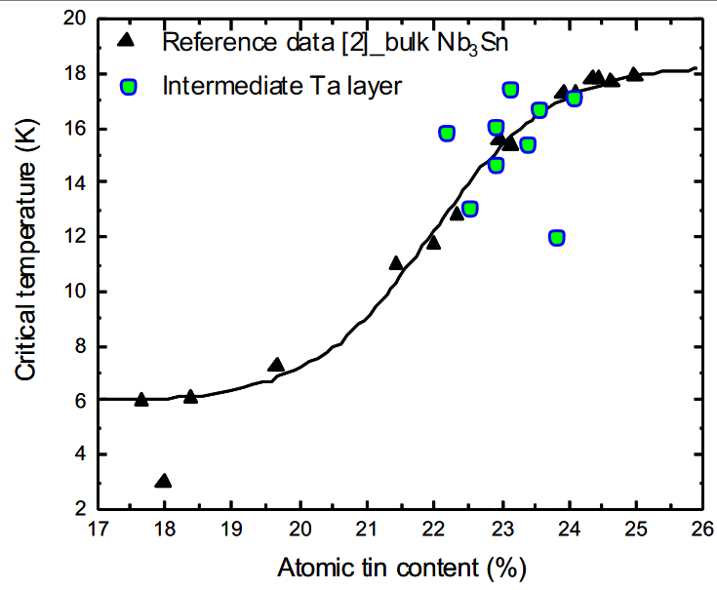
Nb₃Sn/Cu thin film deposition at CERN
K. Ilyina-Brunner et Al., FCC 2018

Slide 27
SRF technology for FCC-ee
Bulk Nb (N-doping)
Nb₃Sn/Nb
Nb/Cu
Nb₃Sn/Cu
Alternative fabrication methods

Slide 28
Electrohydraulic forming applied to SRF cavities
C. Abajo et Al., FCC 2018

Slide 29
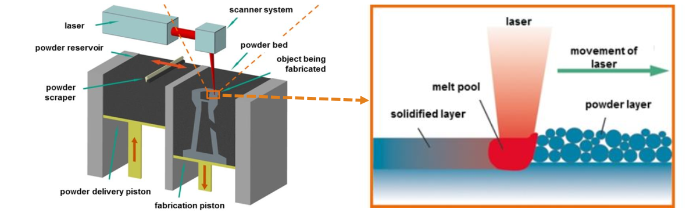
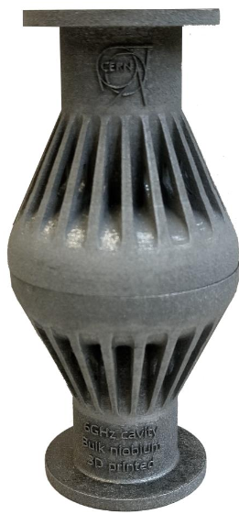
Selective Laser Melting for SRF application
R. Gerard et Al., FCC 2018

Slide 30
Conclusions
E. Jensen, FCC 2018

