Slide 1
Highlights of ALCW 2018
Sam Posen
https://agenda.linearcollider.org/event/7826/

Slide 2
ILC Status 1-Slide Summary
Main message from Linear Collider Board / Japanese scientists / ICFA regarding ILC status:
Japanese ILC advisory panel working groups (Physics and Technical) to conclude very soon (spring 2018)
Consultations between MEXT and ILC Advisory Panel, Science Council of Japan must result in a conclusion by December 2018 to have ILC be considered by ESG
ILC would have been a no-go in Japan without ~40% cost reduction -> mostly moving to 250 GeV, also R&D
Crucial to maintain strong message of support from community that ILC 250 GeV (vs 500 GeV) is of strong scientific interest
International meetings important show of support from world
Very positive meetings with Japanese delegation to France and Germany in early 2018 – Italy/Spain/UK in fall 2018
Cost reduction via US/Japan + Japanese delegation visiting US in July (including meeting with Undersecretary Dabbar)

Slide 3
L. Evans – LCC Status

Slide 4
L. Evans – LCC Status

Slide 5
L. Evans – LCC Status

Slide 6
K. Kawagoe/S. Yamashita – Political Status

Slide 7
K. Kawagoe/S. Yamashita – Political Status

Slide 8
K. Kawagoe/S. Yamashita – Political Status

Slide 9
T. Nakada – LCB report

Slide 10
HEP in Europe – E. Elsen
E. Elsen: “Need clarification because if Japan is interested, the whole world becomes simpler - would be invigorating for the field - CERN can focus on LHC and upgrade - 'no' is a challenge for the strategy discussion”

Slide 11
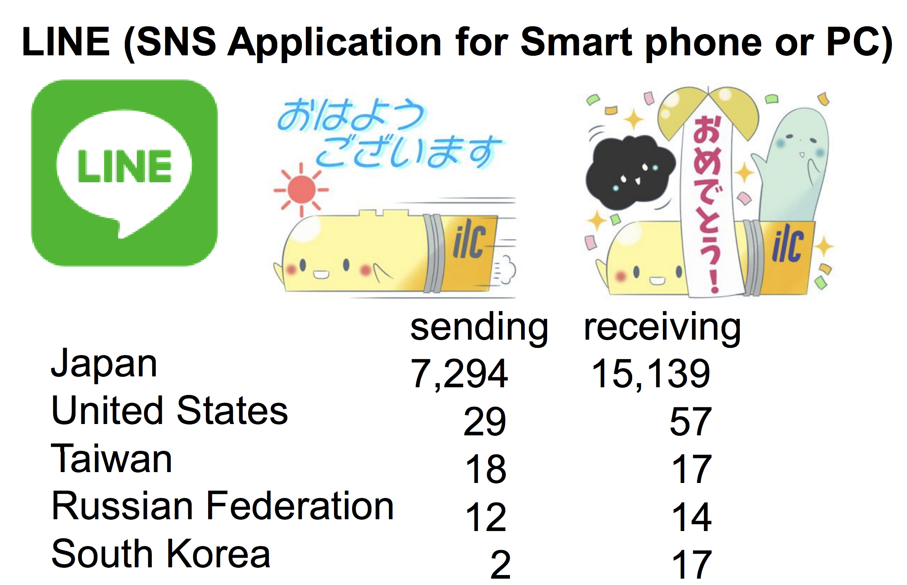
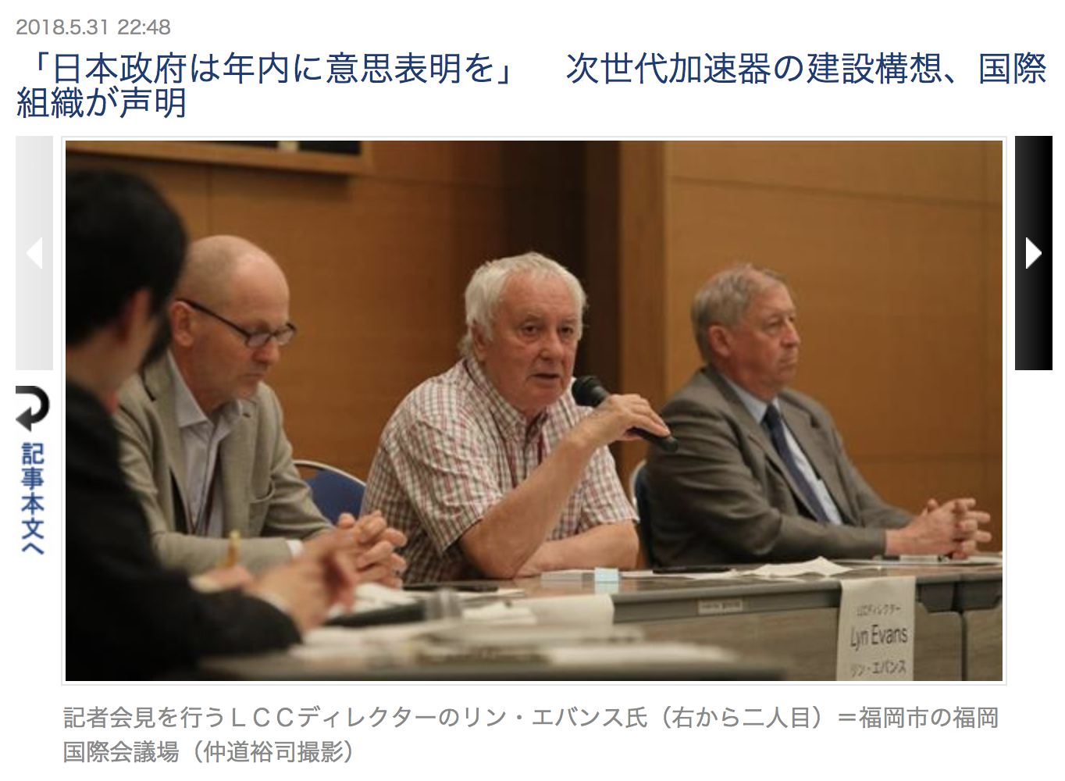
ILC Outreach
“Good morning”
“Congrat-ulations!”

Slide 12
Lyn Evans et al. – Fukuoka Statement
Statement on “Towards the realization of the International Linear Collider, an
update”
31 May 2018, Fukuoka
Scientists who gathered for the Linear Collider Workshop in Tokyo in 2015
issued a statement confirming their strong support for the scientific
justification for a prompt realization of the International Linear Collider
(ILC). The Linear Collider Collaboration (LCC) and the worldwide
participants at the 2018 Asian Linear Collider Workshop (ALCW2018) in
Fukuoka, Japan, reconfirm the scientific importance of the ILC. We are
closer to the realization of the project, but it is now in a critical phase.

Slide 13
Lyn Evans et al. – Fukuoka Statement
Results to date from the CERN Large Hadron Collider indicate that we are at a
crossroads in our quest to uncover the origin and history of the Universe. We now
know that precision measurements, in particular of the properties of the Higgs boson,
are an essential next step to advance our understanding. Precise measurements in
electron-positron interactions at a center of mass energy of 250 GeV at the ILC will
deliver a leap in our scientific knowledge and, together with future results from
the LHC and SuperKEKB, will propel us toward the ultimate theory of particle physics
and a deep understanding of the Universe itself.

Slide 14
Lyn Evans et al. – Fukuoka Statement
(2) We have been preparing for the ILC for many years, in collaboration with
industries and in discussion with governments worldwide. The ILC is now the
most mature and realizable electron-positron collider project, and offers the
energy expandability of a linear collider. The successful operation of the
European XFEL in Hamburg and recent advances in the superconducting R&D in
Fermilab near Chicago and other laboratories, together with a cost reduction by
changing the initial center of mass energy to 250 GeV, increases the ILC
technical and financial feasibility whilst maintaining the physics potential of the
machine at this energy. The superconducting technology being developed for the
ILC has a great impact on industrial and medical applications of accelerators. We
deeply appreciate the evaluation process by the Japanese government for the
proposal based on the new ILC design.
Note: XFEL is a mini-ILC (~1/10th scale) – success shows confidence in technology and substantial reduction in technical risk
Note: FNAL leading cost reduction R&D for SRF
Note: cost reduction by 250 GeV and cost reduction R&D ~40%

Slide 15
ILC Status – A. Yamamoto

Slide 16
ILC Status – A. Yamamoto

Slide 17
Lyn Evans et al. – Fukuoka Statement
(3) The ILC can only be realized as an international project, and a nation who wishes to host the project should lead the international negotiations. A positive message from the Japanese government expressing readiness to initiate these discussions this year is critically important because work on the update of the European Strategy for Particle Physics, including collaboration in the ILC construction, will start early next year. This update will have a large impact outside Europe on the future of high energy physics projects worldwide. While we will strongly present the scientific case for the ILC in these discussions, it is now essential to hear a positive message from the Japanese government in a timely manner.
Lyn Evans
LCC Director
For scientists from LCC and ALCW 2018
Note: Timeline is crucial! Just ~7 months left now before European Strategy
Note: XFEL and FAIR style, not ITER – i.e. first declare hosting, accept expectation to spend ~50% of cost, begin negotiations after
Note: meetings with international partners at this stage are extremely important – not yet negotiating contribution levels, but expressions of interest help boost confidence that declaration will bring about joint endeavor with international community

Slide 18
European Particle Physics Strategy Update – J. D'Hondt

Slide 19
CLIC overview – P. Burrows

Slide 20
CLIC Preparation Phase – S. Stapnes
Question: Could there be any in-kind contributions to CLIC?
Answer: Haven't really been thinking about it. Would welcome in-kind contributions though. Note that LHC was 88% CERN, 12% in kind contributions.

