Slide 1
MEBT 200 Ohm Kicker Mechanical Design
Alex Chen
Final Design/Procurement Readiness Review for the PIP-II MEBT kickers
2 August 2018

Slide 2
Outline
Specification & requirement
  Tolerances
  Cooling
  vacuum
Mechanical Design
  Mechanical
  Material choice
  Vacuum seals
  Brazing, Winding, laser welding,
  Assembling
  QA/AC
Analyses and Tests
  Thermal/Cooling/Vacuum
Summary

Slide 3
Specification & Requirement
Function Requirement(mechanical):
Insert Length (flange-to-flange): ≤650 mm
Effective electromagnetic length: ~500 mm
Vertical gap:
  16mm±0.5 between opposite electrodes
  13mm± 0.5 in protection electrode
Protection electrodes
Temperature ≤ 100C on helix due to epoxy(-60~130C)
Vacuum:
Self-sustain better than 1E-7 torr
UHV compatible
Low particulate practice not required.

Slide 4
Specification & Requirement (helixes)
Item | Parameter | Value | Units
 | Helix
1 | #13 flat magnet wire dimensions, nom. (w x t) | .105 x .042 | inches
2 | Number of helical turns | 47.5
3 | Pitch (p). Tolerance of each turn location is with respect to the reference (one end of the ceramic spacer). | .412 ±.002 (10.46 ±.050) | inches (mm)
4 | Helix wire height above ground in the central section (h) | .240 ±.002 (6.10 ±.05) | Inches (mm)
5 | Copper tube central section OD (the helix “ground”) | 1.116 ±.003 (28.35 ±.1) | Inches (mm)
6 | Central section tube length having the OD value stated in item 4 | 18.746 ±.01 (47.615 ±.03) | Inches (cm)
7 | Copper tube stepped-end OD at both ends, see Physical Requirement 4, below, and Figure 3. | . 800 ±.002 (20.32 ±.050) | inches (mm)
8 | Helix length, measured between wire centers where wire is clamped at both ends (47.5 turns) | 19.570 (501.4) | inches (mm)
9 | Approximate Microstrip wire total length, 47.5 turns | 263 (6.68) | inches (m)
10 | Helix diameter, microstrip wire center-to-center | 1.638 | inches
11 | Electrode dimensions (copper or bronze) | .300 ±.002 x .7874 ±.002 x .020 (7.62 ±.05 x 20 ±.05 x .508) | inches (mm)
12 | Ceramic spacer thickness, (thickness is 1/8 in. nom.) | .136 ±.002 (3.45 ±.05) | Inches (mm)
13 | Ceramic spacer dielectric constant | 5.9 ±.2
14 | Ceramic spacer thermal conductivity, minimum | 50 | W/m/K
15 | Space between facing helix electrode surfaces of the two parallel helices | .630 ±.02 (16 ±.5) | inches (mm)
16 | Minimum space between helix wire and enclosure surface—top, bottom and sides | 2.5 (63.5) | Inches (mm)

Slide 5
Specification & Requirement
(Helixes, cont.)
 | 200 Ohm Interconnecting Microstrip Transmission Lines
17 | Signal wire size | #16 solid round wire (dia. = .051 in.)
18 | Signal wire height above ground, wire center to ground surface | .350 ±.005 (8.89 ±.12) | Inches (mm)
19 | Ground strip, copper shim stock; width x thickness | .75 ±.01 x .010 (19 ±.12 x .254) | Inches (mm)
20 | Space between microstrip signal wire and enclosure wall, minimum | 1.0 (25.4) | Inches (mm)
Heating Estimates
6W electrical power dissipates along the helix.
40W steady state beam absorption
20J of accidental beam loss

Slide 6
Mechanical Design
Mechanical
Material choice
Vacuum seals
Brazing, Epoxying, Winding, Laser Welding,
Assembling
QA/AC

Slide 7
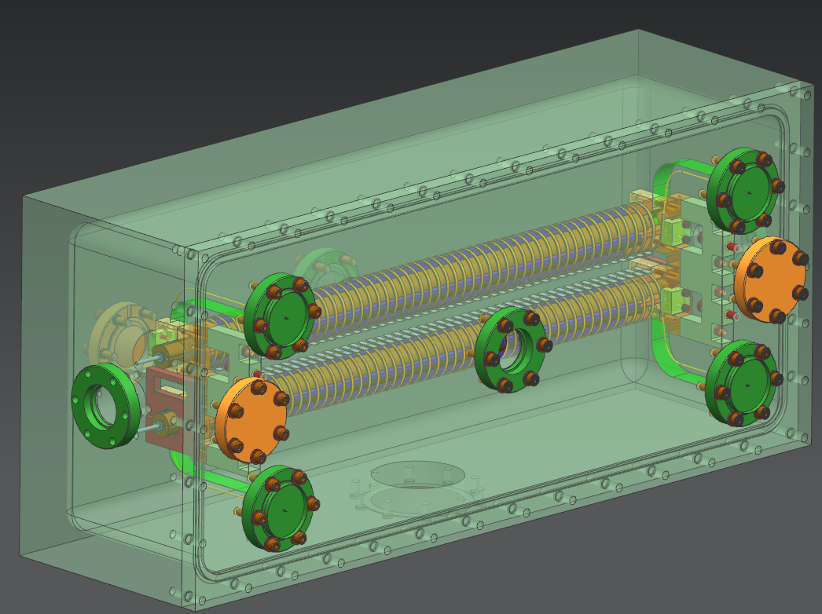
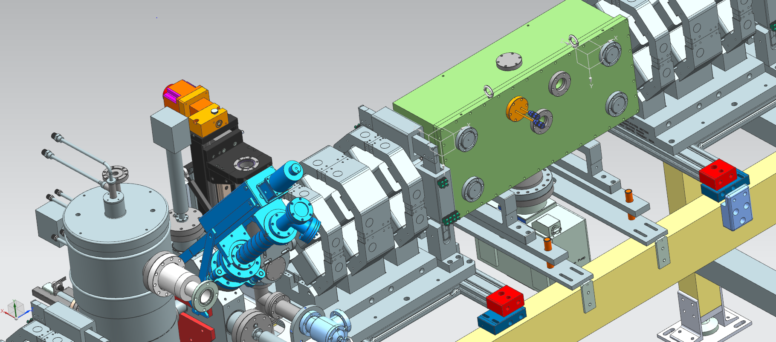
Mechanical Design
FT of Protection electrodes
Cooling FT
Power FT(4)
ViewPort
Pump Port

Slide 8
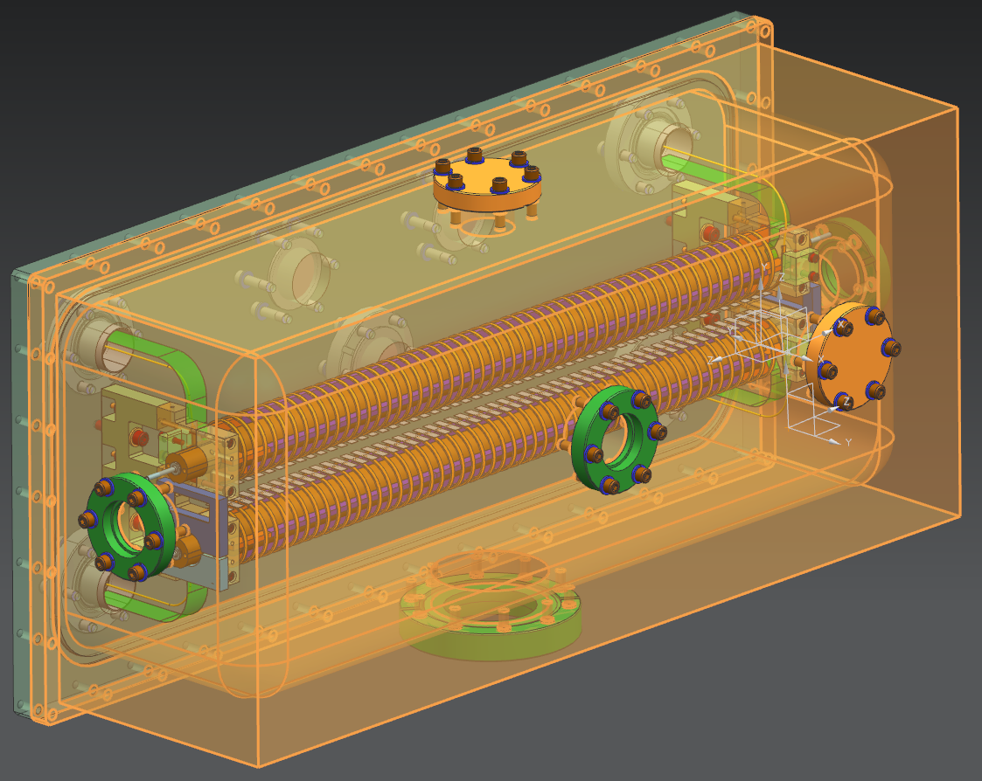
Mechanical Design
FT of Protection electrodes
Gauge port
Cooling FT
Protection Electrode (2)
Power FT(4)
ViewPort
Beam
Pump Port

Slide 9
Materials choices
Cu, (OFHC): ground tube, excellent electrical and thermal conductivity
Stainless 304: Base Plates, CF flanges
Alu 6061-T6: for vacuum box, EASY to machine
 | Thermal conductivity (w/m.k) | Thermal Expansion coefficiency (10⁻⁶ /°C) | Electrically conductivity (10⁻⁶ Ω.cm)
OFHC | 385 | 17.3 | 1.7
6061-T6 | 167 | 23.6 | 4.0
SS 304 | 16.2 | 17.0 | 72

Slide 10
Materials(ceramic)
 |  |  |  | Photoveel II (helix spacers) | Macor (stands)
General Properties | Density (g/cm³) |  |  | 2.56 | 2.52
 | Water Absorption (%) |  |  | 0 | 0
Mechanical Properties | Bending Strength (MPa) |  |  | 440 | 90
 | Young's Modulus (GPa) |  |  | 157 | 67
 | Vickers Hardness (GPa) |  |  | 2.3 | 4.5
Thermal Properties | Max.Operating Temperature (°C) (In nonoxidizing atmosphere) |  |  | 1000 | 1000
 | Coefficient of Thermal Expansion (1/°C×10⁻⁶) |  |  | 1.4 (RT~400°C) | 6.3-9.7
 | Coefficient of Thermal Conductivity (W/m×K) |  |  | 50 | 1.46
 | Thermal Shock Resistance ΔT (°C) |  |  | 600 | 25-100
Electrical Properties | Volume Resistivity |  | 25°C | 2.2×10¹⁵ | >10¹⁷
 |  |  | 300°C | -
 | Dielectric Constant |  | 10GHz | 5.9 | 6.03
 | Dielectric Loss (×10⁻⁴) |  |  | 10
 | Q Factor (×10⁴) |  |  | 0.1
 | Dielectric Breakdown Voltage (KV/mm) |  |  | 35 | 40

Slide 11
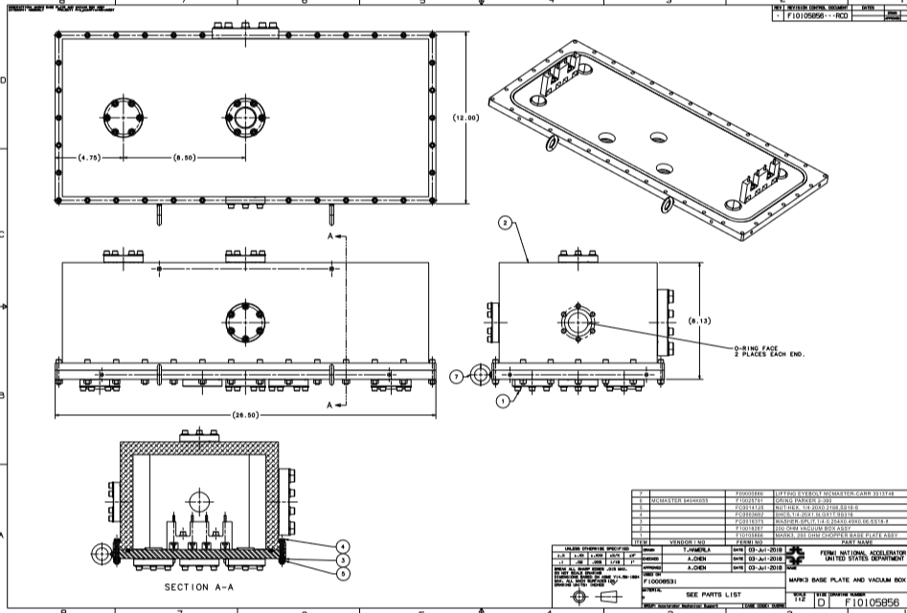
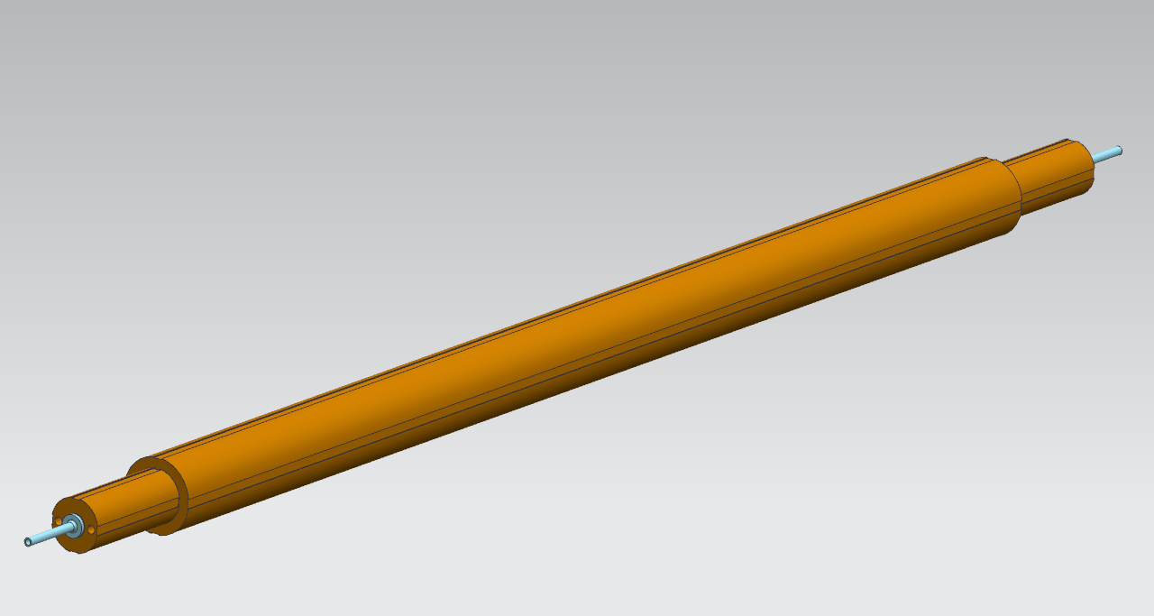
Assembly(F10105856)
View Port
Vacuum Gauge Port
Beamline Port
Pumping Port
Lifting (4)

Slide 12
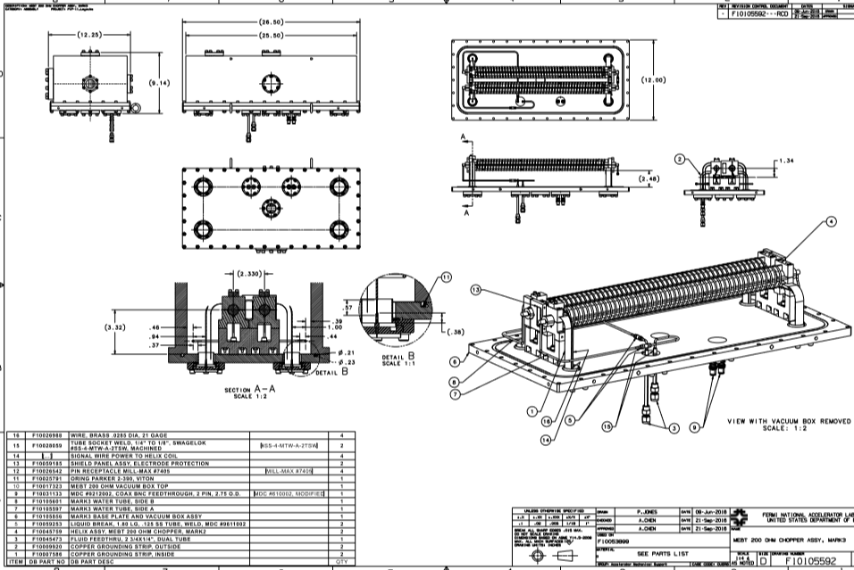
Assembly(F10105592)
NEW routing of cooling line
Pumping Port
View Port
FT of LCW
FT of Protection Electrodes

Slide 13
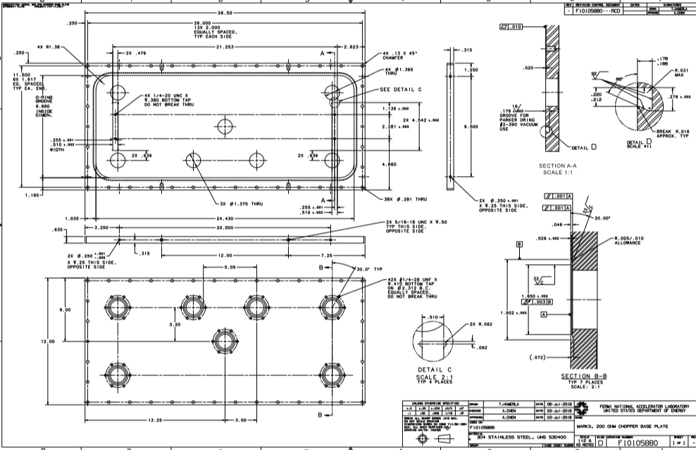
Base Plate(F10105880)
line to align the base of stands

Slide 14
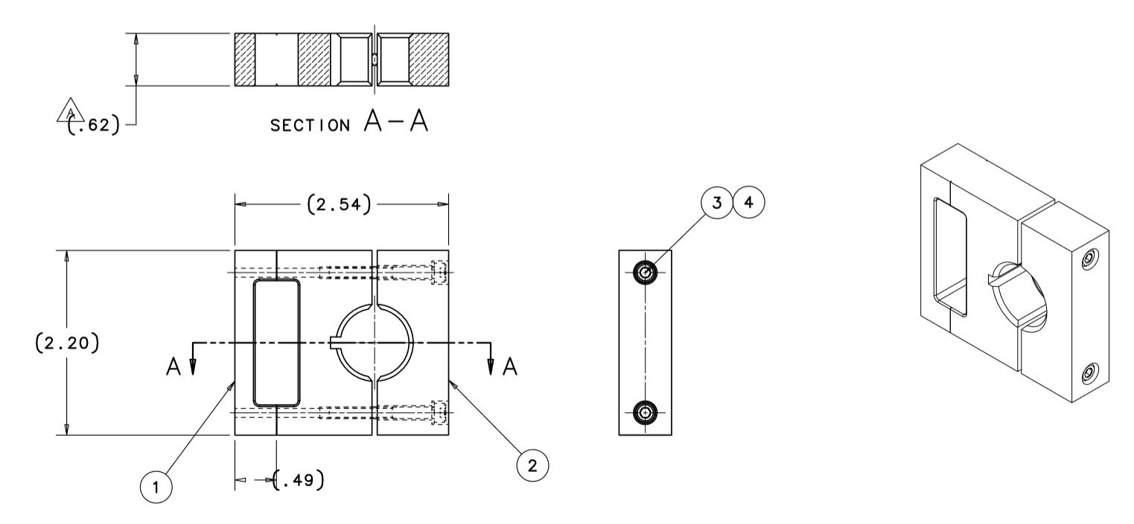
Protection Electrodes(F10059185)
NEW:
Doubled thickness to increase cooling
Kapton@MT, and Epoxy
contact area
Radius | 0.402 | inch
length | 0.52 | inch
Area (90% of half circle) | 0.59 | in2
Kapton data |  |  |  | Heat
thickness | 0.002 | inch |  | 40 | watt
working Temp (cont) | 200 | C
one time | 400 | C |  | dT
thermal conductivity | 0.12 | w/(mK) | Kapton | 44.4 | C
 | 0.46 |  | Kapton MT | 11.6 | C
 | 0.75 |  | Kapton MT+ | 7.1 | C

Slide 15
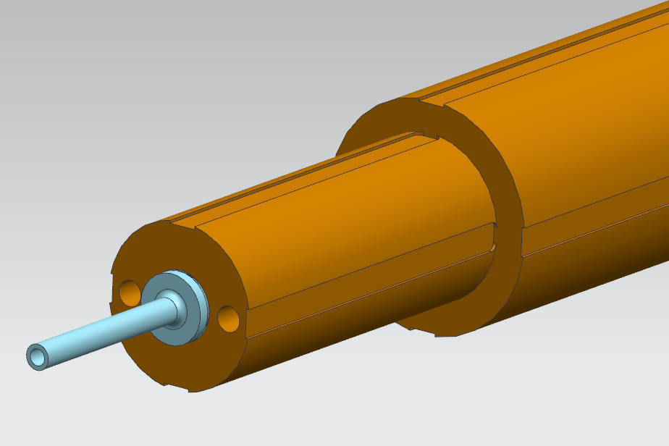
Ground Tube with Brazed cooling tubing
Positioning Groves

Slide 16
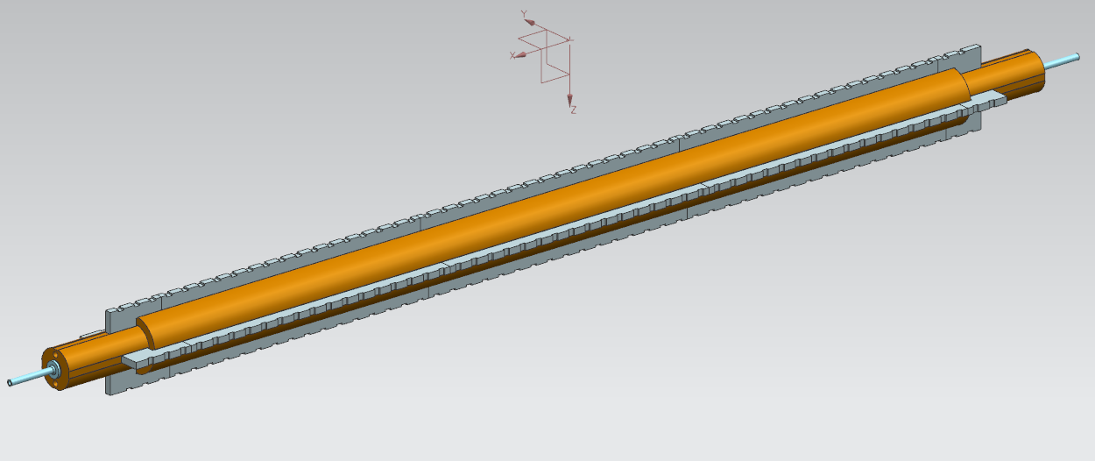
Ground tube with Ceramic Spacers, (Epoxy)
Ceramic Spacers:
Photoveel II (machinable AlN)
12 identical mid pieces
8 unique end pieces

Slide 17
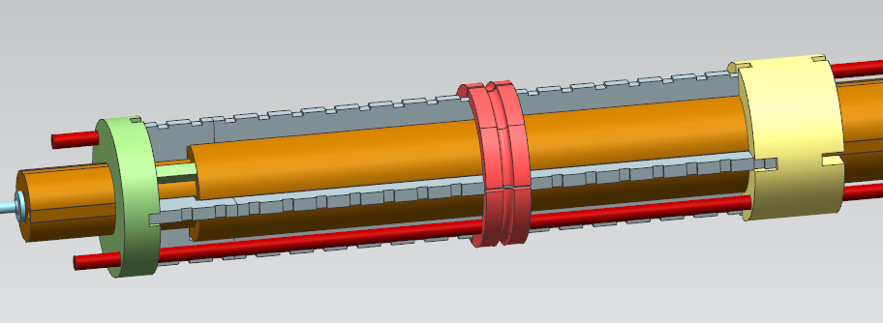
Positioning Ceramic Spacers with Epoxy
End Disk
to set longitudinal position,
to keep spacers in radial direction
Ring Clamps
To align spacer-spacer joint
To stay radial
To remain pressure
Ring Clamp
To apply longitudinal pressure
To keep spacers in radial

Slide 18
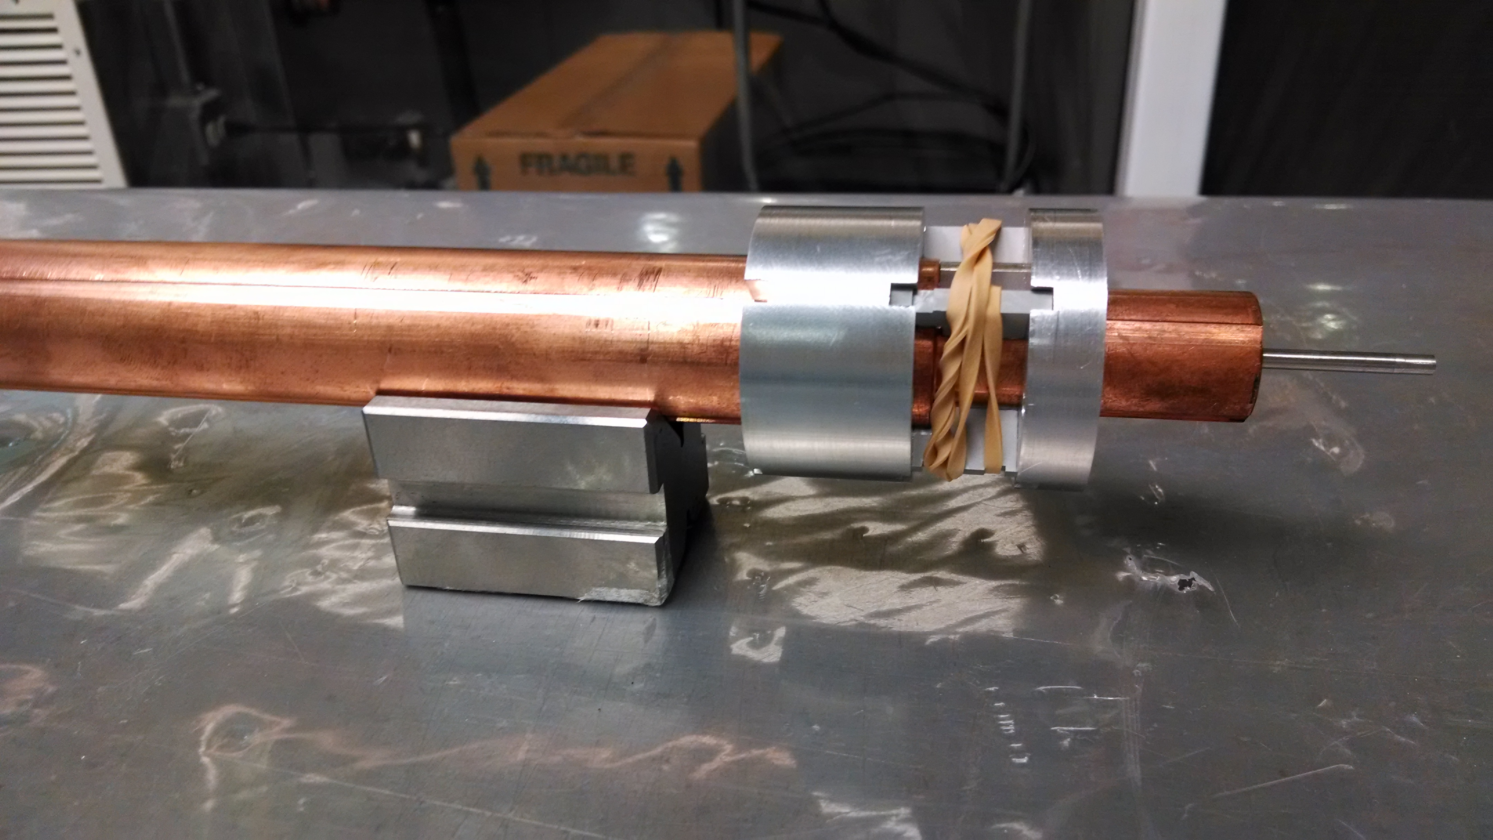
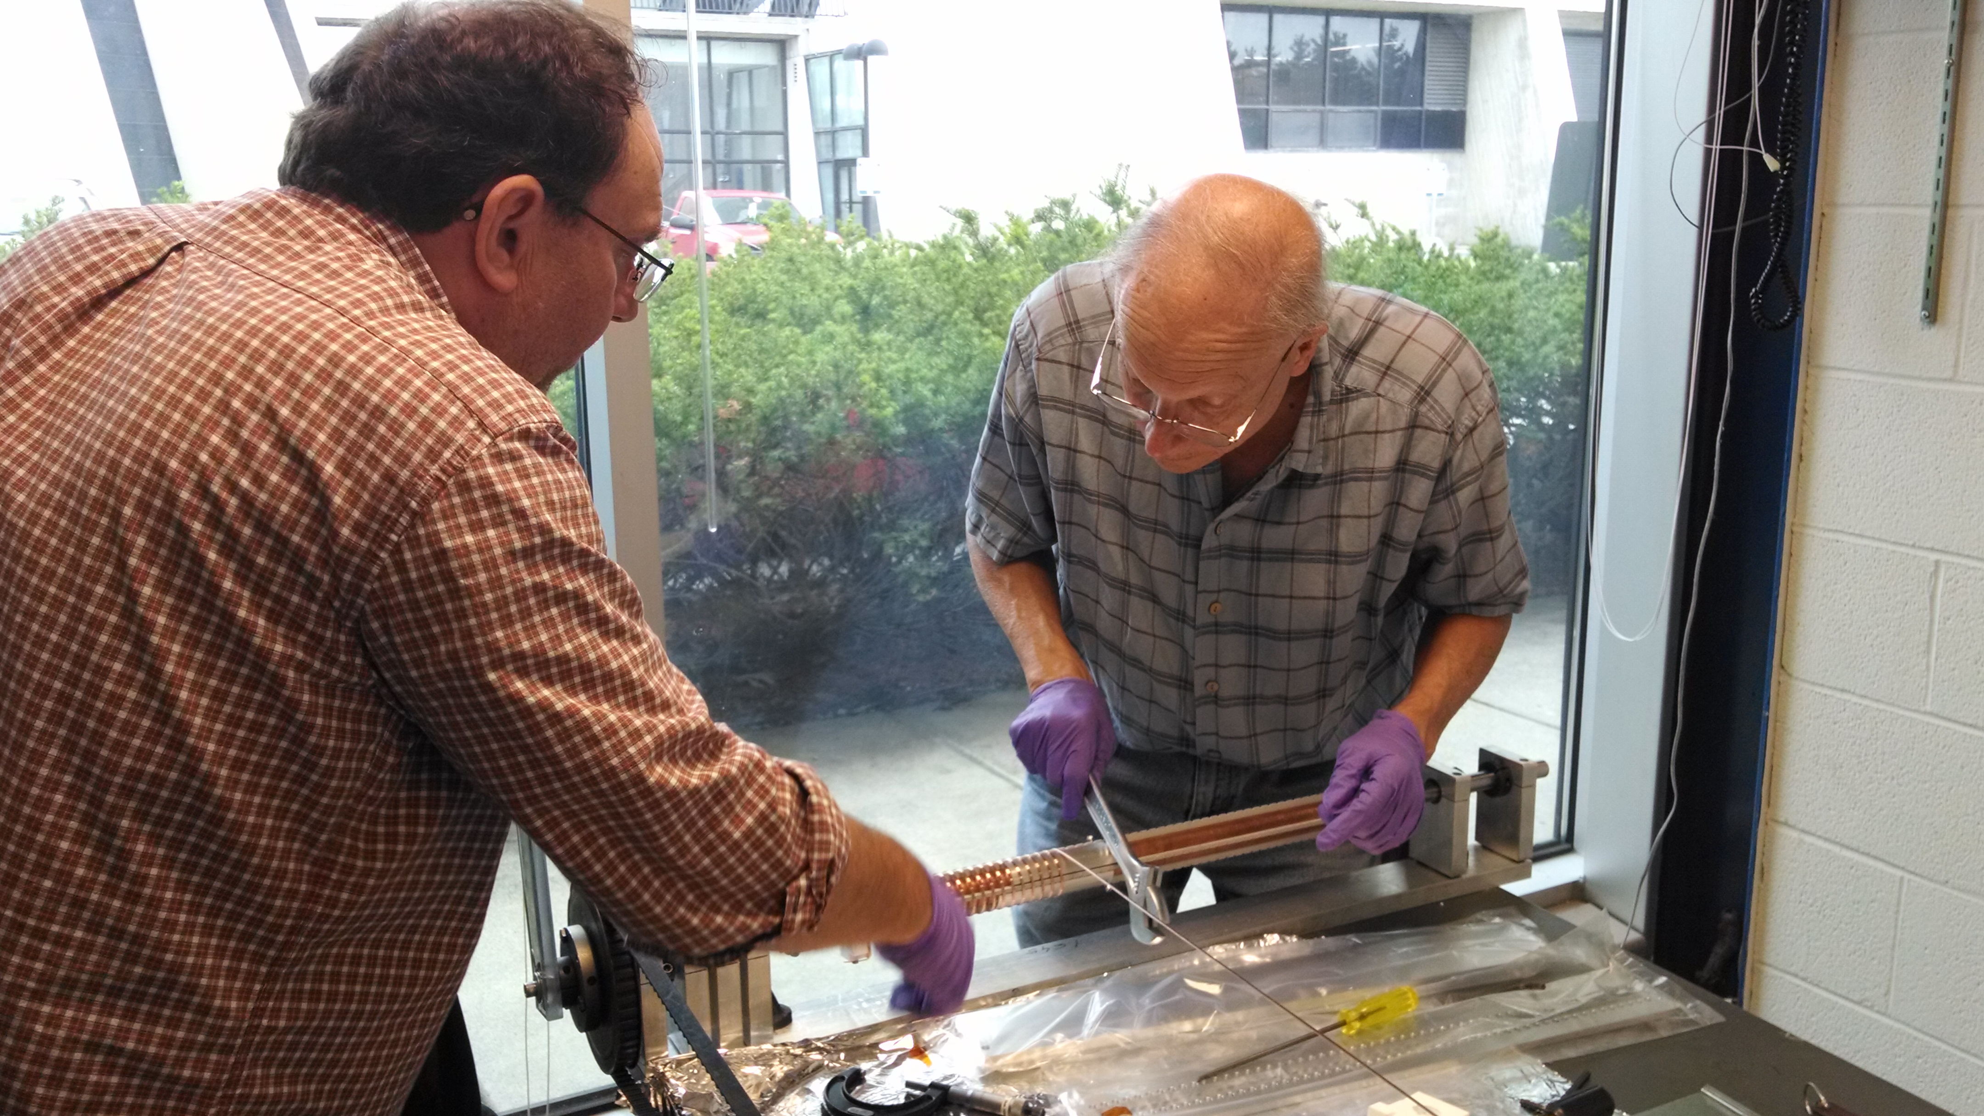
Epoxing

Slide 19
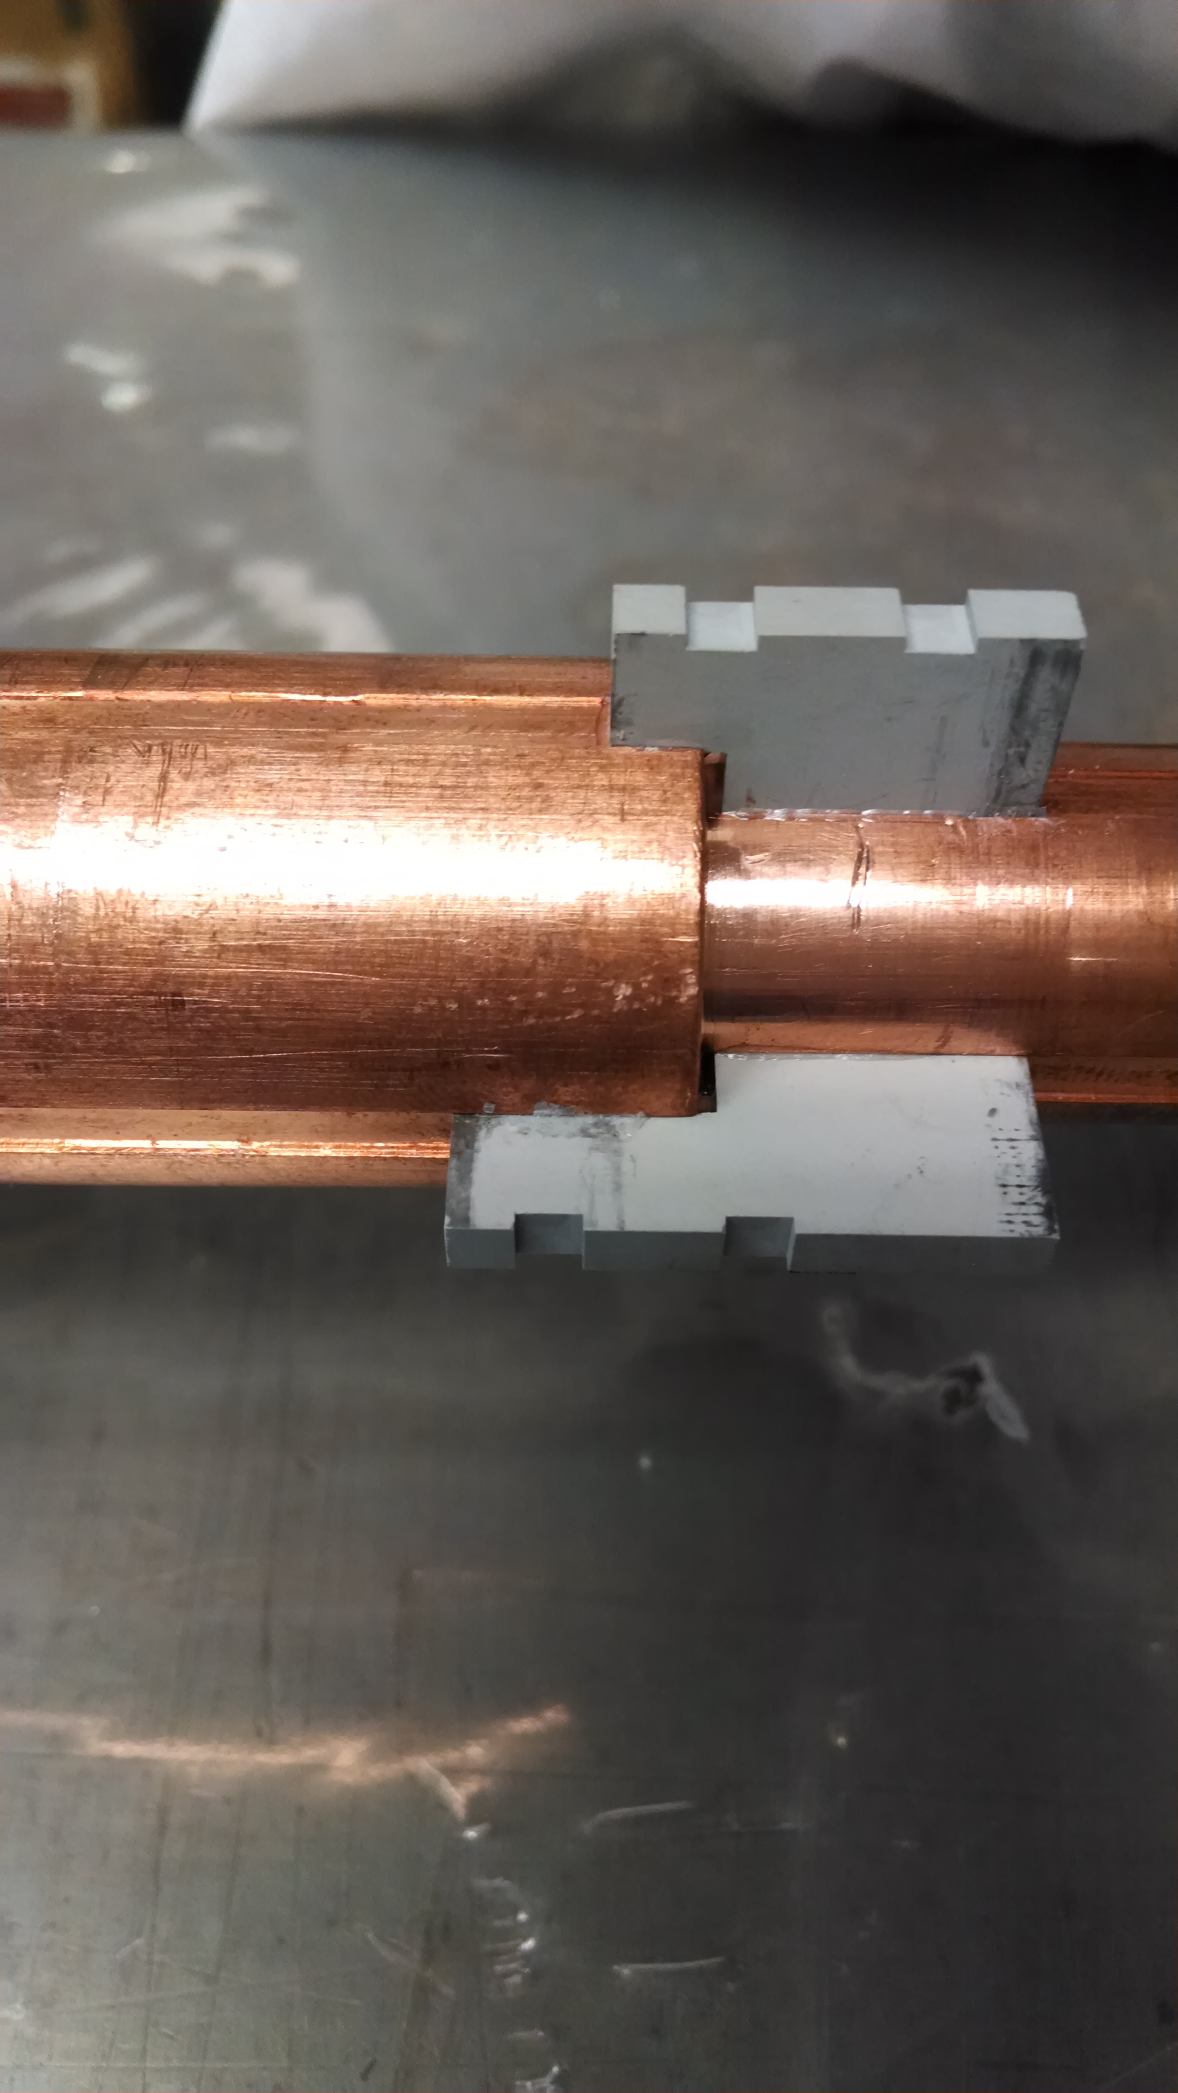
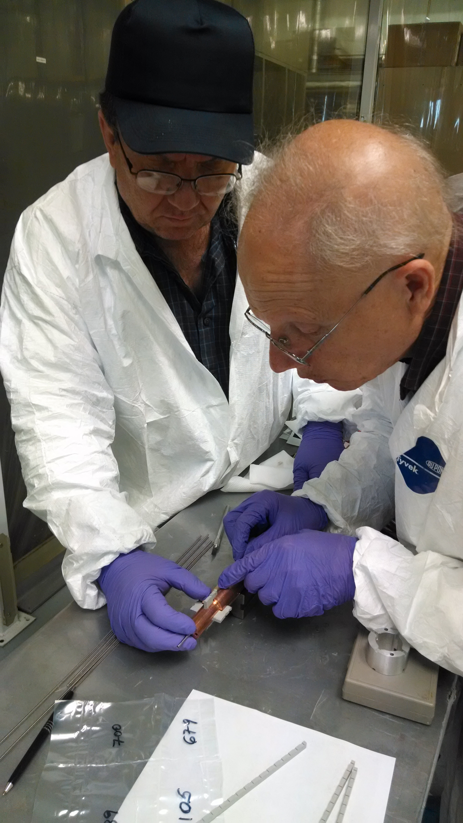
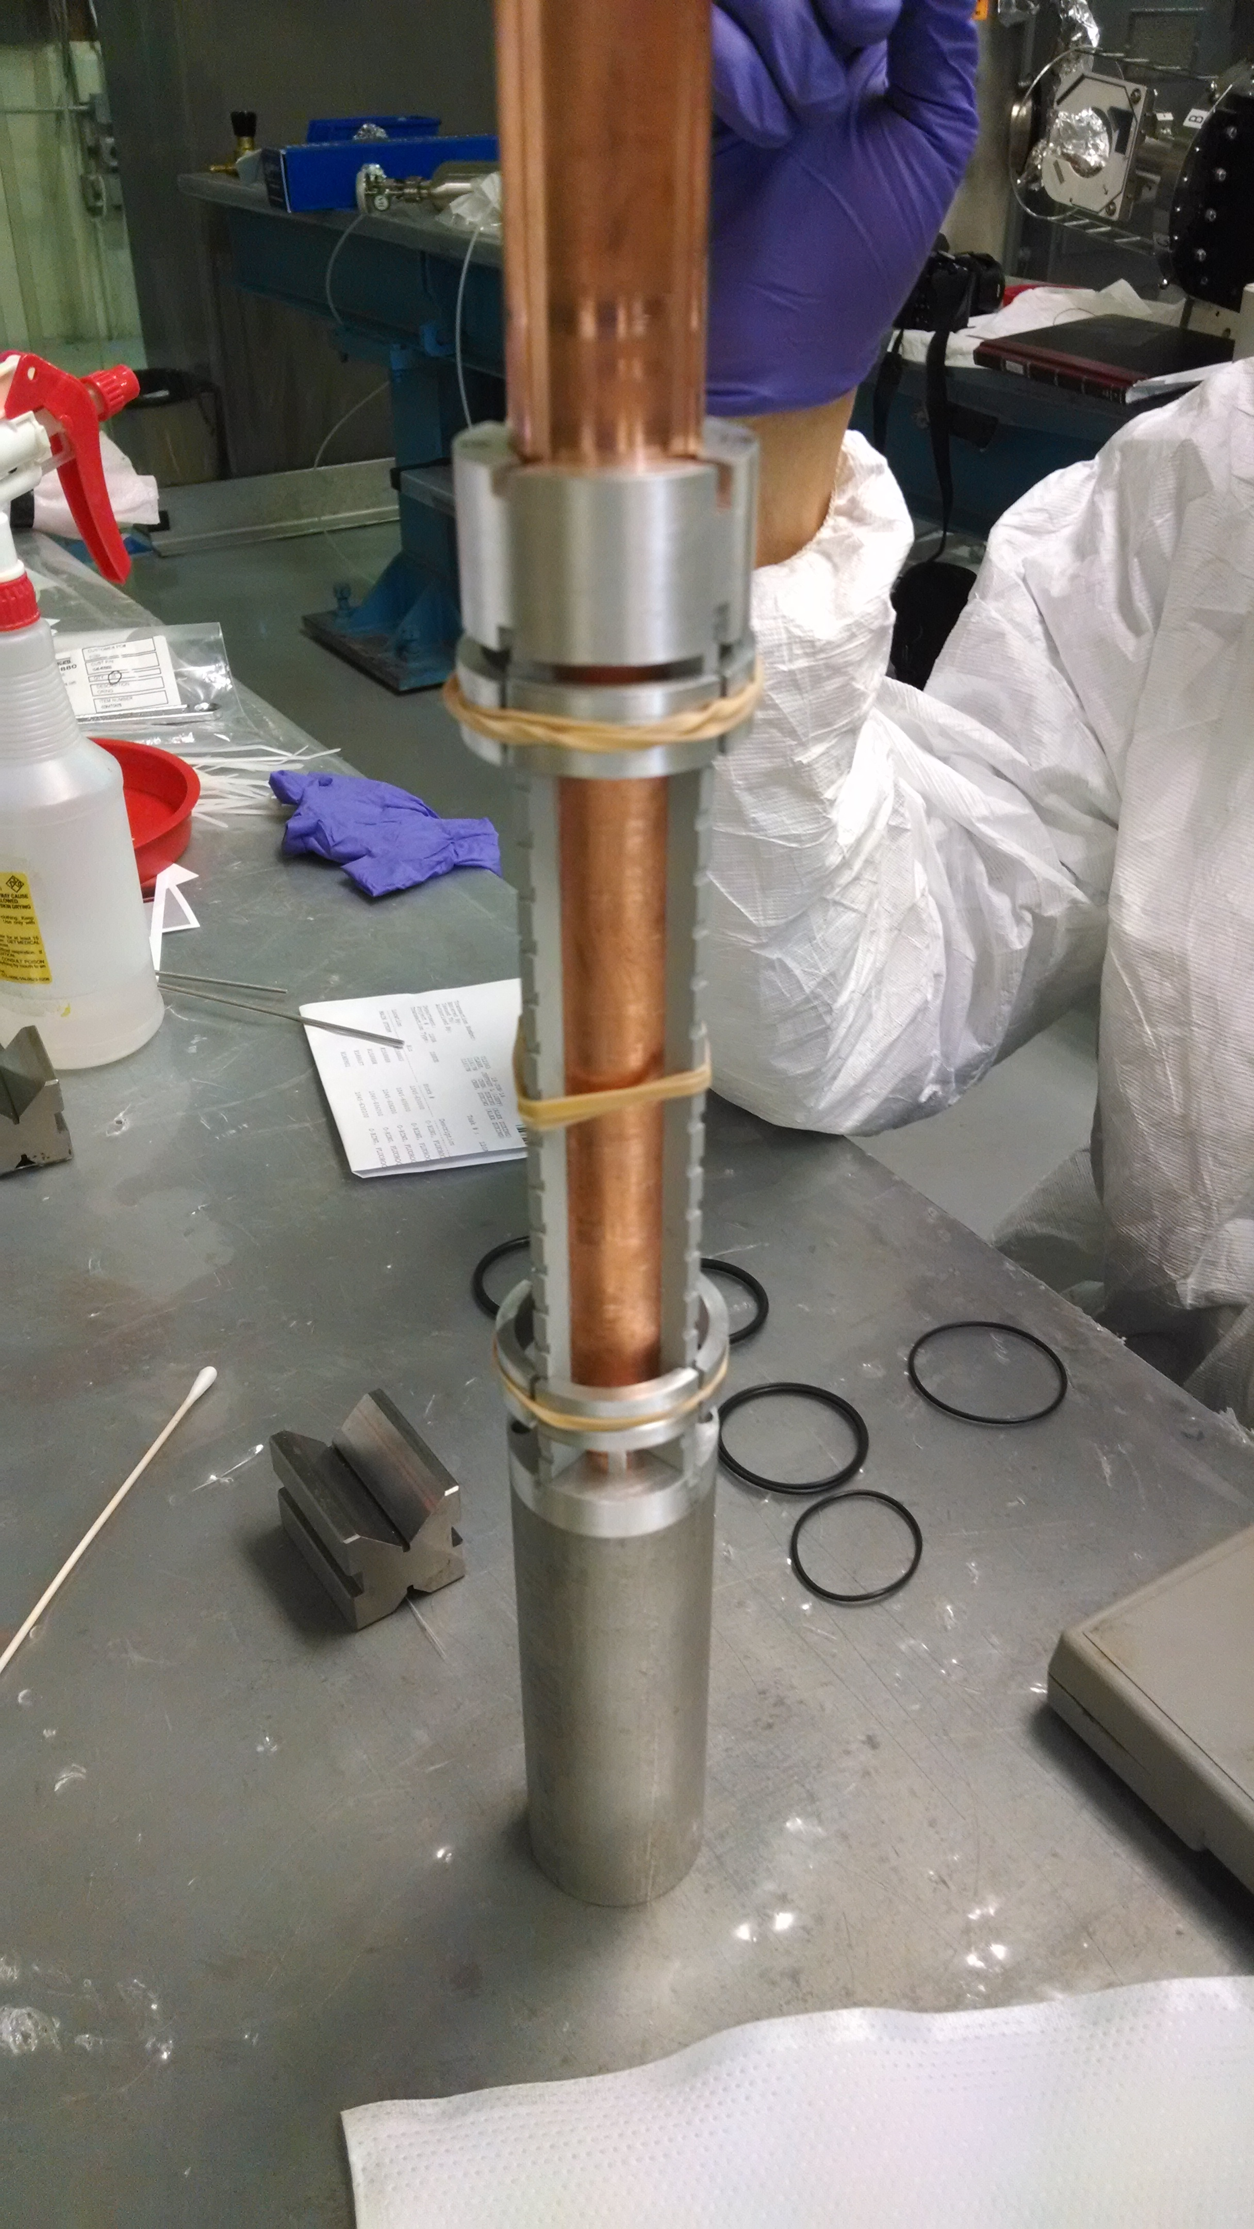
Epoxing
Curing overnight

Slide 20
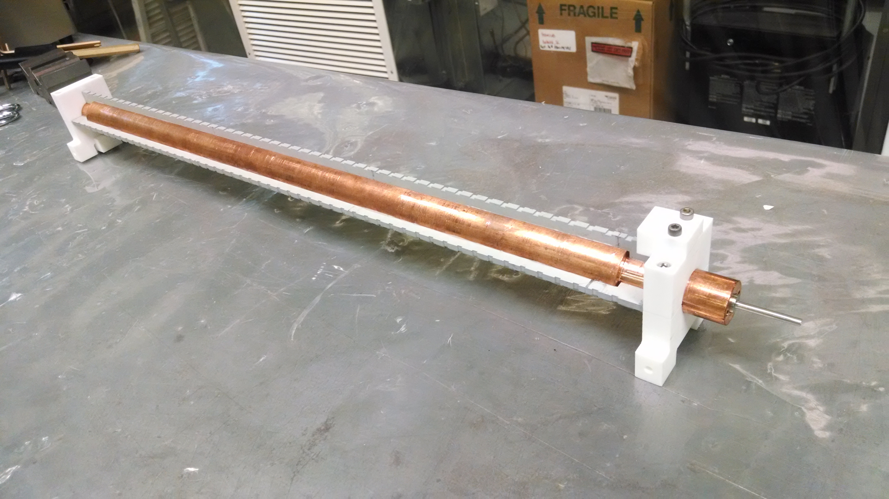
Epoxing
Complete epoxying and assembled with end stands

Slide 21
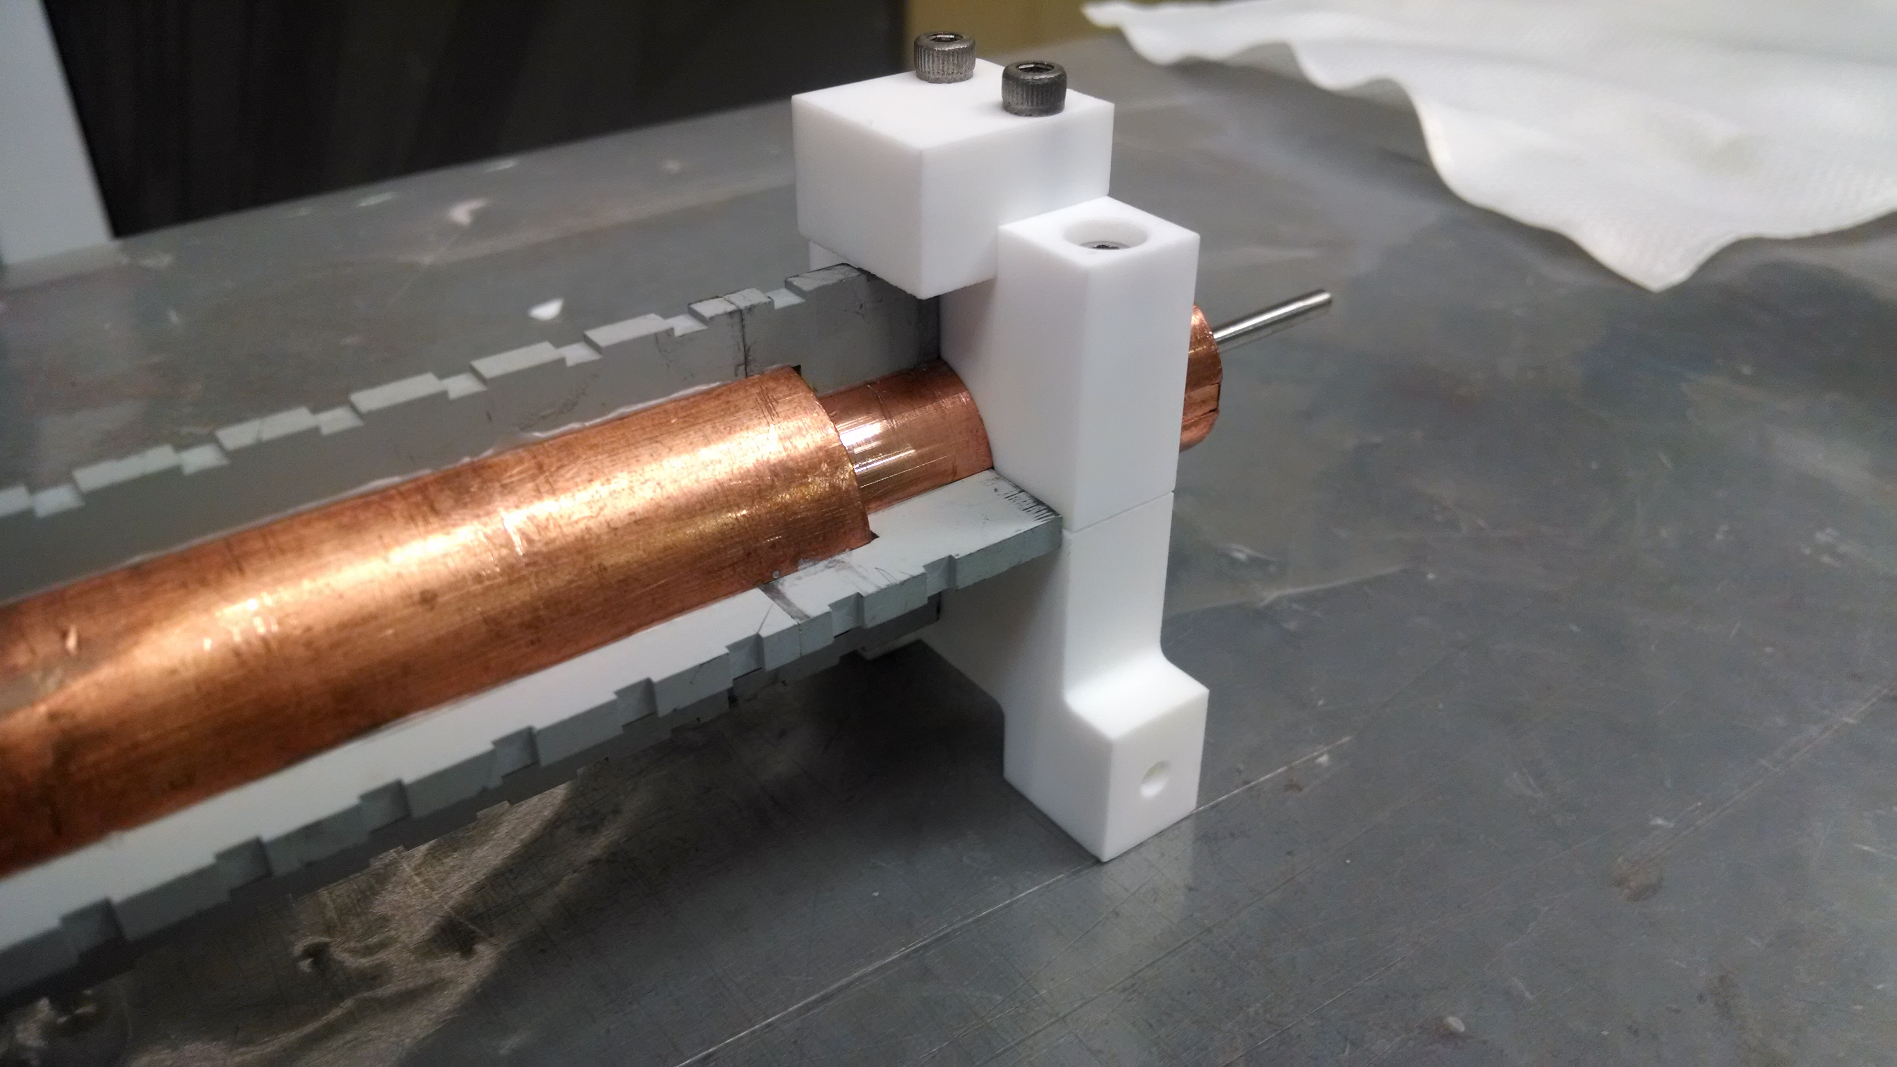
Epoxing

Slide 22
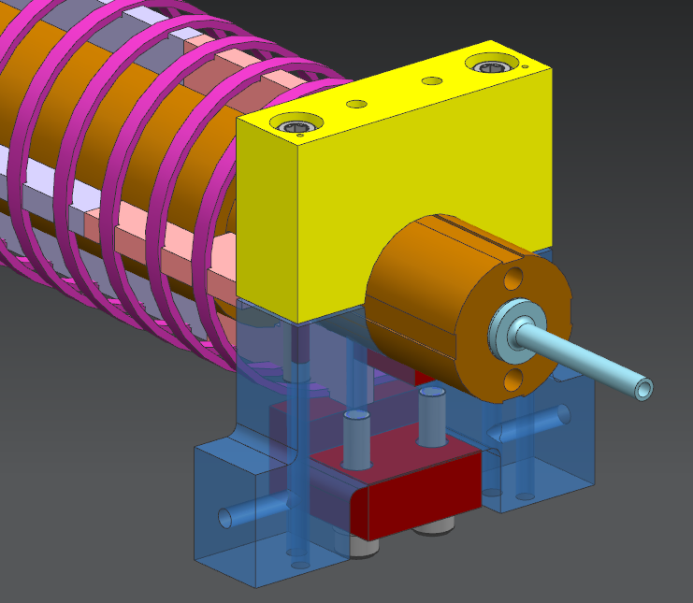
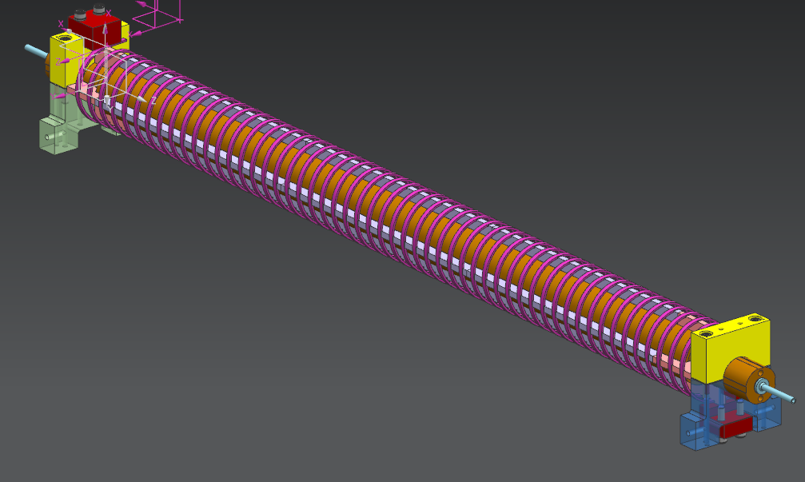
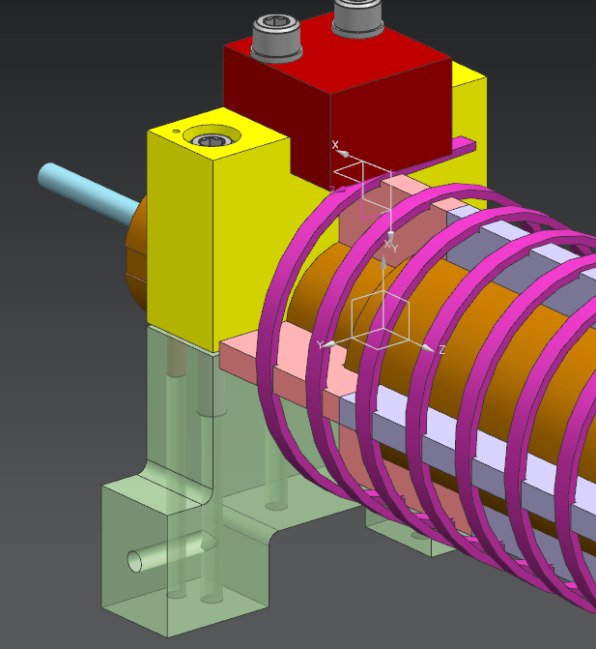
Winding Helix
Macor ceramic clamps & stands and vented screws
Positioning Key (Ceramic)
Macor Ceramic End Stands & Clamps

Slide 23
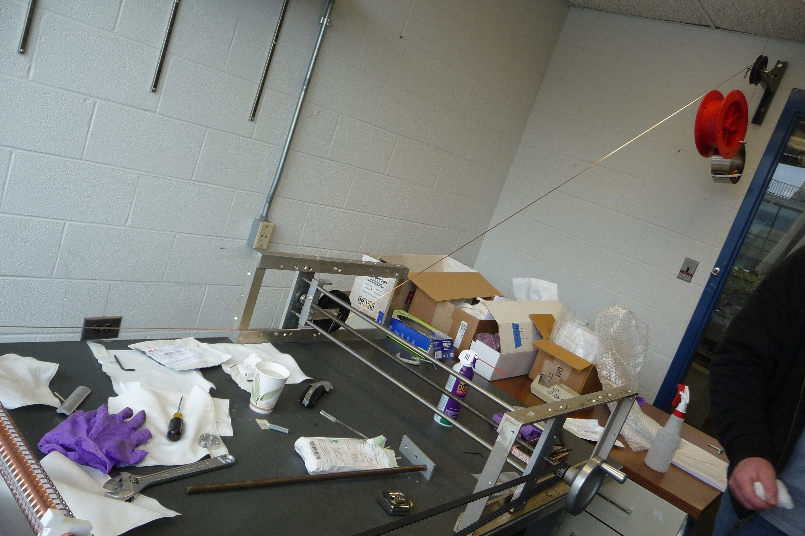
Winding
Winding setup
Weight to stabilize tension on conduct
Toothed belt driving to synchronize feeding with pitch angle

Slide 24
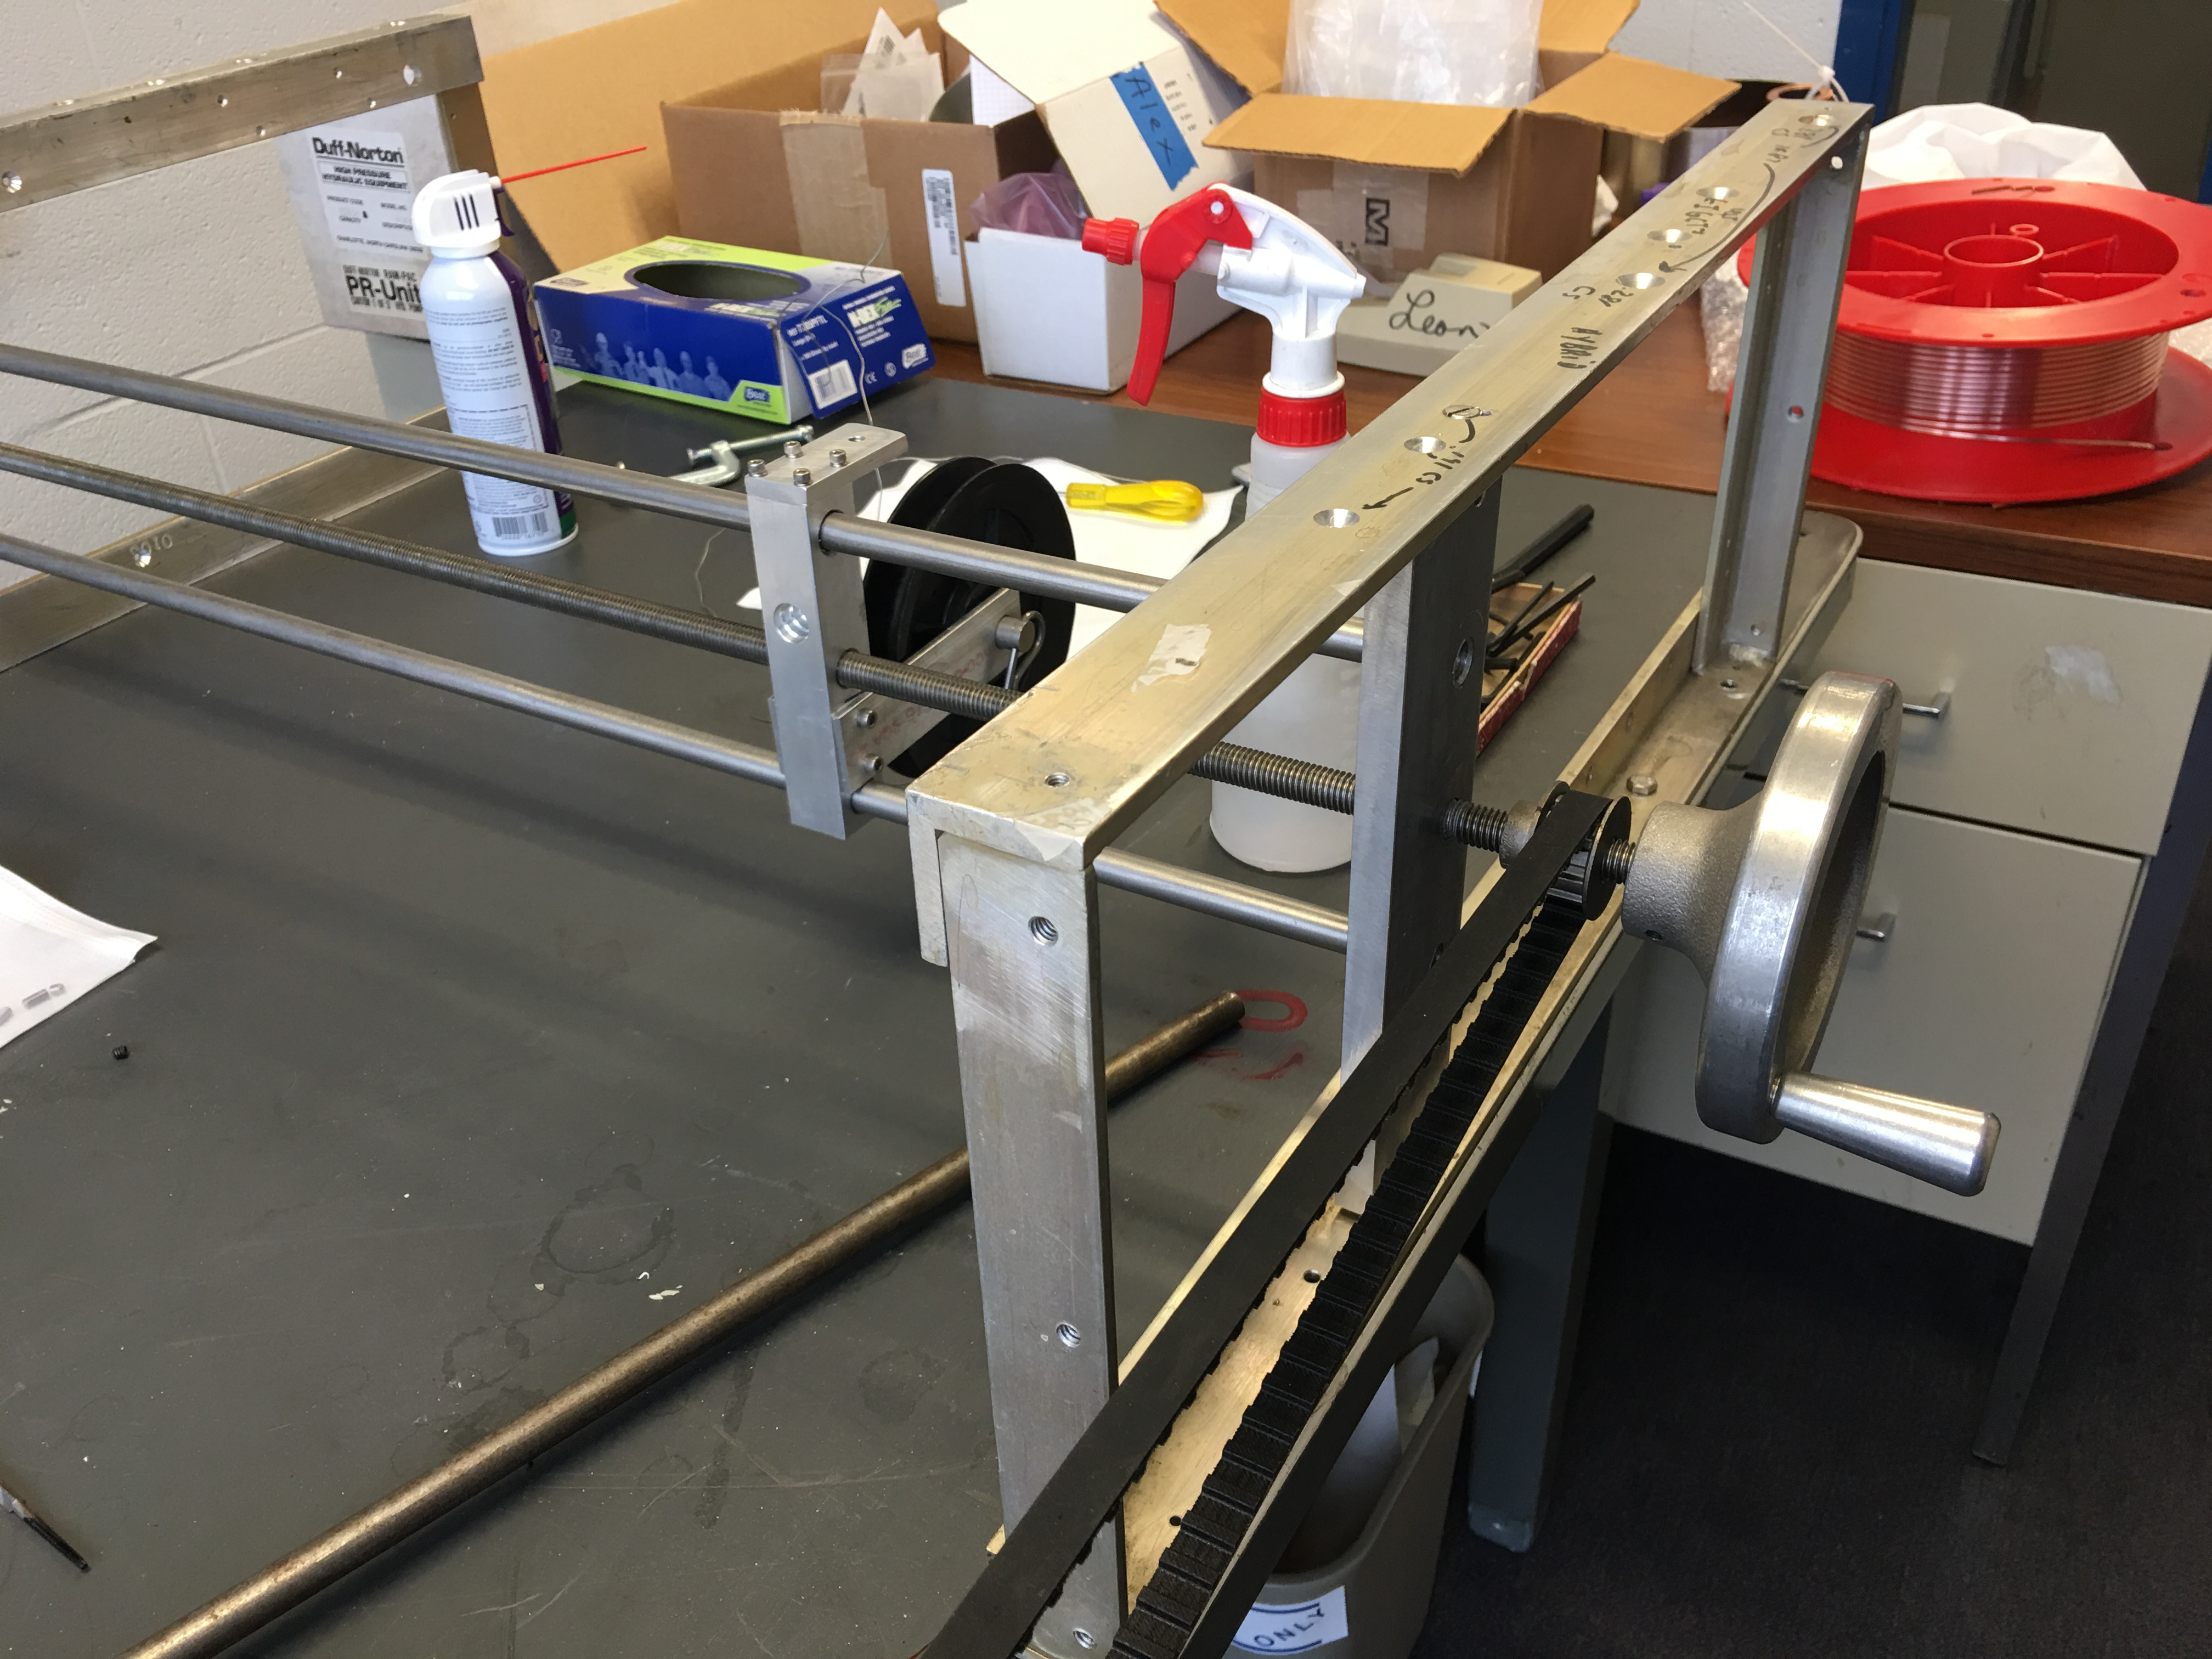
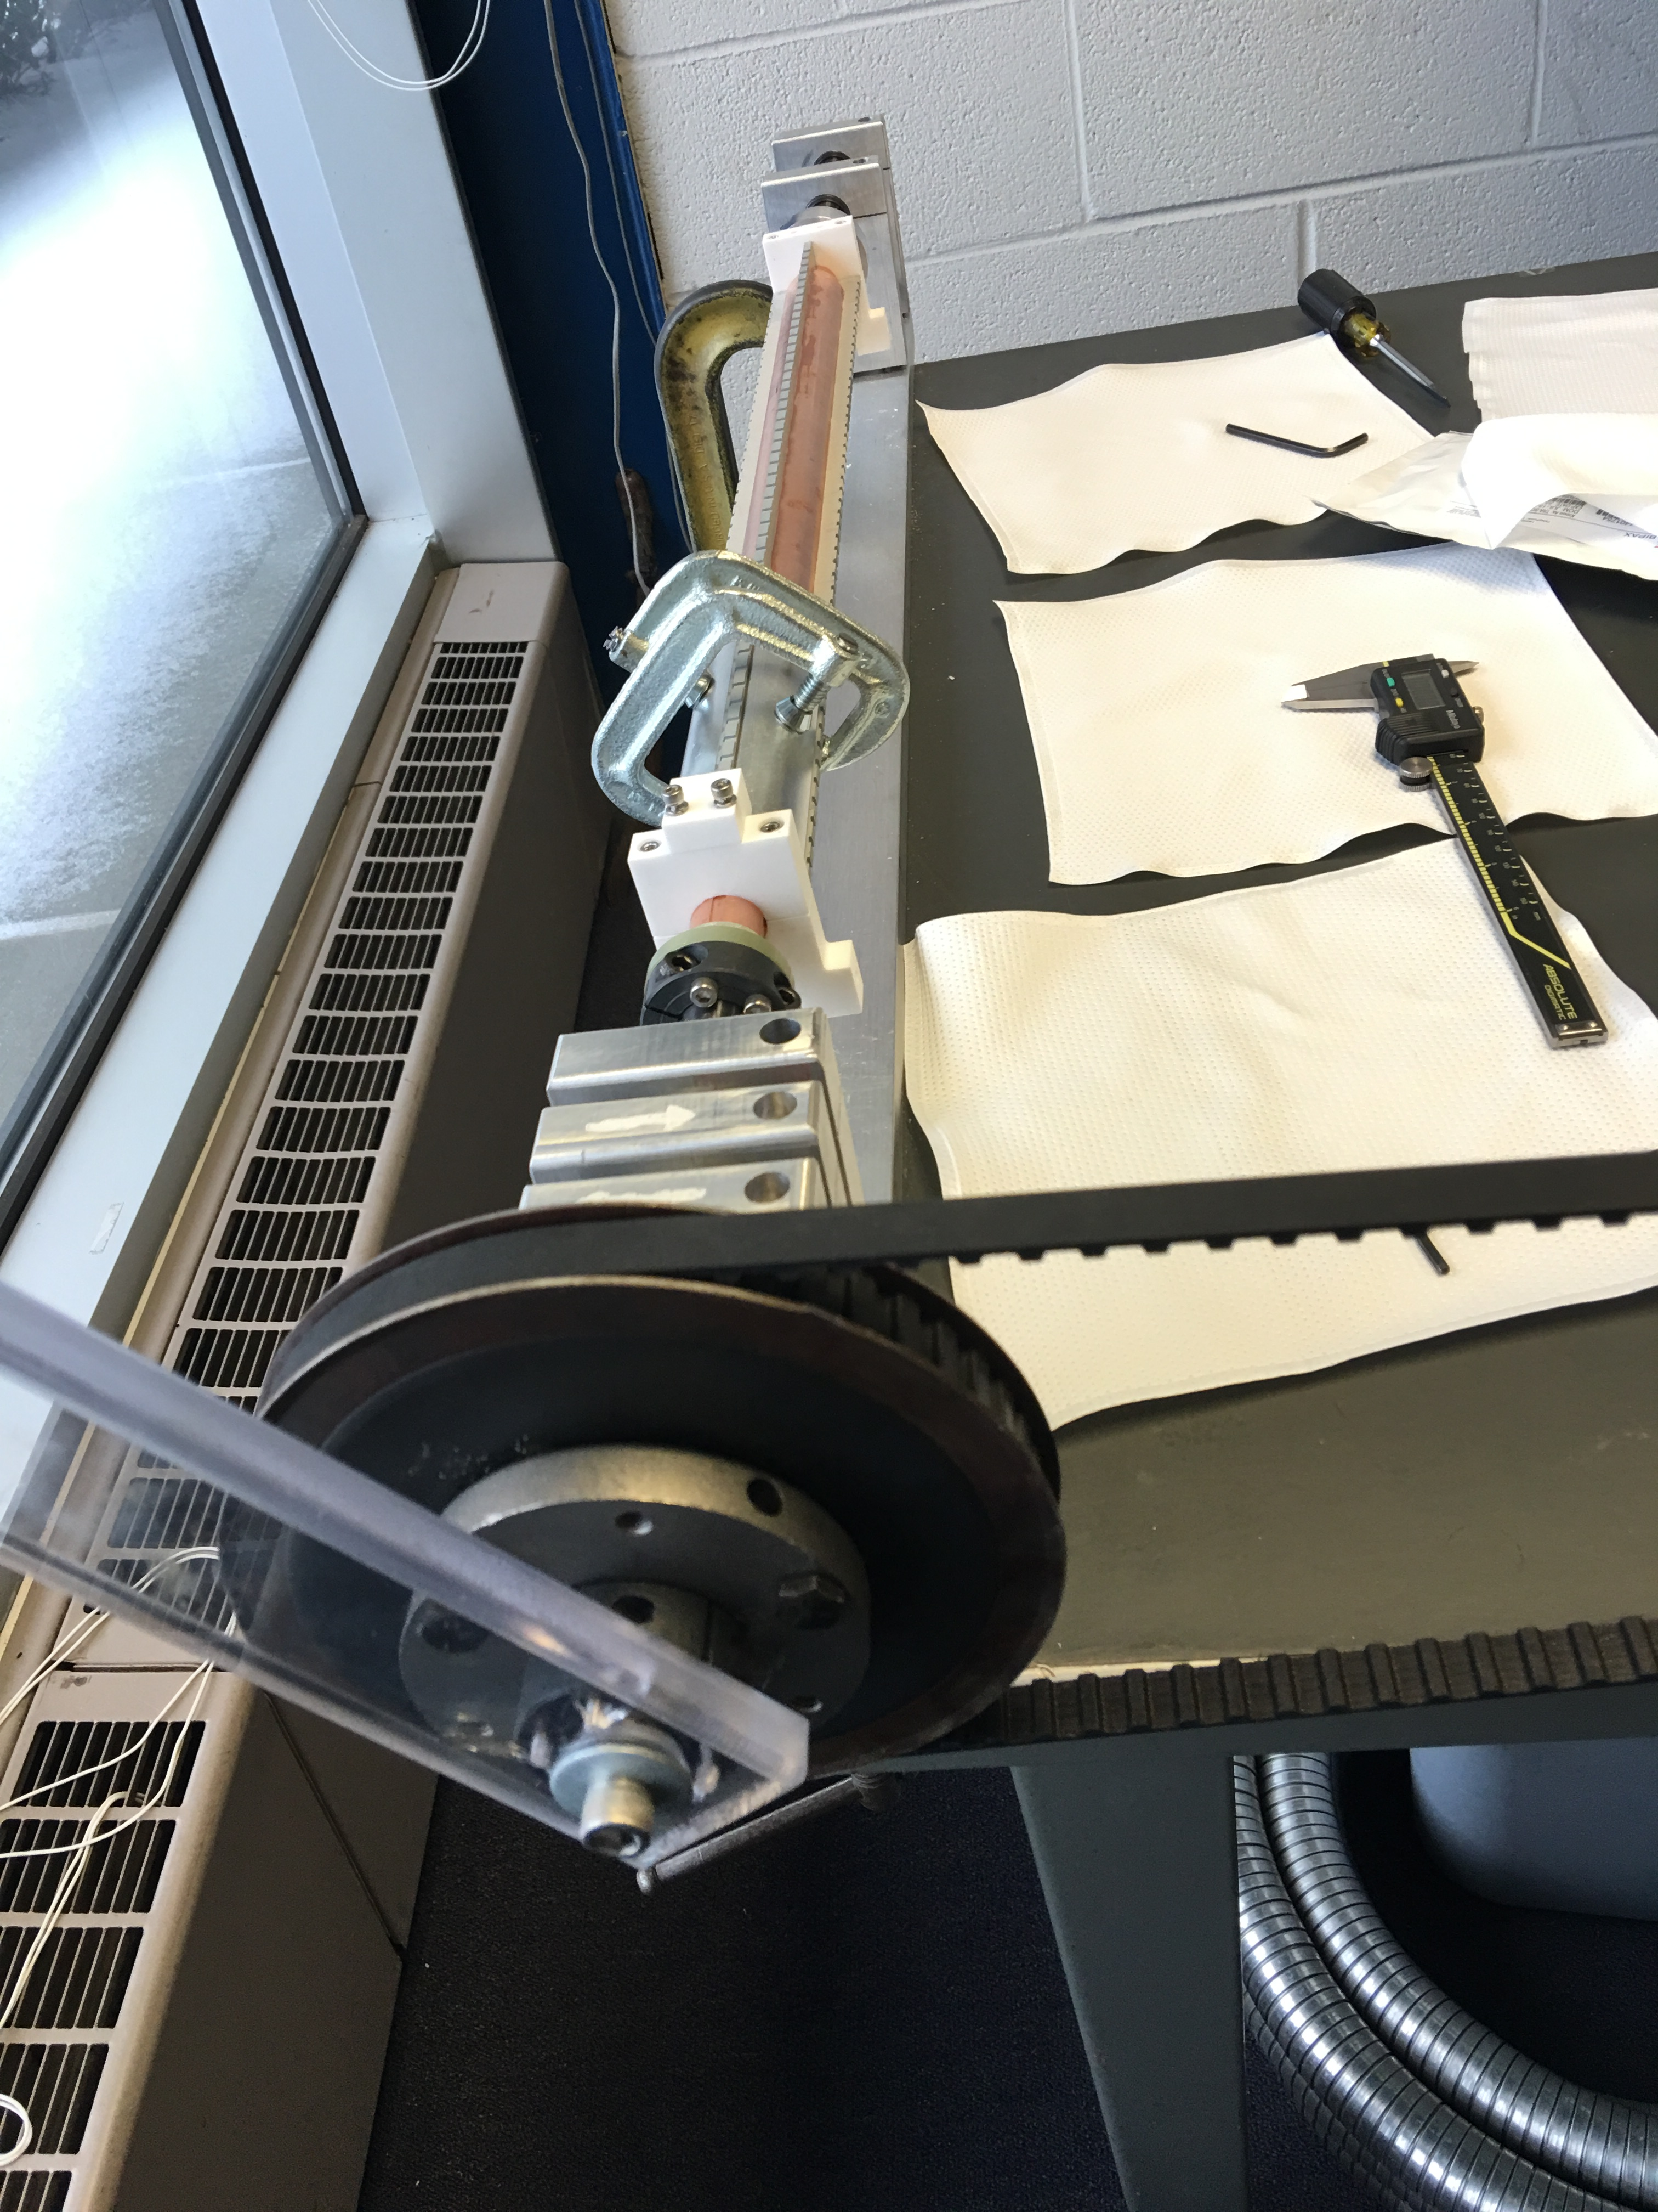
Winding setup
10:48 ratio

Slide 25
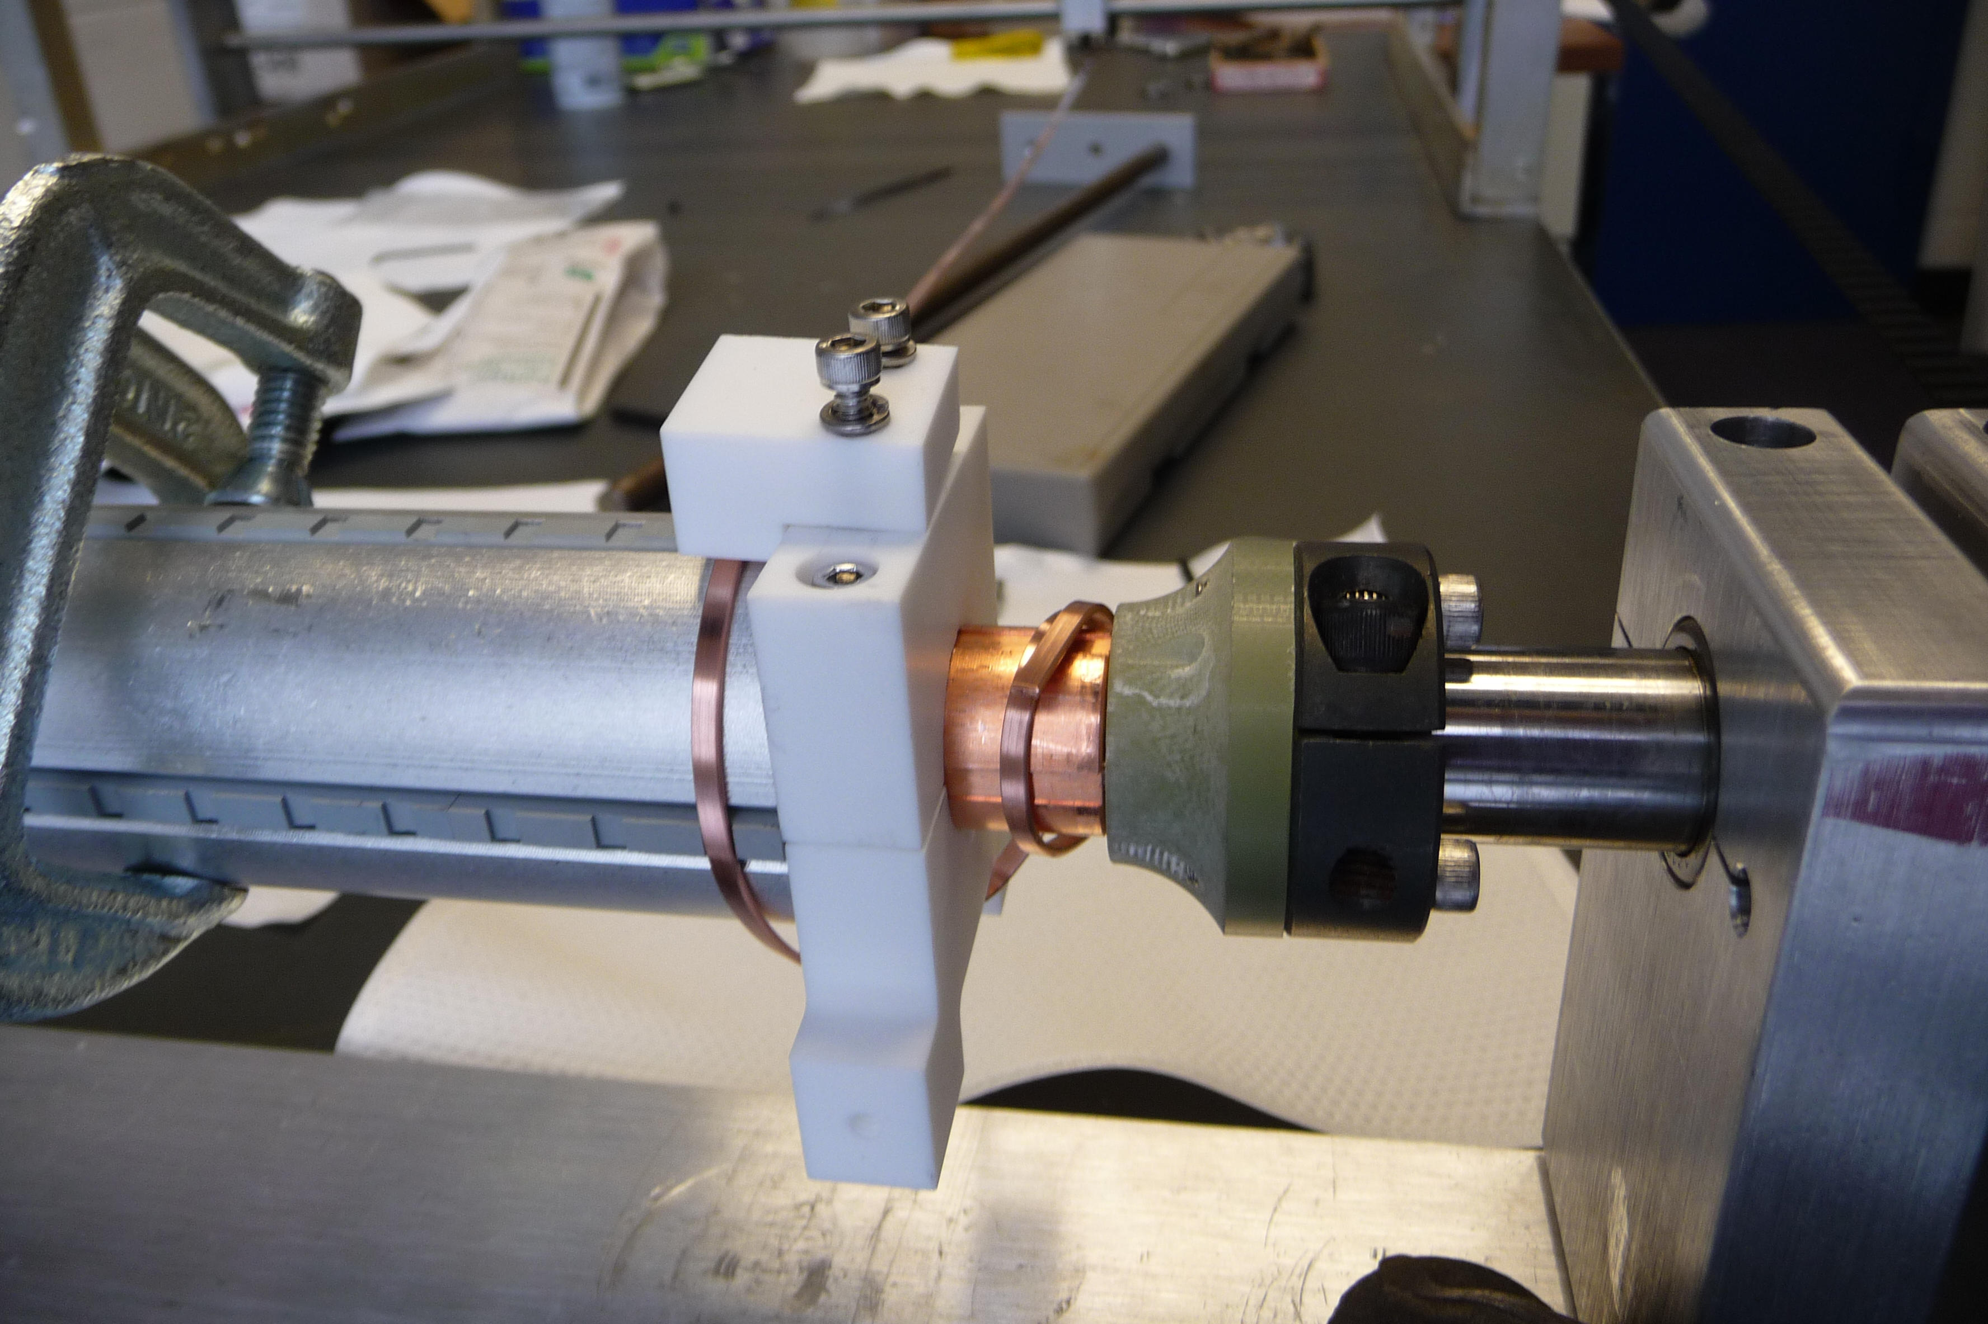
Winding
Winding setup
Starts with mandrel pieces clamped

Slide 26
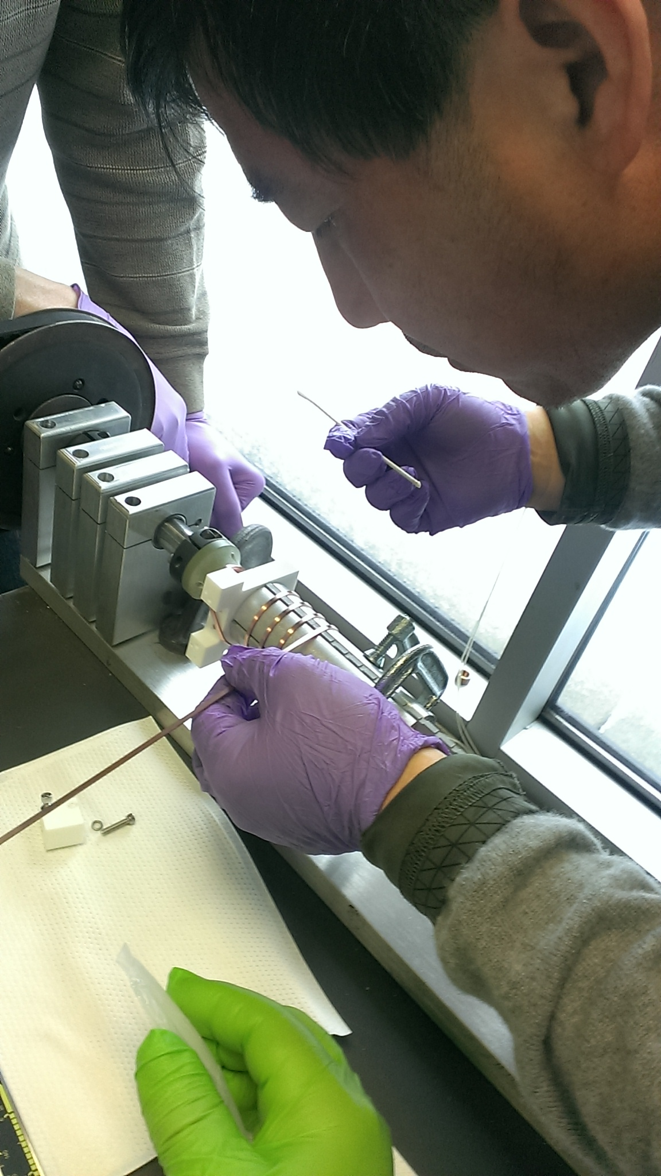
Winding
Apply proper amount epoxy in each notch
Watch conduct carefully when it engages w notch , avoid landing on edges.
Vacuum epoxy KL-320
Thermal Conductivity | N/A
Coeff. of Expansion | 55 x 10⁻⁶ cm/°C
Volume Resistivity | @25°C: 6 x 10¹³ ohm-cm @100°C: 1 x 10¹⁰ ohm-cm
Uncured Resin | Milky paste
Tensile Shear | @25°C: N/A
Shelf Life | @Room Temp.: 4-5 mo
Pot Life | @Room Temp.: 30 mins
Cure Cycle (After Mixing) | @25°C: 18hr @65°C: 4hr
Working Temperature | -60°C to 130°C

Slide 27
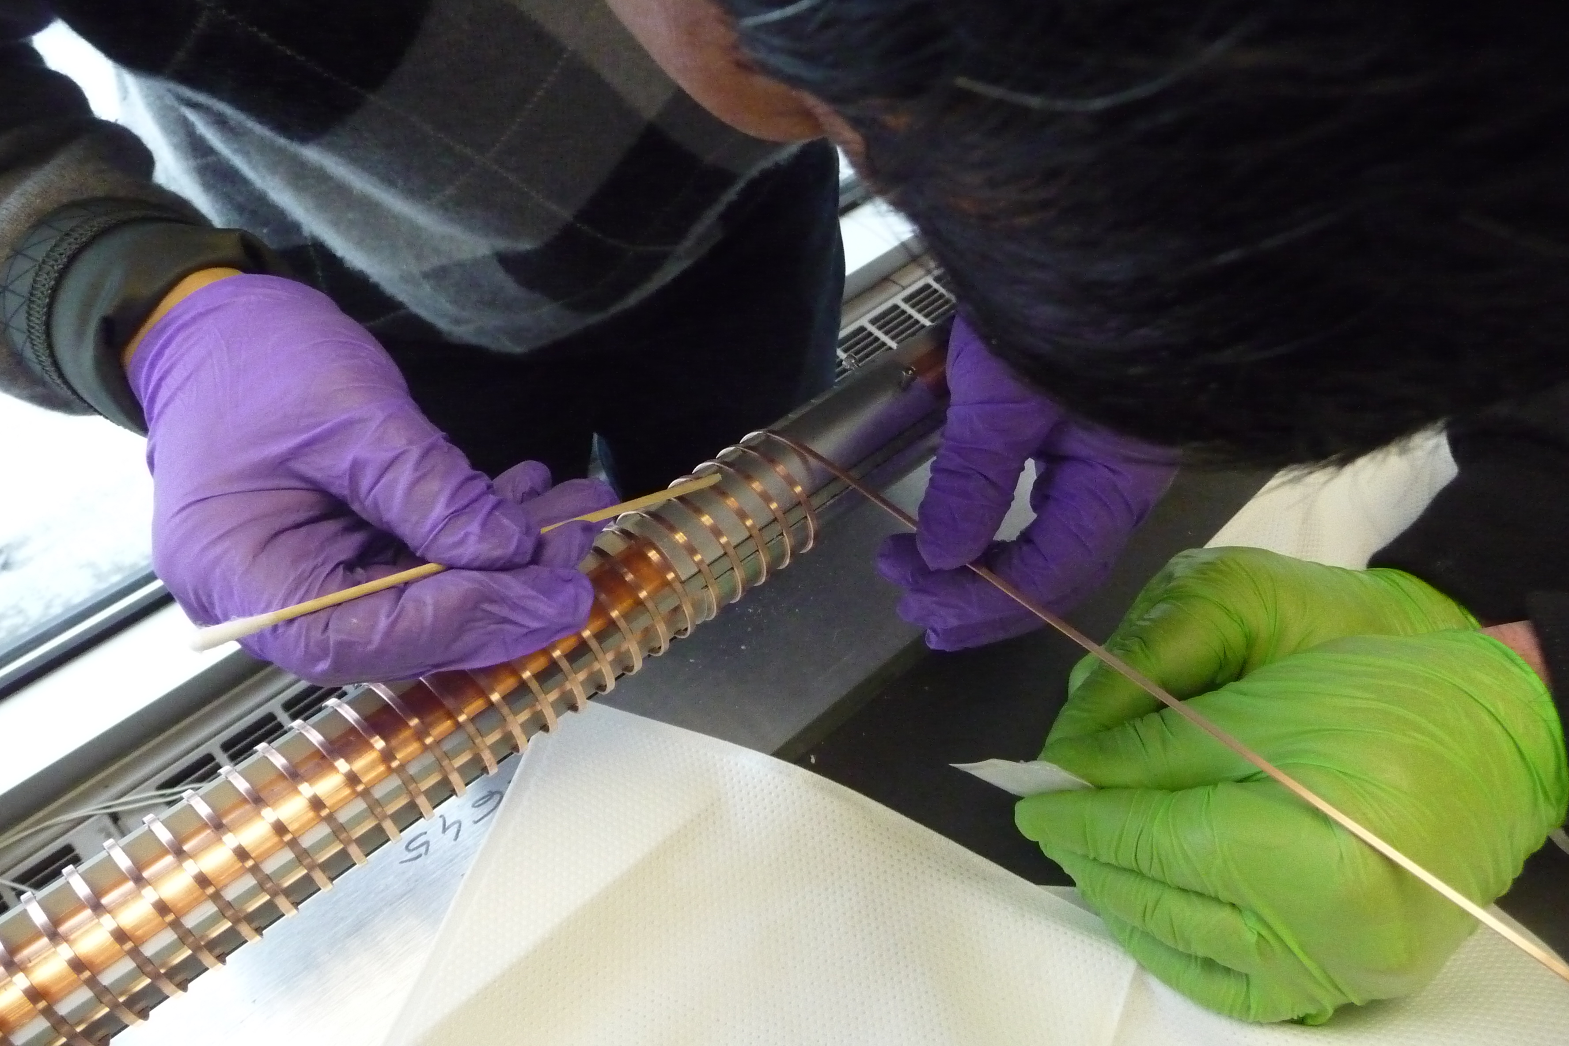
Winding
Remove any excess of epoxy

Slide 28
Winding
Move mandrel pieces after 6~7 turns

Slide 29
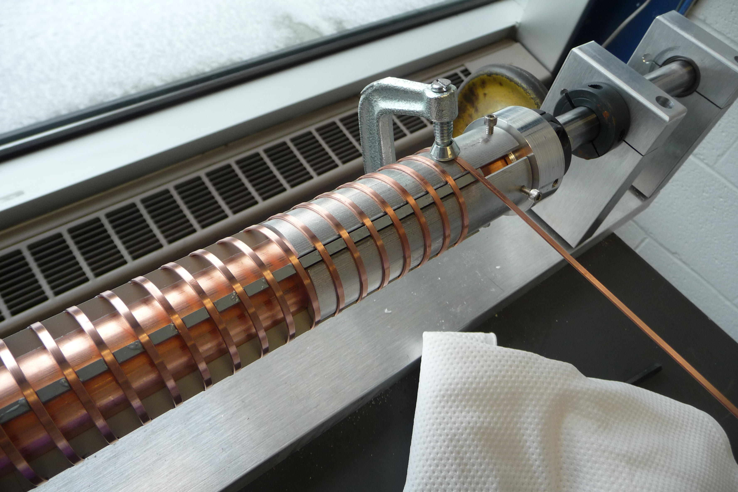
Winding
Clamp at the end

Slide 30
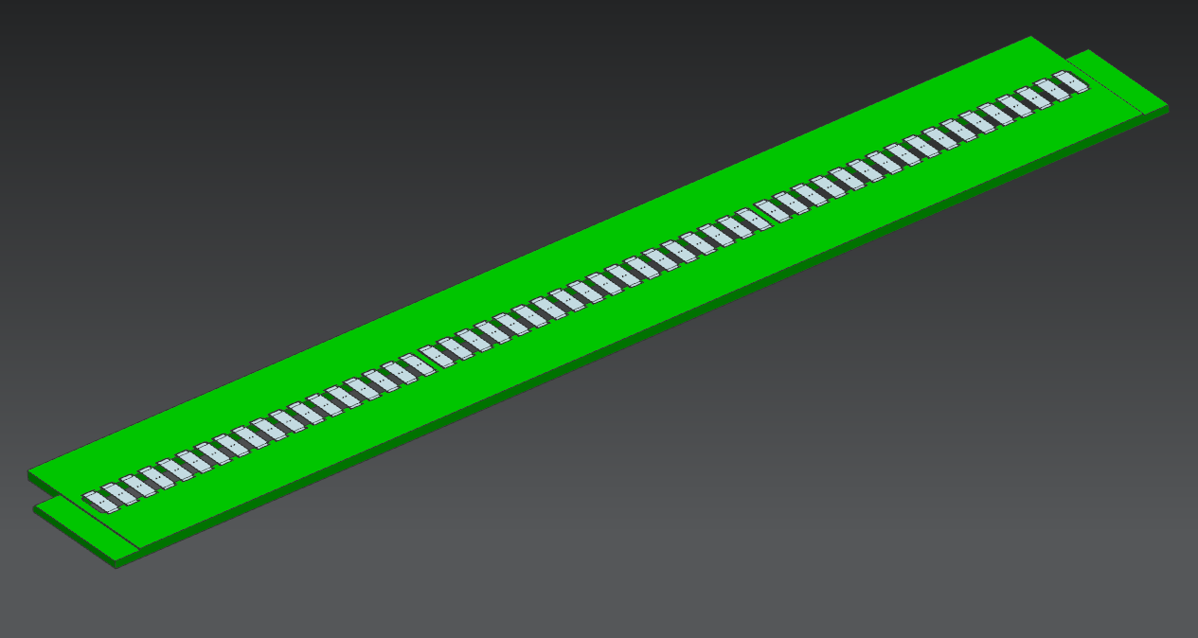
Laser Welding Setup
Positioning electrodes on fixture

Slide 31
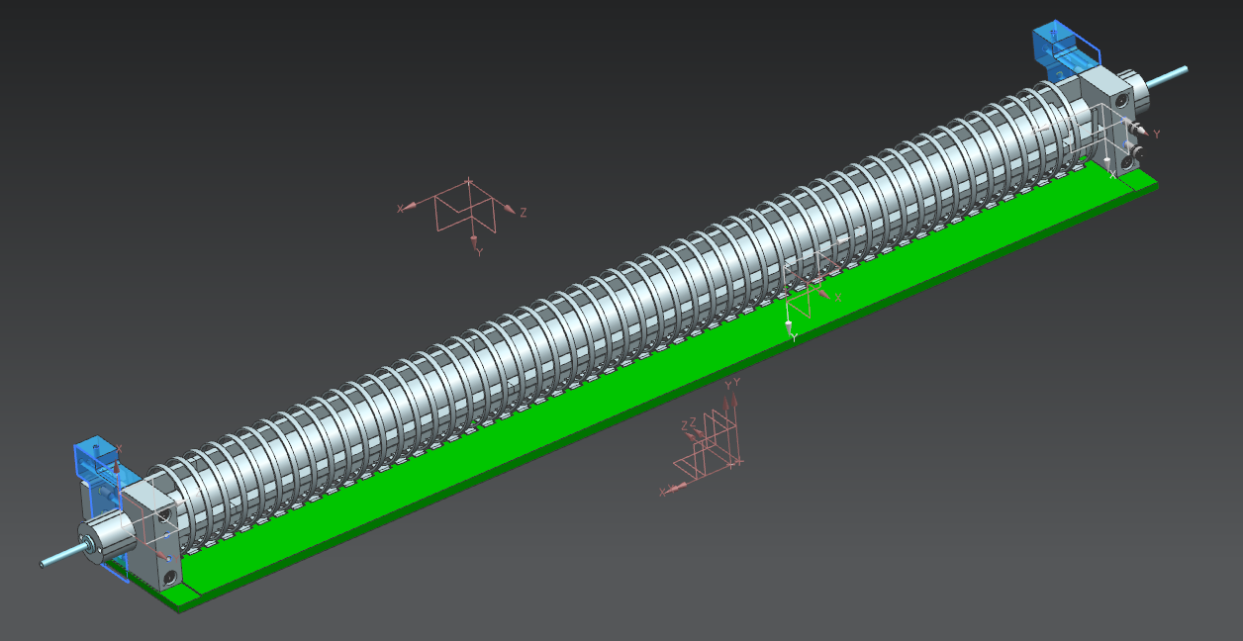
Laser Welding Setup
Positioning Helix on fixture
Check again for any excess epoxy on the top of helix conduct where it contacts electrode, remove any excess with knife

Slide 32
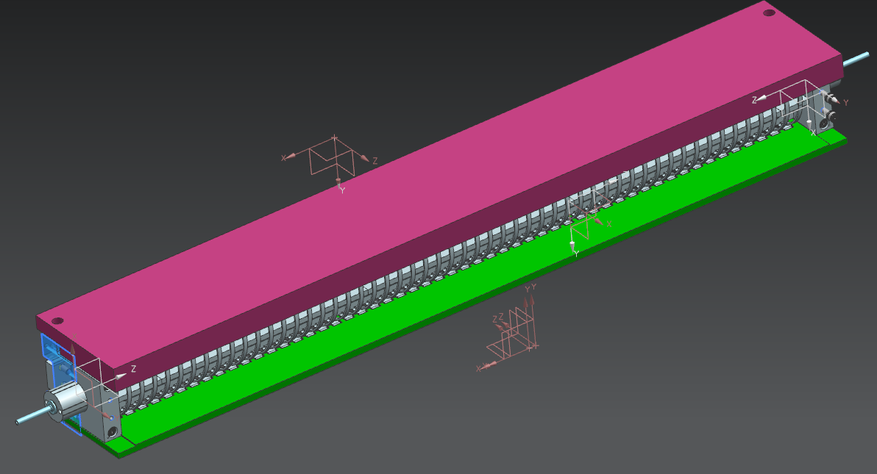
Laser Welding Setup
Adding the Strongback

Slide 33
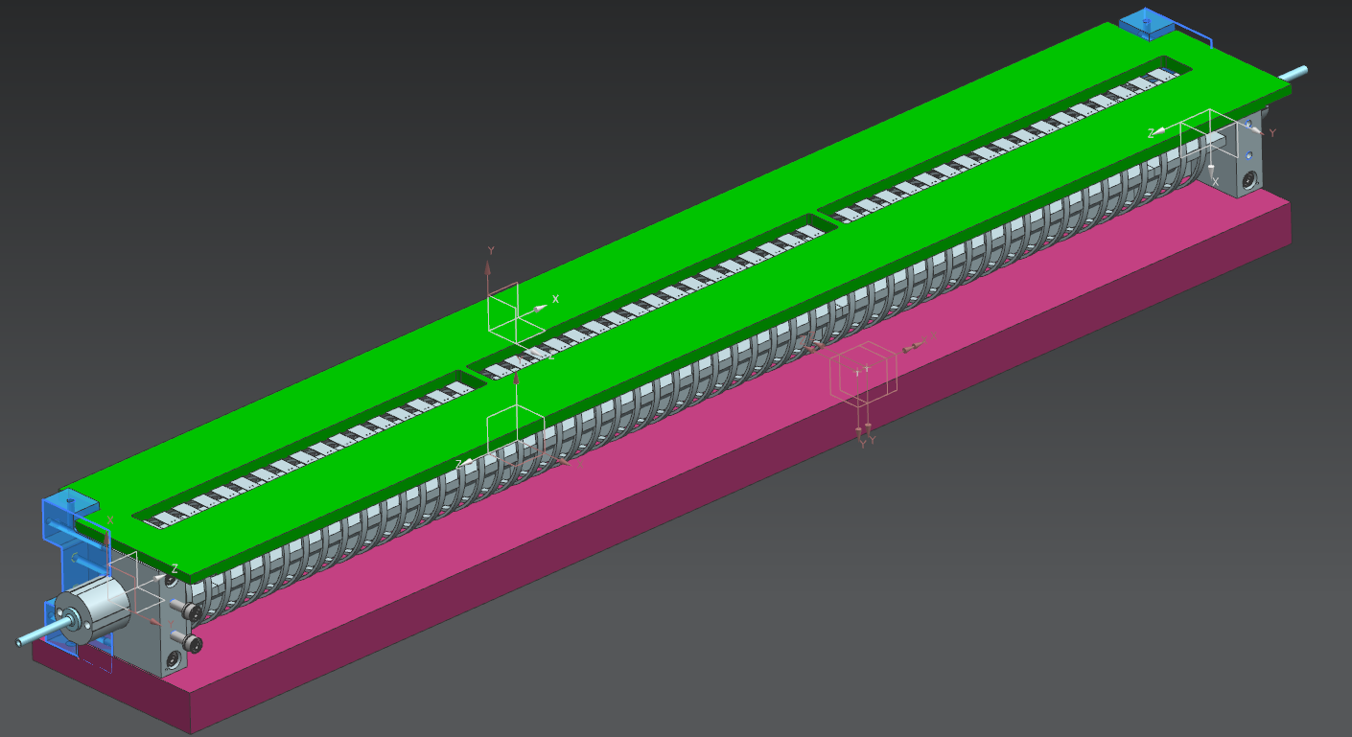
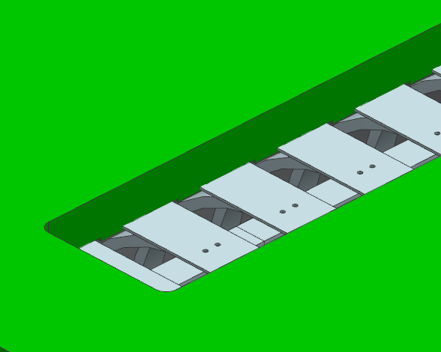
Laser Welding Setup
Ready for Laser welding
Check all electrodes to be within their pockets,
Check holes on flat portion of conduct
Check “no gap” in between electrode and helix

Slide 34
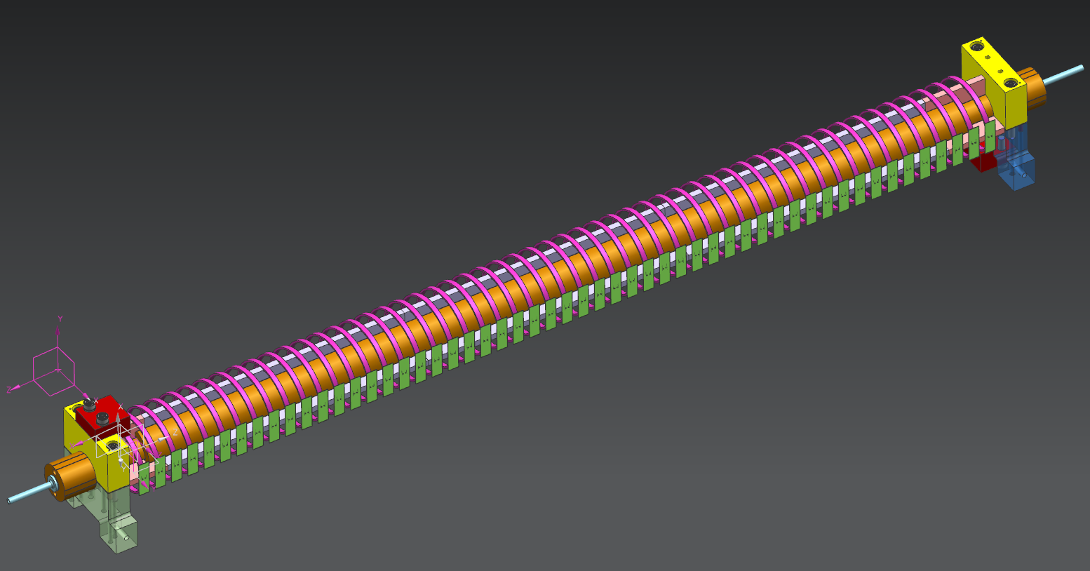
Helix with Electrodes

Slide 35
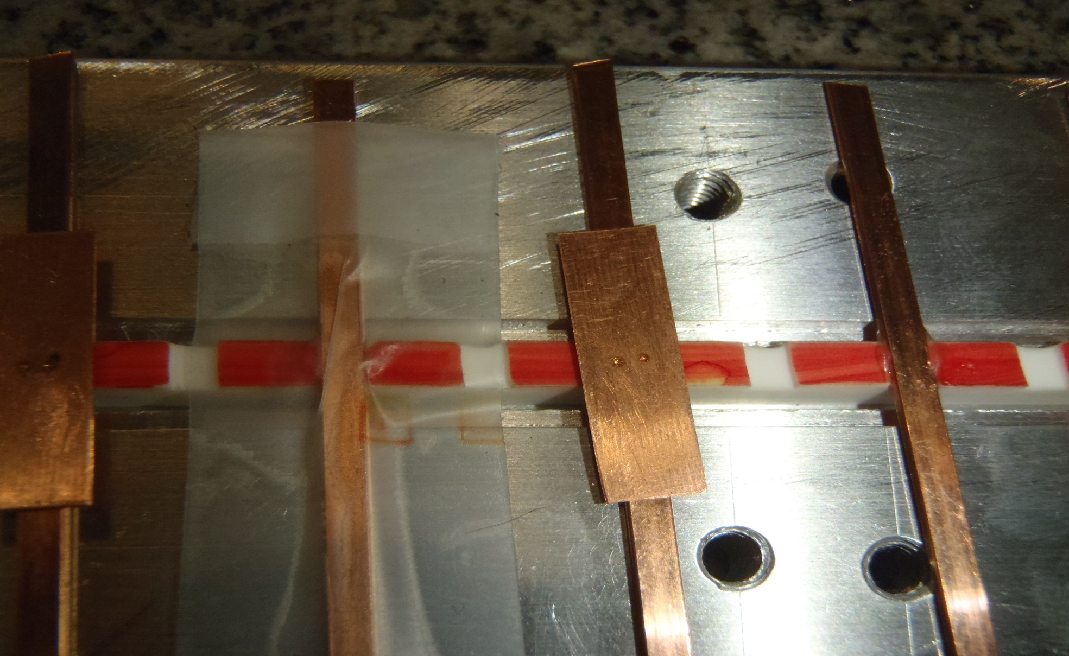
Laser Welded Electrode
Test piece
2 point laser welding
0.02” dia.
Vacuum grade epoxy, remove any excess that will create gap in between electrode and helix conduct

Slide 36
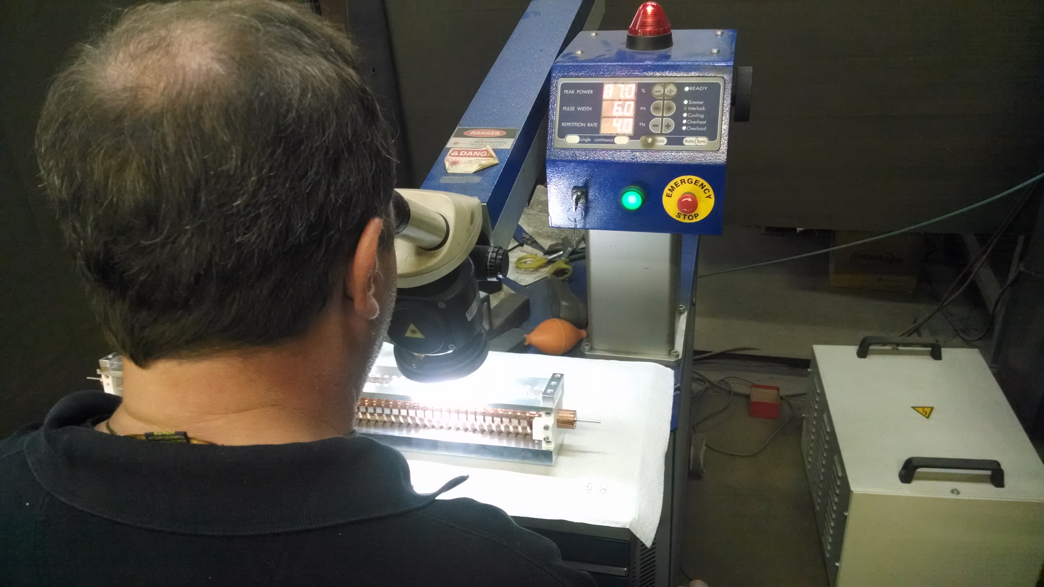
Laser Welded Electrode
2 point laser welding
0.02” dia.
Inspection and
Align for laser
Adjust gas (Argon) nozzle into welding area
Vacuum grade epoxy

Slide 37
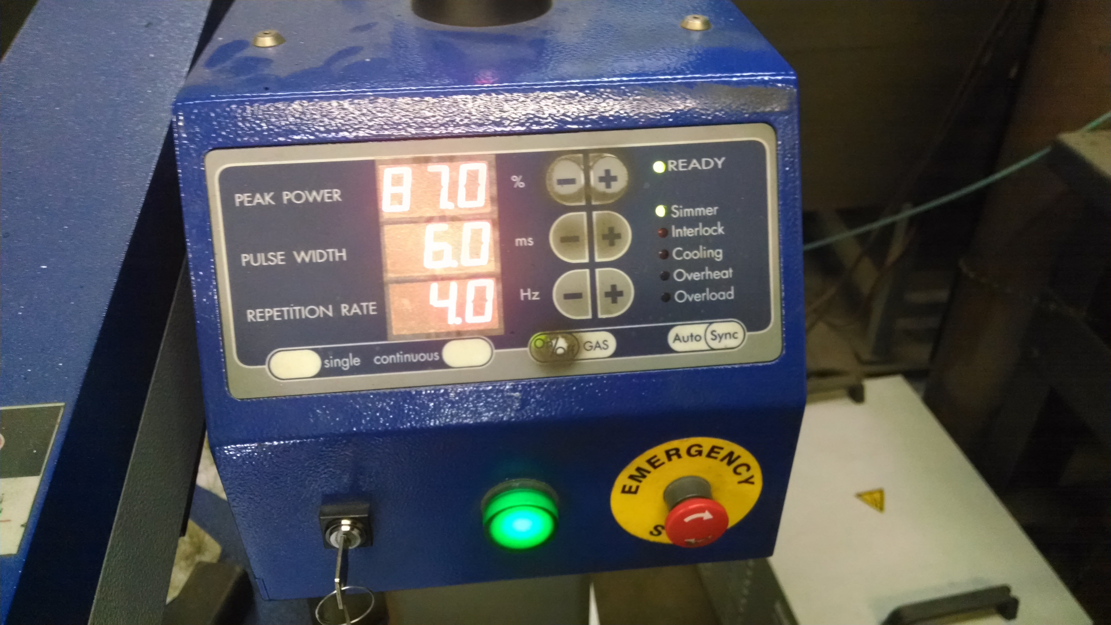
Laser Welded Electrode
2 point laser welding
0.02” dia.
Typical setting
Vacuum grade epoxy

Slide 38
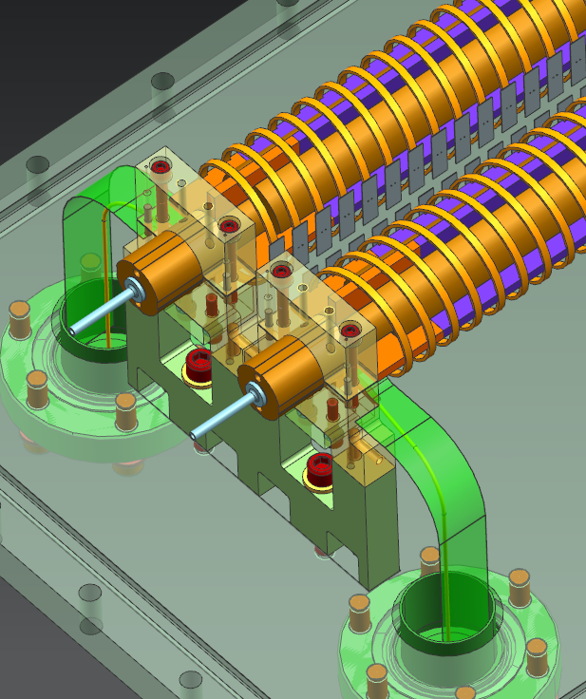
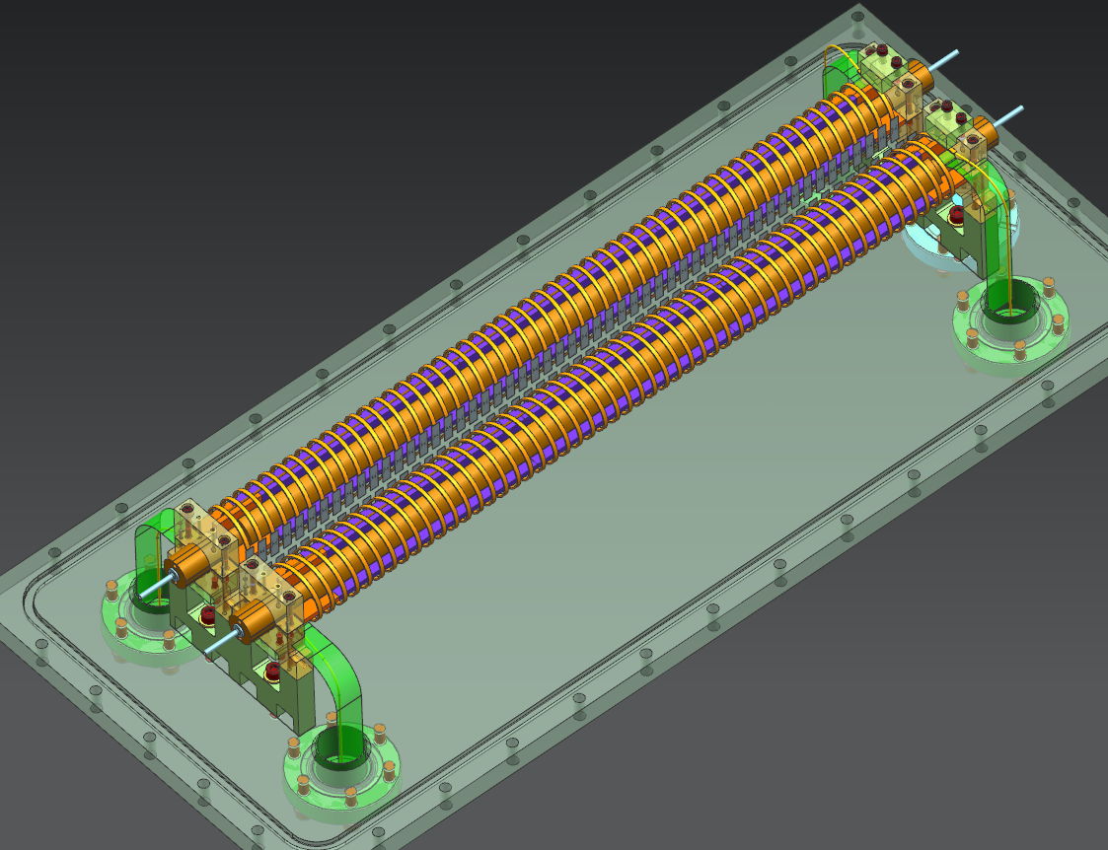
Assemble Two Helixes on Base Plate

Slide 39
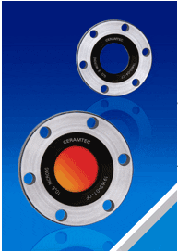
Measurements of the helix temperature
Suggestion: use a thermal imager, available at EE support (Bob Brooker)
  Fluke Ti32
  temperature range -20°C to +600°C; spectral range 8 to 14 µm
Requires a ZnSe window (0.55 – 18 µm)
  For example, from CeramTec
Check of calibration
  heat up the helix in vacuum with a DC current, using the helix resistance as indication of temperature
  Measure with imager
  Repeat with RF heating

Slide 40
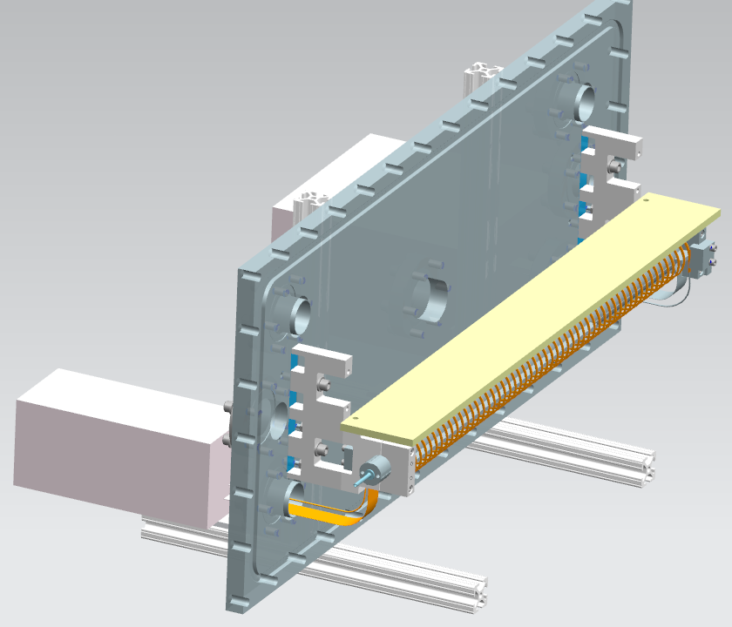
Bench Test Setup
Driver
Load

Slide 41
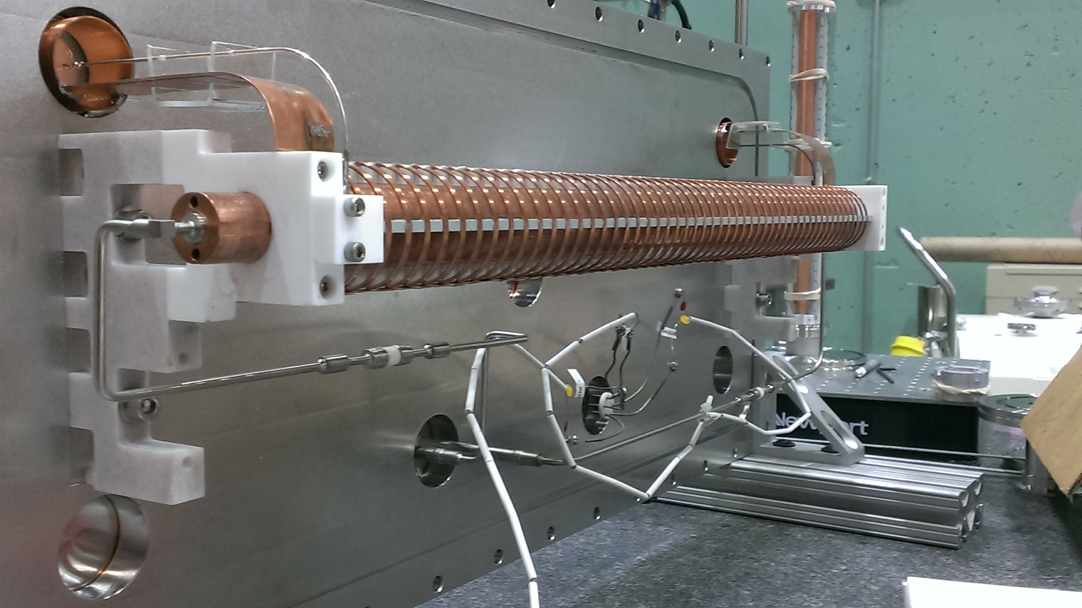
Bench Test Setup

Slide 42
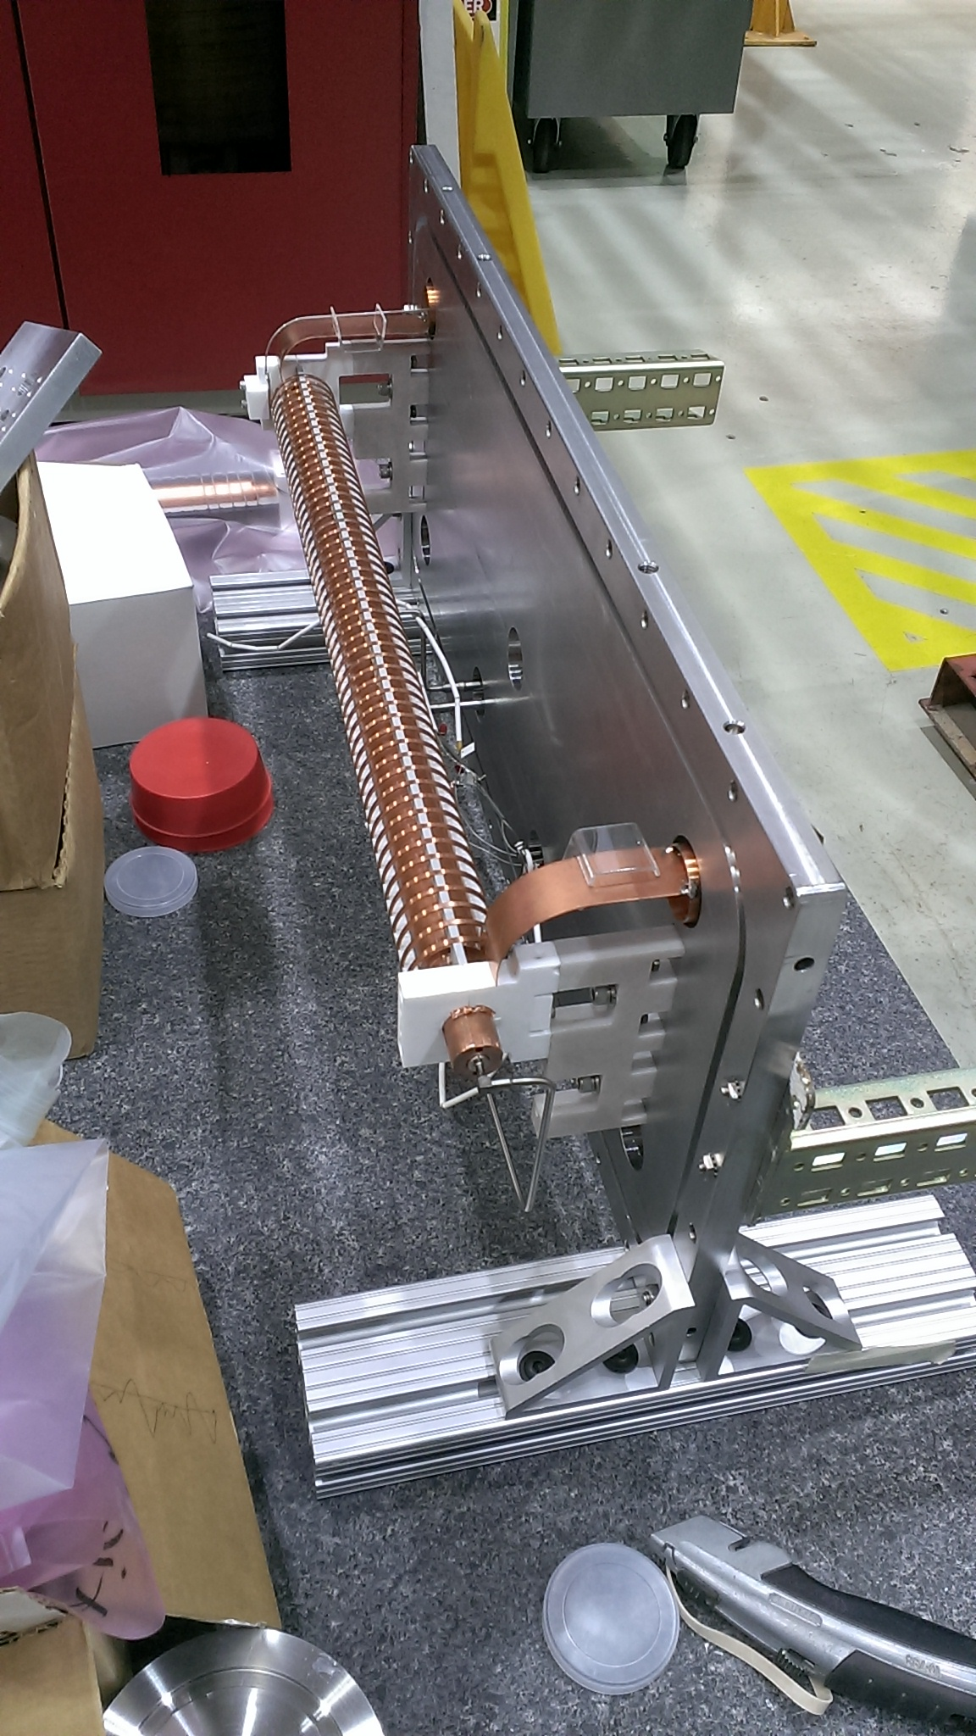
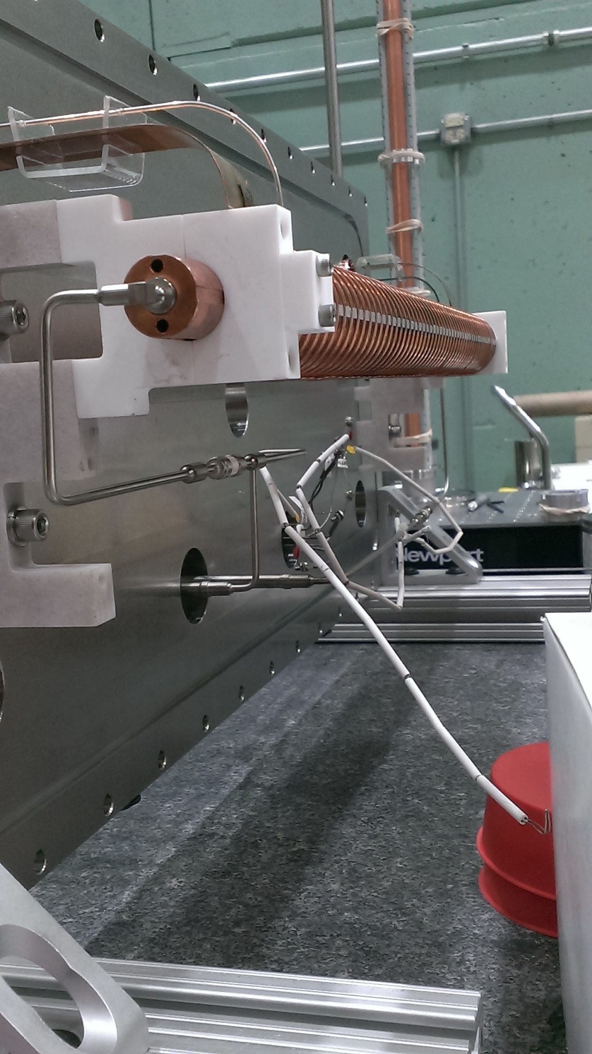
Bench Test Setup
Load

Slide 43
Vacuum
Seals:
  metal seals at feedthroughs on SS base plate
  Brazing and welding on water cooling line
  O-Ring on Al Vacuum Box with total permeation 8e-7 torr.l/s
4 ½” Port for IP 100 l/s Pumps to achieve mid E-8 torr without beam
UHV handling with cautiousness of Low Particulate environment

Slide 44
RGA results (1)
Residual gases are Hydrogen, Water, and Air
Hydrocarbons are very low, more than 3 decades below.
N₂

Slide 45
RGA results(2)

Slide 46
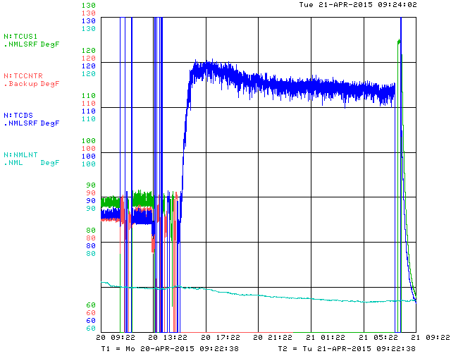
Thermal Test: Temperature Rise (in air)
Power Off
Water Cooled
Water Stop
Water @85F
~50F rise
Room @67F
~4F rise
Vast majority of heat conducted into water

Slide 47
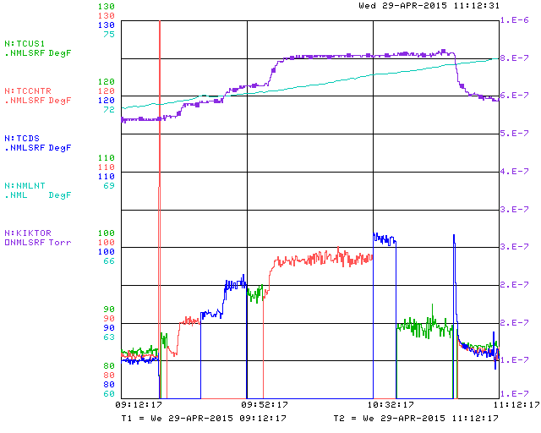
Thermal test: Temperature Rise (in vacuum)
30A
25A
OFF
20A
Helix
Water@86F
G. Tube

Slide 48
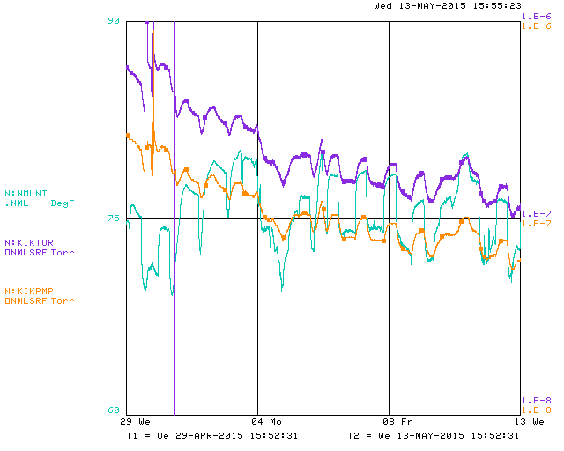
Vacuum improved over 2 wks
Ambient T
Gauge
Ion Pump

Slide 49
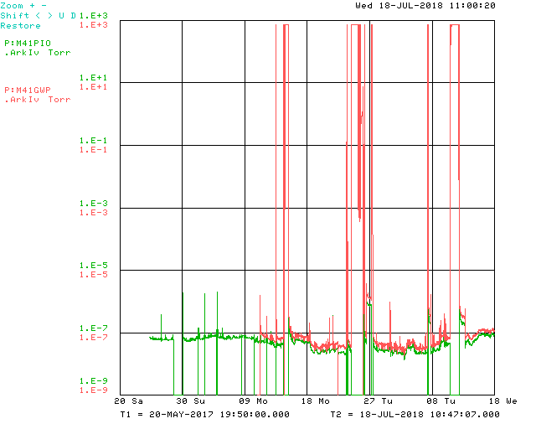
Kicker Vacuum in Operation
Gauge and Ion pump readings during May 20, 2017-July 18, 2018

Slide 50
Thermal Estimates
Q=46 watt (40 beam + 6 electrical)
Over 48 (electrodes + turns)
Heat each turn q=46/48=.9 watt
∆T = 11.6 °C for Photoveel II with 10% Cu-Ceramic Contact
Instant temperature rise due to 20J beam loss
∆T=3.1 ° C (uniform on 48 electrodes)
∆T=150 ° C (on single electrode)
Water temperature rise 1.8°C with 0.1 gpm flow rate

Slide 51
Thermal Estimates
Thermal Caculation on Greg's Kicker
 |  | Dimmenssions |  |  | Material Property
 |  |  |  | mm | thermal conductivity |  | conductance per pitch |  | resistance
ceramic strip |  | width | length | height | w/(m.K) |  | w/K |  | K/w
 | inch | 0.125 |  | 0.185
 | mm | 3.175 | 500 | 4.699 | 50 |  | 0.28581 |  | 3.50
copper wire | inch | 0.105 | 1.180 | 0.042 |  |  | conductance per quart turn
 | mm | 2.667 | 29.98 | 1.067 | 385 |  | 0.0365 |  | 27.4
coil |  | pitch (mm) | diameter(inch) |  | turns
 |  | 8.46 | 1.503 |  | 48
Heat(watt) | total resistance per turn |  |  | contact |  | DT (K)
46 | R for 4 contacts | 2.6 |  | 100% |  | 2.5
 |  | 4.3 |  | 50% |  | 4.1
 |  | 7.7 |  | 20% |  | 7.4
 |  | 12.1 |  | 10% |  | 11.6
 | R for 2 contacts | 15.436 |  | 100% |  | 14.8
 | C for 2 contacts | 0.06478
flow rate of LCW (gpm) | 0.1
dT of water in C | 0.0
electrode volume (mm3) | 38.7
density (g/cm3) | 8.96
mass (g) | 0.35
specific heat (j/gk) | 0.385
instant heat (J) | 20
instant dT uniform | 3.12
instant dT on single | 149.8
DT between electrode and ground tube
Photoveel II

Slide 52
Thermal Estimates
Macor

Slide 53
QA/QC
Visual inspections on receiving, during assembling
tests
  Vacuum,
  pressure
  thermal

Slide 54
Summary
FRS has been met on prototype
Drawings and procedures established
Prototype fully tested

