Slide 1
PIP2 MEBT Kicker Review
Greg Saewert
Chopper Review Meeting
2 August 2018

Slide 2
Outline
Requirements overview & system design approach
Challenges
Design details
Electrical performance results
Issues to be addressed

Slide 3
Kicker Requirements
Kick individual bunches (bunch-by-bunch)
Rise/fall time 4.0 ns (5-95%) maximum between bunches
This leaves 2.15 ns flattop to both kick and pass
Kicking scheme
+/- 500 V to kick beam out, 0 V to pass
Kick an arbitrary pattern for Booster delivery (at 20 Hz)
45 MHz average switching rate during 550 μs macro-pulse
0.5 MHz overall average switching rate
Beam test modes
81.25 MHz switching rate for 10’s of μs, at 20 Hz
Any arbitrary pattern having switching rates <81 MHz and <0.5 MHz average

Slide 4
Kicker System

Slide 5
Overview – the Helix
Dual 200 Ohm helical, traveling wave structure
200 Ω (as opposed to typical 50) lowers drive current and power making fast switching conceivable
<<10 Watts RF skin effect losses in the vacuum
Symmetric and broadband structure
Potentially low internal reflections
Thermal design
~0.1 gpm water-cooled ground tube for 40 W beam loss
Includes protection electrodes
Challenges
Match propagation to beam velocity
Reflections
Discontinuities between helix, 200 Ω strip lines and load
Frequency dependent effect (referred to as “dispersion” )
Cause: inter-winding coupling and winding capacitance to ground

Slide 6
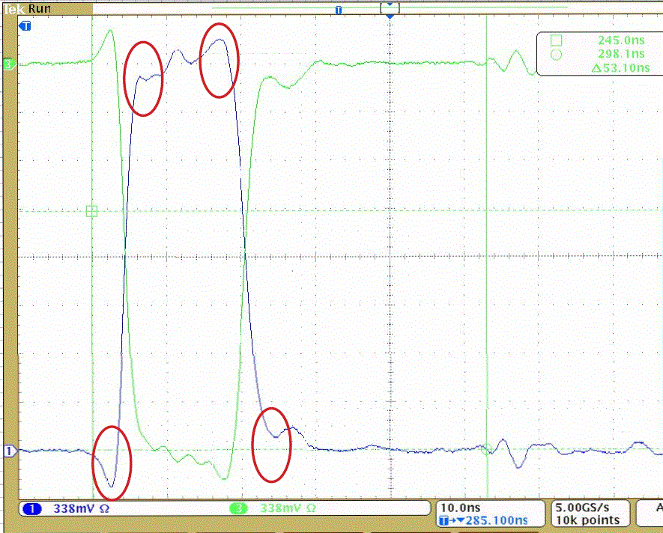
“Dispersion” Effect
Low-side Switch Pulse
Low-side Switch Pulse
“Dispersion” effect is circled in RED
Influence on the beam is an integration: ½ of the peak voltage shown
“Dispersion” effect
circled in RED
High-side Switch Pulse
High-side Switch Pulse

Slide 7
Addressing the Helix Design Challenges
Propagation time is matched to beam beta by a tuning procedure
Both prototype helices were tuned to -0.5% of ideal
Reflection issues
Microstrip lines in and out are designed for 200 Ohms
Feed-through to strip line to helix reflections are low
Helix low impedance end-effects cause reflections
Coupling between windings raises strip line impedance from ~140 to 200 Ω … but the turn at each end lacks the coupling
Modeling used to find suitable compensation scheme
Ground tube stepped 1-turn, both ends, raises impedance
Reflection reduced about 30%
Load reflection can be compensated with small series inductance
Switch-driver close to feed-through (and no coax) reduces reflections
Dispersion effect reduction
Helices are located away from ground surfaces by 1.75”
Helix dimensions were chosen to be slightly faster than beam beta
Adding inter-winding capacitive plates provides compensation
Compensation decreases dispersion and increases propagation time
Integrated value of dispersion voltage peaking reduced to <5%

Slide 8
Overview – Helix Drivers
Kicker drivers are fast switches
One single-switch driver per helix, opposite voltage polarity
Apply ±500 V to kick beam out, 0 V to pass
Switches are series-connected FETs to share switching losses
Total switch switching loss from Cds, 3 FETs in series:
$$3∗\frac{1}{2}Cds{(\frac{v}{3})}_{ }^{2}f=\frac{1}{3}∗\frac{1}{2}CdsV^{2}f (Watts)$$
Switch construction
Each switch fully isolated
Each FET is individually gated simultaneously
Driver design challenges
Switch on and off fast enough
Custom FET gate driver required for this switching speed
Determine FETs reliability to handle thermal cycling
Handling switching losses for Booster requirement
1 μJ switching loss per cycle – capacitive switching loss
45 Watts are dissipated per FET at 45 MHz rep rate

Slide 9
Addressing the Driver Design Challenges
Photonics laser and transmitter provides precision triggering
The generator signal gates laser
Splitters deliver triggering to all FETs simultaneously to photo detectors on each GaNFET driver board
Switching speed is obtained using GaN FETs (GaN Systems, Inc.)
GS66502B: 7 Adc, 15 A pulsed; 650 V; 20 pF d-s, 65 pF g-s
GaNFET driver circuit kept as small as conveniently possible minimizing parasitics
Custom FET gate driver circuit designed with operating margin
Turn-on time is settable to <2 ns
3-FET switches operate at 500 V above 90 MHz; and 81.25 MHz at 600 V
A Calibration procedure used to match FET timing
Both turn-on and -off delay are matched to +/-100 ps
Allowance remains for shifts due to time and temperature

Slide 10
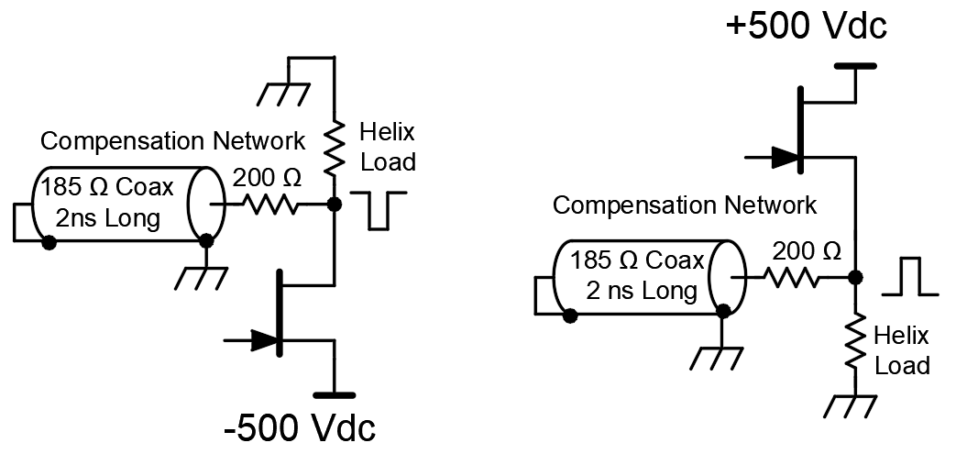
Addressing the Driver Design Challenges (cont.)
FET reliability test: 3-FET switch was operated for 4 months 24/7
500 V bias, 45 MHz for 550 μs at 20 Hz (Booster ave. switching rates)
No evident timing variations
Demonstrates GaN FETs are not overly stressed
Turn-off time reduced to <4 ns with compensation:
500 V on the plate assumes 100% efficient kicker
Helices are 95-97% efficient
3 V drop in the switch
Required bias voltage is ~528 Vdc
Our present limit is 500 Vdc bias voltage
High-Side Switch
Low-Side Switch

Slide 11
Helical kickers
Load
Compensation
Water
Line
200 Ω Strip
Lines

Slide 12
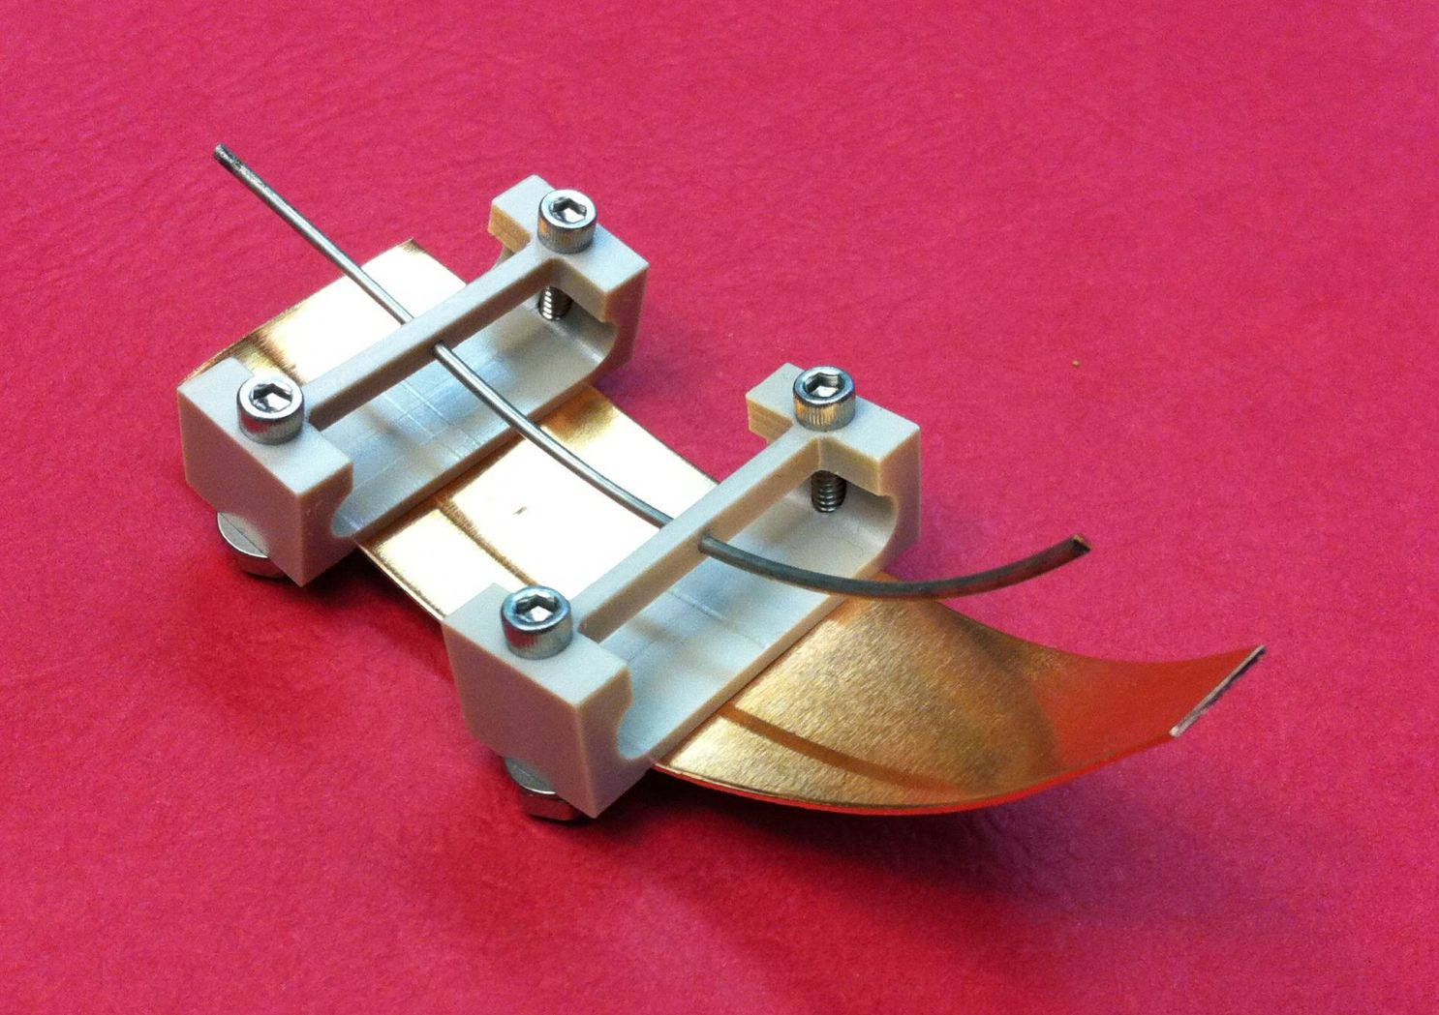
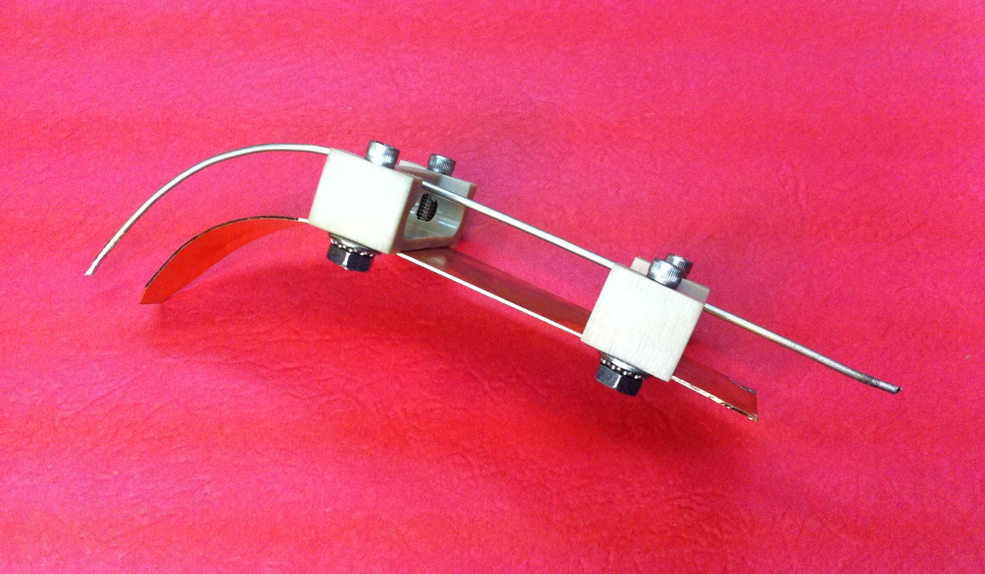
Dual-Helix Assembly
Dispersion compensation:
capacitive plates
Strip line Construction

Slide 13
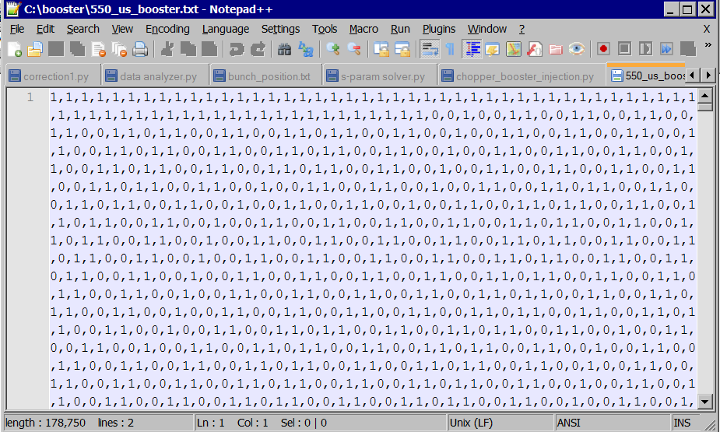
LLRF’s Arbitrary Waveform Generator
1’s/0’s in a file define kick/pass switching pattern are downloaded to the Generator
Phasing as well as turn on/off edge adjustments can be set with ~40 ps resolution
The arbitrary 550 μs Booster pattern was used at PIP2-IT:
The File
The Arbitrary Kicking Pattern

Slide 14
Electric to Fiber Transmitter & Switch
-600 V Switch
Photonic transmitter
1550nm optical pulses
Temperature controller
Photonic
receiver
Driver
& FET
200V
6 dB
Optical
Splitter
Laser
Semiconductor
Optical Amplifier
3 dB
Optical
Splitter
Photonic
receiver
Driver
& FET
200V
Electrical
pulses
Laser optical
power
controller
Photonic
receiver
Driver
& FET
200V
SOA Driver
To the + 600 V splitter and switch
ARB Pulse
Generator
RG-114 coax
-600 V
LLRF
To the kicker’s lower helix

Slide 15
Photonic Transmitter Chassis
Photonic transmitter:
0.6 V TRIGGER INPUT
1550 nm OUTPUT

Slide 16
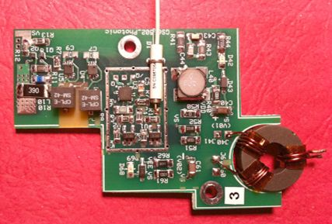
GaNFET Driver Circuit
GaNFET Gate Driver
Detector Stage
Delay Tuning Stage
Common source +
source-follower circuit
Photo detector
1 GHz opamps: gain (x2)
280 MHz comparator
Turn-on &
Turn-off
delay adjustment
GaNFET Driver Circuit PCB
Shields not installed
size: 2.5” x 1.75”

Slide 17
GaNFET Driver Circuit: AC/DC Power
3.5 V, 500 kHz AC in
3 Well-regulated DC voltages out

Slide 18
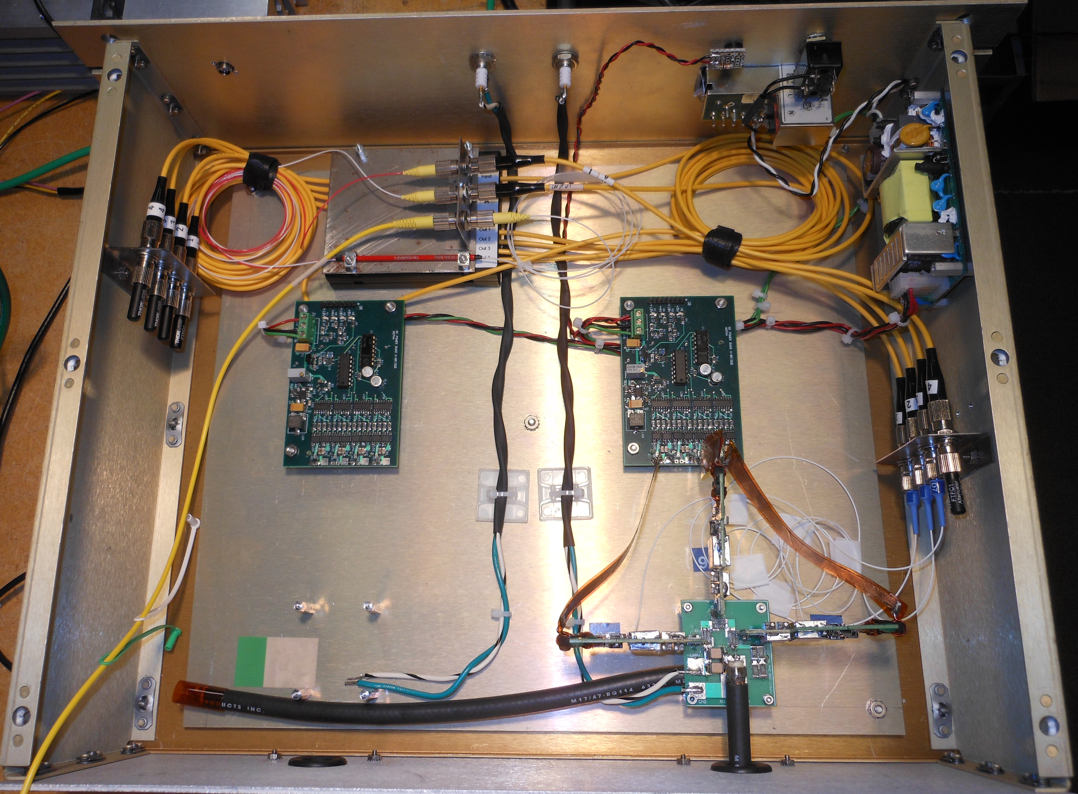
The Switch-Driver Chassis (Photonic Gate Version)
This Version has two switches +/- 600 Volts, in one chassis. Coax cables connected outputs to the feed-throughs.
Driver Cards
185 Ohm Coax Out
FETs
(3)

Slide 19
Driver as installed now in the MEBT

Slide 20
Driver as installed now in the MEBT

Slide 21
First 200 Ohm Chopper Installed at PIP2-IT (Transformer Gate Version)
Drivers
185 Ω Loads
Assembly shown similar to intended final version
Switch Driver assembly bolted to the helix plate

Slide 22
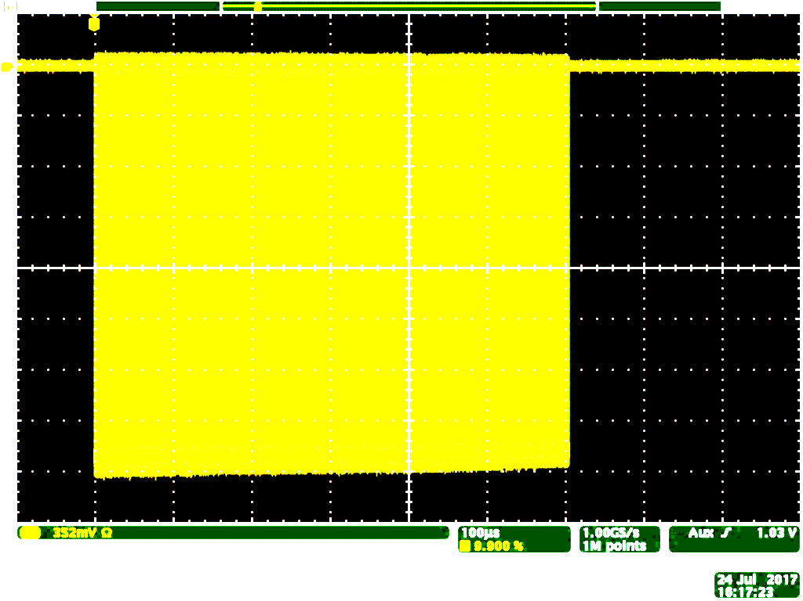
Switch performance
Switching at 81 MHz, 10 us bursts:
600 Vp-p, 4 ns / div
Switching at 45 MHz average rate for 600 us:
600 Vp-p, 100 us / div

Slide 23
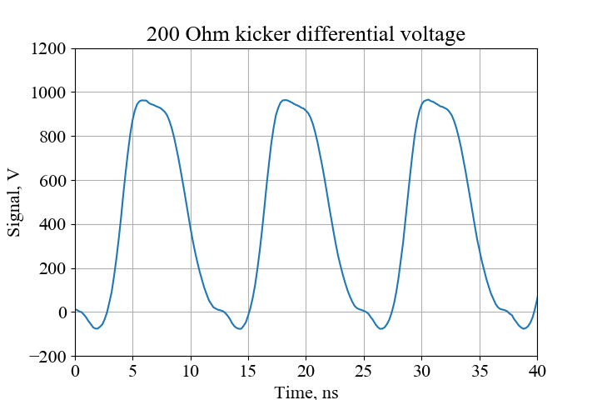
±500V Bias at 81.25 MHz, 20 Hz Repetition Rate
Photonics triggered driver version as operated at PIP2-IT
Individual Helix Waveforms
Differential voltage

Slide 24
±500V Bias, Arbitrary Pattern

Slide 25
Switching 1100 V, 45 MHz for 600 μs at 20 Hz
Transformer-triggered Switches
Upper Helix
Lower Helix
Difference Voltage
Simulated beam bunches
Vertical
≈ 220 V /div
Horizontal:
100 μs /div

Slide 26
Switching at 81.25 MHz, ±600 V; kick every other bunch
Transformer-triggered Switches
Through-voltages
+600 V
Upper Helix
-600 V
Lower Helix
+1200 V
Difference Voltage
Simulated beam bunches
Vertical
≈ 220 V /div
Horizontal:
10 ns /div
Amplitudes are consistent up to 40 μs bursts at 81.25 MHz

Slide 27
Switching at 40.625 MHz, ±600 V; kick 2 pass 2
Transformer-triggered switches
Through-voltages
+600 V
Upper Helix
Lower Helix
-600 V
Difference Voltage
+1200 V
End of pulse train
showing low reflections
Vertical
≈ 220 V /div
Horizontal:
20 ns /div

Slide 28
Remaining Design Issues – all straight forward
Design MEBT Kicker instrumentation interface
Upgrade GaN FET gate driver stage
Improve GaNFET PCB layout
In-line not in a loop
Mount switch driver circuits against the feed-throughs
No coax
Design mechanical mounting
Drivers
Loads
Address operating voltage limitation
Operating voltage now limited to 500 Vdc

Slide 29
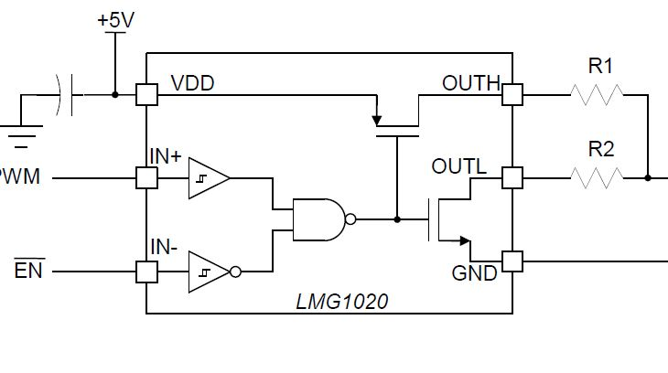
Upgrade GaN FET Driver Stage
GaNFET Gate Drive Stage
Detector Stage
Delay Tuning Stage
LMG1020 GaN FET Gate Driver
0.4 ns Trise/fall into 100pF
1 ns pulse width
7A source, 5A sink currents
60 MHz CW rep rate
Eliminates inductor performance compromise
Circuit power reduced from 1.25W to 0.1W
Forced-air cooling needed to prevent turn-on and –off timing shifts
Enables reducing PCB size & decrease Driver Circuit parasitics-to-everything

Slide 30
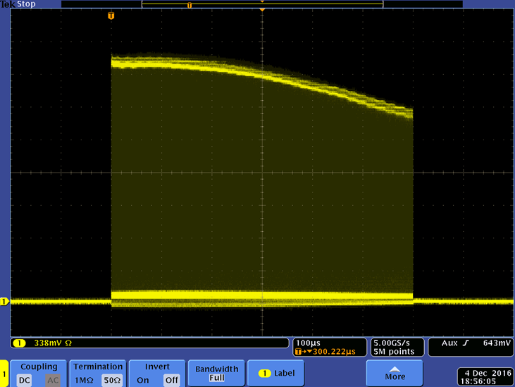
Operating Voltage Limitation
Problem is an average power dissipation issue
Operating voltage envelope sags during the 550 μs
FET gate threshold voltage is temperature dependent
Junction temperatures are not matched
FET timing diverges at junction temperatures about 70 ºC (absolute)
Switches do not break; FETs recover

Slide 31
Cooling enhancement options for >530 V operation
5% added to 528 V = 550 V providing desirable margin
Option 1: build 4-FET switches instead of 3-FET
Total switch power dissipation remains roughly the same
Per-FET power dissipation would be less
Option 2: mount GaN FETs on AlO₂ ceramic substrate
Cost estimate is ~$1800 for 10 substrates
Option 3: improve cooling on existing G10 PCB
Increase air flow rate
Added small radiators on PCB bottom side

Slide 32
Summary
A 200 Ω kicker lowers power dissipation everywhere and made it possible to develop a switch-driver and achieve bunch-by-bunch chopping
Even for only Booster delivery with its 550 μs macro bunches, 0.5 MHz average rep rates
Current helix design will simply be replicated for two kickers
Both switch driver versions operated with beam at PIP2-IT demonstrated inherent multi-FET switch capabilities:
Switching speed to kick and pass bunch-by-bunch
Operation at and above 500 Vdc bias
To switch at Booster average 45 MHz switching rate
Operation at 81.25 MHz for 10’s of microseconds at 20 Hz
Photonic trigger system proved crucial
Allows delivery of the arbitrary waveform for Booster injection
Provides fine temporal adjustment of on/off delay as well as pulse width
4-month test proved GaN FET reliability despite junction thermal cycling
There are a number of options to improve cooling and allow operation >530 Vdc bias

Slide 33
Acknowledgements
Management
Sasha Shemyakin, et al.
Dan Wolff, Chris Jensen
Engineering contributions
Daniil Frolov
Alex Chen
Howie Pfeffer
Mohammed
Brian Chase
Technical assistance
Jeff Simmons
Kevin Roon
Dave Franck
Vendors
GaN Systems, Inc.
Gary James, elabinc@mtnhome.com
MPF Products, Inc.
JFW Industries, Inc.

Slide 34
END

Slide 35
Issues regarding high rep-rate multi-FET switch
Switching losses at megahertz rates dominate FET dissipation
Solution: transition faster (for example: well below 2 ns rise/fall)
Lowers FET dissipation
Increases difficulty of setting and maintaining synchronous timing match
Reality of mismatched FETs
FETs originally timed close (+/- 100ps)
Tuned for ~2 ns turn-on time (5-95%)
They will be sharing to a significant degree even if we can measure differences in temp.
GaN FET rating is 650V
They won’t break even if grossly mismatched (we’ve demonstrated this)
Mismatch problem is timing shift not thermal melt-down
Timing shifts occur at ~70ºC junction
How many FETs in series to use?
1 FET or 2 FETs not enough
3 or 4 both work
Real issue is to provide enough substrate cooling for average power

Slide 36
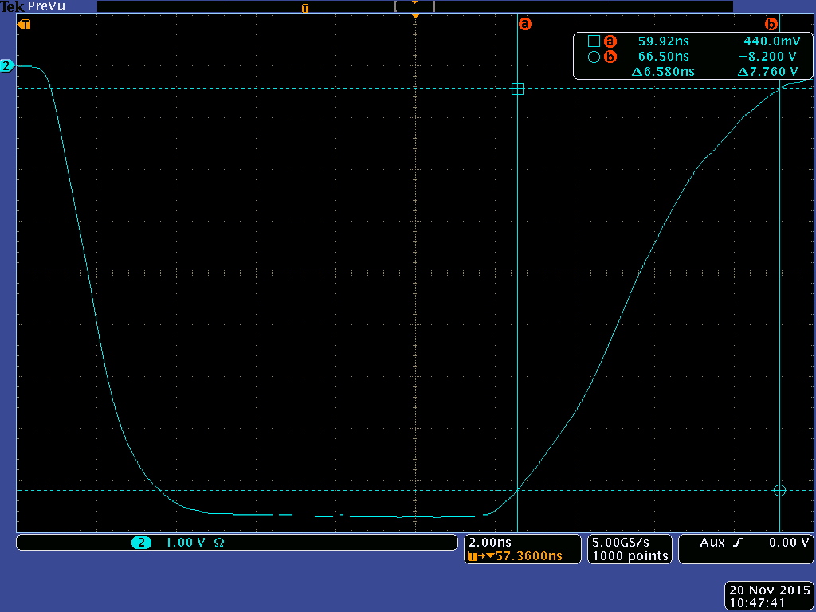
Switch turn-on/-off time difference without output compensation
Turn-on = 2.72 ns
Turn-off = 6.58 ns

