Slide 1
Kickers characterization with beam at PIP2IT
A. Shemyakin
Kicker review
2 August 2018

Slide 2
Outline
Requirements
Setup and measurement procedure
50 Ohm kicker measurements
200 Ohm kicker measurements
Conclusion

Slide 3
Requirements to kickers (recent version)
Bunch-by-bunch selection (of bunches separated by 6.15 ns)
  “Booster injection” pulsing (20 Hz x 0.55 ms)
  Un-needed bunches are removed; <0.5% left
  Requested bunches are passed with low emittance growth (<10%)
  Translates for the nominal beam parameters into
    Difference in deflection of passing and removed bunches: 7.4 mrad
      For bunch length 6σ =1.3 ns
    Jitter of passing bunches’ centroids <0.4 mrad
    Small variation of deflection along the passing bunch
Need to survive when a powerful beam goes through
  Beam tails; accidental beam shifts; etc.

Slide 4
MEBT-3 configuration
2 doublets + 7 triplets; 3 bunching cavities
  pair of dipole correctors after each doublet/triplet
Instrumentation:
  BPM in each doublet/triplet; 2 current transformers (ACCT) and dump; Allison scanner; Fast Faraday Cup (FFC); Resistive Wall Current Monitor (RWCM)

Slide 5
Drivers
50 Ohm kicker – RF amplifier tuned to 81.25 MHz
  The only way we found without buying wide-band PAs
  Pulsed or CW
200 Ohm kicker – fast switch
  Capable of forming an arbitrary pulse sequence
  Limited to ~500 kHz of average switching rate
    E.g. 20 Hz x 0.55 ms x 45 MHz (“Booster injection” pattern)

Slide 6
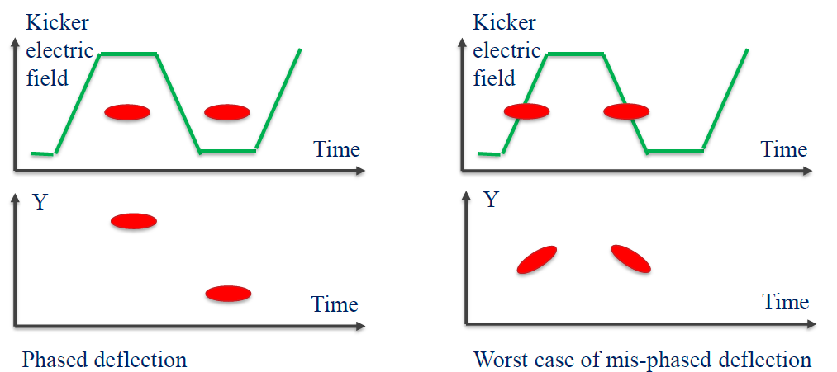
Kicker phasing
Tuning of delays to maximize bunch separation
  Done with 81.25 MHz waveforms, deflecting every other bunch
  Delay between the plate voltage signal and beam
  Also checked delays between upper and lower plates

Slide 7
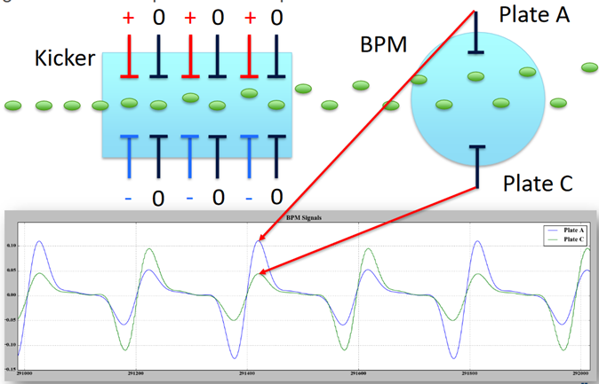
Phasing with scrapers and BPM
BPM signal + fast scope: bunch-by-bunch information
  Good for quick phasing; difficult to get separation in mm
Scraper profile: slow but gives also the value for separation
  Most of measurements were made with “flat” beam (heavily scraped in vertical direction with upstream scrapers)
(a)
(b)
Signal from vertical BPM plates and pictorial illustration.
D. Frolov.
F-scraper profiles for optimum delay (a) and shifted by 1.73 ns (b). 50 Ohm kicker. The fitted rms beam size is 1.15 mm, and the bunch separation is 8.2 mm (a) and 4.4 mm (b). Flat beam.

Slide 8
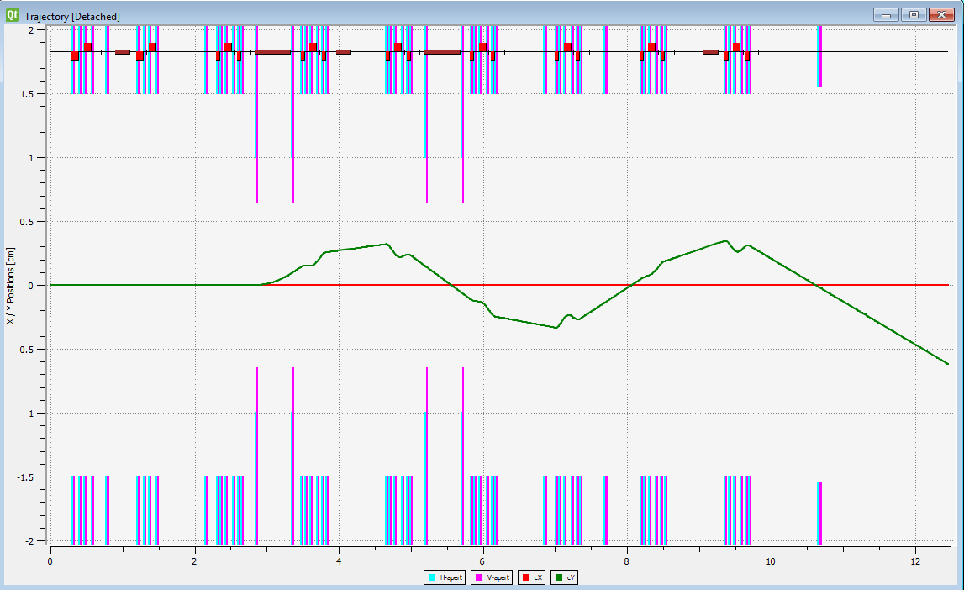
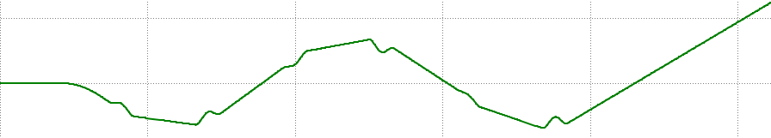
50 Ohm deflection measurement
Either by separation at F-scraper or with BPMs
  81.25 MHz voltage is applied to both plates of 50 Ohm kicker
50-Ohm kicker
F-scraper
Kicker on, Traj. 1 (1/2 of bunches)
Kicker off
Kicker on, Traj. 2 (1/2 of bunches)
A. Saini, L. Prost.

Slide 9
Phasing/deflection curve (50 Ohm kicker)
Nominal voltage = 250 V, +/-10 V drift over the duration of the measurements (a few hours)
Analysis with OptiM: the maximum deflection is 8.4 mrad
Bunch separation at the location of F-scraper as a function of the global delay.
L. Prost.

Slide 10
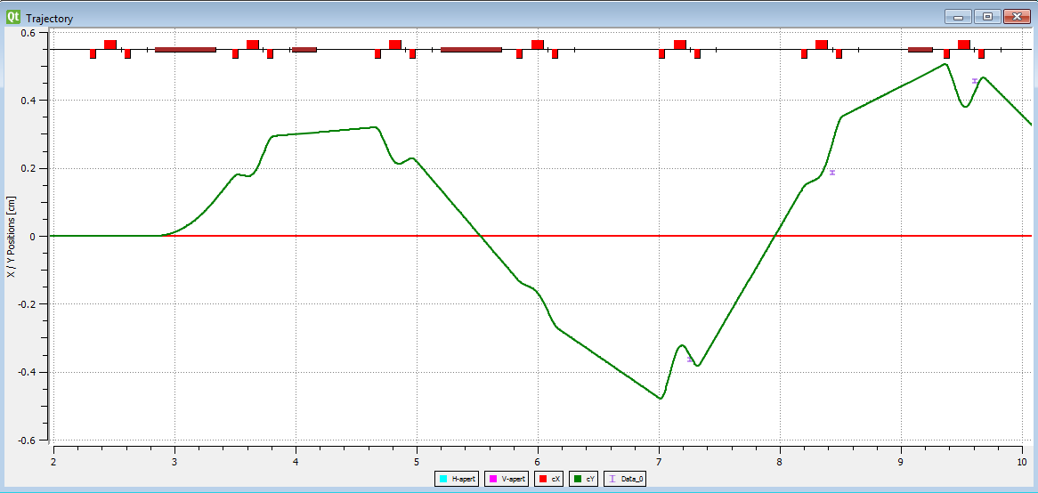
Measuring the kick with differential trajectory
  Record a trajectory with BPMs when the kicker is off
  Turn the kicker on with optimum phasing; remove one of set of deflected bunches with F-scraper
  Record the trajectory of remaining bunches; subtract the kicker-off trajectory; compare with OptiM
Fit corresponds to 8.8 mrad of deflection difference
OptiM fit to the differential trajectory.
L. Prost.

Slide 11
Discussion on 50 Ohm kicker measurements
Both measurements gave deflection values larger than specified, 8.4 and 8.8 vs 7.4 mrad
  Might be related mostly to uncertainties in knowing the optics at that time
    3 quad triplets and bunching cavity between the 50 Ohm kicker and F-scraper; even more for BPMs downstream
  Both amplifiers and the kicker structure allowed for even an larger deflection, but for the un-scraped beam it would result in scraping at the protection electrodes
Sometimes the voltage delivered by amplifier drifted at the level of ~10%, preventing more detail measurements

Slide 12
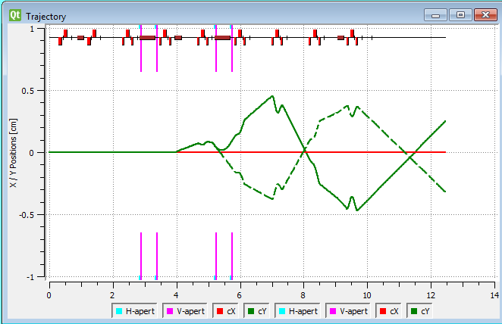
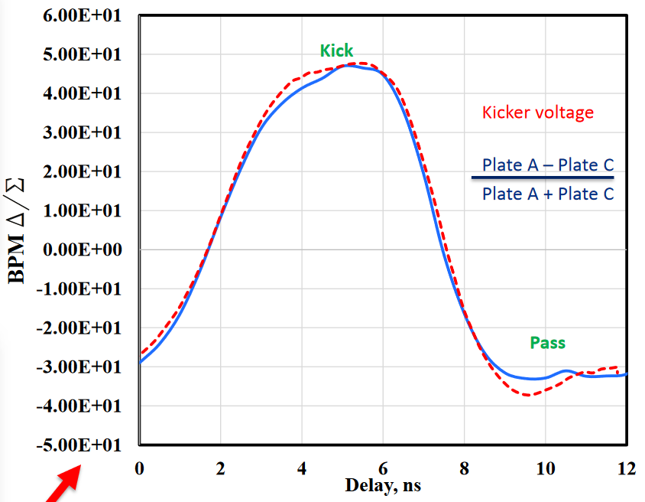
200 Ohm deflection measurement
Phasing was done in a manner similar to 50 Ohm’s
Measurements with F-scraper + OptiM: 7.0 mrad at 500 V
  Consistent with simulations (7.1 mrad)
  Max measured deflection is 7.7 mrad at 550 V
F scraper
Kicker off
Kicker on
Kicker voltage form and deflection vs time measured with BPM.
D. Frolov.

Slide 13
Effects on passing bunches
Because the kicker voltage changes slightly along the length of passing bunches, the beam emittance may grow. Effects:
  The beam centroid is deflected and oscillate with respect to the trajectory with the kicker off.
    If the beam line is tuned for un-perturbed beam, it appears as increase of the effective emittance.
  Different parts of the beam are deflected differently =>
    Transverse rms emittance increases
    Longitudinal tails contribute to growth of transverse tails (was not studied)

Slide 14
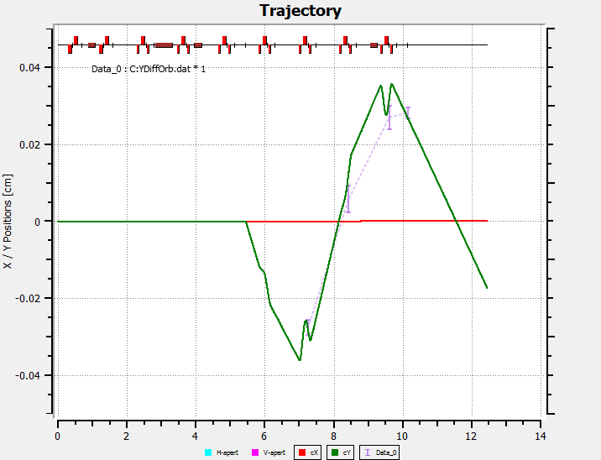
Centroid motion of passing bunches
The worse scenario is when only a single bunch is passed (measured with 81.25 MHz pattern)
  Deflected bunches are removed; trajectory of passing bunches measured by BPMs is compared with the case of the kicker off
  Fitting in OptiM gives 0.3 mrad
    Vs 7.7 mrad for deflected bunches
    For the un-scraped beam, would give 2% emittance increase
Comparison of trajectory of passing bunches with OptiM. 81.25 MHz; flat beam. A. Saini.

Slide 15
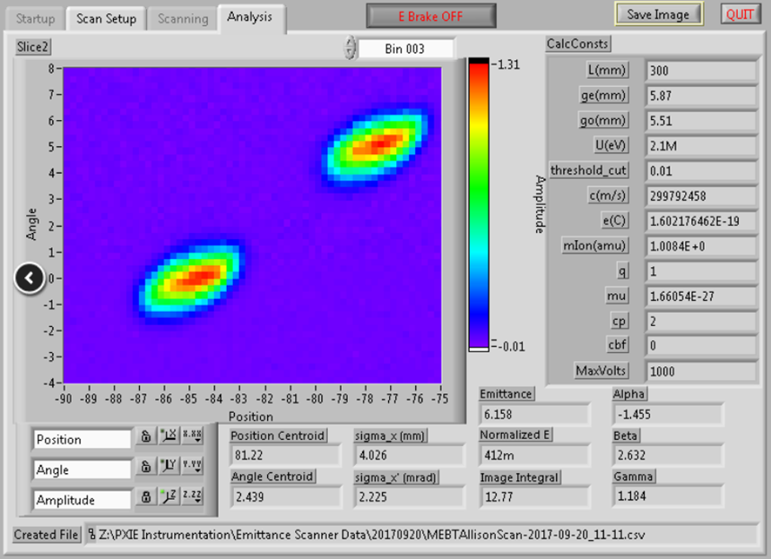
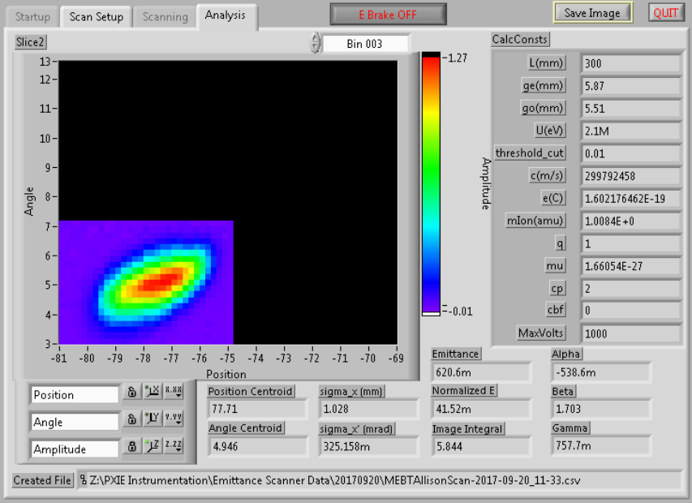
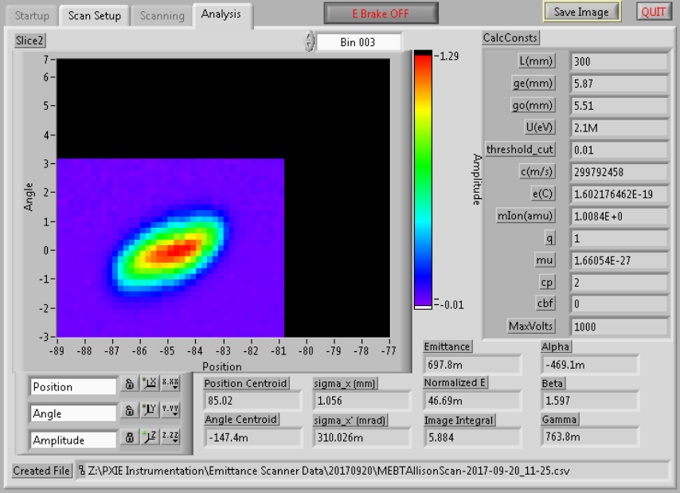
Effect on passing bunches
Before installation of Differential Pumping Insert (DPI), could pass both “passing” and “deflected” bunches to the end
  Emittance growth is unresolvable (equivalent <1% for full beam)
    Same for ±0.5 ns shifting
Deflected
Passed
Phase portrait with the kicker pulsing at 81.25 MHz. Scraping a 5.1 mA beam to a “flat beam” with 1.5 mA. 20-Sep-2017.

Slide 16
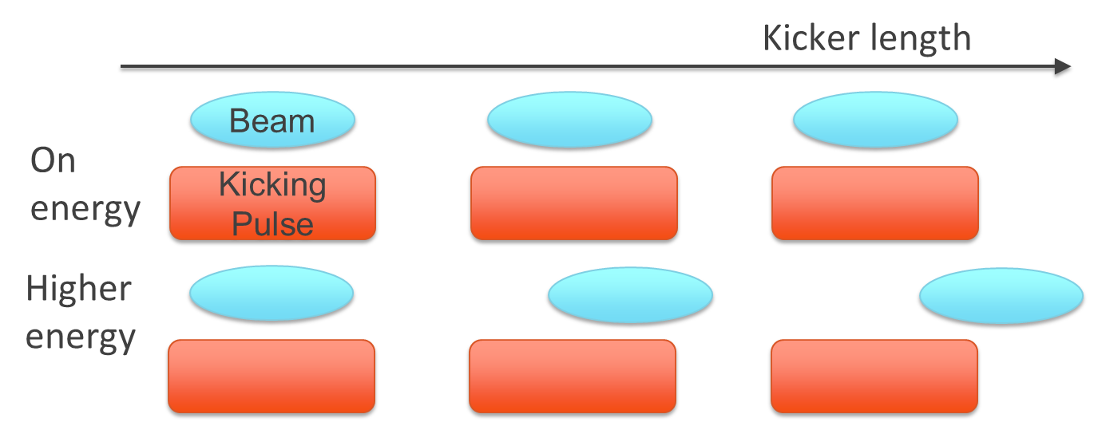
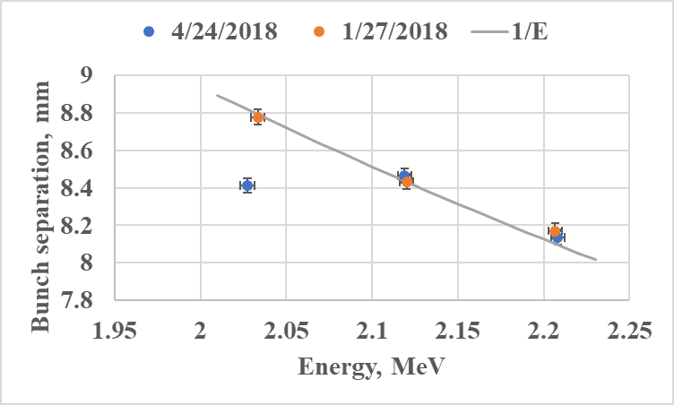
Verification of the phase velocity matching
Compared the deflection at different beam energies
  The energy was changed by ±86 keV using the bunching cavity upstream
  The dominant effect is 1/E increase of the deflection for lower energy => velocity mismatch is negligible
Bunch separation measured with the F-scraper vs beam energy. Two sets are measured at different voltage of the kicker plate power supply, with separation scaled to 500 V. The solid curve is 1/E dependence drawn through the point measured at the nominal energy.
C. Richard.

Slide 17
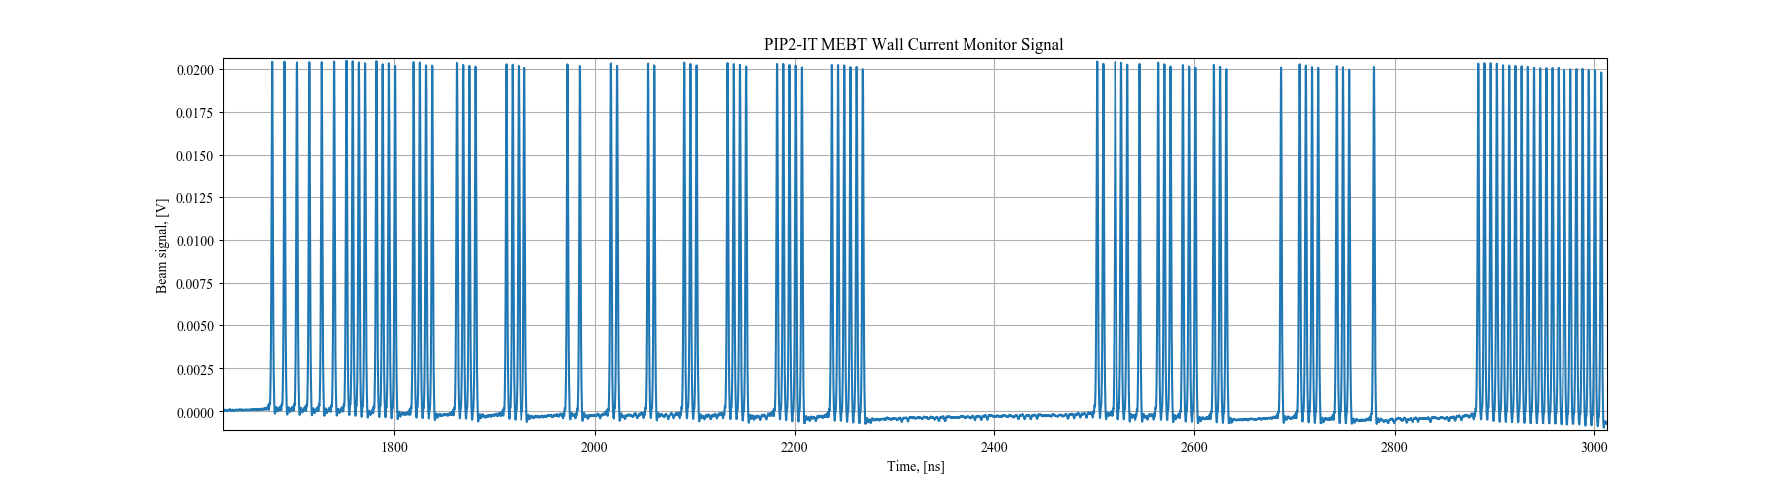
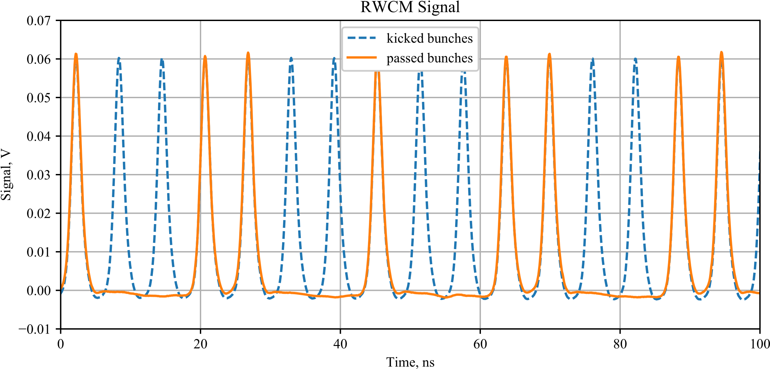
Arbitrary structure
200 Ohm kicker allowed forming a variety of bunch patterns
  Flat beam + scraping with F-scraper
  Examples: 81.25 MHz; “Booster injection pattern; “remove 10- pass 10”; randomly chosen sequence
Randomly generated bunch pattern.
Part of the RWCM signal recording the 0.55 ms Booster injection sequence (orange), superimposed over the signal when the kicker is off (blue). 1.1 mA flat beam. D. Frolov, G. Saewert.

Slide 18
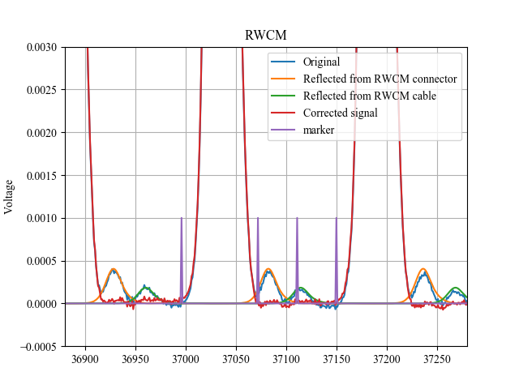
Two kickers working in sync
Bunch separation with nominal 5 mA beam
  In 81.25 MHz pattern, i.e. half of bunches deflected to F-scraper
  “standard” scraping upstream at ~2% level
  Analysis with Resistive Wall Current Monitor: extinction is <0.6%
RWCM signal of an initially 5 mA beam with two kickers operating synchronously at 81.25 MHz.
D. Frolov

Slide 19
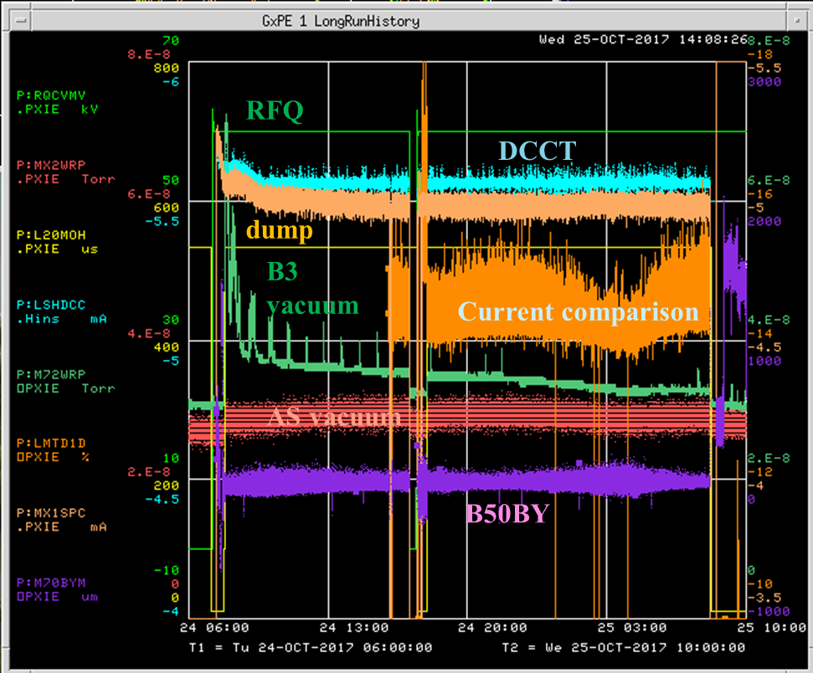
Tests with high-power beam
Passed beam through non-pulsing kickers with the average power up to 5 kW (50% duty factor)
“Booster injection” test – 24 hours
  200 Ohm kicker is pulsing with “Booster pattern”, 0.55 ms
  5 mA × 0.55 ms × 2.1 MeV × 20 Hz
Machine Protection System protected the kickers effectively by monitoring of the kicker protection electrodes’ currents .
24-hrs run. 0.5 mA/div for currents; 2%/div for current comparison; 2.E-8 Torr/div for vacuum; 1 mm/div for BPM.

Slide 20
Conclusion
50 Ohm kicker deflection was measured and found satisfying the specs.
  Disagreement with simulations is large but on the safe side
200 Ohm kicker was studied in more detail
  Deflection agrees with simulations. The maximum amplitude is on the border of the requirement when the kicker is at the Booster pattern.
  Growth of the rms emittance of the passing bunches is low
  No indication of phase velocity mismatch is found
  Arbitrary waveform capability is demonstrated
Synchronous operation of two kickers was demonstrated
  Extinction with the nominal beam might be an issue
    Presently resolution might be limited by the tool (RWCM)

