Slide 1
HL LHC CMS Detector Project: Outer Tracker
Steve Nahn
June 13th, 2018
Slides hastily recycled from recent CD-1 review, and augmented appropriately. Pardon the dust…

Slide 2
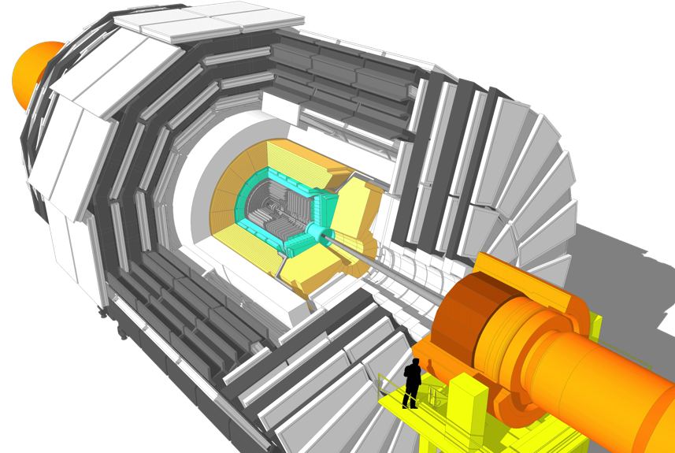

CMS HL-LHC Upgrade Overview
Barrel Calorimeter
New FE/BE electronics for full granularity readout at 40 MHz - with improved time resolution
Lower ECAL operating temperature (8∘C)
Trigger/HLT/DAQ
Track information in trigger at 40 MHz
12.5 µs latency
HLT input/output 750/7.5 kHz
Muon systems
New DT & CSC FE/BE electronics
New station to complete CSC at 1.6 < η < 2.4
Extended coverage to η ≃ 3
New Endcap Calorimeters
Rad. tolerant - High granularity transverse and longitudinal
4D shower measurement including precise timing capability
Beam radiation and luminosity
Common systems and infrastructure
New Tracker
Rad. tolerant - increased granularity - lighter
40 MHz selective readout (strips) for Trigger
Extended coverage to η ≃ 3.8
MIP precision Timing Detector
Barrel layer: Crystal + SiPM
Endcap layer: Low Gain Avalanche Diodes
Notes:
Circle your part of the upgrade

Slide 3
CMS HL-LHC Upgrade Overview
Barrel Calorimeter
New FE/BE electronics for full granularity readout at 40 MHz - with improved time resolution
Lower ECAL operating temperature (8∘C)
Trigger/HLT/DAQ
Track information in trigger at 40 MHz
12.5 µs latency
HLT input/output 750/7.5 kHz
Muon systems
New DT & CSC FE/BE electronics
New station to complete CSC at 1.6 < η < 2.4
Extended coverage to η ≃ 3
New Endcap Calorimeters
Rad. tolerant - High granularity transverse and longitudinal
4D shower measurement including precise timing capability
Beam radiation and luminosity
Common systems and infrastructure
New Tracker
Rad. tolerant - increased granularity - lighter
40 MHz selective readout (strips) for Trigger
Extended coverage to η ≃ 3.8 Outer Tracker to 2.8
MIP precision Timing Detector
Barrel layer: Crystal + SiPM
Endcap layer: Low Gain Avalanche Diodes
Notes:
Circle your part of the upgrade

Slide 4
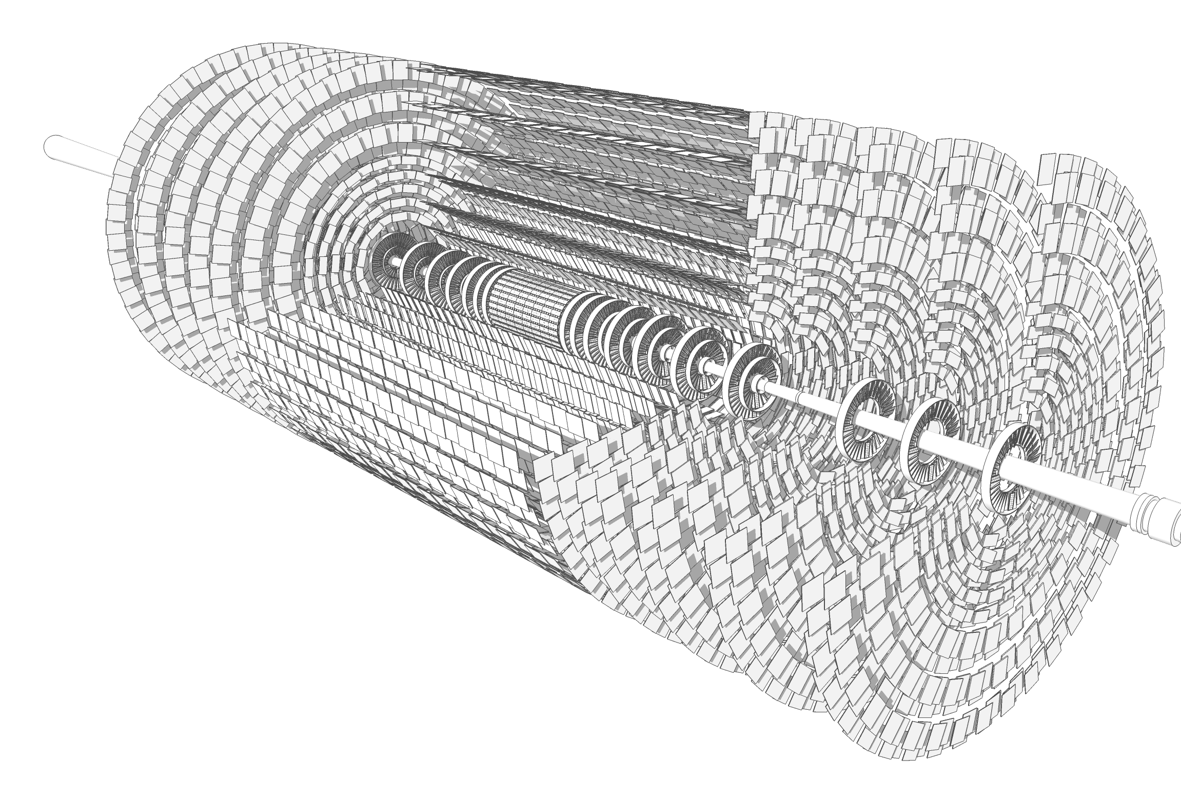
5.3m
1.2 m
TFPX
TBPX
TFPX
Endcap Disks (TEDD)
TEPX
Barrel Cylinders
Inner TBPS
Outer TB2S
Outer Tracker Numbers
23.5 m³ volume
~1600 kg
75 kW total power
192 m² Silicon Area
215 M readout channels
Endcap Disks (TEDD)

Slide 5
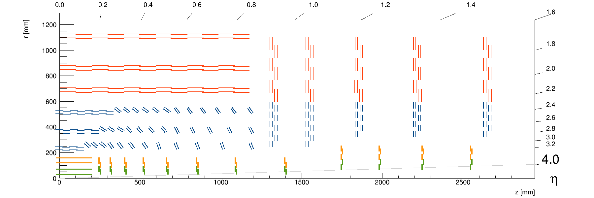
OT Detector Layout
Charge #2
Divided into 6 barrel layers and 5 endcap disks
  Barrel has “Flat” section and “Tilted Section”
  Trigger: Each layer is a sandwich of sensors (next slide)
    Two flavors of pairs, “PS” and “2S”
TB2S
TEDD
Flat TBPS
Tilted TBPS
Inner Tracker – aka “Pixels” NSF scope

Slide 6
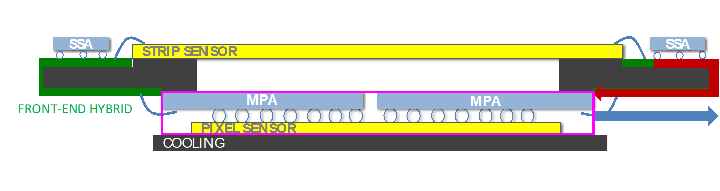
OT – Fundamental Unit: Module
Charge #2
  Sensor “sandwich” provides local curvature information for trigger
    Different spacing in sandwich at different radii to match trigger
  Two types of module
    Pixel-Strip (PS): Strip sensor (PS-s) provide 1D information, Pixelated sensor (PS-p) provide 2D information. Used at lower radius, balance between precision and cost
    Strip-Strip (2S): Strip Sensors (2S) for both slices of sandwich at high radius
  Modules include sensors, ASICs, power and readout hybrids, spacers and mechanical support
    Sensors and Electronics may differ, Mechanics similar

Slide 7
OT Structure and Accessories
Charge #2
Mechanical Structure
  Modules go on Planks
  Planks go on Rings
  Minimize mass: Carbon Fiber
  Dual Phase CO₂ cooling
    ala FPIX Phase 1
Electronics
  Test Systems to support component and module QC
  Off-detector Data Acquisition electronics
    Share of Design and Firmware
    (Trigger part of 402.07)
U.S. scope: Flat Barrel
(layer 1 shown)

Slide 8
OT – U.S. Involvement
Charge #2
KPPs: DocDb-13237
Modules
  Deliverable: 2500 PS and 2000 2S working production modules, plus 5% preproduction and 10% spares. Half of these built at FNAL
    952 PS go to Flat Barrel (below), rest to iCMS collaborators
  Sensors - Procurement (CERN group purchase), QC
  Electronics
    Development of Test systems for iCMS, Procurement for U.S. needs
    Development of Sensor-ASIC assembly: MacroPixel Sub Assembly (MaPSA)
  Modules
    Development of assembly sites
      East Coast and FNAL
    Module component procurements and QC
    Assembly of components into modules and QC
Flat Barrel Fabrication (Key Performance Parameter #1)
  Fabrication of Planks and Rings for the PS Flat Barrel (inner 3 layers)
  Assembly of (U.S.) PS Modules onto Planks/Rings, QC
  All of this done at FNAL

Slide 9
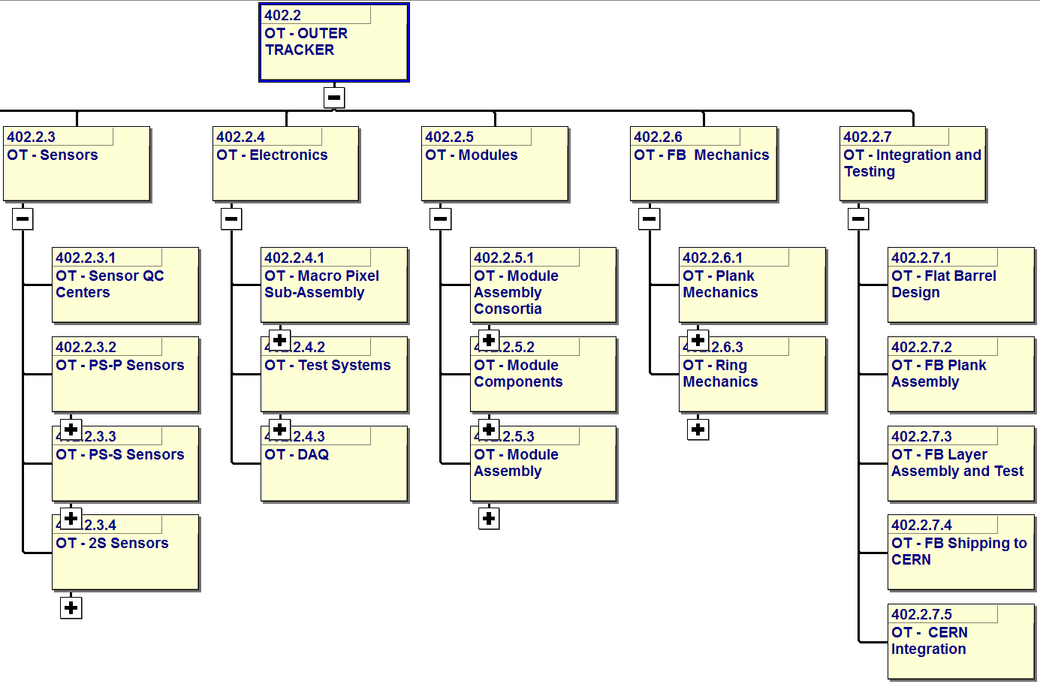
WBS to Level 4
Charge #5,7
WBS dictionary: DocDb 13216
Suppressed: 402.2.1 Milestones and 402.2.2 Management
Uli Heintz, Brown
Petra Merkel FNAL
Yuri Gershtein, RU
Lenny Spiegel FNAL
Meenakshi Narain BR
Stefan Gruenendahl,
Ron Lipton, FNAL
SG, RL, FNAL
Objective KPP: Work at CERN

Slide 10
WBS to Level 4
Charge #5,7
WBS dictionary: DocDb 13216
Suppressed: 402.2.1 Milestones and 402.2.2 Management
Uli Heintz, Brown
Petra Merkel FNAL
Yuri Gershtein, RU
Lenny Spiegel FNAL
Meenakshi Narain BR
Stefan Gruenendahl,
Ron Lipton, FNAL
SG, RL, FNAL
FNAL responsibility
SiDet
PPD ME
Carbon Fiber, C0₂ cooling
FNAL-driven
SiDet
Irradiation Facility at FNAL
FNAL-driven
-- SCD
SiDet
PPD ME

Slide 11
OT Cartoon Schedule
Charge #3,8
CD1
CD3a
CD 2/3
Installation
LHC
CD4
Sensors
Physics
TS
Physics
LS 2
Physics
TS
Physics
TS
Physics
LS 3
Fabrication
Operation
Sensor QC sites
Prototype
PrePd
Production and QC
Sensors
Electronics
Prototype
PrePd
Production and QC
MaPSAs
Prototype
Production
Production
Test Systems
Components
Systems
Full DAQ
Data Acquisition
Modules
Fabrication
Operation
Assembly sites
Prototype
PrePd
Production
Module Hybrids
Prototype
PrePd
Production
Module Mechanics
Mechanics
Prototype
PrePd
Production
Module Assembly
Prototype
Production
Planks
Prototype
Production
Rings
Integrat’n
Flat Barrel
Prototype
Assembly
CERN Integration
FY17
FY18
FY19
FY20
FY21
FY22
FY23
FY24
FY25
FY26

Slide 12
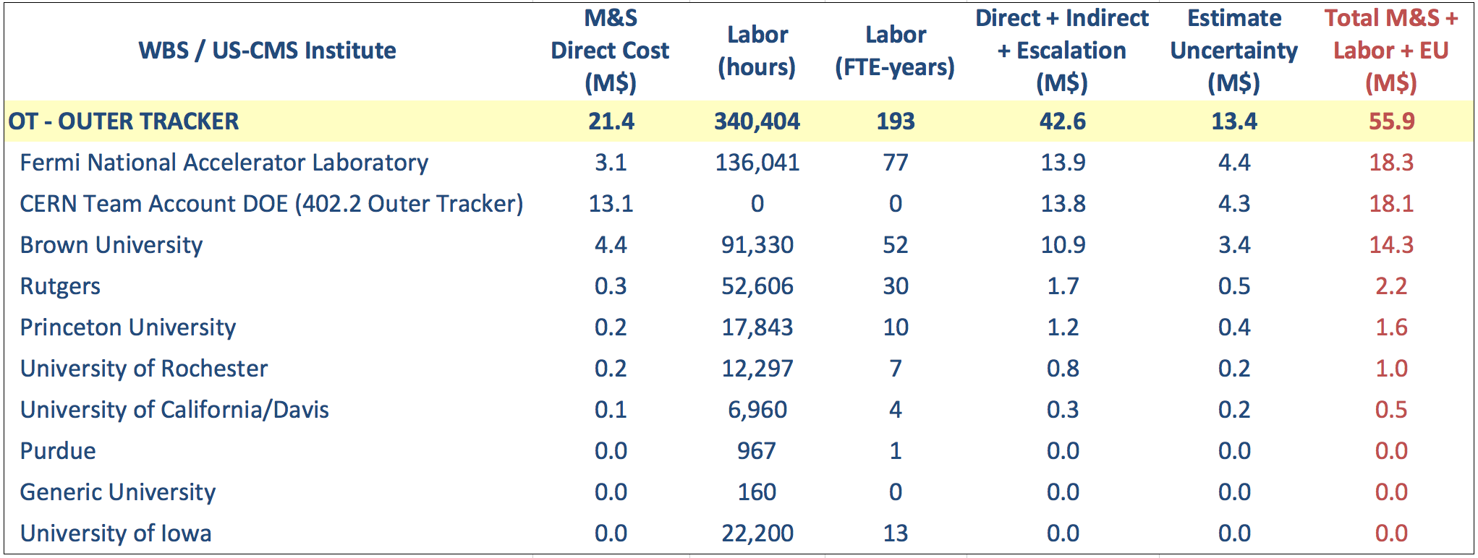
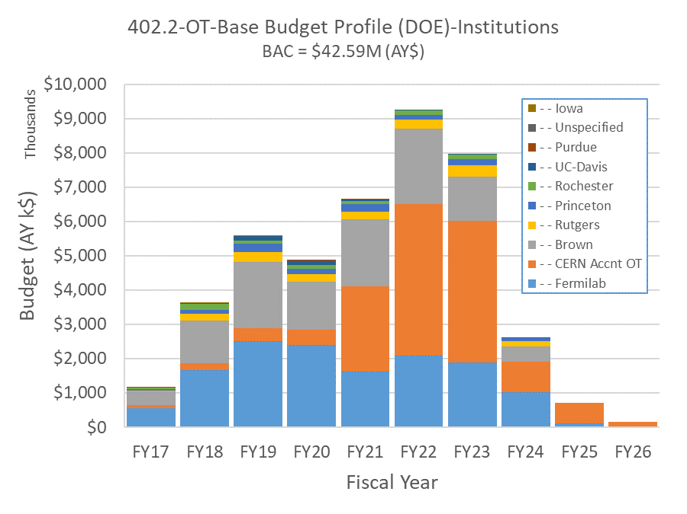
FNAL Budget

Slide 13
Current Estimate of FNAL labor
Estimate not final (and never will be) but
  We are funding-limited, will have to be vigilant about runaway charging
    Often an issue at FNAL – Institutes are constrained by POs
    Working to improve “early warning” system
FTEs ( = 1768 hours/year) are from the Project plan
  Each of 1114 tasks with FNAL labor is estimated in hours,
  Resources at Femilab are Named Employees when possible, however that does not preclude equivalent substitution
    Will need to double/triple up when one employee has > 1 FTE
Huge number of Task Codes to be dealt with
  At ~ L4, but multiplicity for color of money (OPC/MIE), type of Activity (Labor, M&S, COLA, Travel), site of work (CERN, Institute, FNAL)

Slide 14
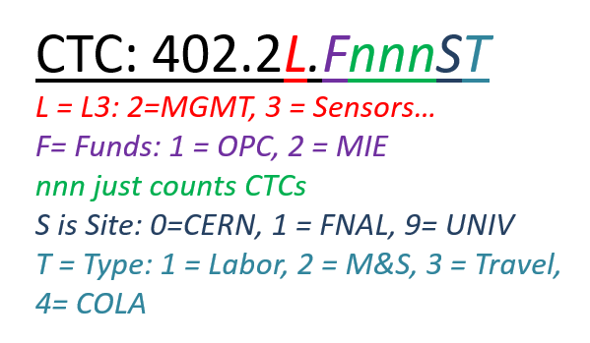
Charge Codes
Please use the correct code
  We are required to keep budget vs actual balanced within tight bounds
If you don’t know, ask the L3
  They can connect names to codes, but sometimes people will need to use more than one
  If you screw up, they will try to correct it
Currently FY18 is a mess, trying to correct it
  Good to mess up when the totals are not so large

Slide 15
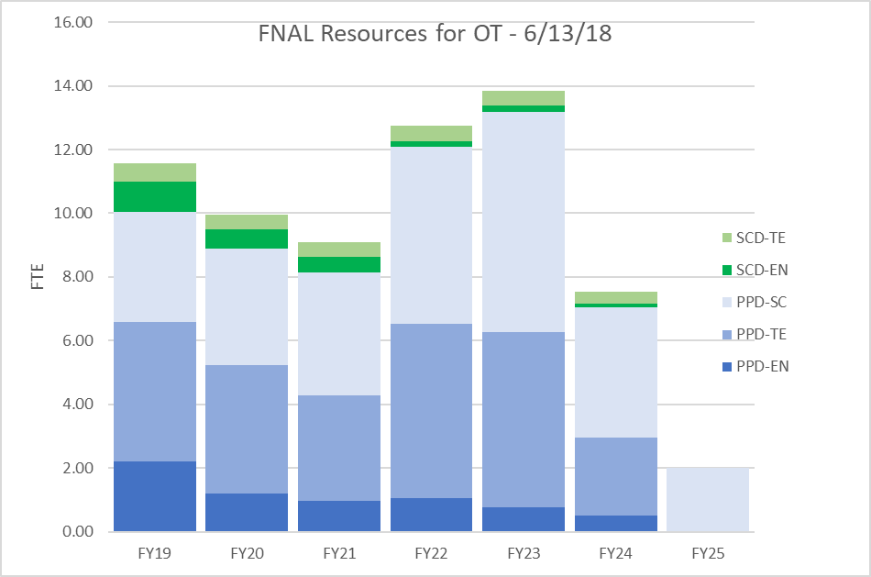
FNAL – Summary

Slide 16
FNAL – PPD Engineering

Slide 17
FNAL – PPD Technicians

Slide 18
FNAL – PPD Scientists

