Slide 1
ARAPUCA Design for CE Test Stand
David Warner
CSU
6-18-18

Slide 2
CE Test Stand TPC (at FNAL)
Test TC ~ 1.05 X 1.65m
~300mm drift (2 sided)
Planned for operation
~ late fall 2018
Figure From Bo Yu

Slide 3
Preliminary schedule from CE group

Slide 4
But-- CE APA Frame slightly undersize
Full “Middle” side
In one side of APA
Full-size APA Bay = 997mm
CE Test Frame 946.8mm wide

Slide 5
Two-supercell ARAPUCA PD Concept
1 or 2 readout channels/module
48 MPPCs/channel
8 groups of 6 passively-ganged MPPCs/channel
Nearly 50% more collection area from ProtoDUNE
Single or double sided
1 or 2-region segmentation (~ 10 X 50 cm area)
Far-end readout (connector on far APA tube)
Requires new 136 X 25mm APA slot (agreed to)
Adaptable to X-ARAPUCA and both bar concepts

Slide 6
Active Ganging area (inside far tube)
Alignment pins
Signal Pins
Active Ganging PCB
Mounts here (1 or 2/module)

Slide 7
Module Attachment Points
M4 captive screw mounts here
(both sides)

Slide 8
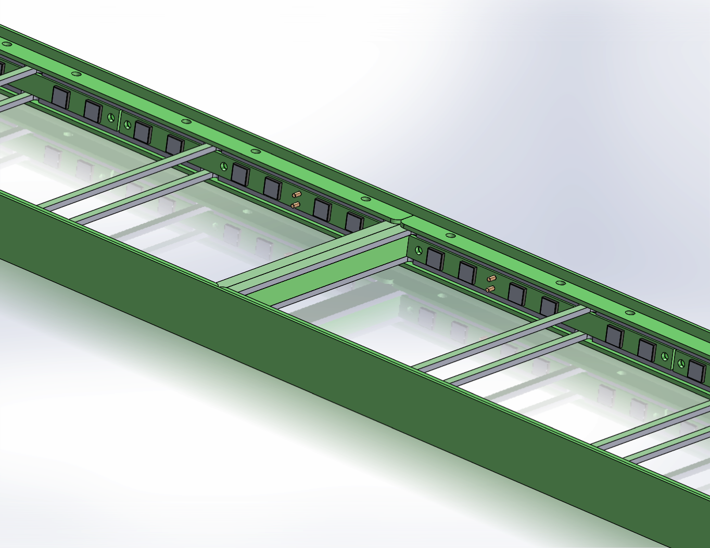
6 filter “Supercell (nee Cartucho) Concept
Optically blocked
Between supercells
6 filter plates
Each 100 X 77 X 2mm
Open between cells

Slide 9
Supercell Detail
8 MPPCs/subcell
(4 on other side)
Cover strips hold plates
In window frames
Connection pins thru to
Side routing bars

Slide 10
6-MPPC Passive Ganging PCB
120 X 8mm 4-layer board.
Passively gangs 6 MPPCs

Slide 11
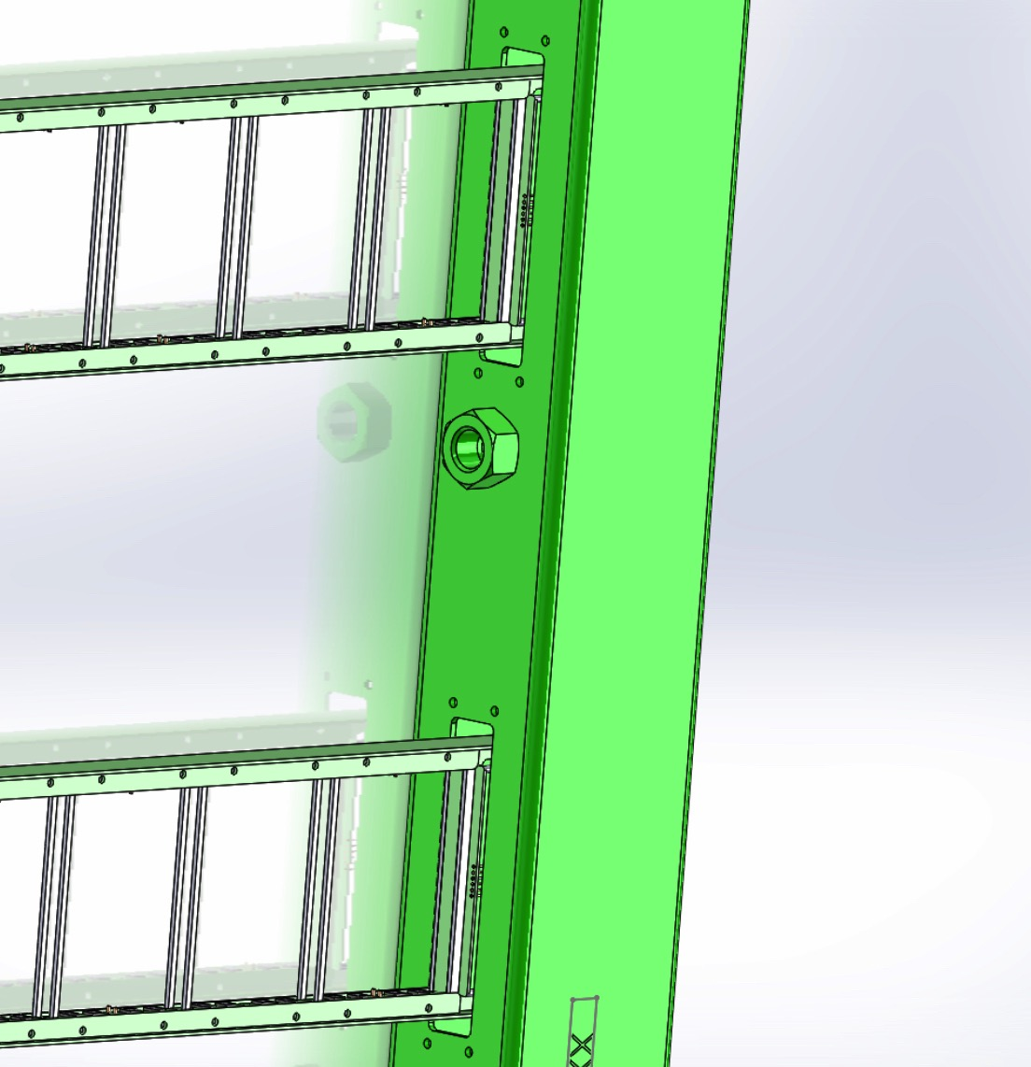
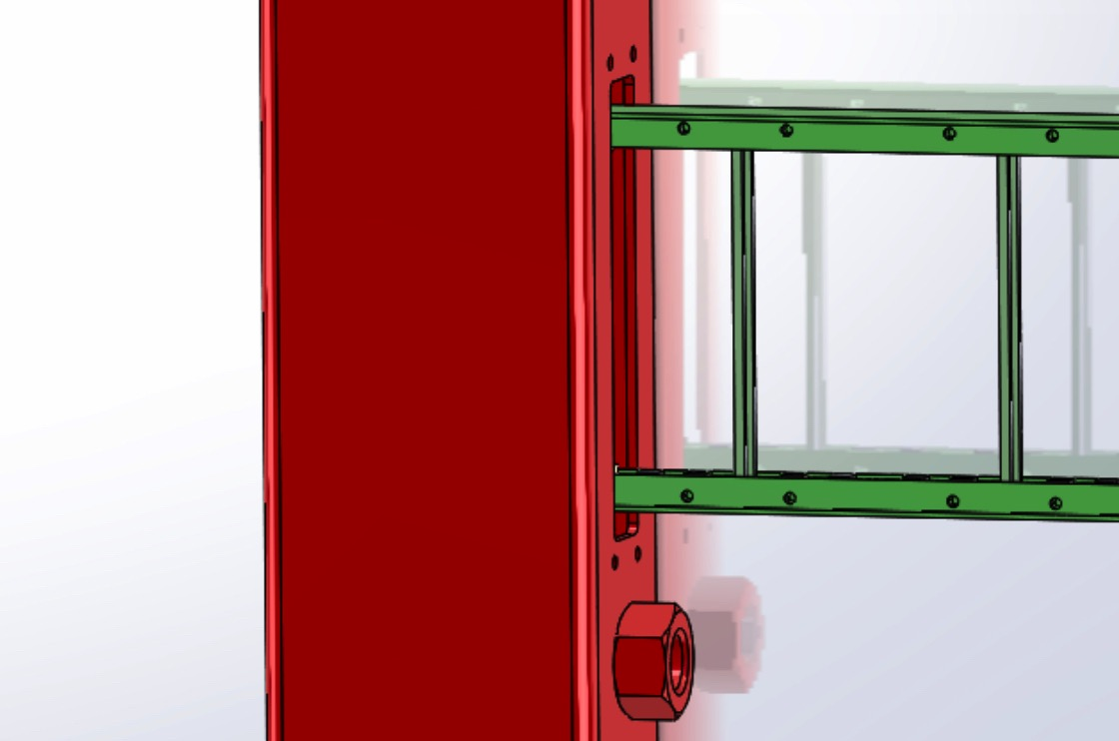
Two-Supercell PD
Buried ~ 50mm
Into load-side APA Tube
Readout side
Must mount flush

Slide 12
Wire Frame (Transparent) View
PD Readout
Inside APA Frame
Active Ganging
Buried PD
End

Slide 13
Options:
1) Re-design Supercell to fit into CE APA
Does not test final configuration
Requires fabricating filter plates and SiPM mount PCBs of a different size from DUNE FD.
2) Use 2-Supercell design as presented, but bury 50mm in feed-side tube (as shown)
1 Supercell not completely exposed. Confusing?
Requires consultation with CE/APA group (but I don’t expect interferences)
3) Mount 1 Supercell per slot
Reduces the number of PDs tested per run
Gives perhaps the best and clearest test of the PD concept

Slide 14
Status of PD Design/Planning
PD Design ~75% complete
APA DESIGN REQUIRES MOUNTING DECISION ASAP
MPPC order placed. Expected delivery ~ mid-July)
Layout for SiPM mounting plates nearly complete. Order to go out this week.
Test PD Module connector plates in hand. Preliminary testing next two weeks.
APA FABRICATION REQUIRES CONNECTOR COMPONENTS AND RAILS MID JULY
Quotation for 60 dichroic filters received. Ordering process begun. Expected delivery ~end of August
Aim for PD module fabrication by late September

