Slide 1
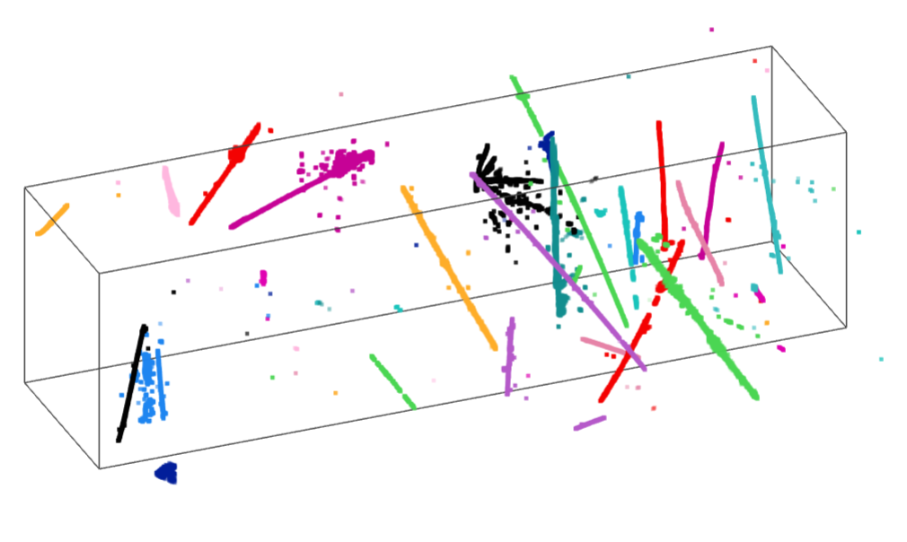
Algorithmic Enhancement of Reconstruction
Xin Qian
BNL
Wire-Cell Reconstruction

Slide 2
Outline
Information content in a LArTPC
Wire-Cell tomographic event reconstruction
Journey to achieve accurate charge determination
Thoughts on pixel readout
“Many-to-many” TPC cluster/PMT flash matching in MicroBooNE
Is pixel readout a sufficient solution for high-multiplicity environment?
Summary

Slide 3
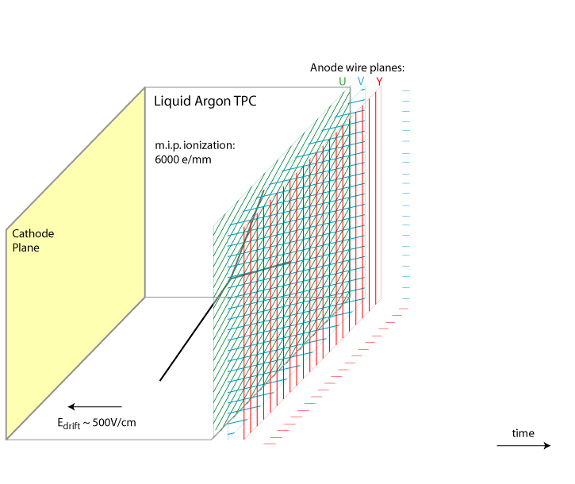
Information Content from a LArTPC
Time Information:
When charge arrive at anode plane
Geometry information:
Where charge arrive at anode plane
Charge information:
How much charge arrive at anode plane
Additional information:
Particle (e.g. energy deposition should be continuous → connectivity, one of unique features for a fully active detector)
Positivity (i.e., electrons only drift towards anode plane)
Sparsity
time
Reconstruction is essentially information processing: converting measured information to particle information (kinematics and type)

Slide 4
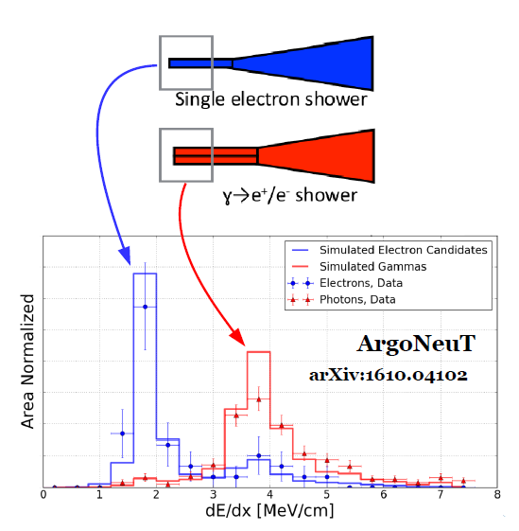
Wire-Readout LArTPC
For pattern recognition
“Time” is more important than “Geometry”
Two hits arrive at different time cannot come from the same energy deposition
Two hits arrive at different wires that do not cross each other cannot come from the same energy deposition
“Geometry” is probably more important than “Charge”
Two hits with very different charge measurements may not come from the same energy deposition
Statement depends on how accurate the charge can be measured
For particle identification and energy reconstruction
“Charge” is obviously crucial (e.g. e/gamma separation)

Slide 5
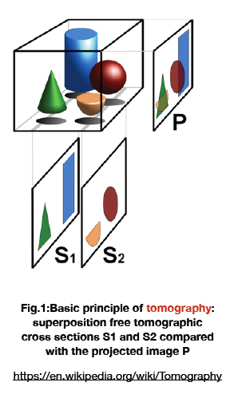
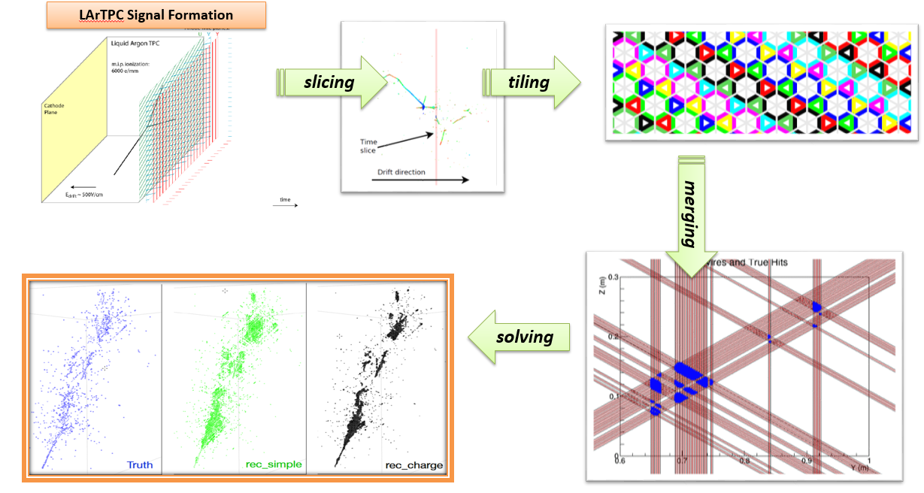
Wire-Cell Tomographic Event Reconstruction
Principle paper: “Three-dimensional Imaging for Large LArTPCs”, X. Qian, C. Zhang, B. Viren, M. Diwan, JINST 13, P05032 (2018)
“Time”
“Geometry”
“Charge”
“Sparsity”
“Positivity”
“Connectivity”

Slide 6
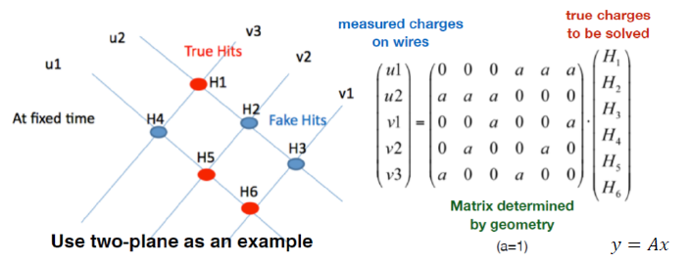
Principle of Solving: Usage of “Charge”
The goal is to differentiate the true hits from fake ones by using the charge information
~ large charge → true hits
~ zero charge → fake hits

Slide 7
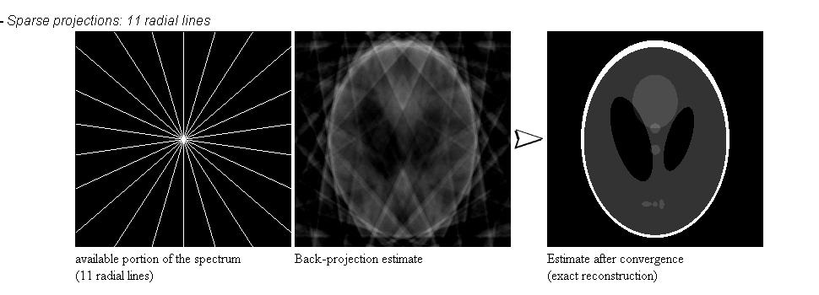
L0 vs. L1 Compressed Sensing
Compressed sensing (or the usage of sparsity and positivity) is very powerful and well known in other communities
The procedure is revolutionized by the equivalent L1 regularization
Candes, Romberg, Tao (2006)
The L0 regularization and is NP (non-deterministic polynomial-time) hard
For the previous example, need to remove 2 out of the 6 possibilities to solve → 15 combinations
Imagine a case of removing “m” from “n” possibilities → n! / (m! (n-m)! )
L1 regularization → reduce computation to O(n k), k: number of zeros in the eigenvalues of matrix “A^{T}V⁻¹A”
Minimization can be achieved through the “coordinate descent” approach, in which “positivity” can be naturally included. “Connectivity” can be achieved through adjusting values of λ for each x_{i}

Slide 8
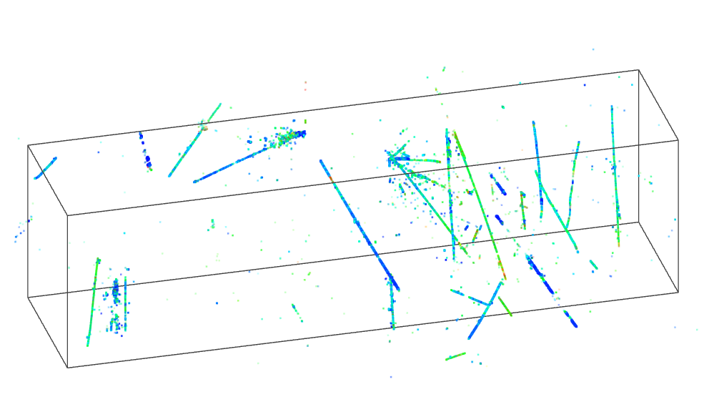
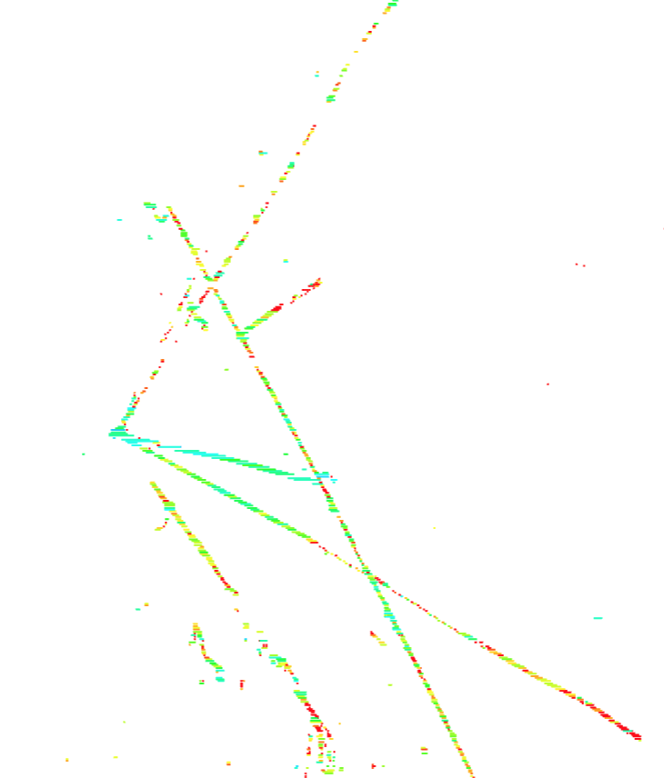
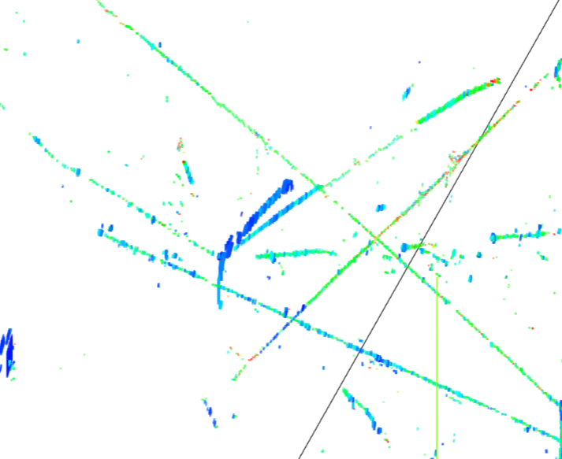
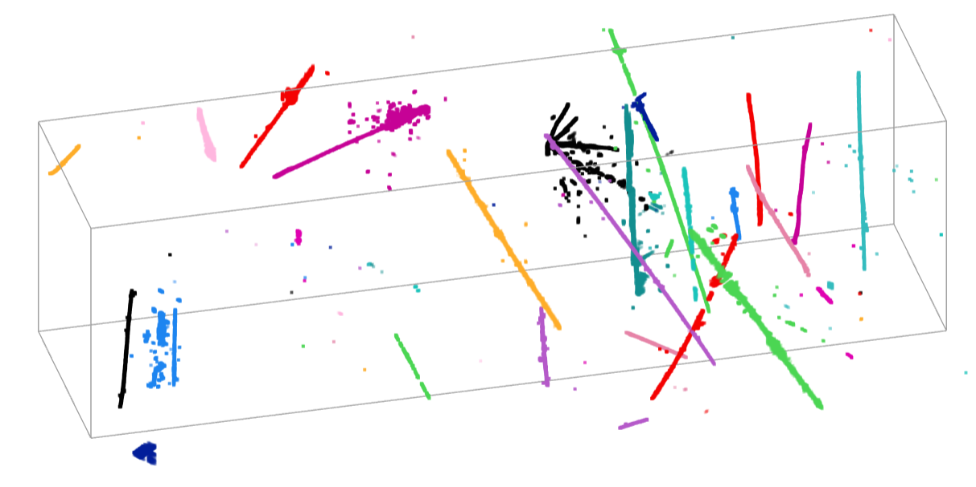
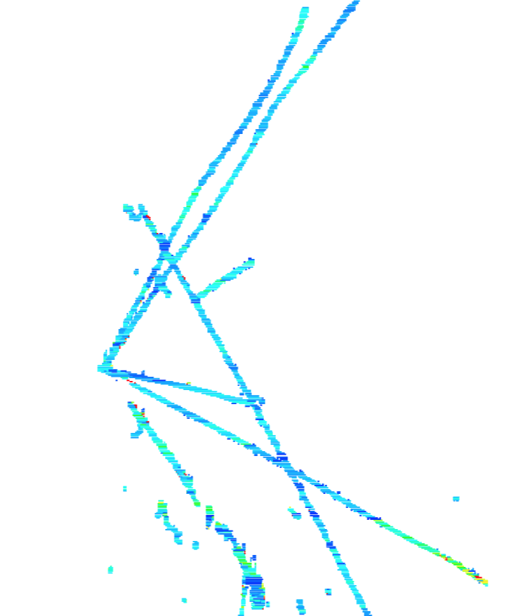
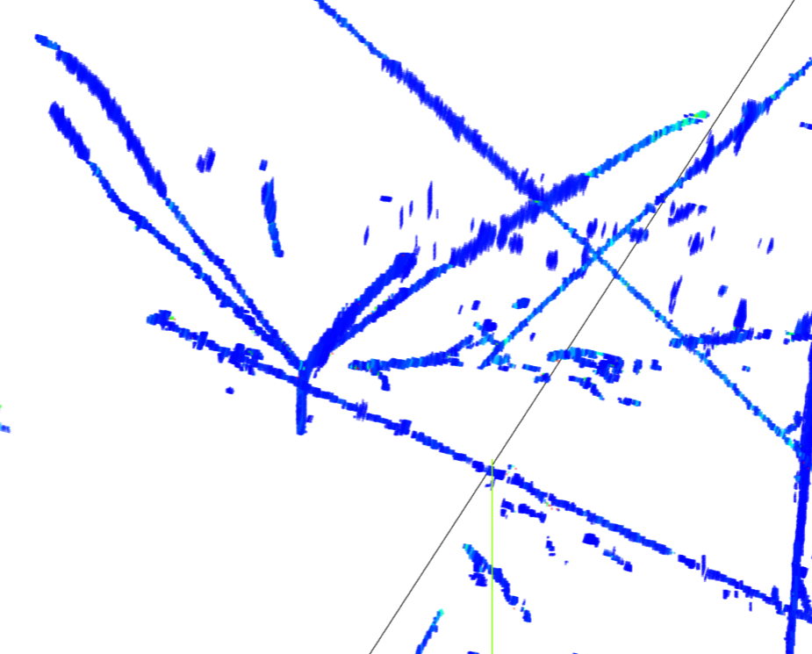
Wire-Cell on MicroBooNE Data
2015, after several hours of running
Bee link
2018, 3 mins of running
Bee link
Advanced algorithms (compressed sensing) significantly reduce the running time
New signal processing chain significantly enhances the efficiencies (thicker lines)
Getting correct “Charge” is crucial → also for PID and energy reco.
Notes:
Significant improvement in SP and … write something … why is better ??? Remove last line, more dots → more hits, high efficiency …

Slide 9
Outline
Information content in a LArTPC
Wire-Cell tomographic event reconstruction
Journey to achieve accurate charge determination
Thoughts on pixel readout
“Many-to-many” TPC/flash matching in MicroBooNE
Is pixel readout an sufficient solution for high-multiplicity environment?
Summary

Slide 10
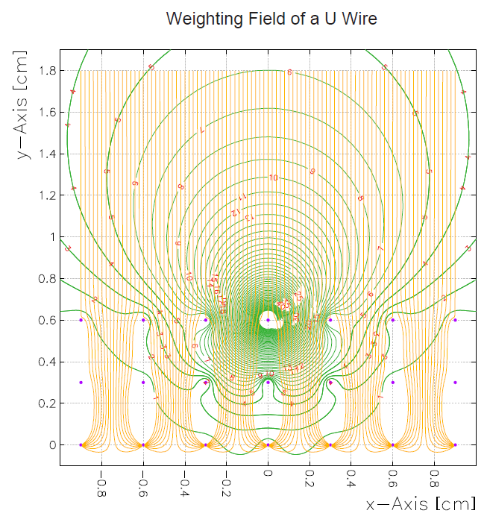
Single-Phase TPC Signal Formation and Processing
True number of ionized electrons
Weighting Potential of a U wire
Field Response
Ramo theorem
Example
Signal on Wire Plane
Electronics Response
v_{q}: velocity
E_{w}: weighting field
q: charge
Signal to be digitized by ADC
(Charge Extraction)
Reconstructed number of ionized electrons
Non-destructive induction wire plane is necessary for position identification in a detector with wire readout
Induction signal strongly depends on the local charge distribution

Slide 11
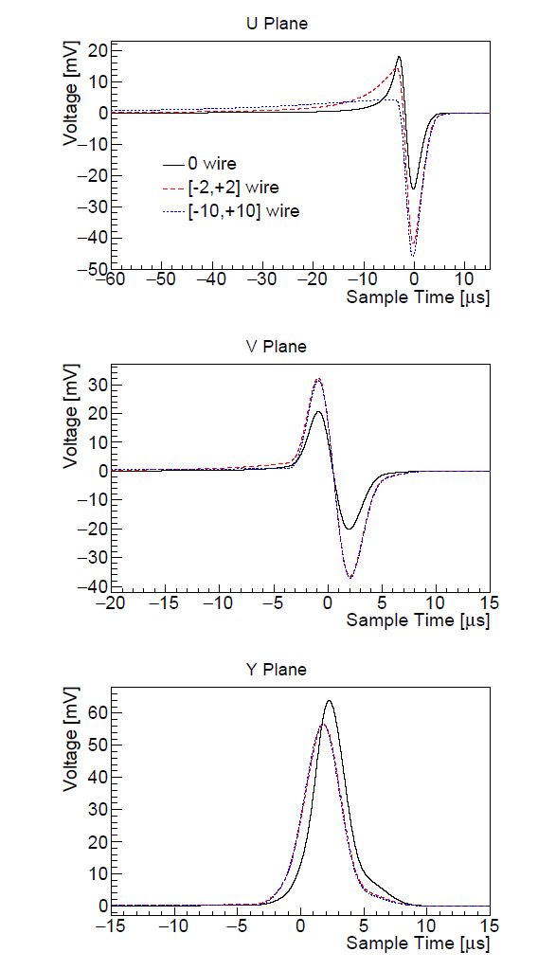
Charge Determination: Field Response Function
Long-range and position-dependent induction effect plays an important role in the signal shape
Without shielding from a grid plane, very long front porch in the induction U-plane signal
Collection plane wires also receive bipolar induction signals
These features are important for the integrated design of charge readout and zero-suppression in electronics
MicroBooNE, JINST 13, P07006
Point Charge Topology
Parallel Track Topology
2D Garfield simulation

Slide 12
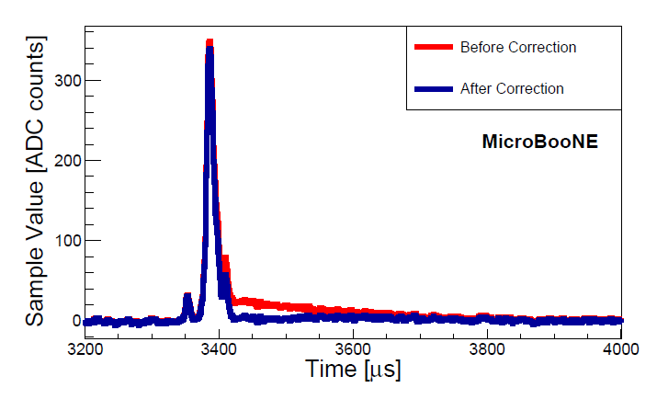
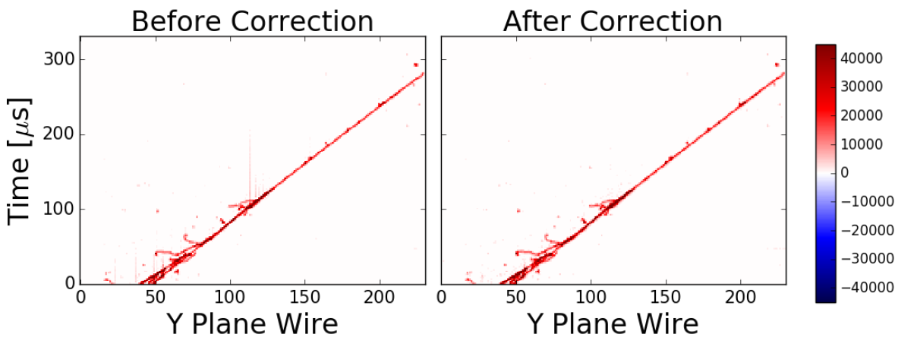
Charge Determination: Electronics Response
Observed imperfect response due to “imperfect pole cancellation”
Significantly reduced in the newer generation of ASICs
Developed a procedure to calibrate out imperfect electronics response in MicroBooNE
JINST 13 P07007 (2017)

Slide 13
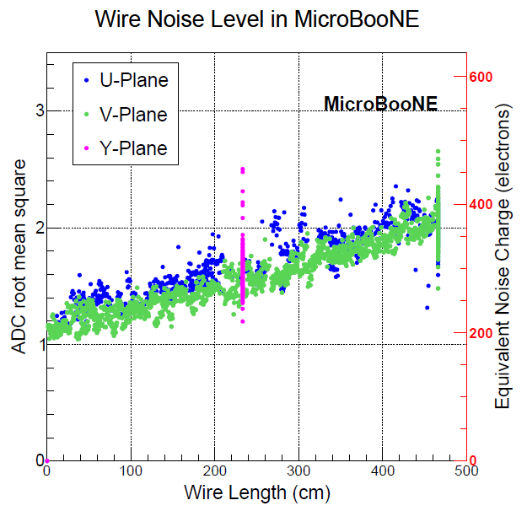
Charge Determination: Electronics Noise
While field and electronics responses are crucial for the accuracy of charge determination (systematics), electronics noise is crucial for the precision of the charge determination (statistics)
In the presence of excess noise, capability of noise filtering would be handy
JINST 12 P08003 (2017)

Slide 14
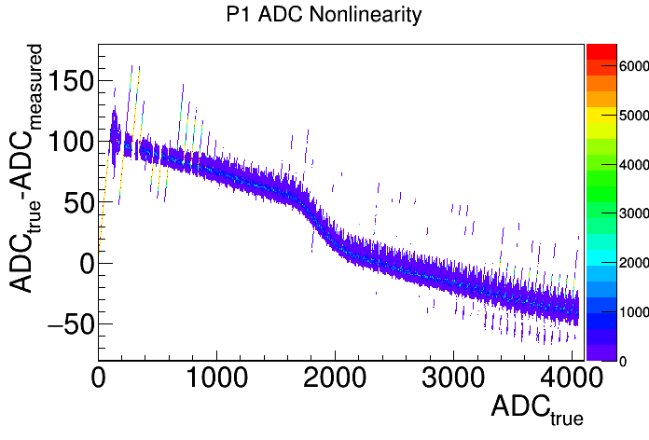
Charge determination: ADC nonlinearity
For a cold ADC, a new challenge is the control of nonlinearity and stuck bits (known issues for protoDUNE P1 ADC)
Not an issue in MicroBooNE using warm ADCs
A software calibration procedure is being developed based on MicroBooNE electronics response calibration
Minimizing the spread of normalized calibration pulses
Stuck bits at 0
Overall
Nonlinearity
Stuck bits at 63
Local oscillation/jump and double peak

Slide 15
Charge Determination: Signal Processing
With induced signals, the signal is still linear sum of direct and induced signals
R₁ represents the induced signal from i+1th wire signal to ith wire
S_{i} and S_{i+1} are not directly related
The inversion of matrix R can again be done with deconvolution through 2-D FFT → 2D deconvolution
MicroBooNE: JINST 13 P07006 (2017)

Slide 16
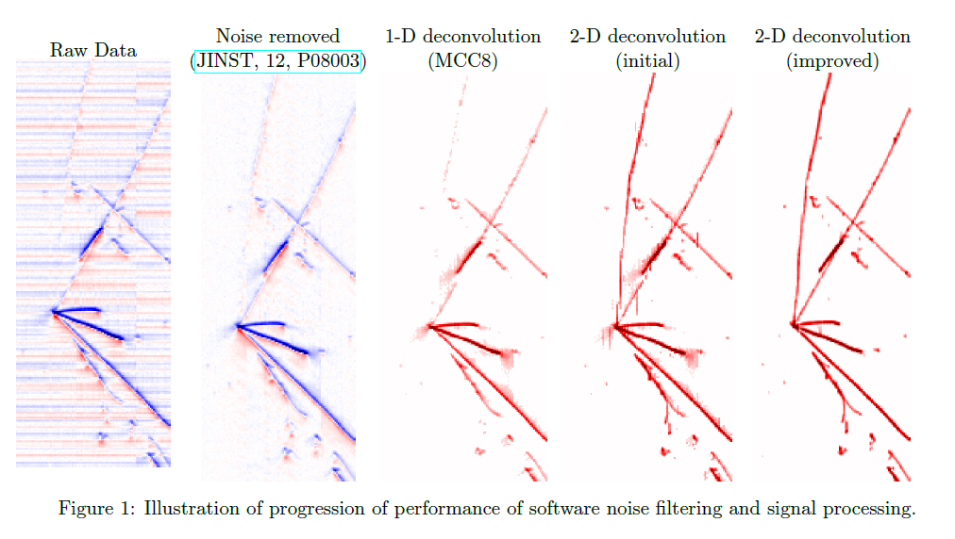
Evolution of Signal Processing in MicroBooNE
~ 2 years of effort
Drift time
Wire number
MicroBooNE: JINST 13 P07006/P07007 (2017)
Notes:
Move into MicroBooNE … , Ehcho to Chao’s talk …

Slide 17
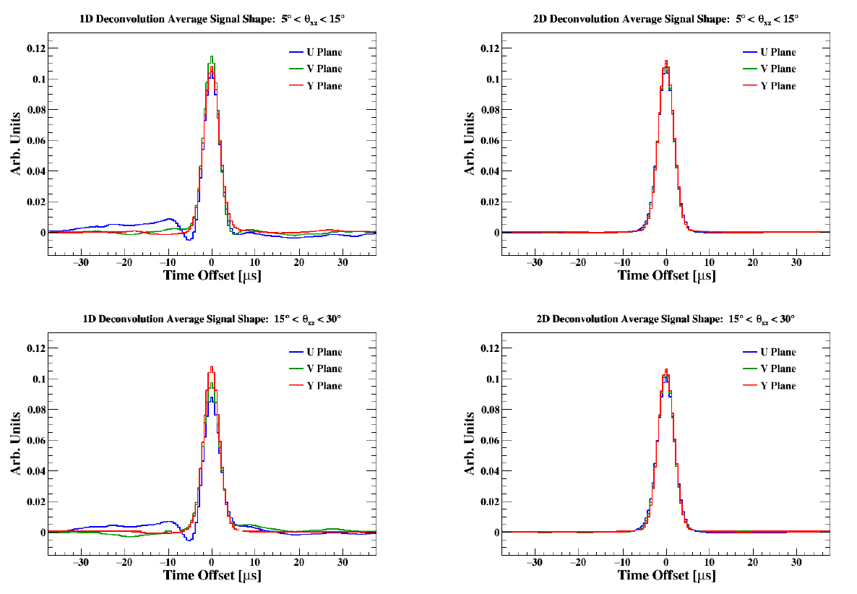
Demonstration of Charge Matching → Wire-Cell Tomographic Reconstruction
2D, New
1D, Old
MicroBooNE: JINST 13 P07006/P07007 (2017)
Notes:
One set of plots … First time ever in LArTPC to reach charge matching …

Slide 18
Wire-Cell on MicroBooNE Data
2015, after several hours of running
Bee link
2018, 3 mins of running
Bee link
New Signal Processing chain significantly enhances the efficiencies (thicker lines) → continuous energy deposition in fully active detector, which is crucial for the later pattern recognition tasks
Notes:
Significant improvement in SP and … write something … why is better ??? Remove last line, more dots → more hits, high efficiency …

Slide 19
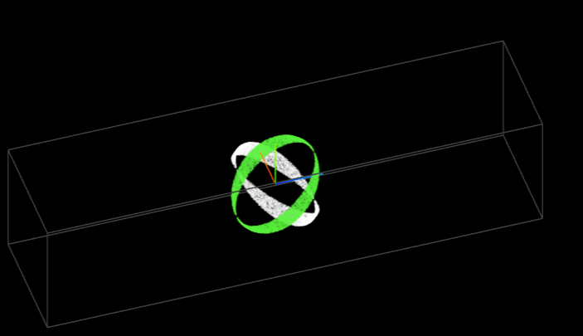
Induction Plane Signal Processing Challenge for “Prolonged” topology
Though “2D deconvolution” significantly reduce the inefficiency in induction-signal processing, there are still holes in the phase space for very-long induction signal
Drift Time
Wire number

Slide 20
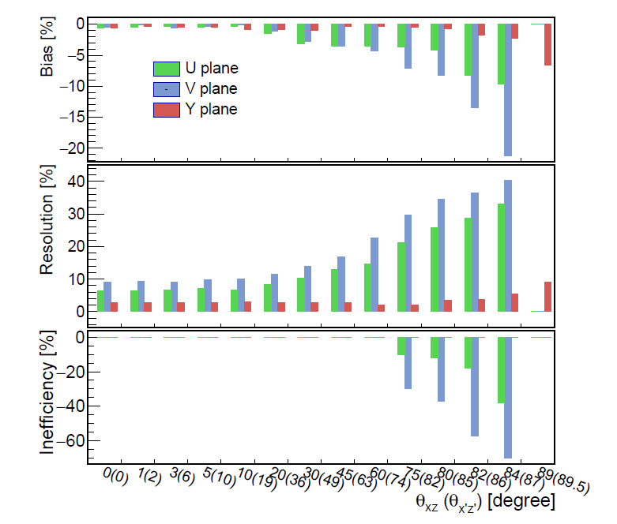
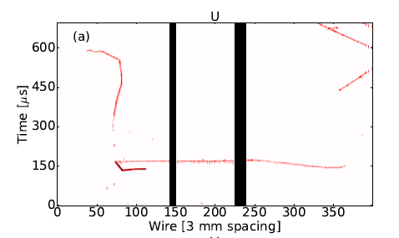
Signal Processing Evaluation
Quantitative evaluation of the signal processing chain → inefficiency for prolonged tracks (large-angle) track
4-wire plane proposal for DUNE
MicroBooNE: JINST 13 P07006 (2017)

Slide 21
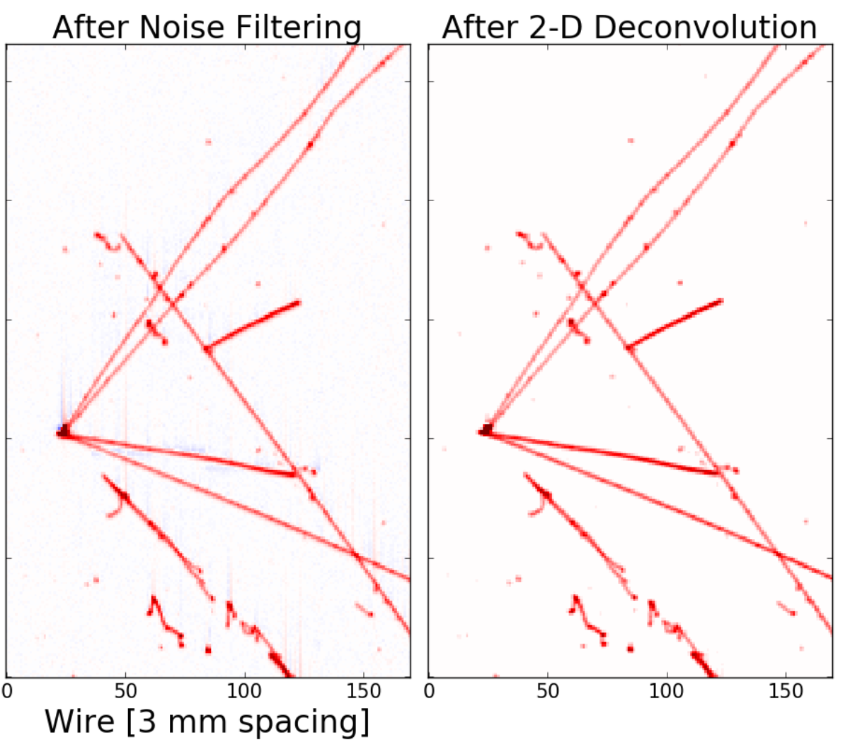
Thoughts of Requirements on Pixel Readout
Statistical uncertainty of charge determination
Control electronics noise → low ENC
Ability to filter electronics noise is desired → scheme of zero suppression
Systematic uncertainties of charge determination
Field response
Scheme of zero suppression, grid plane
Electronics response
Uniformity and calibration
ADC performance
Nonlinearity and calibration
Charge readout must respect the fully-active detector design
No gap is crucial for subsequent pattern recognition steps
Signal Processing can benefit collection plane signals as well

Slide 22
Outline
Information content in LArTPC
Wire-Cell tomographic event reconstruction
Journey to achieve accurate charge determination
Thoughts on pixel readout
“Many-to-many” TPC/flash matching in MicroBooNE
Is pixel readout an sufficient solution for high-multiplicity environment?
Summary

Slide 23
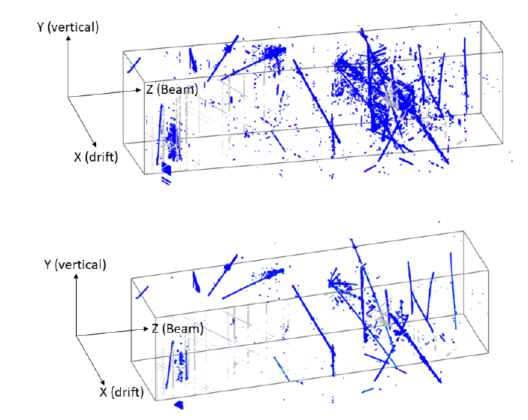
Wire-Cell on MicroBooNE Data
The damage of 10% dead channels can be sufficiently mitigated in the reconstruction for cosmic muons
A set of 3D clustering algorithms is developed based on data events
Different TPC clusters represent separate physics interactions
MicroBooNE-PUB-tech-note-40

Slide 24
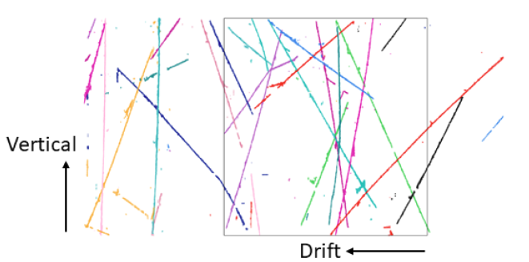
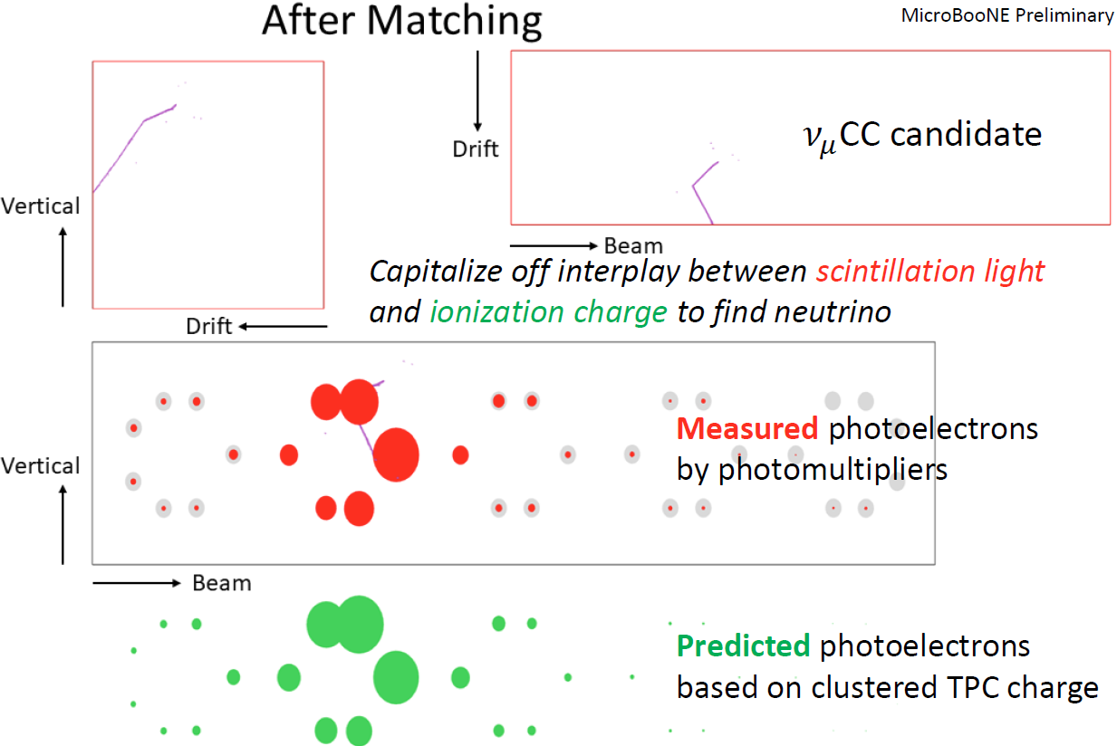
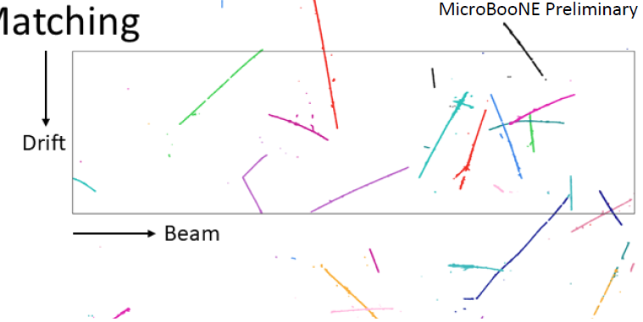
Clustering and Neutrino Selection
Cosmic removal after TPC cluster/ PMT flash matching
Recognized clusters based on 3D event image reconstructed with charge matching
CC ν_{μ} candidate
A novel “many-to-many” TPC/flash matching algorithm is developed
~25 TPC objects vs. ~40 PMT flashes
Combinatorial problem → compressed sensing
MicroBooNE-PUB-tech-note-40

Slide 25
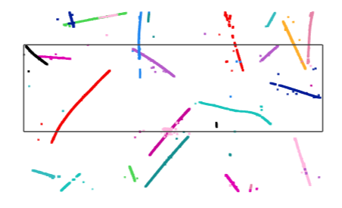
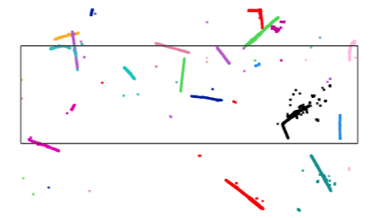
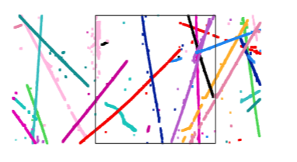
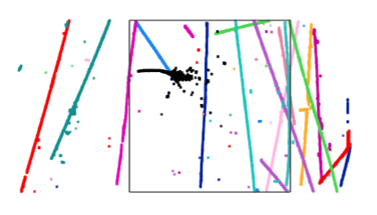
Example of CC ν_{μ} and ν_{e} candidates (all activities)
Side view
Top view
Side view
Top view
Front view
Front view
CC ν_{μ} candidate
MicroBooNE-PUB-tech-note-40
CC ν_{e} candidate

Slide 26
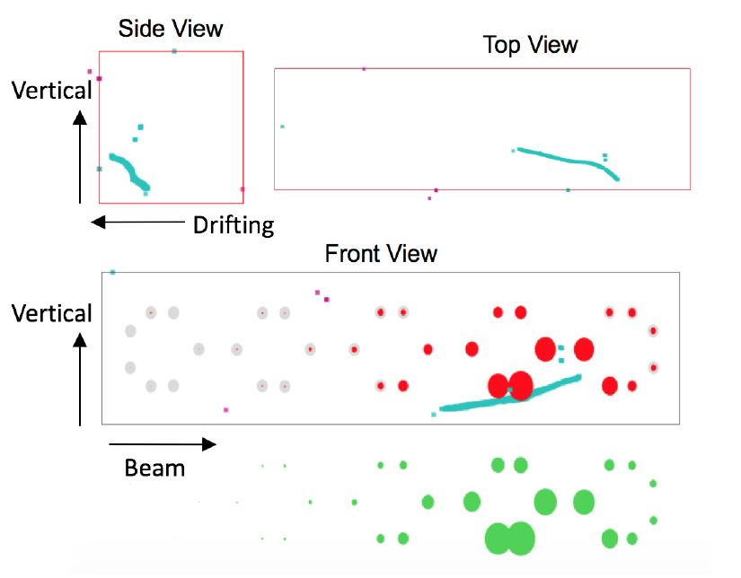
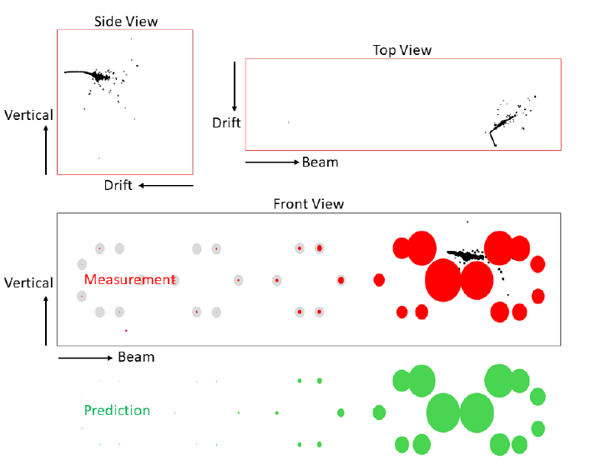
Example of CC ν_{μ} and ν_{e} candidates
CC ν_{μ} candidate
MicroBooNE-PUB-tech-note-40
CC ν_{e} candidate
Cosmic background can be sufficiently rejected with this technique in MicroBooNE
Same technique should benefit protoDUNE, SBND, and ICARUS

Slide 27
Is pixel readout an sufficient solution for high-multiplicity environment?
Pixel readout is certainly preferable for a high-multiplicity environment (such as DUNE ND)
Ambiguity caused by wire-readout may not be sufficiently controlled even after including charge, positivity, sparsity information at extreme high rate in a 3-wire-plane setup
However, for neutrino energy reconstruction, clustering of disconnected pieces (neutrons, low-energy gammas, high energy gammas from πº) are important
Experience from the MicroBooNE neutrino selection (rejection cosmic activities through many-to-many TPC/flash matching)
With expected high statistics in a LAr ND, one can explore low-intensity beam spills (e.g. one low-intensity x1/20 spills in every 10 beam spills → lower the event multiplicity in the DUNE LAr ND)
High-intensity spills can still be used to select simple event topologies

Slide 28
Summary (I)
Event reconstruction in single-phase wire-readout LArTPCs has been significantly enhanced with implementation of advanced algorithms
2D deconvolution, sparsity/positivity/connectivity information through compressed sensing, many-to-many TPC/flash matching, L1SP …
Accurate charge determination is not trivial, but essential
Prolonged signal in the induction wire plane still represents a challenge
Problem can be reduced by adding a 4th wire plane with a different orientation or pixel readout

Slide 29
Summary (II)
TPC readout design must respect the fully-active detector concept of LArTPCs (no gap → subsequent pattern recognition steps)
Accurate charge determination is the key to judge the success of pixel readout in LArTPCs
Field response, electronics response, ADC nonlinearity, and electronics noise
The power of PID and energy reconstruction
Low-intensity beam spill is essential to achieve accurate neutrino energy reconstruction for DUNE ND with a Pixel readout

