Slide 1
Accelerator Division Status
Duane Newhart
All Experimenters’ Meeting/Lab Status Meeting
25 June 2018

Slide 2
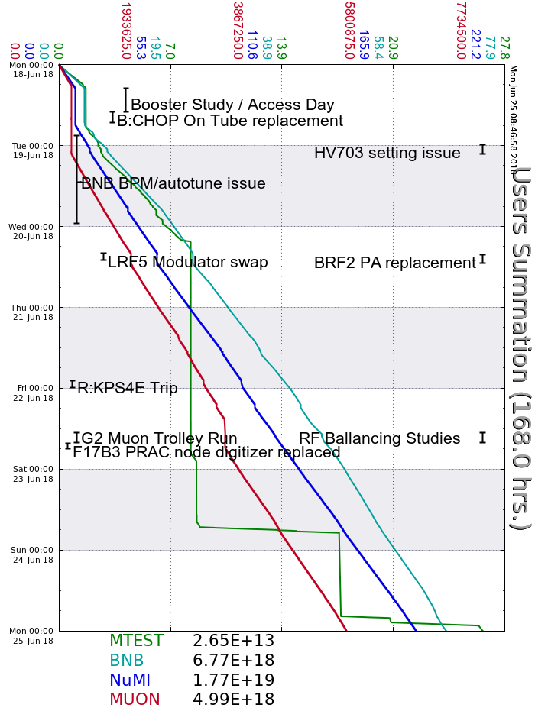
Accelerator Operations Summary
From: June 18, 2018 (0000 hours)
To: June 25, 2018 (0000 hours)
Calendar Week # 25
NuMI Weekly Integrated Intensity 1.77 E19 protons
Beam Hours To NuMI 147.1 hours
BNB Weekly Integrated Intensity 6.23 E18 protons
Beam Hours To BNB 147.4 hours
Muon Weekly Integrated Intensity 4.99 E18 protons
Beam Hours To Muon 137.4 hours
MTest Weekly Integrated Intensity 2.65 E13 protons
Beam Hours To MTest 40.2 hours
MCenter Weekly Integrated Intensity 0.00 E12 protons
Beam Hours To MCenter 0.0 hours

Slide 3
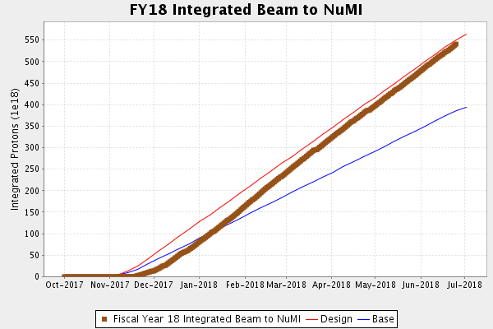
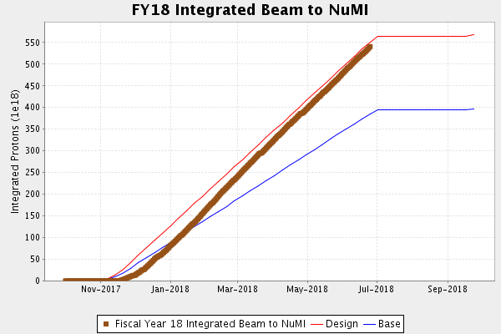
NuMI Operation

Slide 4
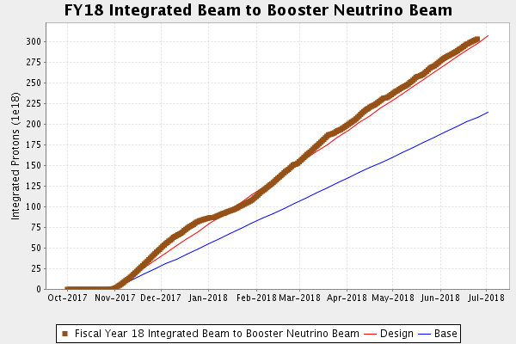
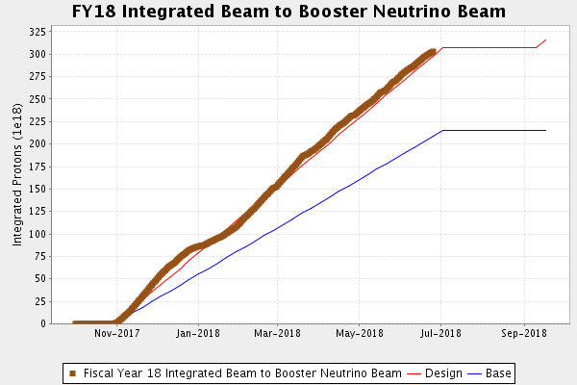
BNB Operation

Slide 5
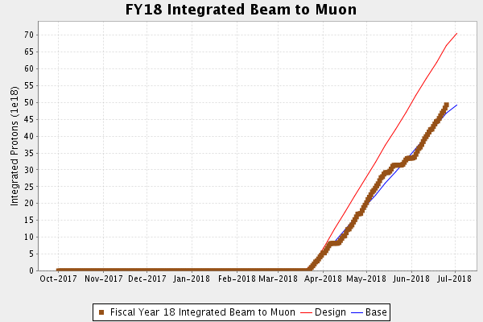
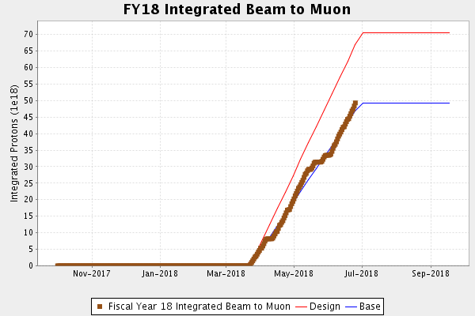
Muon Operation

Slide 6
Complex Status
LINAC
  Running well
    Moved LRF5 to tube modulator to prep test stand for Marx
Booster
  Running well
  RF Studies Monday and Friday
    Studies while g-2
MI/RR
  Running well
NuMI
  Monitoring NuMI target (TA-02) helium leak
Booster Neutrino Beamline (BNB)
  Taking beam
    BPM VPTGTS failed/required new file build
Switchyard
  Meson Test taking beam
Muon Campus
  G-2 taking beam
General
  TLG reboot this week
  Summer Shutdown starts July 9
    Beam off on July 7 for cooldown

Slide 7
PIP-II Injector Test & FAST/IOTA Status
PIP-II Injector Test
  Shutdown for Cryogenic Transfer Line (CTL) installation
  Continuing to qualify cavities for SSR1 at MDB
FAST/IOTA
Checkout of the FAST beamline has begun.
  All quad and trim magnets in the 50 and 300 MeV lines are on.
  The RF Group started warmup of the klystron filaments to all 4 stations.
ORC to begin cooldown has been approved.
  Expect the Cave to become ODH 1 on Tuesday.
  Pumpdown of the CC1, CC2, and Cryomodule insulating vacuum systems has begun.
Beam operations are schedule to begin in July.

Slide 8
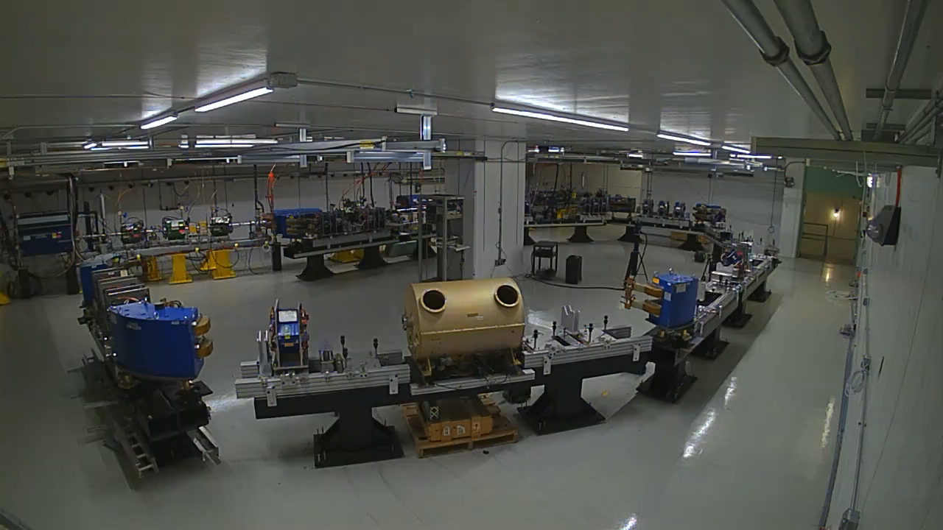

Slide 9
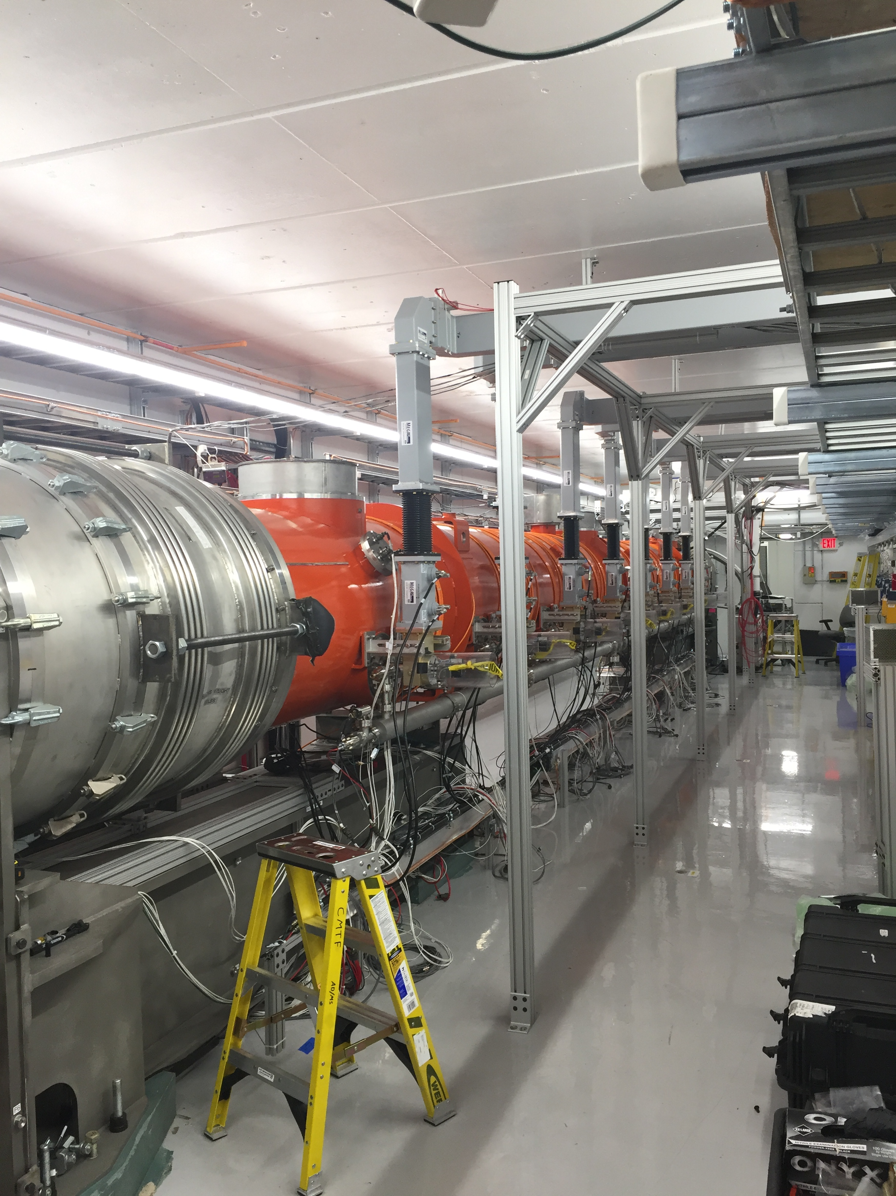
CMTS1 Status
LCLSII Cryomodule F1.3-08
  Testing has gone well
    Unit test (all 8 cavities at ~16 MV/m) plus magnet coils powered to 20 A is in progress at this time
  Expect to complete this week and warm up

Slide 10
Power Outages

Slide 11
Power Outages

Slide 12
Power Outages

Slide 13
Power Outages

Slide 14
Schedules and Links
Schedule can be accessed from the Operations Department Home Page
  Schedules -> Operations Schedule
Direct link to schedule
  http://www-ad.fnal.gov/ops/schedule.html

