Slide 1
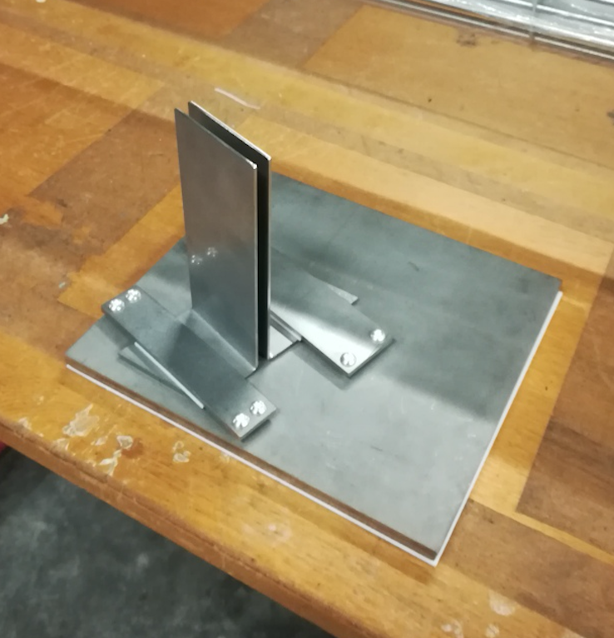
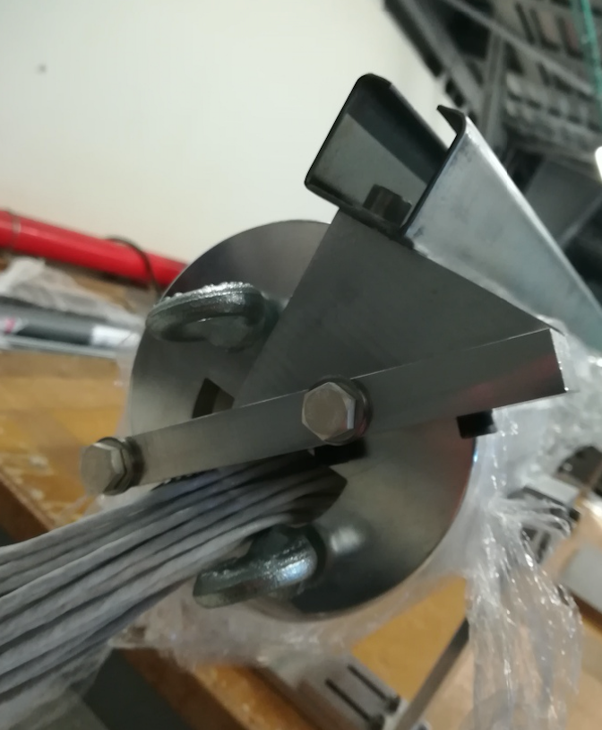
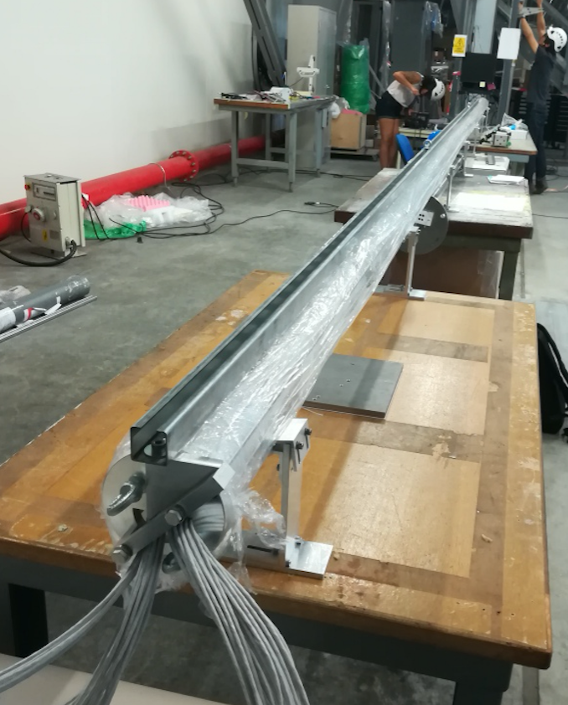
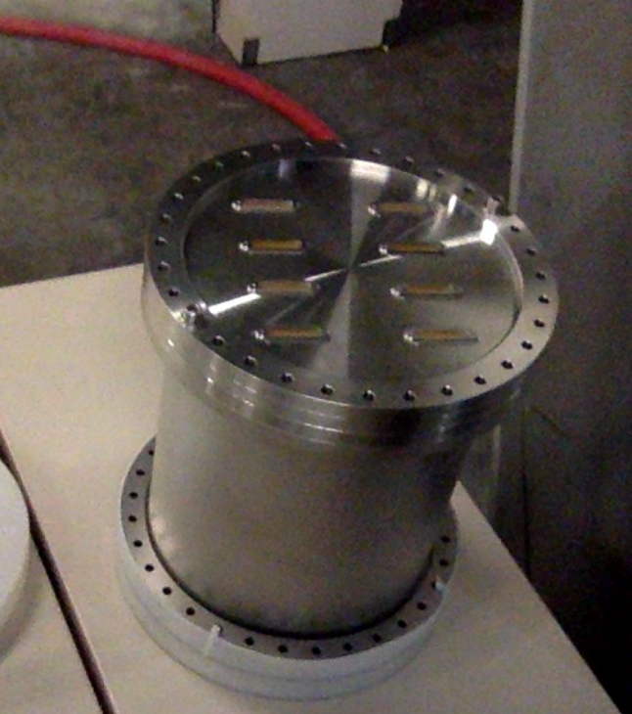
Static T-gradient
All pieces at CERN
Installation procedure fully defined
Scheduled for installation on June 27th
Pablo, Miguel and I will be at CERN from June 26th to June 29th
Lifting bar installed
(will be cut today)
Bottom piece
Al piece for lifting bar
Top Flanges
Anselmo Cervera Villanueva, IFIC (UV-CSIC)—Valencia

