Slide 1
Design Review Planning
Farshid Feyzi
28 June, 2018

Slide 2
Topics
Scope of reviews
Objective of reviews
Applicable documents and processes
Design review deliverables
Target dates

Slide 3
Scope of Far Detector Design Reviews and Stages
Internal components of the Far Detector:
Time projection chamber
Detector support structure
Feedthroughs, cables, instrumentation
Installation
External components of the Far Detector:
Racks, electronics, rack services, instrumentation
Feedthroughs, warm cables and fibers
DAQ equipment in the CUC
Equipment and infrastructure for detector assembly and installation
Equipment for use at the integration and test facility
Review stages:
30% review (conceptual design)
60% review (preliminary design)
90% review (final design)
Production readiness review
Production progress reviews
Details of design review deliverables in backup slides

Slide 4
Excluded from Scope of Far Detector Design Reviews
Conventional facilities, cryostats, cryogenics, cryogenics distribution and infrastructure.
Operational Readiness Clearance Review will be required before equipment may operate
Above are outside the scope of the design review process defined here and will be organized separately

Slide 5
Applicable Documents and Processes
Fermilab Engineering Manual http://directorate-docdb.fnal.gov/cgi-bin/RetrieveFile?docid=34
Far detector engineering risk assessment (DUNE DocDB 213)
Design of items within scope are standard risk
Process defined in accordance with Engineering Manual
DUNE far detector interface documents
Dune International Schedule (DocDB 7677)
LBNF/DUNE QA Plan (DocDB 120)
Fermilab Environmental, Safety, and Health Manual http://eshq.fnal.gov/manuals/feshm/

Slide 6
Responsibility
Full system reviews, as defined here, are under the purview of technical coordination
Sub-component reviews are the responsibility of the consortia to organize with technical coordination involvement, they are not defined here
Consortia may ask technical coordination to organize sub-component reviews as appropriate
Reviews with significant technology selection will be organized by technical coordination
Responsibility for the 30% full subsystem design review may be delegated to the consortia
Production progress reviews (PPR) may be primarily organized by the consortia, technical coordination may also organize PPRs.
All other reviews are the responsibility of and arranged by technical coordination

Slide 7
Preparation of Design Review Plans and Going Forward
Received and incorporated comments from technical coordination, system engineering, quality assurance and safety
Received input from David Mertz (Electrical Safety Subcommittee) and Mike White (Mechanical Safety Subcommittee) regarding design standards and codes
Draft 10 of review plan is ready and is being discussed today (posted to Indico page for today’s meeting)
Going forward:
Feedback from consortia
Need to start soon
Hold 30% review for DSS in August and as practice
Need to agree on timeline and incorporate in schedule

Slide 8
Target Dates
Review | 60% Review Date | Predecessor Task ID | 30% Review Date
Cryogenic Instrumentation | 1/1/2019 | 22-27 | Combine with 60%
Slow Controls | 1/31/2019 | 41 | 11/1/2018
Anode Panel Assembly | 1/1/2019 | 95 | Combine with 60%
DAQ | 3/22/2019 | 129 | 10/1/2018
DP Electronics | 3/22/2019 | 344 | Combine with 60%
DP Photon Detector | 3/28/2019 | 221 | Combine with 60%
High Voltage | 3/1/2019 | 421, 422 | Combine with 60%
SP Electronics | 2/18/2019 | 403 | Combine with 60%
SP Photon Detector | 2/22/2019 | 317 | 11/1/2018
Detector Support System | 1/1/2019 | NA | 8/20/2018
Went through the schedule and determined approximate time for 60% review based on consortia schedules
60% design review needs to be completed before TDR
Combine 30% and 60% design review for systems that have been developed and prototyped for ProtoDUNE

Slide 9
Backup Slides

Slide 10
30% Deliverables (Conceptual Design)
Design requirements in accordance with detector requirements
Design concept and approach to production
Preliminary engineering drawings, schematics, models and interface drawings
Preliminary interface documents
Preliminary engineering analyses and documentation, plan for further analyses
Preliminary installation and testing plans
Identification of applicable design codes and standards
Market survey and manufacturing concepts
Rough cost estimates and schedule

Slide 11
60% Deliverables (Preliminary Design)
Design choice identified
Detail engineering drawings, schematics, and preliminary parts list
Interface documentation review with other systems
Complete engineering analyses and documentation
Incorporation of ProtoDUNE lessons learned
Finalization of applicable design codes and standards
Manufacturing methods and acquisition strategy
Plans for production and evaluation of prototypes
Draft manufacturing, quality assurance, testing and procurement plans
Installation plans including special tools and fixtures
Preliminary cost and schedule estimate
Value engineering exercise
Resolution of 30% review recommendations

Slide 12
90% Deliverables (Final Design)
Complete manufacturing drawings, schematics and specifications
Engineering and safety analysis reports
Procurement specifications and bid documents
Production site plans for all production sites
Evaluation of prototypes and design modifications
Final quality assurance plan and quality control tools
Final cost and schedule estimate
Resolution of 60% review recommendations

Slide 13
Production Reviews
Production Readiness Review
Performed at production facility
Final QA plans for institutions not adopting the LBNF/DUNE QA Plan
Final production drawings, specifications and manufacturing and test procedures
Final safety documents (i.e. Hazard Analysis documentation)
Component QC plan (i.e. travelers, test reports, software verification and validation documents, supplier documentation)
Final procurement documents per institution practice
Completion and evaluation of prototypes, review of production process and QC results
Production Progress Reviews
Performed at production facility
Periodic review of production status
Verification of QC program
Validation of product quality

Slide 14
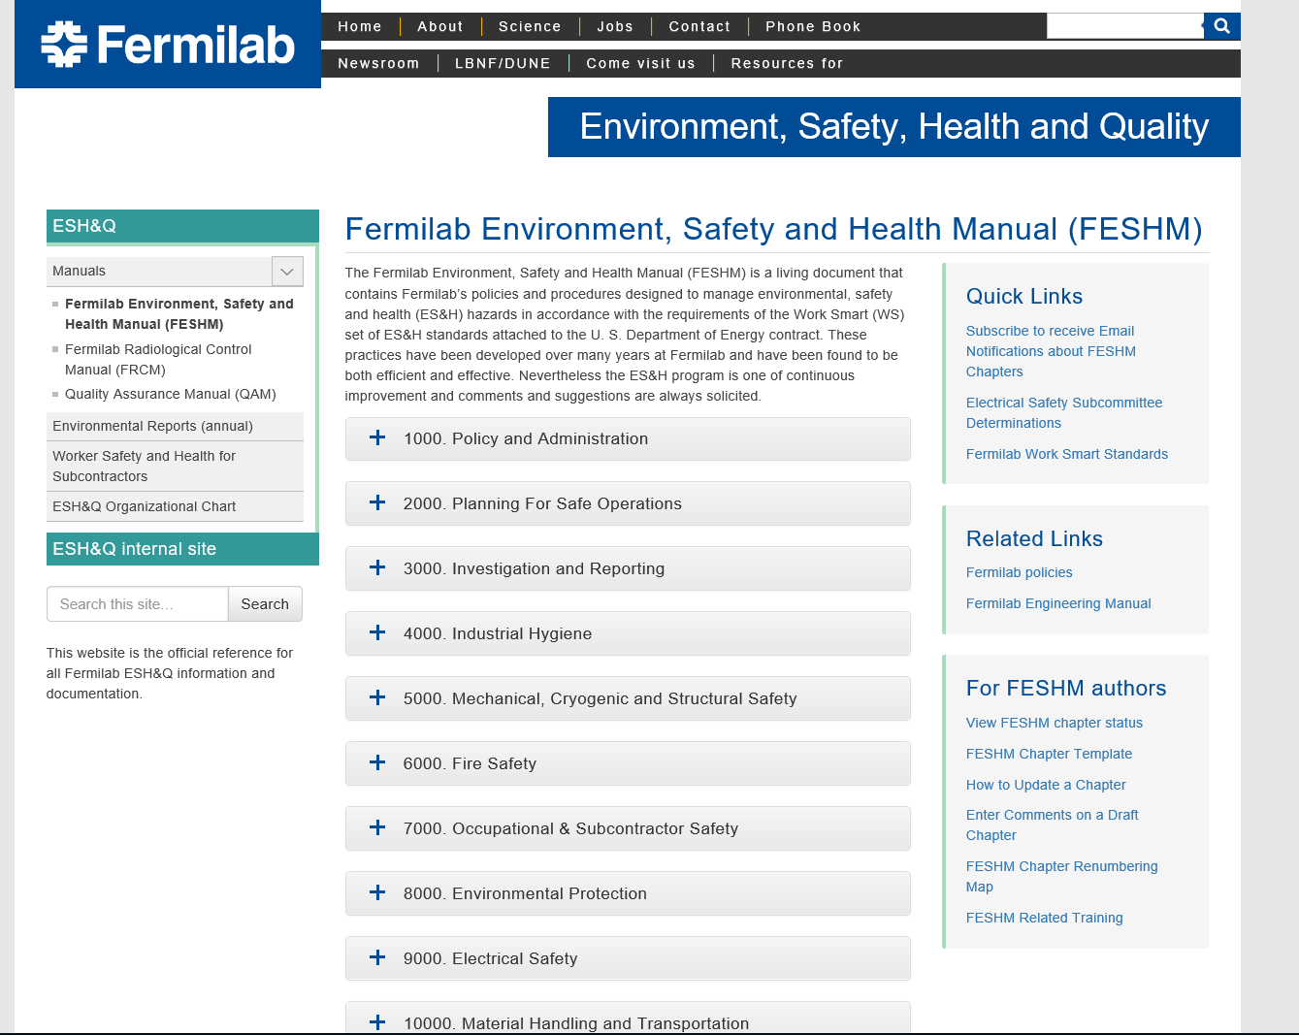

Slide 15
Structural Safety
Structural safety chapter 5100 includes applicable codes
All applicable codes need to be reviewed and agreed to by
Process defined for equivalency evaluation of European codes

Slide 16
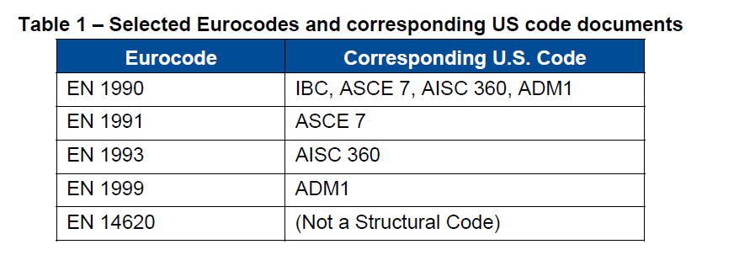
Eurocode Equivalency White Paper

Slide 17
Operational Readiness Clearance
Chapter 2005 of FESHM
Not addressed at this time, it will be required prior to operation
Experiments make a request to have systems reviewed as part of operational readiness

