Slide 1
Cosmic Frontier Strategic Planning
Josh Frieman
Head, Particle Physics Division
Presentation to Fermilab PAC
July 18, 2018

Slide 2
FNAL Cosmic Planning
The lab is undertaking a 3-phase strategic planning process on its Cosmic Frontier (CF) program this year:
  Phase 1: identify the critical, unique capabilities that the laboratory must preserve for the health of the OHEP CF program;
  Phase 2: identify the major CF activities that the lab should pursue over the next 5-10 years, that build upon these capabilities and that align with OHEP priorities;
  Phase 3: put in place a sensible program for redirection of effort from CF activities not deemed essential in the first two phases of the planning process.
This process, which OHEP has endorsed, will address and respond to the optimization guidance received last Fall from DOE.
The Fermilab cosmic planning optimization white paper constitutes our initial Phase 1 plan.
For scale, Cosmic program currently comprises ~4% of the lab budget.

Slide 3
FNAL Cosmic Activities
Addressing P5 science drivers:
  Understand cosmic acceleration (inflation and dark energy)
  Pursue physics of neutrinos
  Pursue new physics of dark matter
Leading DES, currently world-leading dark energy experiment
Partnering with labs & universities on future program:
  Dark Energy: DESI construction, LSST operations
  Dark Matter: G2 experiments SuperCDMS SNOLAB, LZ, ADMX
  Inflation, neutrinos, dark sector: CMB experiments SPT-3G, CMB-S4
Astro theory and Detector R&D programs support and stimulate these efforts.
Planning process will review this portfolio and lay out a focused program of R&D, projects, and theory that optimally exploits the lab’s unique capabilities.
Lab has ramped down its efforts on Auger, SDSS, DAMIC, COUPP, PICO, DarkSide, Holometer.

Slide 4
FNAL Critical Capabilities on the Cosmic Frontier
Precision assembly, integration, and testing at SiDET
Cryogenic engineering & operations
Radio frequency engineering
Innovative detector R&D
Design, construction, and operation of cosmic surveys
  including advanced data processing and handling
Project management for construction & operations
Theoretical Astrophysics and Cosmology theory
  Dark sector phenomenology, cosmic surveys, numerical cosmology
These capabilities leverage and synergize with Energy & Intensity Frontier activities.

Slide 5
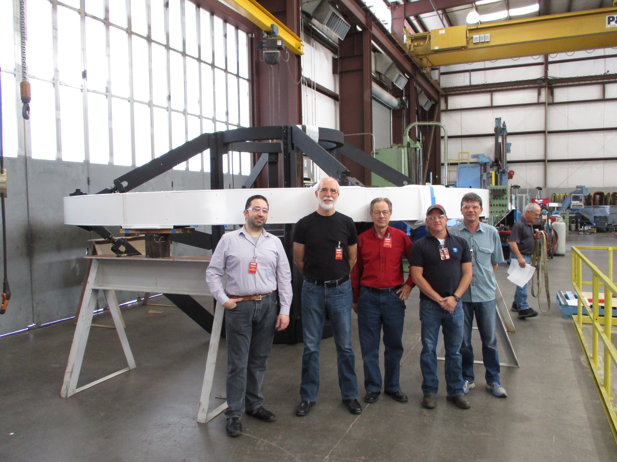
FNAL Critical Roles on the Cosmic Frontier
DES: led construction, operations, management, key science roles
DESI construction: management, corrector, database, fiber positioning SW, CCD packaging & testing (build on DES)
LSST operations: data handling, computing ops, scheduling & strategy (build on DES)
CMB: SPT-3G cryostat, detector packaging and FP design, camera installation, survey ops (groundwork for CMB-S4)
SuperCDMS: cryogenic design, warm electronics, calibration, on-site infrastructure
LZ: cryogenic and process control engineering
ADMX: lead lab
Astro theory: dark phenomenology, analysis, seed projects
Detector R&D: ultra-low-noise CCD readout, mKIDS, high-Q cavities & single microwave photon detectors (quantum)

Slide 6
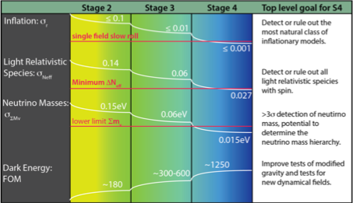
Cosmic Surveys: Science Goals
Timeline
2016
~2022
~2030

Slide 7
DES Year 1 Cosmology Results
ΛCDM+Planck CMB predicts 10³ growth in fluctuations to 4% (with no free parameters).
DES Y1 results agree with this prediction and for the first time achieve comparable precision to CMB.
DES Y3/Y6 results will improve substantially over this.
DES ranked in highest-priority group in recent HEPAP portfolio review.
This is the beginning of a decade-long program with DESI/LSST that will test ΛCDM on many scales and times.
DES Collaboration 2017

Slide 8
Transition to LSST DESC and Survey Operations
Major simulation effort underway to support Dark Energy science analyses in advance of operations
DESC contributions:
    WLpipe - framework for Weak Lensing analysis on catalog outputs from data management
    Workflow management systems
    Cosmosis - framework for combining outputs of WLpipe and other analyses, running MCMC, producing cosmological parameters
    Observing strategy – simulating and evaluating different strategies
    Data access - building tools and documentation for accessing data products and software
    Scientific validation - validating simulated data sets for quality and science-readiness
  Survey Operations contributions:
    Observatory support, data release systematics, community support, production scientist, service professional, file services and db admin, IT systems admin, WAN manager and architect
7/18/18
Cosmic Frontier Planning

Slide 9
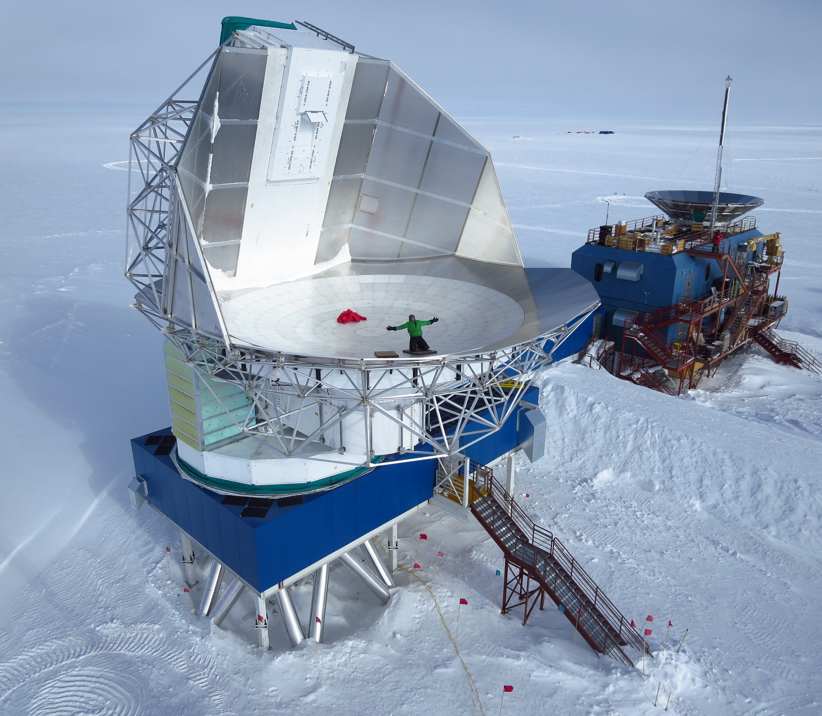
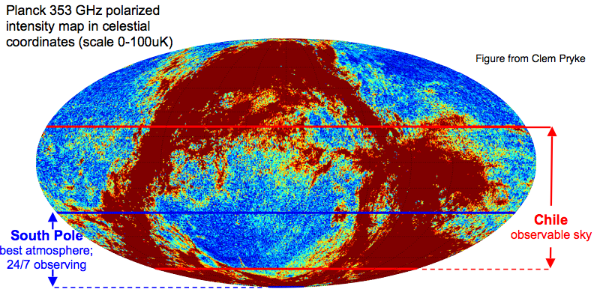
Cosmic Surveys: CMB
SPT-3G operations (2018-2023)
  4-year survey from 2018-2021
  Science analysis
CMB-S4 project (2019-2026)
  Notional timescale: CD0-CD4 from 2019-2026
  400,000+ TES detectors at 100 mK
  Two sites: Chile and South Pole
  Potential FNAL roles:
      Detector readout electronics
      Cryostat and cryogenics
      Detector and camera integration
CMB-S4 operations (2027-2036)
  8-year survey with science analysis

Slide 10
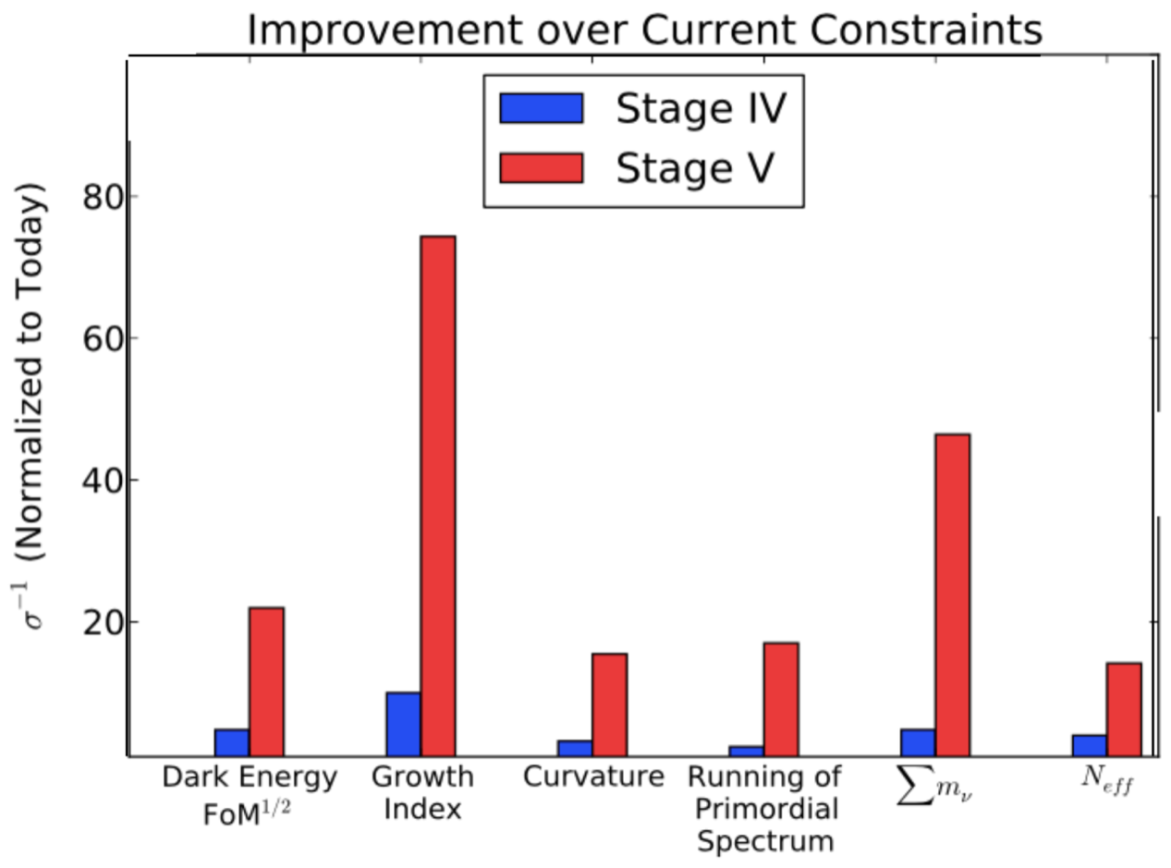
Cosmic Surveys: A Future Stage-5 DE Experiment
Dark Energy Cosmic Visions report
(arXiv:1604.07626)
Future cosmic surveys can make significant improvements in key physics constraints beyond Stage IV
Southern Spectroscopic Survey
    Overlap LSST & CMB-S4 surveys
    Science goals: dark matter, dark energy
    Exploit FNAL project and hardware expertise
New Directions
    21 cm:
        Higher redshift / more volume
        Science: Dark energy, cosmic expansion, inflation, neutrinos

Slide 11
Future Southern Spectroscopic Survey
Instrument Overview:
  Spectroscopic survey to overlap with LSST and CMB-S4
  Scope of project varies depends on strategy and goals, roughly:
      Spectrograph with ~5k-50k fibers on a 4-10m class telescope
      Operations starting in mid-2020’s to early 2030’s
Multiple science goals:
      Dark Matter: Indirect astrophysical probes of dark matter from galaxy and lensing measurements
      Neutrinos: Cosmic >4σ detection of sum of the neutrino masses
      Dark Energy: More objects over more volume = better constraints
      Joint analysis with LSST and CMB-S4 surveys will improve overall constraints and provide consistency checks of cosmological information
FNAL Expertise:
    Build upon instrument/ops/data/science expertise from SDSS, DES, DESI

Slide 12
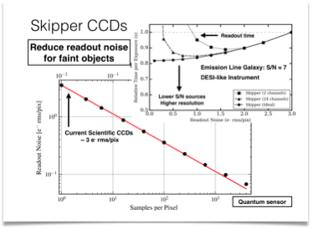
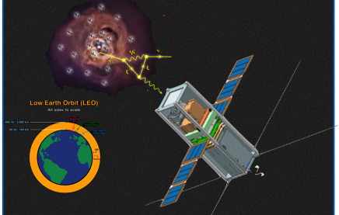
Cosmic Survey R&D: Skipper CCDs
Sub-electron readout noise CCDs J. Tiffenberg ECA
Developed on LDRD, many applications across cosmic frontier:
      Electron recoil dark matter (SENSEI, arXiv: 1804.00088)
      Quantum imaging / sensors LDRD (J. Estrada)
      Coherent neutrino nucleus scattering
      Future southern spectroscopy survey (A. Drlica-Wagner)
      LDRD (S. Timpone) for X-ray CubeSat to search for astrophysical DM
3.5 keV X-ray
DM CubeSat

Slide 13
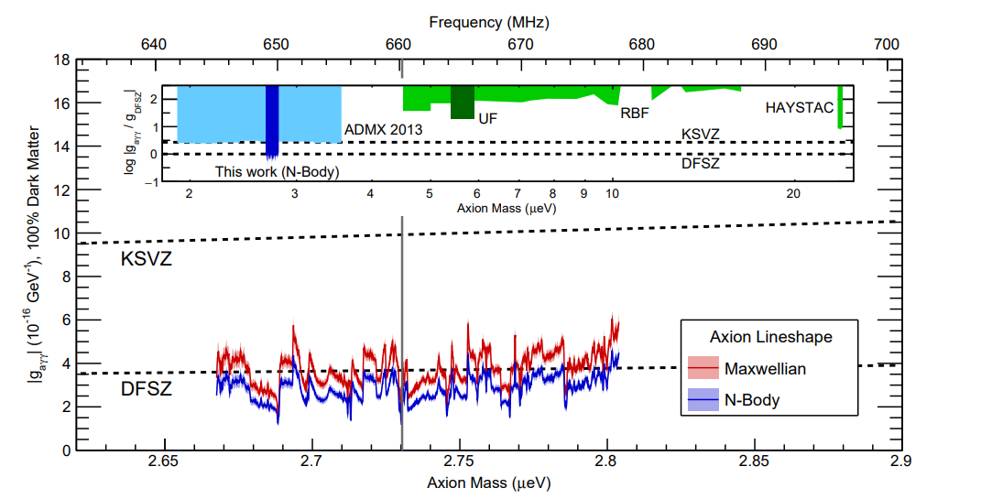
First Results from ADMX-G2
ADMX-G2 is first experiment to reach sensitivity needed to directly test most axion dark matter models.
Future runs will expand mass (frequency) coverage.
ArXiv 1804.05750 & PRL April 2018

Slide 14
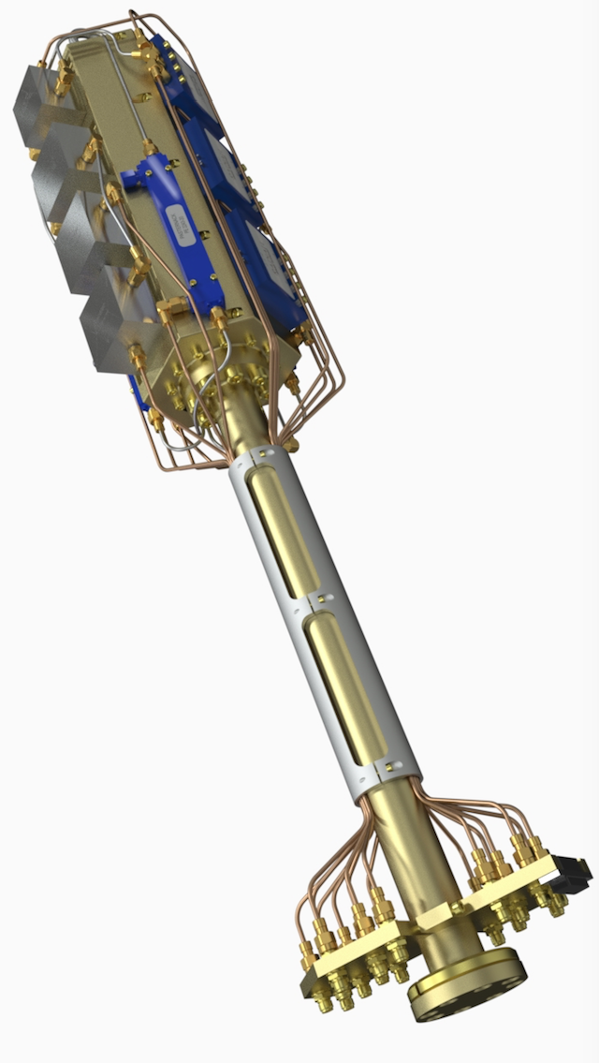
Fermilab Roles in ADMX-G2
Lead lab for ADMX operations
  Operations manager (Andrew Sonnenschein)
  Coordination between groups (U. Washington, Washington U., U. Florida, UC Berkeley, LLNL, LANL, PNNL)
  Responsible for budget and schedule, interface with DOE.
Cryogenic engineering
Cavity system integration tests
Data management
Analysis Coordinator (Aaron Chou)
R&D towards next generation experiment (quantum sensors, resonators)
Fermilab’s cryo electronics package design

Slide 15
Timeline For Current and Next Generation Experiment
ADMX- G2 approved for operation through 2021 at U. Washington.
They hope to extend running at U. Wash. to 2024.
Next generation experiment could be located at Fermilab with construction starting as early as 2022.

Slide 16
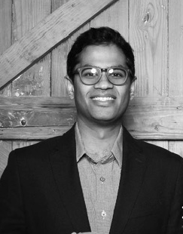
New R&D Consortium:
Quantum Metrology for Dark Matter Axion Detection
Funding from new cross-disciplinary DOE QuantISED program pending
Aaron Chou/Daniel Bowring (FNAL), David Schuster(Chicago): Qubit sensors
Konrad Lehnert(Colorado/JILA): Stimulated emission of photons from axions
Reina Maruyama (Yale): Rydberg atom-based single photon detection

Slide 17
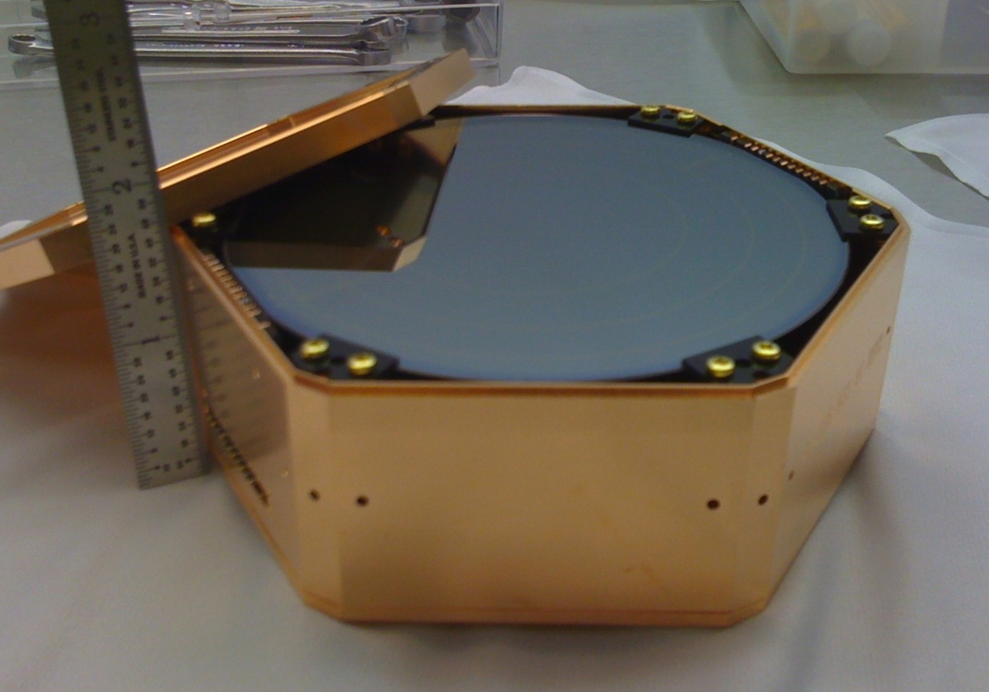
SuperCDMS SNOLAB
CRESST
DAMIC
Si iZIP
DAMA/LIBRA
Will provide superb sensitivity to low mass WIMPs with Ge and Si operated in both HV and iZIP modes
Ge iZIP
SNOLAB Ladder Lab
“future home”
CDMSlite
(Soudan)
CDMS II Si
SuperCDMS
Si HV
XENON100
projected
SuperCDMS
Soudan
Ge HV
sensitivity
PandaX
neutrino floor
LUX
PRD 95, 082002 (2017)
vacuum bulkhead for signals
One of three experiments in U.S. “suite” of Generation 2 dark matter experiments
Expected to begin operation in early 2020 and run for ~5 years
Facility designed for future upgrade to reach neutrino floor
iZIP
10 cm X 3.8 cm
Notes:
Explain the results just shown (while modest in improvement) will form basis for the searches done with G2
Aiming to build a completely new installation at SNOLAB…
Why go to SNOLAB? Reduce cosmogenic background and make a better, cleaner setup, replace very aged Soudan infrastructure, build a bigger experiment

Slide 18
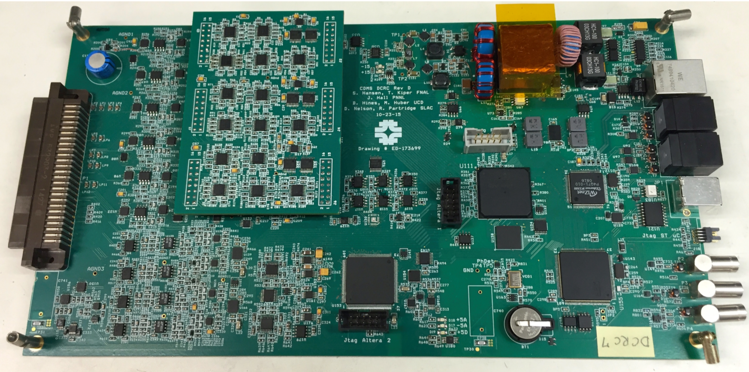
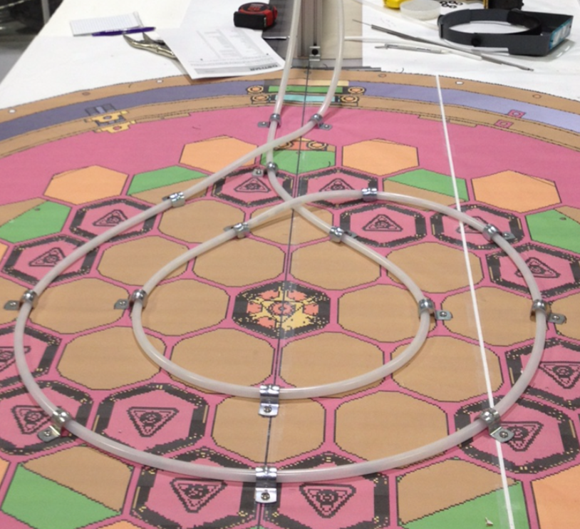
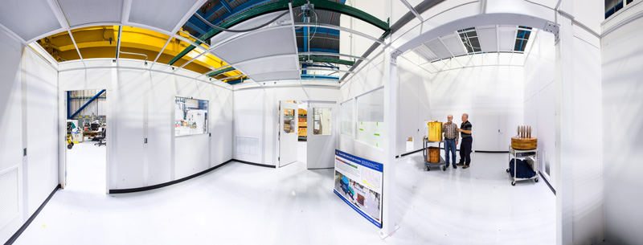
SuperCDMS at Fermilab
Detector control and readout card
FNAL continuing 20 years of involvement with SuperCDMS with major roles in G2 project:
  Cryogenic design
  Warm electronics design and fabrication
  Calibration system design
  Infrastructure and Integration for whole experiment
Lab-G is home-base for SuperCDMS efforts at FNAL; will commission cryogenic and calibration systems here.
SNOLAB Ladder Lab
“future home”
Calibration system prototype at Lab G
SuperCDMS cleanroom in Lab G
Notes:
Explain the results just shown (while modest in improvement) will form basis for the searches done with G2
Aiming to build a completely new installation at SNOLAB…
Why go to SNOLAB? Reduce cosmogenic background and make a better, cleaner setup, replace very aged Soudan infrastructure, build a bigger experiment

Slide 19
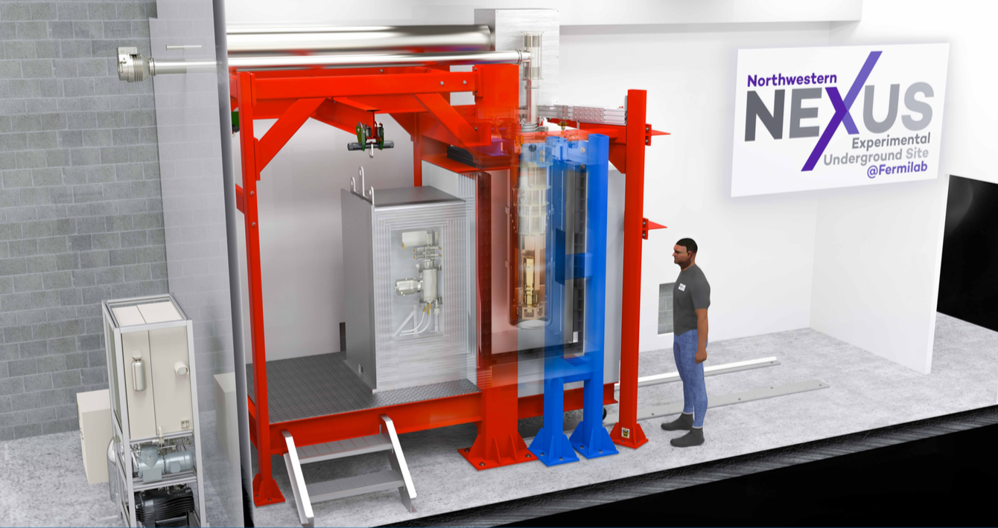
SuperCDMS R&D
Northwestern cryogenic testing facility (NEXUS) to be installed in MINOS near detector hall:
  Allows low background testing of “beyond G2” detectors
  Installation to take place this summer
  Developed in collaboration with FNAL SuperCDMS group and with support from FNAL detector R&D funds
SNOLAB Ladder Lab
“future home”
Notes:
Explain the results just shown (while modest in improvement) will form basis for the searches done with G2
Aiming to build a completely new installation at SNOLAB…
Why go to SNOLAB? Reduce cosmogenic background and make a better, cleaner setup, replace very aged Soudan infrastructure, build a bigger experiment

Slide 20

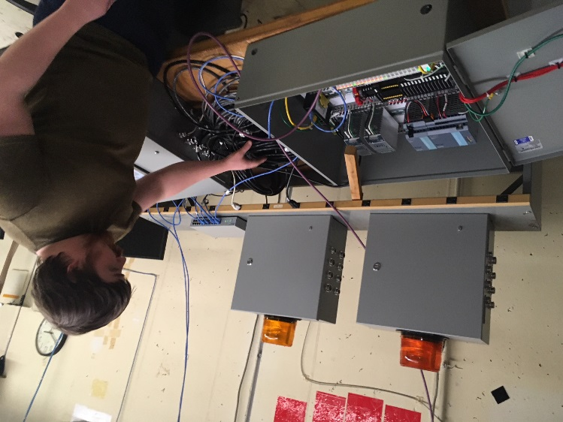
LZ
Flagship DOE dark matter direct detection experiment
Completed CD3 in February 2017
  First physics run April 2020
Construction ramping up rapidly
  Cryostat being leak checked at SURF this July (first big piece)
FNAL responsibilities
  Control system for cryogenic and xenon handling
    Including xenon recovery
Control Hardware at FNAL
  LXe circulation tower – key heat exchanging element in the purification system
  Xe Skin veto system – initial construction August 2018
  Safety – ODH analyses, oversight

Slide 21
LZ
arxiv:1802.06039
First physics paper on sensitivity of LZ
  Led by H. Lippincott as first LZ Physics Coordinator from 2016 to early 2018
Commissioning and verification coordinated by E. Dahl (joint FNAL with Northwestern) as Instrument Scientist,
Second Mock Data Challenge in full swing, with postdoc A. Cottle responsible for delivering high quality simulated data as LZ Simulations Coordinator

Slide 22
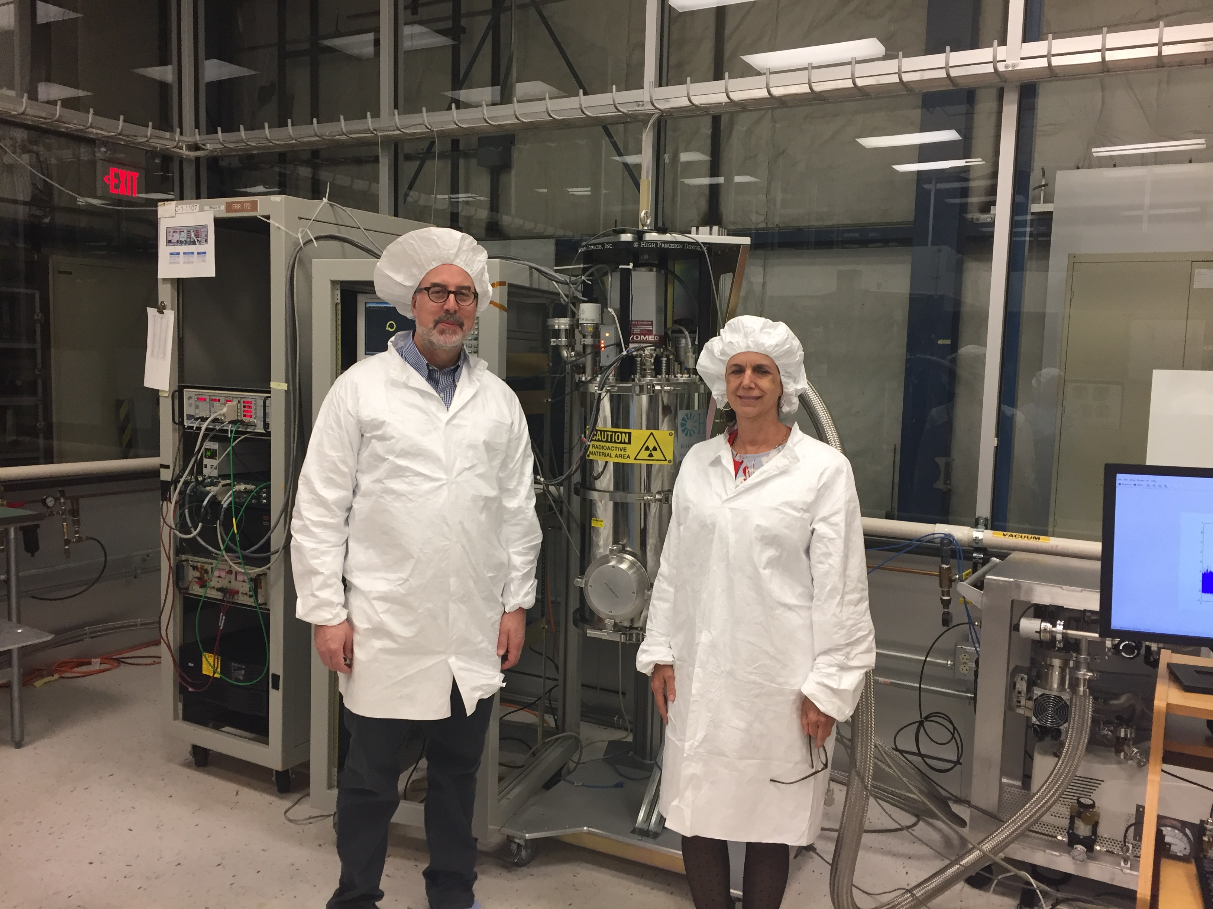
Cosmic Planning Process
Feb./March/April: 3 Astro mini-retreats
  Focused on 2026+ time-frame
  Broad menu of ideas, projects, concepts
  Broad discussions of where the field is/might be heading
March: Phase 1 Optimization white paper to DOE
April 26: summary presentation of mini-retreats to lab-wide scientist retreat (B. Benson)
June: formed Fermilab Cosmic Planning Steering Group
  Dark matter: Lauren Hsu, Hugh Lippincott, Andrew Sonnenschein
  Cosmic Survey science: Alex Drlica-Wagner, Brenna Flaugher
  CMB: Brad Benson
  Detector R&D: Juan Estrada
  Theory: Dan Hooper
  Herder in chief: JF
June: 2-day visit from Kathy Turner

Slide 23
Cosmic Planning Steering Group
Charge: A (well-)written document (10-20 pp) laying out a vision/plan/roadmap for cosmic frontier activities over the next 5-20 years, potentially under different funding scenarios
Include not only experiments but theory and the unique roles of the cosmic program at the lab (e.g., connections to the Energy and Intensity Frontiers particularly wrt neutrinos, training of postdocs and students, the future of the Fermilab Center for Particle Astrophysics, etc).
Steering group will take the lead but seek input from the Fermilab community and beyond. Group to consider how this will feed into broader planning processes (European PP plan, DOE Cosmic Visions, BRN workshops, Decadal Astronomy, future Snowmass and P5,...)
Goal: initial draft by late August, followed by mini-retreat to discuss with larger group. Advanced draft by October.

Slide 24
Emerging Themes?
Multi-pronged Dark Matter program:
  Direct detection
  Indirect detection
  Astrophysical (surveys)
  Collider
Cosmic Neutrino initiative:
  Cosmic surveys
  CMB (3G→S4)
  Theory/simulations
  Connections to/synergy with long-baseline program
  Cosmic/astro neutrino workshop to explore this
Cosmic Acceleration:
  Inflation (CMB)
  Dark Energy (DES→LSST→SSSI)

Slide 25
Rebooting the FCPA
Goal: energize connective community activities at the lab
LPC and NPC models seen as successful
  Host/support visiting scientists
  Host graduate students
  Host community workshops and collaboration working meetings
  These will collectively make the lab an attractive, intellectually vibrant hub of cosmic activity
Questions to address:
  Value add to the lab and to the community
  Funding vs other priorities
  Synergies and connections with KICP at U. Chicago
  Connections with Argonne
  Chicagoland Cosmology community

