Slide 1
Muon g-2 Status and Outlook
Chris Polly on behalf of the Muon g-2 Collaboration
July 2018 PAC Meeting
17 July 2018

Slide 2
Charge
Muon g-2 Status and Plans
We ask the committee to comment on the status of the experiment, progress towards the first physics result, and the prospects for achieving the design sensitivity given the anticipated future performance of the accelerator and experiment.

Slide 3
Contents
Muon g-2 theory update
Highlights from the 2018 run
Remaining challenges and summer shutdown plans
Outlook for 2019 and beyond

Slide 4
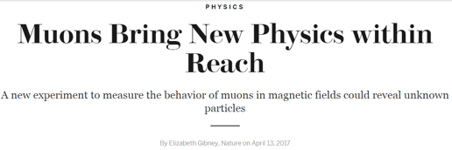
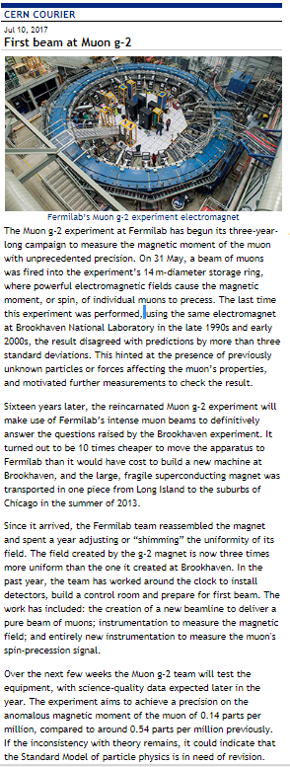
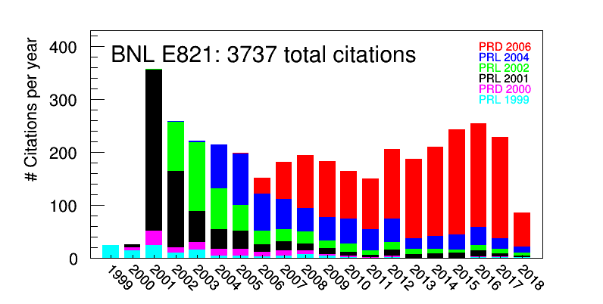
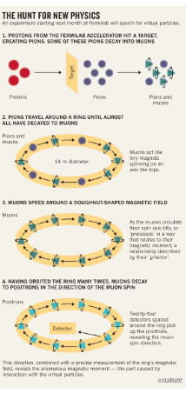
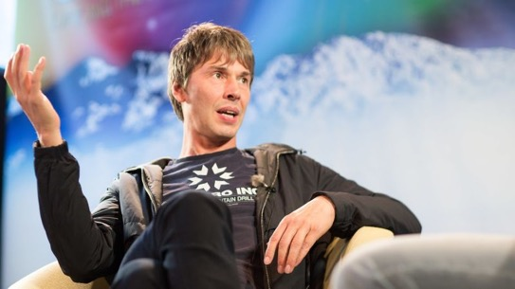
g-2 in the news
Nature 2017
Science 2018
CERN Courier 2017
RFM: And finally, what do you think are the most important outstanding mysteries in physics? (Gizmodo)
BC: One of the biggest discrepancies in particle physics at the moment is the g-2 experiment. It’s a measurement of the way the muon behaves in a magnetic field. The experiment shows a significant discrepancy with the Standard Model that’s getting more significant with time. It’s a low-profile experiment, but it’s extremely sensitive to new physics. It’s still running, but if I were to put my money on something that would signal new physics, it’s the g-2 experiment at Fermilab. I think it’s really fascinating.

Slide 5
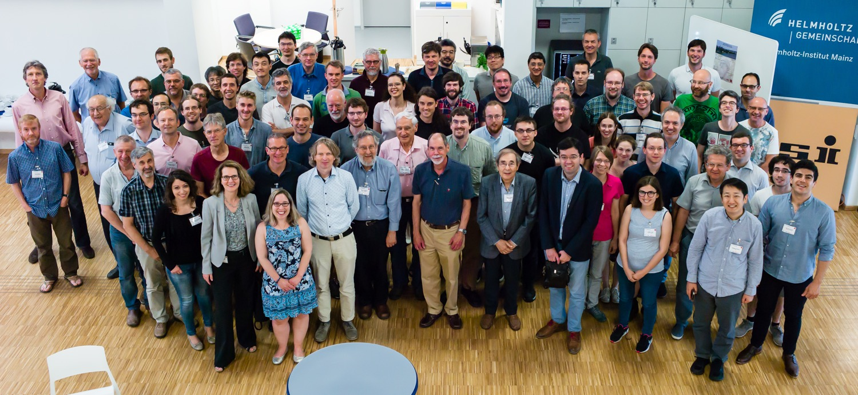
Muon g-2 Theory Initiative
Second Plenary Workshop of the Muon g-2 Theory Initiative
18 June 2018 - 22 June 2018
World-wide effort underway to advance the theoretical prediction prior to the experimental result
Anticipating final report to appear in early 2019

Slide 6
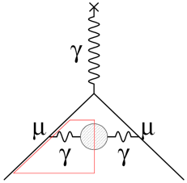
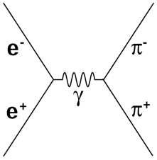
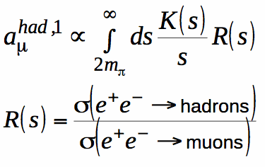
Data-driven hadronic evaluation continues to improve
New e⁺e⁻ data for HVP continues to contribute
  BESIII latest to map crucial 2π contributions
  Multi-hadron final states from b-factories
  CMD3 at VEPP2000
Data driven approaches to HLBL
  LE tagger at KLOE to measure γ∗γ∗ physics related to 70% of HLBL.
  New data-driven evaluation of the pion-pole contribution spot on (Hoferichter et al. arXiv:1805.01471)
arXiv:1802.06229

Slide 7
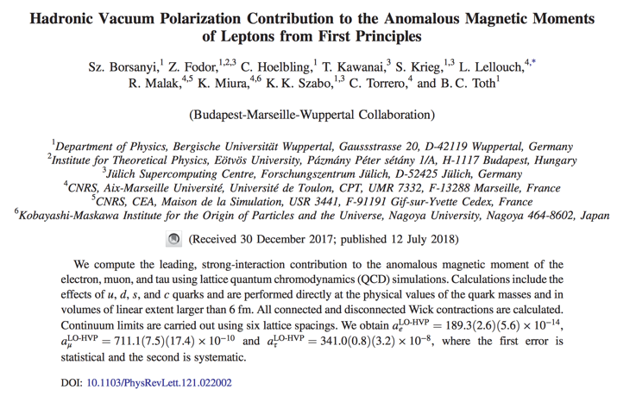
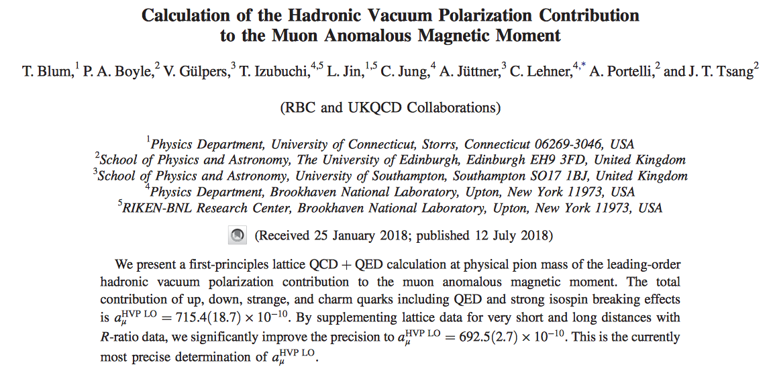
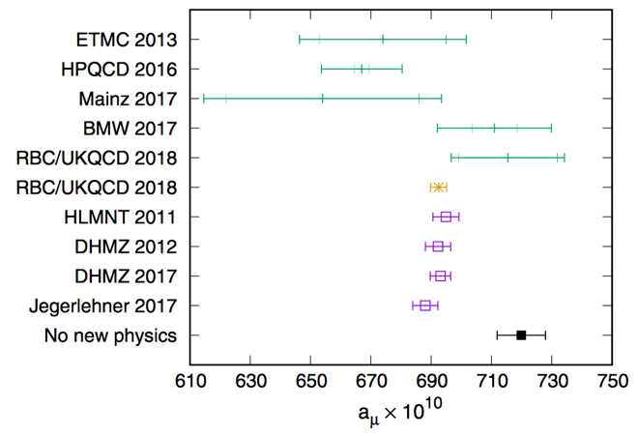
Looking for lattice to provide first-principles calculation
Two major groups with updated LOHVP calculations this month
Still need reduction in error for lattice to be competitive, but sense in community is that shrinking the error is going to be straight-forward

Slide 8
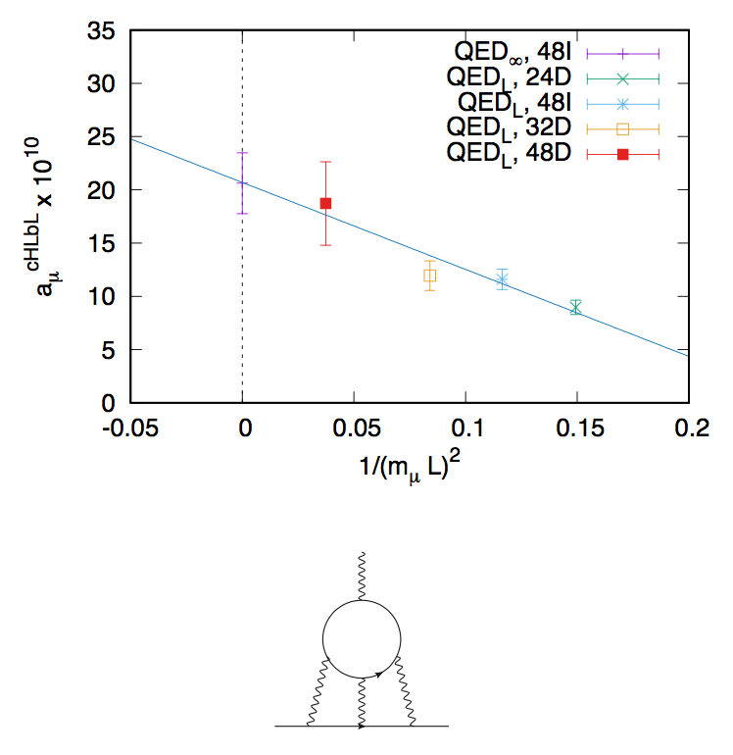
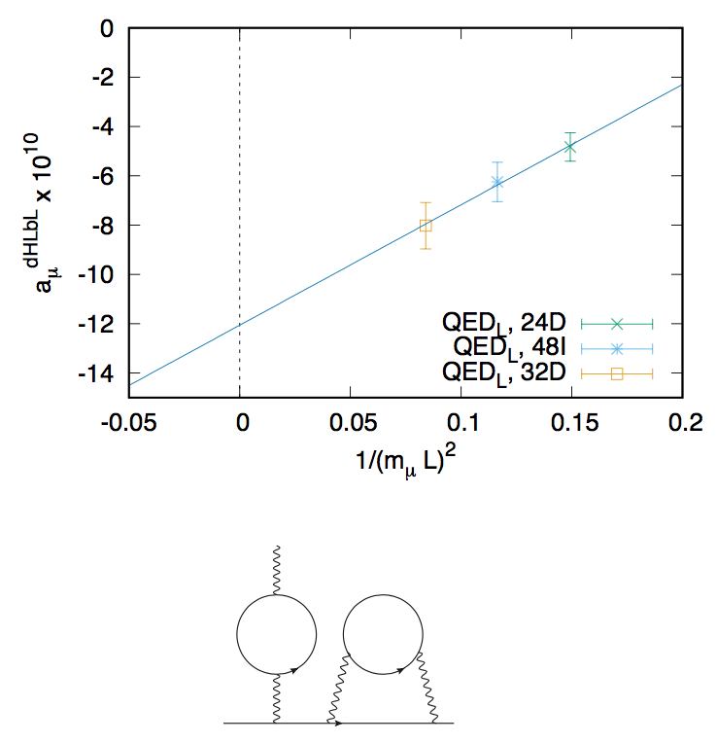

Hadronic light-by-light on the lattice
Calculation of connected plus leading disconnected diagrams now complete
  In good agreement with model calculation a_{μ}(HLBL) = 10.5 ± 2.5 x 10⁻¹⁰
  Already clear that HLBL unlikely to be source of 26 x 10⁻¹⁰ discrepancy

Slide 9
Contents
Muon g-2 theory update
Highlights from the 2018 run
Remaining challenges and summer shutdown plans
Outlook for 2019 and beyond

Slide 10
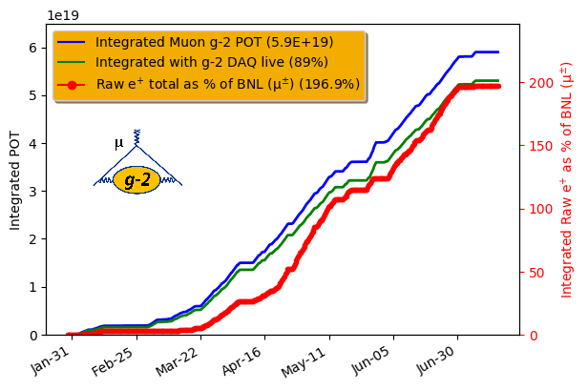
Muon delivery in 2018
Oct-Jan focus was on commissioning
  Commissioned higher rep rate (12 Hz design) Delivery Ring injection
  Implemented proton removal in the Delivery Ring
  Muon flux tune-up
  Fine shimming of magnetic field
  Surface coil commissioning
  Field calibration
  Quad conditioning
  Push to increase kicker voltages
Vacuum incident in February caused some damage to in-ring electrostatic quad plates → pushed production running back to end of March
Collected 2x BNL in raw stats over 3-month production run → after DQ cuts we will have a result surpassing the BNL precision!
  BNL precision: 560 ppb
  FNAL data in can: ~440 ppb
  Ultimate goal: 140 ppb
    100 (stat) ⨁ 70 (ω_{a} syst) ⨁ 70 (ω_{p} syst)

Slide 11
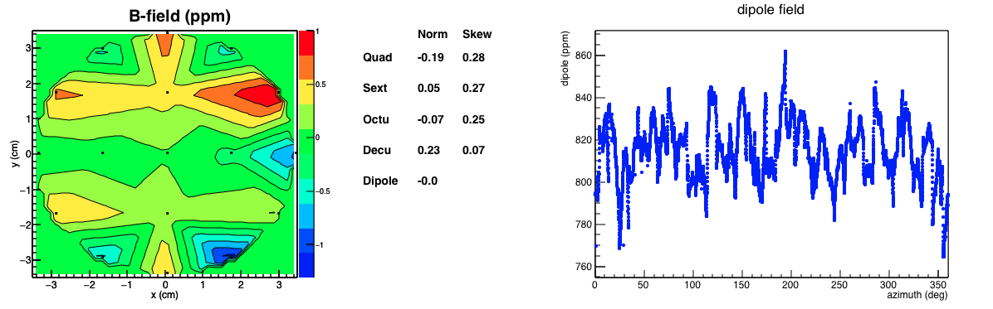
2018 highlights - field
Starting with field as uniform as possible is key to 70 ppb
  Significant improvements relative to BNL
Moments < 0.28 ppm! Goal was < 0.5 ppm
Variation of field +/-1ppm over storage region, 2x improvement from BNL
Dipole RMS =14.2 ppm
BNL RMS = 29 to 39 ppm
Just completed absolute calibration campaign last week with, met goal of 30 ppb consistency on the cross-calibration with trolley

Slide 12
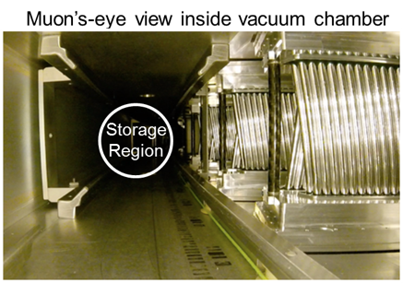
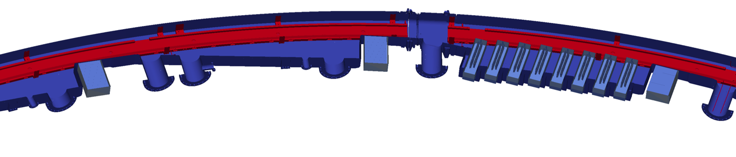
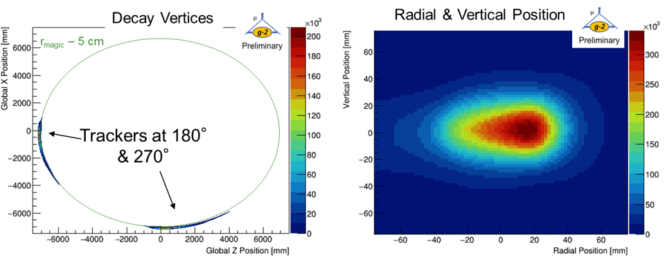
2018 highlights - trackers
Decay e+
Top down view of ring section
Vacuum Chamber
Calorimeters
Tracker
Extrapolate tracks back to point of tangency to get beam distribution:

Slide 13
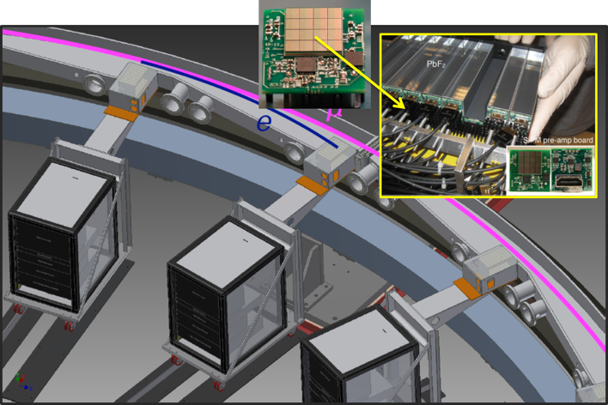
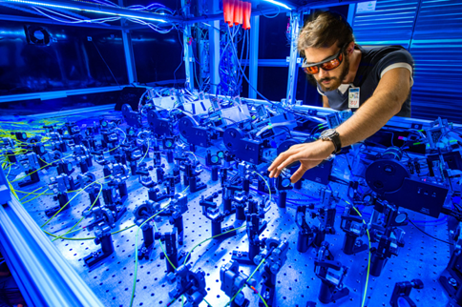
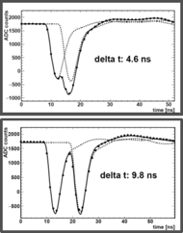
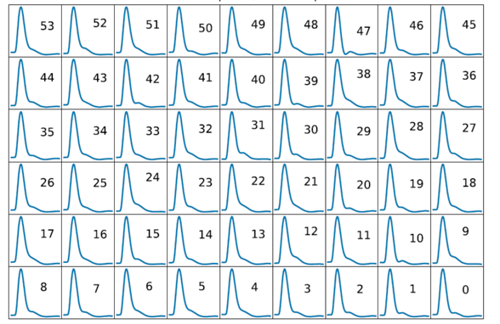
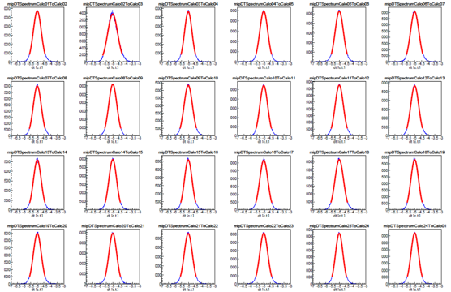
2018 highlights - calorimeters
54 PbF₂ crystals with individual laser calibrations into each channel
Inside the laser hut
Custom Pulse Shapes for all Xtals
Relative time alignment to 5 ps
Laser gain stability to 10⁻⁴

Slide 14
2018 highlights – analysis
Analysis algorithms very mature for experiment at this stage
  Benefit from E821 experience
  E989 versions under development for last couple of years and adapted for better instrumentation
    segmented calorimetry, in vacuo trackers, 800 MHz 12-bit waveform digitizers
Muon precession
  Two quasi-independent calorimeter reconstructions in production
  Algorithms in place to mitigate and assess impacts from key systematics
    losses, gain, pileup, coherent betatron oscillations
  Multiple independent ω_{a} analyses in progress, expected to enter combination for first physics result
Magnetic field
  Tracking looks good although temperature stability of the hall complicates analysis
  Absolute calibration completed last week, big effort at ANL to cross-calibrate absolute probes
  Aiming for two independent ω_{p} analyses for each important step in the calibration
Beam dynamics
  Several codes (BMAD, COSY, GEANT4-gm2ringsim) in place and being vetted against data
  Straw trackers providing detailed information on muon distributions and dynamics in ring
Analysis is going smoothly, but still much work to do before we can unblind and publish

Slide 15
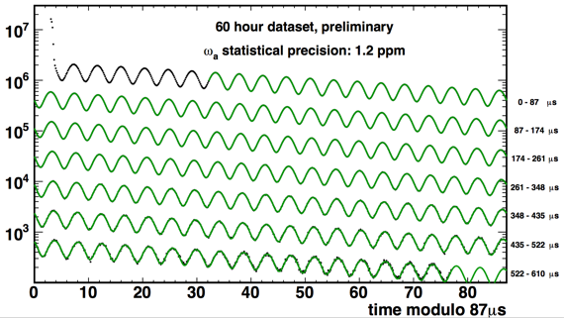
2018 highlights – 60 hour data set
Nearing completion on a full analysis of a 60-hour subset of the data (1200 ppb statistical precision)
  Exercising all the machinery and finishing code development on a more manageable data sample
Moving to a 9-day now (800 ppb) and will transition to the full sample this fall

Slide 16
Contents
Muon g-2 theory update
Highlights from the 2018 run
Remaining challenges & summer shutdown plans
Outlook for 2019 and beyond

Slide 17
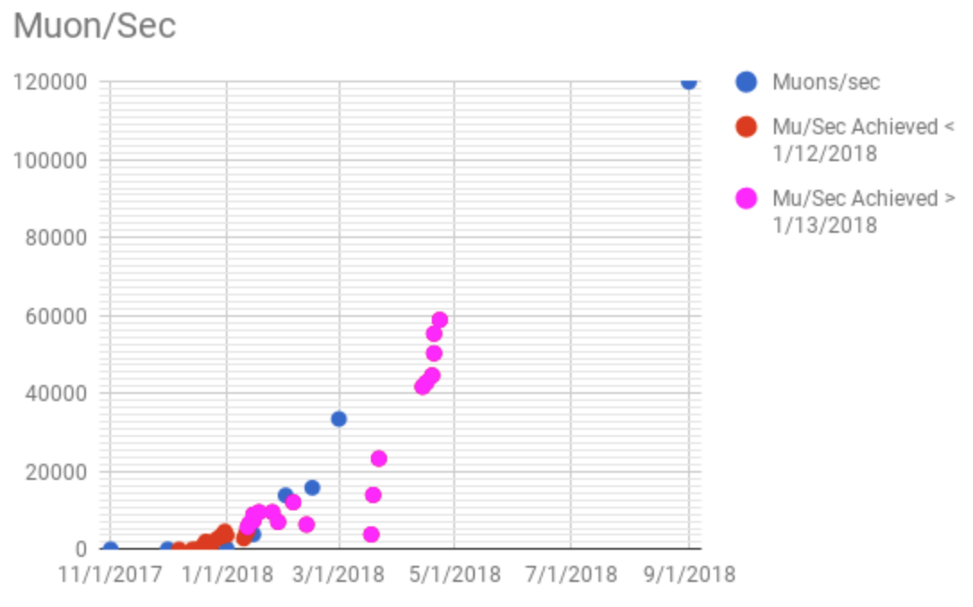
Top challenges
TDR Goal
Achieved 50%
Although we achieved ~2x BNL in FY18, we peaked at about ½ of design goal for the flux
We are under-kicking the beam at injection leading to increased systematics for the E-field correction and CBO
Overall reliability of the pulsed systems needs improvement

Slide 18
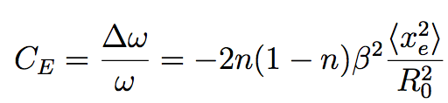
Momentum Distribution
Momentum distribution at FNAL is broader (high-side p tail) and not centered on p-magic
We care because of the implication for the E-field correction
0, by choice of γ = 29.3
 | <x-x₀> | σ_{x} | <x-x₀>² + σ_{x}²
BNL | 2 mm | 9.8 mm | 100 mm²
FNAL | 7 mm | 10.6 mm | 161 mm²
For a Gaussian,
<x_{e}²> = <x-x₀>² + σ_{x}²
E-field correction at BNL was 470 +/- 50 ppb…scale by 161/100 → 756 ppb +/- 80 ppb at FNAL

Slide 19
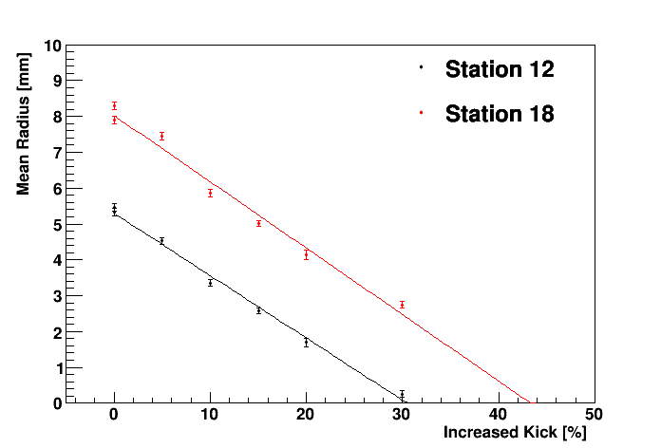
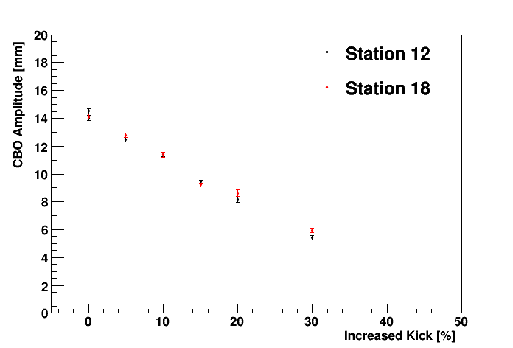
Summer shutdown plan
End of run test with
higher kicker HV
Priorities
  Routine maintenance and improved safeguards against magnet quenches
  Increasing the kicker voltage
  Improve reliability of operations
  Double the muon flux

Slide 20
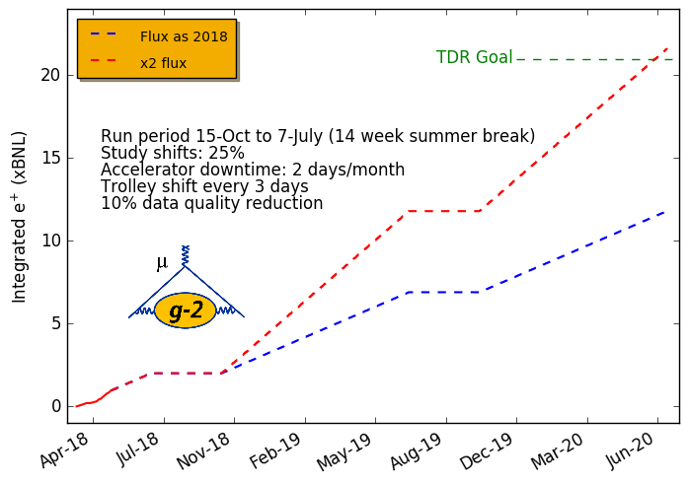
Path to higher flux
At current muon flux, g-2 would collect ~12x BNL statistics running in FY19/20 (full 40-week runs)
With improvements outlined below, can still achieve 21x BNL goal
Gain | Cause
1.40 | Installation of new open-ended inflector
1.20 | Installation of momentum-collimating wedges (cooling) in beamline
1.1-1.2 | Higher kicker voltages
1.1 | More reliable operation of electrostatic quads at higher voltage
1.05 | Installation of 2 faster-switching PS in upstream beamline
2.03 | TOTAL Product
Notes:
Add why are we at 50%

Slide 21
Busy summer
Key event
Resource Not Available
Resource Required
Partial Resource
Non MC-1 Resource
Experiment
Syst
Collab Mtg
First shots to MC-1
50% beam ready
90% beam ready
Magnet/Cryo
Inflector
Mu2e Cryo Work
Experiment
Vacuum
Partial Ring
Install
SRV On/Off
Ready
Inflector
Evaluate angle
Remove Old
Install in
Chamber
Install
Chamber
Test
Commission/Tune
Experiment
Quad
Test
Disassemble/ Repair
Test
Ext. Test
Elec
Cond
Experiment
Kicker
Integrate
Experiment
Bazooka
Design
Fabricate
PAB Test
Install
Test
Feedthrough
Design
Fabricate
Install
Test
Blumlein
Disassemble / Clean
Fab / Trans upgrade
Reassemble
Test
Infrastructure
A0 Controls
Cryo Maint.
Integrate Helium
Field
Abs Cal
Go Pro
Out
Calibration Work @ ANL
Go Pro
Reinstall / test
Abs Cal
Experiment

Slide 22
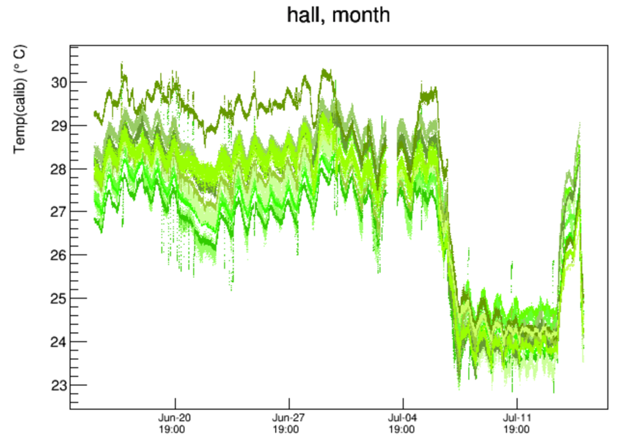
Other challenges
Data processing struggled in FY18, eventually got to point of just keeping up
  Will be challenging to keep up with rates doubled in FY19 and parallel re-processing of FY18 2x BNL likely
Temperature
  Lost control of hall temp
  in April/May
  40 kW experimental load
  much higher than design
  Very bad for field stability
  Looking at installing 28 kW
  chiller prior to next March
Turned
off expt.
Setpoint range

Slide 23
Contents
Muon g-2 theory update
Highlights from the 2018 run
Remaining challenges & summer shutdown plans
Outlook for 2019 and beyond

Slide 24
2018 (Run I) Analysis Structure
Q Data Conditioning
Q Fit (Uky)
a_{μ}(Expt)
~
T,A,E (UW)
ω_{a}
T,E (Cornell)
Recon W
T,BNL (UIUC)
T,A (U Miss)
ω_{p}
Muon
Dist
Recon E
⊗
T (China)
T (Italy)
Team A
Tracker
R (BU)
Team B
Fast Rotation
R (UK)

Slide 25
Publication Plan
Planning on three generations of a_{μ} publications
  1-2 x BNL (~400 ppb) collected in FY18 and aiming for publication by Summer 2019 conferences
  5-10 x BNL (~200 ppb) collected over FY18+FY19 with publication by end of 2020…caveat that we now enter unknown regime
  20+ x BNL (~140 ppb) collected by end of FY20 with final publication at end of 2021 or early 2022
Muon EDM and CPT/LV physics results in at least two generations
3rd a_{μ} pub
2nd a_{μ} pub
1st a_{μ} pub
CY18
CY21
CY19
CY20

Slide 26
Ideas for the future
Muon g-2 and Mu2e cannot run simultaneously…can swap in ~1 week if a few steps are taken now to accommodate that scheme
Physics beyond finishing the 20 x BNL μ⁺ run intertwined with Mu2e schedule and other program planning, ideas under consideration
  μ⁻ running
    At full rate, we can complete a BNL-level μ⁻ result with 5 weeks of running!
    Useful as a CPT test (μ⁺ vs μ⁻) and for setting limits on particular Lorentz-violating terms in a sidereal analysis
  Dedicated EDM
    Looking at options for adding addition Si trackers for x10 acceptance
    Still evaluating expected improvement in d_{μ}

Slide 27
Conclusions
Theory making outstanding progress, looking forward to release of ~300 page report from the Muon g-2 Theory Initiative early next year
  Continually incorporating new data-driven inputs
  Lattice becoming competitive, path forward is clear
Achieved ~2x BNL statistics in FY18…10% of ultimate goal
  Overall, experiment ran quite well
Executing plan to address remaining challenges this summer
On track for publishing a physics result surpassing the BNL precision in FY19
Our ‘ask’ to the committee: Now that the experiment has entered the production running phase, we ask the PAC endorse the original schedule with Muon g-2 operations prioritized within program planning to achieve the full 4-fold reduction in the error on a_{μ} by the end of FY20.

