Slide 1
FNAL High Field Magnets taskforce report
Anna Grassellino, Giorgio Ambrosio, X. Xu, S. Stoynev, S. Krave, V. Kashikin, V. Lombardo, P. Li
DOE HEP visit, Germantown
6/7/2018

Slide 2
Introduction
A. Grassellino

Slide 3
Magnet Task Force Goals – Charge Letter
Advisory Committee:

Slide 5
Task Force format
Met weekly – diverse group, with members with magnet and non magnet background (SRF, AD, PPD…); first two months we had weekly presentations on magnet technology, conductor, design etc…
We then created eight working groups and members met weekly for two months
In the last two months we met all together again to present results of the working groups and converge on a roadmap
Emphasis on high field magnets for future colliders, but one WG on other applications as well

Slide 6
Working Groups
Nb₃Sn Conductor:
  Nb­₃Sn improvement: achieve higher performance through Artificial Pinning Centers; reduce magnet operating margin by using conductor with higher specific heat at 1.9K-4.2K temperature wrt present state-of-the-art Nb₃Sn conductors; …
Cost assessment and reduction:
  understand cost drivers for high field accelerator magnets, and explore ways to reduce them including industry engagement;
  Provide feedback to coil and magnet fabrication technology aiming at cost reduction through industry engagement.
Nb₃Sn Coil & Magnet fabrication technology: develop Nb₃Sn coils & magnets aiming at:
  Reducing magnet operating margin wrt present technology;
  Fewer fabrication steps and/or less labor intense
  Explore possibilities for faster training
  Explore possibilities for cheaper and faster (sub-scale) testing
HTS Conductors & fabrication technology:
  Study other conductors (ReBCO, BiSCCO, Iron based, …) and assess best candidate(s) for FNAL HFM R&D.
  Develop technology for HTS coil fabrication
  Develop technology for HTS magnet assembly
  Explore possibilities for cheaper and faster (sub-scale/insert) testing
Understanding of training and Improved instrumentation:
  Develop and implement instrumentation providing better understanding of quench start mechanism in order to give feedback to the effort of reducing HFM operating margin;
  Assess state-of-the art and develop magnet protection techniques suited for HTS and hybrid (Nb₃Sn-HTS) magnets.
High Field Magnet design: develop HFM dipoles aiming at:
  16+ T aiming at cost reduction wrt designs presently under development
  20+ T aiming at Nb₃Sn and HTS integration
Other superconducting magnets
Equipment and test facilities: Explore options for improving equipment and test facilities in support of the HFM R&D at FNAL

Slide 7
General Findings – 1/2
We recognize that our magnet R&D program needed re-assessment
It had stronger emphasis on design, fabrication and test of large, accelerator quality magnets, causing long time constants for results
Should be strengthened in areas like more fundamental understanding of performance limiting mechanisms, short turnaround experiments to learn important lessons quickly (eg analogous of single cell cavity experiments in SRF)
Should be strengthened in involvement of young PIs, postdocs, students
From advanced instrumentation, to devising new small scale experiments, to plan for new facilities to support evolving R&D, we have agreed that the new R&D program will be more scientific and less engineering oriented

Slide 8
General Findings – 2/2
However, there was general consensus that the healthiest program would be pursuing fast turnaround studies in parallel with (and feeding to) demonstrating improved performance and cost reduction in an accelerator quality magnet
We have therefore identified 6 key areas and six corresponding PIs who possess unique expertise and ideas which, combined with FNAL unique infrastructure, have produced a strong and unique roadmap towards the successful demonstration of high field magnets for energy frontier colliders
While we recognize the importance of HTS, and have a proposal for HTS technology development, our program has a stronger focus on Nb₃Sn since it is our in house strength (from conductor to large scale magnets)

Slide 9
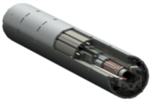
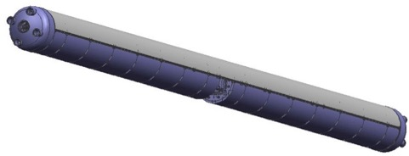
Nb₃Sn High Field Magnet Cost Analysis
Part | Labor (k$) | M&S (k$) | Total (k$)
Four insulated cables | 120 | 840 | 960
Four coils fabrication (w/o cables cost) | 840 | 240 | 1,080
Structure procurement & Magnet assembly | 220 | 820 | 1,040
Magnet Vertical test at BNL | 290 | 110 | 400
Yield assumptions (cost per magnet) |  |  | 519
TOTAL per MQXFA magnet |  |  | 3,999
Table 1: Cost analysis of MQXFA magnets by US LHC Accelerator Upgrade Project (CD-1 data)
MQXFA magnet = magnetic element w/o cold mass & cryostat
Cost has several main drivers: conductor, coil fabrication, magnet structure, risk mitigation features (vertical test & yield assumptions):
Our R&D program therefore focuses on delivering accelerator quality magnets with higher field and reduced cost, by tackling all drivers: double Jc of the conductor, simplify/optimize/eliminate coil fabrication steps, simplify/reduce structure cost, reduce or eliminate quench training
TARGET COST REDUCTION PER MAGNET: ~30%

Slide 10
Nb₃Sn High Field Magnet Cost Analysis
Part | Labor (k$) | M&S (k$) | Total (k$)
Four insulated cables | 120 | 840 | 960
Four coils fabrication (w/o cables cost) | 840 | 240 | 1,080
Structure procurement & Magnet assembly | 220 | 820 | 1,040
Magnet Vertical test at BNL | 290 | 110 | 400
Yield assumptions (cost per magnet) |  |  | 519
TOTAL per MQXFA magnet |  |  | 3,999
Table 1: Cost analysis of MQXFA magnets by US LHC Accelerator Upgrade Project (CD-1 data)
MQXFA magnet = magnetic element w/o cold mass & cryostat
Cost has several main drivers: conductor, coil fabrication, magnet structure, risk mitigation features (vertical test & yield assumptions):
Our R&D program therefore focuses on delivering accelerator quality magnets with higher field and reduced cost, by tackling all drivers: double Jc of the conductor, simplify/optimize/eliminate coil fabrication steps, simplify/reduce structure cost, reduce or eliminate quench training
TARGET COST REDUCTION PER MAGNET: ~30%

Slide 11
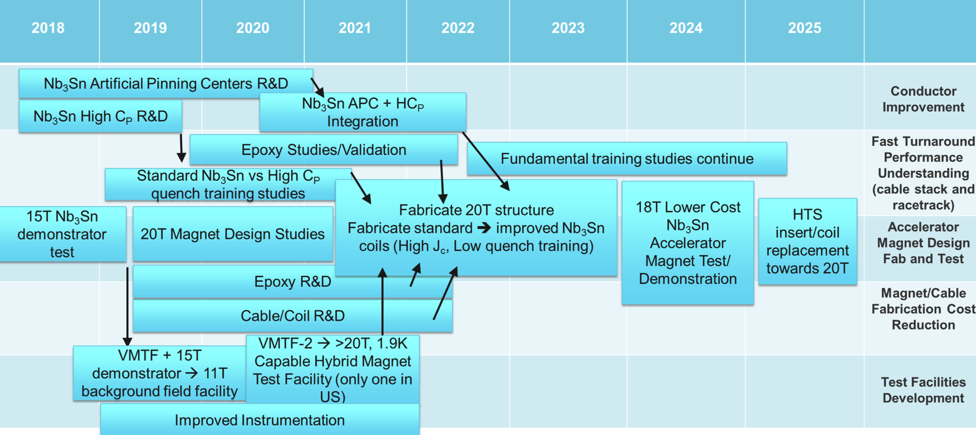
Fermilab HFM R&D Roadmap
European Strategy
P5
Target R&D: accelerator quality magnet demonstrating field 16-18T with 30% cost reduction (compared to state of the art + projection)

Slide 12
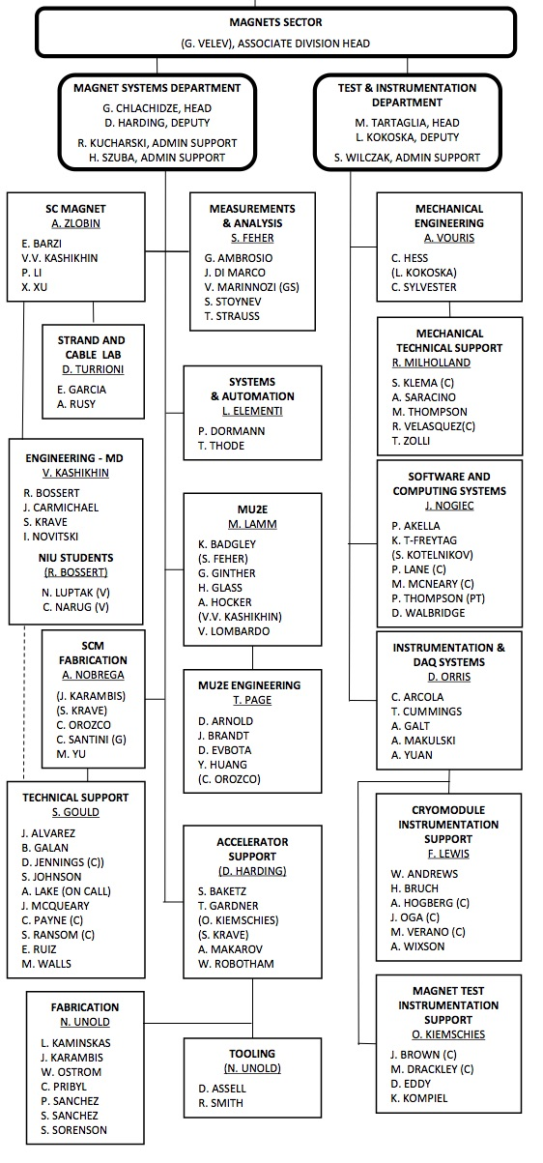
Magnet Sector Organization
About 100 staff members (scientists, technicians, engineers) with long term experience in magnet design, fabrication, test
Working on high priority projects like High Lumi AUP, mu2e, LCLS-2, FNAL accelerator complex magnet support, plus HFM R&D
New young talented hires -new postdoc from CERN (Tiziana Spina), new Toohig fellow (Marinozzi), and new associate scientist from ANL (Maria Baldini)
As in the case of SRF sector, we want to move more towards a matrixed model where people contribute to both projects and R&D for best efficiency and output

Slide 13
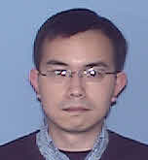
PIs and new organization to strengthen emphasis on R&D
Giorgio Ambrosio
Program Technical Coordinator and Deputy Group leader (2020)
Anna Grassellino
R&D advisor
George Velev, Group Leader and Program Manager
X. Xu
Conductor R&D
S. Stoynev
Fast Turnaround R&D, advanced instrumentation
S. Krave
Fabrication Cost Reduction
V. Kashikin
Magnet Design
V. Lombardo
HTS development
P. Li
Test Facilities

Slide 14
CAPST – FNAL-Northwestern University Partnership
Our Center for Applied Superconductivity with Northwestern University provides access to unique facilities for nano-characterization and unique knowledge (superconductivity theorists and experimentalists, material scientists)
We can expand from next year to include conductor science/R&D to pursue fundamental understanding of conductor performance (e.g. flux pinning) and push to beyond state of the art conductor performance
Prof. Jim Sauls
Professor of Physics
Max Planck Research Prize, 1994
John Bardeen Prize, 2012
Fritz London Prize 2017
Prof. David Seidman
Walter P. Murphy Professor of Materials Science and Engineering
Founding Director of the Northwestern University Center for Atom-Probe Tomography (NUCAPT)
Prof. Bill Halperin
Professor of Physics
Alfred P. Sloan Fellow
Yamada Science Foundation Fellow
Fellow, American Physical Society
Fritz London Memorial Prize, 2017
Prof. John Ketterson
Fayerweather Professor of Physics
Author of textbooks on Superconductivity and Physics of Solids
Fellow, American Physical Society
Fellow, American Association for the Advancement of Science

Slide 15
Conductor R&D
PI: X. Xu

Slide 16
Xingchen
PhD from Ohio State (M. Sumption) on Nb3Sn conductor R&D
Patent on APC
Postdoc
  At Fermilab , earned LDRD on Nb3Sn Conductor APC R&D
Associate scientist (Peoples Fellow)at Fermilab
  Since last year

Slide 17
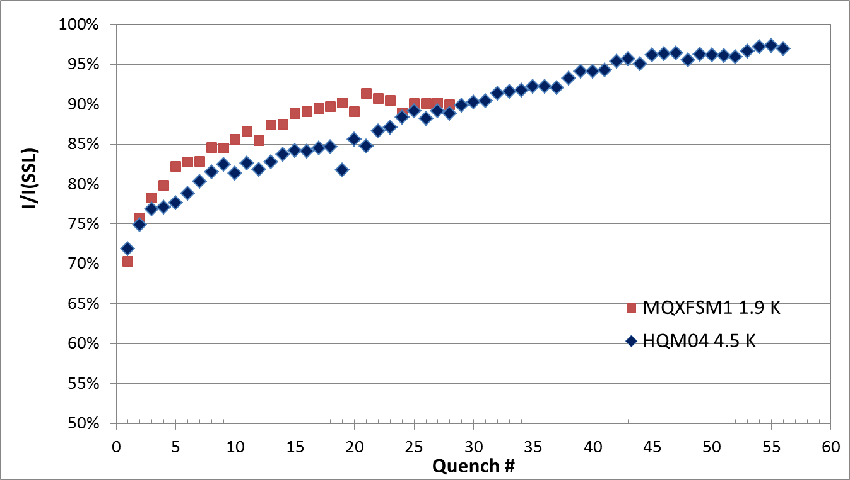
Overall problem statement for Nb₃Sn conductors
To make cost-efficient 16 T dipoles, even present best Nb₃Sn conductors are far from sufficiency.
Which properties of present Nb₃Sn conductors need to be improved for >16 T magnets?
Task 1. Increase Critical current density (J_{c}) – APC R&D
Task 2. Reduction of magnet training – high C_{p} conductor
I_{c}-B curve
Improved I_{c}-B curve
Critical Current, I, A
Load line: B ∝ W*I
B, T
B_{ss}
B_{ss}’
B_{c2}
J_{c} is the key to higher fields.
Insufficient J_{c} ➔ big coils ➔ high cost.
Projects like HE-LHC or FCC need ktons of Nb₃Sn: for 16 T increasing J_{c} of present state-of-the-art conductors by 50% can reduce substantially the conductor cost
Record J_{c} of Nb₃Sn has plateaued for nearly two decades (but subelement size D_{s} has been reduced).
Significant advance needs a revolutionary technology.
Nb₃Sn magnets train slowly: 20-25 quenches per magnet: take ~10 days
Training cost per magnet: ~$400k
Next circular collider: 2k-6k magnets
Training: cost – $billions, time – decades
Other: improvement of stress tolerance, reduction of a.c. loss, etc.

Slide 18
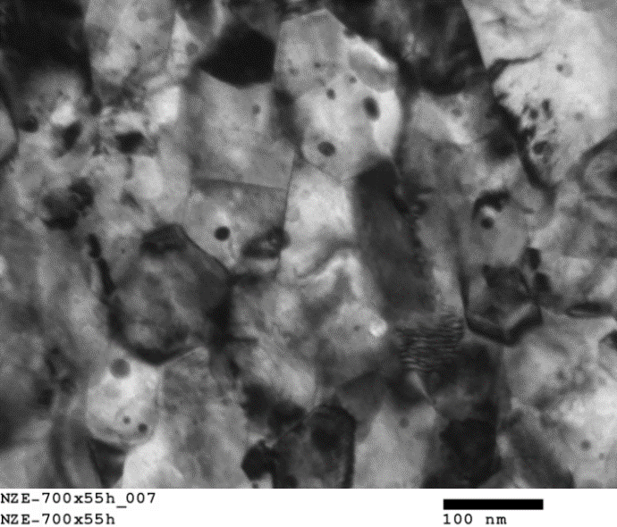
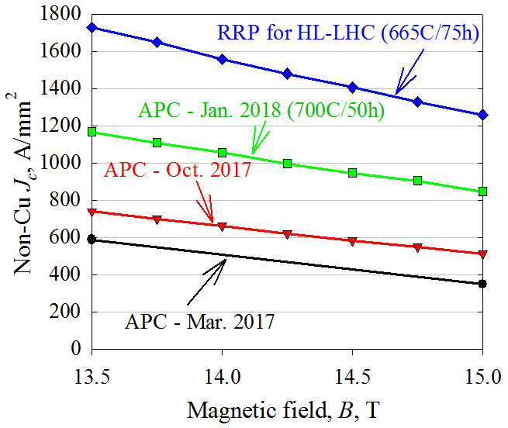
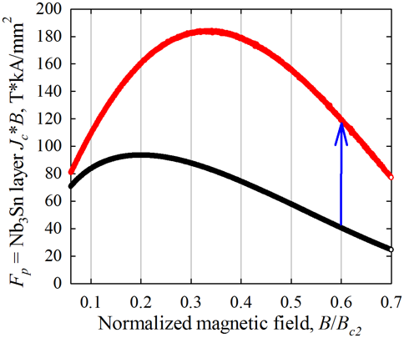
Task I – to further improve Nb₃Sn J_{c}: APC conductors
How? Engineering fluxon pinning – a “holy grail” since 1980s.
Finally realized recently – artificial pinning center (APC) technique.
Nb or Nb-Ta
Nb-1%Zr
Sn source (Cu, Sn, etc.)
Sn source + O source
Intra-granular ZrO₂ particles
Inter-granular ZrO₂ particles
X. Xu et al., US Patent # 9,916,919, Mar. 2018
(Regular technology)
(New technology)
Two effects of ZrO₂ particles:
  Grain size: 120 ➔ 40nm. F_{p} = J_{c}*B ∝ 1/GS
  Point pinning centers ➔ shifting F_{p,max} to 1/3B_{c2}
Tripling of Nb₃Sn J_{c} at 15-20 T.
Currently supported by Fermilab LDRD; working with a US company (Hyper Tech)
Does not harm wire manufacturing: 25μm D_{s}.
New type of conductors: need a lot of R&D.
APC Nb₃Sn
Non-Cu J_{c} (15 T) is 70% of RRP, with only 1/4 of Nb₃Sn%; non-uniformity limiting J_{c}.
Working to improve Nb₃Sn %:
Select designs & precursors
Optimize conductor recipe
Improve conductor quality
x3
Present state-of-the-art Nb₃Sn
X. Xu | Conductor R&D

Slide 19
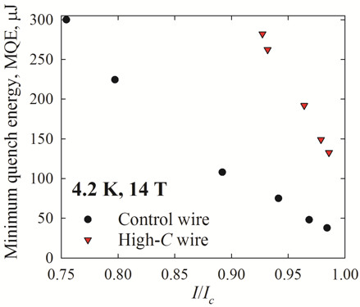
Task II – to reduce magnet training: high-C_{p} conductors
What causes magnet quench: external perturbations (epoxy cracking, conductor motion, etc.) supply heat Q, causing ΔT = Q/C_{p}. C_{p}: specific heat.
A new technology to improve C_{p} of conductors:
Replace Cu rods and some Nb₃Sn subelements by Cu tubes filled with high-C_{p} materials.
Gd₂O₃ has C_{p} ~1000 times higher than Cu at 2 K.
Compatible with present Nb₃Sn manufacturing.
Critical property – minimum quench energy (MQE)
As perturbation energy Q > MQE, quench occurs.
How to reduce magnet training:
  reduce perturbation Q
  increase MQE: need to increase conductor C_{p}
X. Xu et al., Supercond. Sci. Technol. 31, 03LT02, 2018
A mixture of Cu and Gd₂O₃ powders.
Cu conducts heat among Gd₂O₃.
In this wire the ratio was not proper.
First high-C_{p} wire:
The first high-C_{p} wire is far from optimization, but still MQE tripled.
Optimization for effectiveness:
1. Cu & Gd₂O₃ ratio and mixing
2. High-C_{p} filaments positioning
3. Increasing Gd₂O₃ to 2 vol.%
Expected deliverables:
Improve overall conductor C_{p} by a factor of ~20 at 1.9 K.
With proper design, this can improve MQE by > 10 times.
Wires drawn to 0.7 mm without breakages.
RRR or non-Cu J_{c} not affected.

Slide 20
Timeline and Milestones
Time:
Now
12/2018
06/2019
12/2019
12/2020
Solve variation issue, make J_{c} similar to present best
Push J_{c} above FCC spec, make 217-sub wires in kms
Push Nb₃Sn% to 40%, double present record J_{c}
Cable the new conductors and test.
Apply the method in RRP, push Nb₃Sn % to 60%.
APC conductors:
High-C_{p} conductors:
Optimize recipe of high-C_{p} tubes (e.g., Cu/Gd₂O₃ ratio)
Fabricate a 61-Re RRP wire with improved design
Fabricate a 169-Re RRP wire with optimized design
Cable the new conductors and test.
Fabricate racetrack coils, demonstrate reduced training

Slide 21
Fast Turnaround R&D, advanced instrumentation
PI: Stoyan Stoynev

Slide 22
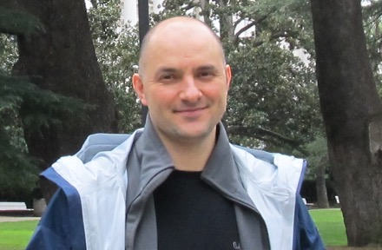
Stoyan
PhD from University of Sofia, Bulgaria
  2005
  In High Energy Physics
Postdoc
  At Northwestern University, 2006-2014
  (stationed at CERN in 2012-2014)
  Multiple contributions for CMS, LHC
Associate scientist at Fermilab
  Since January 2015
  Principal investigator for 11 T/15 T and LARP/AUP magnet testing at FNAL
  L3 deputy for the horizontal test stand upgrade (AUP)
  Magnet sub-project manager (SPM) in PIP-II
  Superconducting magnet data analysis and instrumentation development

Slide 23
Magnet science - main development goals and tools
Emphasis on R&D to understand fundamental
processes and behavior of superconducting accelerator magnets
Main Goals:
Understand training and reduce or eliminate it
  Current AUP plan for Nb₃Sn magnet training ~ 9 days per magnet
  optimistically - one week per magnet for training
  In a future high energy accelerator the projected number of dipole magnets reaches ~5000 – roughly 5000 /52 ~ 100 years/ # facilities for training
  The cost itself is about 15 k$ per quench (rough estimate based on AUP schedules)
Operate magnets closer to conductor limit
Tools:
Advanced, specialized, new and unique instrumentation (e.g. EM - map)
Faster and beyond state of the art quench detection
Racetrack, subscale samples studies

Slide 24
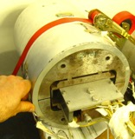
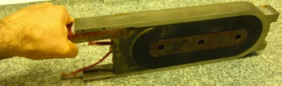
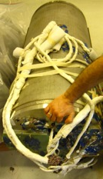
Fast turn-around R&D with subscale models (in external magnetic field)
Nb₃Sn racetrack
from an early
FNAL program
Traditional R&D hierarchy: strand-cable-magnet
Complexity “cliff” between cable and magnet.
Real magnets (project production) are not R&D friendly: costly, slow turn-around, limited instrumentation
(1) R&D focus on subscale samples – “the missing link”
small racetrack coils and cable stacks (~5x5x20cm; in a pressure)
Carry much of the complexity of a real magnet but cheaper and faster to make
Accommodate more instrumentation
Ideal testbeds of new technologies
Quicker turn-around
(see also Steve’s slides)
We aim to have the racetracks and cable stacks in external magnetic field for better approximation of magnet conditions
(see Pei’s slides)
First double aperture
11 T magnet at Fermilab
(MBHDP01)
A couple of examples of proposed R&D with sub-scales on next slides

Slide 25
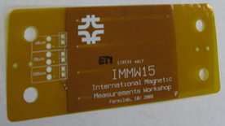
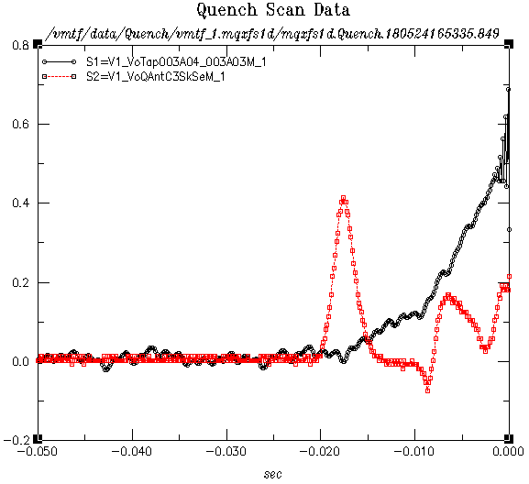
Example 1: Novel instrumentation map for quench understanding
Quench antenna (QA) on a “trace” and EM-map
Relying on many years of leadership in magnetic measurement probe and quench antenna development for accelerator magnet testing
Recent development of “trace” QA
  Thin and flexible electric circuit (“trace”) sensitive to cable
  movements or current redistribution (EM-waves in general)
  Cheap and sensitive, possibility for embedding during fabrication
Plan for grid mapping of a coil with quench antenna sensors – “EM-map”
  Unique development with very good potential
  Fast and accurate quench detection
  Possibility for “cold” multiplexing
  Introduce similar grids with different sensors
Quench antenna /QA/
(three channels)
AU
Beginning
of quench
Coil segment
voltage
From quench testing with the small antenna (above):
excellent signal-to-noise ratio (40/1)
with no on-board amplifiers
very clean signal
faster than coil voltage reaction
QA
Quench
detection
(0.0 s)
QA grid
for
EM-mapping
Coil
(Could be
a 3D map)
Combined with acoustic (a), temperature (t), (…) mapping – aiming to characterize and understand quench and training mechanisms
at fundamental level.
single
QA channel
Number of channels could be very large

Slide 26
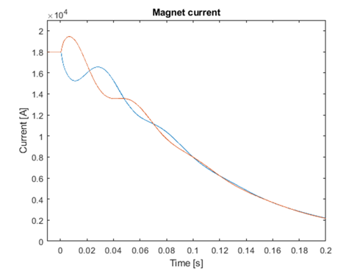
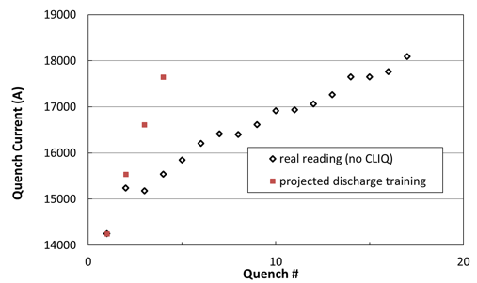
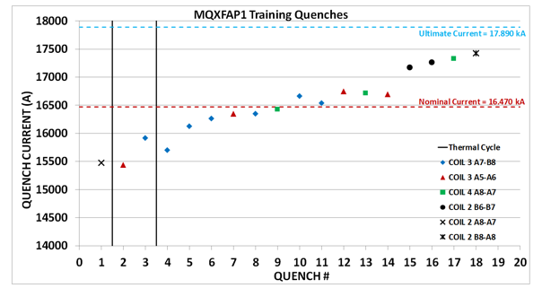
Example 2: Improve training by a capacitor discharge through the coil
Inducing “over-current” (and “over-force”) in quenching coil during training has the potential to skip training steps
A capacitor discharge through a magnet create typical LCR circuit vibrations
  Depending on the circuit over-current is created in part (or whole) of the coil
We plan to test this hypothesis on sub-scale
models and real accelerator magnets
  Needs optimization, higher capacitance (for magnets)
There are already indications the method works
  It was performed as a by-product of “CLIQ” testing
  (discharge is used for quench protection)
Over-current
The black markers are
real magnet data
If we set 1000 A over-current in the same coil for each quench and we assume the mechanical state after it is such that no spontaneous quench will happen below the over-current level, then
Quench current
level
(and
under-current
in part of the magnet)
AUP
AUP
simulation
AUP
Discharge was applied for
the first time
… after which the quench
current jumped and
changed location accordingly

Slide 27
Timeline and Milestones
  - Design and fabrication of
  quench antennas
  - High rate DAQ in place
  - First race track magnet
  fabricated
  - Securing a capacitor device
  for tests (“CLIQ” unit),
  find optimized testing
  scheme
  - Multi-channel acoustics
  instrumentation in place
  - Fabrication and testing of two more race tracks, analysis
  - Design and optimization of a capacitor discharge
  device for magnets
  - Fabrication and commissioning of the “stack-testing”
  device
  - Initial results from training studies (on wires and wire
  “structures”)
  - Preparation of “cable-stacks” for studies
  - First tests with ultrasound quench initialization
  - Refined techniques with “other” instrumentation
  methods, grid developments
2019 | 2020 | …
  - Testing of the first race track magnet
  (including training tests)
  - Fabrication and testing of two more
  (different parameters) racetrack magnets
  - Analysis of data, documentation
  - Optimized versions of the quench
  antennas, documentation
  - Prototypes with “other” instrumentation
  methods (optics, fiber-optics; SC wire grids;
  temperature sensors; “second sound”)
  - Cold signal processing/multiplexing – first
  tests; explore wireless transmission
  - Initialization of a quench-training
  studies program
  - Design and optimization of a “stack-testing”
  device (pressure in external magnetic field)
  - More race tracks and summary results
  - Fabrication and commissioning of a capacitor
  discharge device for magnets
  - Multi-spot heater instrumentation on a race
  track and cable stacks, analysis
  - Testing of cables and cable-stacks, analysis
  - Combined instrumentation grid techniques –
  finished products
  - Potential of ultrasound initialized quenches
  explored further (device design)
S. Stoynev | Fast turnaround R&D

Slide 28
Nb₃Sn Coil And Magnet Fabrication
Performance Improvement and Cost Reduction
PI: S. Krave

Slide 29
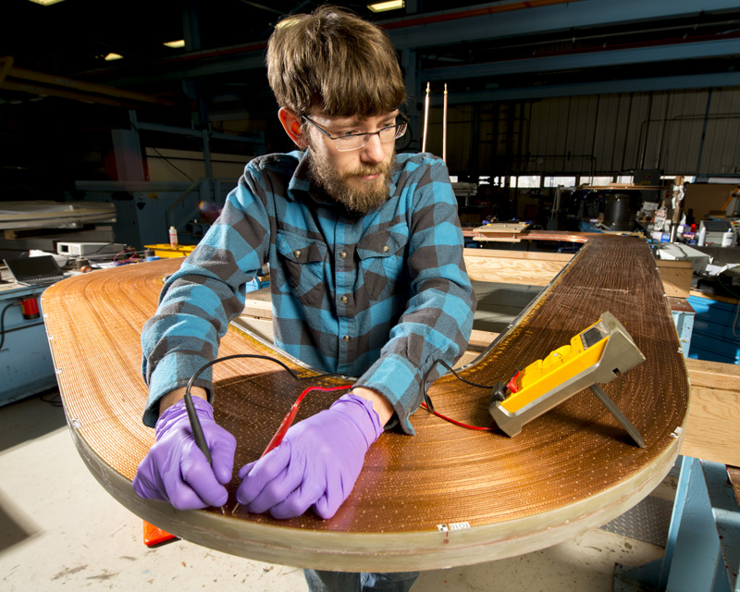
Steve!
Studied Mechanical Engineering and Theatre Production at Bradley University
Started at Fermilab as a summer student in 2010
Eventually got hired…
  Worked as tech for a while
  Built some magnets
  Developed a process and potted TQ coil with Matrimid, tested up to 98% of SSL
Led CLAS12 Fabrication effort after some initial hiccups
  Peak rate ~1 completed coil per month with ~5 technicians
Currently bouncing between building a new inflector for g-2, 15 Tesla, AUP and Mu2e

Slide 30
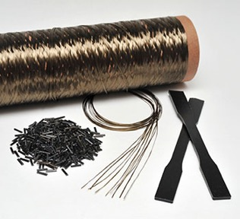
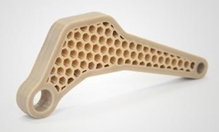
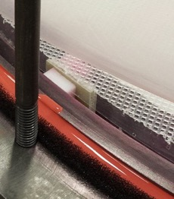
Building Training Resistant Magnets
Training appears to be a result of an evolution of interface conditions as higher and higher forces are experienced by coils in operation. This can be addressed through better control of magnet pre-stress to some extent as well as improvements to the coil composite structure.
Rethink insulation
  Is something more robust than S2 Fiberglass available?
  Are there better matrix materials available?
  Can we reduce and/or mitigate energy release during energization
Rethink process
  Is our Current VPI Scheme sufficient for other resins?
Rethink interfaces
  Can epoxy-coil interfaces be better controlled for more consistent behavior?
  Surface treatments
Economical?
Notes:
What can we dive into?
High level deliverable

Slide 31
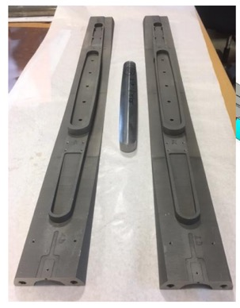
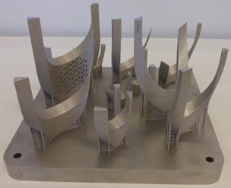
Reduce fabrication steps and/or reduce labor intensity
Consider a “Whole Magnet” philosophy. Fabrication steps and labor are highly material/design dependent, and there is significant room for improvement. It may require a large project with a baseline design to justify as an area of study.
Many topics such as 3d printed parts are in use or under study, however a departure from historical approaches IS necessary to properly leverage technology.
Goals
  Design for manufacturing. Ongoing Effort..
  Combine reaction and impregnation processes by innovative tooling
I believe with proper tooling and process optimization towards a future collider, coil fab labor could be reduced to ~5 days (hands on) per coil. Current AUP is ~50.
  Current fabrication labor is ~1/3 of total cold mass cost. ~30% reduction in total cost.
From G. Kirby. Feather 3d Printed Coil Formers
3d Printed (By CERN) 15 Tesla End Parts
Notes:
Quantify in dollars
timelines

Slide 32
Timeline and Milestones
2018 H2 | 2019 H1 | 2019 H2 | 2020 H1 | 2020 H2
Test High Viscosity Resin Sample ~6 months, Coil ~12 months
Build 1st Thermoplastic matrix Sample
Build 1st High Viscosity Thermoplastic Sample
Continue Development …
Build 1st and 2nd Insulation/Matrix investigation Coil
Investigate Insulation Options
Begin Insulation Characterization
Design React/Impregnate Sample tooling and 1st sample
Design React/Impregnate Coil Tooling
Continue process improvement …

Slide 33
Magnet Design and Integration
PI: V. Kashikin

Slide 34
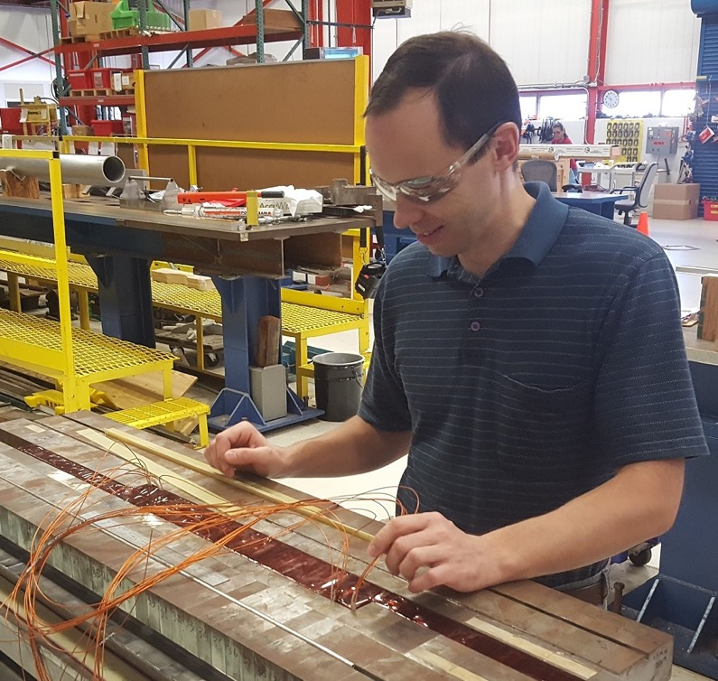
Vadim
Joined Fermilab’s magnet systems department in 1998 as a graduate student. Staff engineer since 2002.
Extensive practical experience in superconducting magnet design, including electromagnetic, structural, thermal, and quench protection analysis.
L3 manager/CAM for the Mu2e Production Solenoid (cost $17M).

Slide 35
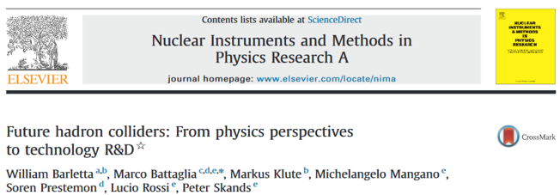
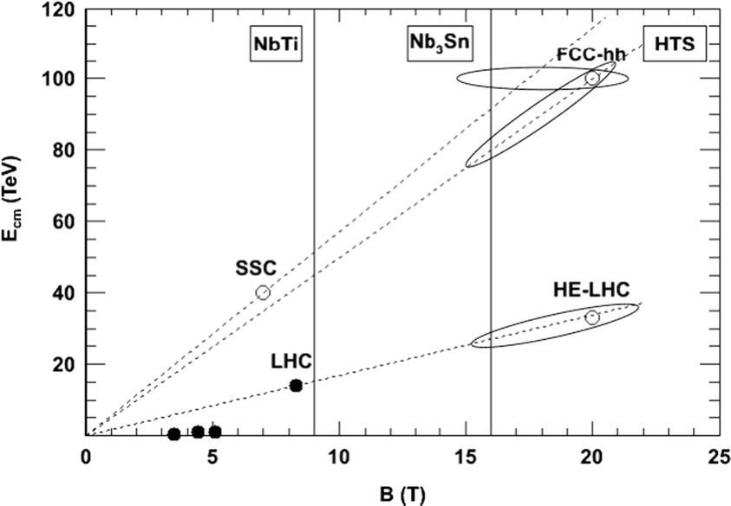
Motivation
There is a continued trend of increasing the magnetic field strength in the main bending and focusing magnets of circular colliders, including SPS, Tevatron, HERA, RHIC, and LHC.
While the machines also historically grew up in circumference, increasing the magnetic field strength remains one of the main ways towards higher beam energies.
It is expected that the next energy-frontier machines will need 16-20 T dipole magnets with a cost-effective design.
Feasibility of such magnets needs to be studied and experimentally demonstrated.

Slide 36
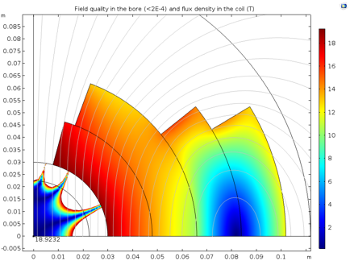
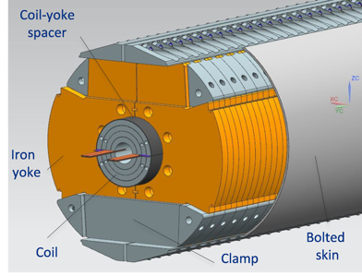
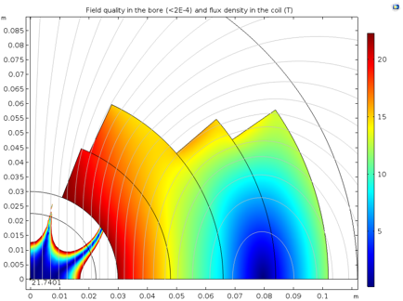
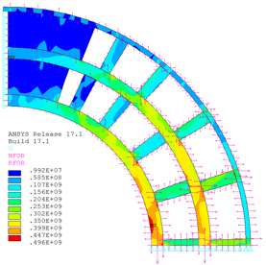
High-field accelerator magnet demonstration
1st step – reach 15 T in 60 mm bore with 4-layer coils.
SSL(1.9K) = 16.3 T
SSL(1.9K) = 19.0 T
All-Nb₃Sn (present J_{c})
All-Nb₃Sn (2xJ_{c})
Presently available
conductors
15 T dipole with 60 mm bore. Test later this year.
2nd step – perform the design studies to determine the optimum design for a 20 T accelerator-quality dipole.
3rd step – build the support structure and test it with high-J_{c} all-Nb₃Sn coils after the cable with APC becomes available.
SSL(1.9K) = 21.7 T
SS structure for the internal stress management
2 x HTS 2 x Nb₃Sn (2xJ_{c})
4th step – build and test HTS insert together with the coils made of high-J_{c} Nb₃Sn to demonstrate fields over 20 T.
Space for cables

Slide 37
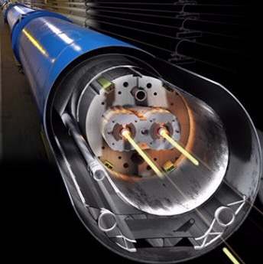
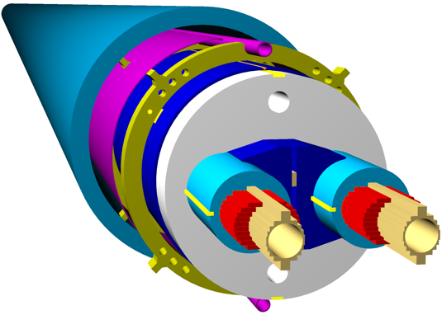
Performance/cost improvement studies
Traditional magnet design
Focus on the 2-in-1 design with 50 mm bore as the most representative of current needs. Use traditional cold yoke design with cos-theta coils as the baseline.
Study the warm yoke design: considerable magnet size and weight reduction. The cold mass weight can be reduced by a factor of 2-3 - cuts down the cool-down energy and time/cost. Needs asymmetric coils.
Study the low-inductance design: considerable reduction of the coil fabrication time/labor and improvement of the quench protection/training due to (a factor of ~20) lower coil inductance. Needs high current (in 50-100 kA range).
Cryostat (OD ~1 m)
Cold yoke at 1.9 K
Multi-turn coils (high inductance)
Fermilab proposed advanced magnet design
Cryostat = warm yoke (OD ~0.6 m)
Low-density materials at 1.9 K
Low-inductance coils
same scale

Slide 38
Timeline and Milestones
2018 | 2019 | 2020 | 2021 | 2022 | 2023 | 2024 | 2025
15 T dipole fabrication and test
Design 20 T dipole support structure
Fabricate and test Nb₃Sn coils with standard/improved performance parameters
Fabricate and test HTS insert to reach the field of 20 T
Magnet design studies aimed at the performance improvement and cost reduction
Down-select options for the 2-in-1 short model
Fabricate and test 2-in-1 short model(s) with the performance/cost improvement features

Slide 39
Facilities to support R&D
P. Li

Slide 40
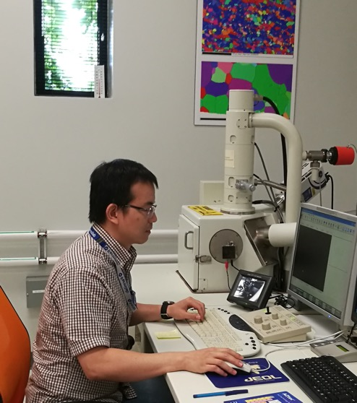
Pei Li
PhD from Florida State University
  Development and characterization of multiple superconducting materials
FNAL
  2013-2016, Guest Scientist
  2016- present, Research Associate
Characterization of materials used in superconducting magnets
  Superconducting strand/cables
  Metals/alloys
  Epoxy and ceramics
Field quality measurements of accelerator magnets

Slide 41
FNAL Magnets facilities:
State of the art facilities for high field magnet fabrication and test, e.g. fab and test of LARP and High Lumi AUP
With the new HFM R&D roadmap, towards higher fields and cost reduction, we will capitalize on existence of current facilities and have a proposed plan for improvements/upgrades to support evolving R&D:
  Samples:
  PPMS, 9T→16T
  Strand probes with HTS leads for better LH efficiency to suit the tests of APC and high-C_{p} strands
  2. Magnet testing
  test facility for proposed fast turn-around subscale experiments (e.g. racetrack windings) : start at existing test stand 3, then move to specialized facility: VMTF1 upgrade:
      Combine existing 1.9K VMTF1 + 15T demonstrator to obtain background field ~12T
      Large bore size to house the sample and instrumentation, >100 mm
  HFVMTF: combine interest of future >16T HFM for HEP to Fusion

Slide 42
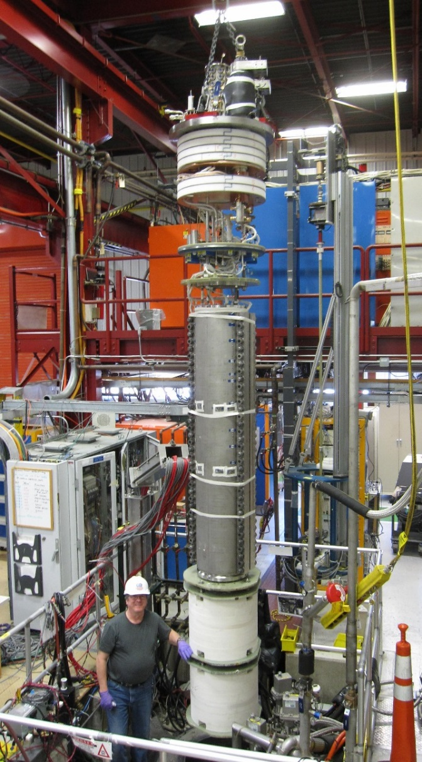
Upgrade of VMTF1 (currently test stand for accelerator magnets at FNAL)
Parameters | VMTF
Operating Temperature | 4.5/1.9 K
Maximum current | 30 kA
Cryostat diameter | 655 mm
Cryostat depth | 5000 mm
Maximum length of test object | 3750 mm
Maximum diameter of test object | 630 mm
Combine existent VMTF with HF dipole to obtain unique 11T background field facility for racetrack and cable stack studies
Vertical Magnet Testing Facility (VMTF, 1.9K)

Slide 43
New Facility - HFVMTF for Conductor, Cable and Magnet R&D
High Field Vertical Magnet Test Facility (VMTF-2) for Conductor, Cable and Magnet R&D
Testing HF magnets with OD< 1 m
Synergy with fusion
  The facility will have similar parameters like FRESCA2@CERN and EDIPO@PSI
  Possibility to test HTS cables and small coils
  External filed ~ 14-15 T – magnet provided in collaboration with MDP
  1.9 K temperature
  Existing infrastructure
  Trained personnel for test support
Conceptual design
X-Section of the pit
P. Li | Test Facilities

Slide 44
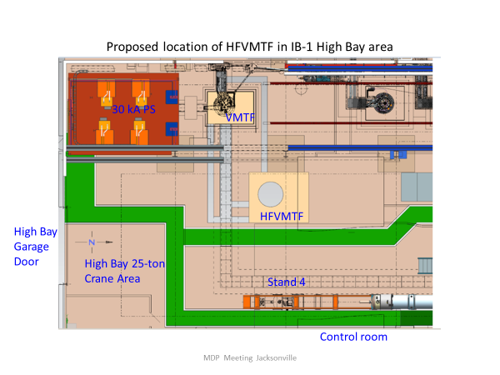
HFVMTF test stand
Parameter | HFVMTF
Operating Temperature | 1.8-1.9K
Maximum Current (1st PS) | 30 kA (re-use existing)
Maximum Current (2nd PS) | Incl. 10 to 15 kA ( to test hybrid magnets )
Helium Vessel Diameter | 42 inches (1066 mm)
Maximum Length of Test Object | >2000 mm (funds limited)
Maximum Diameter of Test Object | 1000 mm
Crane Capacity | 25 tons (existing)
Location | IB-1 (IB1 High Bay)

Slide 45
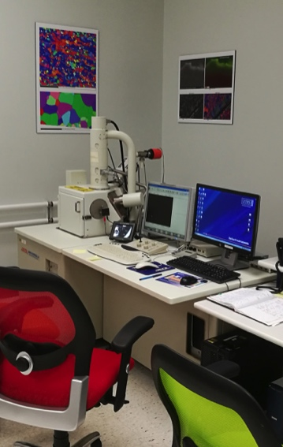
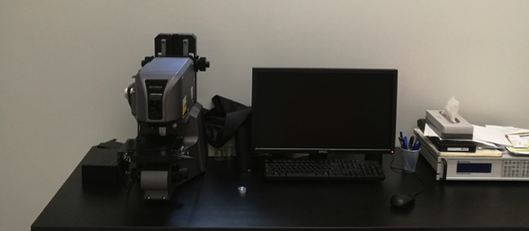
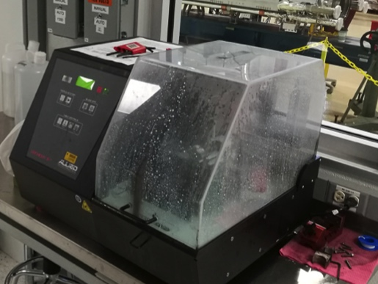
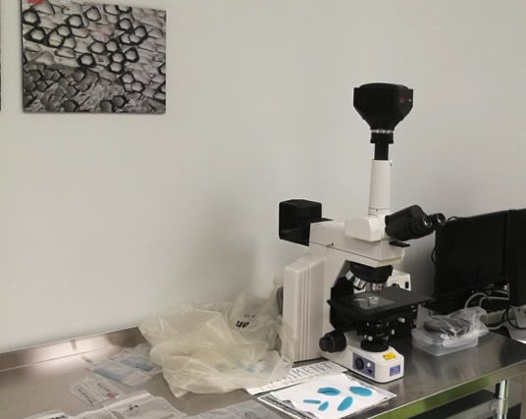
Existing FNAL R&D Facility(useful to both magnet and SRF) – Material Science Lab
Metallurgy and microstructural analysis for strand, cable and related materials
Laser Confocal Microscope
Scanning Electron Microscope (SEM)
Diamond saw for sample preparation
Metallurgy Optical Microscope

Slide 46
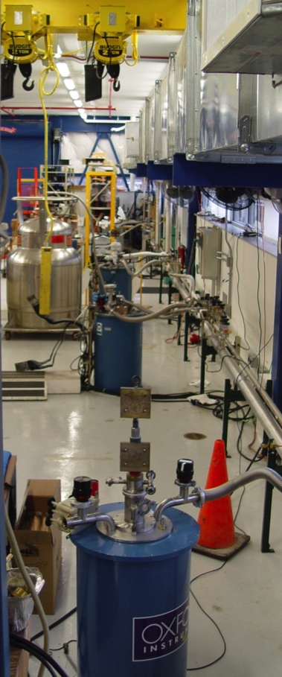
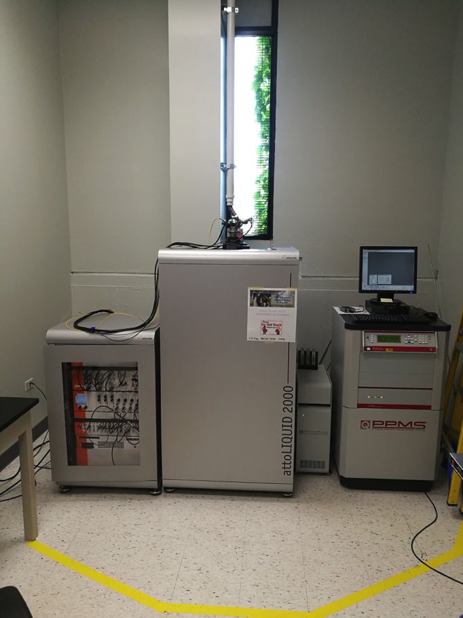
Electrical-magnetic characterization of strand and cables
Three solenoid R&D magnet systems
4.2K
15T/50mm bore, 8T/150mm bore
1800A power supply
MSL: Physical Property Measurement System (PPMS) with AFM and MFM
2K, 9T
Low current (100 mA) transportation; magnetization; thermal property
Small sample size (10x10x10 mm)
Upgrade Plan: Strand probes with HTS leads for better LH efficiency to suit the tests of APC and high-C_{p} strands
Upgrade Plan: 14-16T magnet for APC pinning studies

Slide 47
Timeline and Milestones
2018 | 2019 | 2020 | 2021 | 2022 | 2023 | 2024 | 2025
15 T dipole fabrication and test
16-20T Magnet Design Studies
16-18T Nb3Sn Magnet Fabrication and Test
Fabricate and test HTS insert to reach the field of 20 T
VMTF + 15T demonstrator → 11T background field facility
VMTF-2 → >20T, 1.9K Capable Hybrid Magnet Test Facility (only one in US)
P. Li | Test Facilities

Slide 48
Conclusions and Outlook
G. Ambrosio

Slide 49
Outline
Opportunity 1: the Team
Opportunity 2: Nb₃Sn Magnets from gen. 1 to the future
The plan: High Field Magnets for next High Energy Collider
The challenge: The US may fall behind
Conclusions

Slide 50
Opportunity 1: the Team
Very talented group of “junior” scientists and engineers
  Years of experience with High Field Magnets
  Lots of out-of-the-box thinking
  Very motivated: ready to hit the road and run!
  But also committed on many projects (Mu2e, AUP, …)
A small amount of resources (~ 2 post-docs) can unleash great potentialities

Slide 51
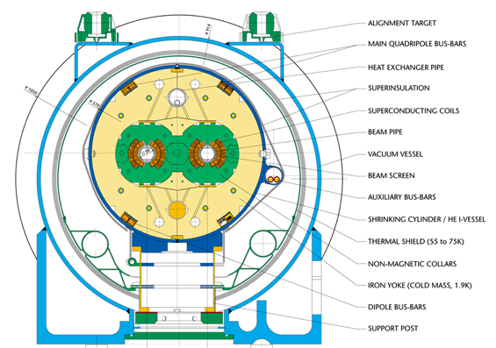
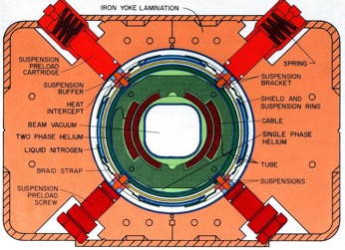
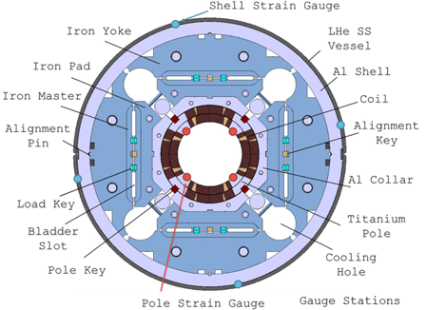
Opportunity 2: Nb₃Sn Magnets re/evolution
Generation 1
NbTi
Present
Revolution + Evolution
Generation 1: “conservative” design & technology based on features demonstrated by LARP
Nb₃Sn
Advanced Nb₃Sn magnets:
Higher performances
Reduced cost/time
enabling new generation of Hadron Colliders
Revolution + Evolution

Slide 52
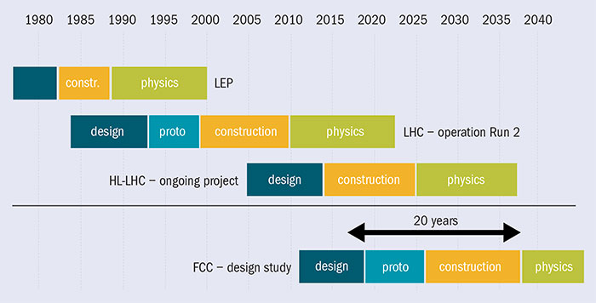
Accelerator Timelines from Design to Physics
M. Mangano, et alt. “Physics at its limits”, CERN Courier, Apr. 13 2017

Slide 53





HE-LHC Timeline & This Plan
Time w/o physics at energy frontier
We have ~8 years to make a significant contribution
HE-LHC design study
Extended construction time because of Nb₃Sn technology
4 years of conductor development (FY19-22)
3-6 years of Technology Development (FY19-21/23)
3 years of HFM Design Study (FY19-21)
European PP Strategy Update approval: May 2020
5 years of Short Models fabrication & test (FY22-26)
AUP budget starts going down in FY21-22
and then scale-up demonstration…
GARD
Directed R&D?

Slide 54
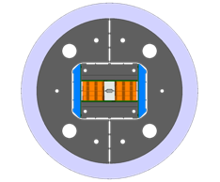
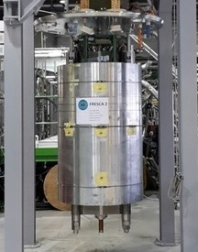
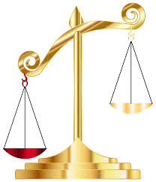


The Challenge: The US may fall behind
CERN:
ERMC
RMM
FRESCA2
HFM R&D in Europe:
US
EU
FRESCA2: 14.6 T,
100 mm bore
May 2018
D. Tommasini (CERN)
2nd WP5 EuroCirCol Review, Oct 2017
(I am reviewer for WP5 = HF Magnets)

Slide 55
The Challenge: The US may fall behind
HFM R&D in Asia:
Japan:
- D1 for LHC HiLumi
- NbTi 5.6 T
China:
100 km SPPC ring
Iron Based Superconductor
Common-Coil dipoles: 12 T (24 T upgrade)
Qingjin XU, FCC Week 2017
FRESCA2: 14.6 T, 100 mm bore
May 2018
China may take time to get to SPPC with IBS
Europe is running fast planning to use Nb₃Sn:
“Only if we start now a focused R&D the US will have leadership role in the design and fabrication of High Field Magnets for next HE Hadron Collider”

Slide 56
Conclusions
We have re-assessed and re-structured our HFM R&D program at FNAL
We would like you to consider starting ASAP a more focused R&D to support the US contribution/Leadership for next High Energy Hadron Collider
This R&D is going to provide Knowledge & Toolbox for US/DOE to make well informed decisions and be leader as soon as plan is clear
Fermilab has people and expertise to do it in very effective way
  Junior scientists/engineers
  Senior management with LARP experience and mindset
    Method: thorough exploration, close interaction with all stake-holders, international feed-back & reviews, down-select
  Note: excellent opportunity for Toohig or similar fellowships

Slide 57

Breakthrough in gradient for Tesla shape SRF cavities
Eacc ~ 49 MV/m
New results showing reproducibly unprecedented accelerating gradients for TESLA shape 1.3 GHz cavities: 49MV/m (B_{pk}=210 mT), with higher Q
Highest ever measured for Tesla shape cavities was 45 MV/m (very rare)
New surface treatment involves slight modification of the low temperature bake (120C bake), no nitrogen
Q ~1.5e10 @ 40MV/m and ~1e10 at 49 MV/m
So far obtained in 2/2 single cells; nine cell to be tested soon

Slide 58
Potential impact for ILC
If verified with sufficient statistics, could allow to raise ILC operating point to 40-45 MV/m
Impact:
  Reach 250 GeV with cost reduction of the SRF linac >20%
Or
  Raise energy from 250 GeV to >300GeV

