Slide 1
Update on HiRes analysis
University of Florida LANL
Shriram Jois Leanne Duffy
N. S. Sullivan
David Tanner

Slide 2
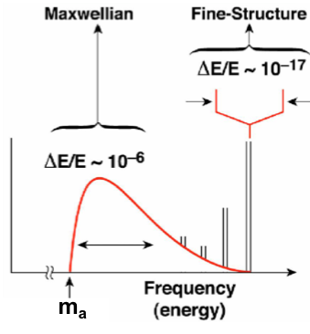
Blind injection of synthetic axion signal by a team with in the collaboration
Rest of collaboration does not know
Synthetic DFSZ signal at 730.196 MHz
Time spacing between the points = 10.24 micro seconds
Sampling time of 100 s, Frequency resolution of 0.01Hz
Program to read the data files and take FFT

Slide 3
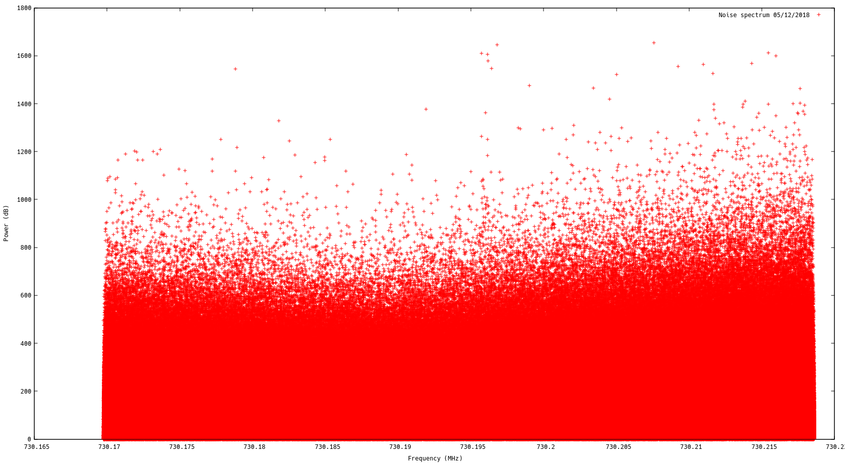

Slide 4
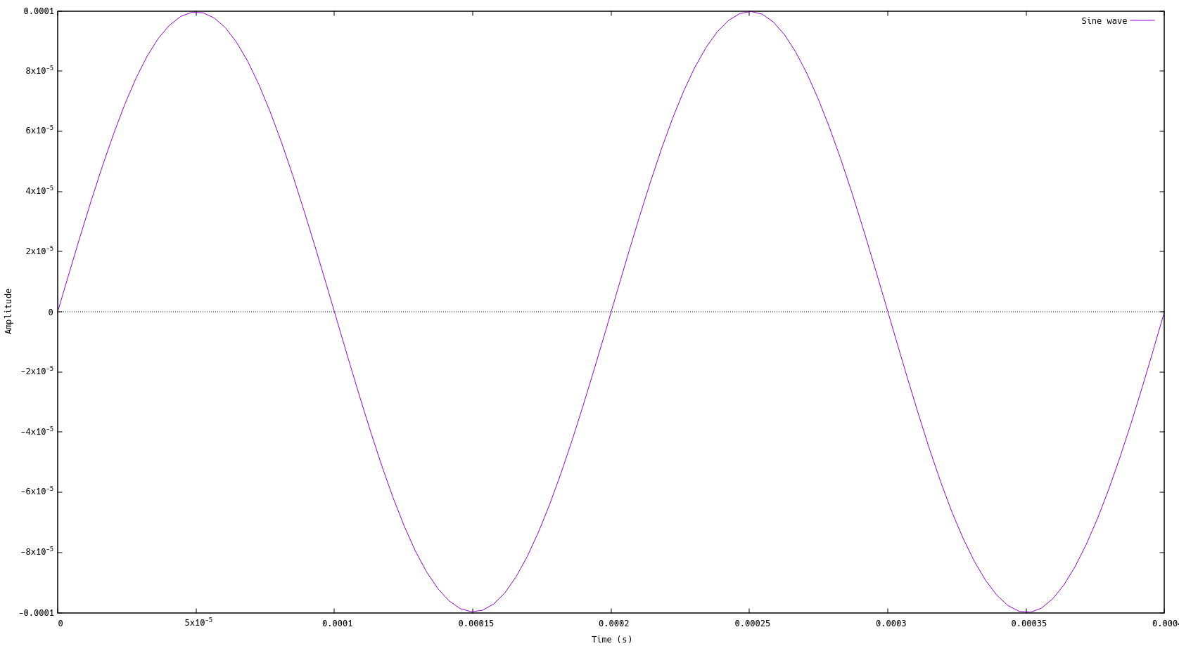
Sine wave with f
First 150 points are shown

Slide 5
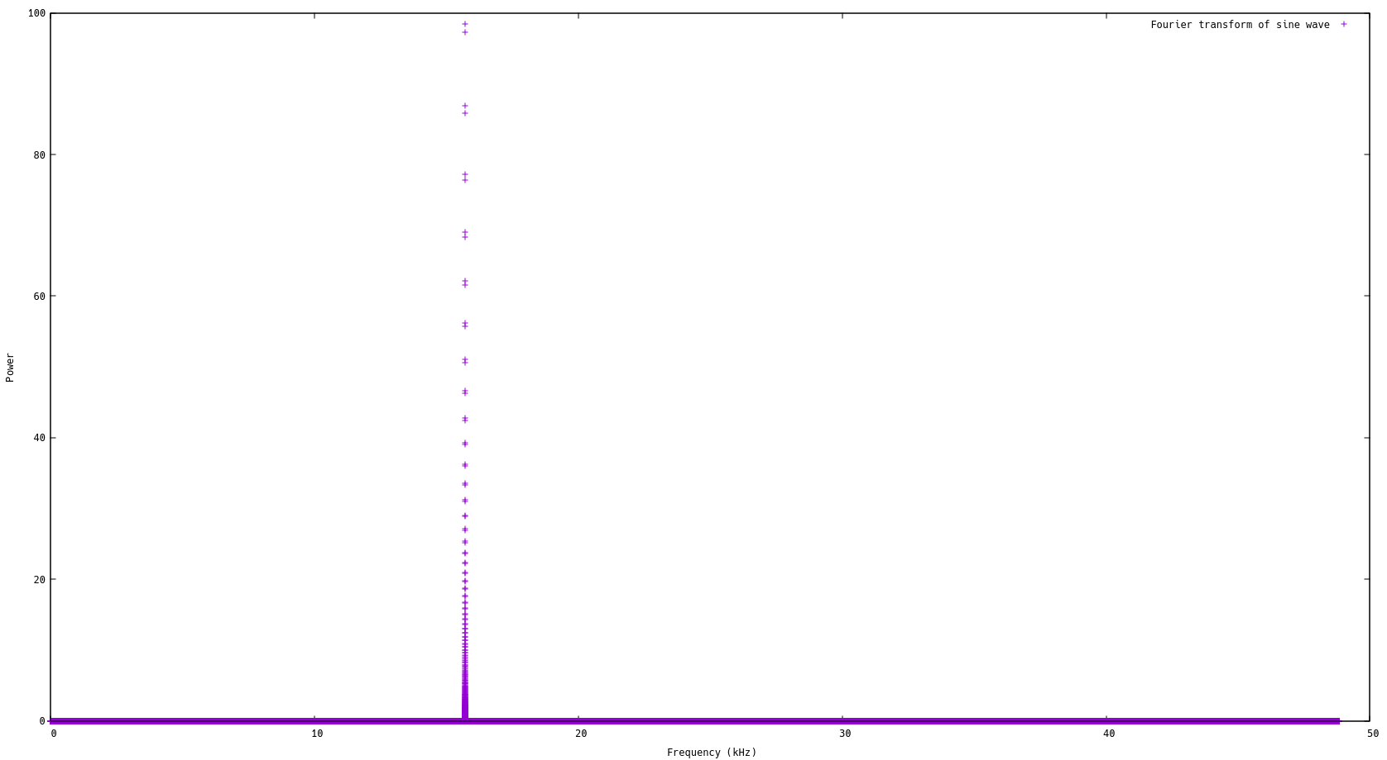
Fourier transform of sine wave

Slide 6
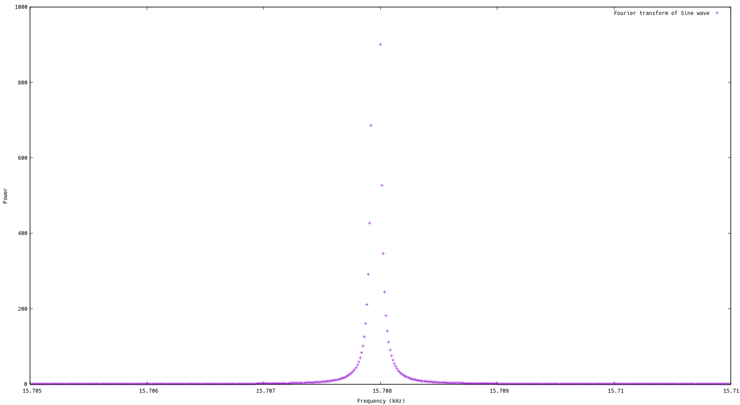

Slide 7
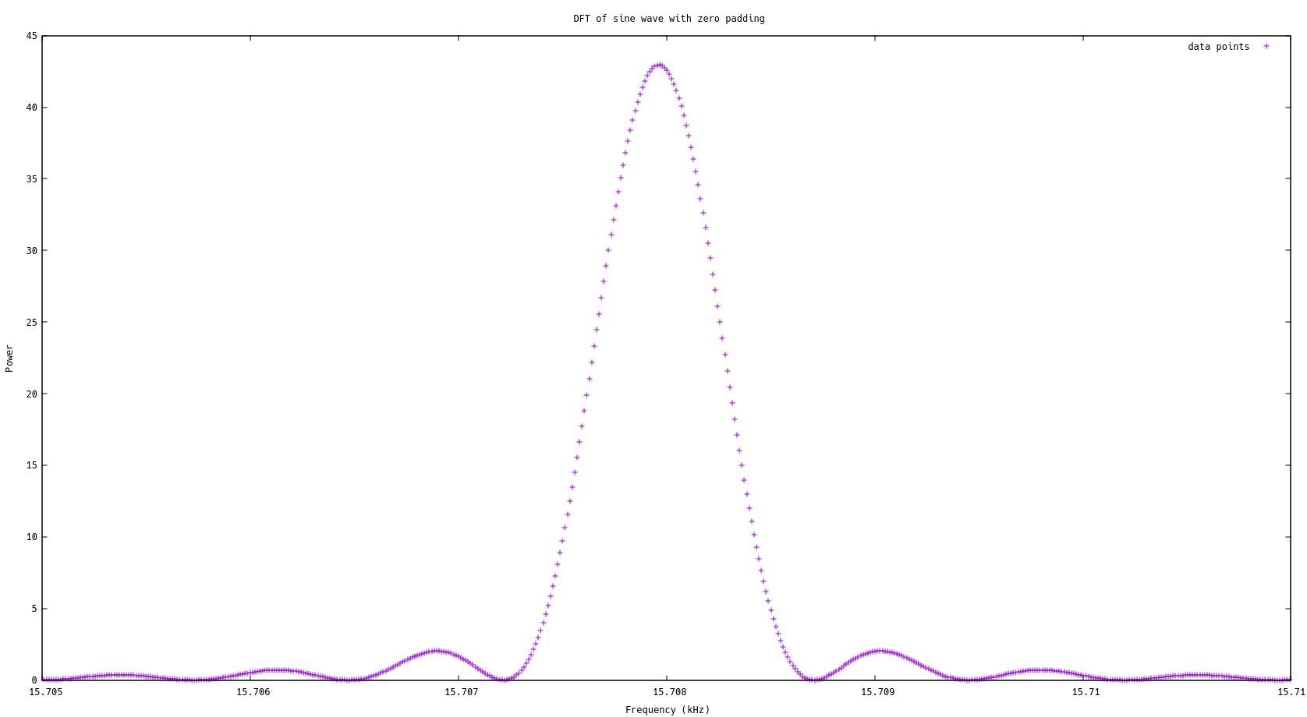

Slide 8
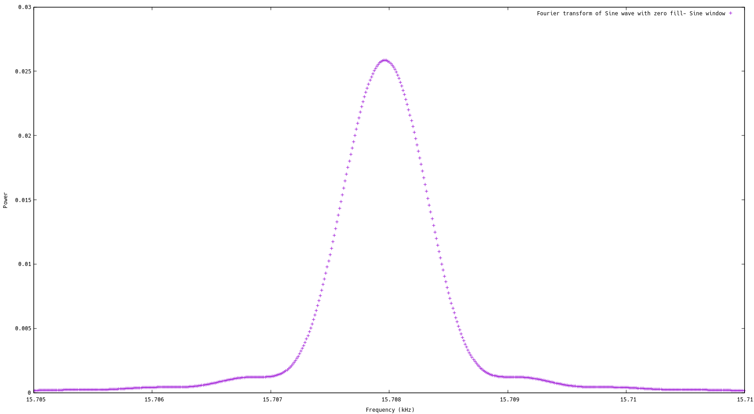

Slide 9
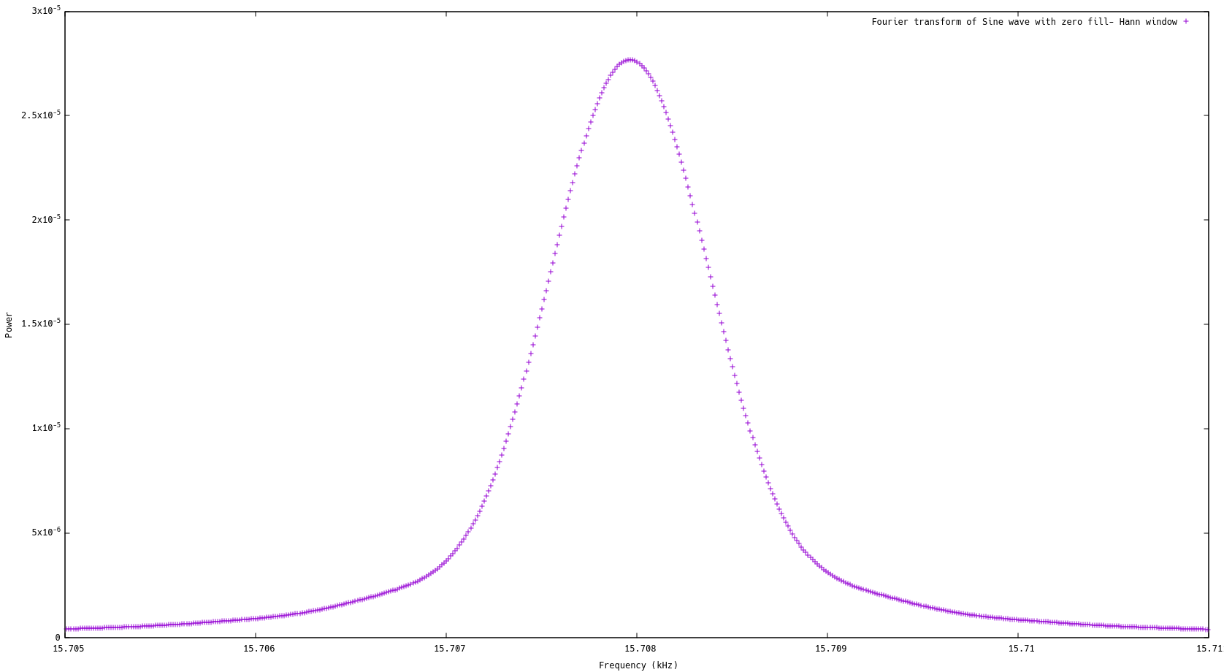

Slide 11
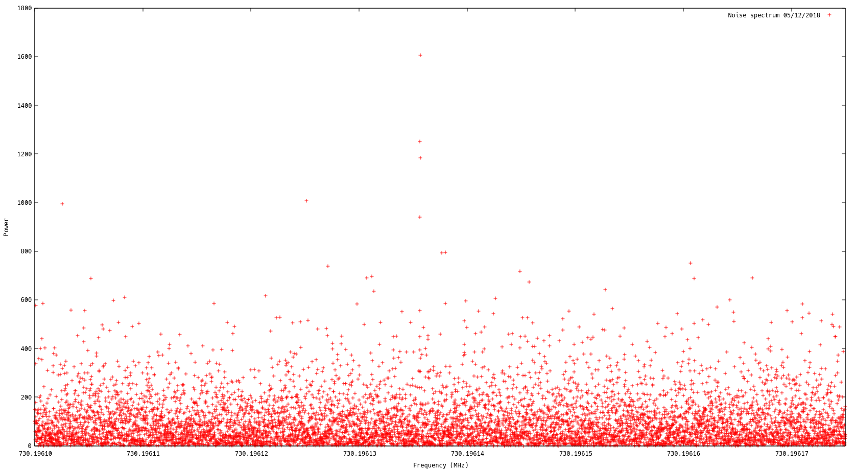

Slide 12
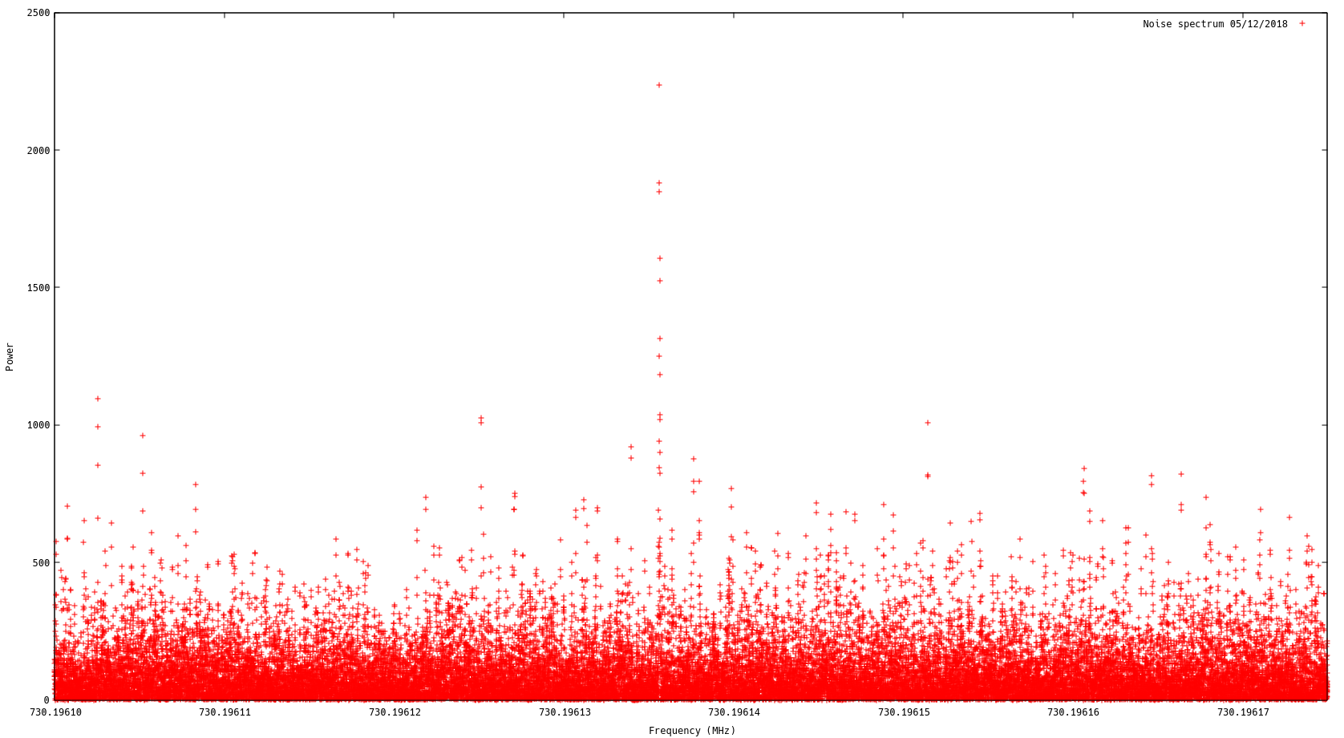

Slide 13
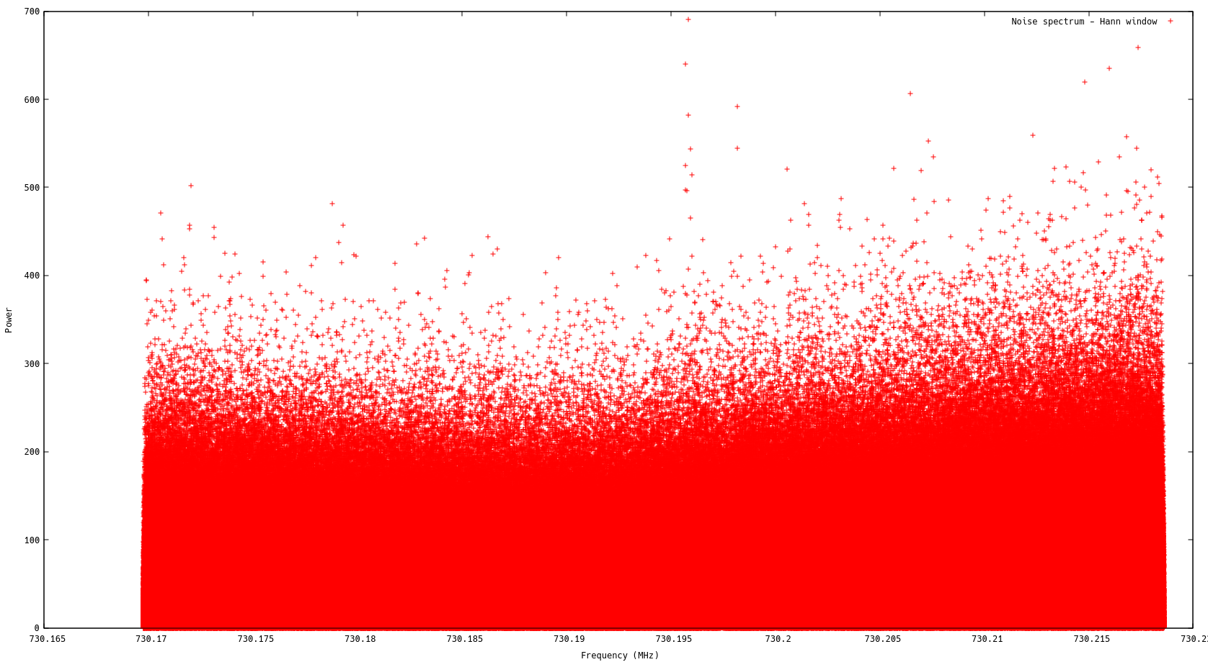

Slide 14
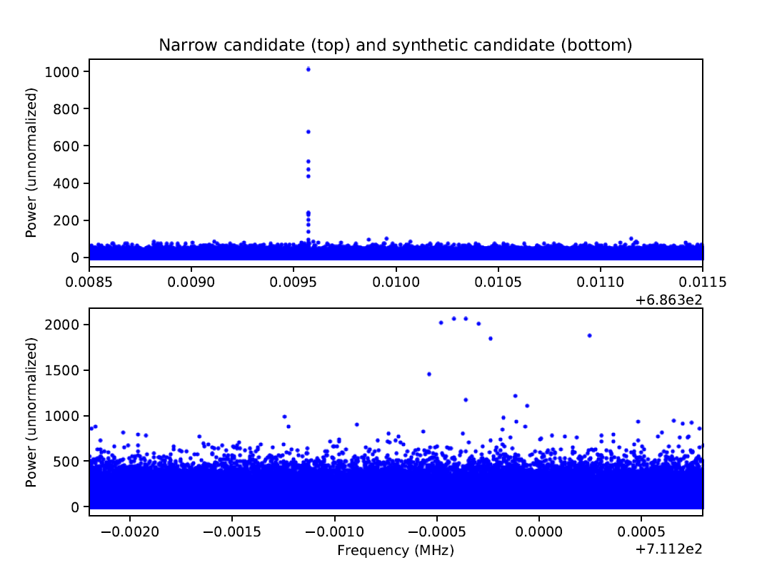
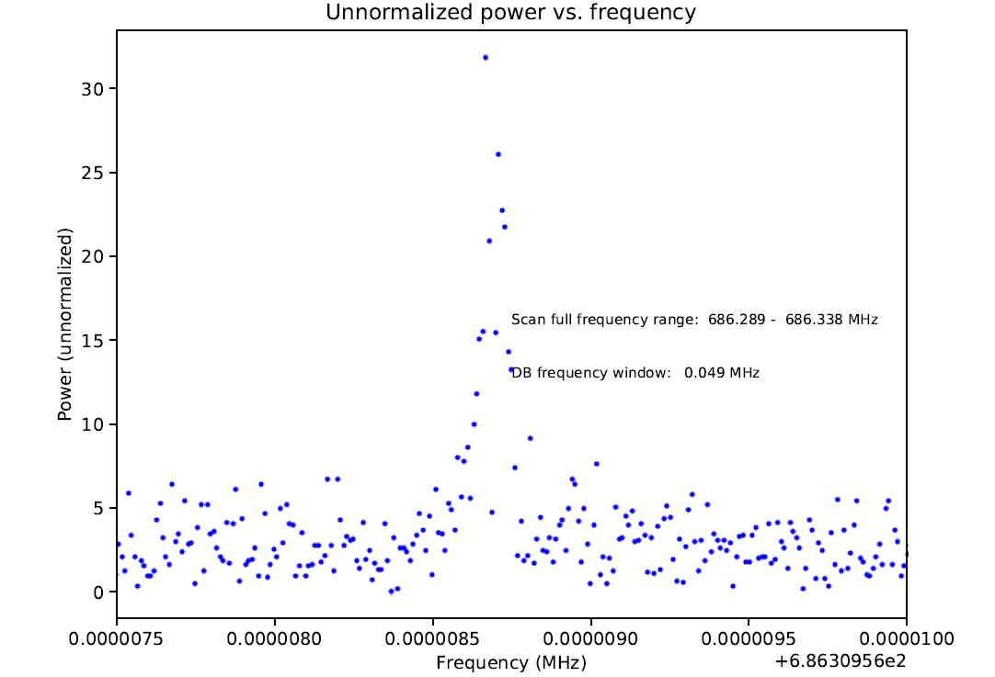

Slide 15
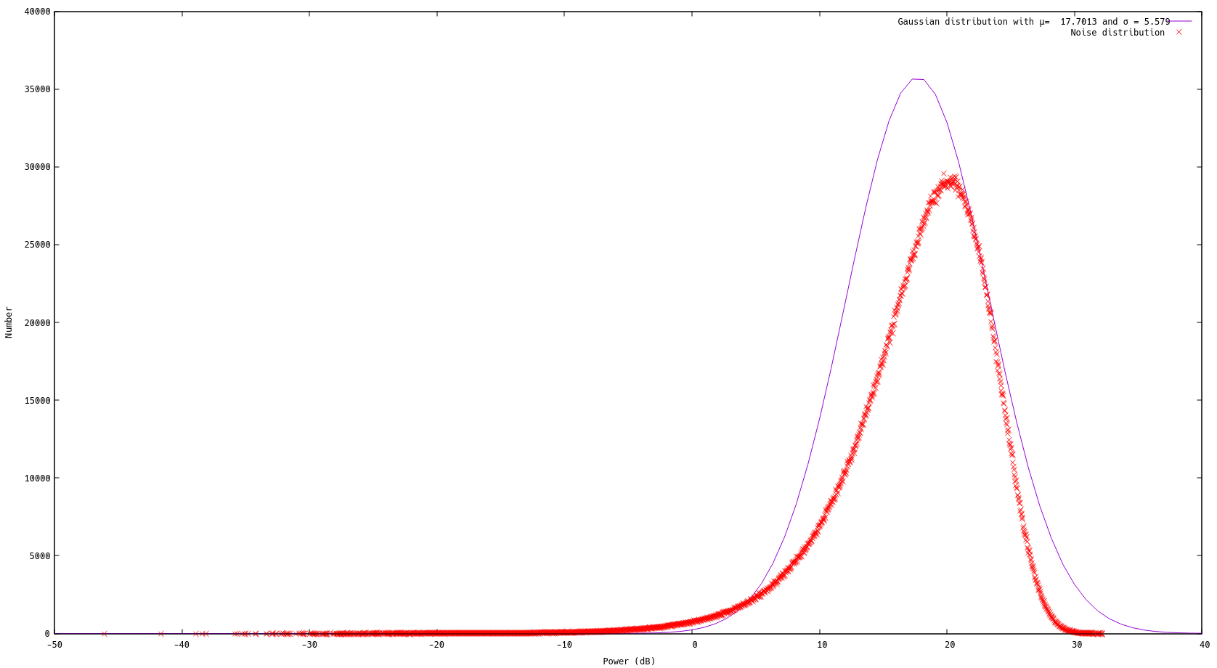

Slide 16
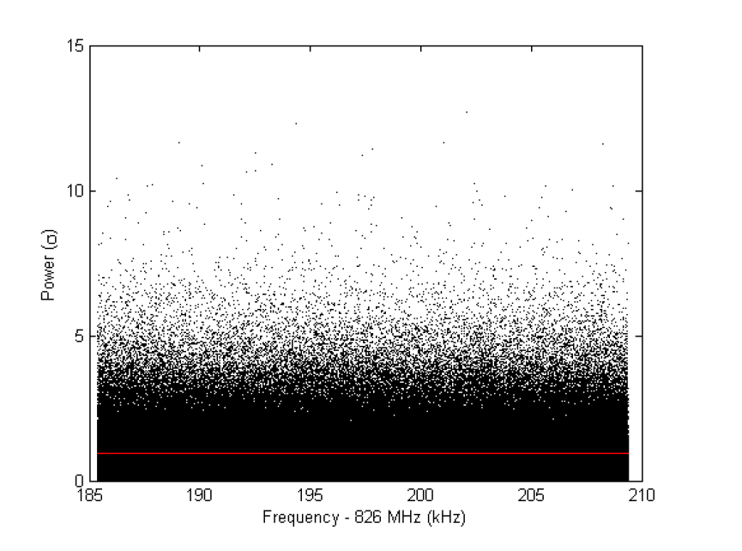
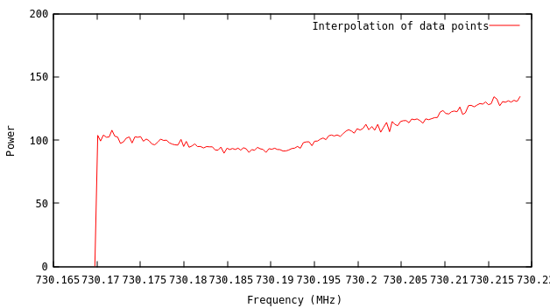
Broad spectral structure – receiver response
Originates in amplifier and reflected back from the cavity
Varies with frequency thus slightly different for each data file
Interpolation fit can be adopted to remove the receiver response and flatten the power spectrum
Example plot - Flattened power spectrum taken from Jeff Hoskins thesis

Slide 17
Summary
Synthetic axion at 730.196 MHz – a sharp peak in frequency spectrum
Using window function and zero filling can enhance the signal
HiRes spectra can distinguish a real and synthetic signal
Noise baseline to be determined after establishing receiver chain response.
Work in progress . . . To be continued . . .

Slide 18
Thank you

