Slide 1
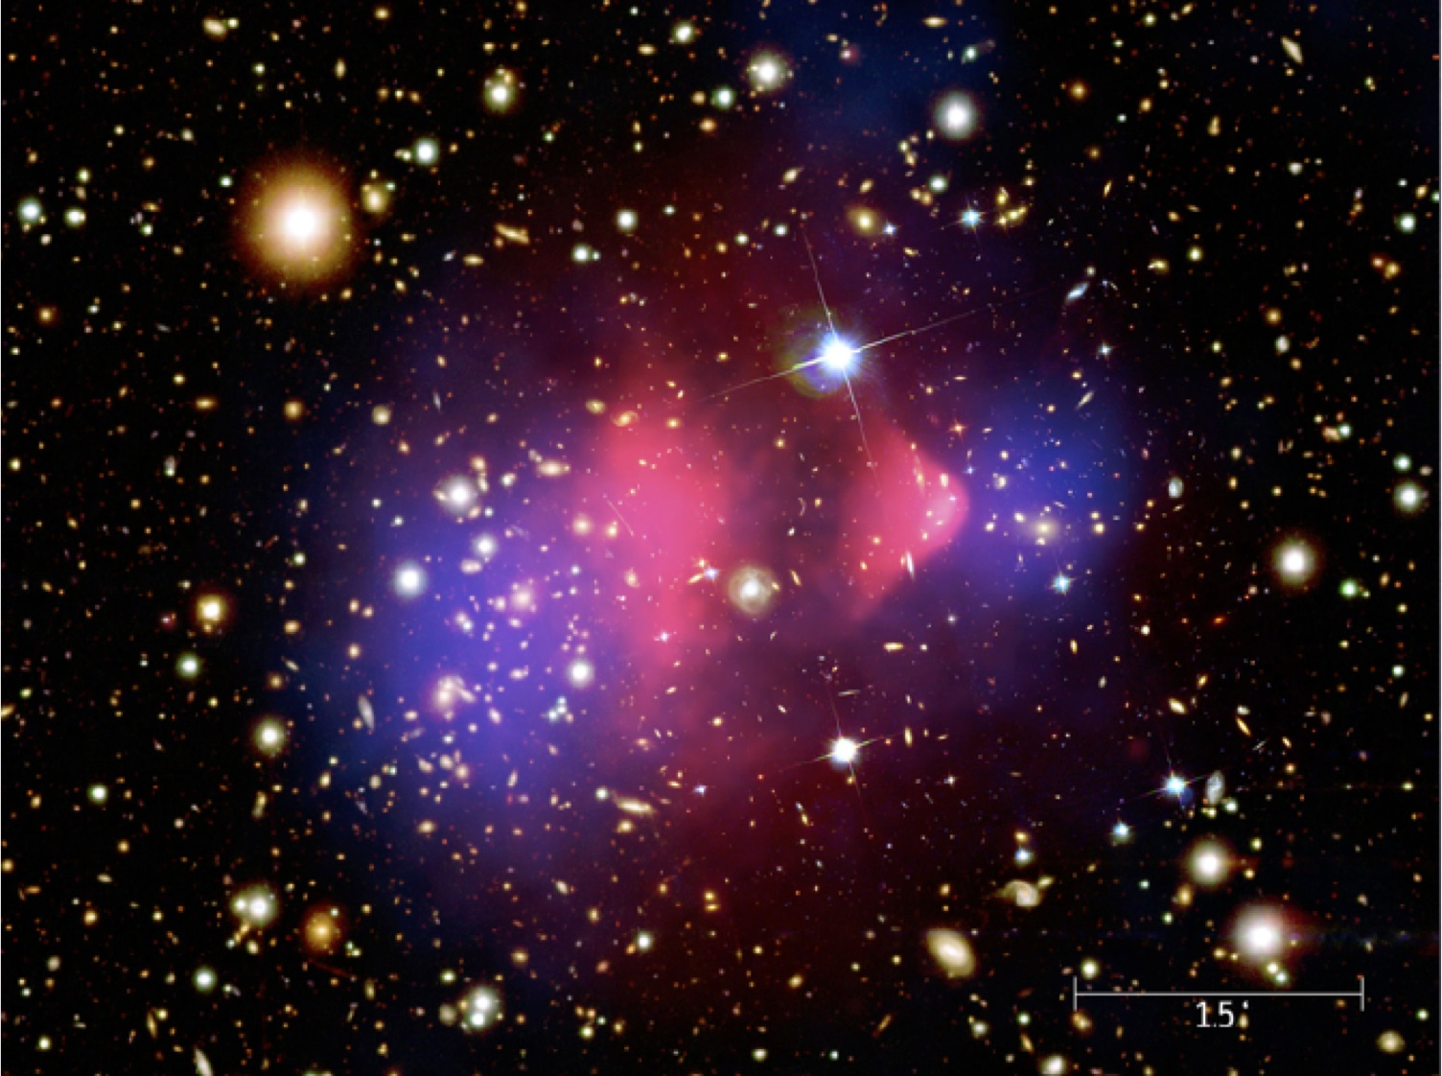
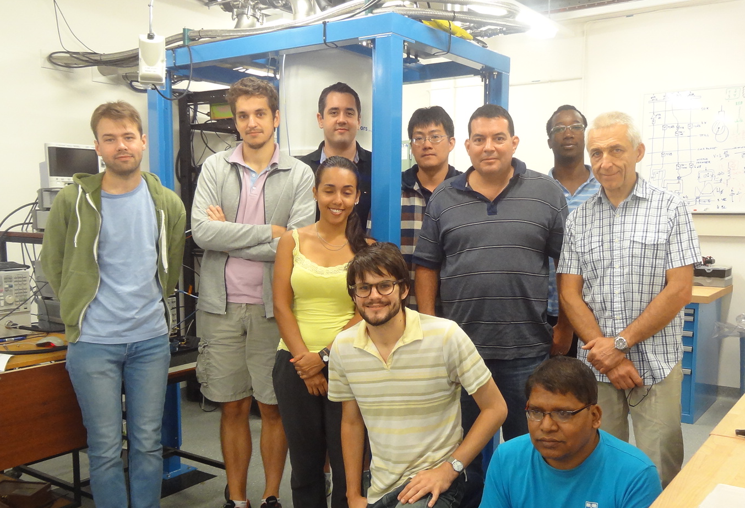
Frequency and Quantum Metrology Research Group
Research Staff
Michael Tobar
Eugene Ivanov
John McFerran
Alexey Veryaskin
Sascha Schediwy
Maxim Goryachev
Jeremy Bourhill
Students
Ben McAllister
Akhter Hoissan
Graeme Flower
Scott Hardie
Lewis Teixeira
Catriona Thomas

Slide 2
Modified Axion Electrodynamics and the BEAST Experiment
Axion modified electrodynamics as a magnetization and polarization of the vacuum
Polarizations and magnetisations induced by a DC Magnetic Field
Magnetizations and polarizations induced by a DC Electric Field
Broadband low-mass experiments
Inductor in DC Electric Field
Capacitor in DC Magnetic Field
Broadband Electric Axion Sensing Technique (BEAST)

Slide 3
Modified Axion Electrodynamics
$$\overset{⃗}{∇}⋅\overset{⃗}{D}=ρ_{f}+g_{aγγ}\sqrt{\frac{ϵ_{0}}{μ_{0}}}\overset{⃗}{B}⋅\overset{⃗}{∇}a$$
$$\overset{⃗}{∇}×\overset{⃗}{H}=\overset{⃗}{J_{f}}+\frac{∂\overset{⃗}{D}}{∂t}-g_{aγγ}\sqrt{\frac{ϵ_{0}}{μ_{0}}}\left(\overset{⃗}{B}\frac{∂a}{∂t}+\overset{⃗}{∇}a×\overset{⃗}{E}\right)$$
$$\overset{⃗}{∇}⋅\overset{⃗}{B}=0$$
$$\overset{⃗}{∇}×\overset{⃗}{E}=-\frac{∂\overset{⃗}{B}}{∂t}$$
$$\overset{⃗}{D}=ϵ_{0}\overset{⃗}{E}+\overset{⃗}{P}$$
$$\overset{⃗}{H}=\frac{\overset{⃗}{B}}{μ_{0}}-\overset{⃗}{M}$$
Type to enter a caption.

Slide 4
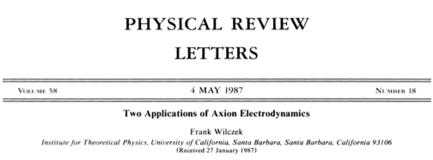
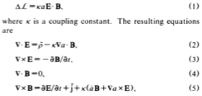

Slide 5
Vector Identities
$$\overset{⃗}{B}⋅\overset{⃗}{∇}a=\overset{⃗}{∇}⋅(a\overset{⃗}{B})+a(\overset{⃗}{∇}⋅\overset{⃗}{B})$$
$$\overset{⃗}{∇}⋅\overset{⃗}{B}=0$$
$$\overset{⃗}{∇}×\overset{⃗}{E}=-\frac{∂\overset{⃗}{B}}{∂t}$$
$$\overset{⃗}{∇}a×\overset{⃗}{E}=(\overset{⃗}{∇}×(a\overset{⃗}{E}))-a(\overset{⃗}{∇}×\overset{⃗}{E})$$
Modified Gauss’ Law and Ampere’s Law
$$\overset{⃗}{∇}⋅\overset{⃗}{D}=ρ_{f}+g_{aγγ}\sqrt{\frac{ϵ_{0}}{μ_{0}}}\overset{⃗}{∇}⋅(a\overset{⃗}{B})$$
$$\overset{⃗}{∇}×\overset{⃗}{H}=\overset{⃗}{J_{f}}+\frac{∂\overset{⃗}{D}}{∂t}-g_{aγγ}\sqrt{\frac{ϵ_{0}}{μ_{0}}}\left(\frac{∂(a\overset{⃗}{B})}{∂t}+\overset{⃗}{∇}×(a\overset{⃗}{E})\right)$$

Slide 6
Reformulate Modified Electrodynamics
$$\overset{⃗}{∇}⋅\overset{⃗}{D_{a}}=ρ_{f}$$
$$\overset{⃗}{∇}×\overset{⃗}{H_{a}}=\overset{⃗}{J_{f}}+\frac{∂\overset{⃗}{D_{a}}}{∂t}$$
Similar to Standard Model Extension Modifications for Lorentz Invariance Violations
$$\overset{⃗}{∇}⋅\overset{⃗}{B}=0$$
$$\overset{⃗}{∇}×\overset{⃗}{E}=-\frac{∂\overset{⃗}{B}}{∂t}$$
Modification in the Constitutive Relations
$$\overset{⃗}{D_{a}}=ϵ_{0}\overset{⃗}{E}+\overset{⃗}{P}+\overset{⃗}{P_{a}}{\overset{⃗}{P}}_{a}=-g_{aγγ}\sqrt{\frac{ϵ_{0}}{μ_{0}}}(a\overset{⃗}{B})$$
$$\overset{⃗}{H_{a}}=\frac{1}{μ_{0}}\overset{⃗}{B}-\overset{⃗}{M}-\overset{⃗}{M_{a}}{\overset{⃗}{M}}_{a}=g_{aγγ}\sqrt{\frac{ϵ_{0}}{μ_{0}}}(a\overset{⃗}{E})$$

Slide 7
Axion Interaction similar to odd parity Lorentz Invariance Violation
~

Slide 8
Sidereal Modulations of Constant Background Fields
www.physics.indiana.edu/~kostelec/
Axion is similar to an oscillating odd parity background SME Lorentz invariance violation field.
Cannot shield against these type of violations -> Source Terms.
Oscillating Background Fields Create EM Radiation

Slide 9
arXiv:hep-th/9609099 v1 11 Sep 1996
Vacuum acts as Dielectric and Paramagnet!

Slide 10
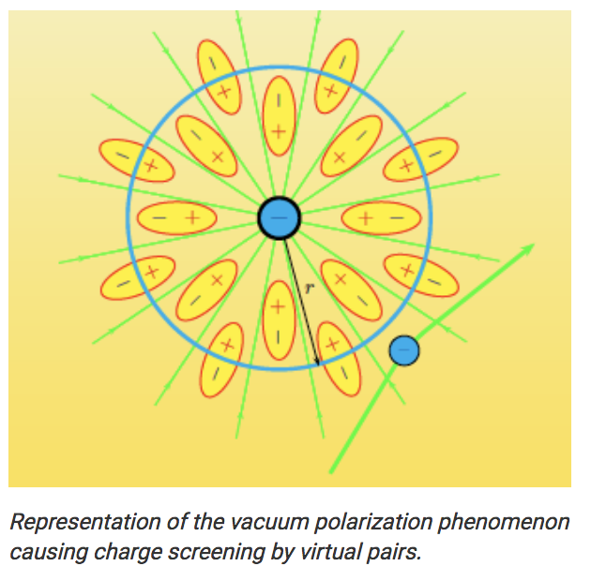
Axion-Photon Interaction as Oscillating Vacuum Polarization and Magnetization Fields
*Vacuum polarizations and magnetisation cause running of the fine structure constant
* Magnetic anti-screening and Electric screening gives =1/137 at low energy and 1/128 at 90 GeV
$$α$$
$$α$$
*Tiny oscillating refractive index or fine structure constant
* Similar to Brillouin scattering in media nonlinear -> Frequency Shift Goryachev (Tomorrow)

Slide 11
Axion Induced Virtual Bound Charges and Currents
Virtual Particle Bound Charge
Virtual Particle Polarizarion Current
Satisfies the Continuity Equation
Virtual Particle Bound Current
Boundary Conditions
Calculate from integral form of modified Maxwell’s equations
(no free charges and currents)

Slide 12
Axion induced Polarization and Magnetization Fields under DC Magnetic Field
Assume Infinite Solenoid
Calculate Vacuum Magnetization
Match Boundary Conditions
Effective/Pseudo Fields
= -

Slide 13
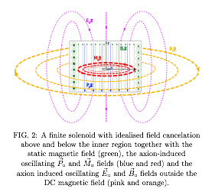
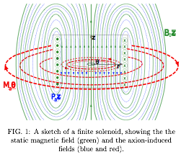
DC Solenoid of Finite Length
Finite Solenoid with ideal Field Cancelation Above and Below
Finite Solenoid->Dipole Field

Slide 14
Axion induced Magnetization and Polarization Fields under DC Electric Field
Assume Infinite Capacitor no Fringing Field
At boundary r=R

Slide 15
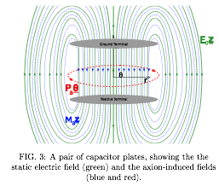
DC E-field from Finite Length Capacitor

Slide 16
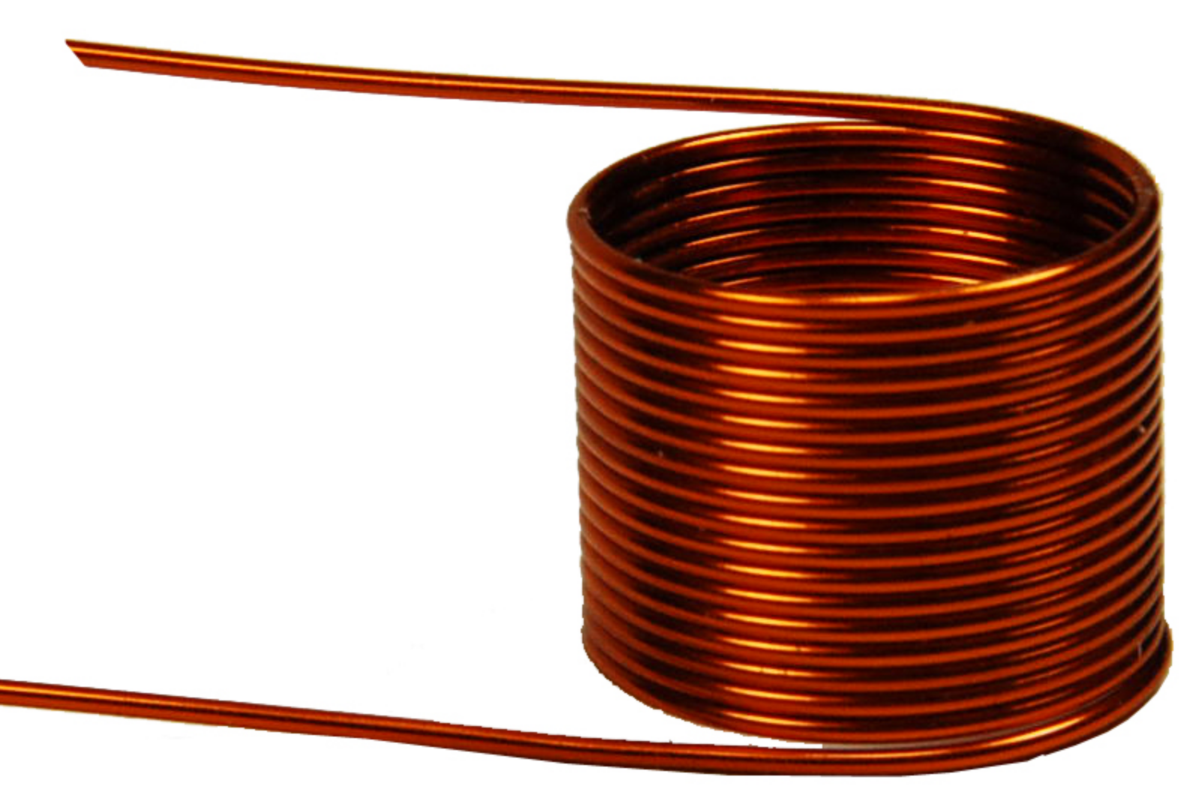
Inductor in a DC Electric Field

Slide 17
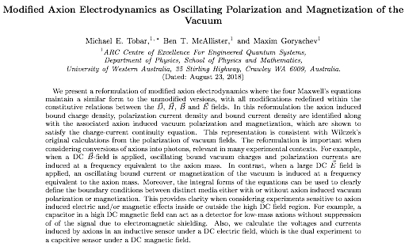
Paper to be Posted on ArXiv Very Soon

Slide 18
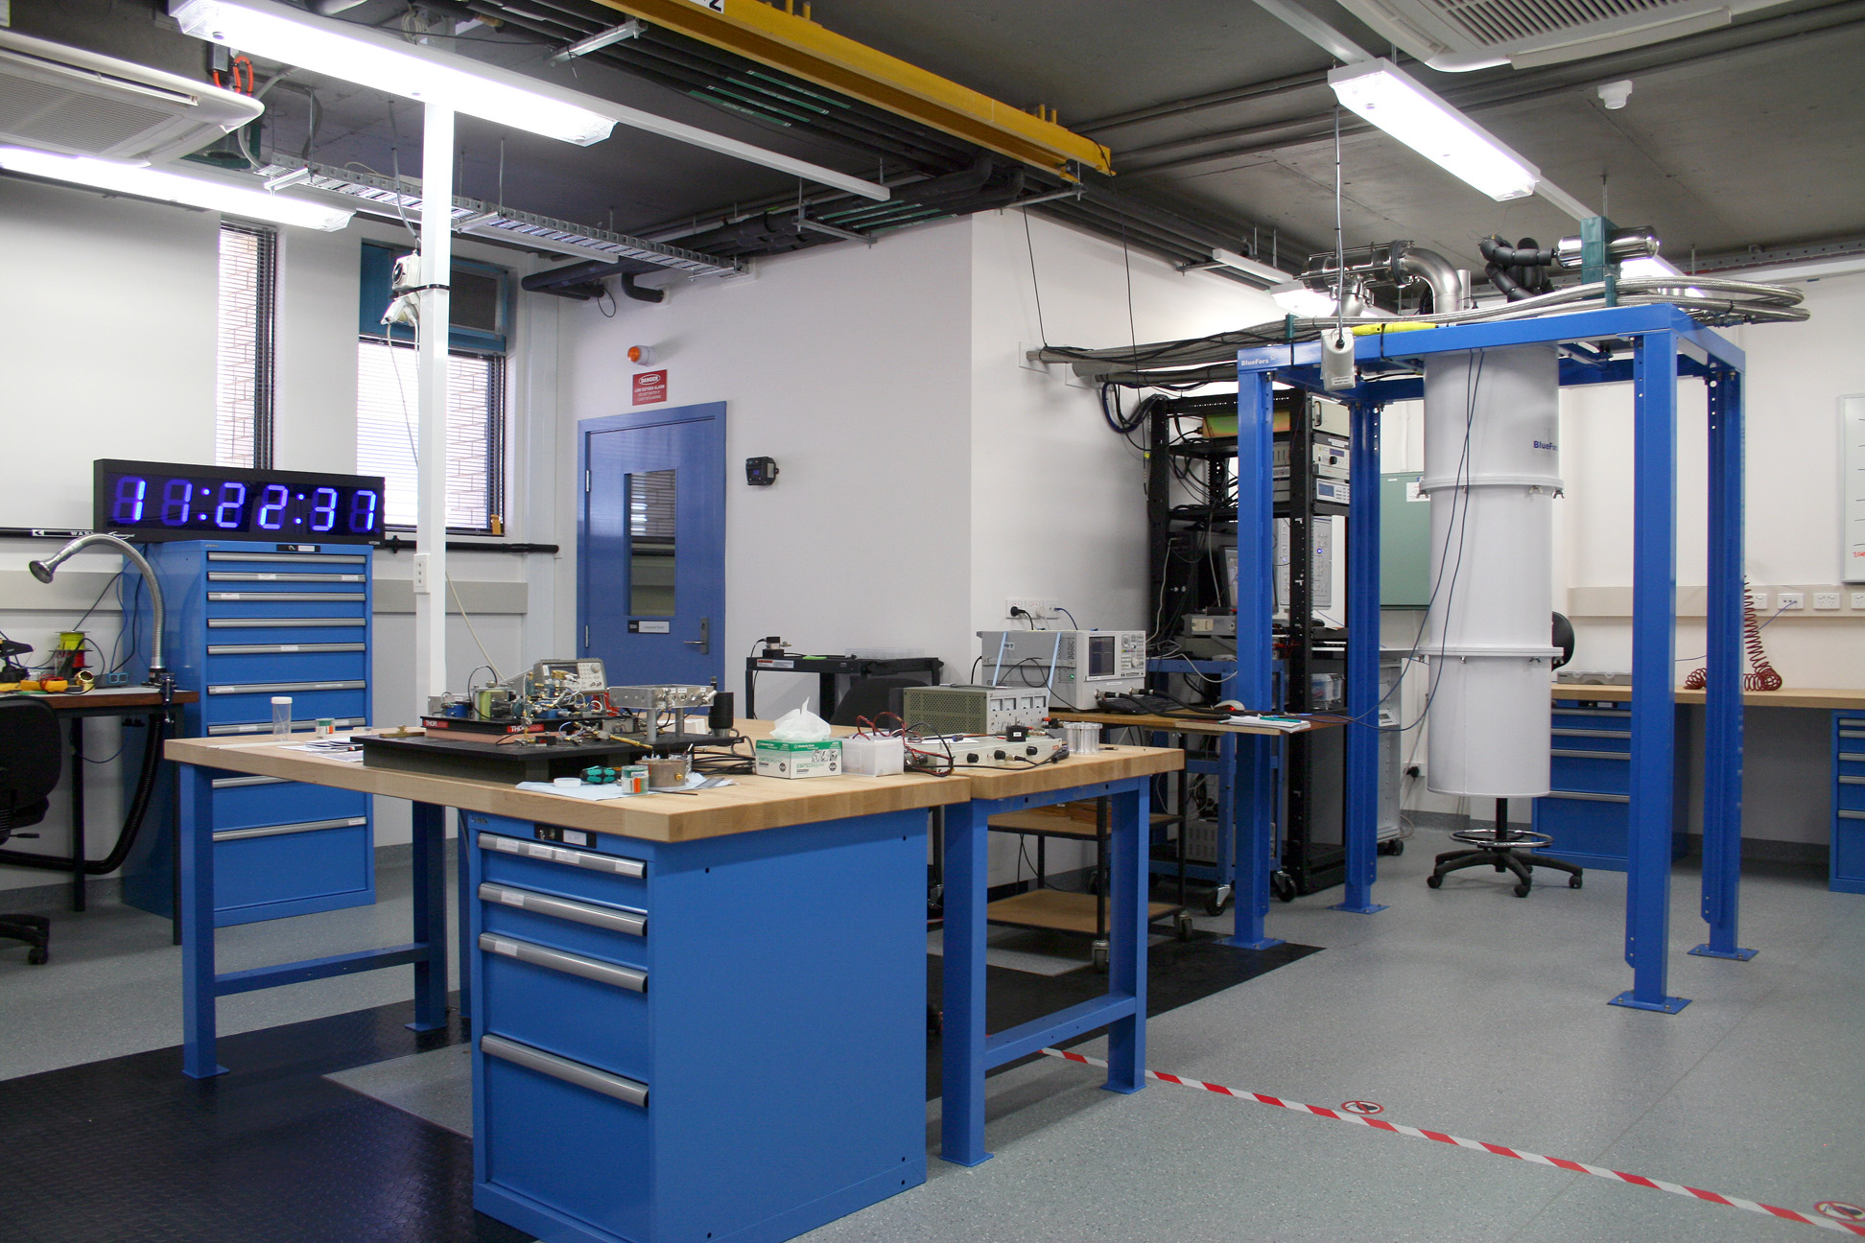
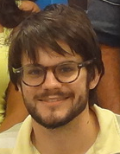
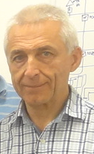
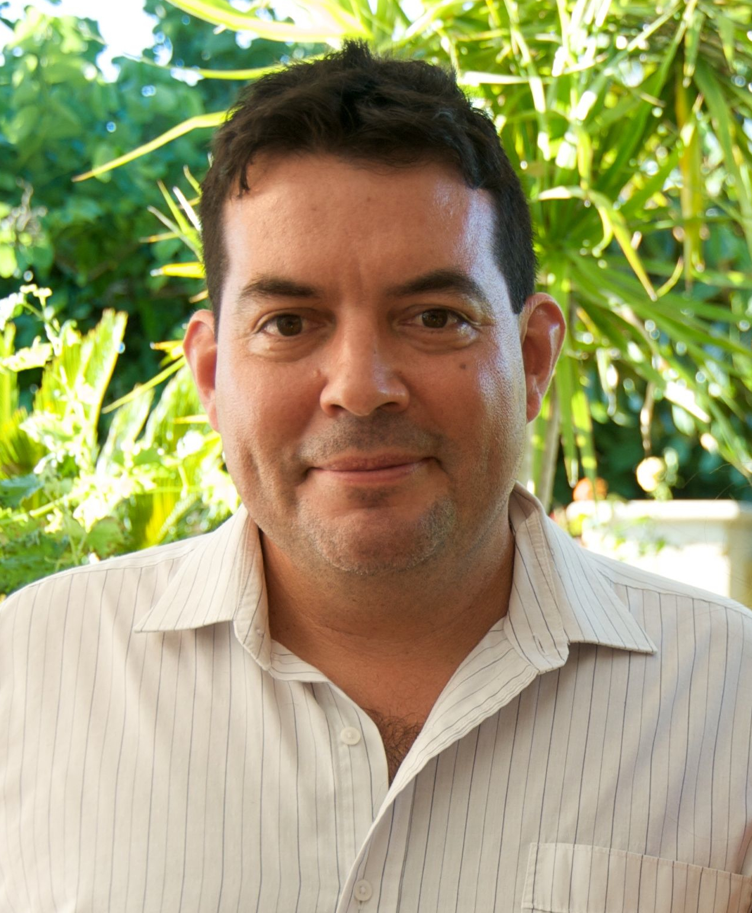
Broadband Electric-field Axion Sensing Technique (BEAST) BT McAllister, M Goryachev, J Bourhill, EN Ivanov, ME Tobar
Faculty of science
Perth, Australia

Slide 19
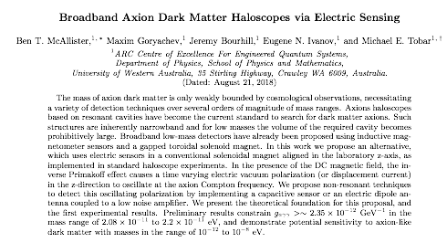
Paper rewritten with respect to Axion Modified Electrodynamics as discussed previously
Vacuum polarisation term, not E-field, so low-mass signals not suppressed

Slide 20
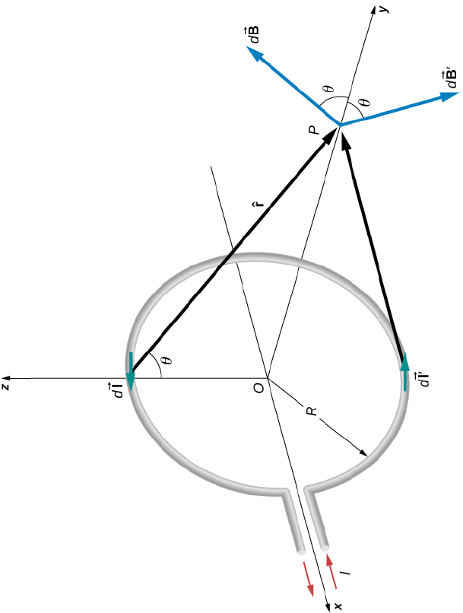
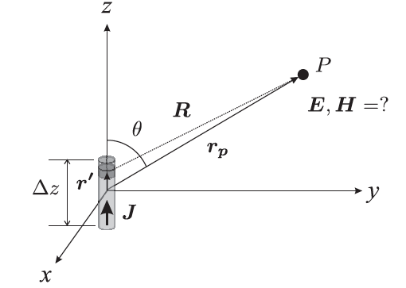
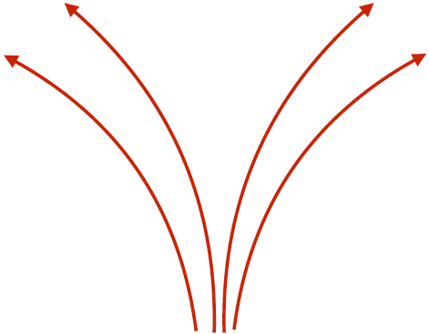
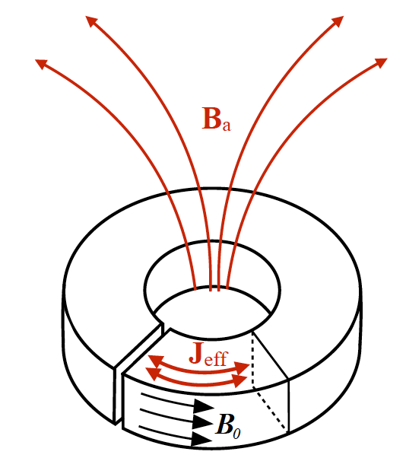
Geometry Comparison with ABRACADABRA
ABRACADABRA (Axion Magnetic Dipole)
BEAST (Axion Electric Dipole)
Similar to a Loop Antenna
Similar to Hertzian Dipole Antenna
E fields inside antenna conductors are due to oscillating free currents: J = σ E
(metal conductivity)
J
What causes the Axion induced J_{eff}?
-> No conduction electrons
-> Caused by small oscillations of vacuum polarization
-> Bound Displacement Current
E_{a}
J_{eff}

Slide 21
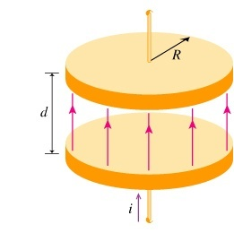
The BEAST Experiment
-
v
+
A=πR²
(DC field)
Measure Currents and Voltages
Measure with SQUID (current) or High Impedance Amplifier (HIA) (voltage)
To improve sensitivity with SQUID ->
Large Plate Area
To improve sensitivity with HIA ->
Large Plate Separation

Slide 22
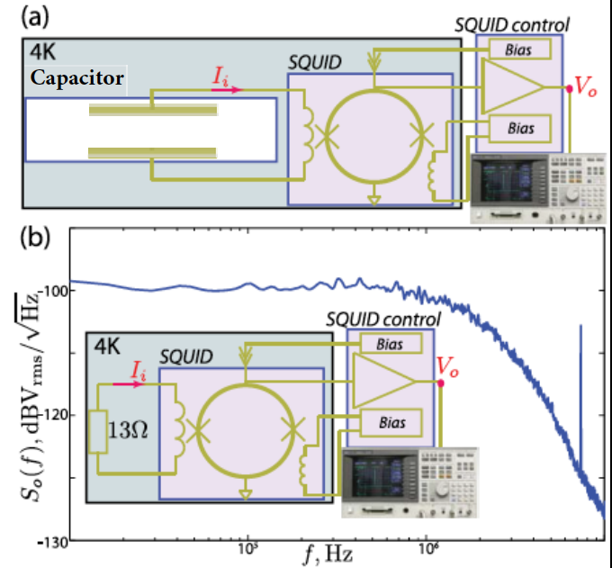
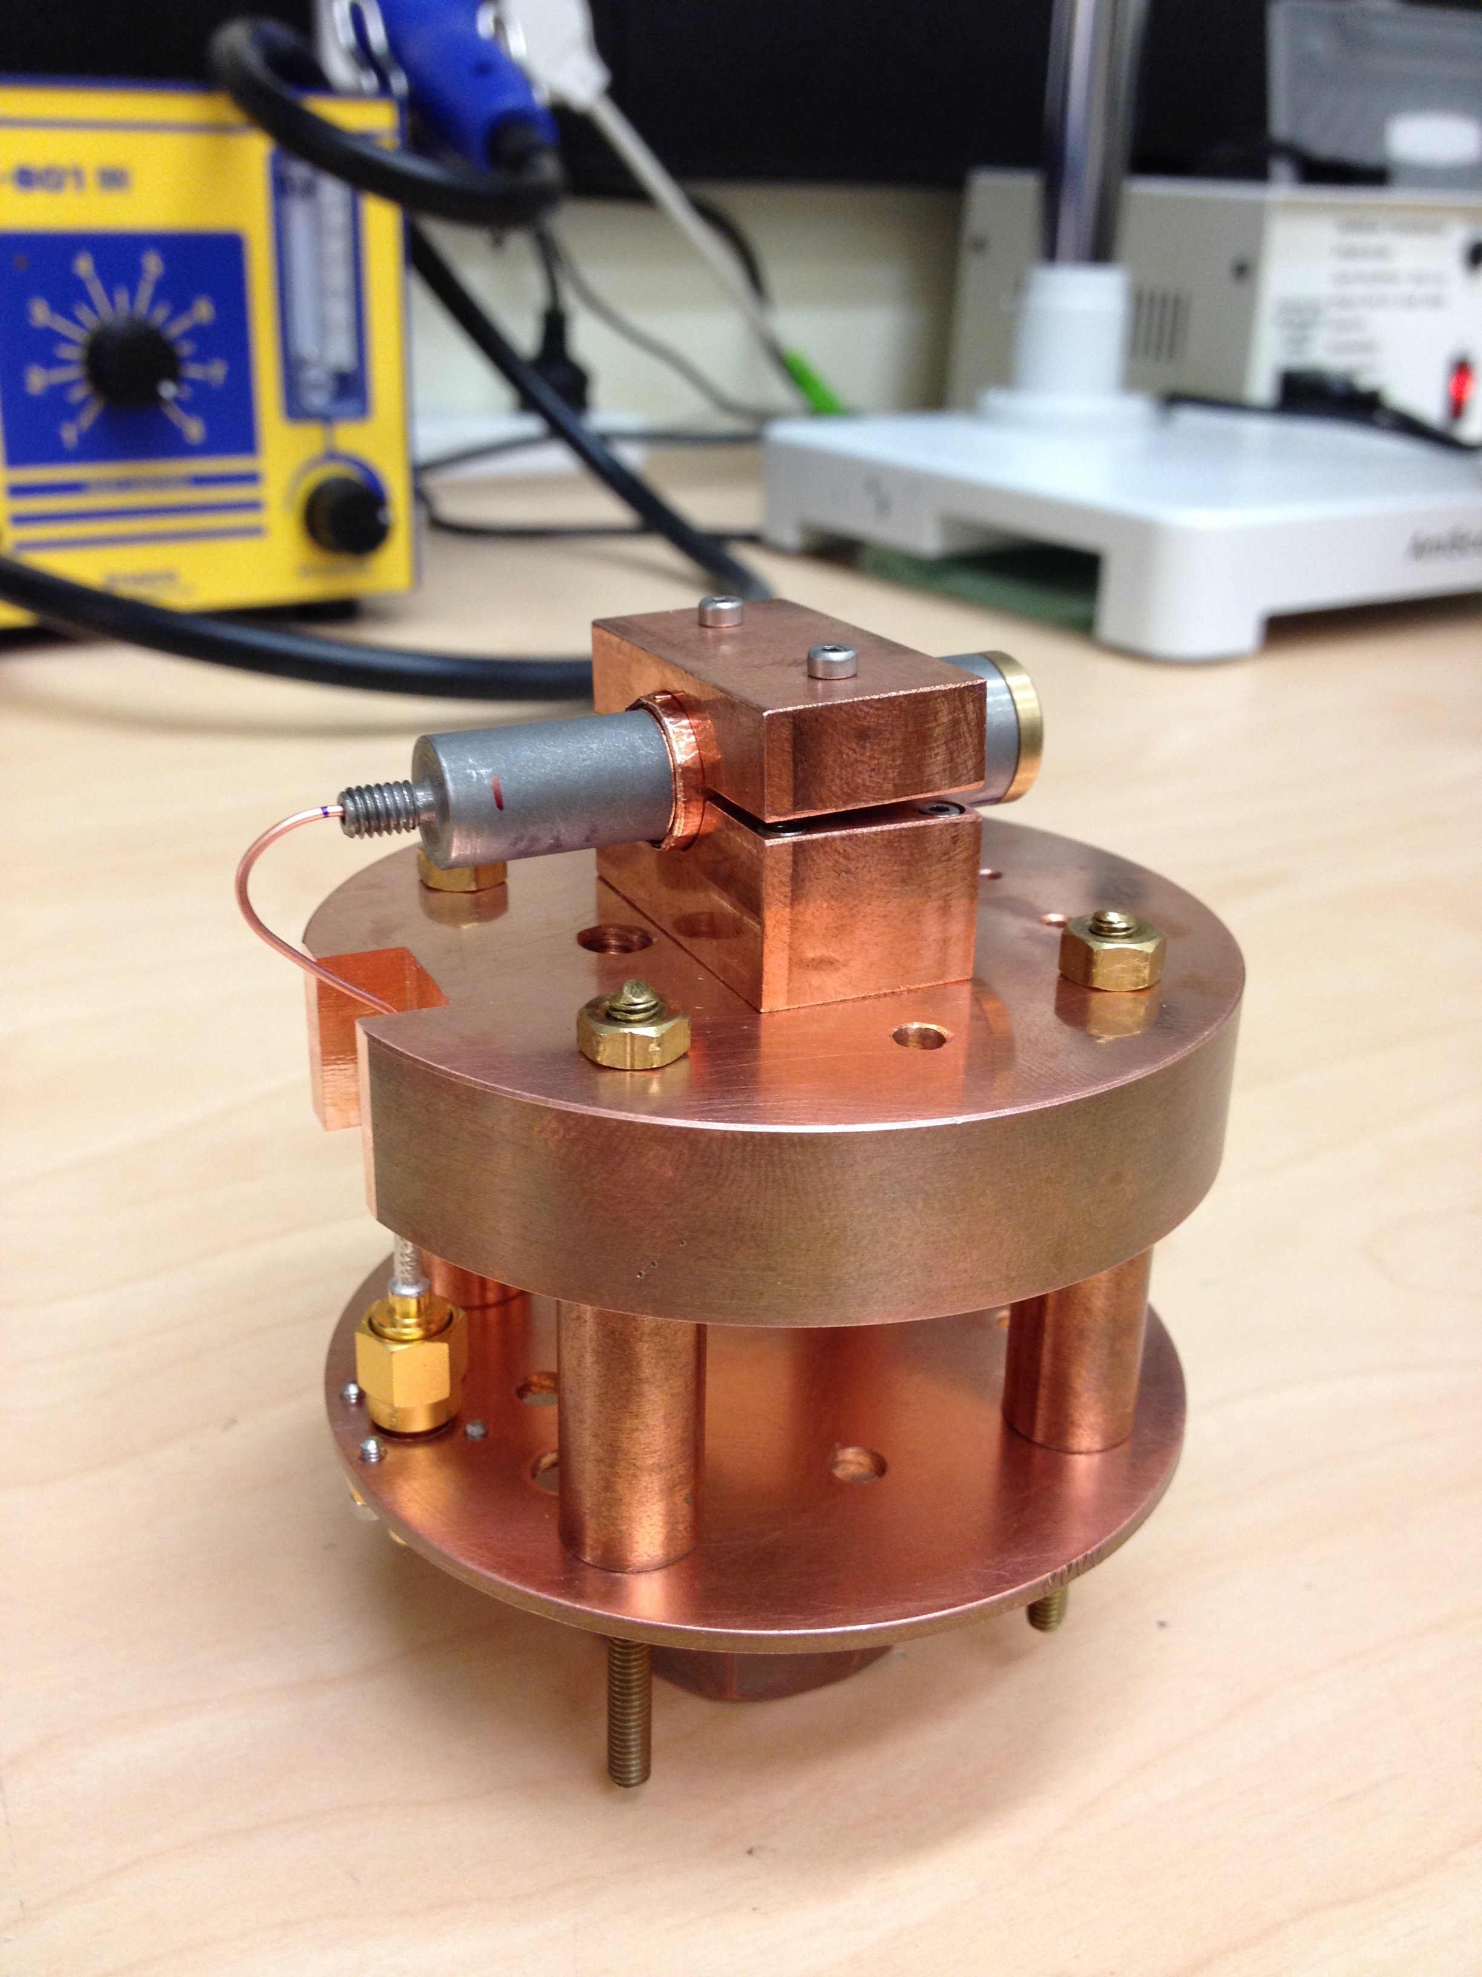
Built Experiment With a SQUID
DC SQUID in a copper holder to be attached to the “cold finger” of the pulse-tube dilution fridge
Calibration: Use resistors instead of capacitors -> Derive SQUID transimpedance ~ 1.2 MΩ
-3dB low pass bandwidth of 2.1 MHz
SQUID RMS current spectral density, ~

Slide 23
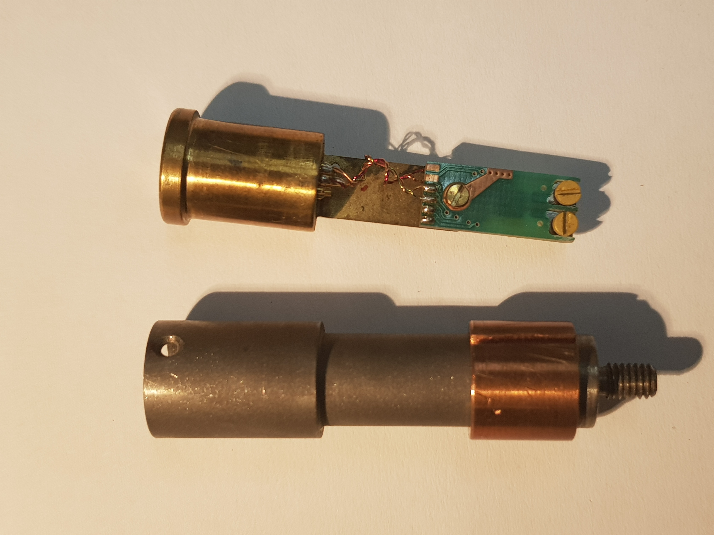
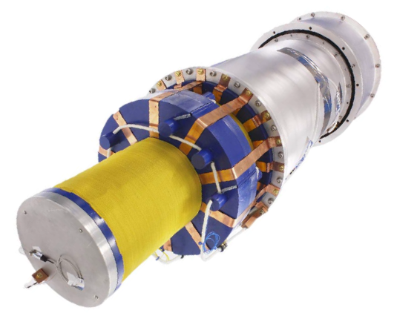
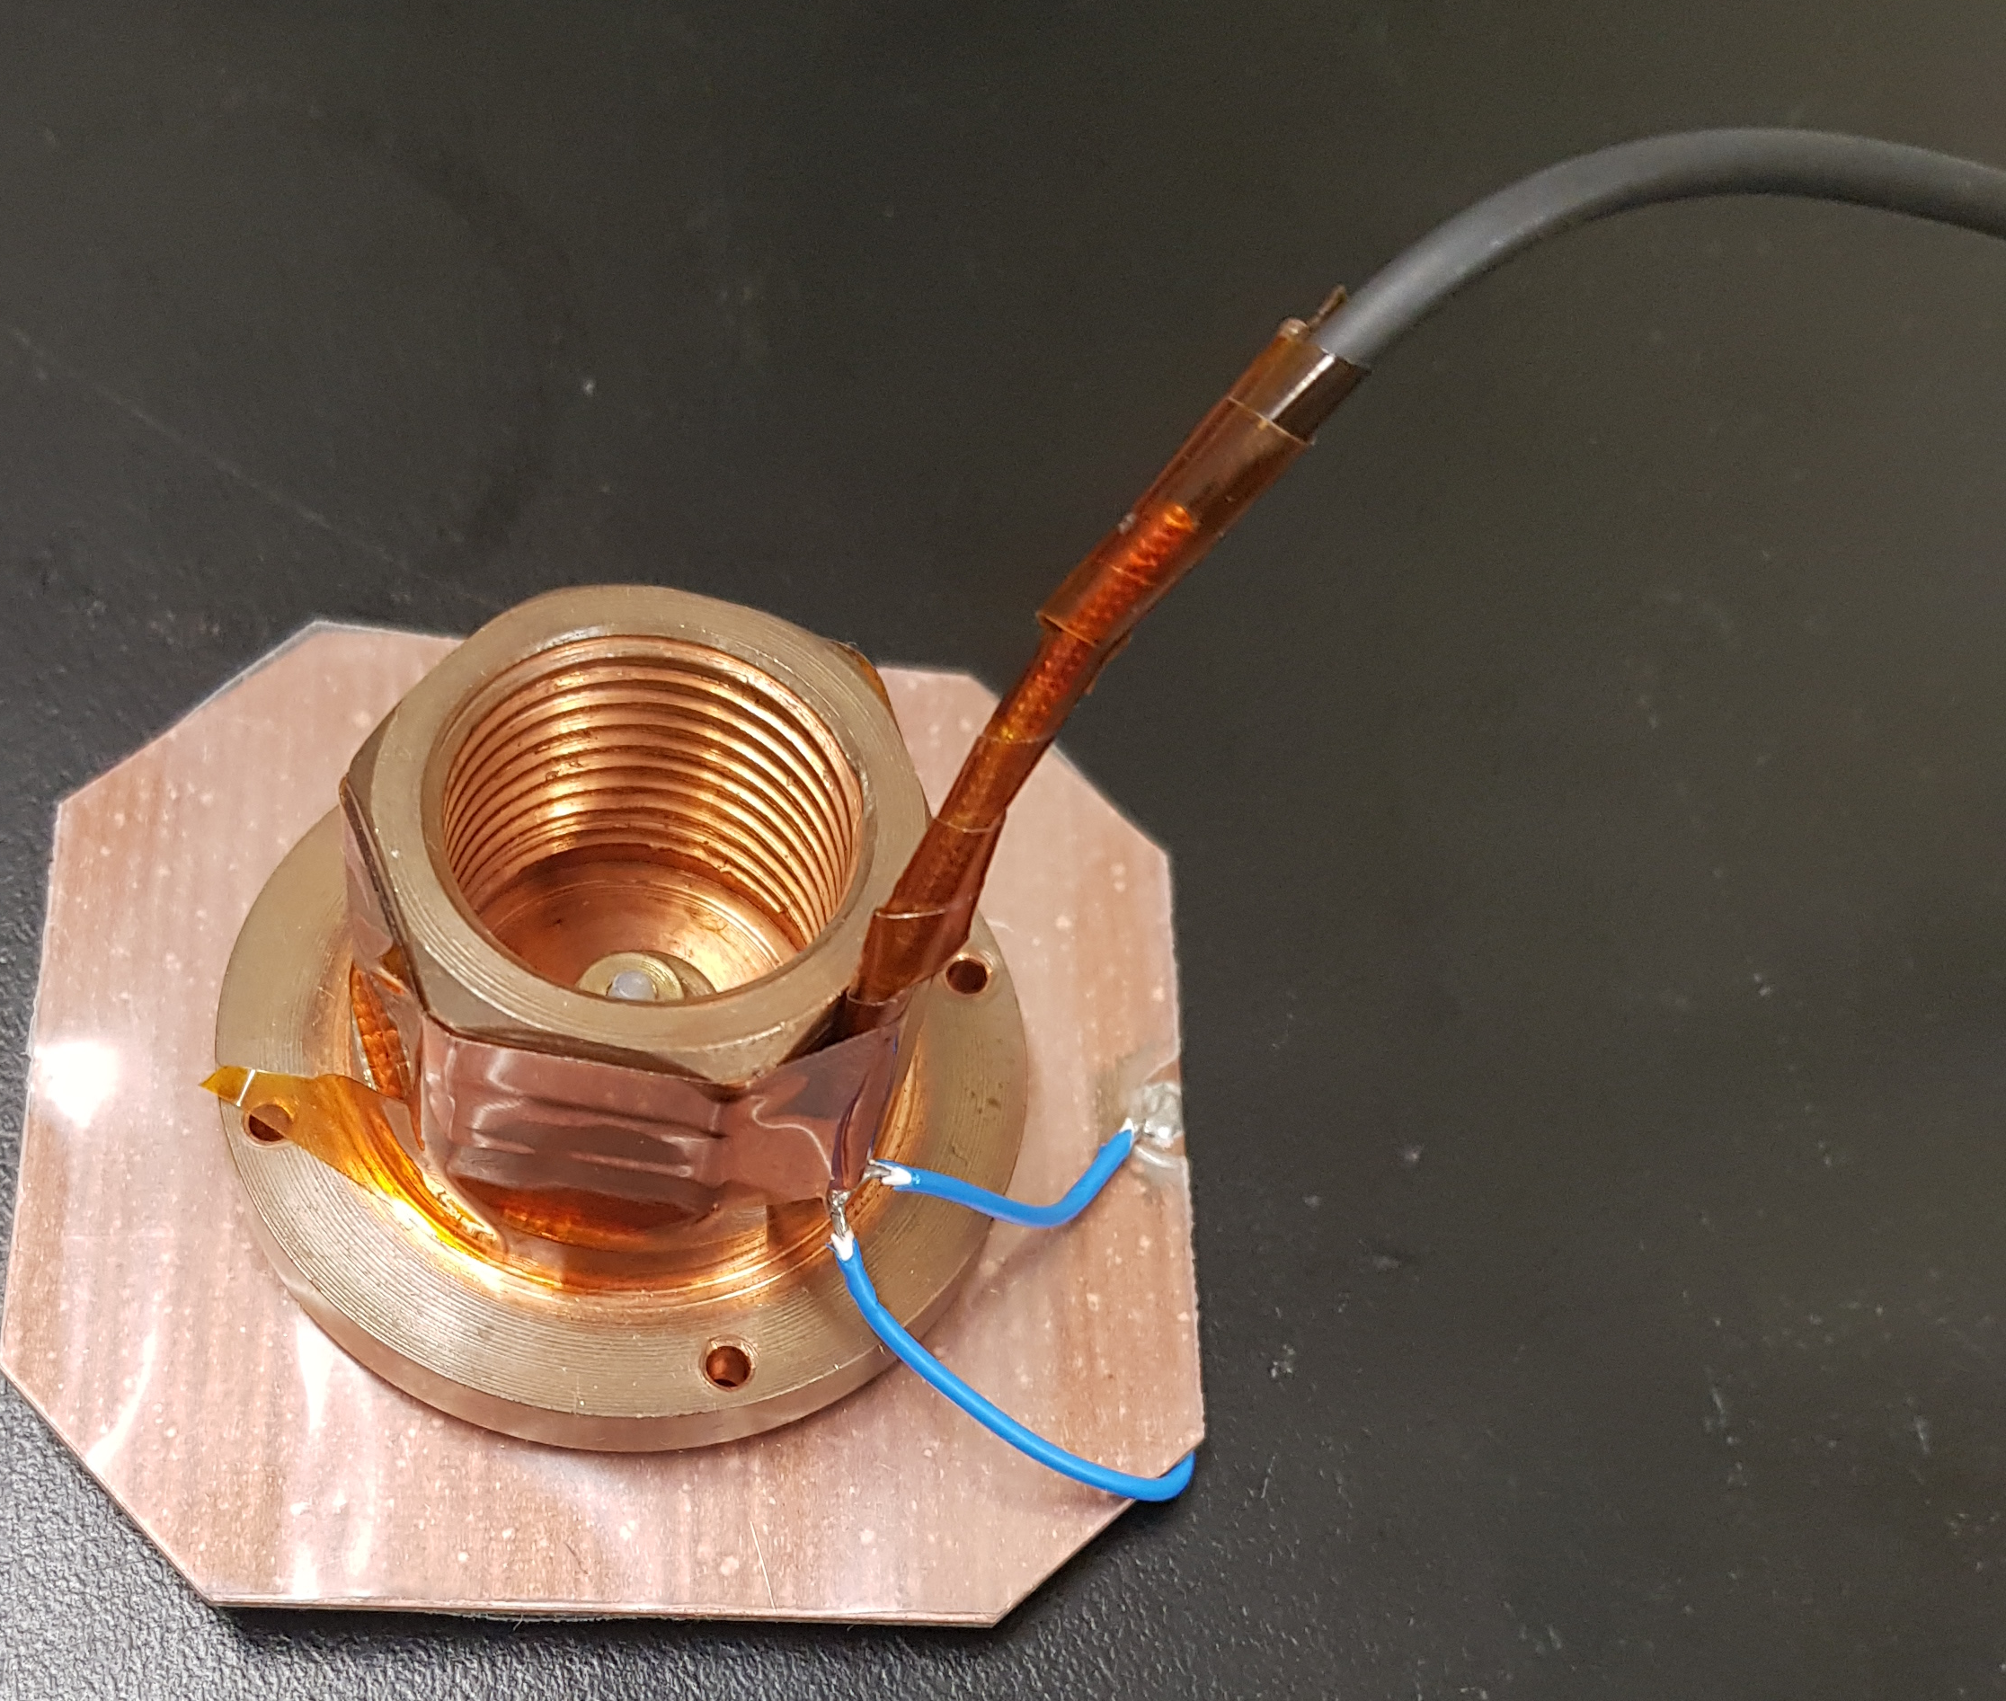
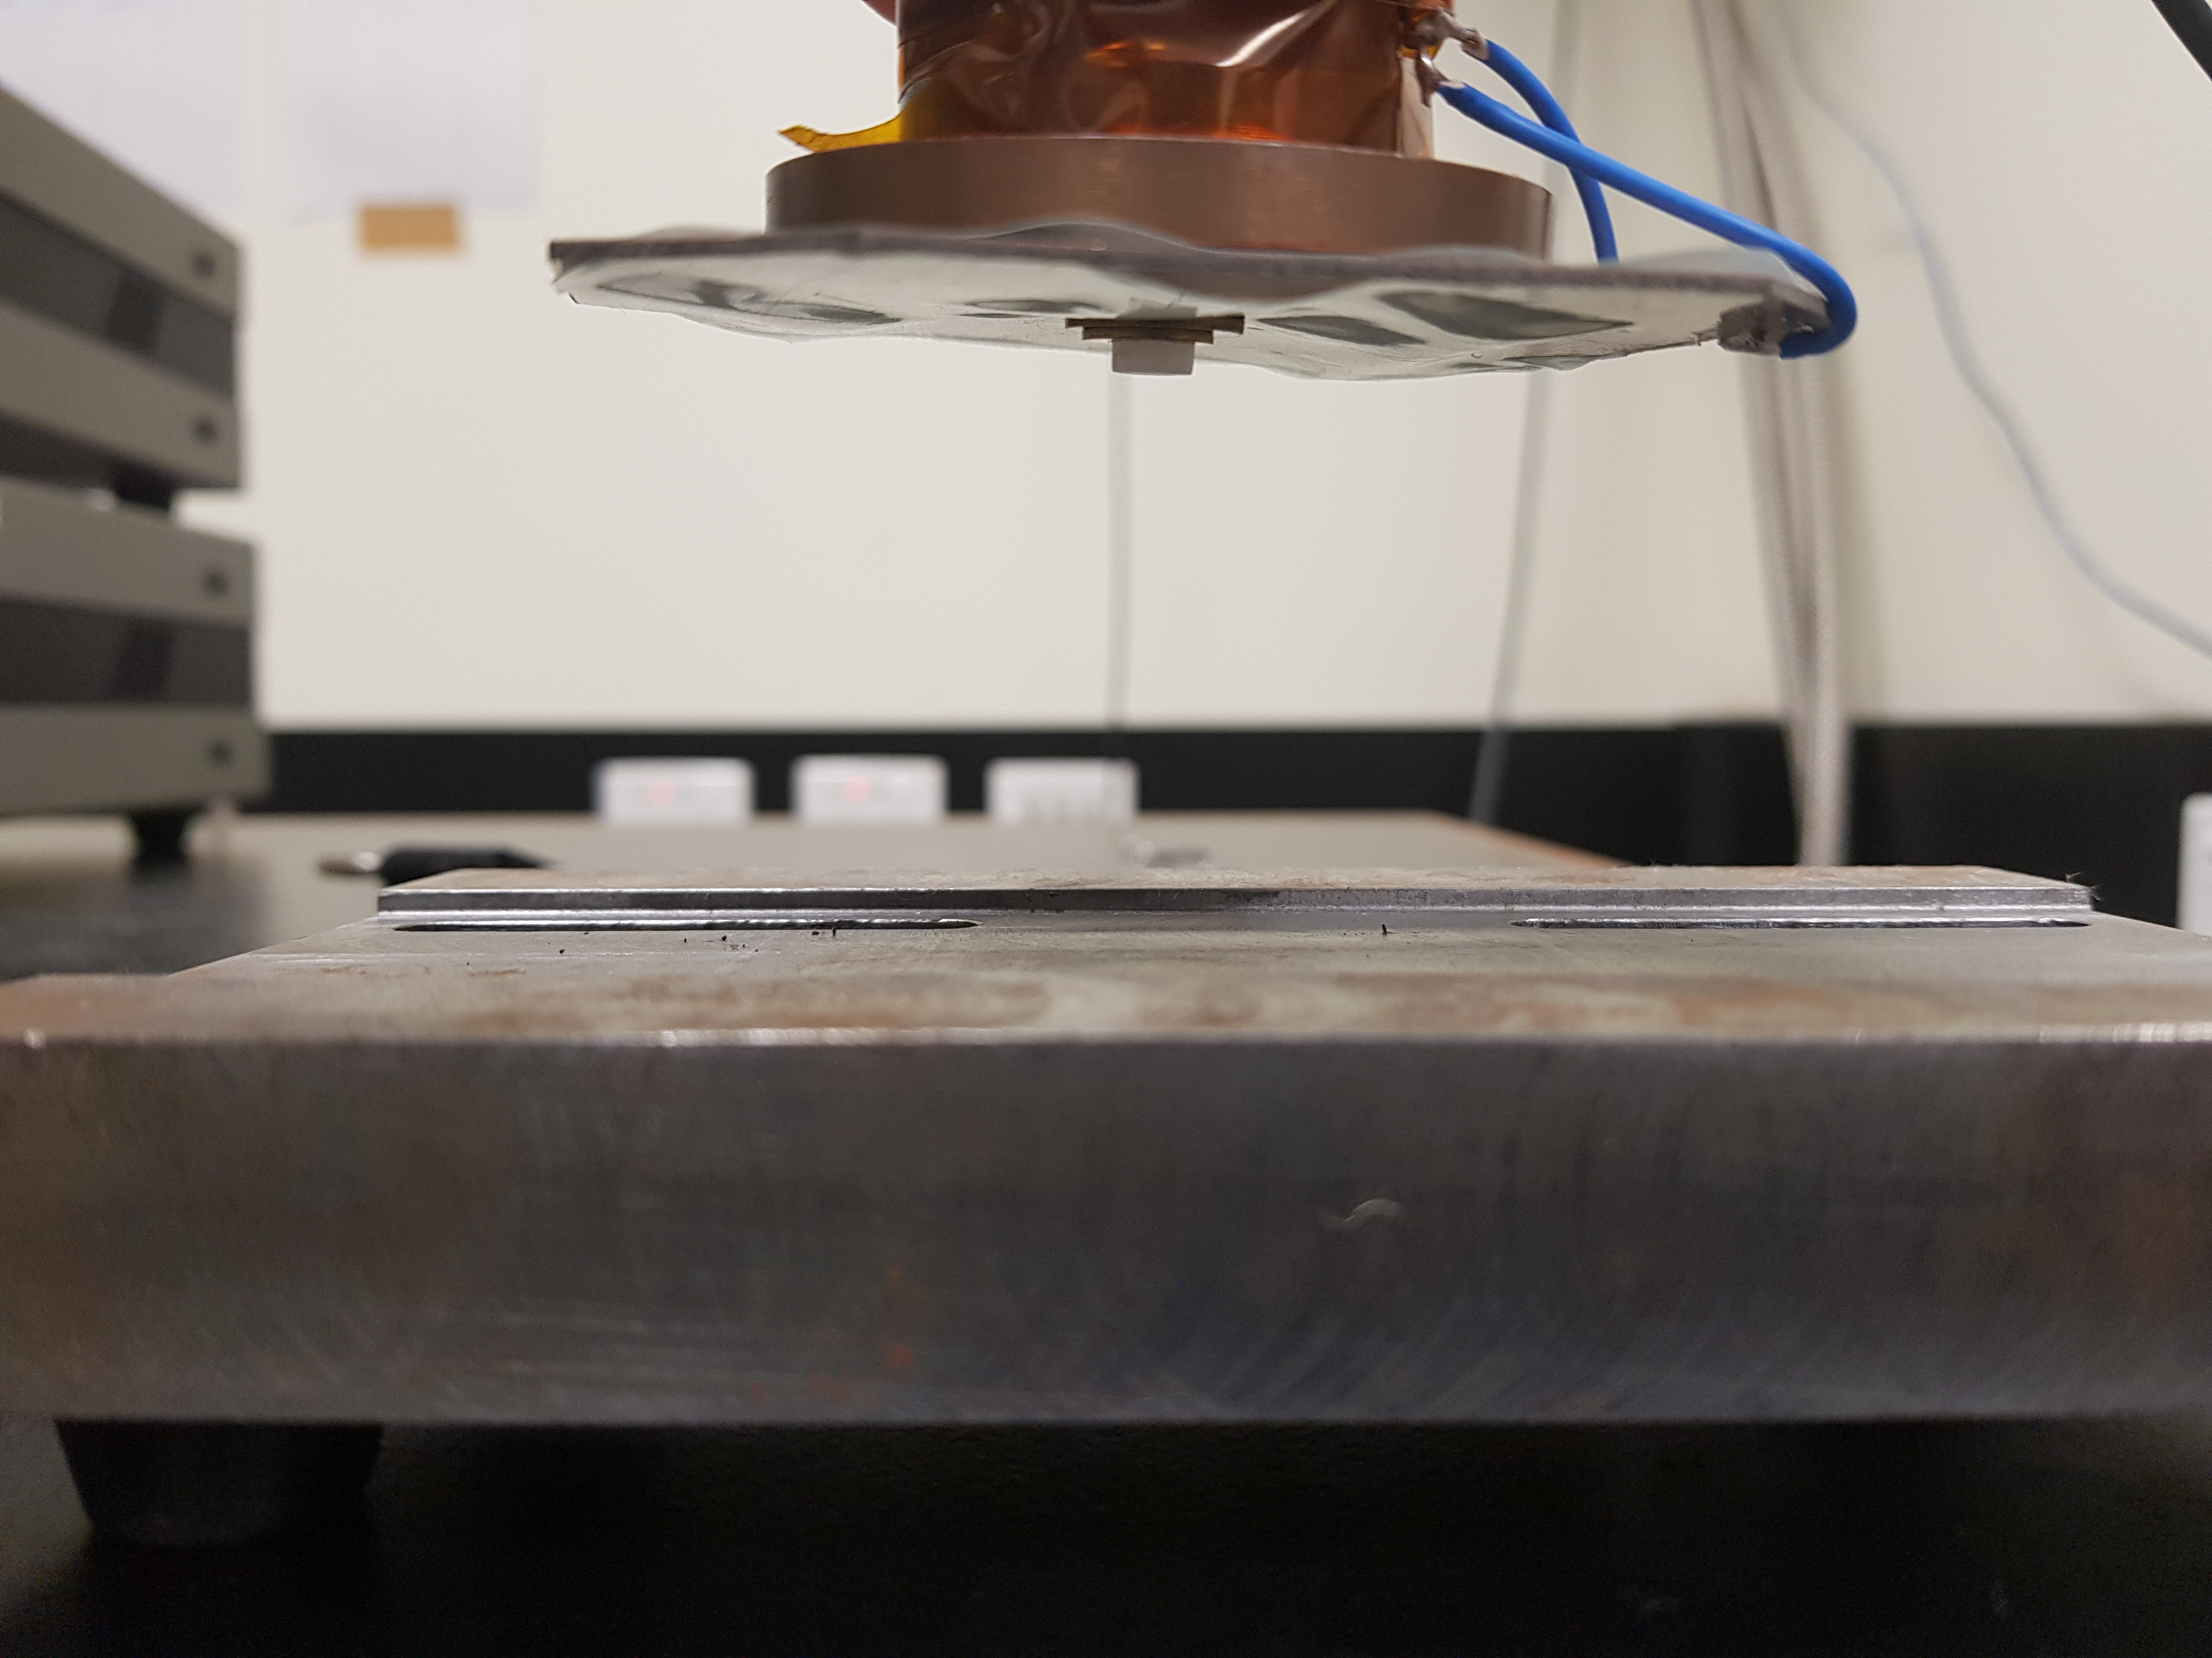
SQUID
7 T Magnet (10 cm bore)
7 T field at 4 K for 8 days of observation time
Large Area Capacitor Plate
7.5 x 7 cm

Slide 24
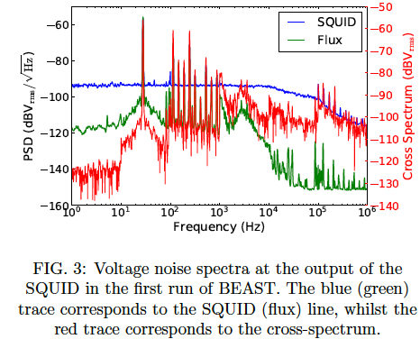
Beast Spectral Density
Possible to discriminate against these spurious signals with the flux line, which is susceptible to spurious RF signals in the lab.
This spectra do not have the requisite to resolution to resolve axion signals with an effective line width of 10⁻⁶ω_{a}

Slide 25
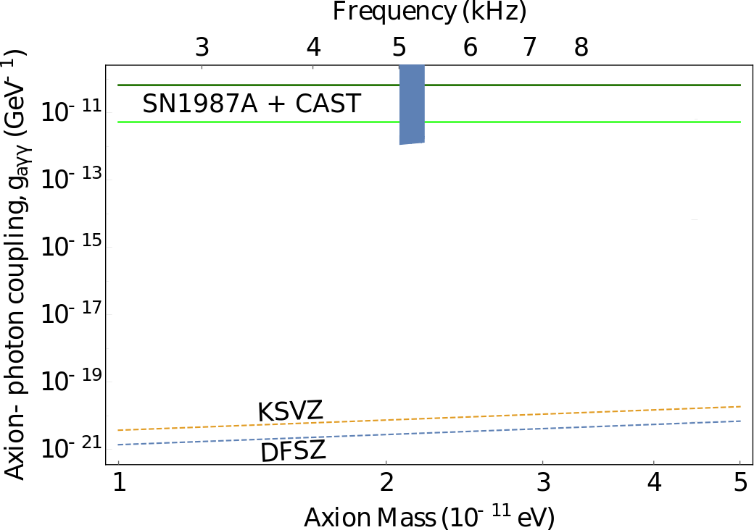
BEAST: First Limits
Higher resolution search was conducted around 5 kHz, with the minimal spectral resolution of 4.5 mHz (increasing at higher frequencies)
All sharp peaks greater than 4.4 standard deviations from the mean originating from the SQUID were able to be excluded, due to a similar signal appearing in the flux line
Using this data, we may place the 95 % confidence exclusion limits on axion-photon coupling

Slide 26
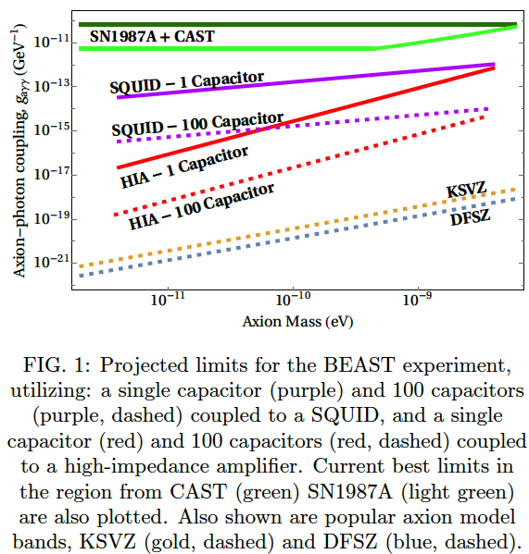
HIA V_{RMS} readout
-> A unimportant
-> d important
Suggests many long and skinny “noodle” capacitors to improve sensitivity
SQUID I_{RMS} readout
-> A important
-> d unimportant
Suggests many long flat “pan cake” capacitors to improve sensitivity
Element cross capacitance stray capacitance and grounding needs to be modeled carefully
Possible Improvements

Slide 27
Long “Noodle” Capacitors not likely: Wire dipole antennas instead?
Response of a Conductor to Axion Conversion?
Free current density induced in a conductor due to axion
Basically governed by Ohms law with current and voltage in phase
Minimizes stray capacitances
A
d
Noodle
BEAST
Bo (DC field)

Slide 28
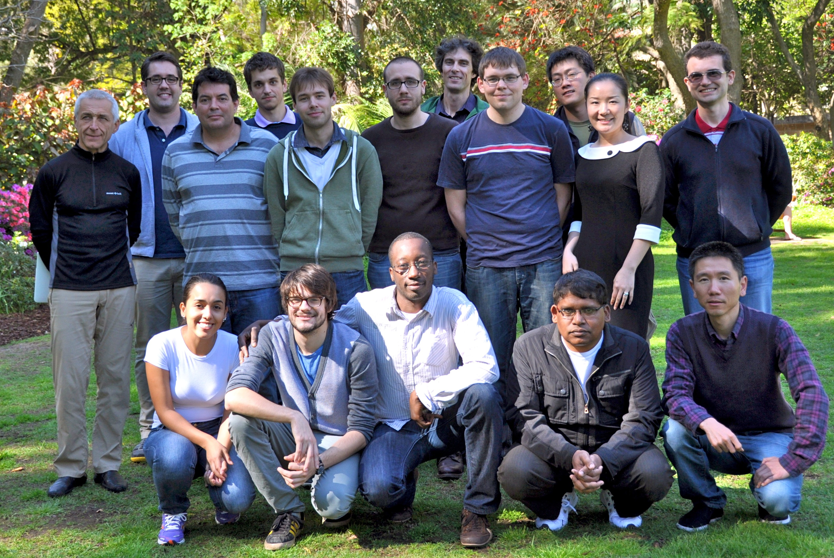
Frequency and Quantum Metrology Research Group
Research Staff
Michael Tobar
Eugene Ivanov
John McFerran
Alexey Veryaskin
Sascha Schediwy
Maxim Goryachev
Jeremy Bourhill
Students
Ben McAllister
Akhter Hoissan
Graeme Flower
Scott Hardie
Lewis Teixeira
Catriona Thomas

