Slide 1

Quantum Metrology Techniques for Axion DM above 10 GHz
Aaron S. Chou (FNAL)
LLNL Microwave Cavity Workshop
8/23/2018

Slide 2
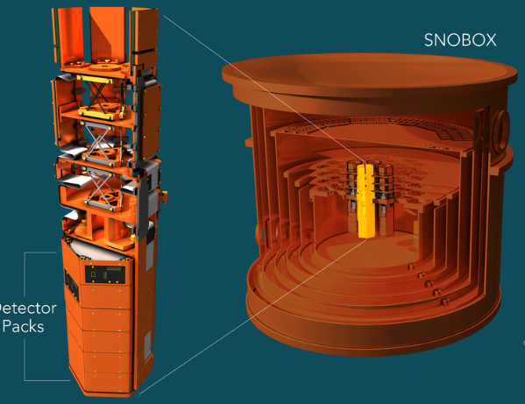
Review panel question:
Why do axion searches take so long???
CDMS: 1 puck (1997)
→ SuperCDMS: 24 pucks in 4 towers
Can we similarly conduct simultaneously operate many haloscopes using identical technology, each assigned a different frequency range?
Turn-key dilution refrigerators and magnets are cheap and low risk.

Slide 3
How to enable an experiment based on commodity refrigerators and magnets???
Backgrounds due to thermal photons and readout noise can be reduced using single photon detection
  Superconducting qubits for QND (Akash Dixit talk)
    2018 DOE Early Career Award to Daniel Bowring
  Rydberg atoms (Reina Maruyama)
Only need to boost signal strength to compensate for low-ish B²V.
  High-Q cavities (Ankur Agrawal talk)
  Stimulated emission (Konrad Lehnert, David Schuster, Aaron Chou)

Slide 4
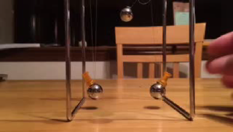
Energy transfer between two coupled oscillators
Weak coupling -- takes many swings to fully transfer the wave amplitude.
In real life, the number of swings is limited by coherence time.
Narrowband cavity response → iterative scan through frequency space.

Slide 5
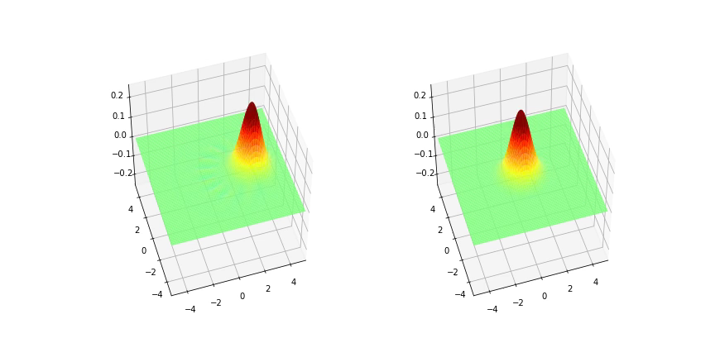
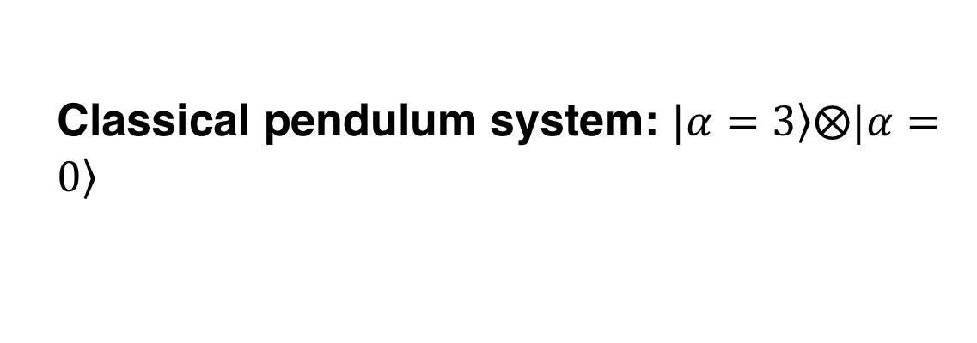
Classical pendulum system: $\left.|α=3\right\rangle ⨂\left.|α=0\right\rangle$
Time evolution of Wigner distributions in X-P “phasor” space
P
X
The two pendula swap their coherent states.
Simulated with QuTIP

Slide 6


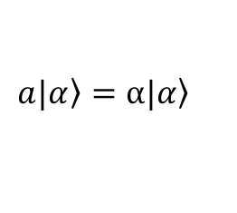
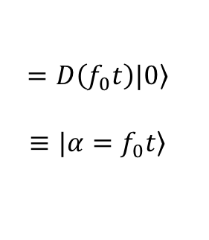
Classically-driven quantum harmonic oscillator
Roy Glauber
Nobel Prize 2005,
“Keeper of the Broom”
classical sine wave drive:
Phasor space evolution of coupled oscillators
$$=D\left(f_{0}t\right)|\left.0\right\rangle$$
$$≡|\left.α=f_{0}t\right\rangle$$
Glauber displacement operator
Glauber coherent state: quantum description of a classical sine wave, eigenstate of the annihilation operator:
$$a|\left.α\right\rangle =α|\left.α\right\rangle$$

Slide 7
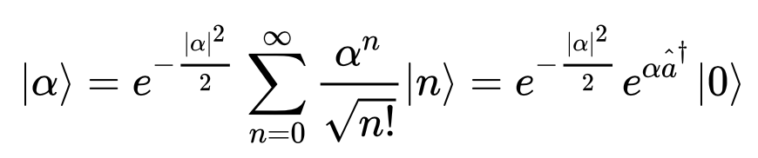
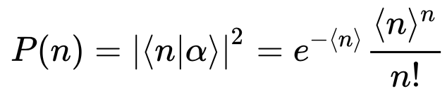

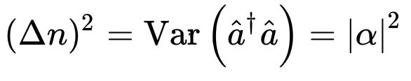

Coherent states in the Fock basis
QM knows that the squared wavefunction describes a Poisson process:
Like the zero-point fluctuations, the Poisson shot noise in classical wave intensity is a consequence of the Heisenberg uncertainty principle.
The shot noise enforces the standard quantum limit in parametric amplifiers.
$$=\sqrt{n}$$

Slide 8
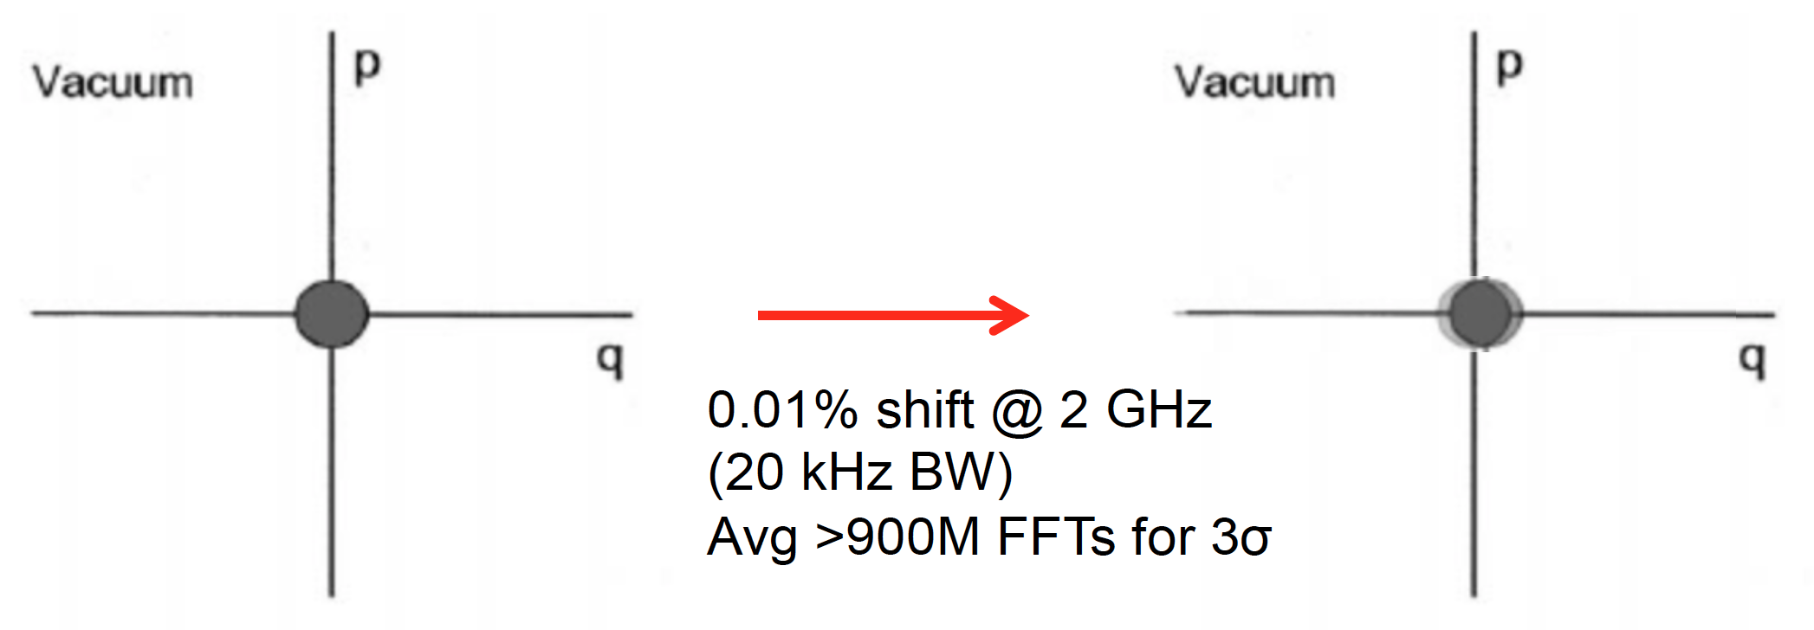

The axion wave displaces the cavity vacuum state by an amount much smaller than the zero-point vacuum noise
p
p
Axion-photon mixing induces tiny coherent state displacement
x
x
(Exaggerated) shift gives tiny probability for populating N=1 state
Cannot easily see the tiny shift above the zero-point noise of the vacuum…

Slide 9
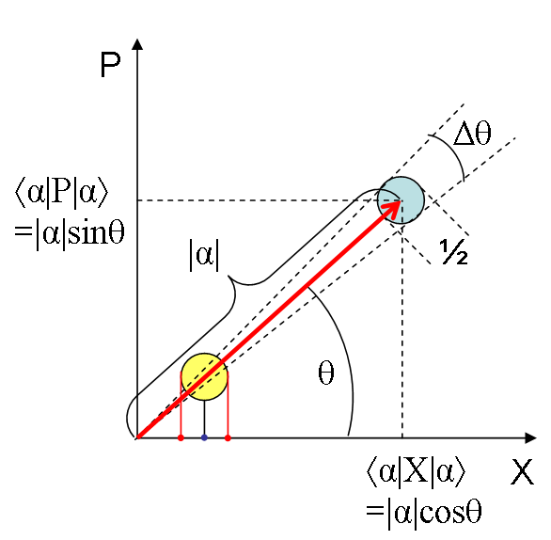
Quantum non-demolition (QND) single photon detectors can do much better than SQL amplifiers
Number operator commutes with the Hamiltonian→ all backreaction is put into the unobserved phase – which we don’t care about...
Avoid the zero-point noise by making measurements in the Fock basis instead of the coherent state basis.
Demonstrated with Rydberg atoms, (Serge Haroche Nobel Prize 2012)
Implemented using solid state artificial atom qubits,
D.Schuster et.al, 2007
Proposed for axion search:
Lamoreaux, Lehnert, et.al, 2013,
Zheng, Lehnert, et.al, 2016
Phase space area is still ½ħ but is squeezed in radial (amplitude) direction. Phase of wave is randomized.

Slide 10

Multi-qubit sensors can achieve vanishing background rates
DFSZ, 0.3 GeV/cc, 14T, C=1/2, Q=5x10⁴@1GHz, 1𝜆³, crit.coup.
SQL bkgd
P_{err} = 10⁻²
→ 1% of SQL.
25 mK blackbody
Potential background
reduction
Error prob. for
n-qubit coincidence counting =
(10⁻²)^{n}
Axion signal
4 qubit dark rate
4 qubit 3σ sensitivity
Signal shot noise limit 3σ, t=10⁴ s
5 qubit 3σ sensitivity
5 qubit dark rate
20 GHz = 80 $μ$eV
Sensitivity is only limited by signal shot noise. Signal rate can be increased with: 1) higher B field; 2) power-combined cavities; 3) higher Q cavities

Slide 11





Use high-Q_{c} cavity (Q_{c}> Q_{a} =10⁶) as signal integrator to match noisy readout rate to the expected signal rate
Why read out at 10⁶ Hz when the signal rate is 10⁻² Hz?
Displacement operator product gives random walk accumulation of signal amplitude (1 step per signal coherence time):
$${→ Π}_{i}D({∆α}_{i})=D(Σ_{i}{∆α}_{i})e^{i(phase)}$$
$$\sqrt{N_{steps}}∆α$$
$E=\sqrt{N_{steps}}∙∆α$ =$\sqrt{\frac{Q_{c}}{Q_{a}}}∙gθBQ_{a}$
$$→ P_{signal} \sim { E}^{2}V∙ \frac{m}{Q_{c}} ∝Q_{a}$$

Slide 12
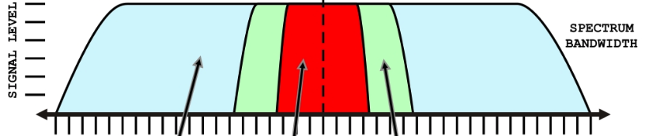
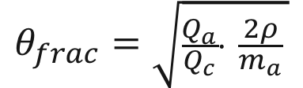
Can also view as detecting the power in a small but highly coherent fraction of the axion broadcast bandwidth
f/Q_{c}
Chaudhuri, et.al
arXiv:1803.01627
f/Q_{a}
Sideband components decohere with the cavity during the random walk
$$θ_{frac}=\sqrt{\frac{Q_{a}}{Q_{c}}∙ \frac{2ρ}{m_{a}} }$$
$$→ P_{signal} \sim { E}^{2}V∙ \frac{m}{Q_{c}} {=(gθ_{frac}BQ_{c}^{ })}^{2 }V∙ \frac{m}{Q_{c}} ∝Q_{a}$$
Require cavity coherence time T2 > axion coherence time T_{a}.
Cavity frequency can drift as long as it stays within the axion signal band on the time scale of the accumulation time = cavity lifetime T1.

Slide 13

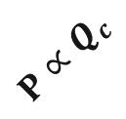





Accumulate signal at the resulting constant power plateau
$$P∝Q_{a}$$
$E=\sqrt{N_{steps}}∙∆α$ =$\sqrt{\frac{Q_{c}}{Q_{a}}}∙gθBQ_{a}$
$$P∝Q_{c}$$
Signal power
$$→ P \sim { E}^{2}V∙ \frac{m}{Q_{c}} ∝Q_{a}$$
Q_{a}
Q_{c}
Need only one “sample point” per axion linewidth, i.e. Q_{a} cavity tunings per octave.
$$∆f=f/Q_{c}$$
(detection bandwidth)
$$f/Q_{a}$$
(axion linewidth = tuning step size)
For a fixed total run time t_{tot} ~ 1 year, the allocated time per tuning is:
$$t_{tune}=t_{tot}/Q_{a}$$
$SNR= \frac{P_{signal}}{{PSD}_{noise}Δf} \sqrt{2Δf∙t_{tune}} ∝$ $P_{signal}∙\sqrt{\frac{t_{tune}}{∆f}} ∝\sqrt{Q_{a}Q_{c}}$
Increases for arbitrarily large Q_{c} !

Slide 14
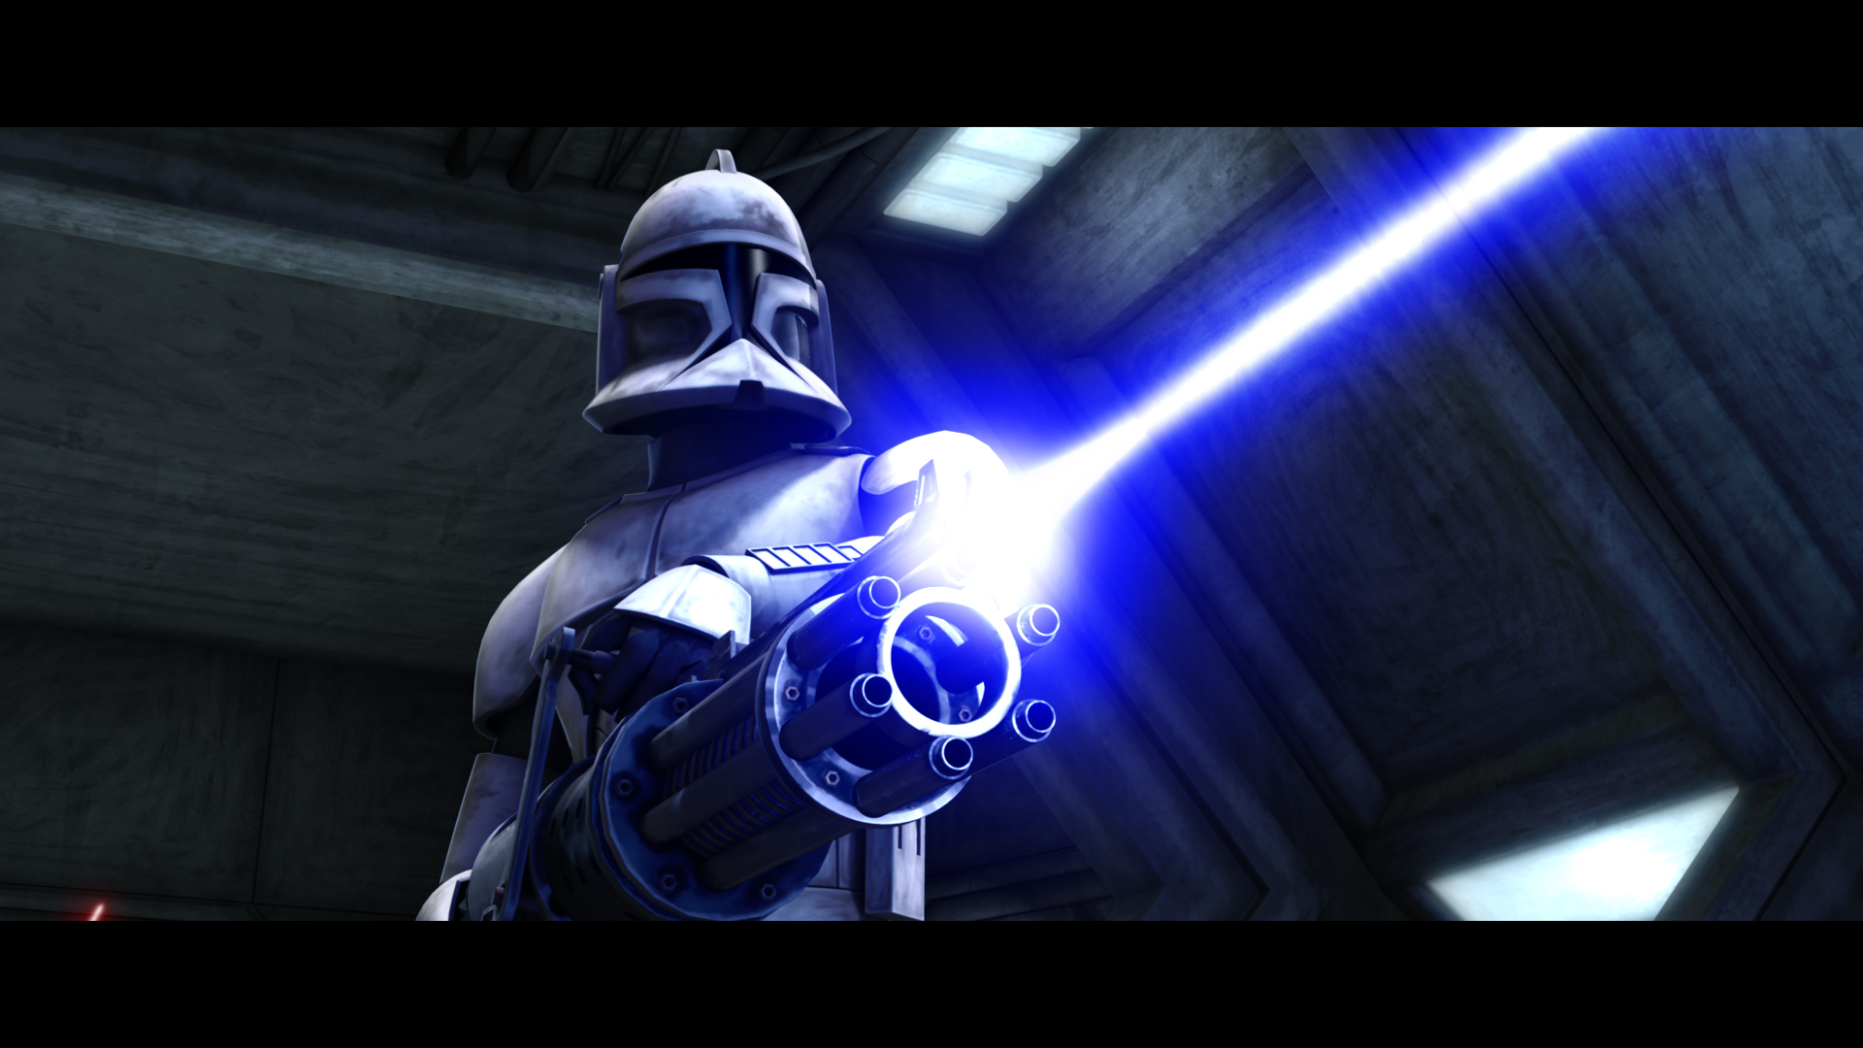
Stimulated emission

Slide 15

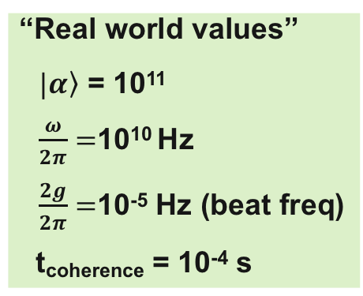
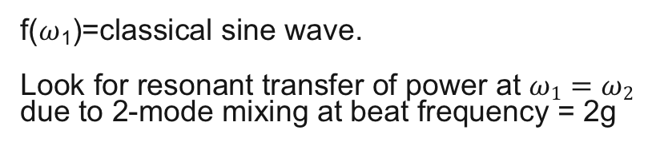
Axion haloscopes are classically-driven quantum harmonic oscillators
“Real world values”
$\left.|α\right\rangle$ = 10¹¹
$\frac{ω}{2π}=$10¹⁰ Hz
$\frac{2g}{2π}=$10⁻⁵ Hz (beat freq)
t_{coherence} = 10⁻⁴ s
$H_{I}$ = $g(f^{∗}b$+${fb}^{†}$)
g
f($ω$₁)=classical sine wave.
Look for resonant transfer of power at $ω1=ω2$
due to 2-mode mixing at beat frequency = 2g
Can we get enhanced Power = (Force $×$velocity) if we start the detection pendulum swinging with some initial velocity?

Slide 16

Pushing the swing at the wrong phase
Good!
Waiting…
Oops
Power = $\vec{Force}∙\vec{velocity}$
Phase offset determines the direction of energy flow.
But the axion wave is a coherent state of unknown phase which changes every millisecond… How do we prepare the cavity oscillator???

Slide 17
Solution: Prepare the cavity in a Fock state which has definite photon number but maximally indeterminate phase
Schrodinger’s cat state of the cavity mode in a symmetric superposition of all possible oscillation phases. Just like the vacuum state, this Fock state will respond equally well to any arbitrary phase of the axion wave…and it has no Poisson noise!
N=1 Fock state
Graphic from Lvovsky, et.al, PRL 87, 050402 (2001)
Think of the phase space distribution as standing waves inside a 2-dimensional potential well. Wigner distributions are Laguerre-Gauss functions.

Slide 18
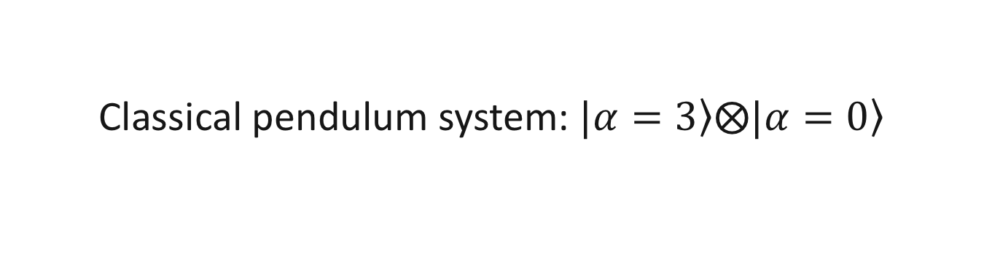
Classical pendulum system: $\left.|α=3\right\rangle ⨂\left.|α=0\right\rangle$
Time evolution of Wigner distributions in X-P “phasor” space
The two pendula swap their coherent states.
Simulated with QuTIP

Slide 19
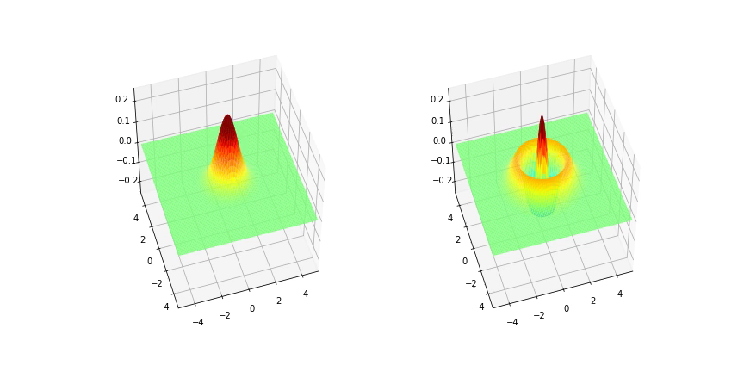

$\left.|α=0\right\rangle ⨂\left.|N=2\right\rangle$
Vacuum and Fock states swap places

Slide 20
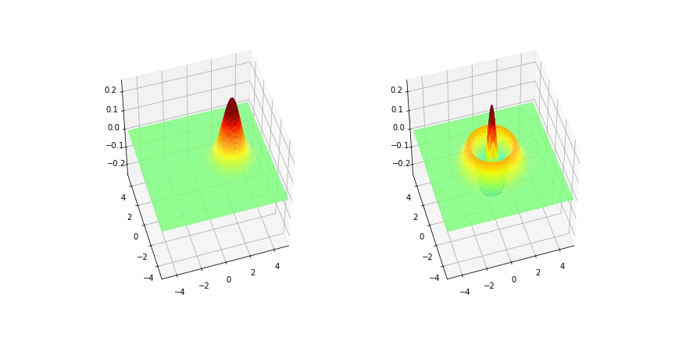
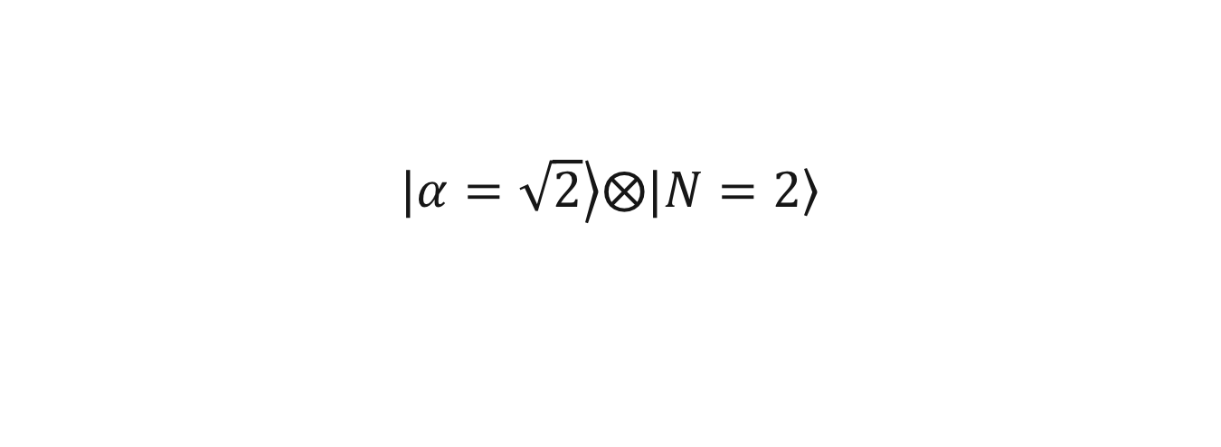
$\left.|α=\sqrt{2}\right\rangle ⨂\left.|N=2\right\rangle$
Coherent and Fock states swap places

Slide 21
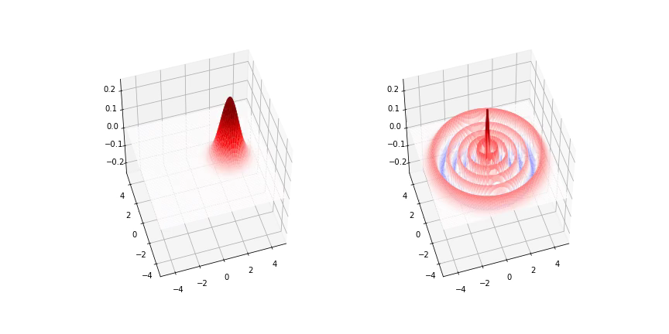
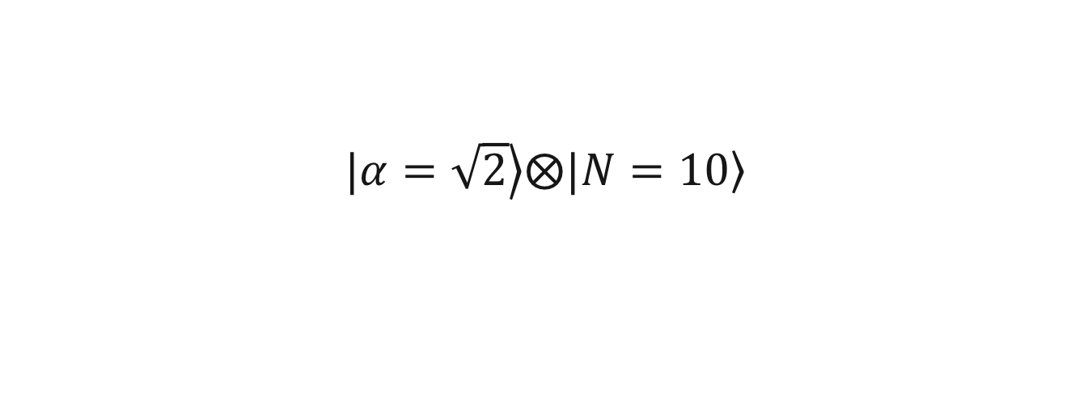
$\left.|α=\sqrt{2}\right\rangle ⨂\left.|N=10\right\rangle$

Slide 22
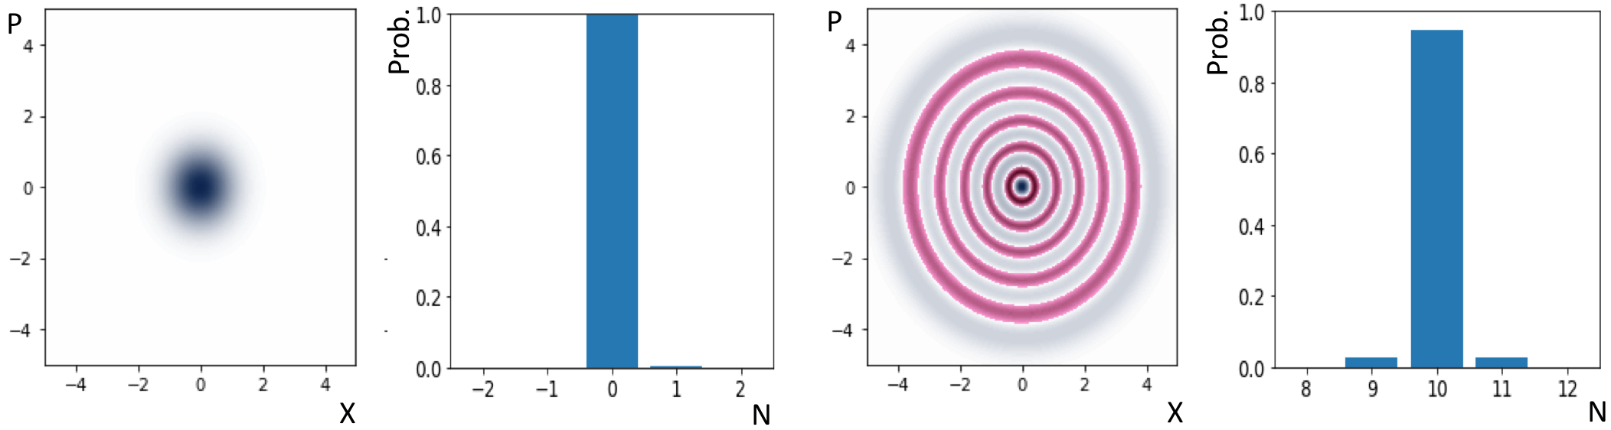
Spontaneous vs Stimulated Emission
signal
signal
Cavity prepared in vacuum state N=0. Interaction with axions displaces this from the origin.
Spontaneous emission gives small population of N=1 state
Cavity prepared in N=10 Fock state. Displacement due to axions moves some components to smaller radius and some components to larger radius, corresponding to stimulated absorption and stimulated emission, respectively
Factor of 10 in transition rates gives much larger signal in the N=11 state
Again, use qubit QND photon counting to measure the final state Fock number.

Slide 23


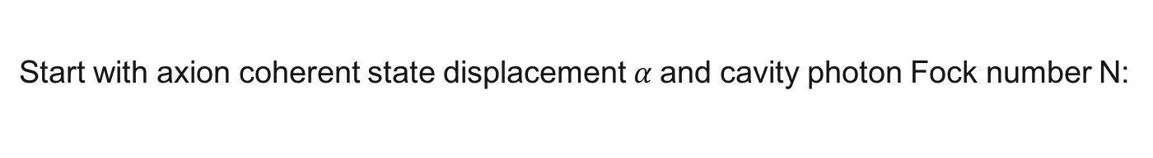
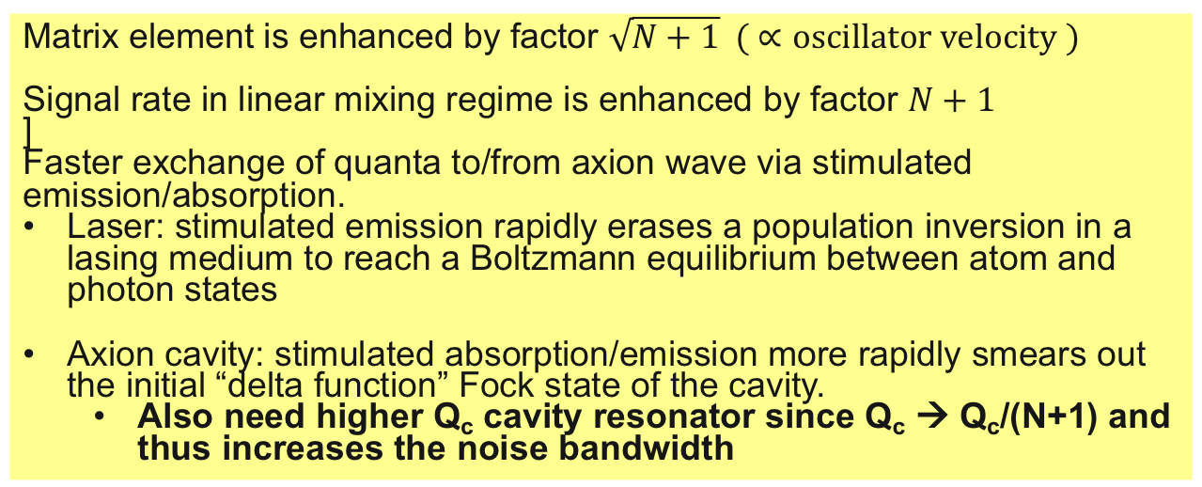
Cavity Fock-state preparation gives stimulated emission/absorption between axion and cavity modes
Interaction Hamiltonian for direct product of 2 bosonic modes:
$H_{I}$ = $g(a^{†}b$+${ab}^{†}$)
Start with axion coherent state displacement $α$and cavity photon Fock number N:
$${\left\langle α,N+1|\right.H}_{I}|α,\left.N\right\rangle =gα\sqrt{N+1}$$
Matrix element is enhanced by factor $\sqrt{N+1} ( ∝oscillator velocity )$
Signal rate in linear mixing regime is enhanced by factor $N+1$
]
Faster exchange of quanta to/from axion wave via stimulated emission/absorption.
Laser: stimulated emission rapidly erases a population inversion in a lasing medium to reach a Boltzmann equilibrium between atom and photon states
Axion cavity: stimulated absorption/emission more rapidly smears out the initial “delta function” Fock state of the cavity.
  Also need higher Q_{c} cavity resonator since Q_{c} → Q_{c}/(N+1) and thus increases the noise bandwidth

Slide 24
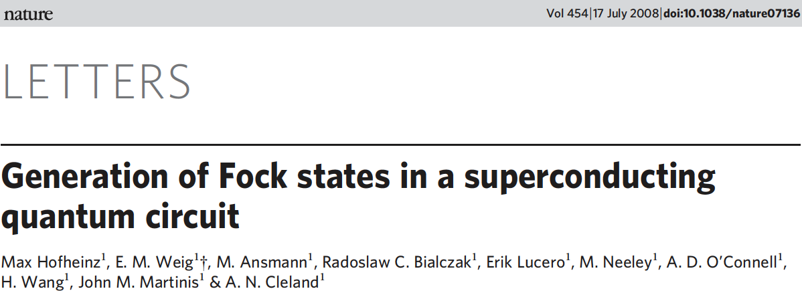
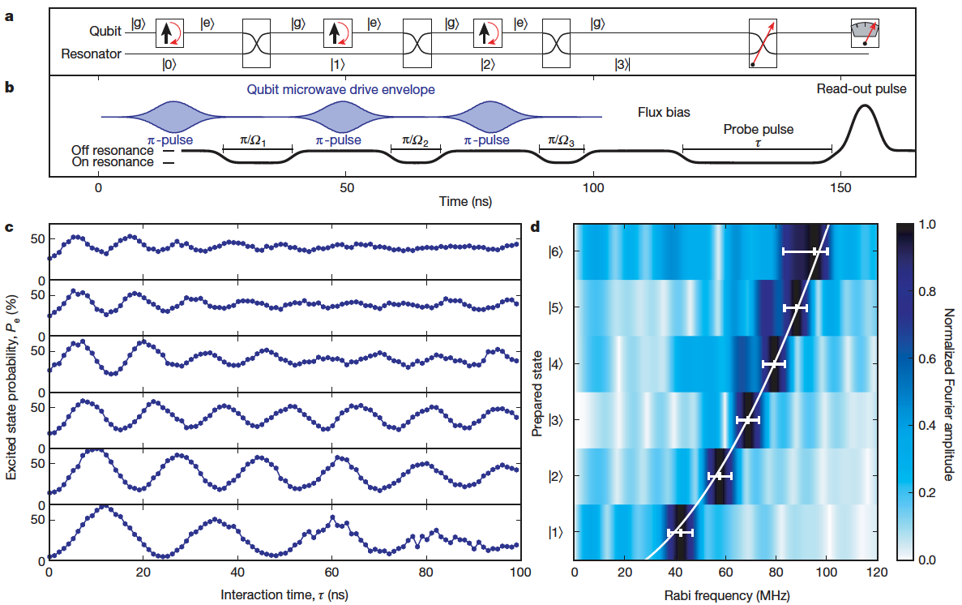
Loading one quantum at a time using swept-frequency qubits as buckets

Slide 25
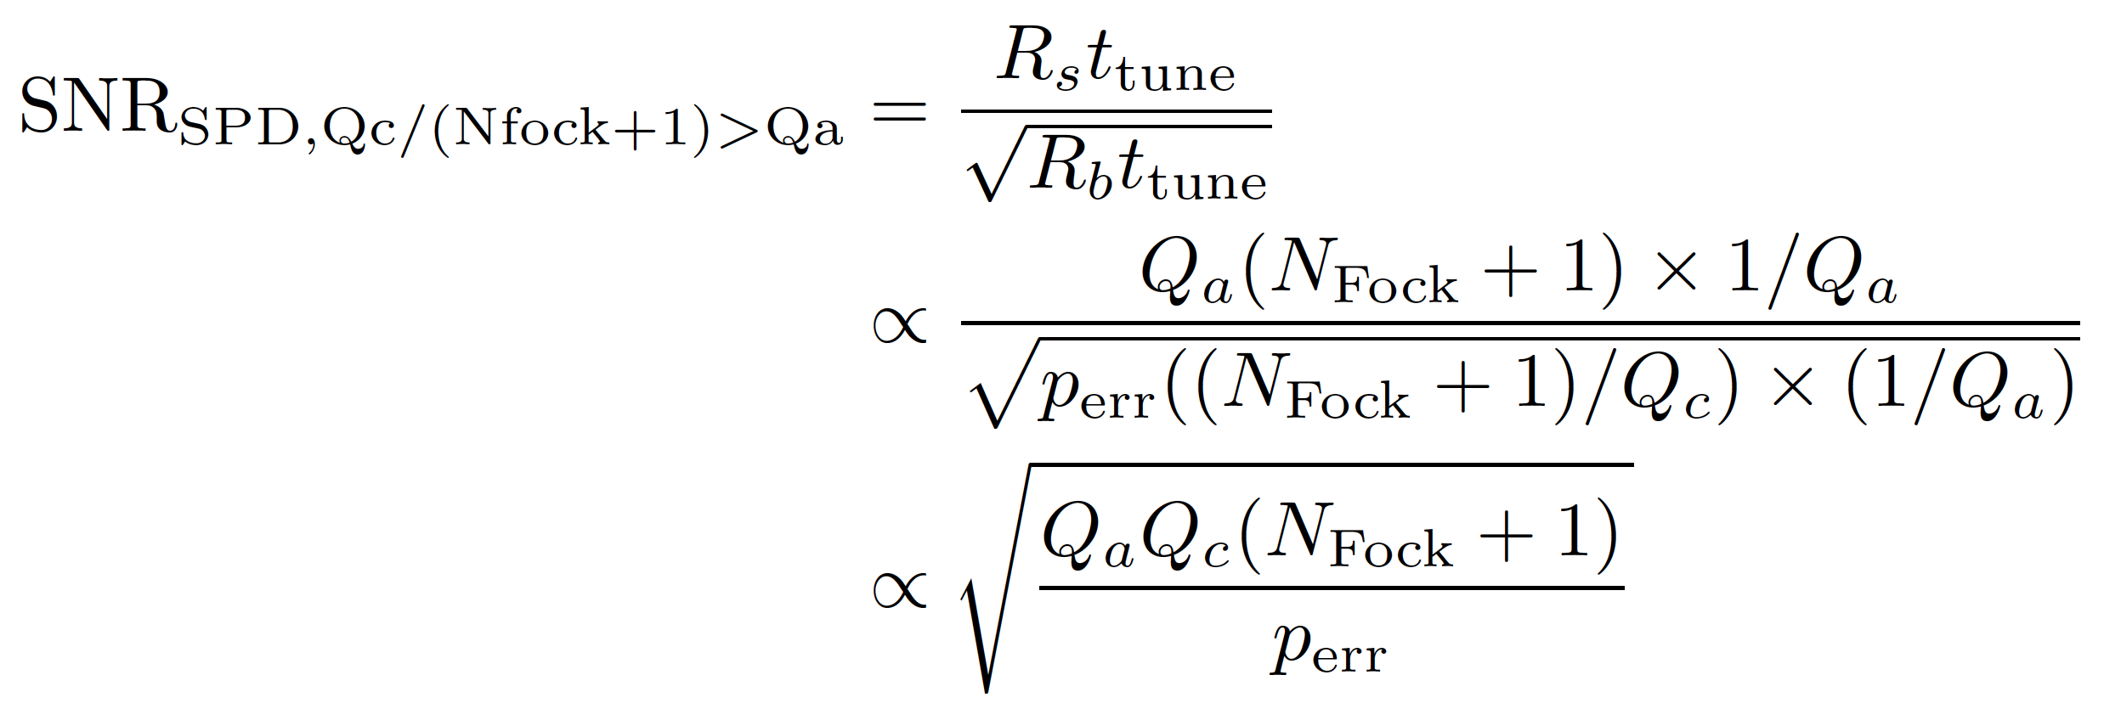
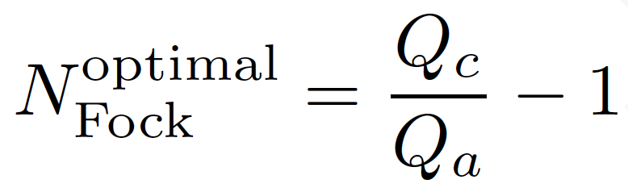
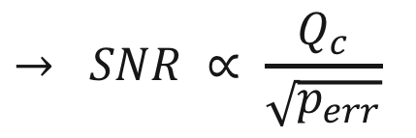
Signal/Noise scaling with Fock enhancement
Set Fock state lifetime = axion coherence time:
$$→ SNR ∝ \frac{Q_{c}}{\sqrt{p_{err}}}$$
Linear scaling with Q_{c}!!!

Slide 26
Roadmap
QND + stimulated emission
Log SNR
QND + accumulation
SQL + accumulation
Log(1/p_{err})
QND
SQL
Q_{a}
Log Q_{c}

Slide 27
Take-aways
Axion searches do not need to be dismally slow.
A next-generation experiment should employ many haloscopes. Why operate a single pixel photodiode when one could operate a CCD? Each haloscope should use identical technology but be responsible for different frequency ranges
The individual haloscopes should be cheap, easy to operate and low-risk:
Commercial dilution refrigerator + 14T solenoid ~$1M
Multi-QND single photon counting by itself could enable sensitivity to DFSZ axions with this setup, but signal is shot noise-limited.
Higher-Q cavities will:
Make qubit- and atom-based QND much easier
Enable accumulation of DM signal over long times to reduce the noise bandwidth
Enable stimulated enhancement of axion-photon transition rates

Slide 28
New Consortium: Quantum Metrology for Dark Matter Axion Detection
Aaron Chou, Daniel Bowring (FNAL), David Schuster(Chicago): Qubit QND sensors
Konrad Lehnert(Colorado/JILA): Stimulated emission, photon transport
Reina Maruyama (Yale): Rydberg atom single photon detection
You?

