Slide 1
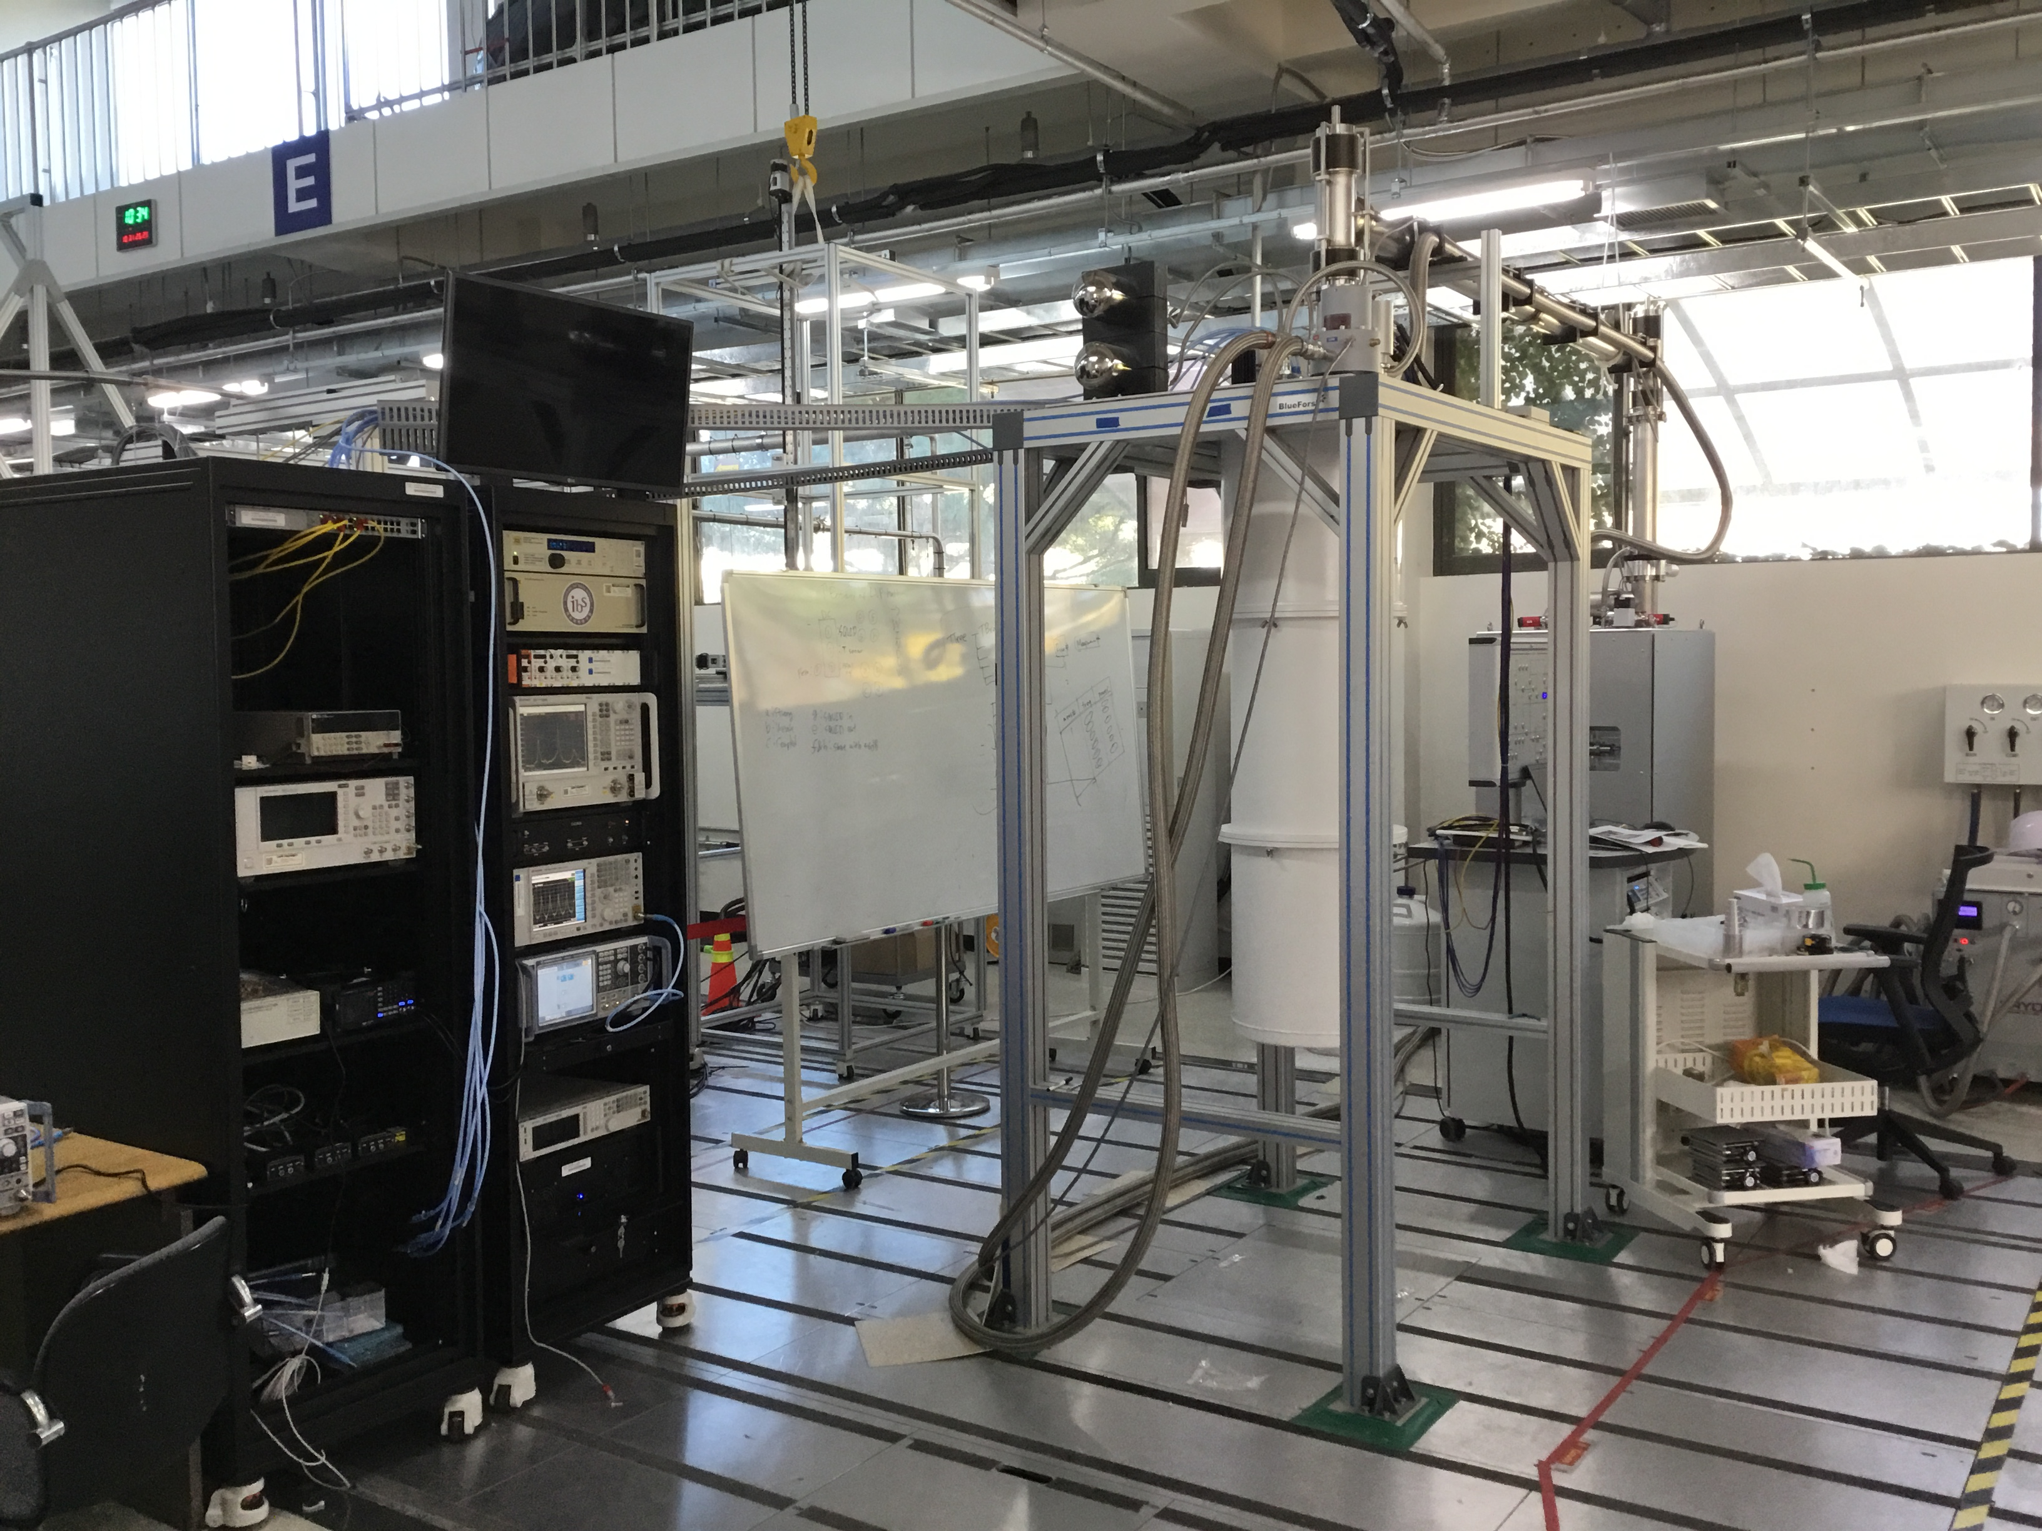

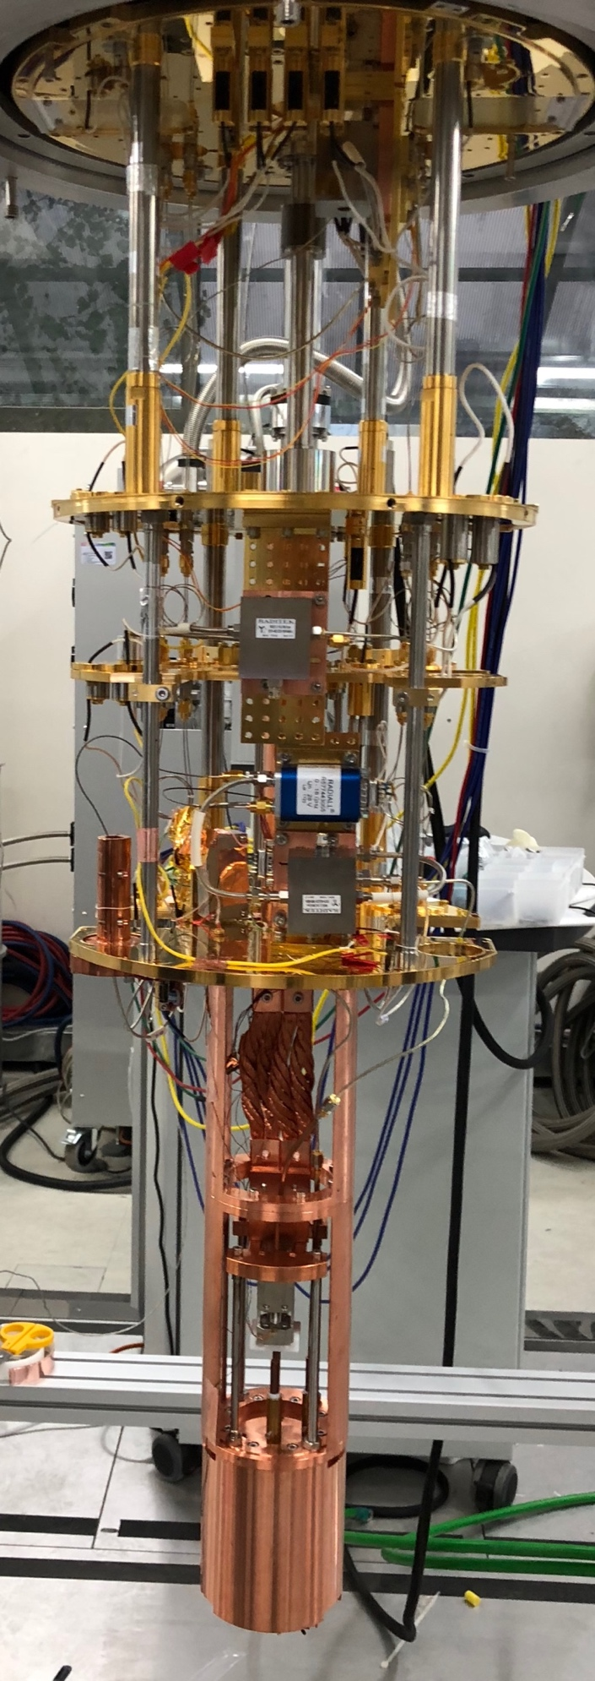
Title
Slide 1
CAPP-PACE experiment with a target mass range around 10 µeV
Doyu Lee
On be half of CAPP-PACE team
IBS/CAPP, KAIST
3rd Workshop on Microwave Cavities and Detectors for Axion Research

Slide 2
Overview
CAPP-PACE
R&D and future plans
Summary
Outline
Slide 2
Overview
CAPP-PACE(Pilot Axion Cavity Exp.)
  1st run
  2nd run(in progress)
  3rd run
  analysis
R&D and future plans
Summary

Slide 3
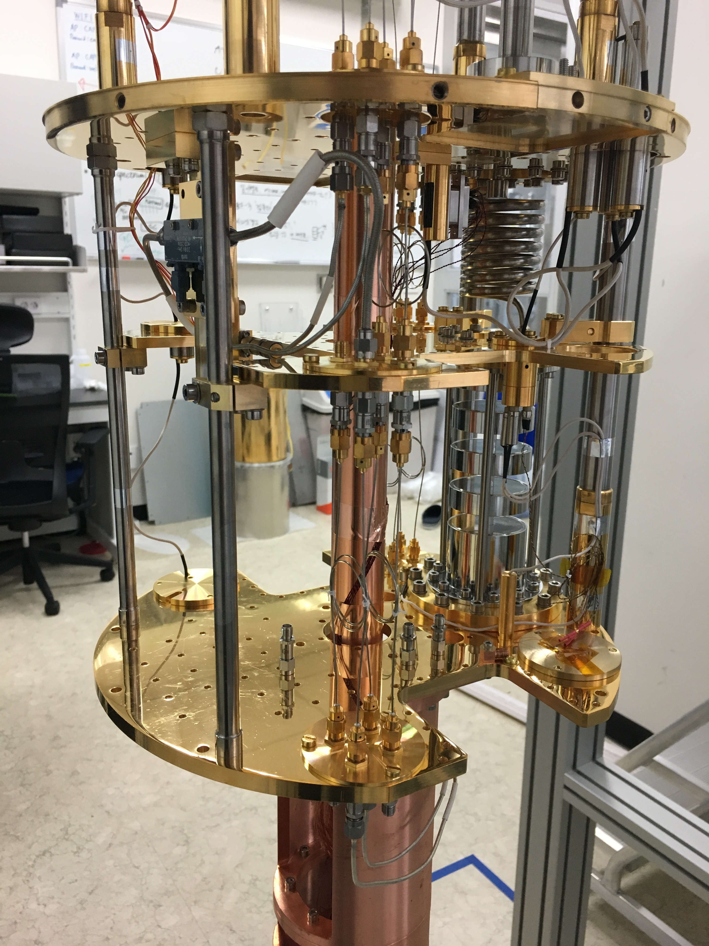
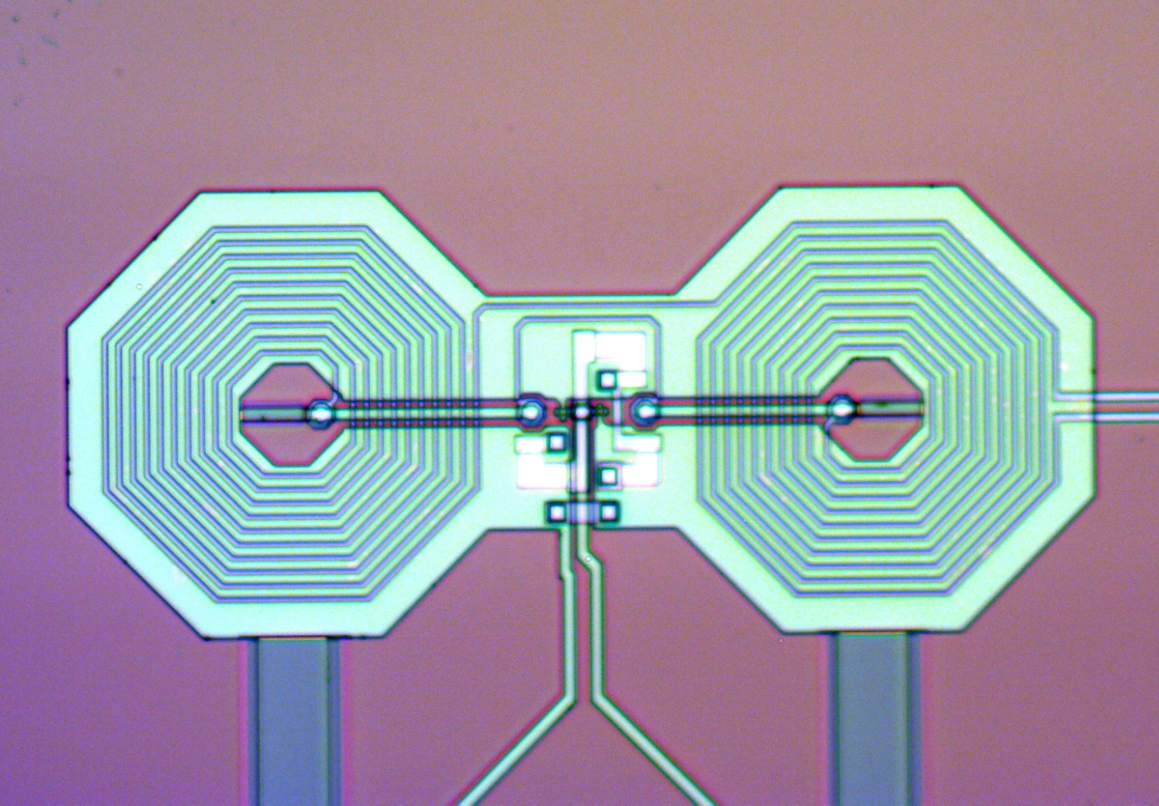
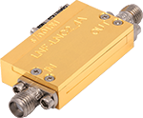

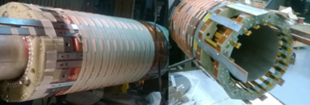
Overview
CAPP-PACE
R&D and future plans
Summary
Overview
Slide 3
Axion Detection scheme
(CAPP-PACE)
P. Sikivie’s Haloscope:
Axion Conversion Power (~10⁻²⁴W):
Signal to Noise Ratio: Scan rate:
Cryogenics
<50mK
Low noise Amplifier
HEMT
or
Quantum limited noise device
MSA or JPA
To RF Receiver
photon
High Field SC Magnet
8T now and 25T soon
BNL(HTS) Design
axion
High Q Tunable Cavity
Copper split design cavity
Superconducting coating.
Virtual photon
(Reverse) Primakoff Effect

Slide 4
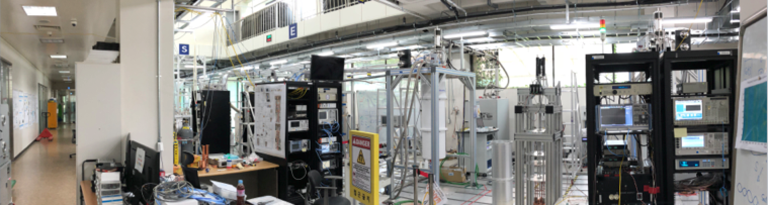
Overview
CAPP-PACE
R&D and future plans
Summary
Overview
Slide 4
CAPP Experimental Hall

Slide 5
Overview
CAPP-PACE
R&D and future plans
Summary
CAPP-PACE
Slide 5
CAPP-PACE
(Pilot Axion Cavity Exp.)
What is it?
The Very First complete axion experiment in Korea
First engineering run was done in Jan. 2018 (2.45 ~ 2.50GHz)
  Flawless operation of Freq. Tuning System(sapphire rod with Piezo tuning system)
  DAQ(Controls, Monitoring) is ready
  Target sensitivity : 10*KSVZ
The Second run (2.50 – 2.75 GHz) is running “NOW”
  Improved scanning speed with bigger cavity (x2)
  Improved scanning speed (x4)
  Tuning with sapphire and copper rod
  Fully automated DAQ (Controls, Monitoring and Emergency plan)
  Target sensitivity : 10*KSVZ
The Third run will have focus on ”KSVZ” axions
  Planned for two months, starting September
Quantum Amplifier Testbed
Preparing for CAPP25T

Slide 6
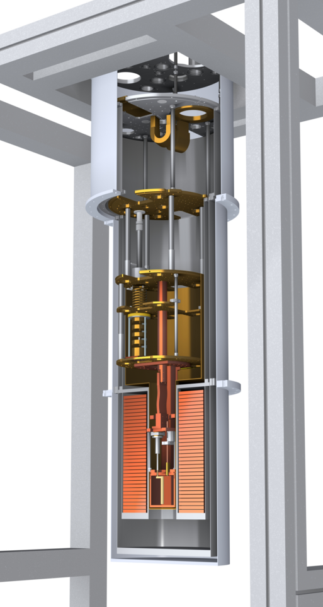
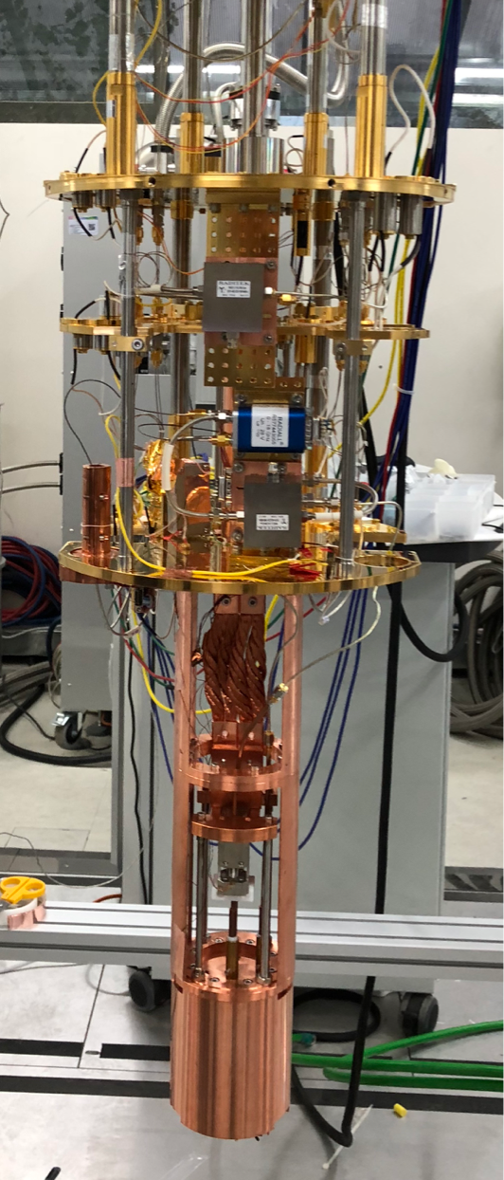
Overview
CAPP-PACE
R&D and future plans
Summary
CAPP-PACE
Slide 6
The run parameters
parameter | value
Frequency | 2.45 – 2.76 GHz
Magnetic Field | 8 T
T_{cavity} | < 50 mK
T_{amp} | 1 - 1.5 K
Cavity Volume | 1.12(0.59) litter
Target Sensitivity | KSVZ, 10*KSVZ
DAQ efficiency | 0.45
Unloaded Q | ~ 80,000
Coupling | 1.5 – 2.0
Form Factor | 0.55
Target SNR | 5

Slide 7
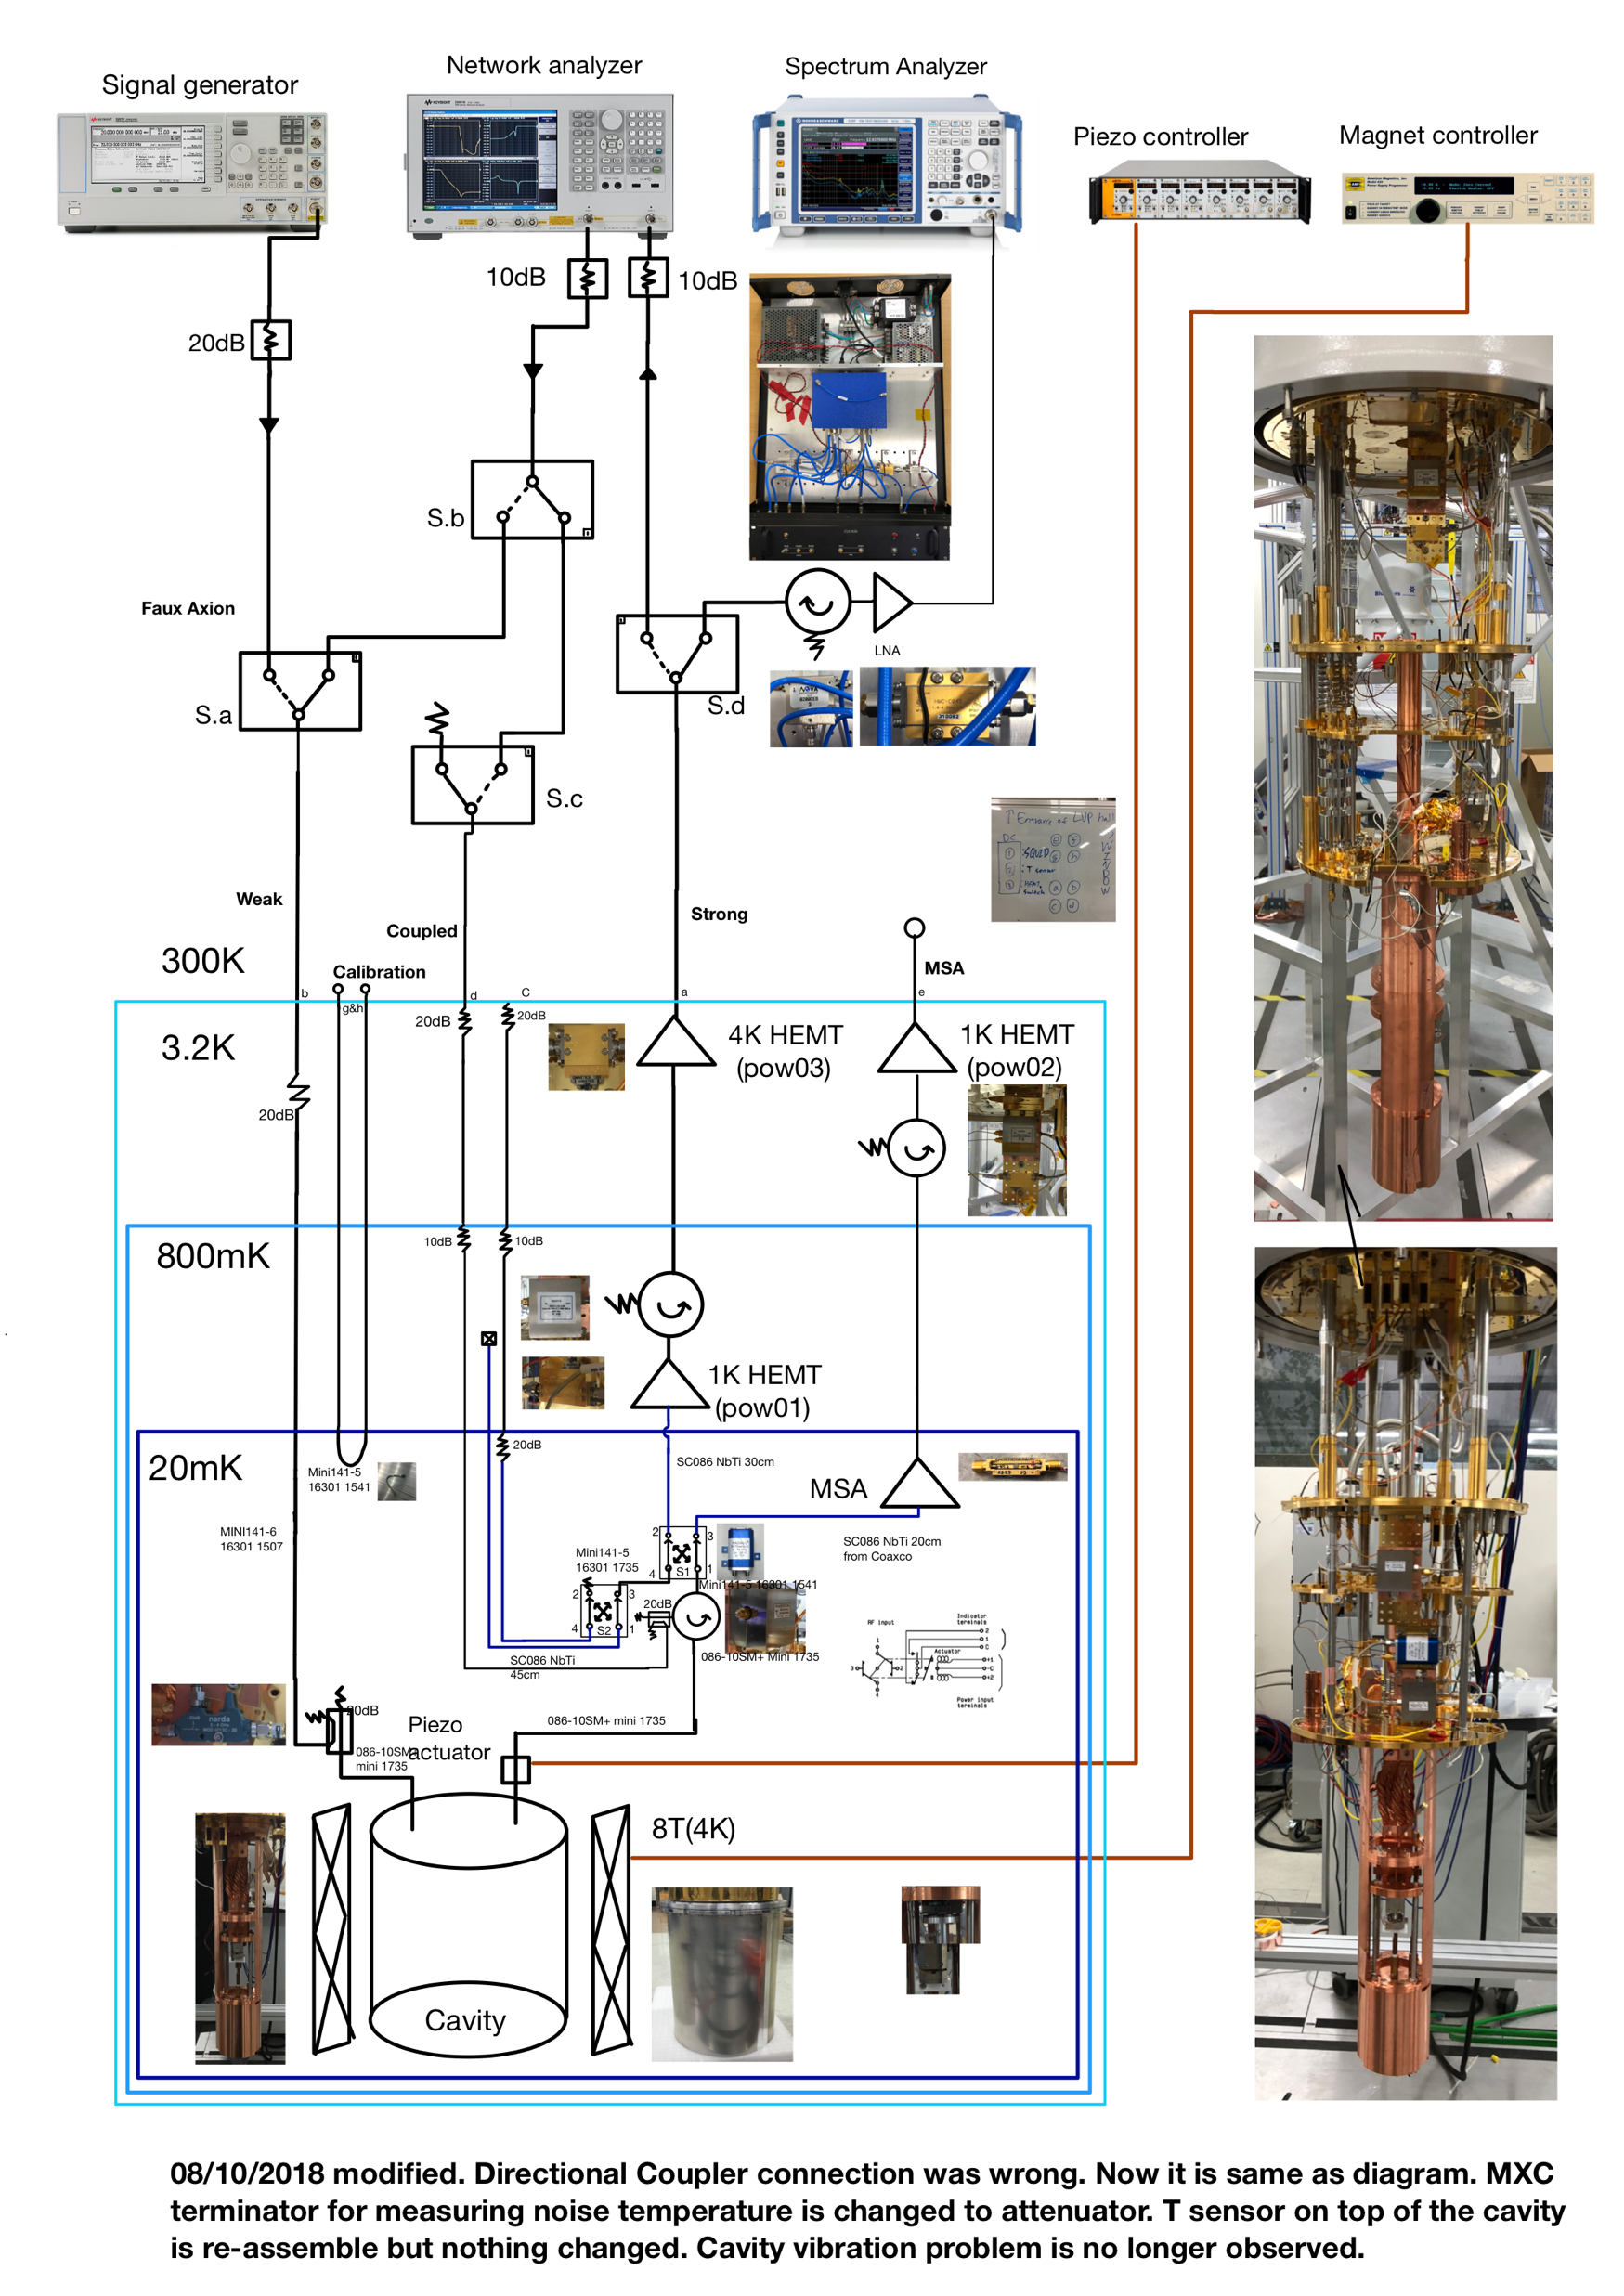
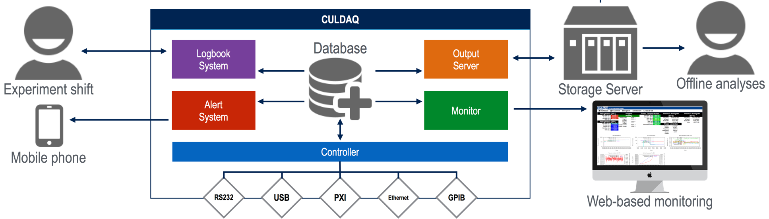
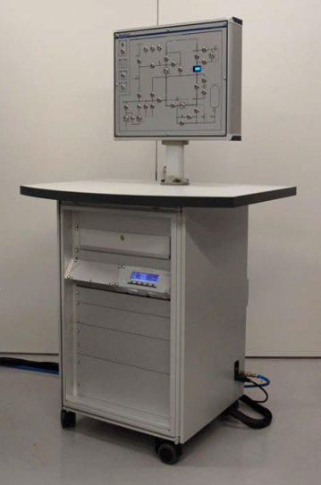
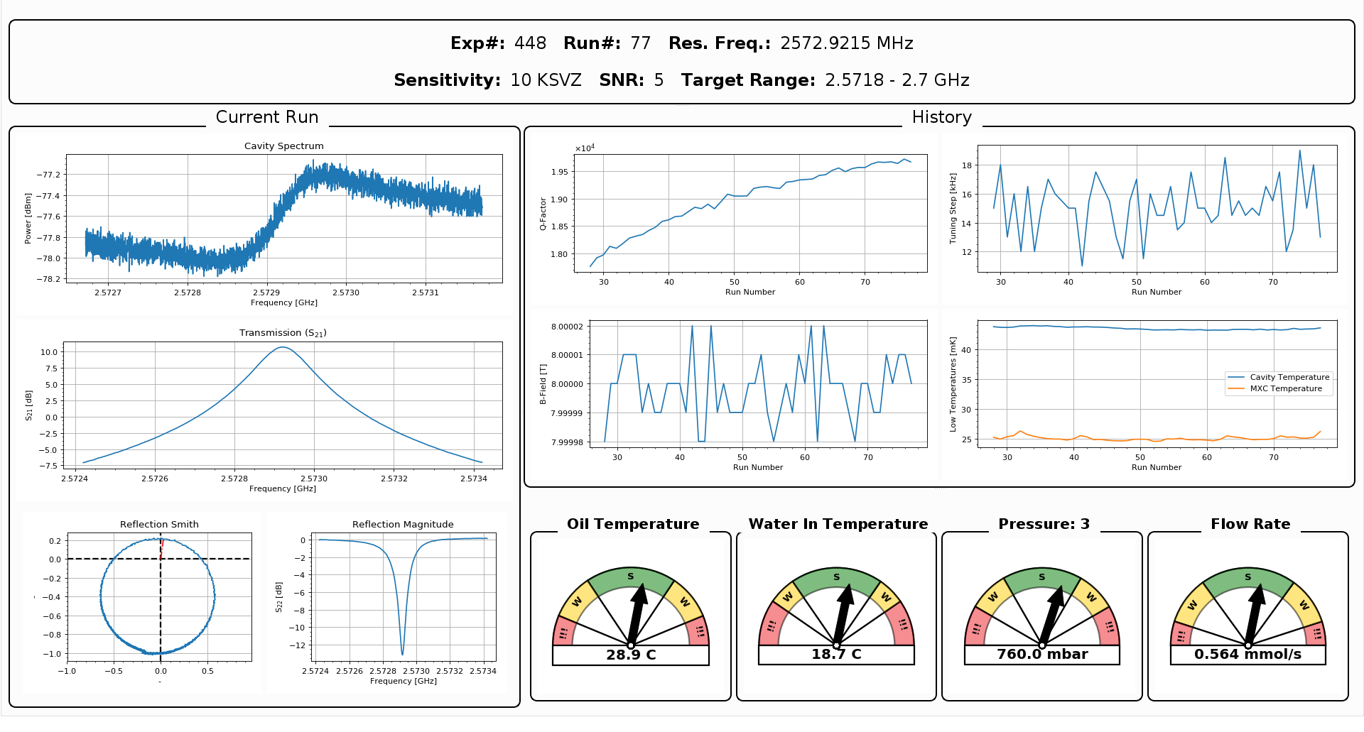
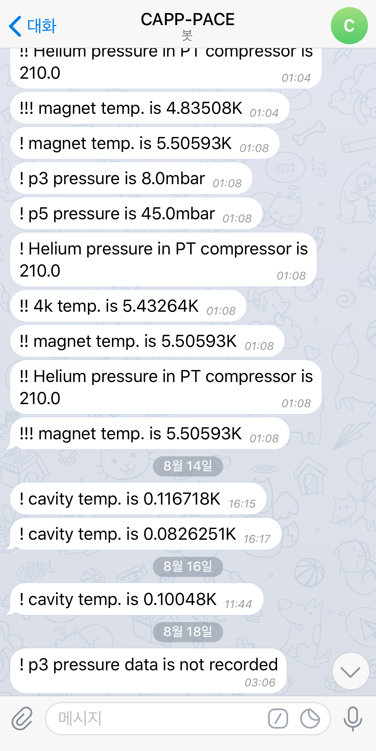
Overview
CAPP-PACE
R&D and future plans
Summary
CAPP-PACE
Slide 7
Experimental design
RF read-out chain & Controls

Slide 8
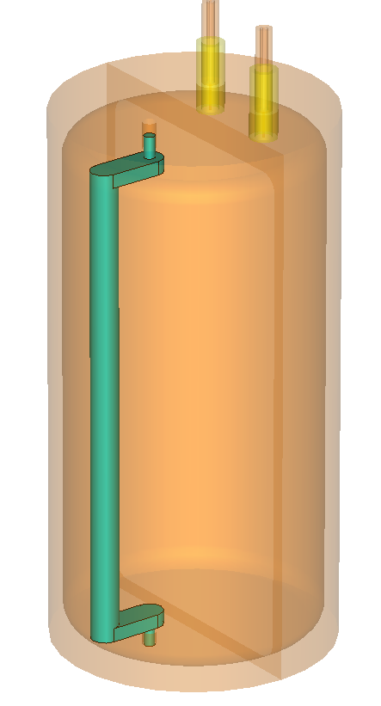
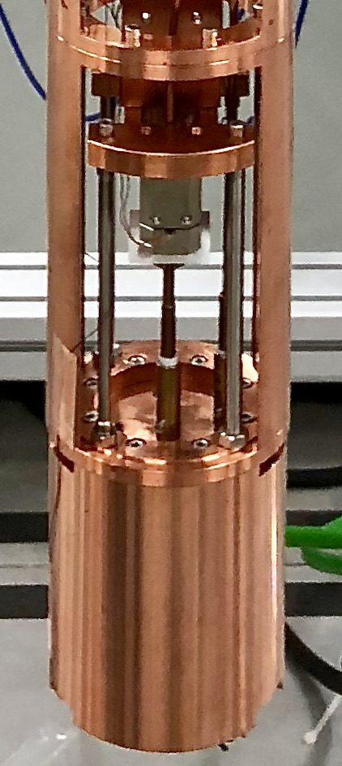
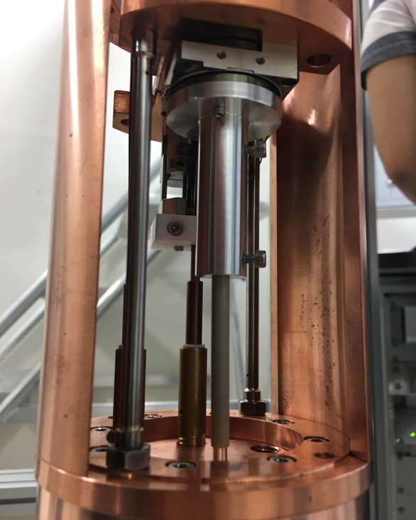
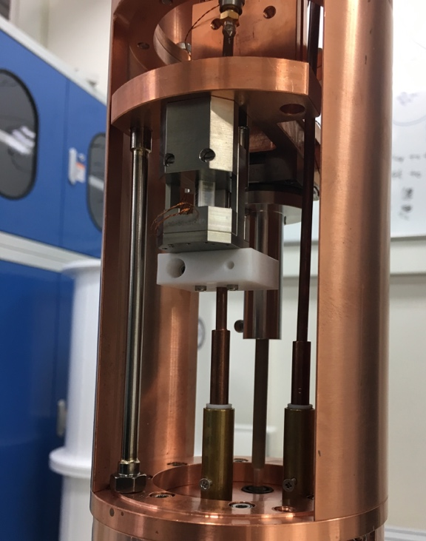
Overview
CAPP-PACE
R&D and future plans
Summary
CAPP-PACE
Slide 8
Cavity & Frequency tuning system
“The first run”
Rotational Piezo
for frequency tuning
Linear Piezo for adjusting antenna coupling
10mm diameter sapphire tuning rod
for 2.45GHz – 2.5GHz searching
Notes:
Mode was clear, thus even don’t need to put graph here. Split design

Slide 9
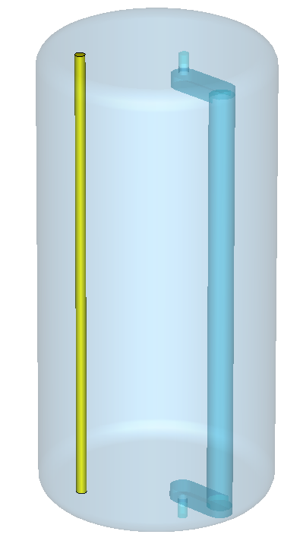
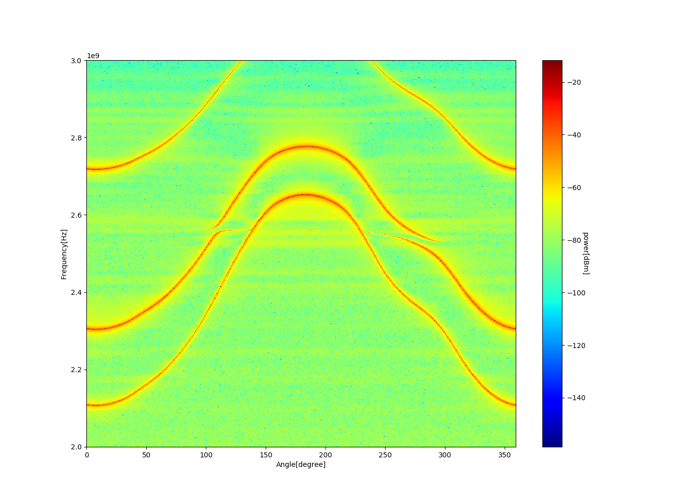
Overview
CAPP-PACE
R&D and future plans
Summary
CAPP-PACE
Slide 9
Cavity & Frequency tuning system
“The second run” 2.5GHz – 2.6GHz
“TM010 frequency of φ90mm cavity is 2.55GHz, thus neither conductor nor dielectric rod can searching axion between 2.5 – 2.6GHz.”
4mm diameter Cu rod
(Fixed to top and bottom)

Slide 10
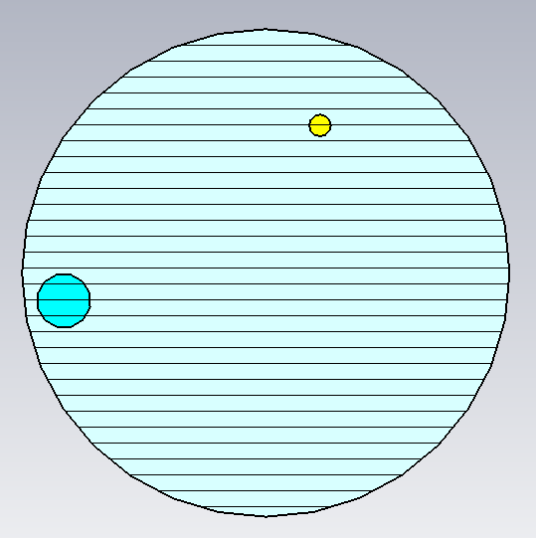
Overview
CAPP-PACE
R&D and future plans
Summary
CAPP-PACE
Slide 10
Cavity & Frequency tuning system
“The second run” 2.5GHz – 2.6GHz
10mm
27mm
19mm
Frequency
C factor
C factor
Q factor

Slide 11
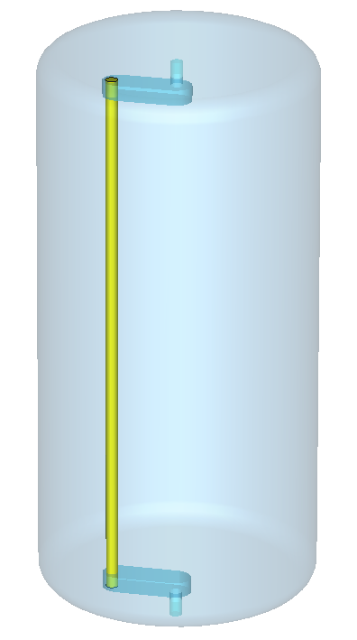
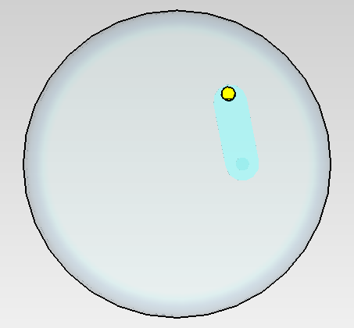
Overview
CAPP-PACE
R&D and future plans
Summary
CAPP-PACE
Slide 11
Cavity & Frequency tuning system
“The second run” 2.6GHz – 2.75GHz
19mm
“For searching in this frequency range, we introduced a copper rod.”
4mm diameter Cu rod

Slide 12
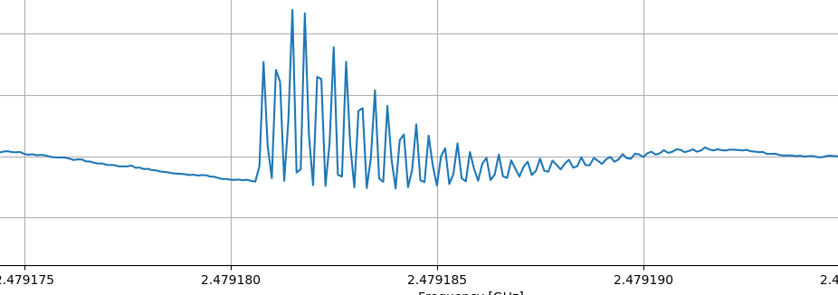
Overview
CAPP-PACE
R&D and future plans
Summary
CAPP-PACE
Slide 12
Analysis basic
The first run information
CAPP-PACE (Pilot Axion Cavity Experiment) at 01-19-18 ~ 02-11-18
Parameters
-T_{MXC}: 40mK
-T_{noise} : <2.5K
-Magnetic field: 8T
-Bore size: 11.8cm
-Cavity volume: 0.59L
-Frequency: 2.45~2.50GHz
-Q unloaded: >90,000
-Low noise amplifier: HEMT (1K noise)
-C (geometrical factor) >0.55
-DAQ Efficiency: 0.45
-Target Sensitivity: 10*KSVZ
Step size : 16kHz
Cavity bandwidth : ~80kHz
Total number of spectra : 2847
Total frequency range : 2.457146 GHz - 2.500377GHz

Slide 13
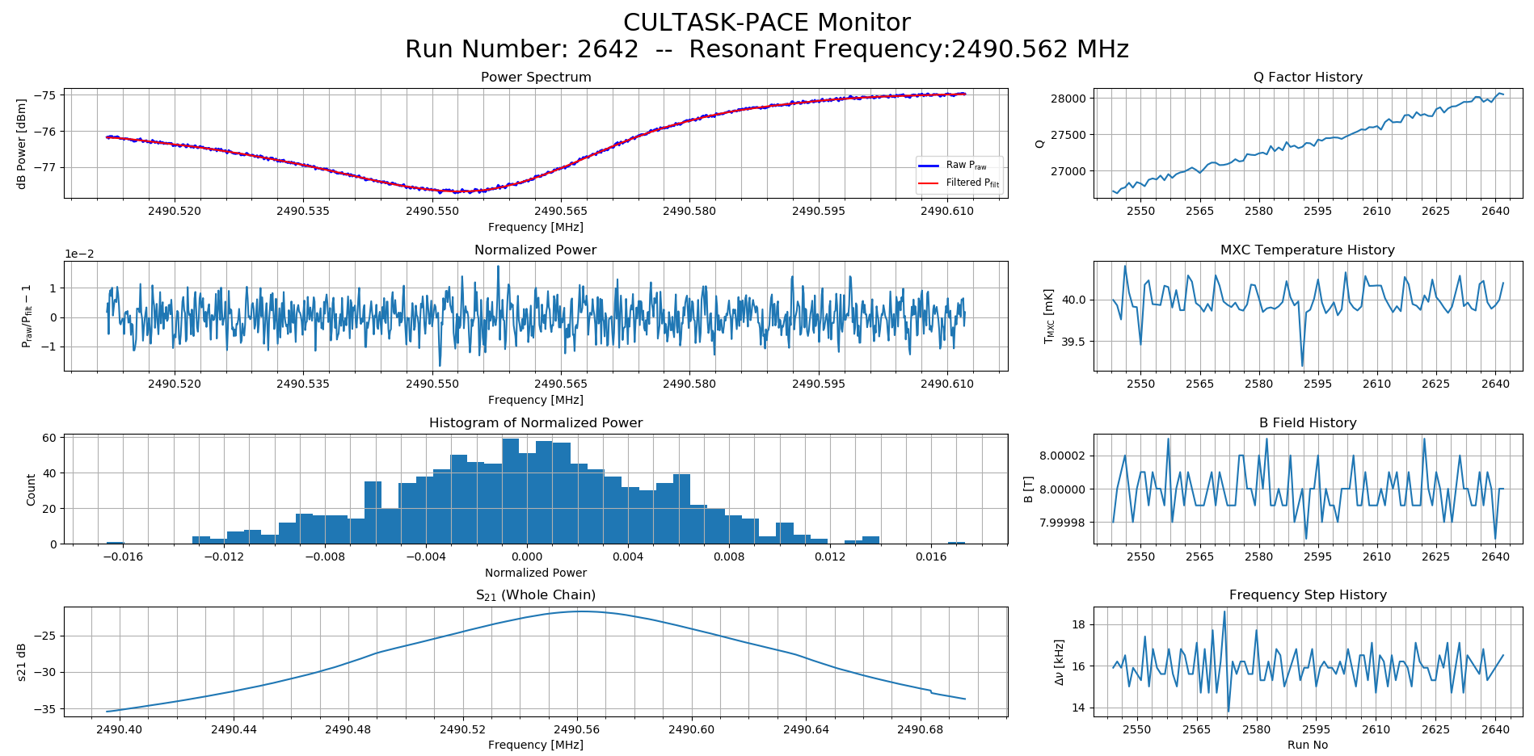
Overview
CAPP-PACE
R&D and future plans
Summary
CAPP-PACE
Slide 13
Data & Analysis
The first run monitor
a
e
b
f
c
g
d
h

Slide 14
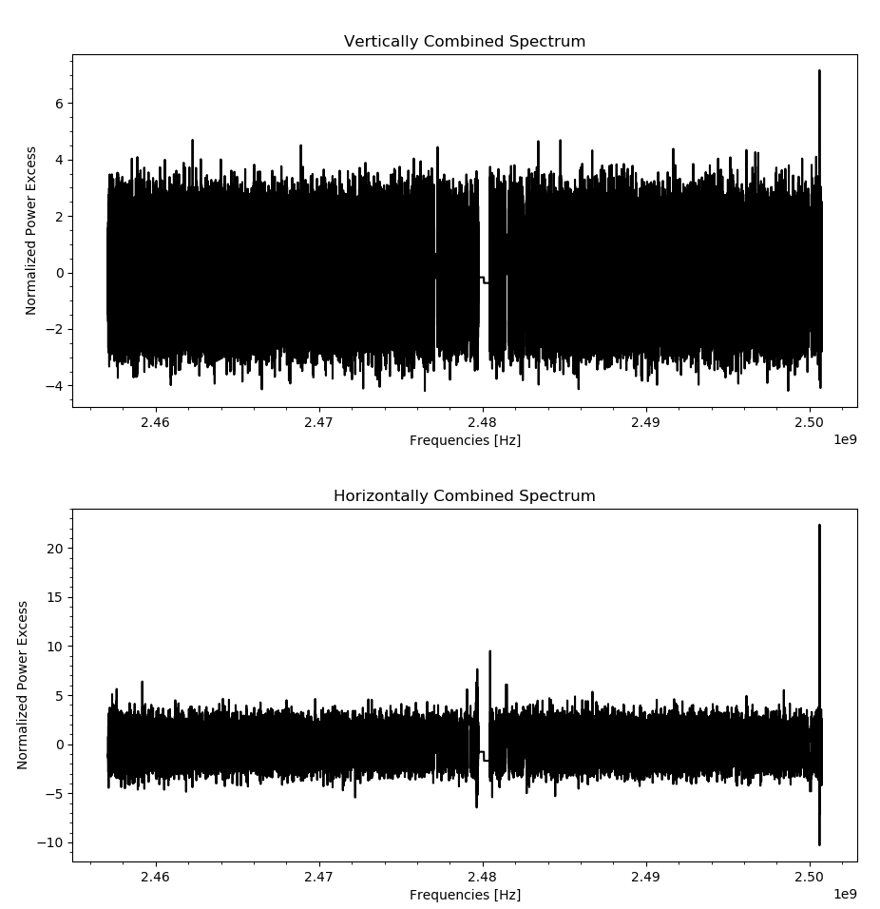
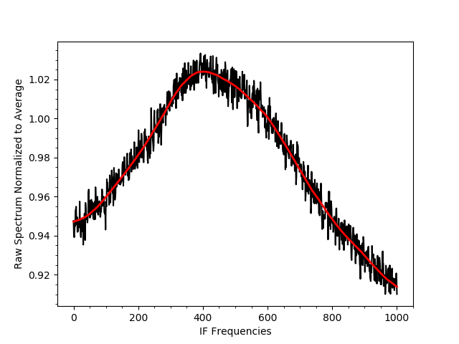
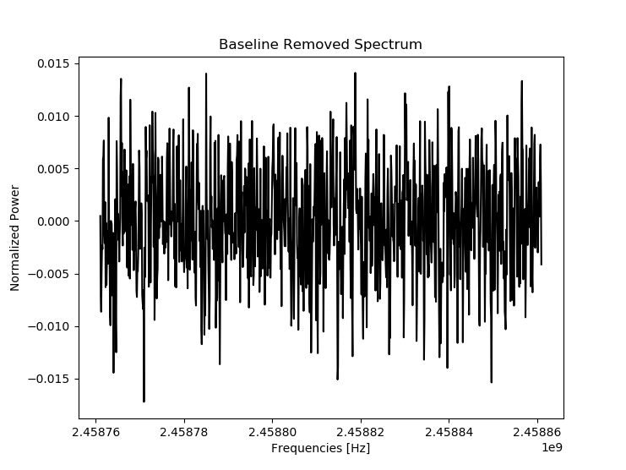
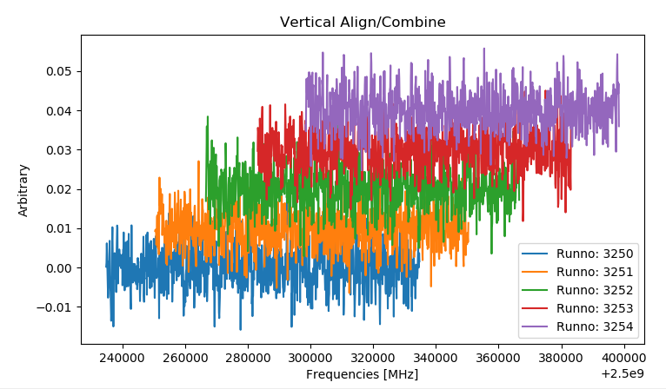
d
Overview
CAPP-PACE
R&D and future plans
Summary
CAPP-PACE
Slide 14
Data & Analysis
The first run Data combining
d
a
b
If bins
c
SNR
e

Slide 15
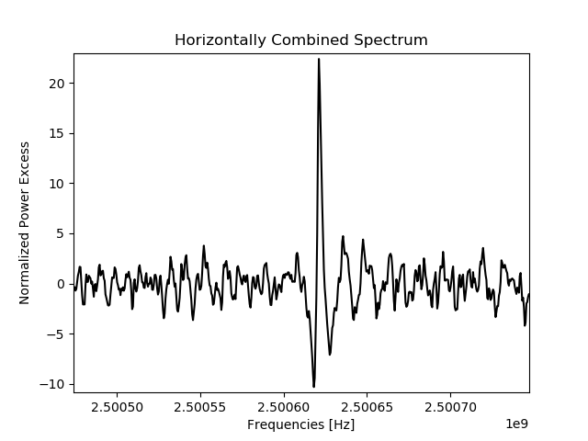
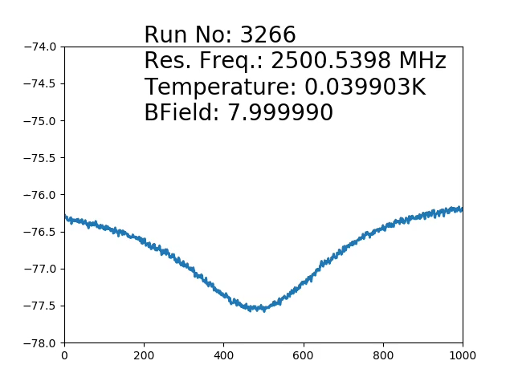
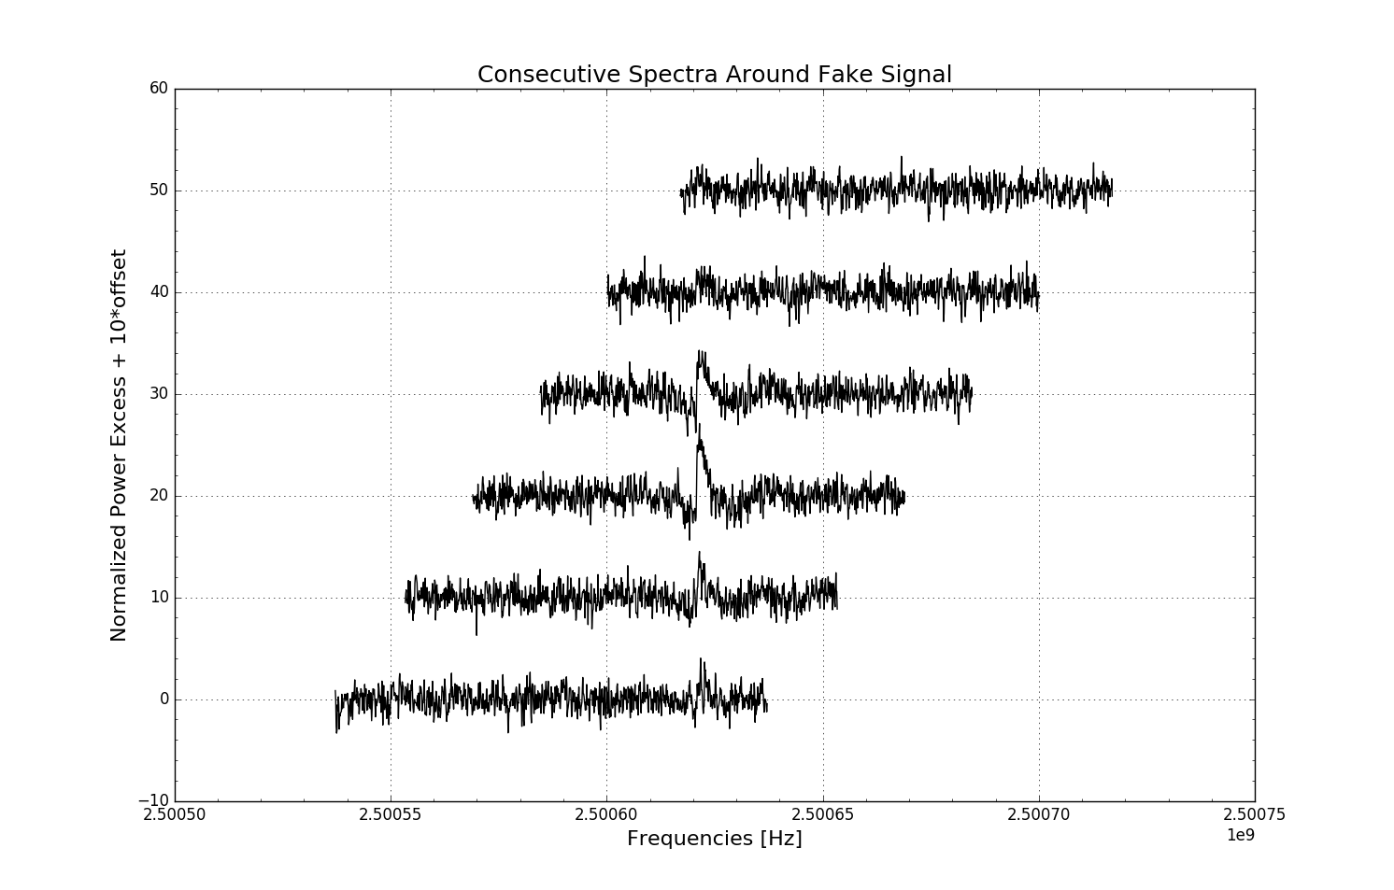
Overview
CAPP-PACE
R&D and future plans
Summary
CAPP-PACE
Slide 15
Data & Analysis
Fake Axion

Slide 16
Overview
CAPP-PACE
R&D and future plans
Summary
CAPP-PACE
Slide 16
Data & Analysis
The second run monitor

Slide 17
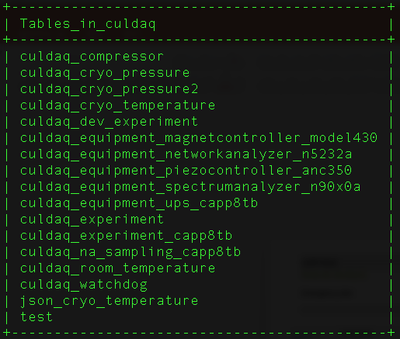
Overview
CAPP-PACE
R&D and future plans
Summary
CAPP-PACE
Slide 17
Data & Analysis
Emergency plan
”Every single parameter related to experiments is saved to our DB. If emergency situations happen(fridge fail, chiller fail, power out, etc.) , then DAQ script will automatically determine how serious it is and..
1. Let us know
2. Ask to us stop experiment or not
3. Immediate stop and ramp down the magnet

Slide 18
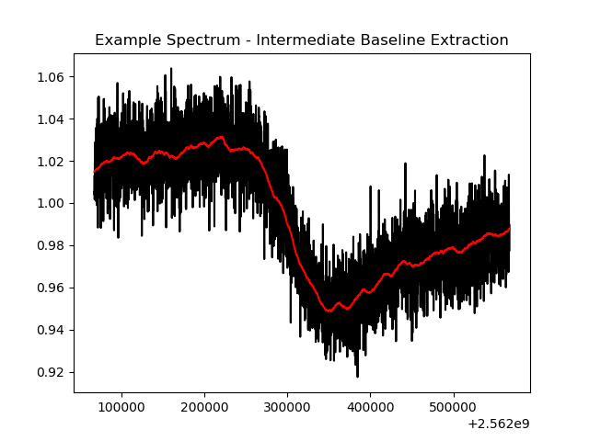
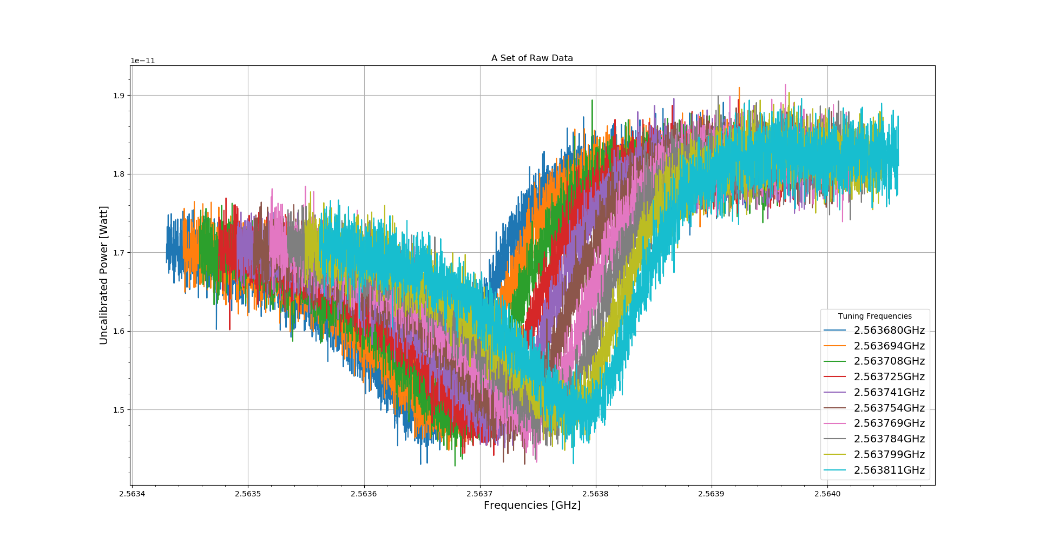
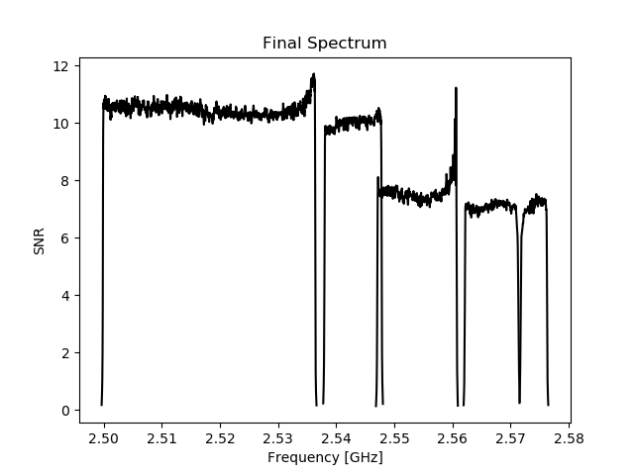
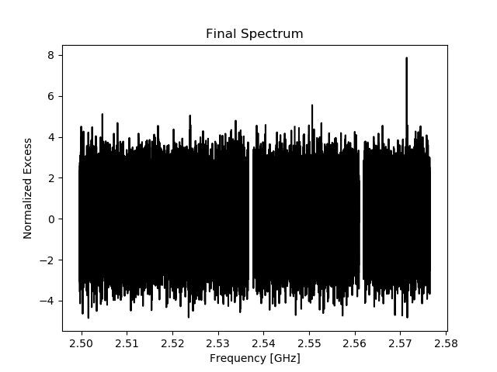
Overview
CAPP-PACE
R&D and future plans
Summary
CAPP-PACE
Slide 18
Data & Analysis
The second run data combining
Notes:
Will be changed to combined data

Slide 19
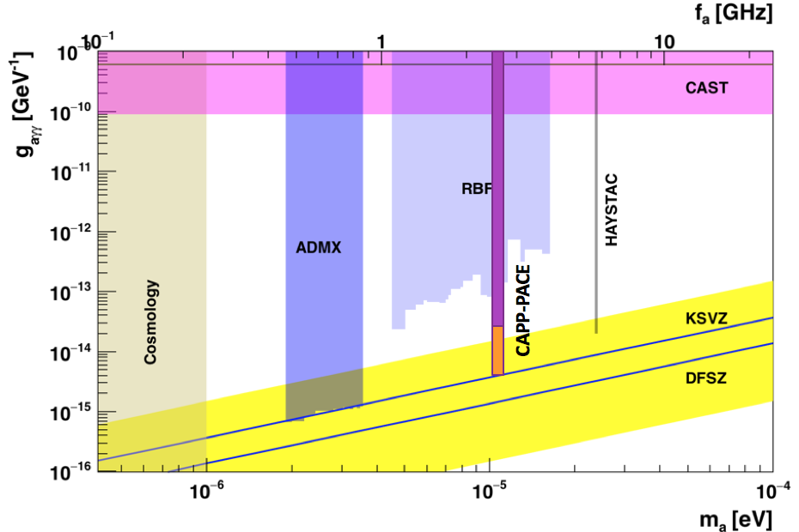
Overview
CAPP-PACE
R&D and future plans
Summary
CAPP-PACE
Slide 19
The third run - KSVZ

Slide 20
Overview
CAPP-PACE
R&D and future plans
Summary
R&D and future plans
Slide 20
R&D and future plans
How to improve?
Maximize B²V
  25T 10cm bore HTS magnet by BNL (2020)
  12T 32cm bore LTS magnet by Oxford (2020)
Higher Frequency
  Multi-cell cavity
Scan faster (minimize T_{amp} ← dominating factor)
  Quantum Amplifier - SQUID or JPA
  Optimize cryo-RF receiver chain
Others
  Improve Q-factor of cavity – pure metal or SC cavity
  Dead-time-less DAQ

Slide 21
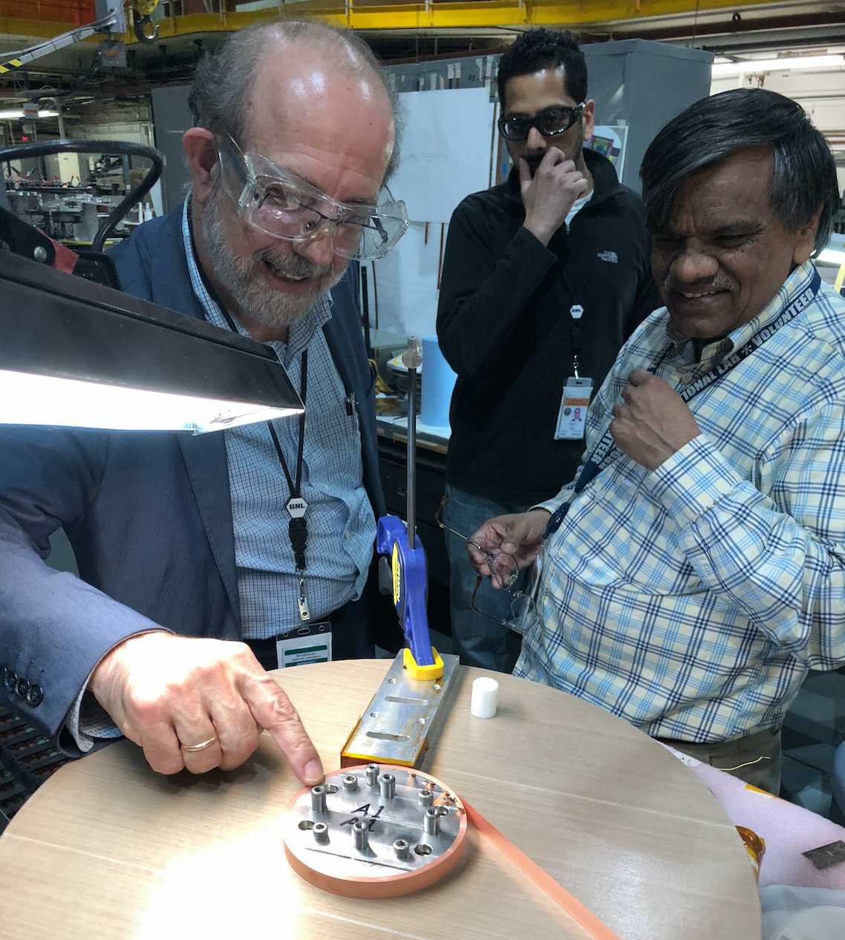
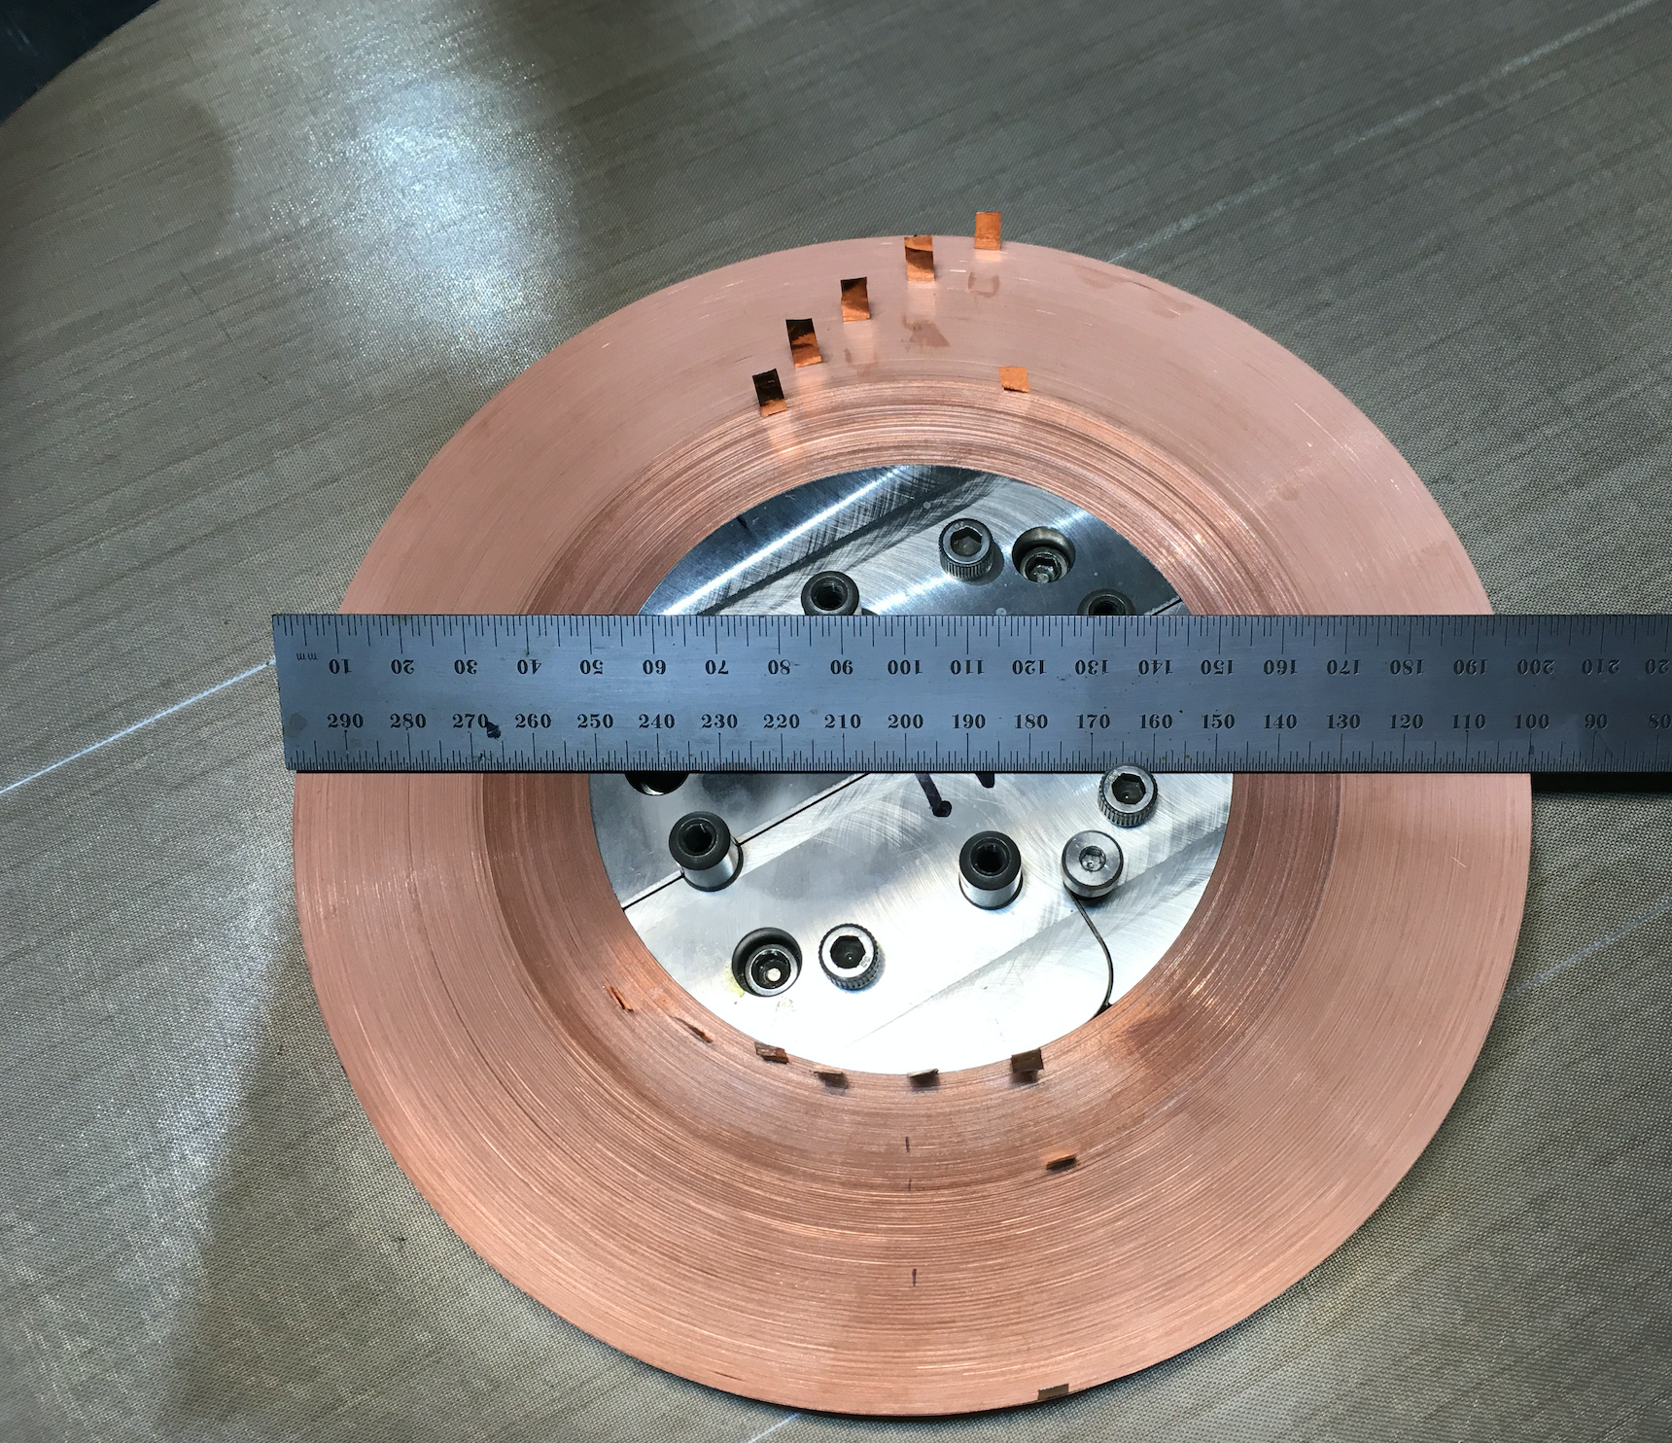
Overview
CAPP-PACE
R&D and future plans
Summary
R&D and future plans
Slide 21
25T magnet by BNL
  25T 10cm bore HTS magnet by BNL
  The first few (of 28) pancakes wound! - tests in progress
  5 km of SC tape will be delivered next 5 months

Slide 22
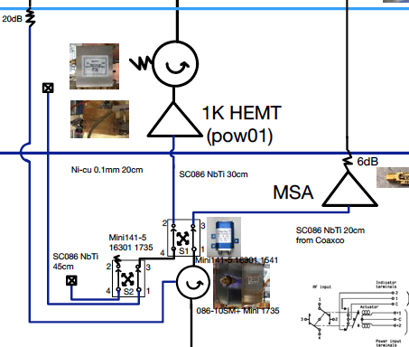
Overview
CAPP-PACE
R&D and future plans
Summary
R&D and future plans
Slide 22
Noise temperature measurements
“Y factor method with two different temperature”

Slide 23
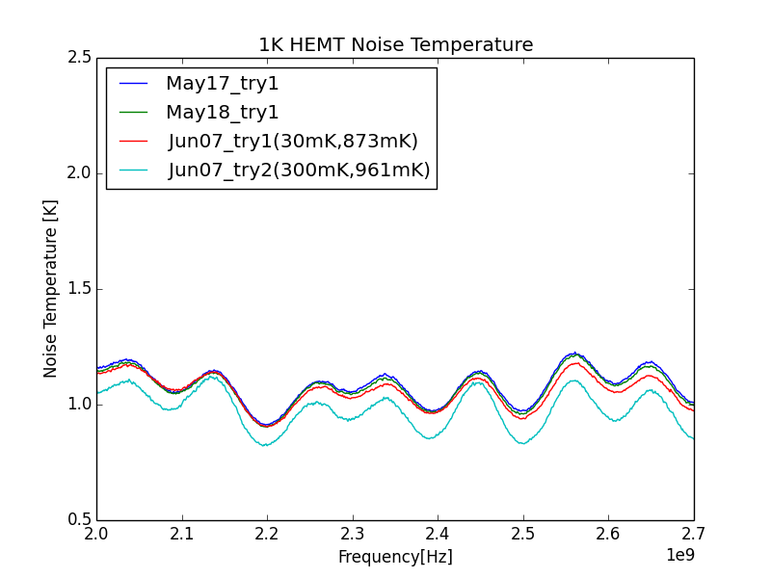
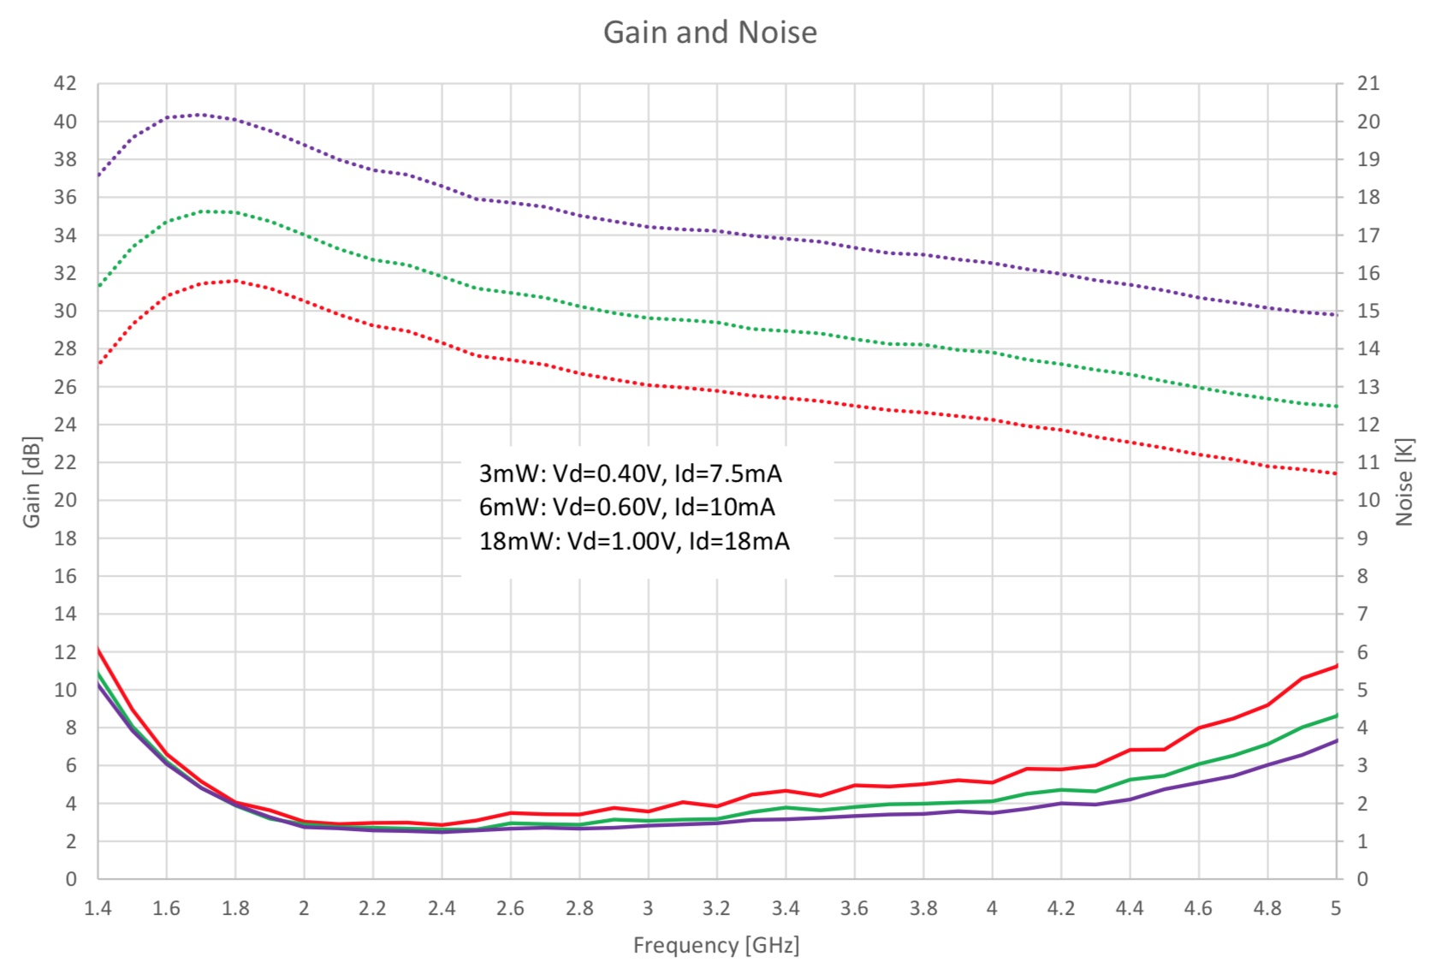
Overview
CAPP-PACE
R&D and future plans
Summary
R&D and future plans
Slide 23
Noise temperature measurement results

Slide 24
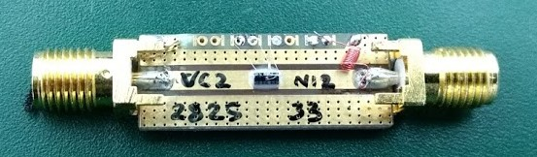
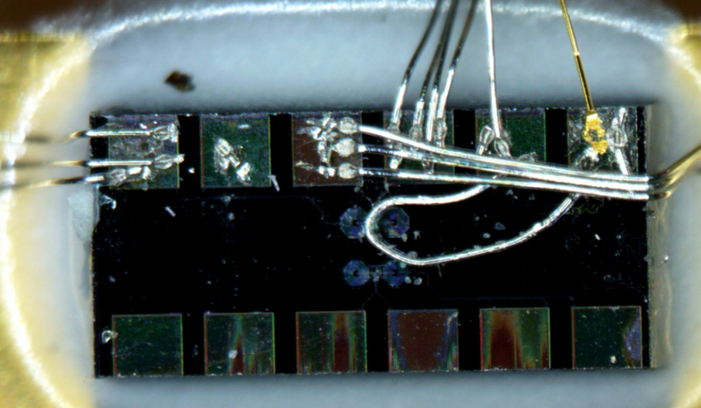
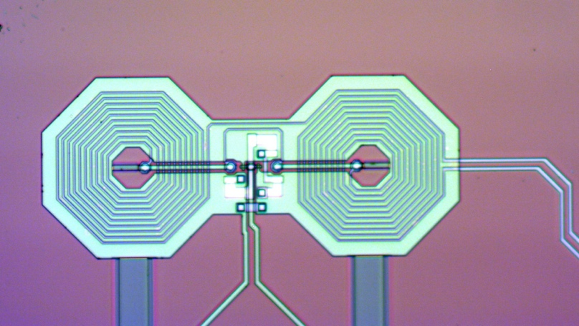
Overview
CAPP-PACE
R&D and future plans
Summary
R&D and future plans
Slide 24
Microstrip SQUID Amplifier
New VC2 SQUIDs from IPHT, Jena
List of SQUID based amplifiers
SQUID from KRISS (Korea)
EZ SQUID (commercial, Germany)
CE1K2 SQUID (IPHT, Germany)
Tested by Dr. Andrei Matlashov
Sergey Uchaikin (from D-Wave) has joined the group in July to lead JPA effort
Input Coil Leads
SQUID Leads

Slide 25
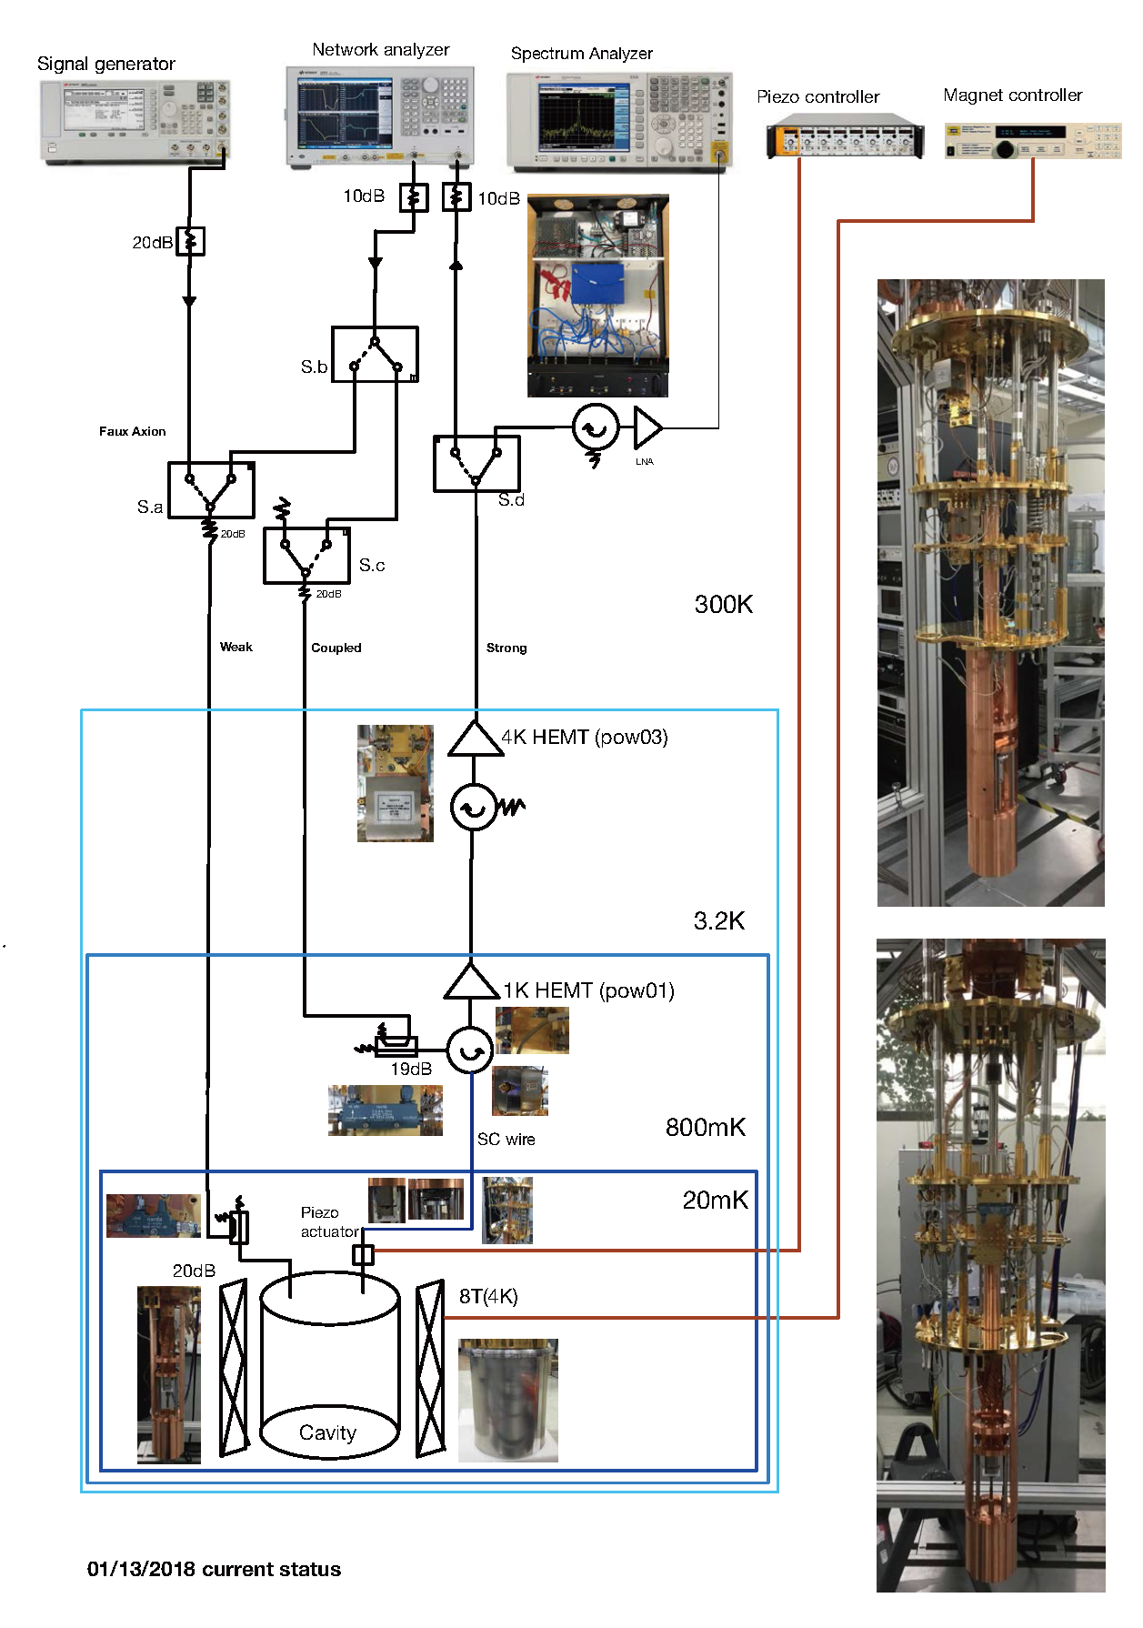
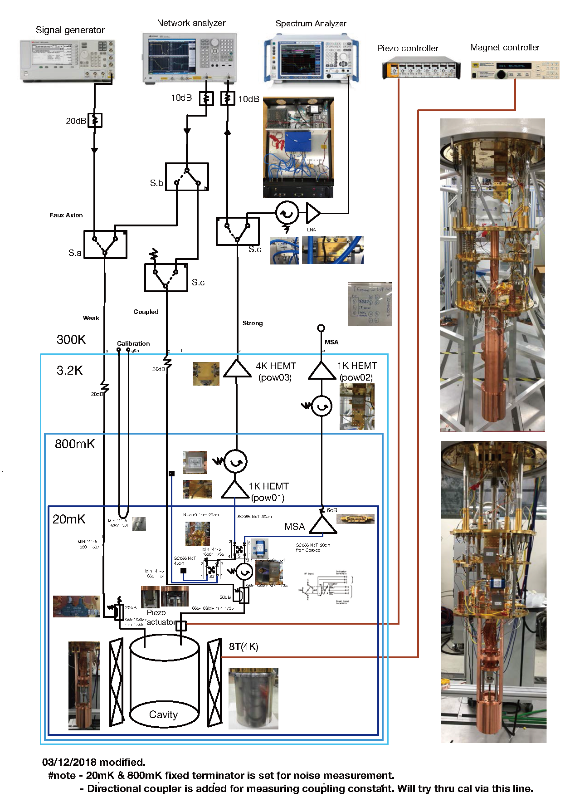
Overview
CAPP-PACE
R&D and future plans
Summary
R&D and future plans
Slide 25
Introduce MSA

Slide 26
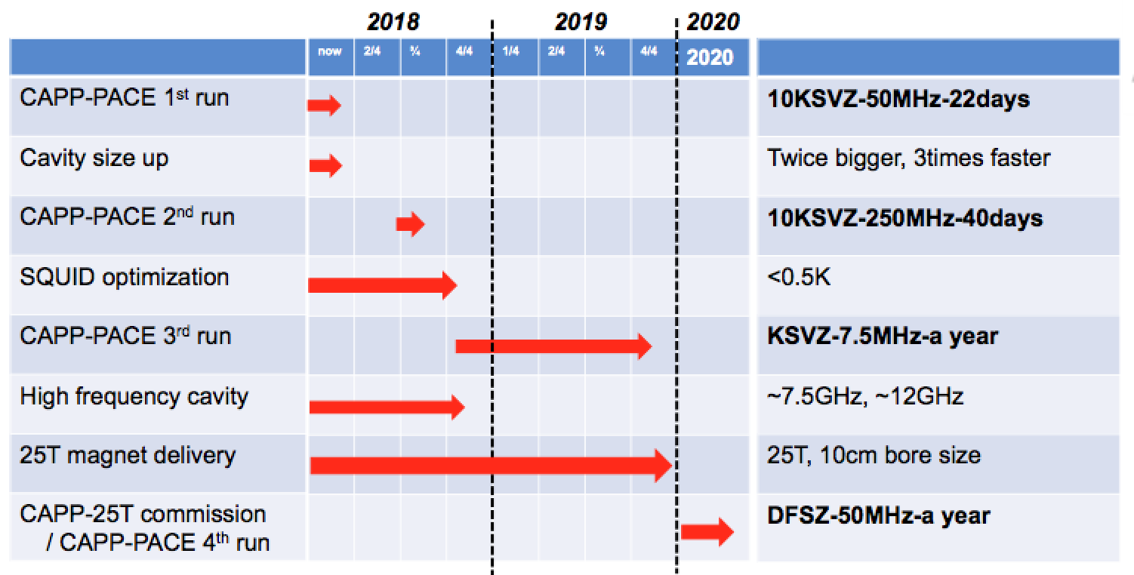
Overview
CAPP-PACE
R&D and future plans
Summary
R&D and future plans
Slide 26
Timeline(CAPP-PACE)

Slide 27
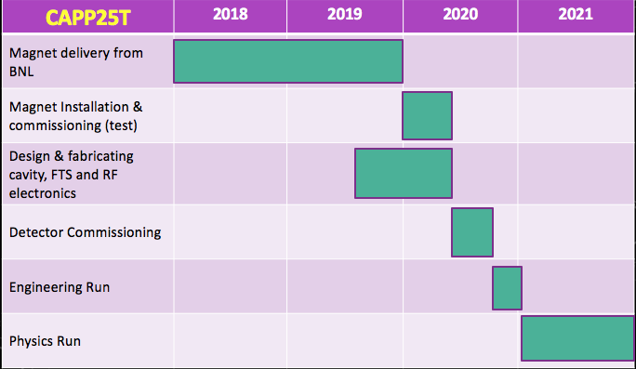
Overview
CAPP-PACE
R&D and future plans
Summary
R&D and future plans
Slide 27
Timeline(CAPP25T)

Slide 28
Overview
CAPP-PACE
R&D and future plans
Summary
Summary
Slide 28
Summary
Axion experiment at IBS/CAPP is being carried out successfully.
Major R&D Efforts
  Higher B Field: HTS (18T, 25T…)
  Larger Volume: (12T 32cm LTS magnet)
  Adding MSA or JPA
  R&D for Higher Frequencies ( >10 GHz)
Quantum limited noise amplifier will be ready soon.
25T 10cm bore HTS magnet(BNL) will be ready as early as 2019.

Slide 29
Thank You!

