Slide 1
PIP-II STFC Risk Management
P McIntosh
13th July 2018

Slide 2
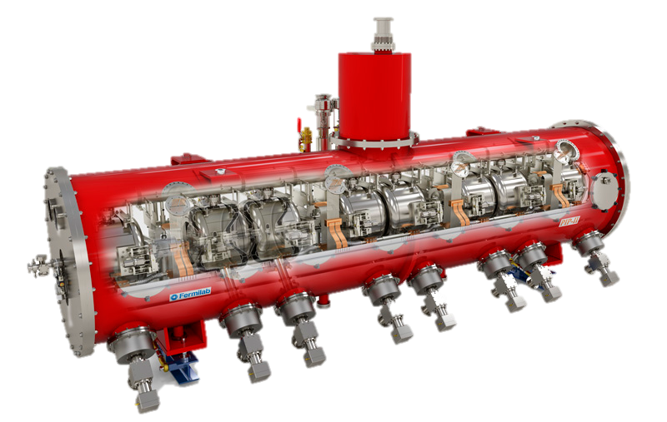
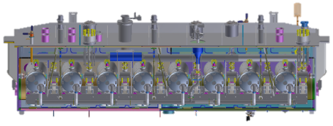
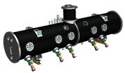


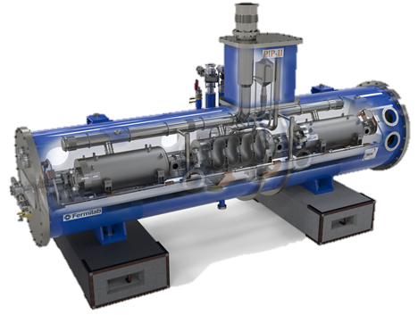





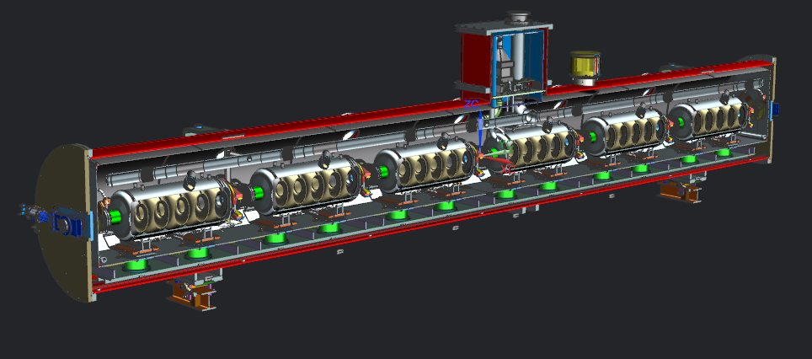

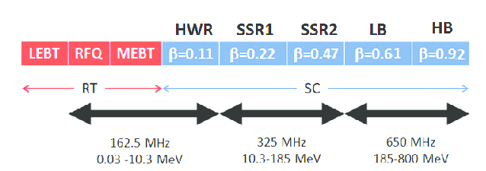
Proposed UK PIP-II Delivery Programme
HWR X 1
SSR1 X 2
SSR2 X 7
Compressor, Coldbox and Distribution system
LB650 X 11
HB650 X 4
1st HB650 CM prototype to be built at FNAL.
3 x HB650 CMs to be integrated at Daresbury, UK.

Slide 3

PIP-II Project Delivery Scope
WP5.0 Project Management
Project governance to deliver PIP-II project to FNAL within scope, cost and schedule.
WP5.1 Testing and Integration Infrastructure
Modify existing ESS Cleanroom, RF, VTF and insert systems (Q3 2021/22)
WP5.2 HB650 Cavity Procurement and Qualification
Procure High-RRR Nb material
Procure HB650 cavities from industry (18 + 2 spare)
Test HB650 cavities in modified testing infrastructure (Q4 2023/24)
WP5.3 HB650 Cryomodule Integration
Develop CM assembly procedures in close collaboration with FNAL (incl Training)
Assemble 3 x HB650 cryomodules
Develop a suitable transport fixture to ship cryomodules safely to FNAL
Once verified, load CMs onto transport frame and ship to FNAL (Q4 2024/25)
WP5.4 UK Industry Fabrication Development
Form collaborations with UK industry partners
Facilitate fabrication infrastructure
Demonstrate PIP-II cavity fabrication capability (Q1 2021/22)
Work with FNAL to perform N₂ doping
Qualify with FNAL testing infrastructure

Slide 4
WP5 PIP-II Cryomodules
WP5.0
WP5 Project Manager (Technology)
Tom Jones
WP5.3: Cryomodule (Technology)
Procurement & Vendor Monitoring
WP5.1: Infrastructure (Technology)
WP5.2: Cavity Testing (ASTeC)
WP5 Principal Investigator (ASTeC)
Peter McIntosh
Cryomodule Integration & Shipment
Procurement & Vendor Monitoring
Cavity Testing
Design & Procurement
WP5.4: Industry Development (ASTeC)
Vendor Development & Procurement
Installation & Commissioning
Training & Knowledge Exchange
WP5 Project Engineer (ASTeC)
Alan Wheelhouse
WP5 Quality Assurance Manager (Technology)

Slide 5
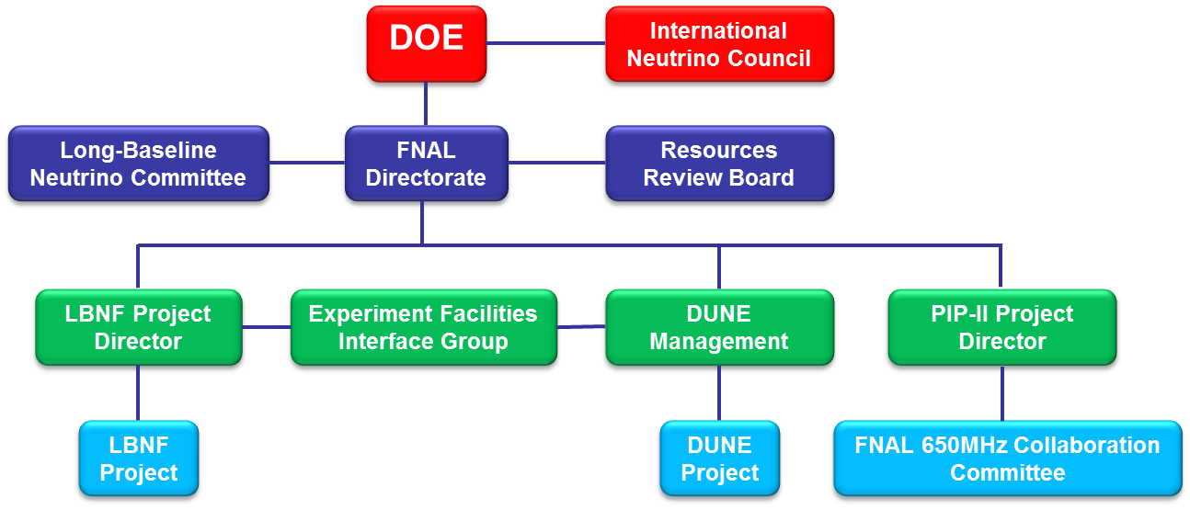
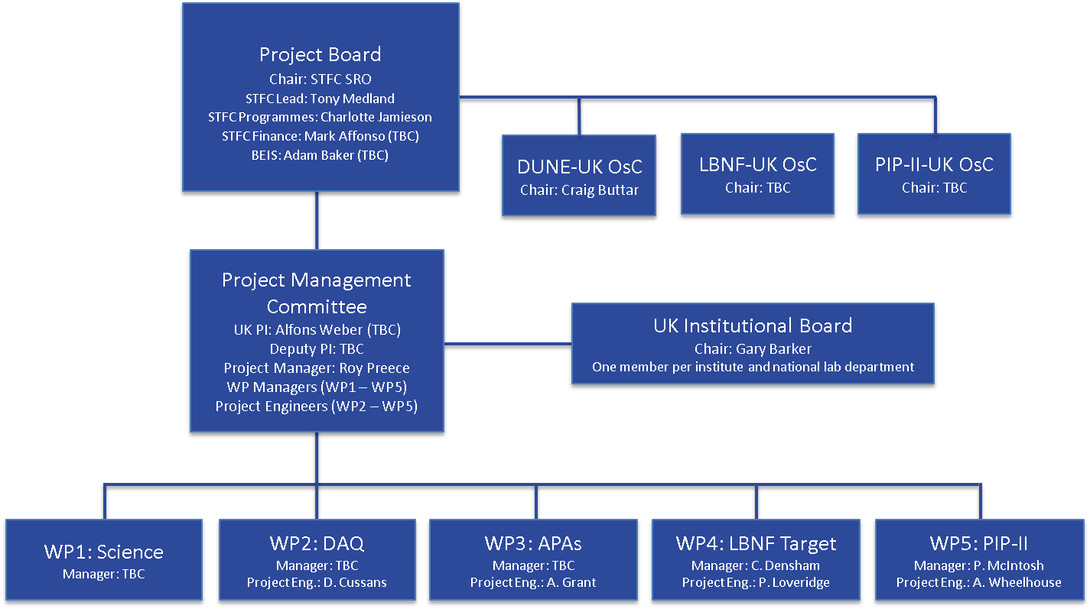
DUNE/LBNF-UK Governance
DoE/FNAL Governance

Slide 6
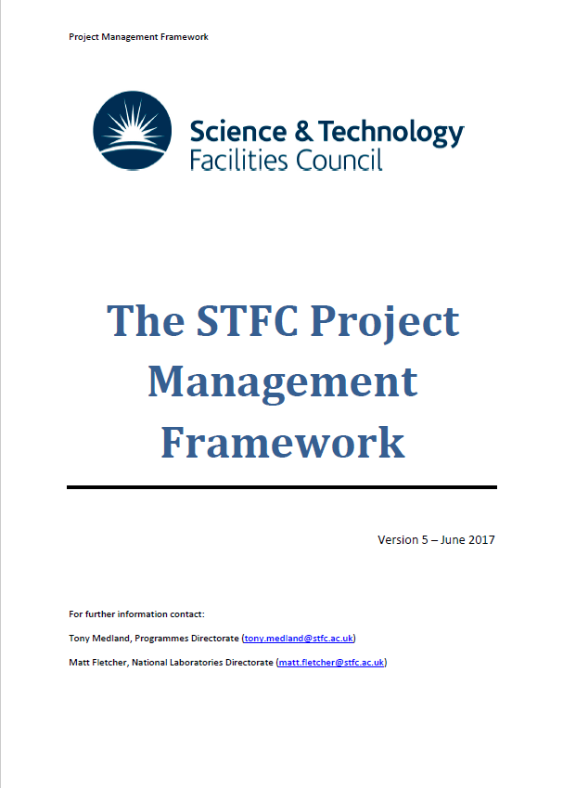
STFC Corporate Project Management Framework (CPMF)
The STFC Project Management Framework sets out STFC’s project management policy and is intended as a reference for anyone involved in the development and execution of an STFC-funded project, including participants from non-STFC organisations.
This Framework reflects government and industry best practice in project management and draws extensively on the Association of Project Management (APM) Body Of Knowledge.
At the programme level the Framework aims to ensure that the project portfolio is aligned to the organisation's objectives, is delivered efficiently and effectively, and is sustainable.
At the project level, it ensures that individual projects are appraised and managed effectively, and that progress through each project phase is monitored and controlled.
https://stfc.ukri.org/files/project-management-framework/

Slide 7
STFC Corporate Risk Management
The objective of risk management is to identify, assess, reduce, accept and control risk in a systematic and proactive way, while at the same time taking into account the project’s technical and programmatic constraints (e.g. costs, timescales, specification).
Risks needs to be captured effectively so that appropriate management attention can be directed to the essential issues. The various stakeholders can then agree on the best course of action for mitigating the risk.
Undesired events are assessed for severity/impact and likelihood. In the assessment of mitigating risk and devising an action plan, risk is considered tradable against known project resources within the management (e.g. cost and schedule) and technical domains (e.g. specification).

Slide 8
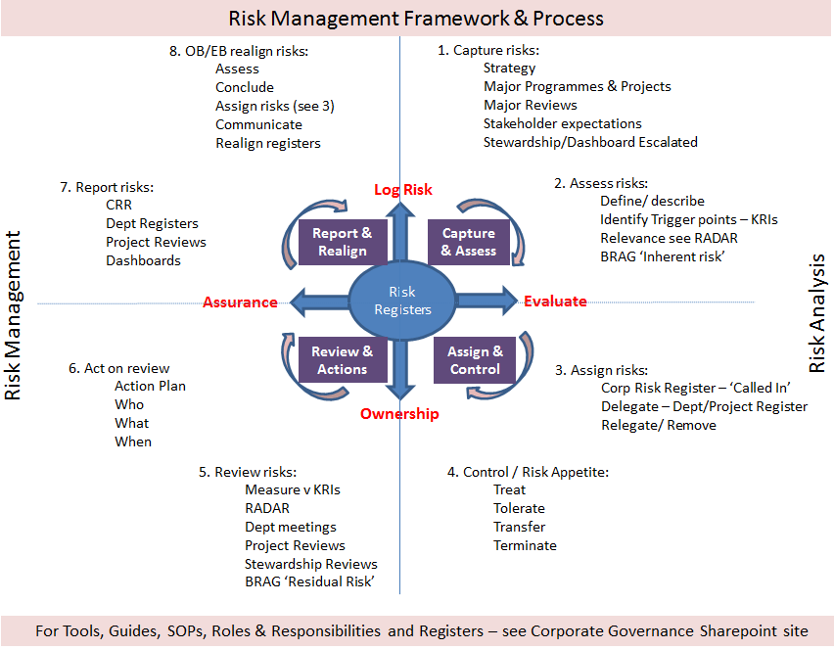
STFC Risk Management Framework

Slide 9
Risk Assessment
Key steps comprise:
Identifying the full spectrum of potential risks through appropriate techniques (e.g. engineering analysis, project team meetings etc).
Analysing and assessing the risks to determine the most serious and rank them through a risk index scheme (see later).
Risk Register should distinguish between inherent and residual risk. The former is the risk present before taking any mitigation action, while the latter is what remains after mitigation.
Devising action plans to mitigate risks either by avoiding the risk, transferring the risk, reducing the probability/impact or accepting the risk.
  This step will require an understanding of the cost and schedule impact of the risk as part of determining an appropriate level of working margin and contingency. Some types of risk lend themselves to a numerical diagnosis – particularly financial or technical risk. For other risks - for example reputational risk - a more subjective view is all that is possible.
Implementing action and control plans and taking appropriate actions when unforeseen risks occur. This will include monitoring, communicating and accepting risks as well as alerting the management team of new risks.

Slide 10
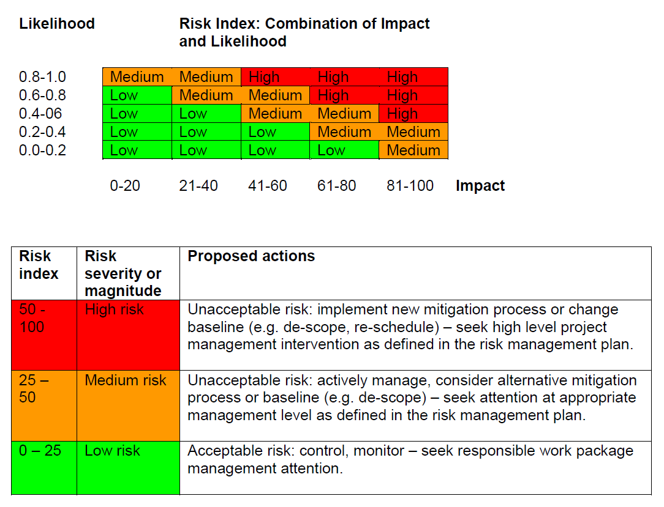
Risk Index Scheme

Slide 11
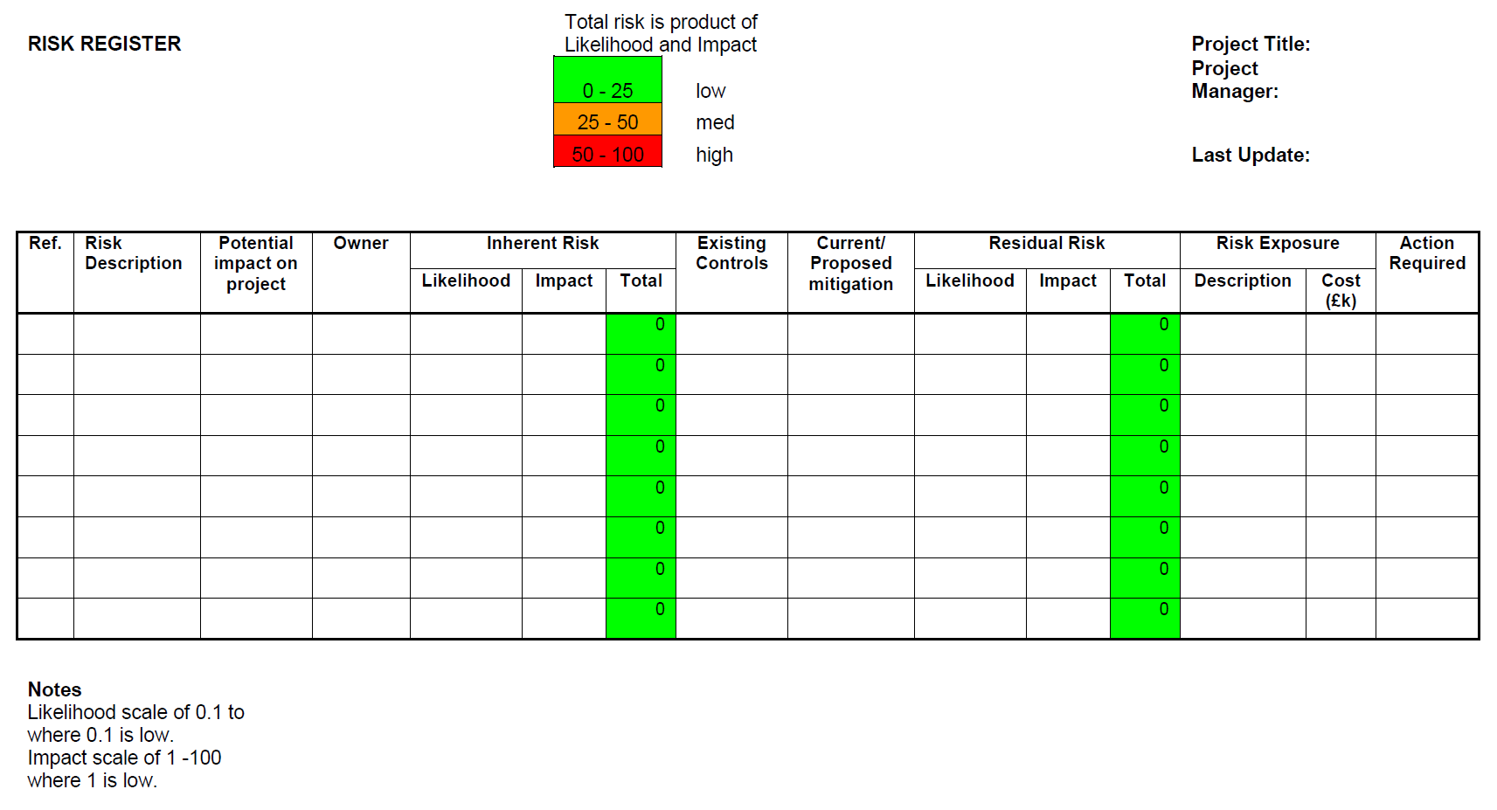
Risk Register Template

Slide 12
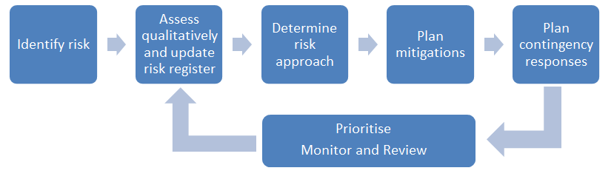
Risk and Mitigation Strategy
The risk register will be maintained by the project manager and will be reviewed routinely at project meetings.
The level of risk on the project will be tracked, monitored and reported throughout the project lifecycle.
Risk history charts shall be plotted to track overall likely cost impact and trends in risk.
All project change requests will be analysed for their possible impact to the project risks.
Management will be notified of important changes to risk status as a component to the project status report (DUNE/LBNF-UK, STFC PRC, ASTeC/TD PIC).
What is the expected FNAL status/risk reporting process?
Priority needs to be provided to those risks currently identified where the risk mitigation has been identified as currently unsatisfactory.

Slide 13
PIP-II Categorised Risks
Resourcing
Resource levels for each of the work packages have been developed from experience gained on similar projects (ESS high-beta cavity, HL-LHC CM, ERL CM).
A 5 - 10 year ASTeC/TD resourcing plan is being developed to review the major ASTeC/TD projects. Resourcing levels to be identified by discipline along with areas where there is insufficient staff levels. A recruitment strategy is to be defined with identified critical areas.
Financial
ROM costs (wherever possible) have been obtained for large cost items. In addition, comparisons have been made with the FNAL cost book.
Hardware will be procured in Sterling to mitigate against unfavourable exchange rate variations.
Schedule
Significant procurement scheduling risks exist, that will need to be undertaken early in the project, it will be necessary to involve the UKSBS procurement team as early as possible so that a procurement plan can be fully developed.
FNAL cavity readiness review: FNAL are aware of the issue and are planning to bring this forward.
Risk of ESS delays: ESS completion date is June 2021 (includes 1 month of contingency). Modifications to cleanroom and equipment can be delayed by a further 6 months without impacting the final delivery date.
Risk of HL-LHC delays: HL-LHC fabrication completes December 2020, which could be delayed by 3 months. CM build commences May 2023. Resource required for PIP-II training needed between March and September 2021 (not conflicting).
Process Control
Various process control risks have been identified, here the main mitigation is to use the experience gained on the ESS cavities and gain experience from the fabrication of the first cavities and CM being performed at FNAL.

Slide 14
WP5 PIP-II Risks
Total of 40 risks currently

Slide 15
STFC PIP-II Risks
Preliminary PIP-II risk register:
Y:\NEW OPPORTUNITIES\DUNE SRF\pm - Project Management\risk - Risk-Management\DUNE-SRF-pm-risk-0001-v0.13-RiskRegister-(20180618)-AEW.xlsx

