Slide 1
Workshop Organization, Roles and Responsibilities PIP-II Risk Management Workshop July 12-13, 2018

Slide 2
Overview
Workshop Organization, Roles and Responsibilities
Risk Identification Process
Risk Assessment Exercise

Slide 3
Workshop Format
Opening Session
Risk Identification and Assessment Sessions
Conventional Facilities
Accelerator Systems, Installation & Upgrades
SRF and Cryo Systems
Project Management Systems
Risk Management Summary and Wrap-up

Slide 4
Keys to a Successful Workshop
This is a Workshop
Participative/open/active
Your input is the key
Subject Matter Experts (fresh eyes)
PIP-II Technical Team (deep knowledge)
What we are asking of you is HARD!

Slide 5
Risk Management Process
In a Nutshell
Formal and structured process
Anticipating and planning for potential problems and opportunities
Better understand and control project outcomes
Risk is an uncertain event that, if it occurs, has a negative effect on a project objective

Slide 6
Risk Management Process
Risk Management Planning
Risk Identification
Qualitative Risk Analysis
Quantitative Risk Analysis
Risk Response Planning
Risk Monitoring and Control
Risk Management Process
Source: PMI PMBOK

Slide 7
DOE Risk Management Process
INITIATION
DEFINITION
EXECUTION
CLOSEOUT
CD-0
CD-1
CD-2
CD-3
CD-4
Risk Planning
Qualitative Risk Identification and Analysis Process
Risk Response Planning, Monitoring and Control
Quantitative Risk Analysis
Risk Documentation and Communication
Lessons Learned

Slide 8
Risk Identification
In a nutshell
Identification, categorization and documentation of a comprehensive, non-overlapping set of “risks” (potential problems)
Events that, if they occur, have a negative effect on a project objective (cost, schedule, technical)
Note that this is different from uncertainty that might also change project cost or schedule, but is not attributed to an event

Slide 9
Risk Identification
Risk Statements
Consist of a defined event and its impact
Represent one risk event
Enhance the next step of analyzing likelihood and impact

Slide 10
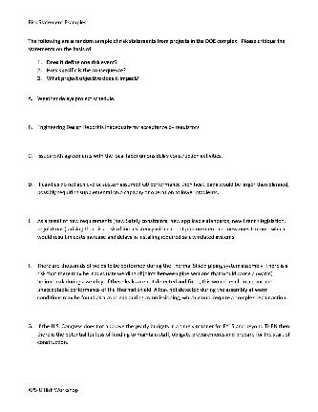
Risk Identification
Risk Statements
“If <RISK EVENT> happens, then <CONSEQUENCE> will <IMPACT> <PROJECT OBJECTIVE>.”

Slide 11
Risk Assessment
One-of-a-kind projects rely on subjective risk assessments for modeling
To make good assessments we must be aware of our biases
Availability
Representativeness

Slide 12
Risk Assessment
Availability
Human judgment tends to over-estimate rare events that are more available or memorable
e.g., deaths from airplane crashes – 1 in 1.6 million
and under-estimate rare events that are less available or memorable
e.g., deaths following total knee replacement – 1 in 4,000

Slide 13
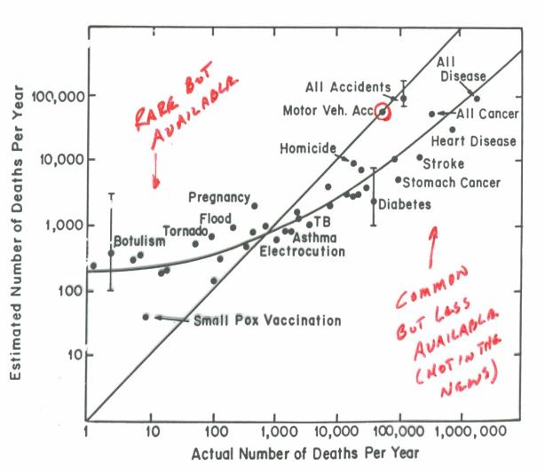
Risk Assessment
Availability

Slide 14
Risk Assessment
Availability – another example
How many seven letter words in the English language contain an “n” in the sixth position?
_ _ _ _ _ n _
How many words ______

Slide 15
Risk Assessment
Availability – another example
How many seven letter words in the English language contain an “n” in the sixth position?
_ _ _ _ i n g
How many words ______

Slide 16
Risk Assessment
Representativeness
True or False
“People with a Ph.D. are more likely to read the New York Times than persons with only a high school education”

Slide 17
Risk Assessment
Representativeness
There is a woman sitting next to you in the cafe who is reading the New York Times…
Which is likely true:
She has a Ph.D.
She doesn’t have a college degree
Base Case Frequency

Slide 18
Keys to a Successful Workshop
Biases and Heuristics
Availability
_ _ _ _ ing
Representativeness
Ignoring base case frequencies

Slide 19
Keys to a Successful Workshop
This is a Workshop
Participative/open/active
Your input is the key
Subject Matter Experts (fresh eyes)
PIP-II Technical Team (deep knowledge)
What we are asking of you is HARD!

